Slide 1
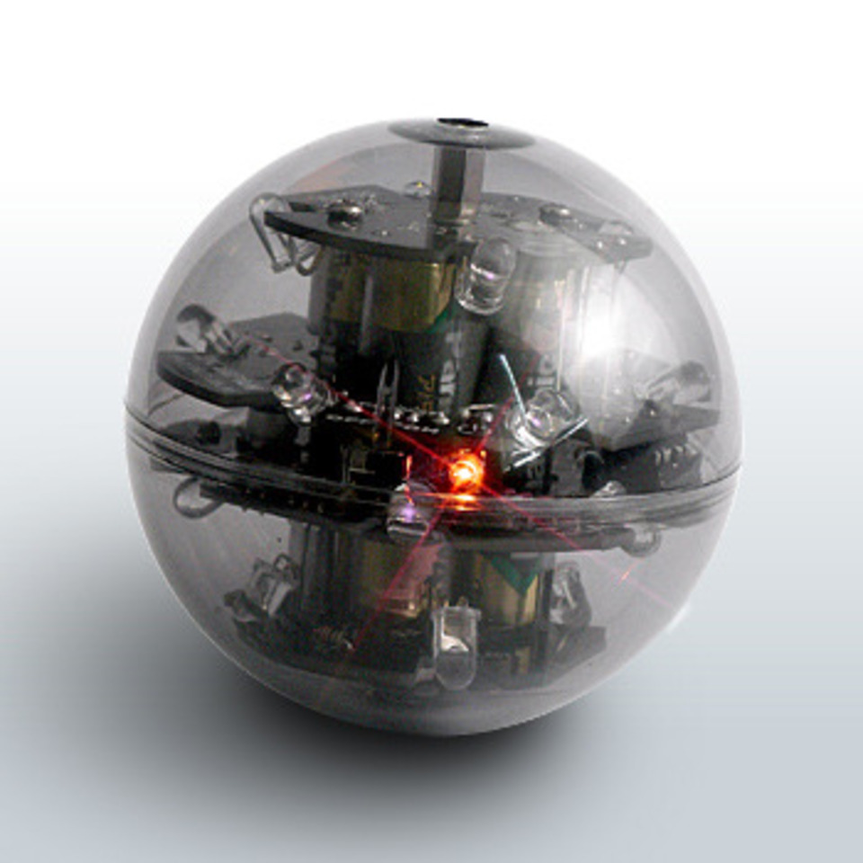
Building an Autonomous Soccer-playing Robot
Ryan Wu, Jordan Reyes, Jessica Wu

Slide 2
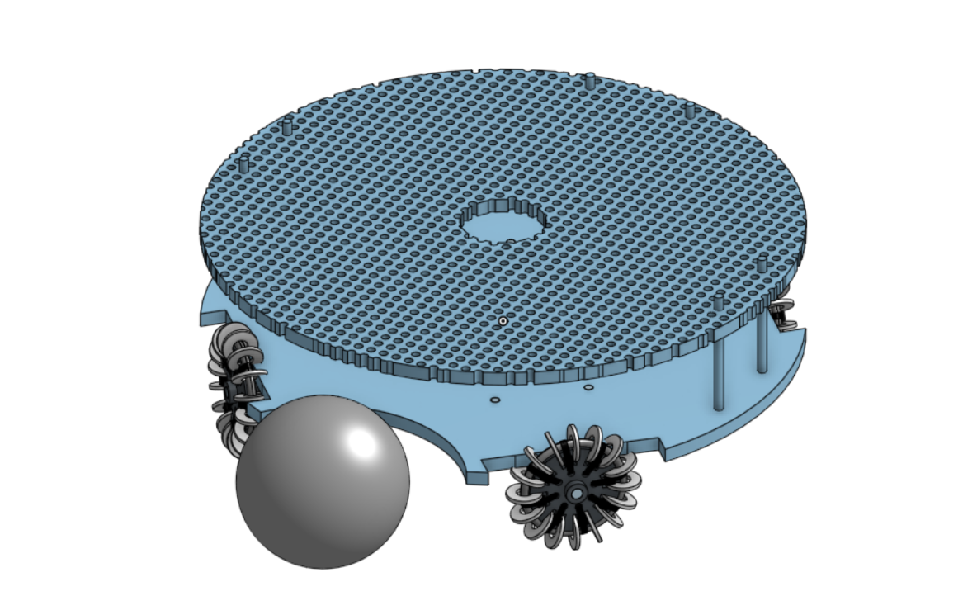
Overview
As this was Team Spirit’s first time participating in the Robocup Junior competition, we did a lot of research, followed by trial-and-error, to get a working robot. We emphasized keeping a low cost on our robot and exploring new ideas.

Slide 3
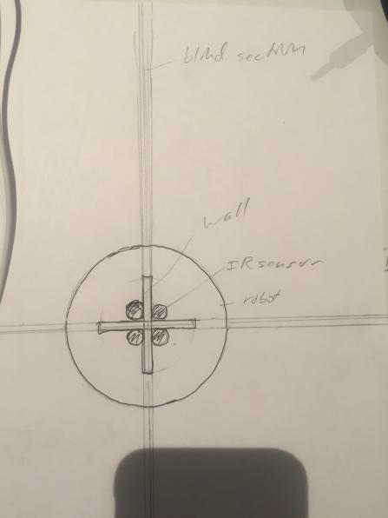
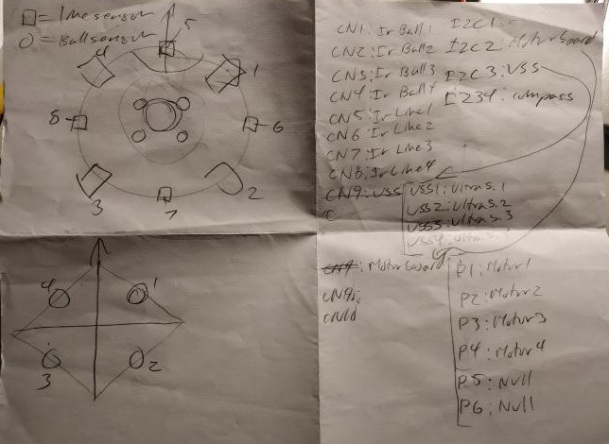
Structure - design of parts
Idea for ball sensor placements + shielding
The majority of our brainstorming was at the beginning, when we considered everything we needed and how to fit that into one robot. Each part had certain constraints and requirements to keep in mind.
Rough diagram showing orientations of sensors/motors on the chassis

Slide 4
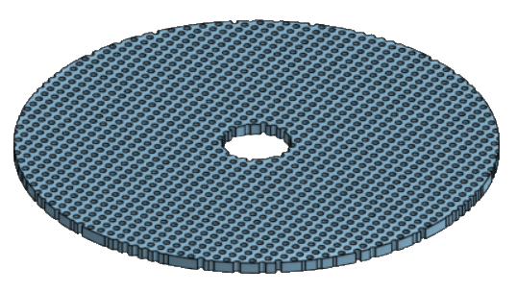
CAD
3d CAD program Onshape → Cloud CAD
Allowed real time collaboration
Teammates didn’t need the physical robot as reference
Were able to incorporate ideas using the CAD as a plan before implementing physical changes
Chassis Top Plate
Designed for liberal placement choices
Can test multiple sensor placements without need for redesigning the entire plate
Any future components added are already accounted for
Chassis Bottom Plate
Solid and dense plate increases structural strength
Allows it to hold against other robots crashing into it
Central hole for wire passage
Connections to IR line sensors and motors at bottom plate
While it appears cumbersome, the motors are powerful enough that there wasn’t major hindrance.
Notes:
To design our robot, we used the 3d CAD program Onshape. It was useful in allowing multiple people to view the 3d design and work on it in real time.
Because of this, everyone on the team didn’t need the physical robot all the time - they were able to incorporate their physical ideas using the CAD as a plan before implementing physical changes.
The cad’s top plate was designed for freedom of choice. The grid of holes would allow us to implement any component anywhere we wanted without worrying about a redesign.
The bottom plate was focused on structural stability - When the whole board is solid and dense it’s very unlikely to experience any structural damage, The hole in the middle permitted wires to travel through it to ir sensors underneath.

Slide 5
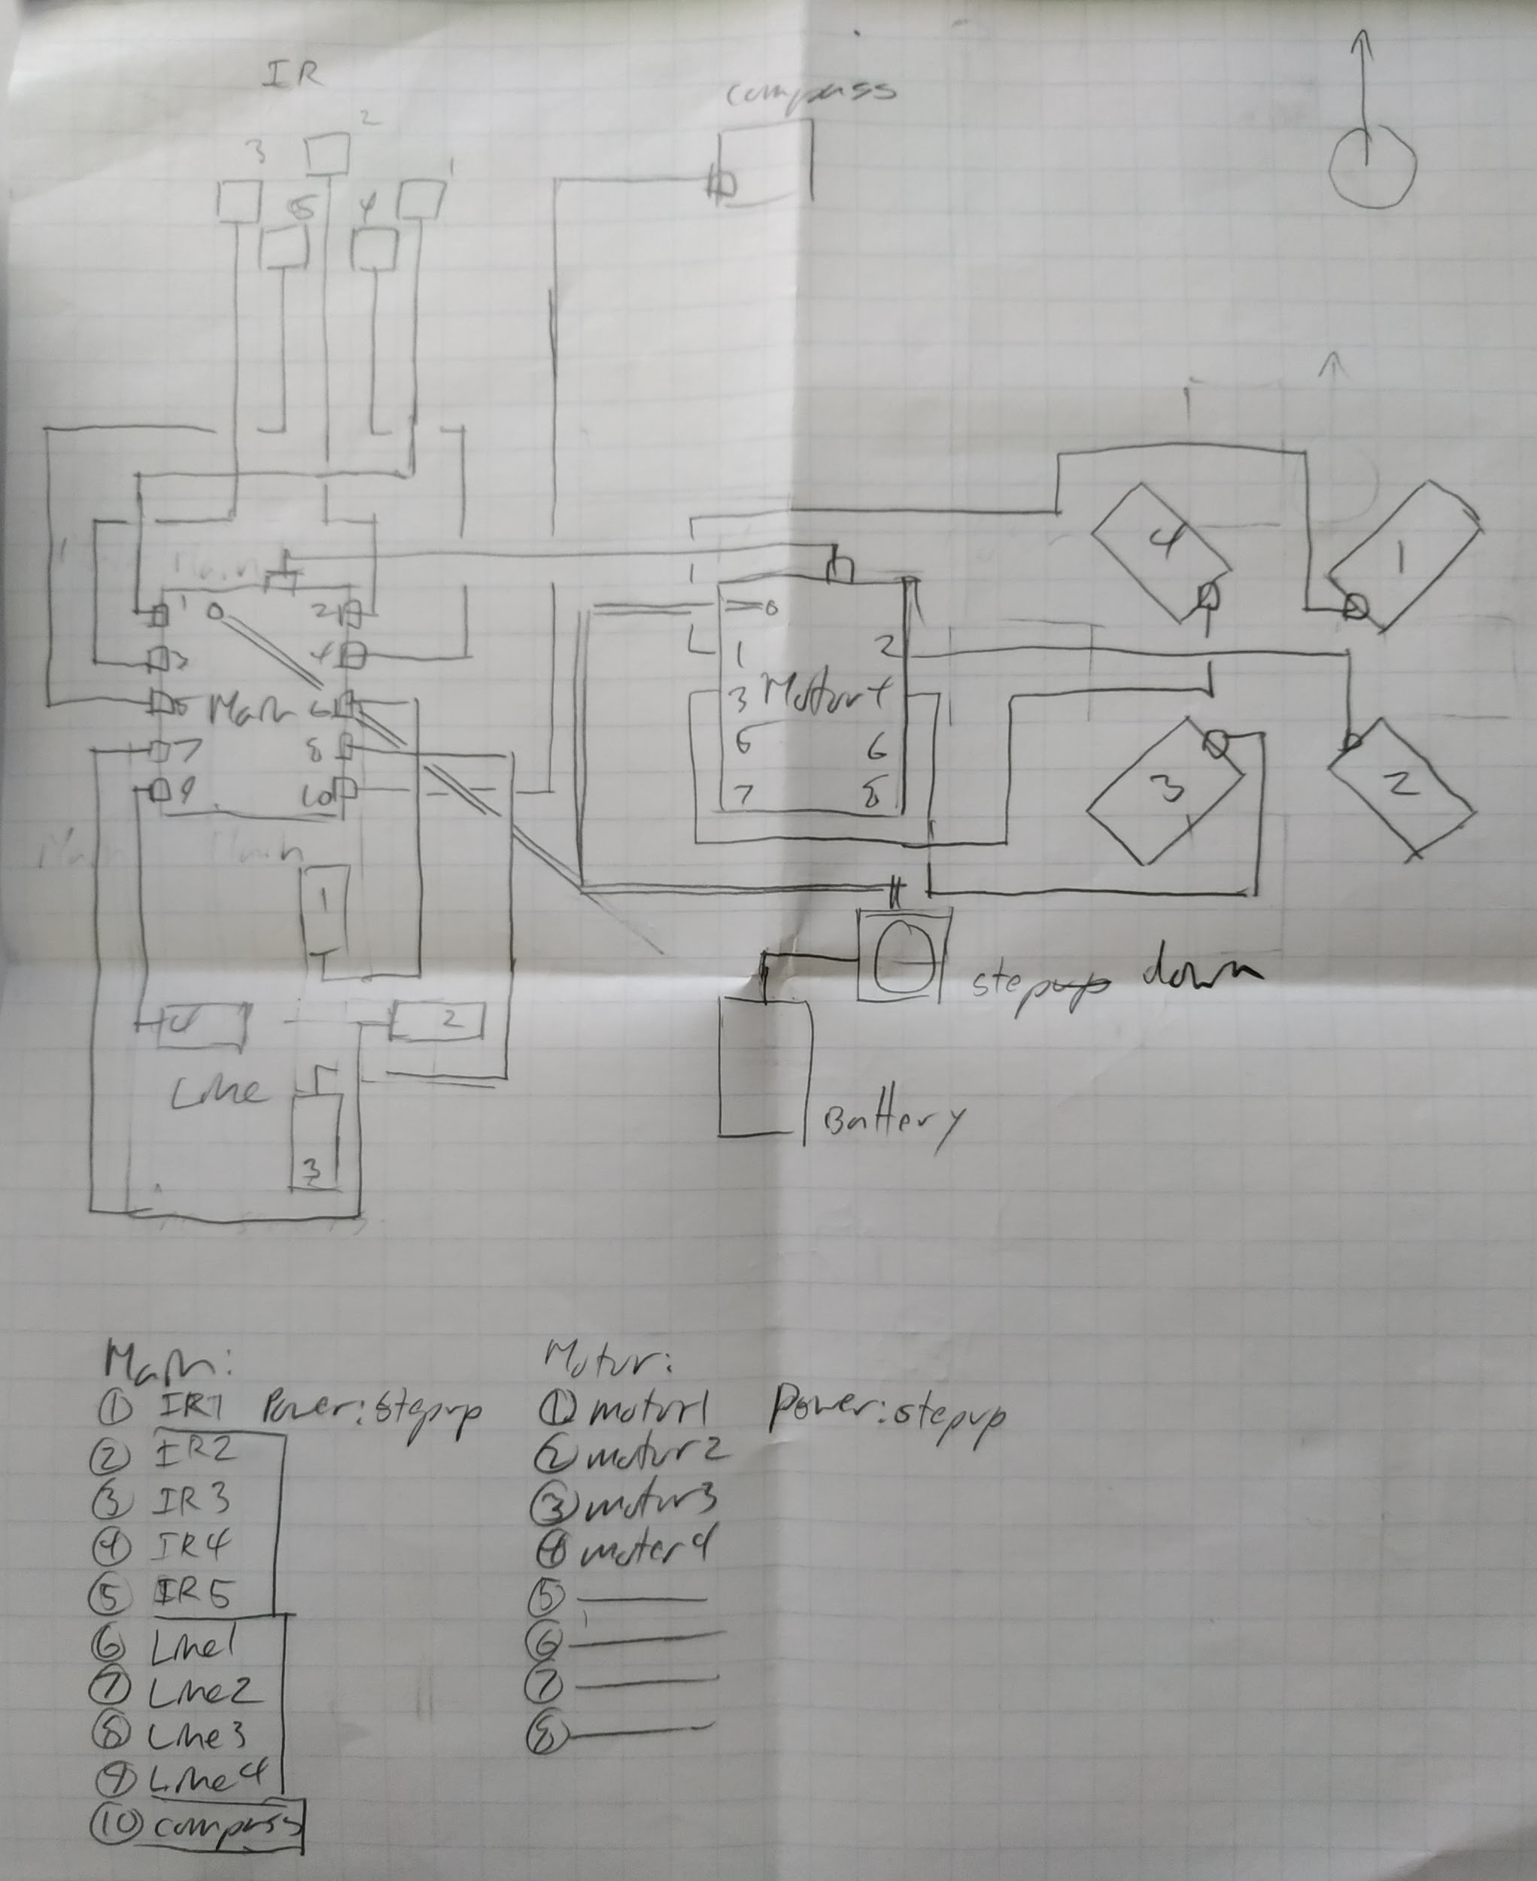
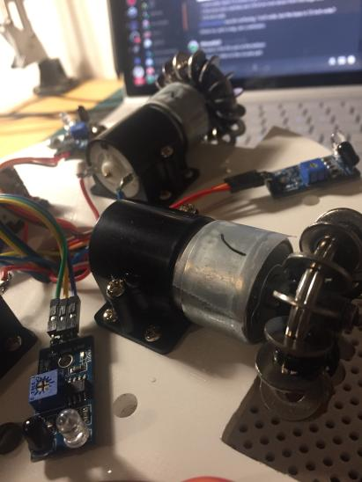
Electrical
For the electrical components, we generally stuck with prefabricated modules, since we had little to no experience with more advanced electronic designs.
Electrical component architecture was centered around two main “hubs”
TJ3B movcore → controlled IR ball sensors, line sensors, ultrasonic I2C relay
Daisen 6 channel MCB → controlled motors facing NW, NE, SW, SE

Slide 6
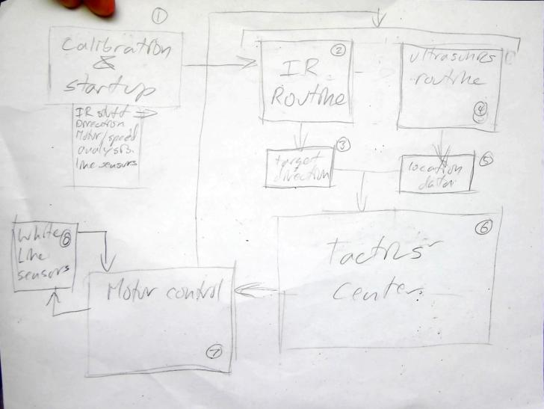
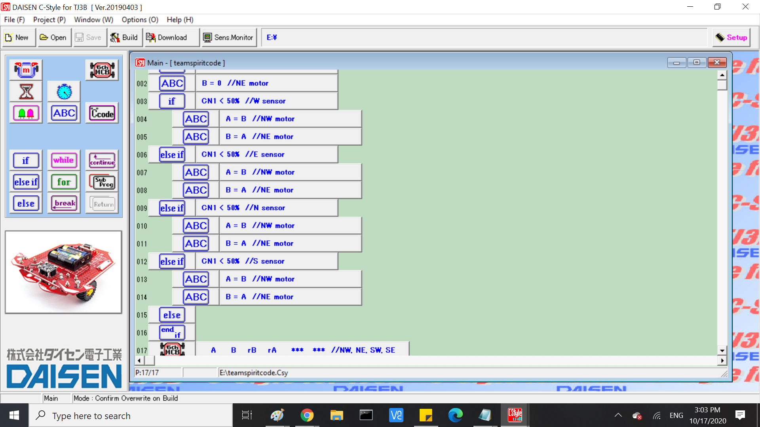
Coding
Outline the code, including sections for each component
Code each specific section
Test, edit code, repeat until success
Used the TJ3B controller board → Daisen C-style IDE’s C-code “mode”
Lack of experience on our part with the program interface and features
Resulted in rather fundamental code, eg no clear cut functions and roundabout ways to do a certain action

Slide 7
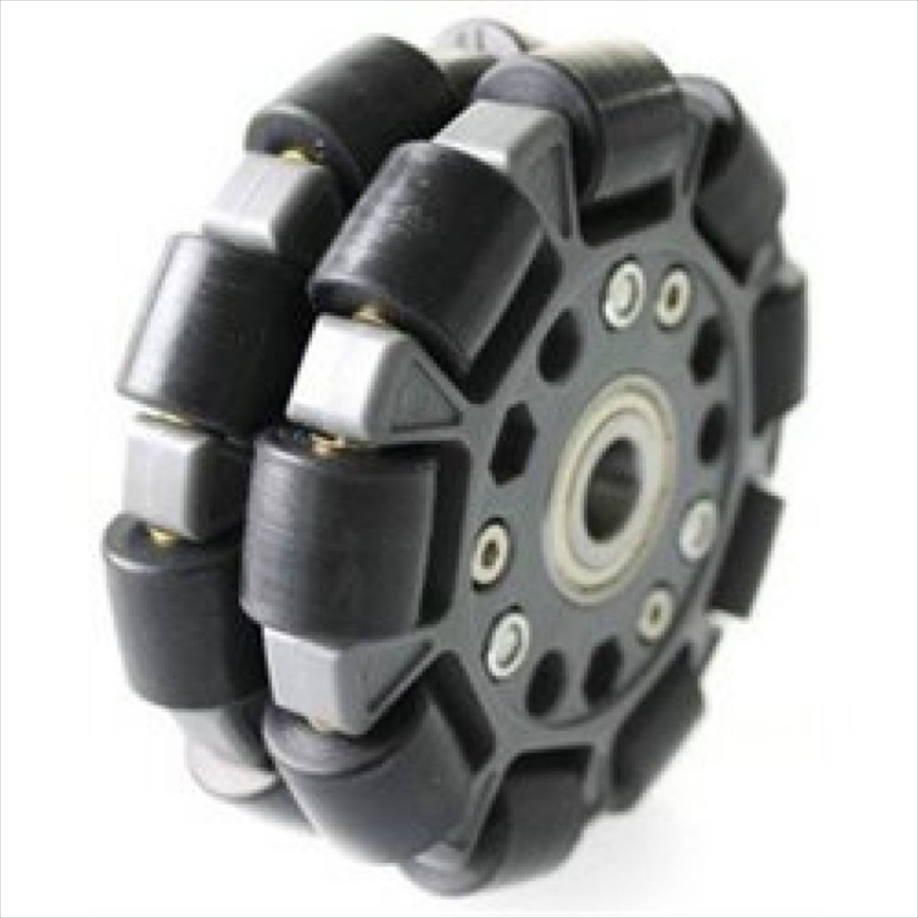
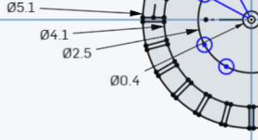
Ideas that we explored
Goal: making a more cost-effective wheel
Took inspiration from Eric Weiser’s design for “homemade” omni-wheels
Bought key ring and washers online, designed and printed the midsection ourselves
$2.5 $25
http://eric-wieser.github.io/ARC/.

Slide 8
Ideas that we explored
← chassis divided into two halves
Goal: making a chassis
Explored using popsicle sticks and balsa wood (before 3d print option was available)
Explored ways of printing the chassis as it didn’t fit within the print dimensions of most printers we had
Infamous popsicle chassis →

Slide 9
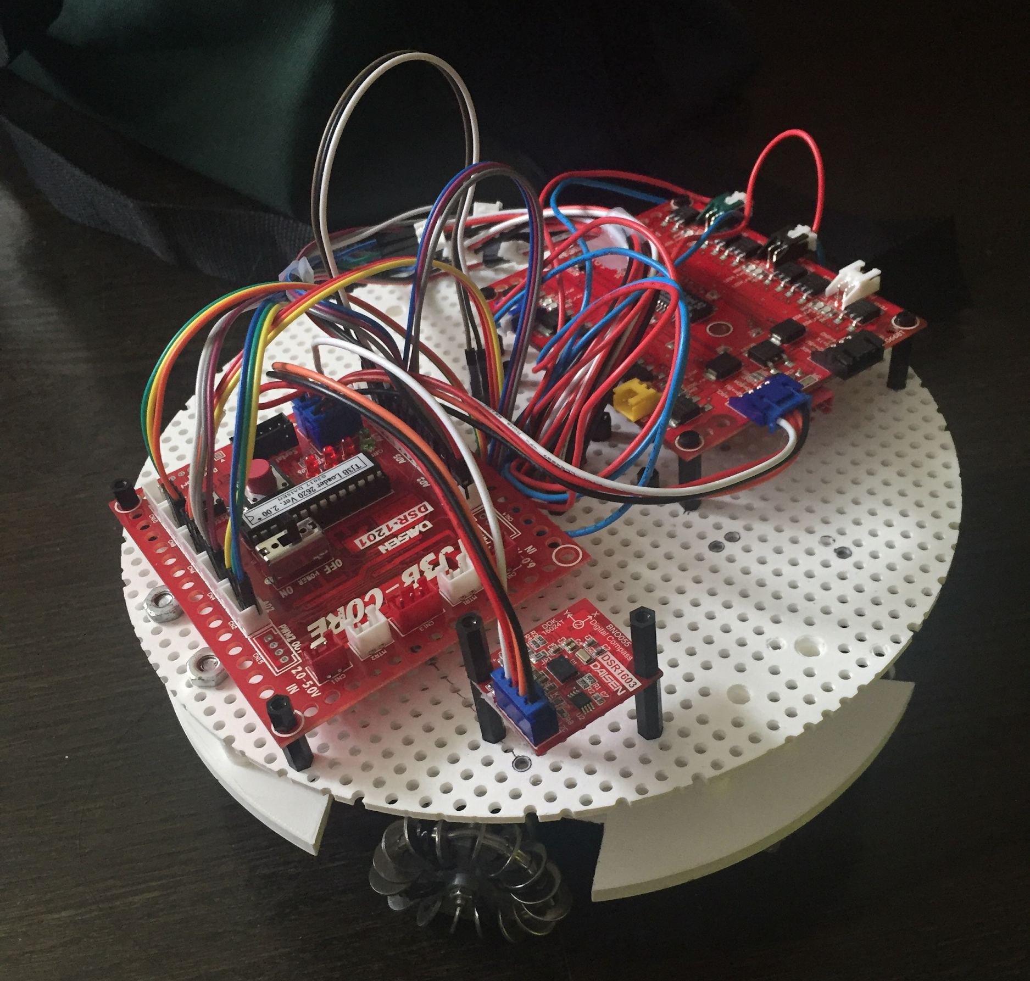
Thank you!

