Slide 1
Shape-Tunable Plasmonic Gold Nanosensors for Quantitative Circulating Tumor DNA Screening
Lauren Zhang
The Lawrenceville School
Mercer Science & Engineering Fair
March 13, 2021

Slide 2
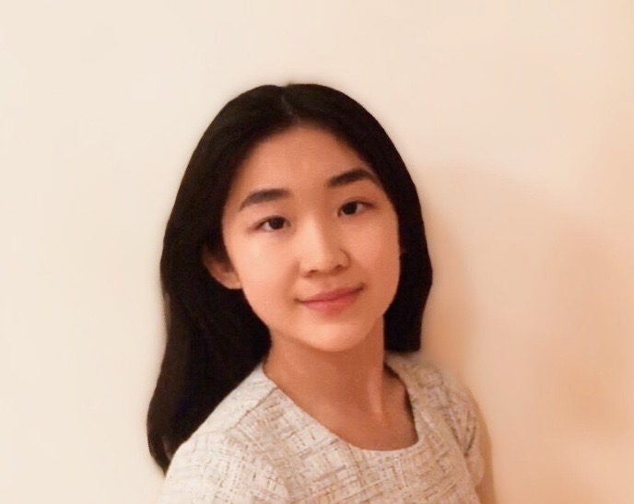
Self-introduction
Currently, a junior at the Lawrenceville School, NJ
Hutchins Stanford Scholar (2020-present)
President of Big Red Biotech [BioOlympiad Team] (2020-present)
Editor of The Lawrencium Journal (2020-present)
1st Place in Bioengineering and Medicine, MSEF (2020)
US Air Force Laboratory Award (2020)
The US President’s Volunteer Service Award – Gold Level (2019)
High Honors Academic Award (2020-present)
Research Publications and Presentations:
“Shape Effects of Plasmonic Gold Nanoparticles of Circulating Tumor DNA Screening”, 2021 TechConnect World Innovation Conference, June 29- July 1, National Harbor, Maryland, USA. (Oral presentation)
“Rational Design of On-Chip Gold Plasmonic Nanoparticles for Liquid Biopsy” , co-authored manuscript in review
“Shape Effects of Plasmonic Gold Nanoparticles for Circulating Tumor DNA Screening”, IEEE Sensors, 2020 (co-author)

Slide 3
2020 Progress
Nanogeometry and Objective:
Designed and synthesized nanobipyramids
Studied effect of sharp angular geometries on plasmonic ctDNA screening
Numerical simulations:
CST simulation studio: for the 3D nanosensor simulation and compute resonance spectra of unique designs
New method of theoretical analysis and accurate resonance spectra prediction
Research Progress:
“Shape Effects of Plasmonic Gold Nanoparticles of Circulating Tumor DNA Screening”, 2021 TechConnect World Innovation Conference, June 29- July 1, National Harbor, Maryland, USA. (Oral presentation)
“Rational Design of On-Chip Gold Plasmonic Nanoparticles for Liquid Biopsy” , co- authored manuscript in review

Slide 4
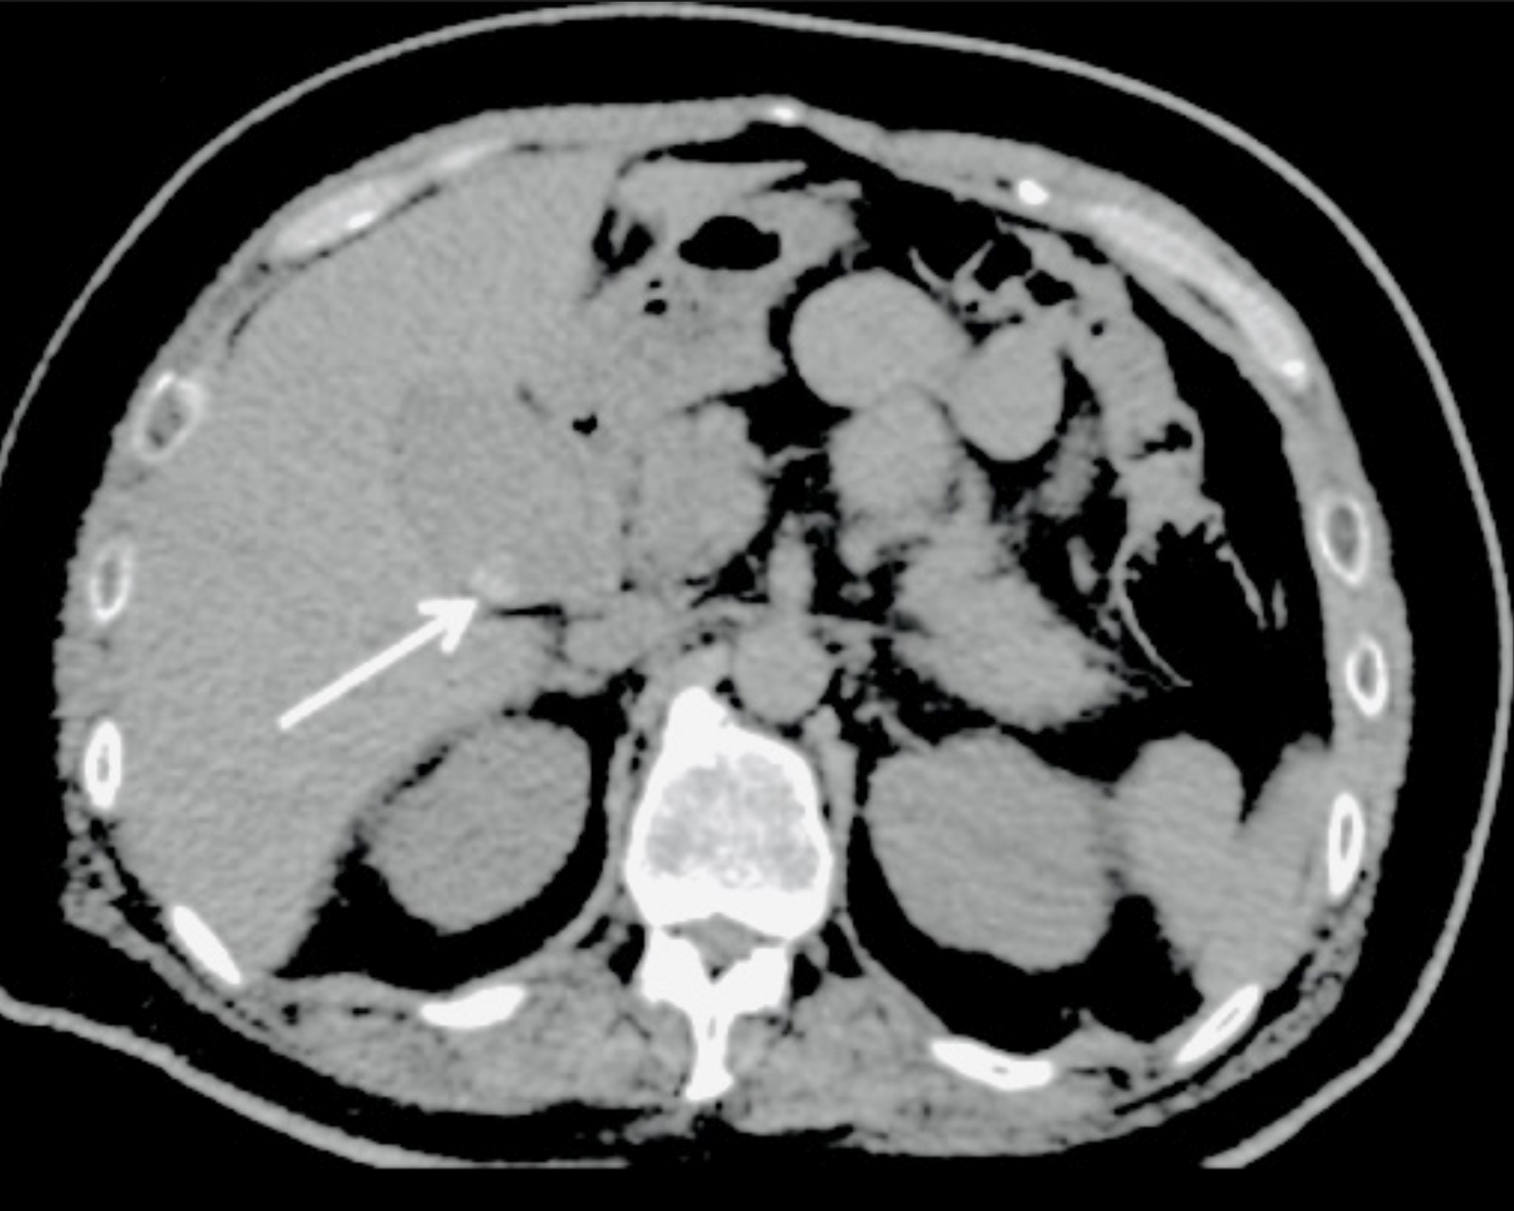
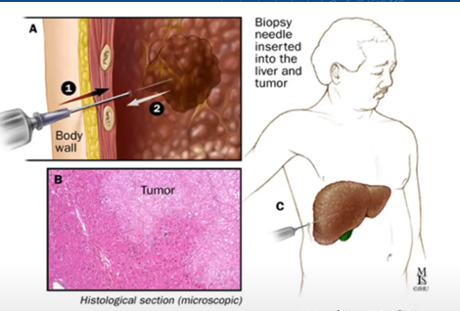
Challenges of Cancer Diagnosis
15M million new cancer cases and 8M cancer-related deaths worldwide in 2020
Average diagnosis cost: $3-5K
United States Cancer Spending: >$100B
Poor prognosis-- caused by late-stage disease diagnosis
Current methods: Tissue Biopsy, Sequencing, and Imaging
- Invasive and expensive
- Slow throughput (>1 week)
Hao-Wen Dai, et al, 2016”
Johns Hopkins Medicine

Slide 5
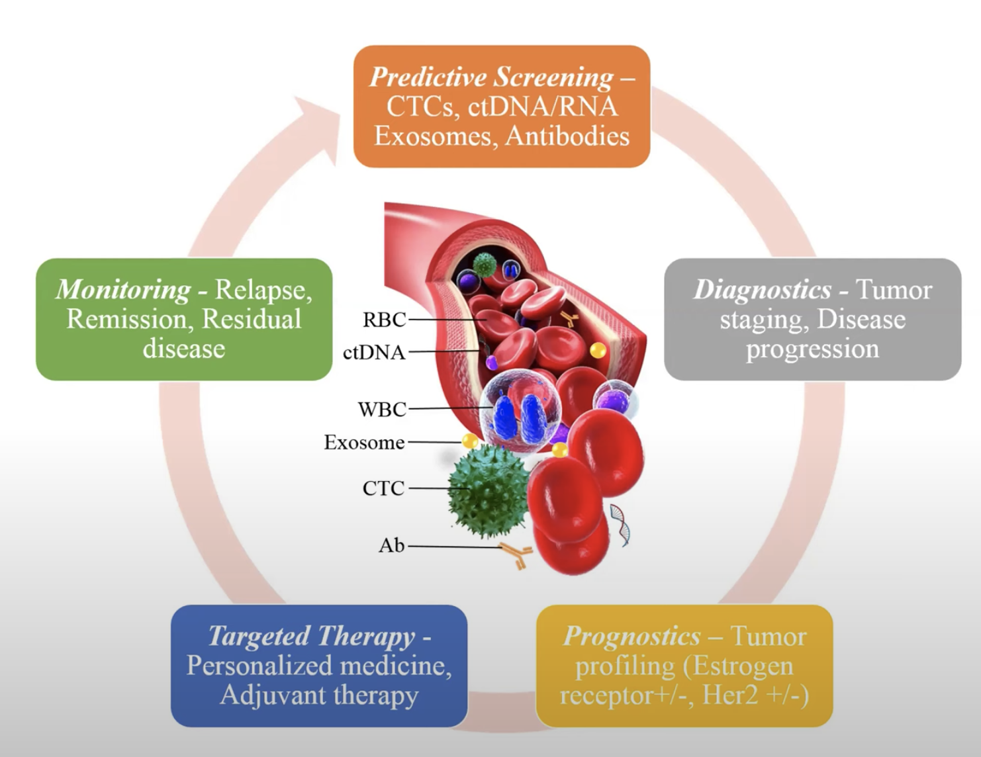
Liquid Biopsy and ctDNA Biomarkers
Liquid biopsy: Capture of tumor-derived biomarkers such as circulating tumor DNA (ctDNA) in a fluid sample rather than a tissue sample
Minimally invasive and low fluid volume required
Cost efficient and fast fabrication
High throughput for personalized analyses
ctDNA: Short half-life (<2 hours)– accurate indicator of genetic and epigenetic changes
New platform for efficient detection without using lengthy DNA amplification(PCR methods)
Tadimety, et. al , Integrative Biology, 9, 22–49, 2017

Slide 6
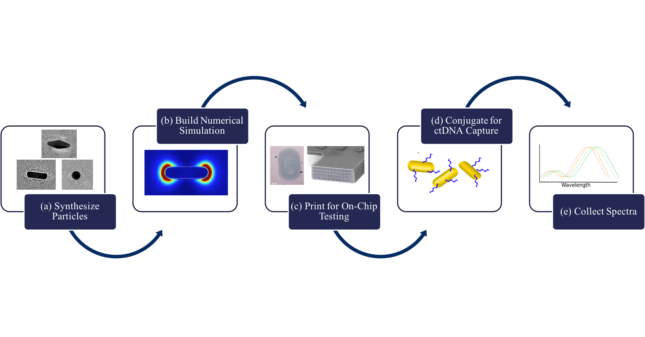
Principles & Design Workflow
Nanoparticle Synthesis
Numerical Simulation
Microfluidics Printing and PNA Conjugation
On-Chip ctDNA Screening
Synthesized gold nanospheres, nanorods, and nanobipyramids
Using electromagnetic simulations to predict plasmonic resonance
Disperse nanoparticles on-chip and Probe development complimentary to G12D mutation in KRAS gene
Local refractive index variation indicating presence of ctDNA in patient serum
“Rational Design of On-Chip Gold Plasmonic Nanoparticles for Liquid Biopsy” , pending

Slide 7
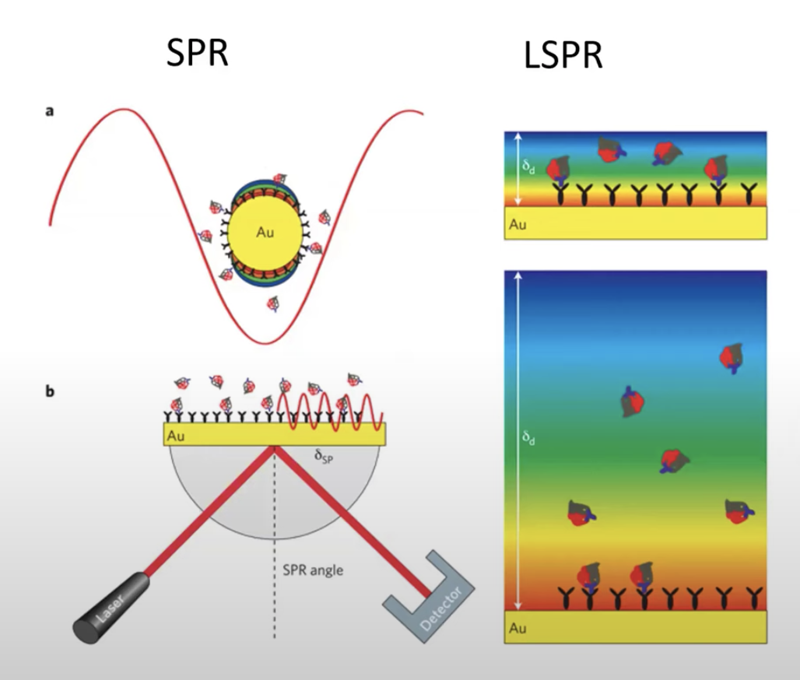
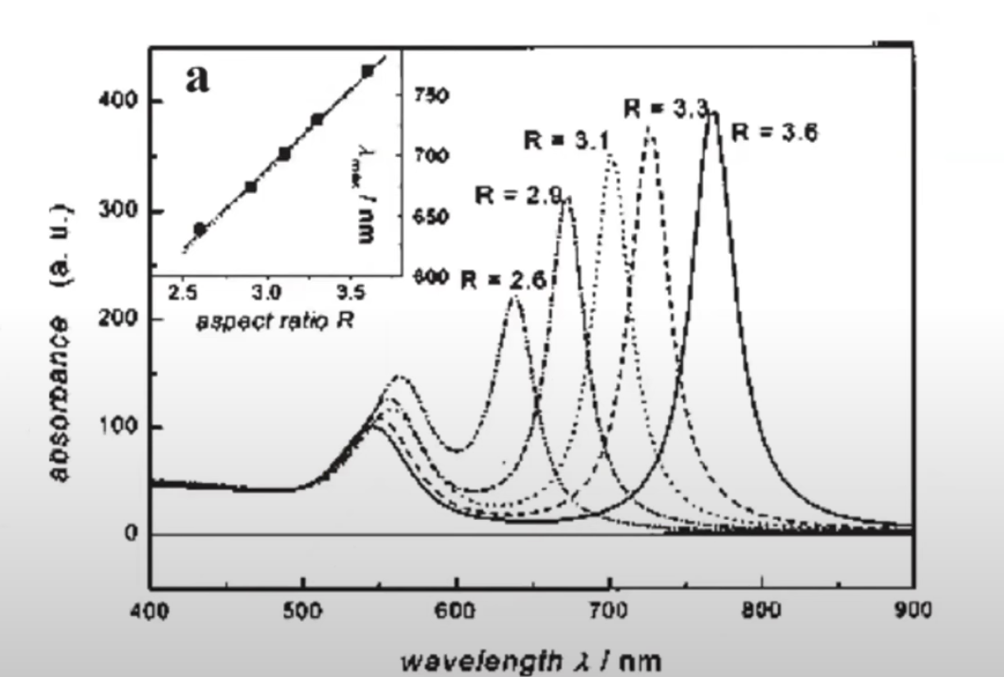
LSPR on gold nanoparticle geometry
Material, geometry, and arrangement of the nanoparticles can change with the surrounding dielectric environment
Metallic nanoparticles support Localized Surface Plasmon Resonance (LSPR) at surface– investigated for sensing applications
Nanosensors with sharper angular geometries may allow for plasmonic enhancement when applied to biomolecular sensing
May also exhibit uniquely shaped resonance spectra that may have higher figures of merit or sensitivity to binding events
Mayer, Chem. Rev, 2011
Brolo, Nature Photonics 2012, 6, 709-713

Slide 8
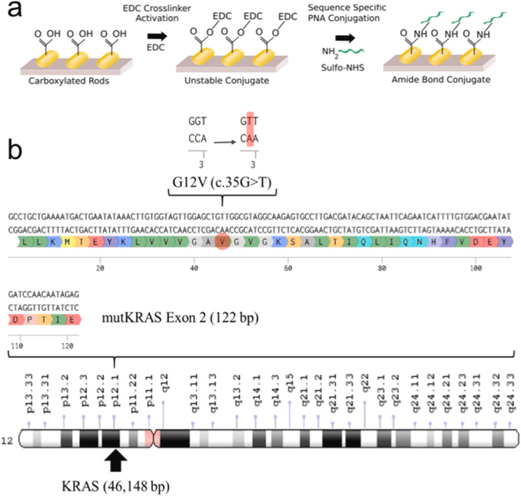
Objectives
Hypothesis: due to the angular tips on the nanobipyramid, it will exhibit enhanced plasmonic sensitivity and ctDNA binding efficiency
Develop numerical electromagnetic simulations to theoretically understand the effects of geometry on plasmonic resonance and sensitivity
We will design gold nanosensors through chemical functionalization of gold nanoparticles-- conjugated with PNA probes for efficient detection
The nanoparticles will be dispersed on-chip using microfluidics printing for testing efficiency
We will test the synthesized particles to understand their bulk refractive index sensitivity and their ctDNA screening sensitivity.
We will apply AuNPs to screening of G12D variant in the KRAS gene, which is implicated in pancreatic cancer. Such technology can be further applied to sense ctDNA in patient serum
G12D (c35G>A)
Biosensors and Bioelectronics. 130, 236-244, 2019

Slide 9
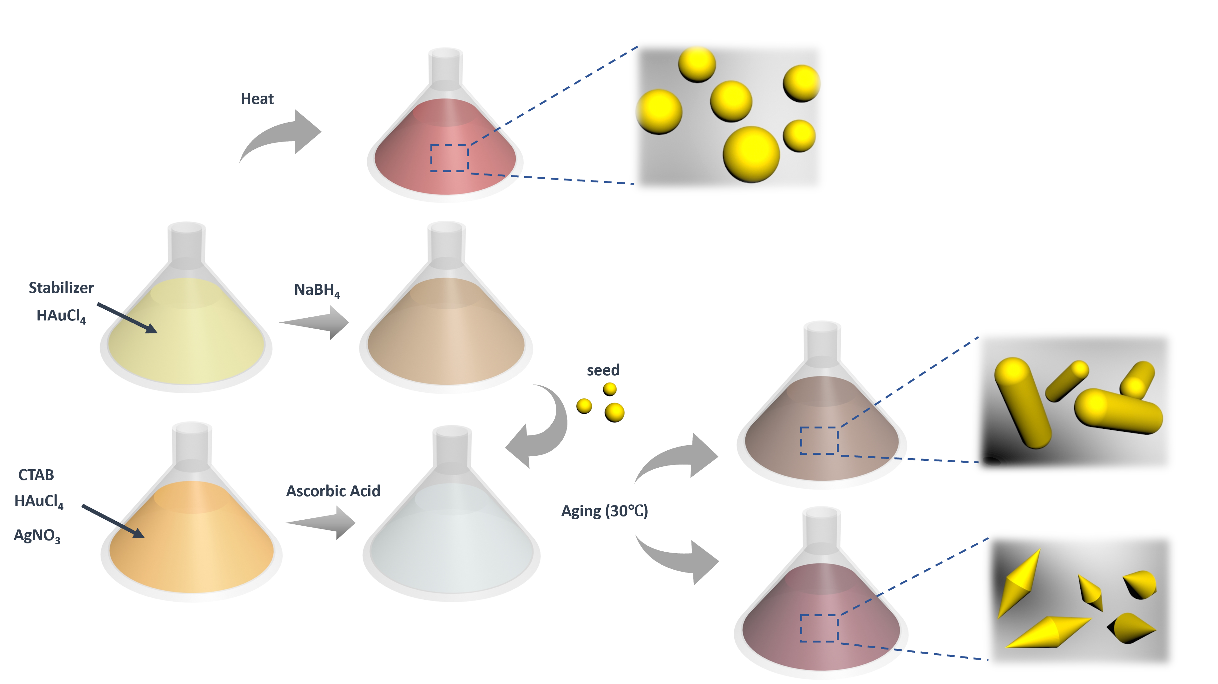
Nanoparticle Synthesis
Chemical synthesis of the gold nanoparticles (AuNPs) included the usage of CTAB, TEOS, Organic Solvent, Catalyst
Nanospheres synthesized by heating
Nanorods and Nanobipyramids synthesized via seed-mediated method
1) Fabricate seeds,
2) Leave seeds in growth solution for geometric development
All nanoparticles were characterized using transmission electron microscopy
“Rational Design of On-Chip Gold Plasmonic Nanoparticles for Liquid Biopsy” , pending
“Shape Effects of Plasmonic Gold Nanoparticles for Circulating Tumor DNA Screening”, IEEE Sensors, 2020

Slide 10
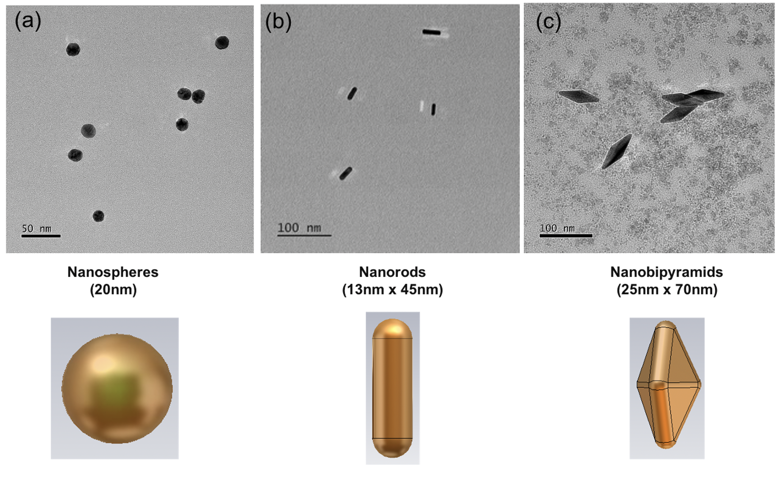
Nanoparticle Characterization
Relatively uniform nanoparticle geometries
These shapes were purified and used for screening experiments
Transmission Electron Microscope(TEM) Micrographs
a) Sphere: 20nm x 20nm
b) Nanorod: 13nm x 45nm
c) Nanobipyramid: 25 x 70nm
“Rational Design of On-Chip Gold Plasmonic Nanoparticles for Liquid Biopsy” , pending

Slide 11
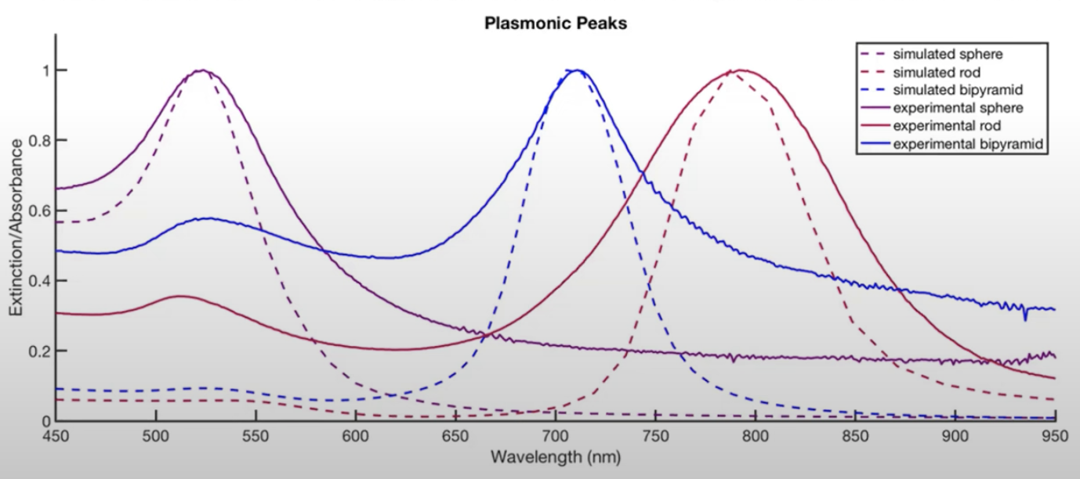
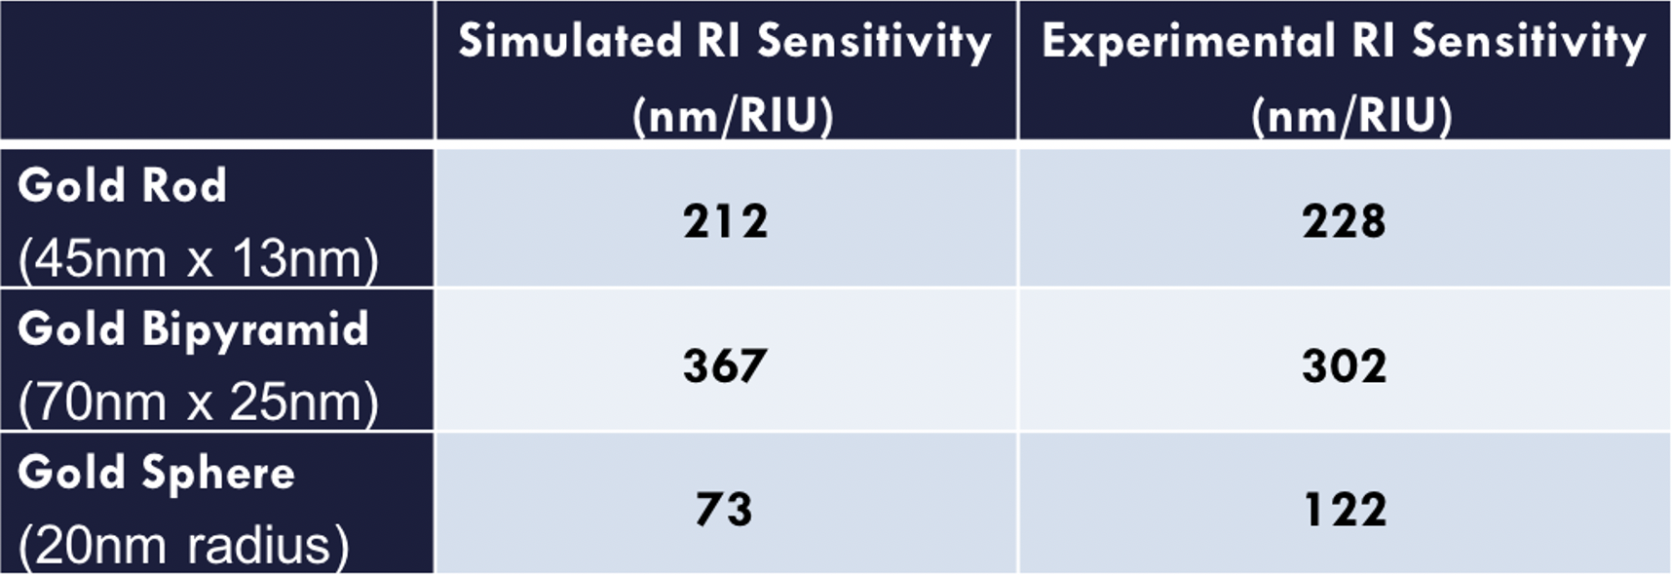
CST Simulations and Experimental Testing
CST Microwave Studio software– used for 3D simulation and observing magnetic field around the nanosensor
Far-field monitors compute resonance spectra of simulated nanosensors
Strong qualitative agreement– simulation can predict resonance spectrum shape
- Nanospheres: ~500nm
- Nanorods: ~700nm
- Nanobipyramids: ~750nm-800nm
Highest sensitivity: gold nanobipyramids
- Sharp corners increased plasmonic sensitivity
- May have high sensitivity in ctDNA detection
“Shape Effects of Plasmonic Gold Nanoparticles for Circulating Tumor DNA Screening”, IEEE Sensors, 2020

Slide 12
PNA Conjugation
Peptide Nucleic Acid (PNA) strands complimentary to the G12D variant
- Versatile: PNA sequence can be altered depending on targeted disease
Conjugated onto nanoparticles using primarily EDC and NHS
Biosensors and Bioelectronics 2019
“Shape Effects of Plasmonic Gold Nanoparticles for Circulating Tumor DNA Screening”, IEEE Sensors, 2020

Slide 13
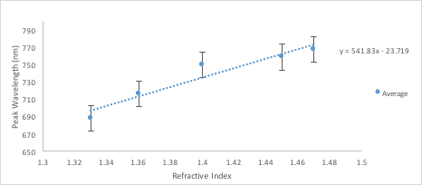
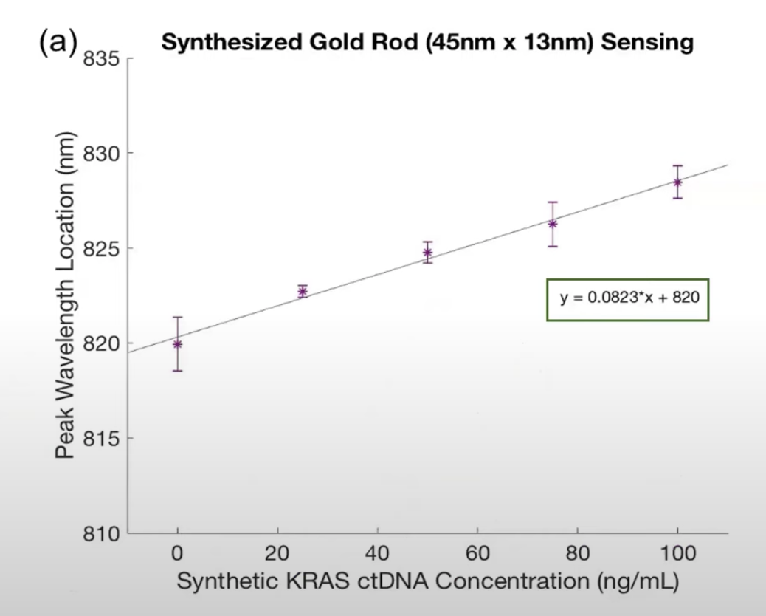
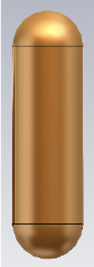
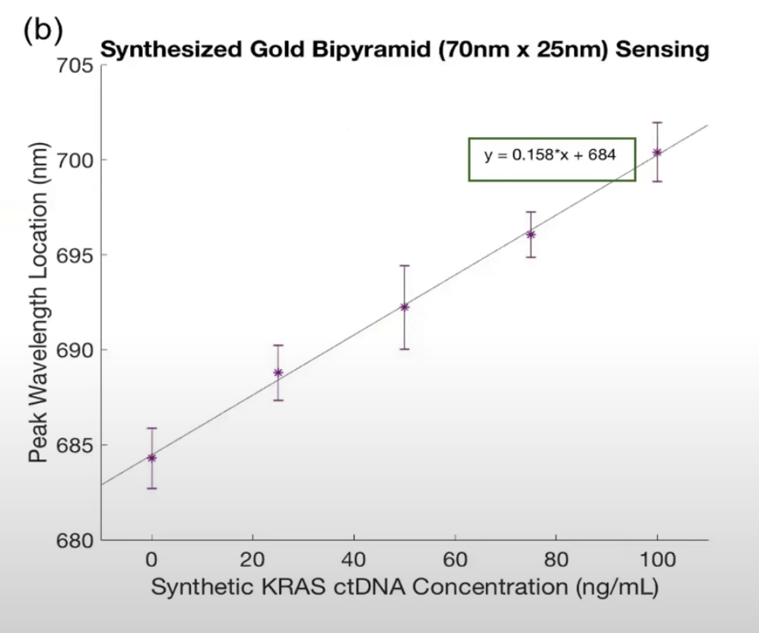
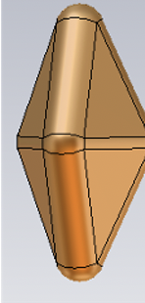
On-Chip ctDNA Screening
On-chip nanosensor dispersion allows for rapid sample delivery (<5 minutes)
Spiked healthy serum samples with synthetic ctDNA: G12D variant in Exon 2 of the KRAS gene (0 nm/mL, 20 nm/mL, 50 nm/mL, 80 nm/mL, 100 nm/mL)
- Gene implicated in Pancreatic Ductal Adenocarcinoma
Increasing linear relationship between ctDNA concentration and peak wavelength location
a) Nanorod sensitivity: 0.08 nm/mL
b) Nanobipyramid sensitivity: 0.16 nm/mL
Plasmonic particle sensor has a linear range within the clinically relevant range of ctDNA
Affirms hypothesis: Nanobipyramids twice as sensitive as nanorods due to angular geometry
“Rational Design of On-Chip Gold Plasmonic Nanoparticles for Liquid Biopsy” , pending

Slide 14
Conclusion
Developed a versatile approach for the rational design of gold nanosensors for nucleic acid screening
Agreement between simulated and experimental data-- numerical modeling can predict resonance spectra of various nanoparticle designs
Affirmation of simulated nanobipyramid sensitivity prediction-- nanobipyramid sensors twice as sensitive as nanorod sensors
Workflow shows promise for the design of nanosensors for sequence specific detection of clinically relevant biomolecules
Notes:
There are ways of detecting cancer in the blood without using tissue biopsy. And this can be just one example of how we can develop a platform using nanoparticles in minimally invasive detection and diagnosis

Slide 15
Acknowledgements
We thank Dr. Amogha Tadimety and Ziqian Wu for guidance on this project. Studies were conducted using Dartmouth Engineering Labs and TEM facilities.

