Slide 1
A Novel Reconstruction and Expression of Endostatin with pDC316 Plasmid in Eukaryotic Cells
Michael (Ziqi) Wang
Mar. 5, 2021

Slide 2
Catalog
Introduction/Background
Research Goal
Method
Result
Discussion
Conclusion
References

Slide 3
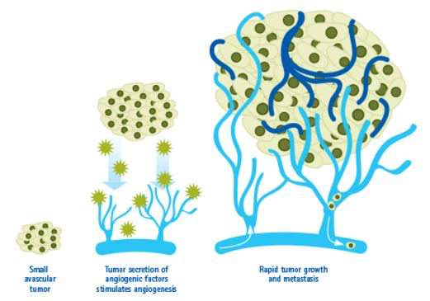
Introduction/Background
Tumor growth is angiogenesis dependent (physiological process that new blood vessels form from pre-existing blood vessels) (1)
Uncontrolled angiogenesis would lead to pathological hyperplasia and neoplastic diseases (2,3)
Notes:
Under normal human physiological circumstances, angiogenesis is highly controlled by some chemical signals in the body such as vascular endothelial growth factor (VEGF)

Slide 4
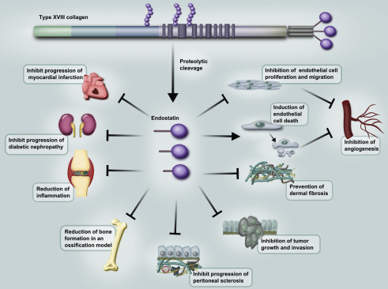
Introduction/Background(con’t)
In 1997, Endostatin (anti-angiogenic peptide) was first found in mouse cells and was subsequently found in humans. (4)
A variety of experiments can confirm that endostatin has an inhibitory effect on growing blood vessels, but has no effect on resting blood vessels, which can effectively limit uncontrolled angiogenesis
The inhibitory effect of endostatin on angiogenesis is very important because of its potential as a cancer treating agent.
Notes:
I know the figure here is vague but we just need to know…...

Slide 5
Research Goal
Endostatin is one of the strongest endothelial cell inhibitory factors that has been found so far, however, endostatin protein is extremely unstable and difficult to prepare and apply.
Investigate a novel biotechnology method to reconstruct endostatin.

Slide 6
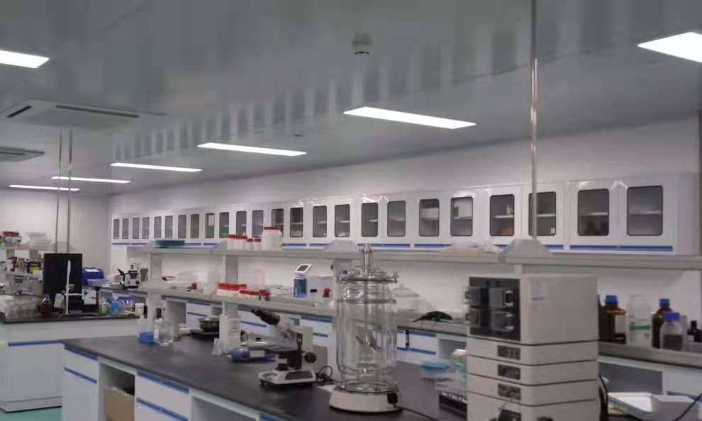
Method
Endostatin gene
amplified by PCR
ligated to eukaryotic expression vector pDC316
transformed into competent cells E. coli DH5α
Single and clear-edged bacteria are tested by bacterial PCR and electrophoresis.
Plasmid was extracted and sequenced
transfected into 293T cells
reverse transcription-polymerase chain reaction(RT-PCR) and gel electrophoresis.
The final product reconstructed by endostatin DNA with the pDC316 vector was confirmed by sequencing

Slide 7
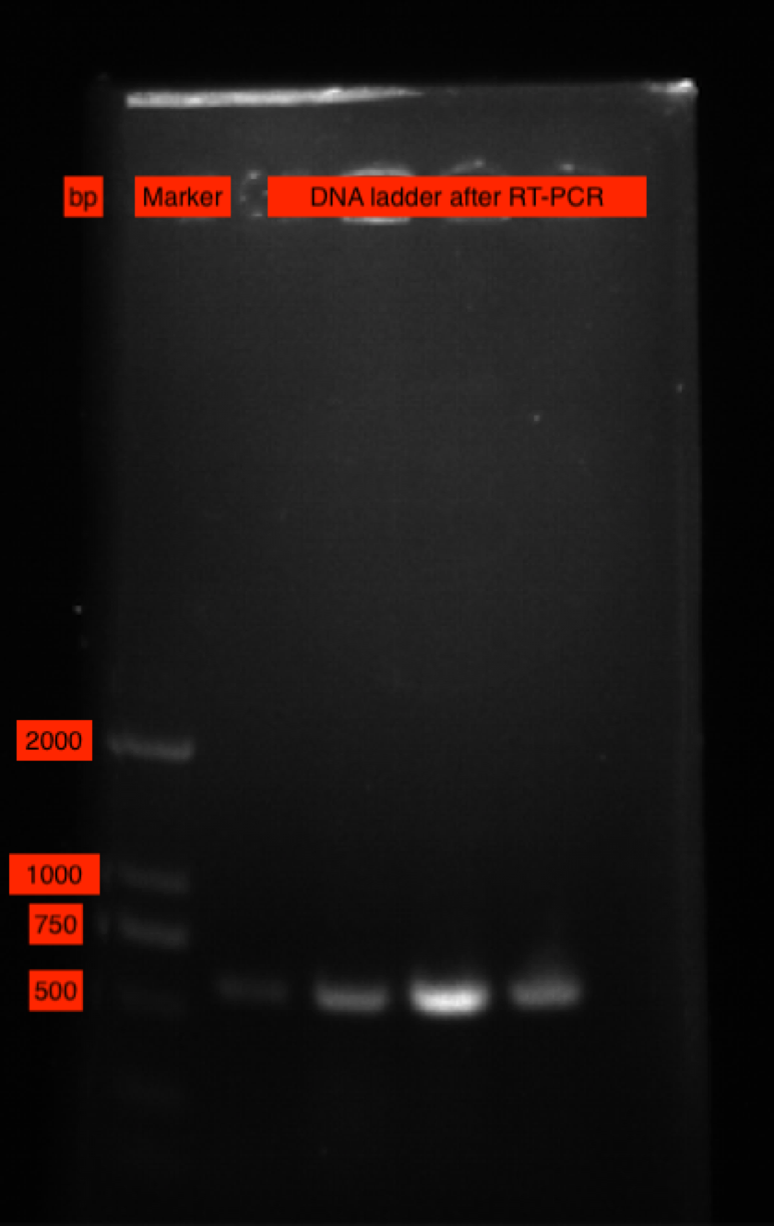
Result
Step by step examination

Slide 8
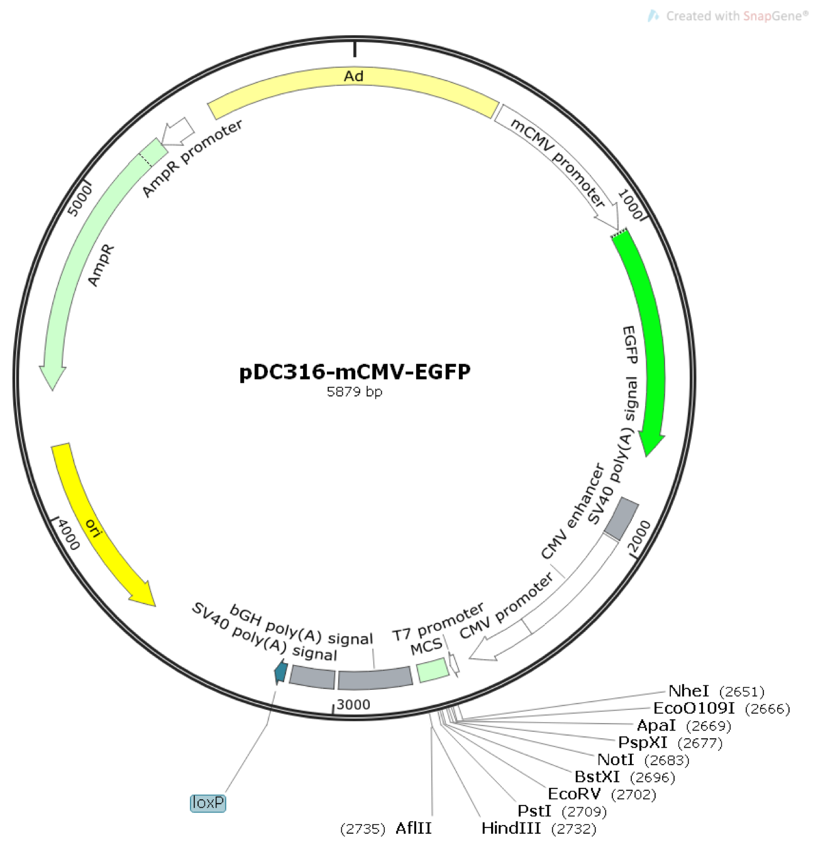
Discussion
Why pDC316?
Notes:
very versatile, with both eukaryotic and prokaryotic shuttle capability and with both prokaryotic and eukaryotic cell promoter originals.
has two antibiotics genes which is easy for expansion.
has a large capacity and can carry large fragments genes

Slide 9
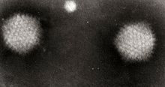
Discussion(con’t)
(5)
Improvements
After RT-PCR, the protein expression in infected cells should be further confirmed by Western blotting.
Future studies
Use Adenovirus type 5(AD5) to package the reconstructed plasmid.

Slide 10
Conclusion
This study successfully reconstructed endostatin into pDC316 plasmid vector and transfected the identified plasmid into 293T cells, which correctly expresses endostatin mRNA. The final product would have potential value in clinical trials and angiogenesis gene therapy.

Slide 11
References
Ribatti D. (2008). Judah Folkman, a pioneer in the study of angiogenesis. Angiogenesis, 11(1), 3–10. https://doi.org/10.1007/s10456-008-9092-6
Yoo, S. Y., & Kwon, S. M. (2013). Angiogenesis and its therapeutic opportunities. Mediators of inflammation, 2013, 127170. https://doi.org/10.1155/2013/127170
Gupta, K., & Zhang, J. (2005). Angiogenesis: a curse or cure?. Postgraduate medical journal, 81(954), 236–242. https://doi.org/10.1136/pgmj.2004.023309
Wikipedia contributors. (2020, April 15). Endostatin. In Wikipedia, The Free Encyclopedia. Retrieved 13:26, September 4, 2020, from https://en.wikipedia.org/w/index.php?title=Endostatin&oldid=951078398
Wikipedia contributors. "Adenoviridae." Wikipedia, The Free Encyclopedia. Wikipedia, The Free Encyclopedia, 7 Mar. 2021. Web. 7 Mar. 2021.

