Slide 1
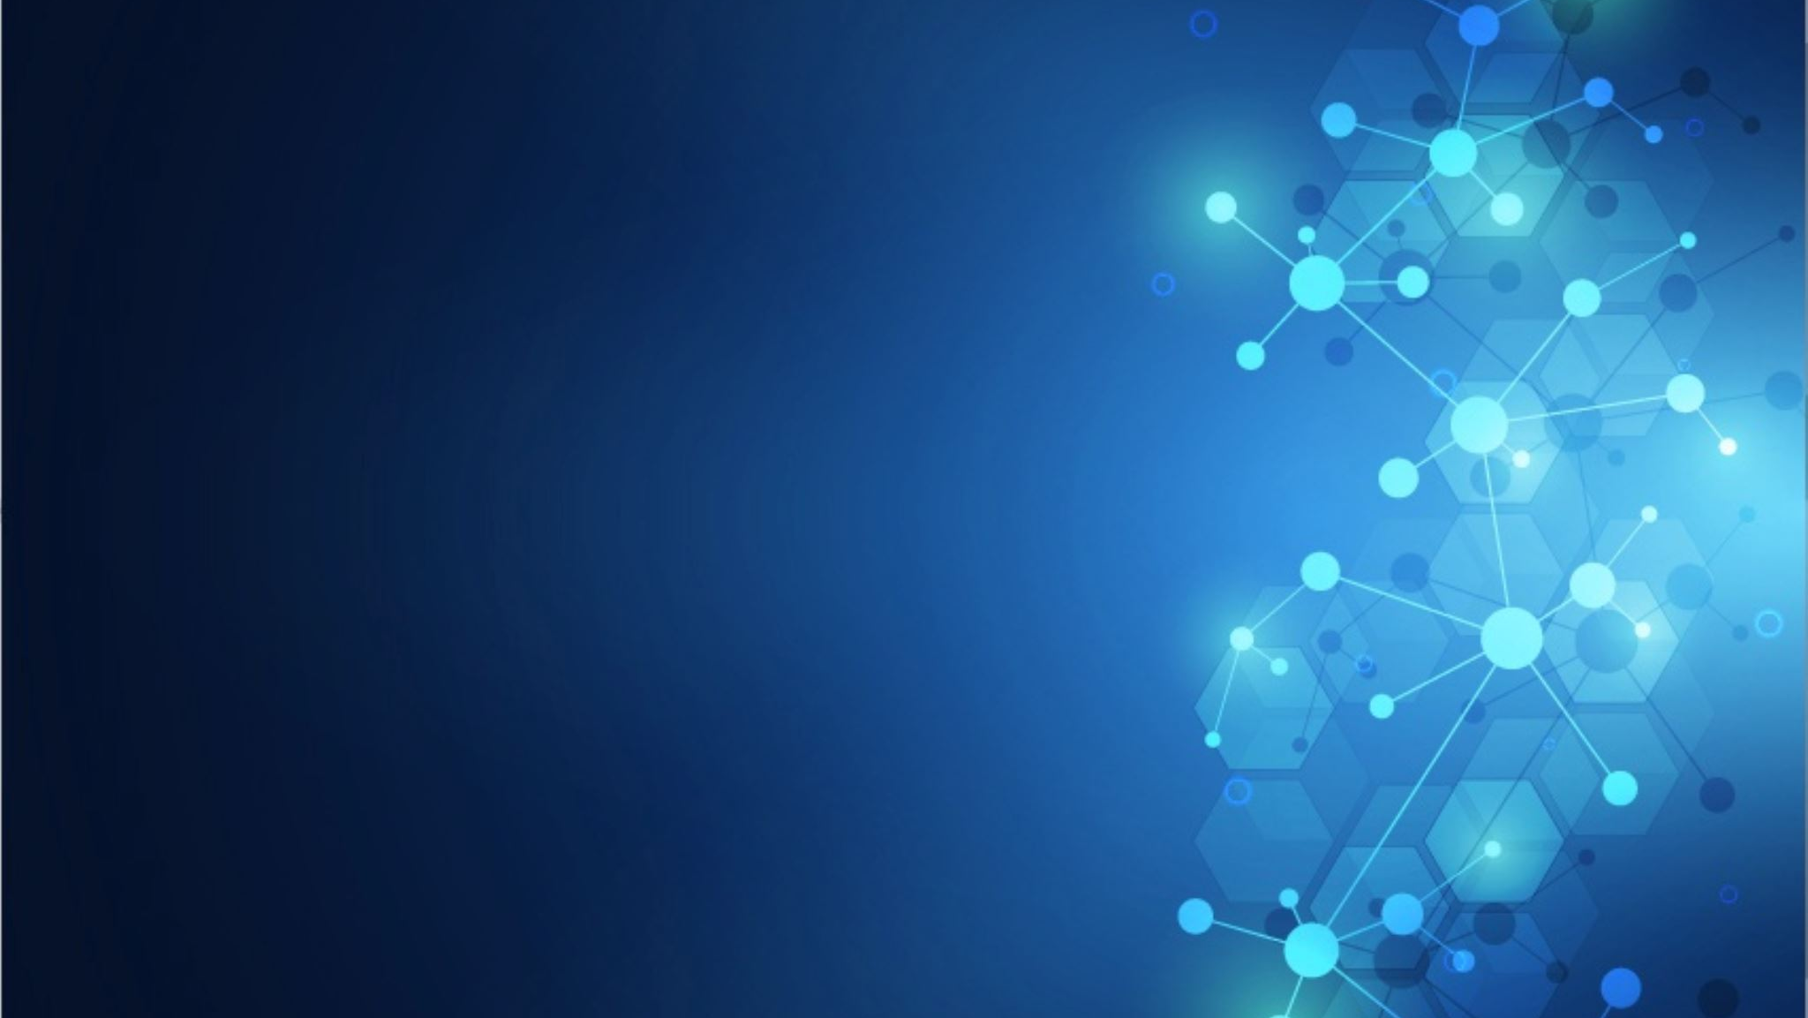
Designing and Evaluating the Use of Machine Learning Models and Nearest Neighbor Algorithms to Identify Colors for People Who Have Difficulty Identifying Them.

Slide 2
Abstract
According to www.color-blindness.com, roughly 8% of all men and .5% of all women in the world are color blind. The purpose of my project is to design and evaluate different algorithms for identifying colors for people who have difficulty identifying them. In the past, I have attempted to identify colors using a scratch program that used conditional statements that had ranges of RGB values to determine a color name. This model was not effective in some cases, which led me to think that other approaches could perform better.
I explored two different approaches to achieve this goal: Machine learning classifiers and the Nearest Neighbors algorithm. My hypothesis is that Machine Learning Classifiers will provide a more effective solution compared to the Nearest Neighbors algorithm. For the first approach, I used a machine learning classifier (neural networks) with different datasets: I started using an existing dataset with 5000 instances of 11 basic colors, which tested well using a random sample of 80% of the dataset as training data and 20% as testing data (accuracy >0.9). However, it did not perform well when tested with colors that are difficult for people with different colorblindness conditions to identify. Hence, I decided to create a new dataset that included more colors (22 colors), including those that are difficult for colorblind individuals to identify. Initially, this dataset had approximately 10 instances of each color which didn’t perform well when tested (accuracy <0.5: 80% training and 20% testing datasets). I found out that this was due to the size of the dataset, so I increased the scale of the dataset from 10 instances per color to approximately 60 instances per color (1309 instances), which produced better results (accuracy >0.9). After this, I decided to create a separate testing dataset with colors that are difficult for people with different colorblindness conditions to identify and colors that are frequently used in color blindness diagnostic tests (141 instances). Using this new testing dataset, the classification accuracy decreased.
I also implemented a Nearest Neighbors algorithm, which used the distance between two points in 3d as the distance measure. Coordinates for each point were based on the RGB values of each color. I tried this approach with two different datasets as centers and tested them with the last testing dataset (141 instances): the first dataset had the original 22 colors as centers and the second dataset was the training dataset used earlier with 1309 instances. The Nearest Neighbor algorithm outperformed the machine learning model regarding accuracy.
In this project, elaborate on the strengths and weaknesses of these approaches in terms of the complexity of the algorithm, the amount of data it requires, and execution speed. I will also elaborate on future work in this field.

Slide 3
Research Plan
Do research on color blindness and machine learning approaches
Implement and evaluate Machine Learning Classifier
Research current machine learning classifiers that can be adjusted for the project
Create the datasets
Make changes to python program to make use of new datasets.
Observe the performance of the classifier during the training and testing periods
Implement and evaluate Nearest Neighbor algorithm with various datasets
Research python dictionaries
Convert CSV of datasets to Dictionary in python program
Implement distance formula and calculate the distances between test colors and dictionary centers
Document performance of the Nearest Neighbor algorithm with different datasets
Compare Machine Learning Classifier and Nearest Neighbor algorithm results
Analyze results and write conclusions

Slide 4
Hypothesis and Purpose
The purpose of my project is to design and evaluate different algorithms for identifying colors, especially those that are difficult for color-blind individuals to identify.
My hypothesis is that Machine Learning Classifiers will provide a more effective solution compared to the Nearest Neighbors algorithm.

Slide 5
Datasets
Existing Dataset
Instances: 5052
Colors: 11
New Dataset 1
Instances: 1309
Colors: 22 (including colors for colorblind individuals)
Testing Dataset 1. It includes colors from Diagnostic images and Colors that are difficult to Identify
Rows: 141
Colors: 22 (including colors for colorblind individuals)

Slide 6
Colors That Are Difficult To Identify By Colorblind Individuals

Slide 7
Testing Original ML Classifier with Colors that are Difficult to Identify by Colorblind Individuals
Color Pairs of Confusion | Original Machine Learning Detection Output
Lime | Green
Red | Red
Royal Blue | Blue
Silver | Grey
Green | Green
Gold | Yellow
Olive | Green
Magenta | Pink
Cyan | Blue
Dark Gold | Yellow

Slide 8
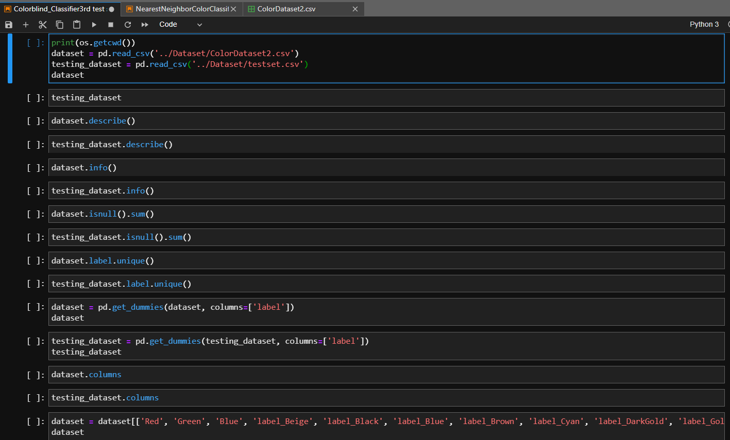
Machine Learning Classifier (Fragment)

Slide 9
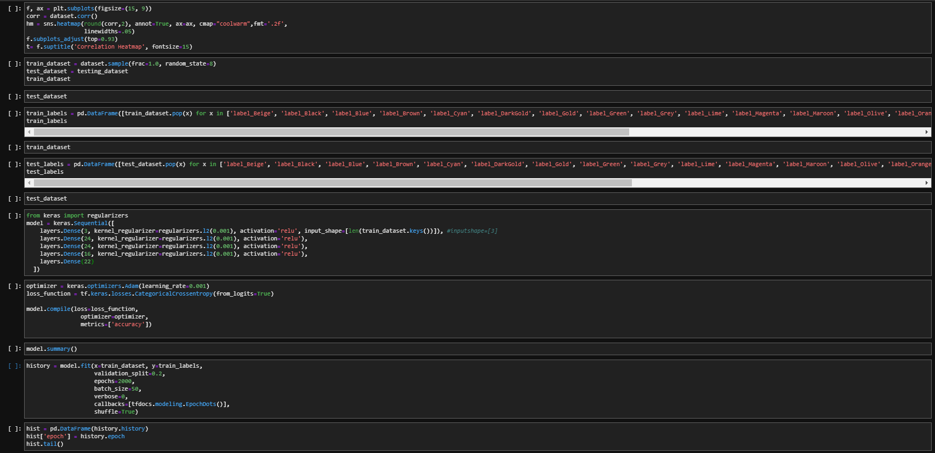

Slide 10
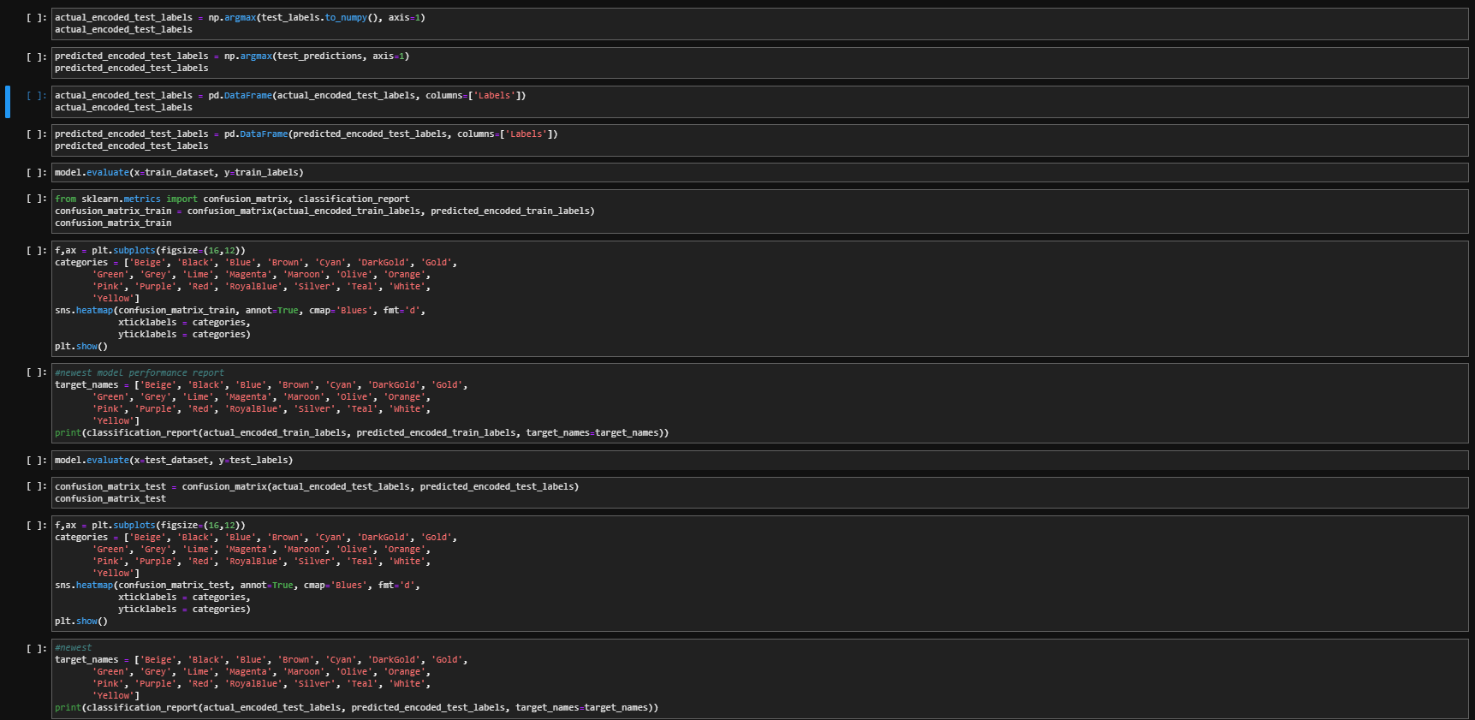

Slide 11
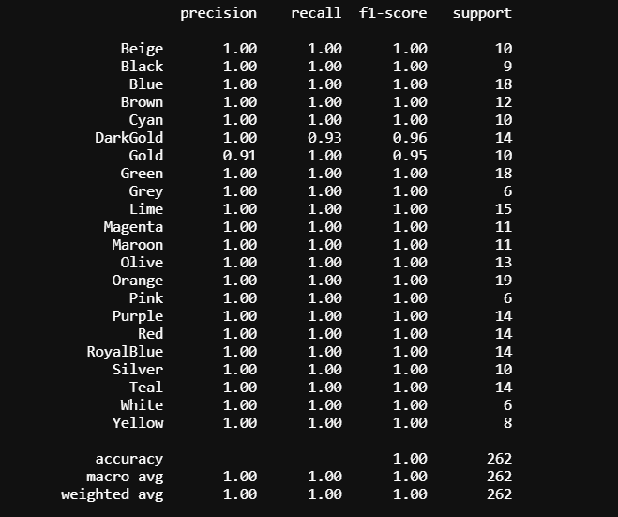
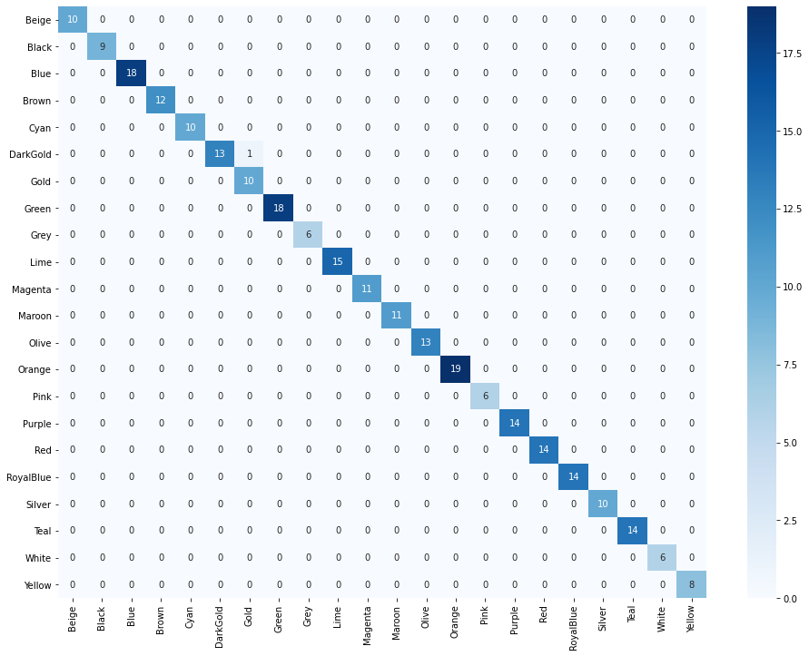
Results of ML Classifier After Using New Training Dataset (1309 instances, 22 colors)

Slide 12
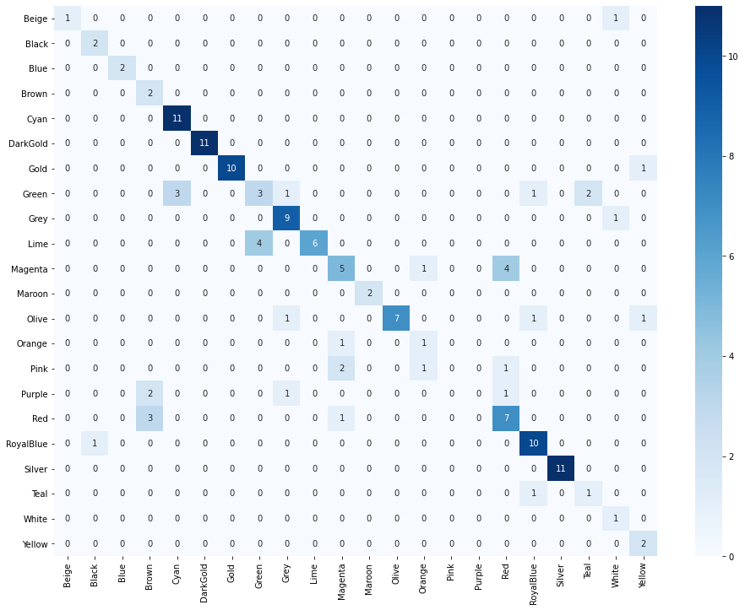
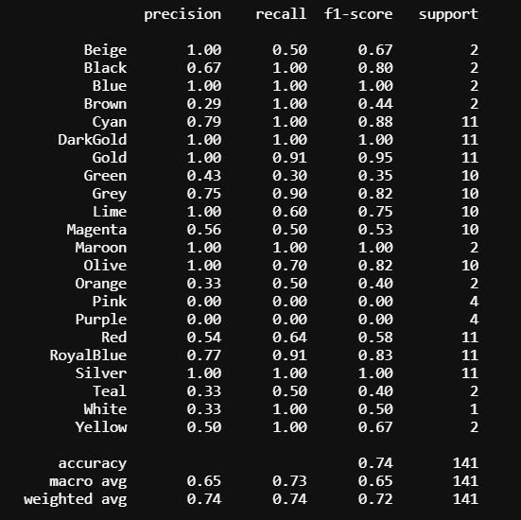
Results of ML Classifier After Using New Testing Dataset (141 instances, 22 colors, training 1309)

Slide 13
Nearest Neighbor Algorithm
I decided to explore the Nearest Neighbors algorithm using 22 selected colors as centers, with the idea of comparing the results with the ones obtained using ML.
The distance is computed using the distance of two points in 3d space.
$d=\sqrt{{(x_{2}−x_{1})}^{2}+{(y_{2}−y_{1})}^{2}+{(z_{2}−z_{1})}^{2}}$
With RBG values as points in 3 dimensions (R₁, G₁, B₁) and (R₂, G₂, B₂).
$$d=\sqrt{{(R_{2}−R_{1})}^{2}+{(G_{2}−G_{1})}^{2}+{(B_{2}−B_{1})}^{2}}$$
The algorithm finds the distance between each color and each of the centers and selects the color of the closest center as the prediction.

Slide 14
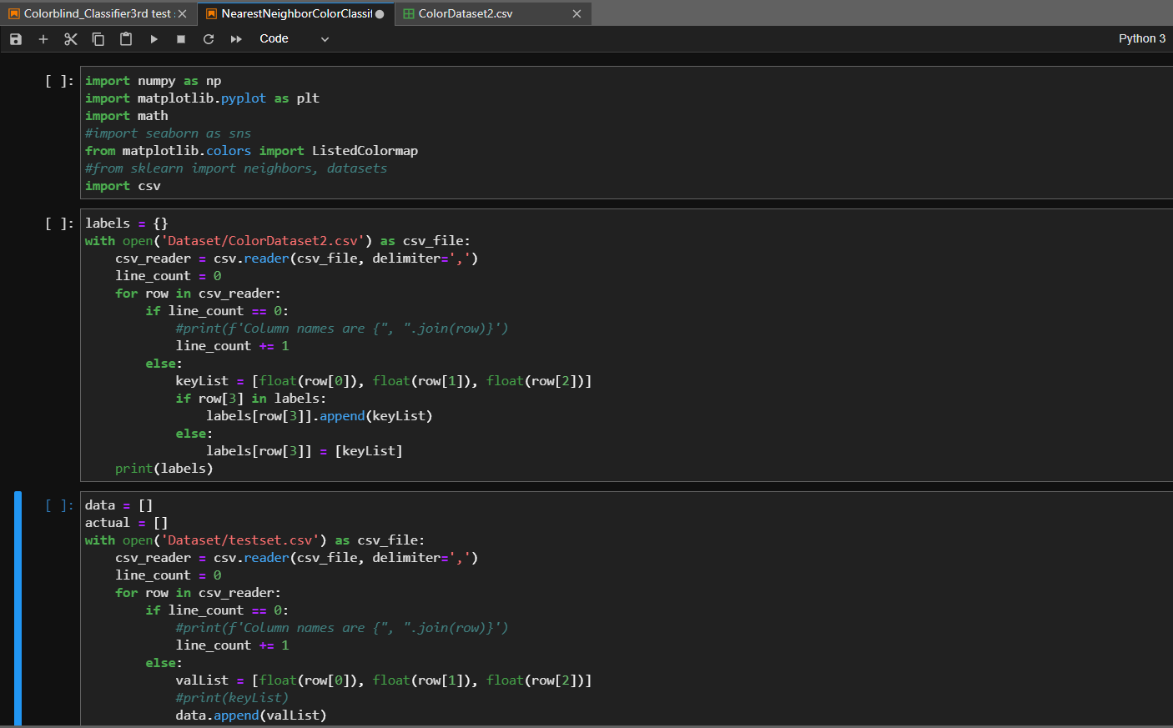
Nearest Neighbors Algorithm (Fragment)

Slide 15
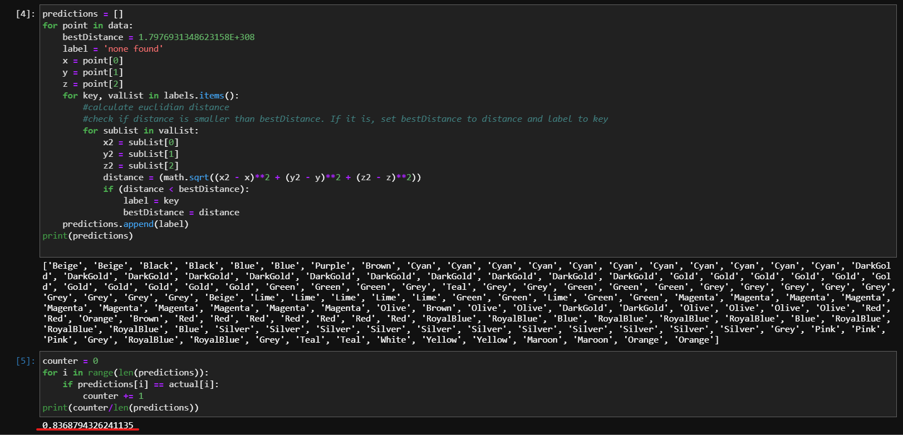
Results of Nearest Neighbors Algorithm Using New Testing Dataset (141 instances, 22 colors, centers 1309)
Accuracy

Slide 16
Results Of Last Trial
New Training Dataset 1: 1309 instances
Testing Dataset 1: 141 instances
Measure | Machine Learning Classifier | Nearest Neighbor Algorithm
Accuracy (correct/total) | 79% (Average of four trials) | 84%

Slide 17
Conclusions and Future Work
The nearest neighbor algorithm seems to provide slightly better results compared to the machine learning classifier.
The complexity of the machine learning classifier is considerably higher than the nearest neighbor algorithm.
The speed of the machine learning classifier is slower than the nearest neighbor algorithm.
The consistency of the machine learning classifier is lower than the nearest neighbor algorithm.
In the future, I think with a better dataset, the machine learning algorithm could improve and perhaps outperform the nearest neighbor algorithm. However, this is not clear because with more centers, the nearest neighbor algorithm could also improve.

Slide 18
Bibliography
Chavan, A. (2020). Building RGB Color Classifier. https://medium.com/analytics-vidhya/building-rgb-color-classifier-part-1-af58e3bcfef7
RGB Color Table. https://www.rapidtables.com/web/color/RGB_Color.html
Nearest Neighbor Search. https://en.wikipedia.org/wiki/Nearest_neighbor_search
Jupyter. http://jupyterlab.io/
TensorFlow Library. https://www.tensorflow.org/
Pandas Library. https://pandas.pydata.org/
Anaconda. https://www.anaconda.com/
Python multidict example – Map single key to multiple values in dictionary. https://howtodoinjava.com/python/datatypes/multidict-key-to-multiple-values/
Fincher, J. Reading and Writing CSV Files in Python. https://realpython.com/python-csv/
Python Casting. https://www.w3schools.com/python/python_casting.asp
Color blindness. https://en.wikipedia.org/wiki/Color_blindness
NumPy Library. https://numpy.org/
Matplotlib Library. https://matplotlib.org/
Git Library. https://git-scm.com/
Seaborn Library. https://seaborn.pydata.org/
Sklearn Library. https://scikit-learn.org/stable/index.html
Plotly Library. https://plotly.com/
CSV Library. https://docs.python.org/3/library/csv.html
Math Library. https://docs.python.org/3/library/math.html
Flück, D. Color Blind Essentials. https://www.color-blindness.com/wp-content/documents/Color-Blind-Essentials.pdf

