Slide 1
Localization of Natural Disaster Survivors Through Drone-based Sound Source Localization
Ian Lee

Slide 2
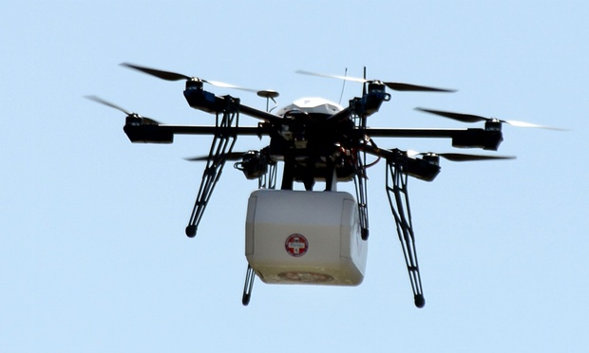
Purpose
To design an efficient and accurate system of sound source localization for rescue drones
Developing a ratio-based method not previously explored
https://temblor.net/earthquake-insights/eye-in-the-sky-saving-lives-and-earthquake-recon-using-drones-2273/

Slide 3
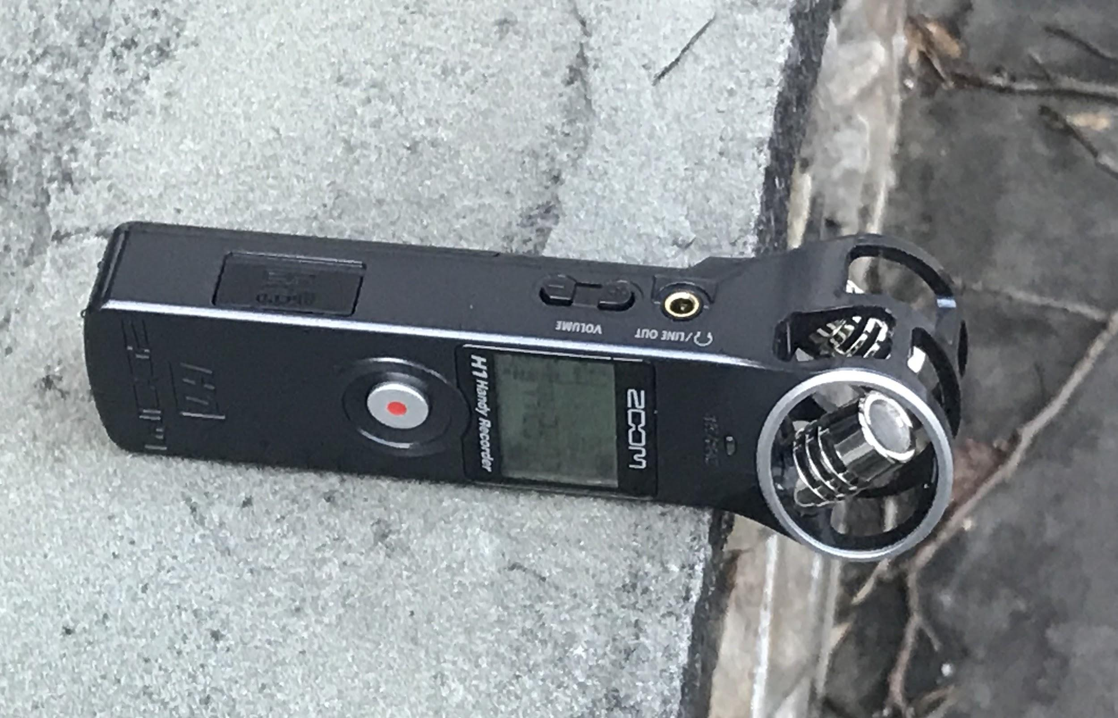
Materials
Zoom H1 Handy Recorder (1x)
Zoom H1N Handy Recorder (1x)
Wolfram Mathematica 12.1 Computer Language (1x)
Intel® Core™ 10700K CPU @ 3.80GHz Desktop Computer (1x)
iPhone 7 Plus (1x) (for testing and tone generation)
Sonic application (1x) (for testing and tone generation)
3,300Hz Rescue whistle (1x)

Slide 4
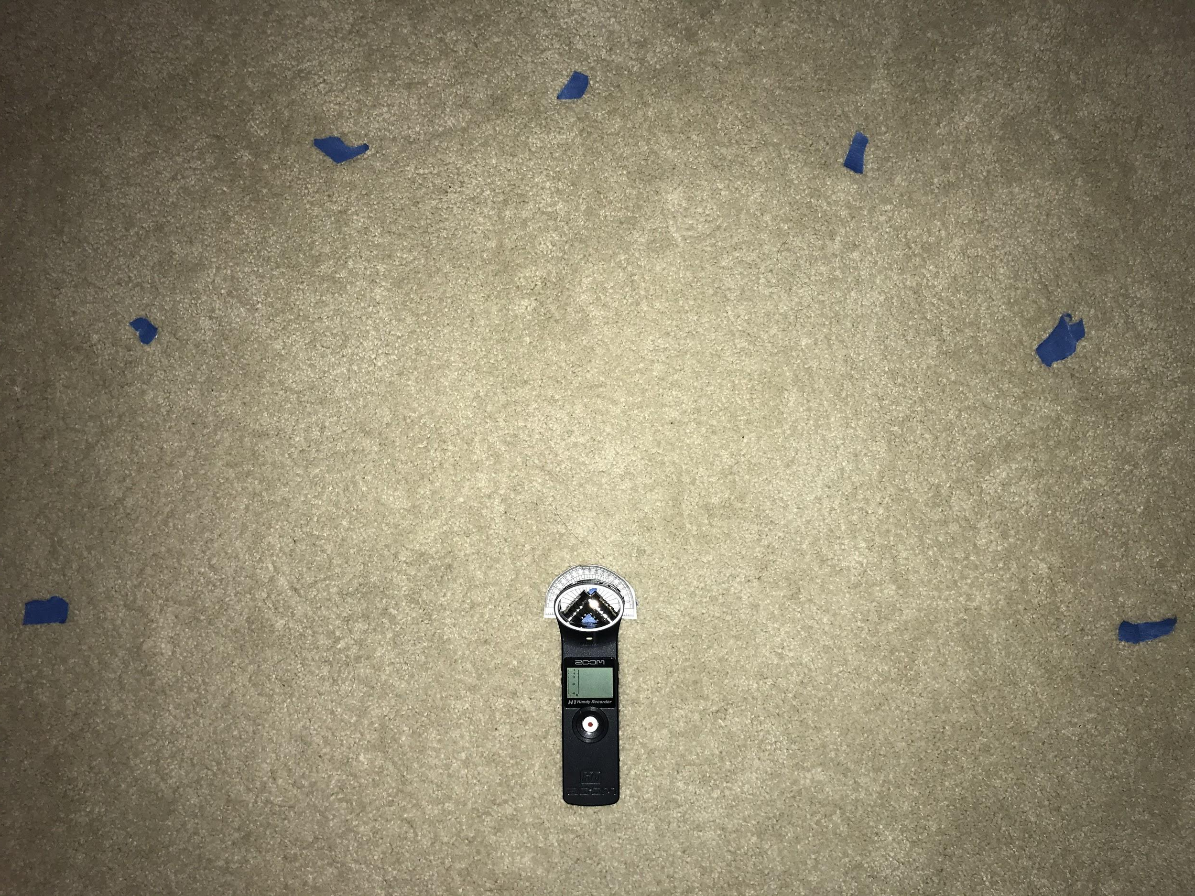
Procedure
Preliminary calibration trials -- Generate angle/ratio pairs
Create mathematical model -- Receives left/right ratio, outputs angle of origin
Write frequency extractor code -- Bandpass filter for 300Hz to 8,000Hz
Conduct tests to assess accuracy and effects of the environment

Slide 5
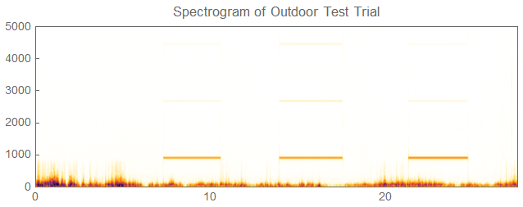
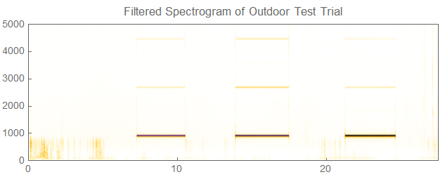
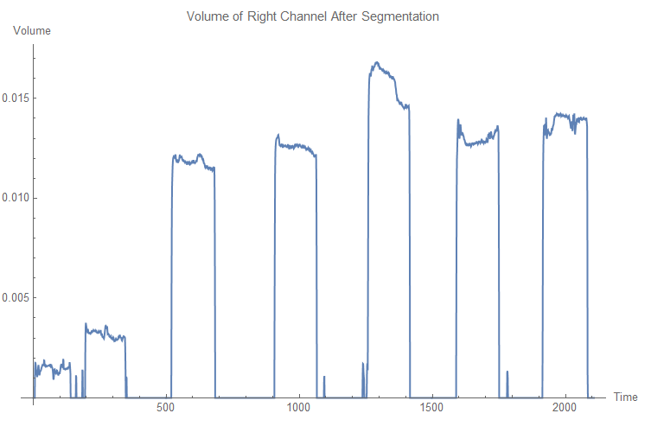
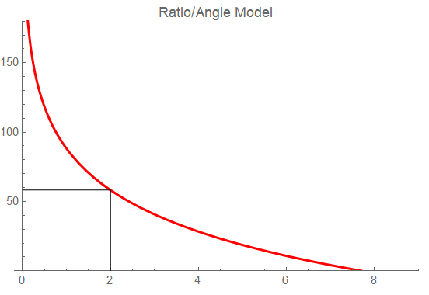
Band-pass Filter is Applied
Microphone Receives Audio Data
Outputs Angle of Origin in Degrees
Automatic Segmentation
Estimation Using Model

Slide 6
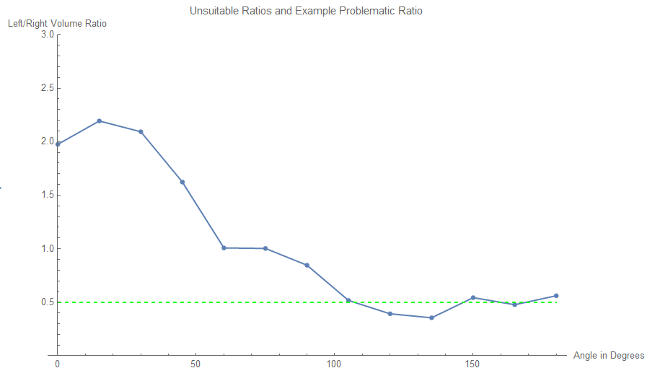
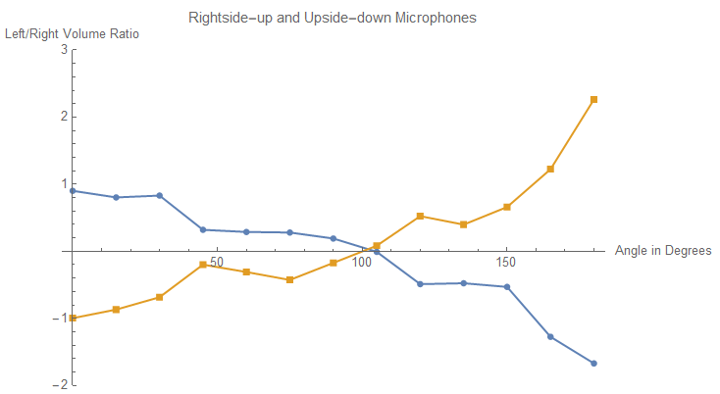
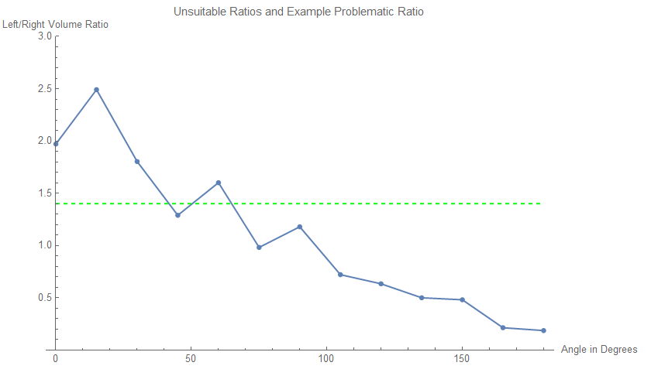
When analyzing the preliminary trials, the data would contain areas where one output corresponded with several input.
Since the inverse function of the graphs on the left would be used, this would be problematic as a measured ratio could be coming from several different angles
The problem was hypothesized to be stemming from an irregularity in microphone measurement, so an experiment was designed
One microphone was placed upside down and on top of the other
Results showed mirror images along the x-axis, indicating that the microphones were not the problem
Instead, reverberation and misplacement was the likely root cause.

Slide 7
Results
Average Indoor Error Range -- 4.9 degrees Average Outdoor Error Range -- 19.2 degrees
Condition Testing
Actual Angle (degrees) | 45 | 90 | 120 | Average Calculation Time | Condition | Average Difference (degrees)
Horizontal Calculation | 54.2929 | 81.5178 | 85.6215 | 0.051 seconds | High wind | 17.3845
Vertical Calculation | 46.28 | 79.3188 | 68.99 | 0.05 seconds | High wind | 20.9904
Horizontal Calculation | 54.8665 | 92.1806 | 113 | 0.05 seconds | No wind | 6.349
Vertical Calculation | 43.6809 | 91.8793 | 108.818 | 0.051 seconds | No wind | 4.7935

Slide 8
Results
Directional Testing
 | Lateral | Vertical | Average Calculation Time
Actual Angle (degrees) | 90 | 110
Trial 1 | 92.5886 | 104.643 | 0.02767 seconds
Trial 2 | 92.0685 | 107.521 | 0.02307 seconds
Trial 3 | 93.2119 | 108.355 | 0.02292 seconds
Trial 4 | 95.7865 | 75.198 | 0.03067 seconds
Trial 5 | 93.5289 | 106.242 | 0.04286 seconds
Average Inaccuracy | 3.43888 | 9.6082
Actual Angle (degrees) | 70 | 100
Trial 1 | 70.25 | 103.025 | 0.02071 seconds
Trial 2 | 71.3979 | 102.192 | 0.0269 seconds
Trial 3 | 70.1597 | 102.071 | 0.0163 seconds
Trial 4 | 66.5222 | 103.088 | 0.02529 seconds
Trial 5 | 69.8221 | 88.5032 | 0.02021 seconds
Average Inaccuracy | 1.09266 | 4.37456
Average Vertical Error Range: 9.94
Average Horizontal Error Range: 7.06

Slide 9
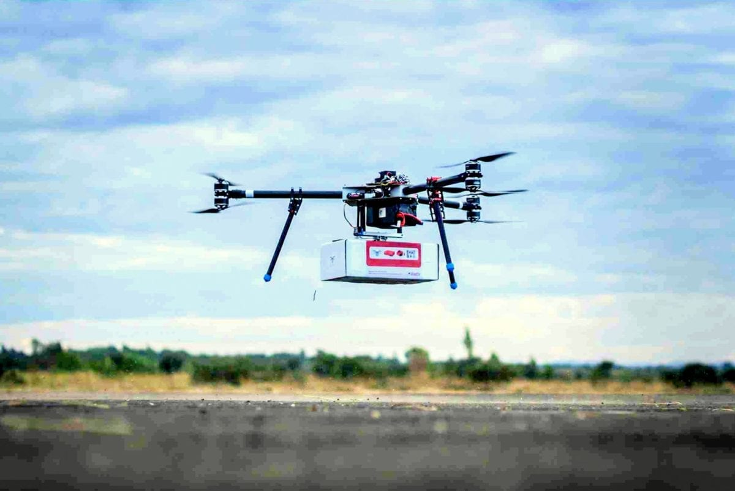
Summary
Time Efficient -- 0.03 seconds on average
Accurate -- 4.9 degrees indoors, 19.2 degrees outdoors, 8.5 degrees overall
Novel approach -- first system that solely uses a ratio of left/right facing volumes
Optimized for Disaster Relief -- only considers sounds that could potentially be from survivors
https://dronebelow.com/2018/11/20/drones-swarms-and-ai-for-search-and-rescue-operations-at-sea/

Slide 10
Ideas for Future Research
Sound Source Localization:
Improve accuracy in high-wind environments
Explore how distance affects accuracy
UAVs and Signal Processing
Mapping survivors and determining most efficient route
Incorporate machine-learning models and expanding scope to other fields such as law-enforcement

