Slide 1
Detection and Analysis of Braess’s Paradox in Bay Area’s Highway Network
By Zheshen Li
Princeton International School of Mathematics and Science

Slide 2
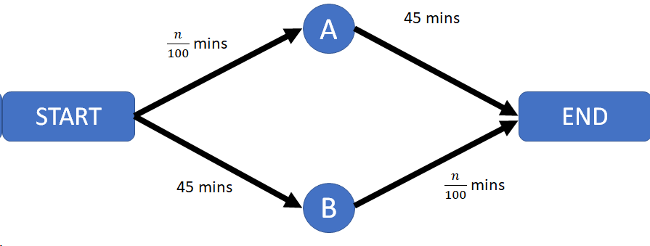
Introduction
Braess’s Paradox: Adding a connection might lead to slower overall traffic.
In this situation, there are 2 symmetrical paths from start to end: via junction A or junction B. For example, if 4000 cars want to go from start to end at the same time, then 2000 will go via A, 2000 via B.
Each car will take 45 + (2000/100) = 65 minutes to travel from START to END.

Slide 3
Introduction
Braess’s Paradox: Adding a connection might lead to slower overall traffic.
Now suppose a new path connecting junction A and B that doesn’t take time is added, it seems optimal to go via START - A - B - END, as (4000/100) < 45. Thus, all 4000 drivers will make the same decision to go on that route. Under this situation each car will use:
(4000/100) + （4000/100） = 80 minutes
0 mins

Slide 4
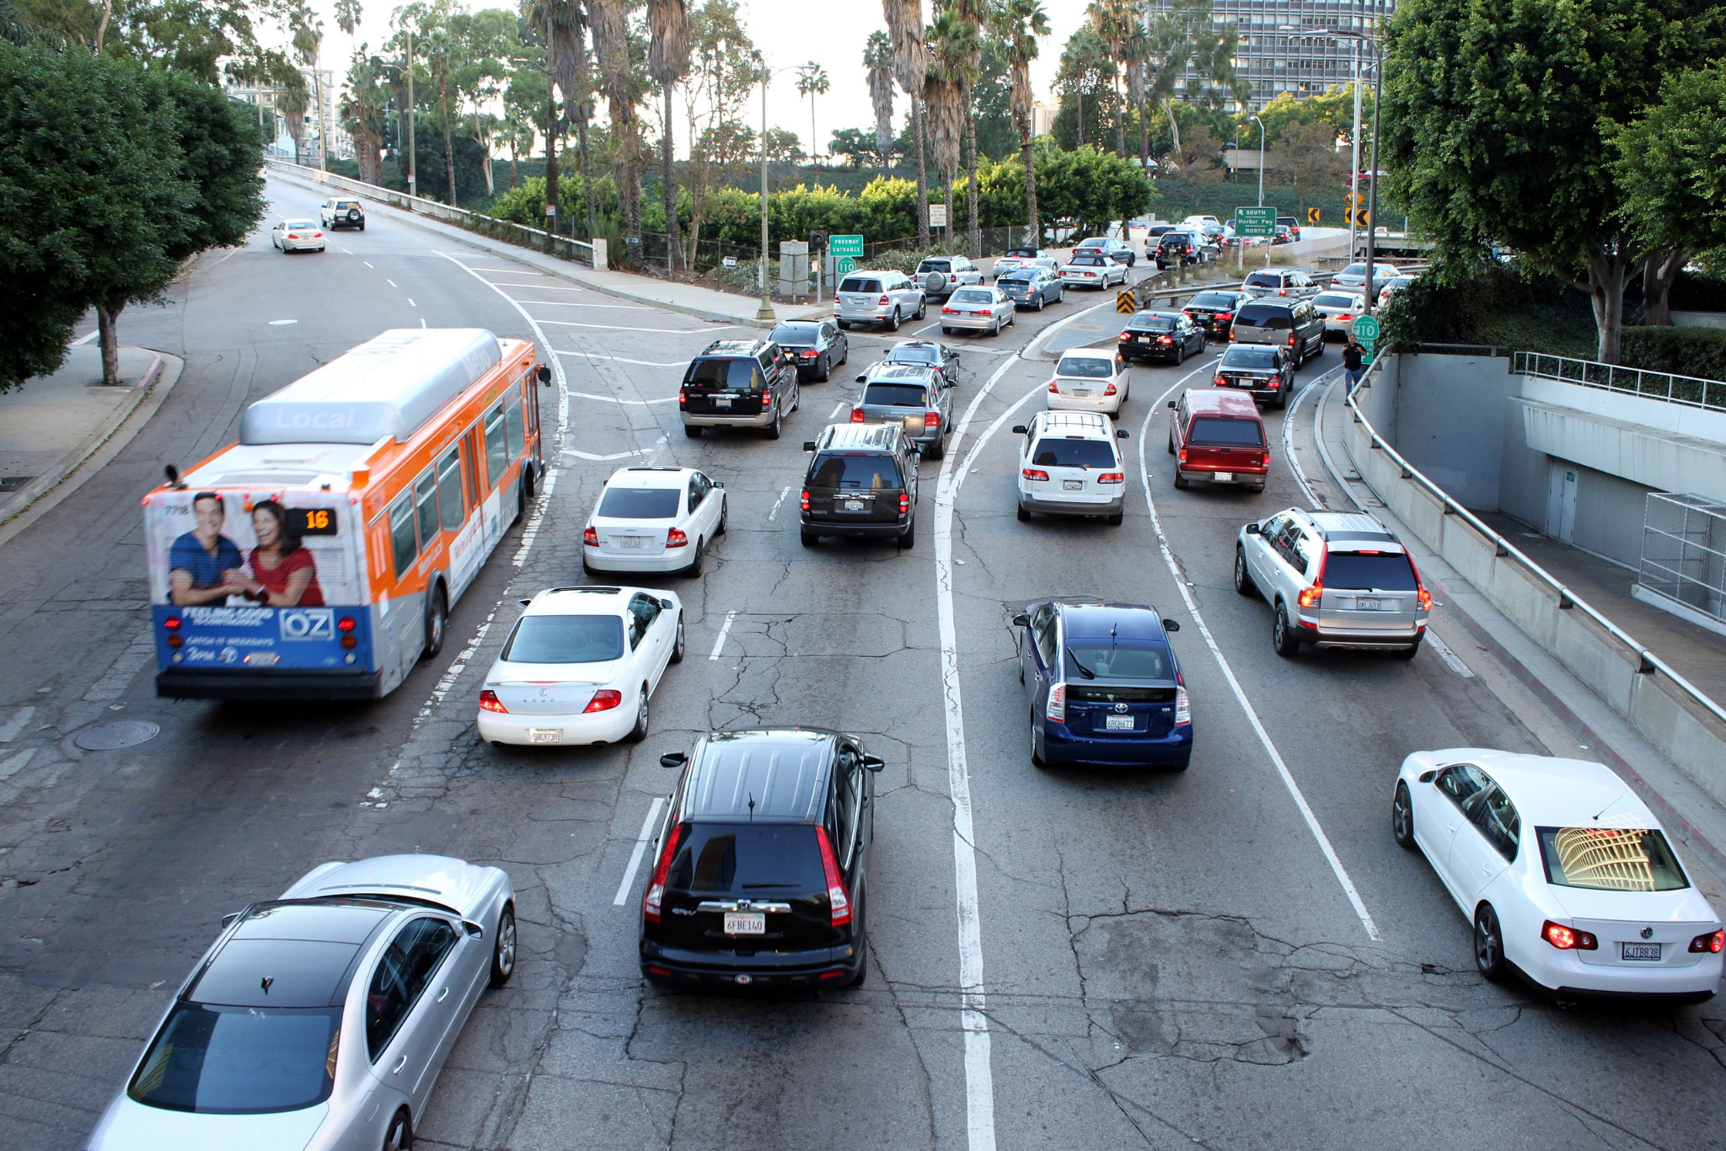
Introduction
In this research, we will mathematically model the traffic and highway networks of San Francisco Bay Area and determine the occurrences of Braess’s paradox in it. We will compare the modeled traffic situations before and after certain connections are removed to determine it.

Slide 5
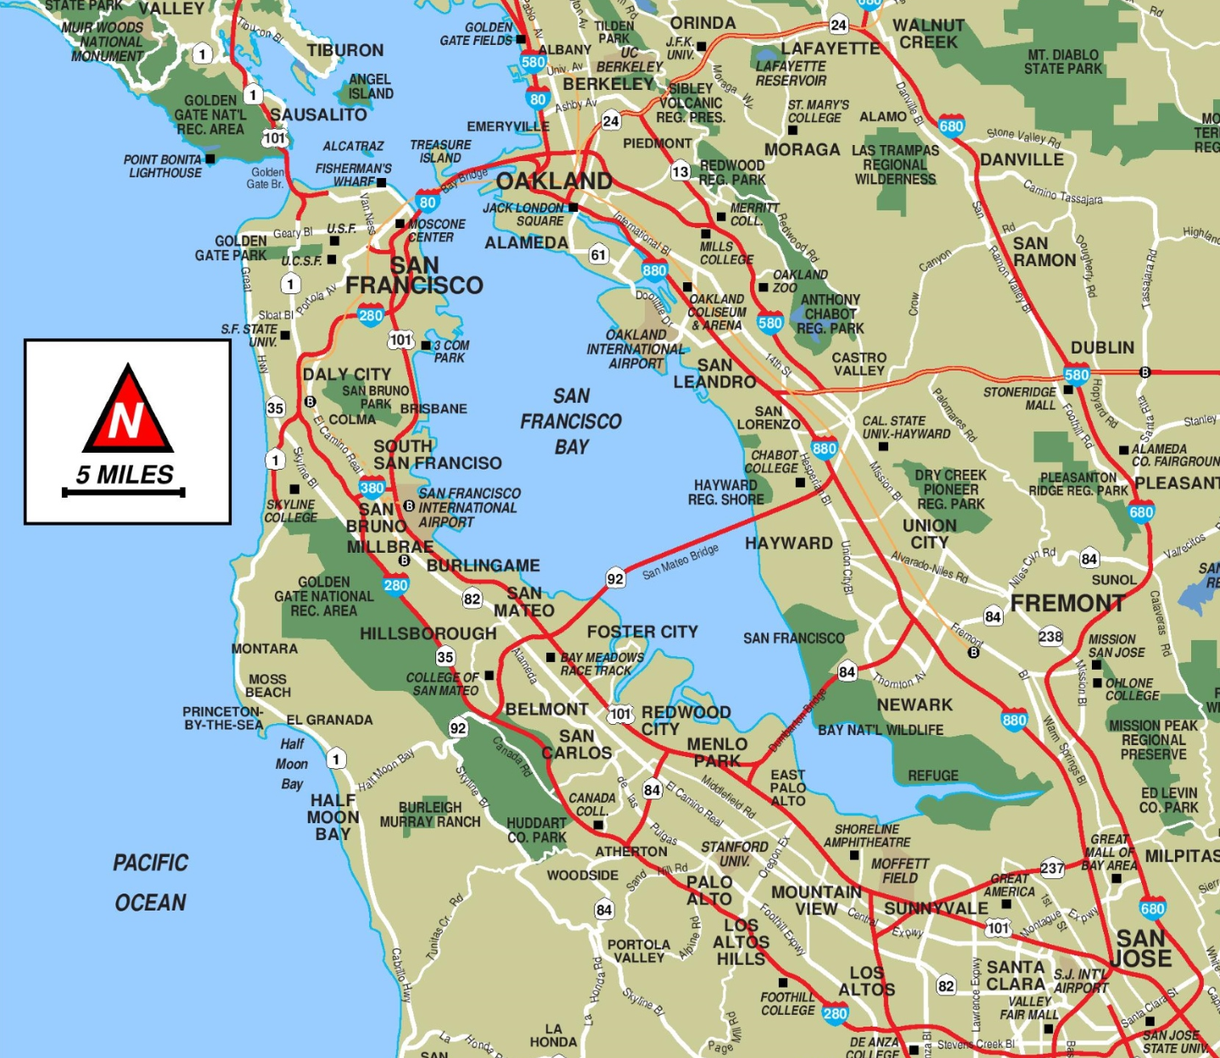
1
9
5
2
10
3
11
6
4
7
12
8
Notes:
The two largest cities in the area are San Francisco and San Jose, each home to around a million people. We will use these two cities as start and end points.

Slide 6
Modeling Methods
San Francisco
(Dest)
San Jose
(Departure)
Notes:
The highway can now be separated into segments.

Slide 7
Modeling Methods
Will Traffic move faster with a connection removed?
If yes: paradox occurs in SF Road Network
If no: paradox doesn’t occur
San Francisco
(Dest)
San Jose
(Departure)
Notes:
The highway can now be separated into segments.

Slide 8
Modeling Methods
Will Traffic move faster with a connection removed?
If yes: paradox occurs in SF Road Network
If no: paradox doesn’t occur
San Francisco
(Dest)
San Jose
(Departure)
Notes:
The highway can now be separated into segments.

Slide 9
Modeling Methods
T_{x} = A_{x} + B_{x} * F_{x}
T_{x} : the amount of time a traveler takes to travel through highway segment x
A_{x} : the free-flow travel time on highway x
B_{x} : the delay parameter of highway x(increase in travel time per car increase on highway x)
F_{x}: the number of cars that travels on highway x

Slide 10
Modeling Methods
A_{x} = L_{x} (miles)/ Speed Limit (mph)
B_{x} = (Actual T_{x}- A_{x})/ Actual F_{x}
L_{x} : the length (miles) of the highway segment x

Slide 11
Modeling Methods
x | Ax | Bx
1 | 8/49 | 0.00463
2 | 14.27 | 0.00772
3 | 11.26 | 0.00772
4 | 7.46 | 0.0115
5 | 9.92 | 0.00579
6 | 7.21 | 0.00579
x | Ax | Bx
7 | 9.92 | 0.00579
8 | 7.21 | 0.00579
9 | 17.00 | 0.00579
10 | 5.94 | 0.00579
11 | 11.17 | 0.00579
12 | 4.02 | 0.00579
T_{x} = A_{x} + B_{x} * F_{x}

Slide 12
Modeling Methods
Equilibrium Situation: the amount of time a driver would take traveling all 5 routes shall be the same, so that no drivers have the incentive to change route and all drivers spend the same amount of time.

Slide 13
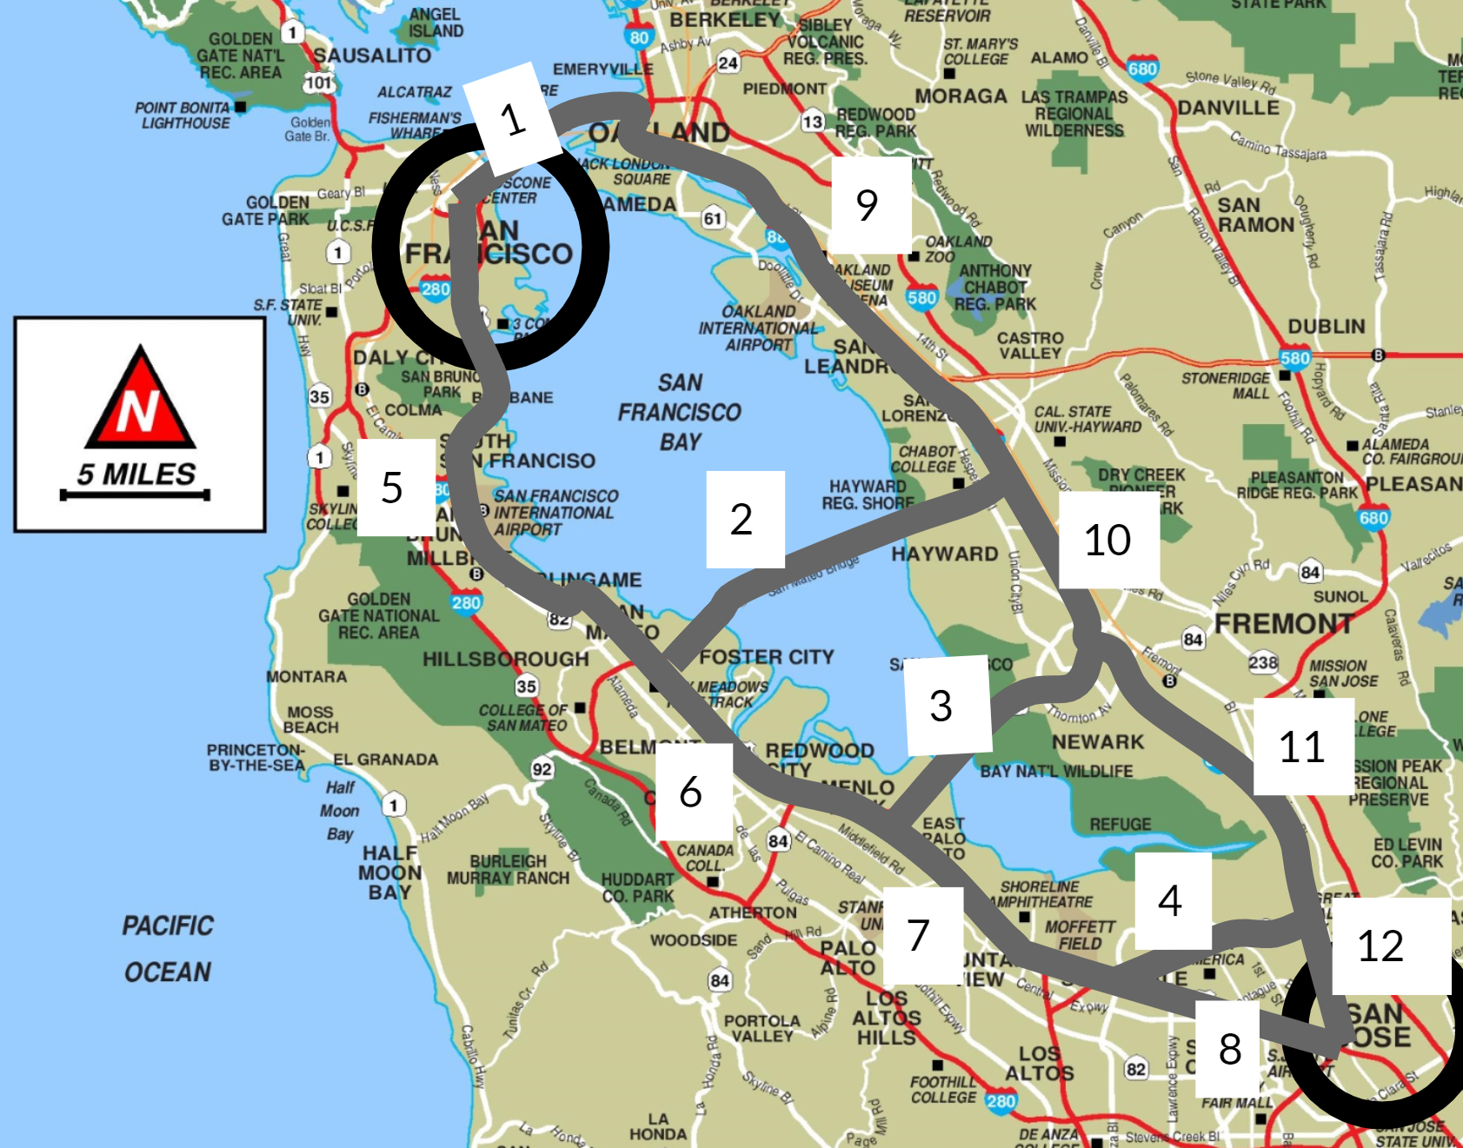
Modeling Methods
Under equilibrium we have:
T₈ + T₇ + T₆ + T₅
=T₁₂ + T₄ + T₇ + T₆ + T₅
=T₁₂ + T₁₁ + T₃ + T₆ + T₅
=T₁₂ + T₁₁ + T₁₀+ T₂ + T₅
=T₁₂ + T₁₁ + T₁₀ + T₉ + T₁

Slide 14
Modeling Methods
Closing Segment 2:
T₈ + T₇ + T₆ + T₅
=T₁₂ + T₄ + T₇ + T₆ + T₅
=T₁₂ + T₁₁ + T₃ + T₆ + T₅
=T₁₂ + T₁₁ + T₁₀ + T₉ + T₁

Slide 15
Modeling Methods
Closing Segment 3:
T₈ + T₇ + T₆ + T₅
=T₁₂ + T₄ + T₇ + T₆ + T₅
=T₁₂ + T₁₁ + T₁₀+ T₂ + T₅
=T₁₂ + T₁₁ + T₁₀ + T₉ + T₁

Slide 16
Results & Discussion
Solving the equations gives:
Traffic \ Highway Closure | None | 2 (San Mateo) | 3(Dumbarton)
5000 | 107.1(mins) | 107.3(mins) | 107.1(mins)
10000 | 170(mins) | 170.1(mins) | 170(mins)

Slide 17
Results & Discussion
Highway Closure | Total Traffic | 1 | 2 | 3 | 4 | 5 | 6
None | 5000 | 2157 | 32 | 0 | 0 | 2843 | 2811
None | 10000 | 4141 | 449 | 0 | 21 | 5859 | 5410
2 (San Mateo) | 5000 | 2221 | 0 (Closed) | 0 | 2 | 2873 | 2873
2 (San Mateo) | 10000 | 4371 | 0 (Closed) | 149 | 2 | 5629 | 5629
3 (Dumbarton) | 5000 | 2157 | 32 | 0 (Closed) | 56 | 2843 | 2811
3 (Dumbarton) | 10000 | 4141 | 449 | 0 (Closed) | 21 | 5859 | 5410

Slide 18
Results & Discussion
Highway Closure | Total Traffic | 7 | 8 | 9 | 10 | 11 | 12
None | 5000 | 2811 | 2811 | 2157 | 2189 | 2189 | 2189
None | 10000 | 5410 | 5389 | 4141 | 214590 | 4590 | 4611
2 (San Mateo) | 5000 | 2872 | 2871 | 2221 | 2221 | 2127 | 2129
2 (San Mateo) | 10000 | 5480 | 5424 | 4371 | 4371 | 4520 | 4576
3 (Dumbarton) | 5000 | 2811 | 2811 | 2157 | 2189 | 2189 | 2189
3 (Dumbarton) | 10000 | 5140 | 5389 | 4141 | 4590 | 4590 | 4611

Slide 19
Results & Discussion
As the compared results in previous slides show, the closure of the San Mateo bridge (segment 2) or Dumbarton Bridge (segment 3) doesn’t lead to many changes in the travel time of individual drivers from San Jose to San Francisco. This suggests that there are no occurrences of Braess’s Paradox in this part of the Bay Area highway network under the tested traffic.

Slide 20
Results & Discussion
The San Mateo Bridge, Dumbarton Bridge and highway segment 4 (CA Route 237) in the middle had very limited traffic flowing through. Thus, the impact of these three connections on the network as a whole is very limited.This is completely different from the Braess’s Paradox scenario in which the majority of travelers choose to travel on a “shortcut” in the middle, leaving it overwhelmingly congested.

Slide 21
Further improvements
More situations of traffic flow
More highways included in the network
Express Lane, Carpool, etc.

Slide 22
References
Braess, D. “Über Ein Paradoxon Aus Der Verkehrsplanung.” Unternehmensforschung Operations Research - Recherche Opérationnelle, vol. 12, no. 1, 1968, pp. 258–268., doi:10.1007/bf01918335.
Pas, Eric I., and Shari L. Principio. “Braess' Paradox: Some New Insights.” Transportation Research Part B: Methodological, vol. 31, no. 3, 1997, pp. 265–276., doi:10.1016/s0191-2615(96)00024-0.
Youn, Hyejin, et al. “The Price of Anarchy in Transportation Networks: Efficiency and Optimality Control.” ArXiv.org, 7 Aug. 2008, arxiv.org/abs/0712.1598.
Willingham, AJ. “Commuters Waste an Average of 54 Hours a Year Stalled in Traffic, Study Says.” CNN, Cable News Network, 22 Aug. 2019, www.cnn.com/2019/08/22/us/traffic-commute-gridlock-transportation-study-trnd.
“San Francisco–Oakland Bay Bridge.” Wikipedia, Wikimedia Foundation, 4 Feb. 2021, en.wikipedia.org/wiki/San_Francisco–Oakland_Bay_Bridge.
Roughgarden, Tim. “On the Severity of Braess's Paradox: Designing Networks for Selfish Users Is Hard.” Journal of Computer and System Sciences, Academic Press, 28 Feb. 2006, www.sciencedirect.com/science/article/pii/S0022000006000109.
Burke, Charles, et al. “The Identification of Partial Capacity Braess Paradoxes: Implications for Road Investment” McMaster University, https://ctrf.ca/wp-content/uploads/2015/02/2014CTRF_S06_2_Regular.pdf

