Slide 1
FEA Analysis on 100% Frontal Collision
Michael Li (Yunze), Mike Yan (Yi)

Slide 2
Purpose
Through this experiment, we aspire to refine the safety contraptions of an automobile to reduce the extent of damage caused in an 100% frontal collision, enhancing passengers and drivers’ safety when travelling, all while reducing the weight of the vehicle to improve energy efficiency and general performance.

Slide 3
Hypothesis
Changing the aluminum alloy material used for the front bumper of an automobile to composite carbon fiber material will improve its performance during an 100% frontal collision.

Slide 4
Softwares Used
- HyperWorks - Modify and organize finite element models
- HyperMesh - Preprocessor for generating finite element models
- HyperView - Post-processor for generating data in a comprehensible format.
- HyperGraph - Graph generator
- LS_DYNA - Force and motion analysis software
* Details in the paper.

Slide 5
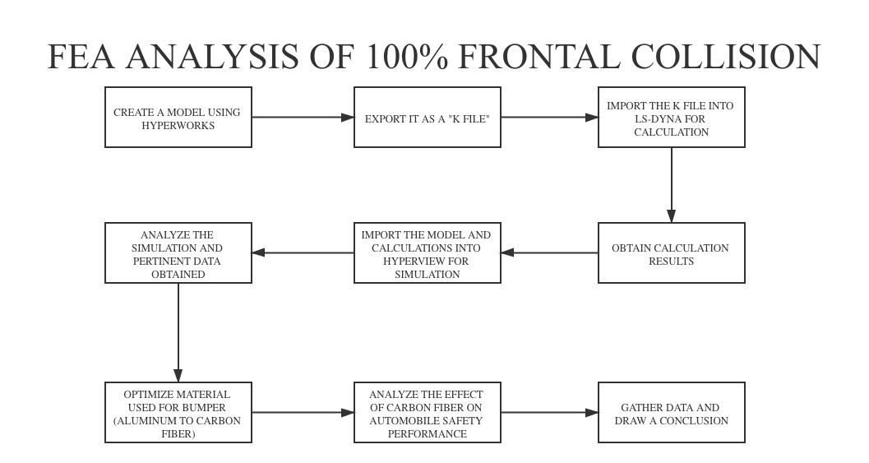
Plan and Procedure

Slide 6
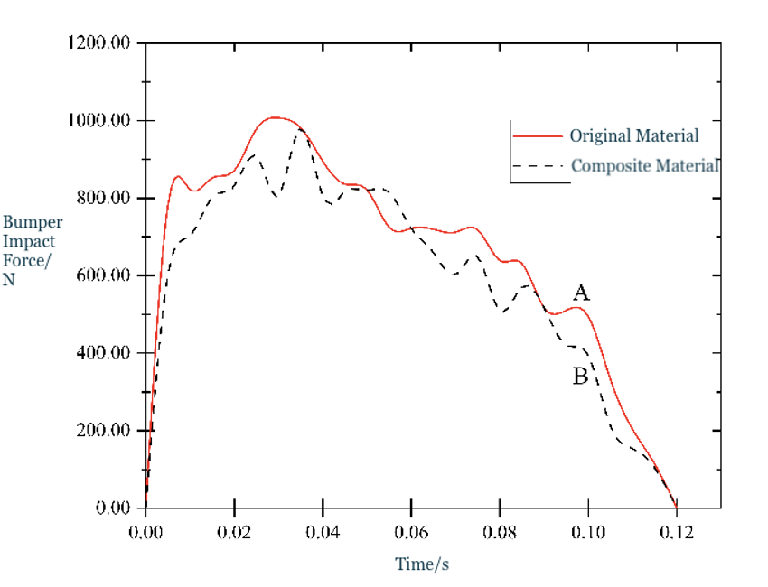
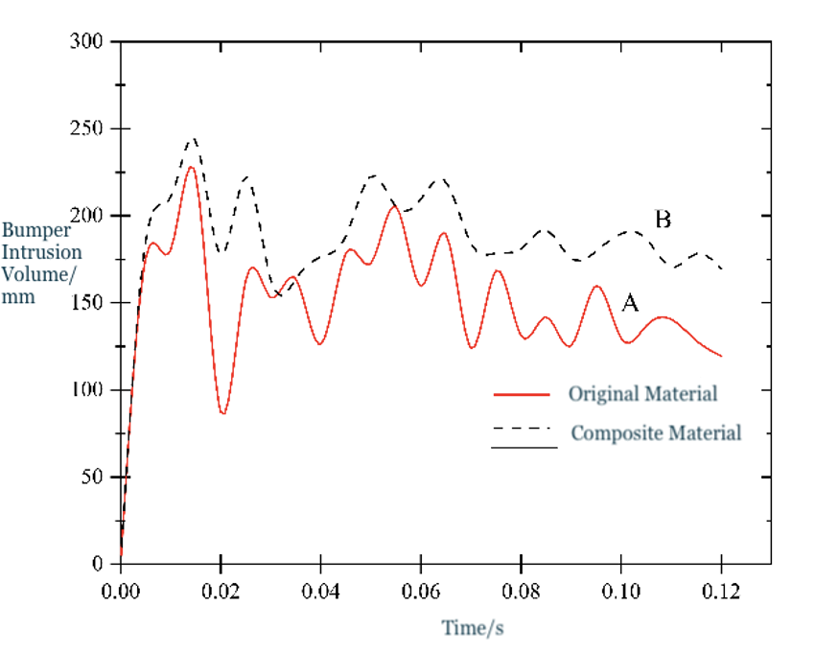
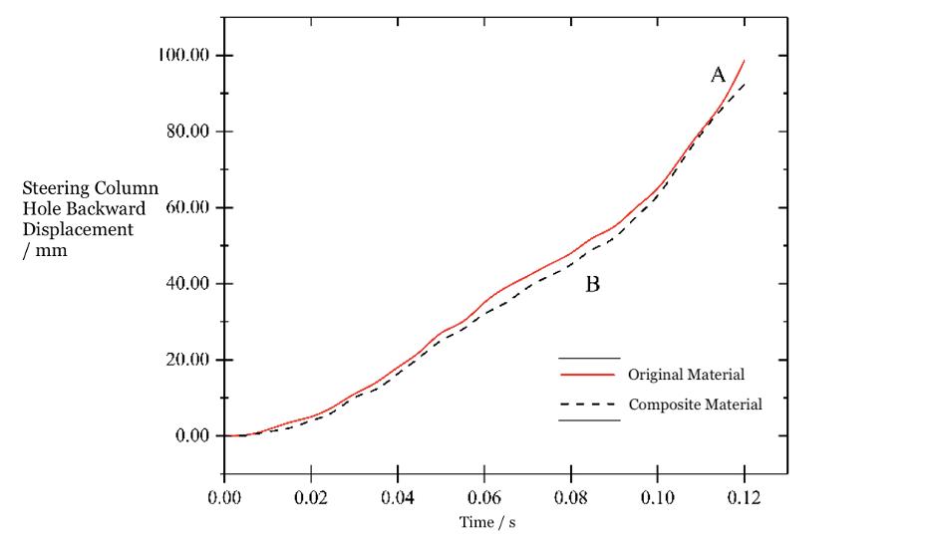
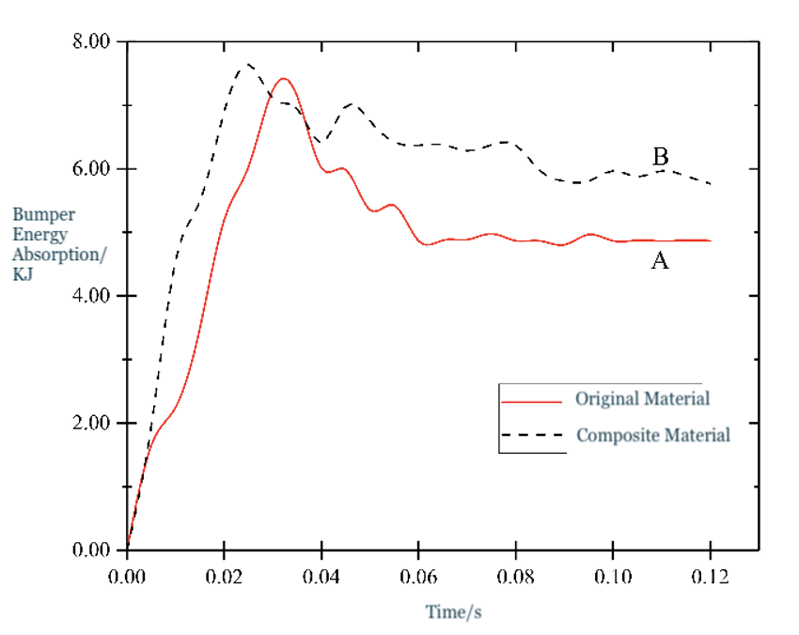
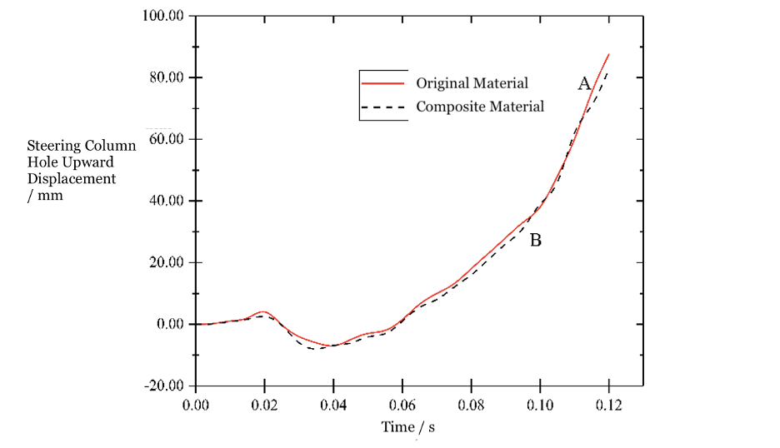
Results
Peak Impact Force ↓↓
Bumper Intrusion ↑↑
Backward Displacement
of SCH ↓↓
**Mass reduced by 43.19%**
Peak Energy Absorption ↑↑
Upward Displacement of SCH ↓↓

Slide 7
Analysis
- It is clear from the results that the change in several safety measures are subtle. However, most of the changes are generally beneficial.
- Plus, all the changes are taking place under the condition that the mass of the bumper is reduced by 43.19%, which is a considerable improvement.
- A decreased mass can largely improve both energy efficiency of the automobile since a lower mass means lower petrol or electricity usage and the general performance.

Slide 8
Summary/Conclusion
- The substitution is successful because it subtly increased the bumper performance while lowering its weight significantly, improving the performance of the automobile from a holistic perspective.
- Usually the bumper uses metal (most frequently, aluminum alloy) as the main material. Composite material, as shown in this study, is proven to be a potential substitute for metal in the automobile industry, and should be further investigated for its application in other parts of a vehicle.

Slide 9
Future Work
- Though substituting aluminum alloy to carbon fiber composite material did indeed improve the safety, it does not exhibit a significant change.
- More studies can be done to further investigate in the direction of exploring more types of materials that could be used in the fundamental structure of the frontal part and other safety-related parts of an automobile.
- It is possible that the fundamental structure of the frontal part of an automobile can be improved to absorb more impact forces. It is also possible that another type of composite material has a better performance than carbon fiber.

Slide 10
Bene facis!
Muchas gracias!
Спасибо!
Thank you very much!
Merci beaucoup!
ありがとうございました!
谢谢!

