Slide 1
Star, galaxy, quasar and star spectral types classification with broadband photometry
Zhixin Wang

Slide 2
Purpose
Explore machine learning methods for the classification of photometric data.

Slide 3
Photometry
Measuring the flux radiated by astronomical objects(e.g stars)
Light is gathered by a telescope
Pass light through a set of bandpass filters
Measure light intensity with a CCD photometer
Source extraction is performed on the CCD image data
Flux is converted to instrumental magnitude, and then calibrated against some standard stars to get the apparent magnitude

Slide 4
What is light?
Astronomical objects emit electromagnetic radiation at different wavelength

Slide 5
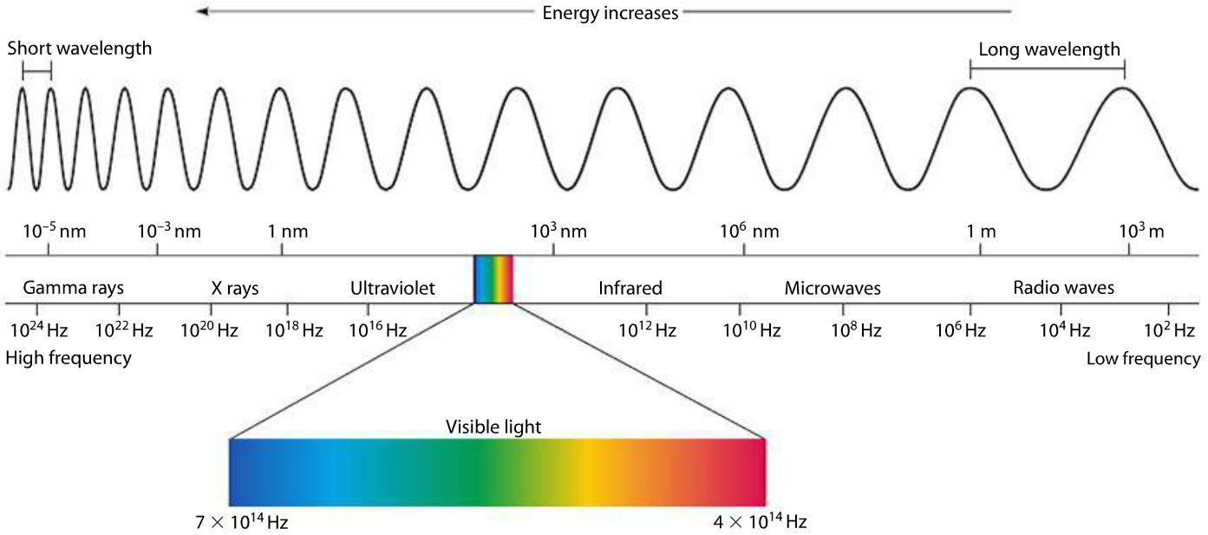
Notes:
but we cannot detect radiations of allw avelenth

Slide 6
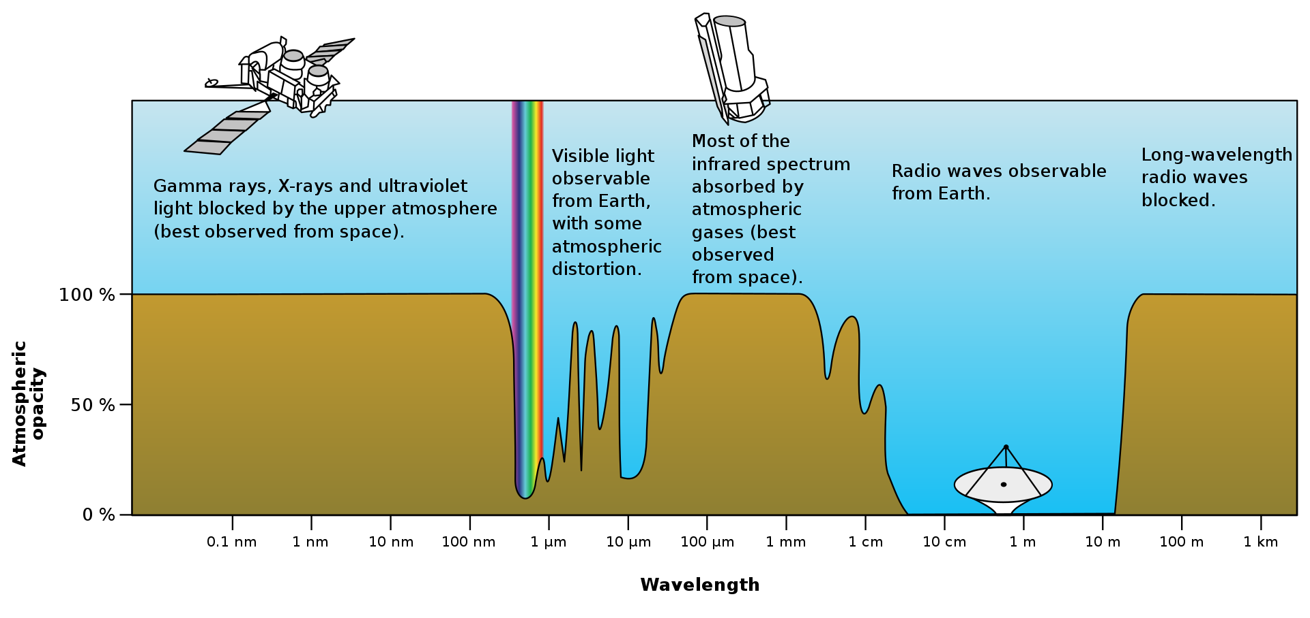
Notes:
due to the absorption of earth atmosphere
Optical Astronomy: ultraviolet to near IR

Slide 7
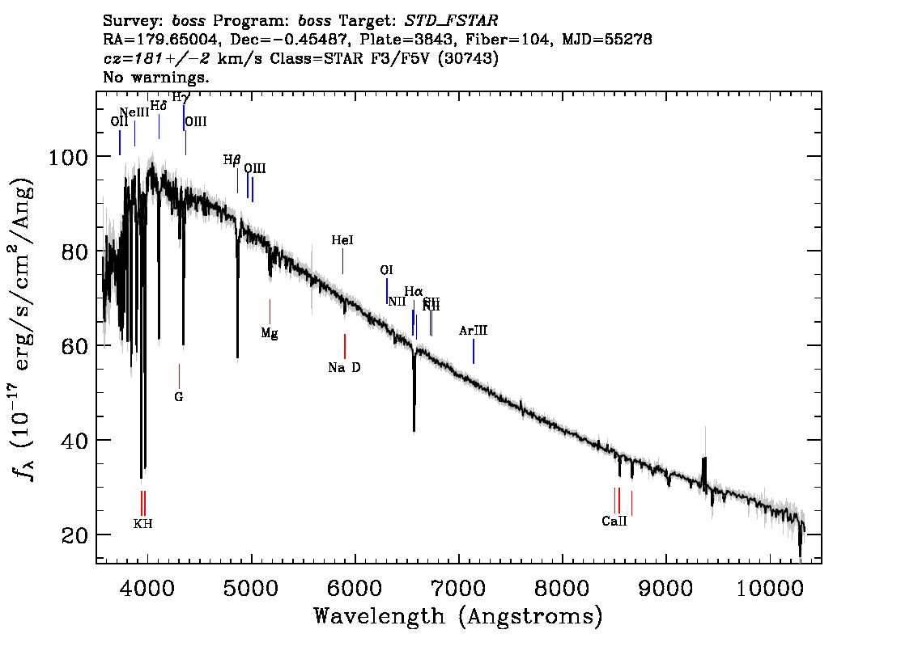
Spectrum
Notes:
x axis: wavelengt(ultra to near-if)
y axis: flux at each wavelength
researcher use methods of spectroscopy to measure the spectrum of objects.

Slide 8
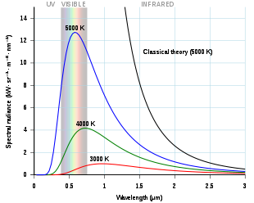
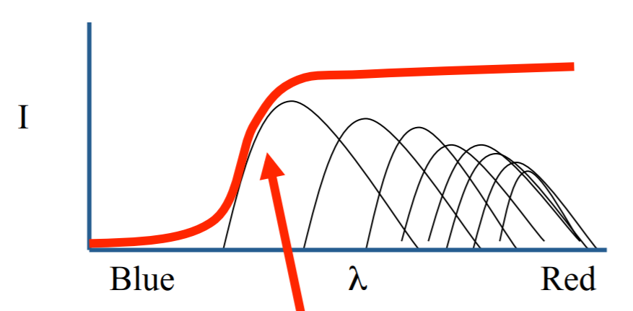
Spectrum ≈ Continuum + Absorption/Emission lines
Star: blackbody radiation
Galaxy: Superposition of stellar spectrum
Notes:
how is the shape of continuum determined
also, emission from gas...

Slide 9
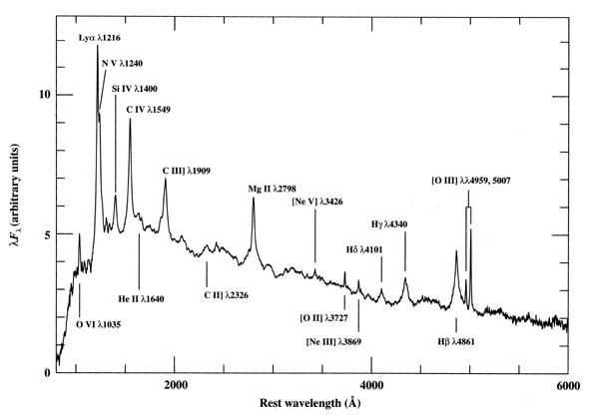
Spectrum ≈ Continuum + Absorption/Emission lines
Quasar: Host galaxy light + Superposition of thermal radiation from different parts of the accretion disk; show a broad and flat flux distribution
Notes:
from rings of diferent radius of accression disk
Temperature increases inward T- r3/4,

Slide 10
Passband: Spectrum -> Photometry
A filter selectively transmits light(only those within a range of wavelength can pass)
The characteristic of a filter is described by its transmission curve
Photometric system is a set of well-defined passband that is usually used in observations.(i.e. observing an object through different filters)
Notes:
question is, how to measure this spectrum using photometry

Slide 11
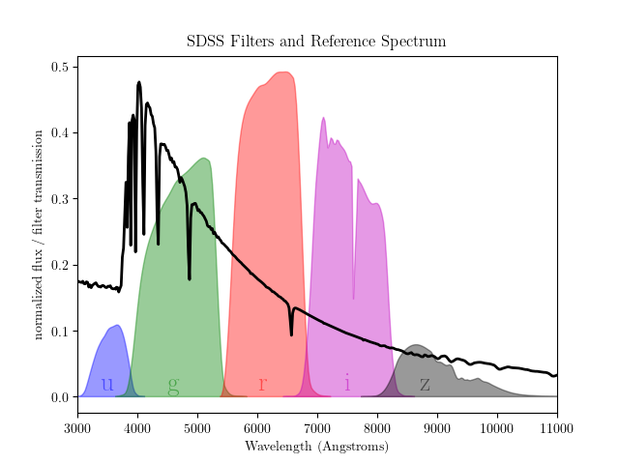
Charge Coupled Device(CCD)
Notes:
Spectrum with very low resolution
sdss photometric redshift
-> ccd(device that counts photons)
you can convolve the spectrum with the transmission curve to get a simulated photometric results

Slide 12
Charge Coupled Device(CCD)
Notes:
Spectrum with very low resolution
The magnitude can be seen as convolving the passband transimmsion curve with the SED; if the zeropoint for filters are defined at vega.(of course, SDSS uses AB magnitude system, so it’s different(normalized at a constant energy

Slide 13
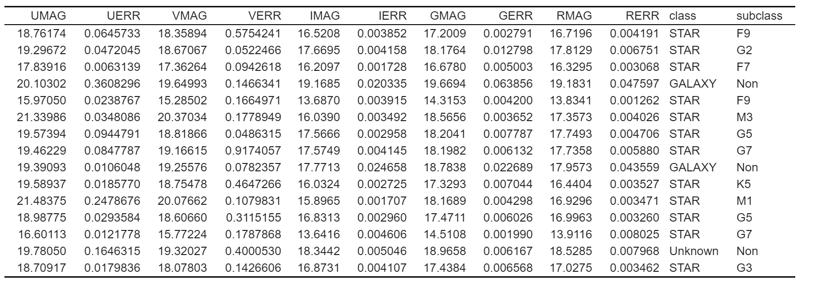
Photometric data & Label
Photometric data from SAGE survey
Notes:
what is magnitude

Slide 14
Machine learning
How can machines help us to classify astronomical objects?
Supervised learning algorithm: Infer a function based on training data that predicts an output value based on the inputs.
In our project…
Task: classification
Input: Magnitudes at each passband
Output: class label(star, galaxy, quasar)
Algorithm: learn the function f(input) -> output
Where’s the training data?
Notes:
specigfcally, classification

Slide 15
Spectroscopic survey
Spectroscopic surveys directly measure the spectrum of the sources(instead of using certain passbands)
Type of an object can be very accurately determined through template fitting techniques(e.g https://arxiv.org/pdf/1207.7326.pdf, for BOOS survey)
Therefore, we consider the labels provided by the spectroscopic surveys as the ground truth
The next step is to cross-match objects in the SAGE catalog with those in the spectroscopic survey
Notes:
what we just talked about are photometric surveys(

Slide 16
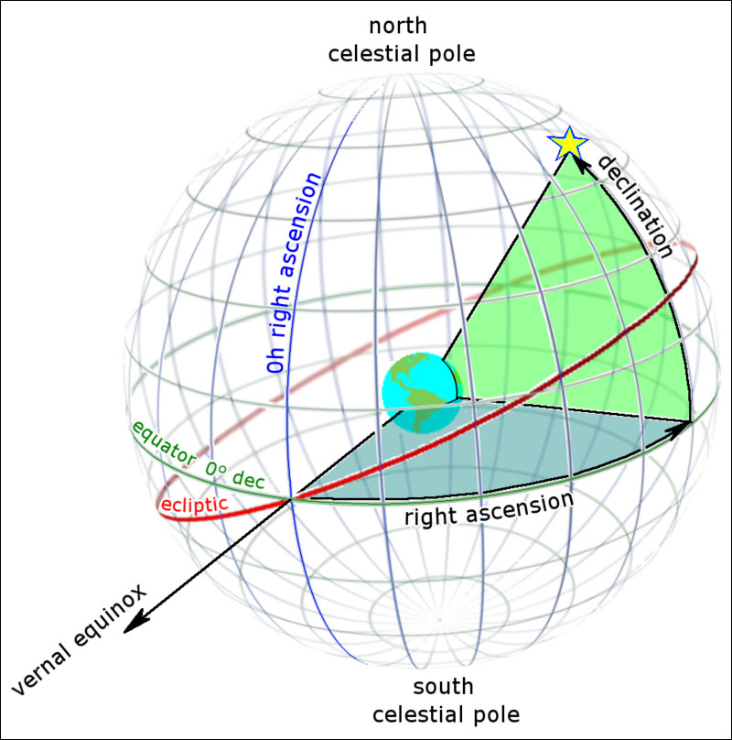
Cross-matching
Cross-matching is done based on the celestial coordinates
A Python package for the R tree algorithm is used
A matching radius of 2 arcsec is used
The SAGE catalog is matched with the spectrum observed in the LAMOST survey.

Slide 17
Photometric data & Label
Photometric data from SAGE survey
Matched Labels

Slide 18
Data Pre-processing
Correct for interstellar extinction
Lights from distance stars or galaxies were absorbed by interstellar medium.
We utilize the dust map given by Schlegel et al. 1998 to correct for this effect.
Magnitute-limited sample:
The two surveys have different depth. Therefore, in order to maintain the completeness of the training data, we only select objects with g-band magnitude g<19 mag.
Convert to photometric colors
We convert the five passband magnitudes to four photometric colors. Color index is defined as the difference between magnitude at two bands.
Notes:
e.g color-> temperature of stars

Slide 19
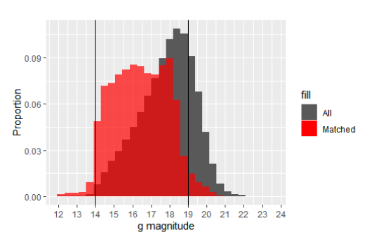
Visualization

Slide 20
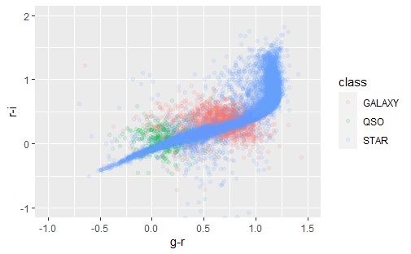
Visualization
Notes:
stellar locus on the color-color diagram

Slide 21
Splitting
To evaluate and optimize the performance of the model, we split the data to training, validation, and test sets.
The model will be trained on the training set, tuned on the validation set, and finally tested on the test set
Notes:
(v set is not necessary, but we didn’t know that, plan to use more than 1 algo

Slide 22
Algorithm: Random Forest
The Random Forests algorithm creates ensemble of decision trees, trained on a subset of the dataset that is created by bootstrap aggregating(bagging), and implements random selection of features at each decision tree split.
Supervised, for task of classification
RF 1: for classifying stars, galaxies, and quasars
RF 2: for assigning star spectral types(OBAFGKM)
Notes:
very robust method

Slide 23
Tuning
Notes:
List of parameters in the model

Slide 24
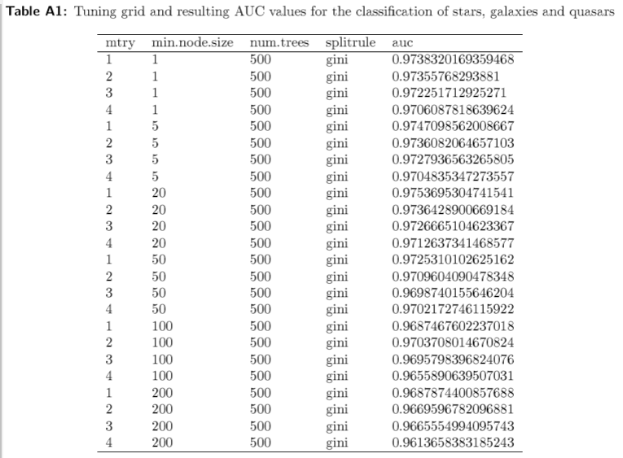
Tuning

Slide 25
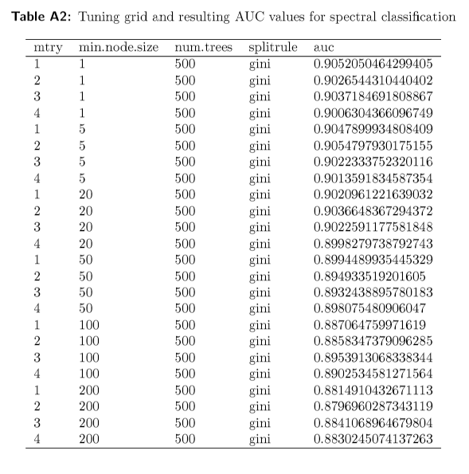
Tuning

Slide 26
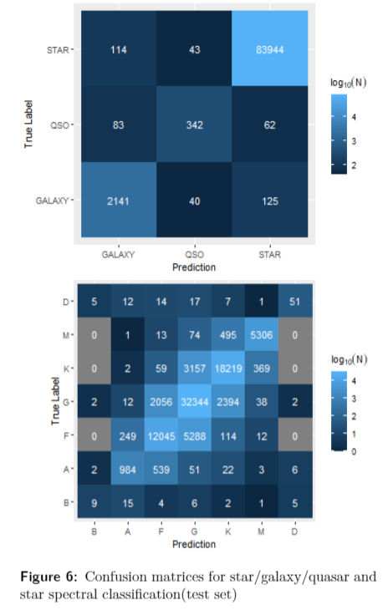
Results
Notes:
the best set of hyp is selected and tested on the test set

Slide 27
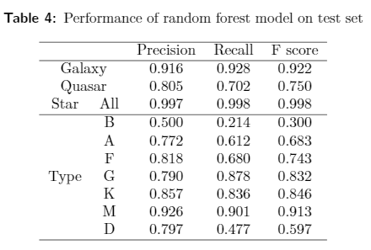
Results
Notes:
Precision is defined as
the fraction of correctly classified instances among those
identified as such; Recall is defined as the fraction of the
total amount of instances that is successfully retrieved;
F
1
score is defined as the harmonic mean of precision and
recall:

Slide 28
Results
Notes:
The
population of star dominates brighter magnitudes(g<18)
which explains the very high precision and recall. At
fainter magnitudes, the precision and recall of star be-
gin to drop due to the decrease of the density of stars. As
for galaxy and quasar, their precision and recall increases
with sample size. For the majority of galaxies, with mag-
ntiude g>17.5, the precision and recall are above 0.90.
Quasars, having larger density at faiter magnitudes, have
precision over 0.80 at g>18 while the recall is around 0.7

Slide 29
Discussion: Misclassified samples
Star->Galaxy
Misclassification in the LAMOST 1D pipeline
Two stars aligned on almost the same line of sight
Notes:
first, stars missed as galaxies
e cross-matched all missed
objects with photometric catalogue from SDSS data re-
lease 16. . By visually inspecting the imaging data as well as their LAMOST spectra, we
find that almost half of the stars missed as galaxies are in- correctly identified as stars by the LAMOST 1D pipeline, whereas our model gives the correct label. Listed in Fig- ure B1 is the spectra and image of several selected sources. This type of misclassification can also be caused by two stars aligned on almost the same line of sight such that the SAGE survey detects a superposition of the two SEDs.(see
the bottom row of This problem can only be addressed by improving the source extraction algorithm of the SAGE survey.It is not fea- sible for us to find all contaminated sources in the data
set, though. Still, we correct the precision,recall and F scores by removing the ”false negatives”. (such error will not exist when we apply the model on unlabeled data)

Slide 30
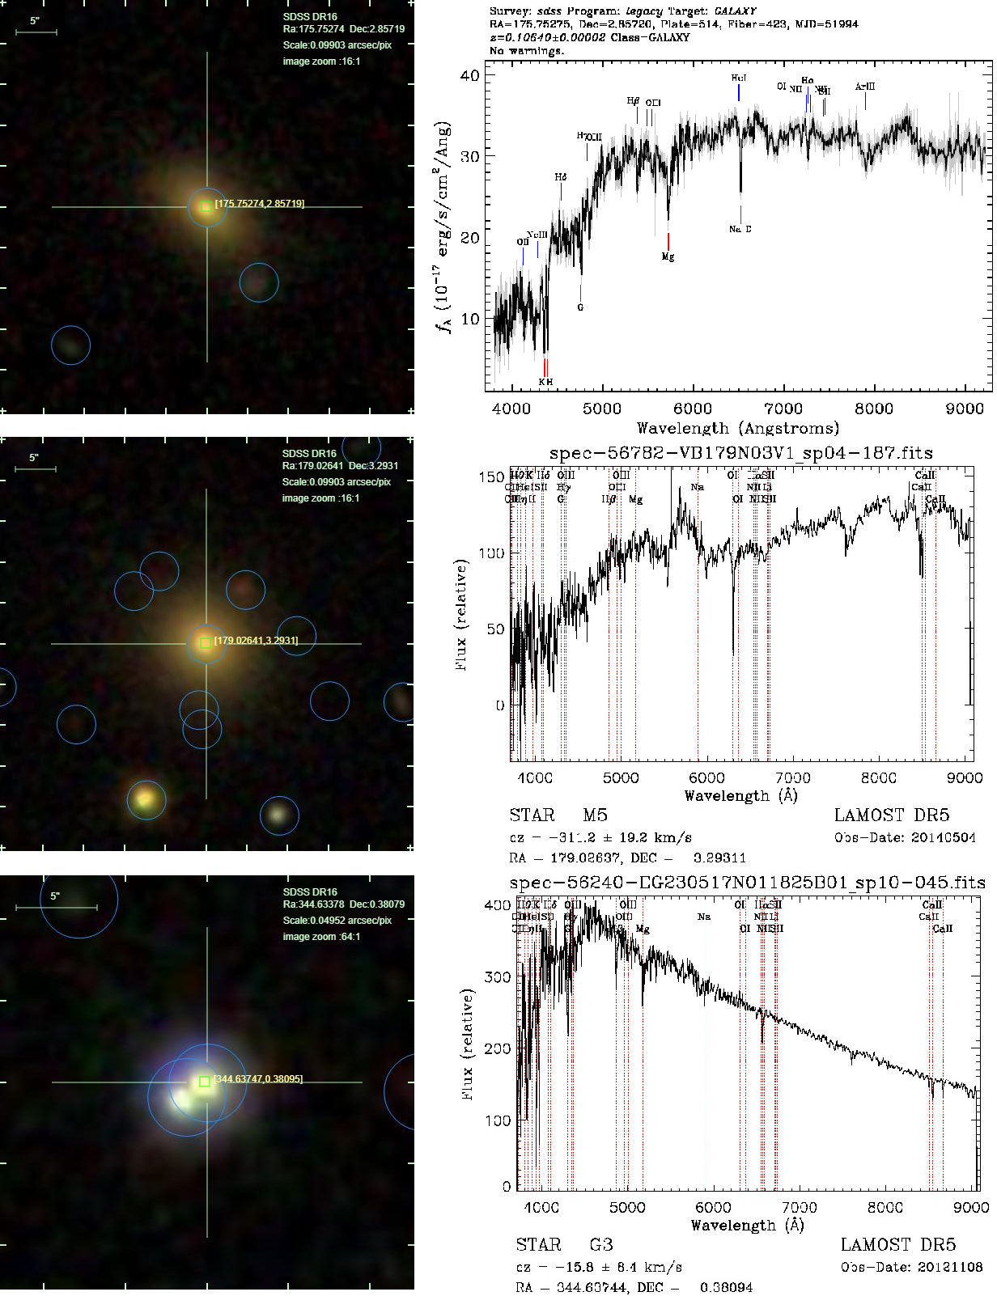
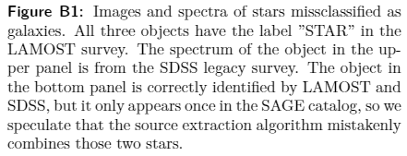

Slide 31
Discussion: Misclassified samples
Galaxy->Star, Quasar
Galaxies misclassified as stars and quasars are located at the border of the decision boundary in the color space(based on probabilities...)
This indicates that the model is lack of discriminative power between these classes
Inclusion of morphological features may reduce this type of error
Notes:
galaxy are resolved sources… we only mag(or flux) or each source instead of their shape, ccd like taking a photo of the sky

Slide 32
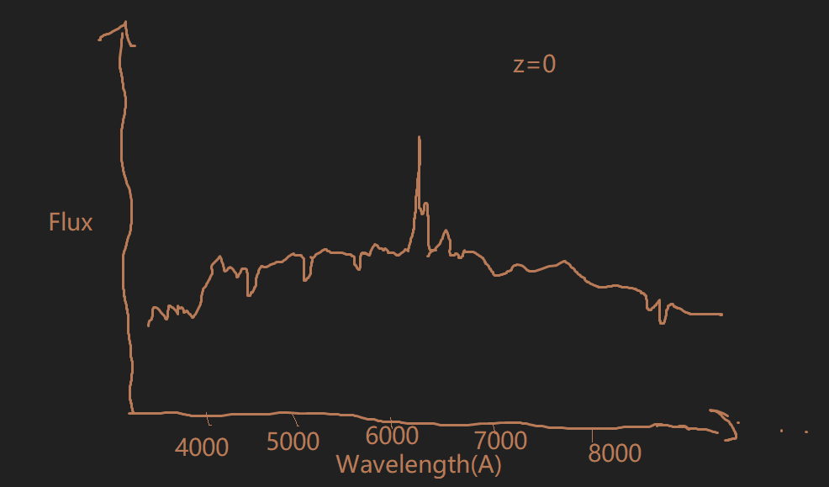
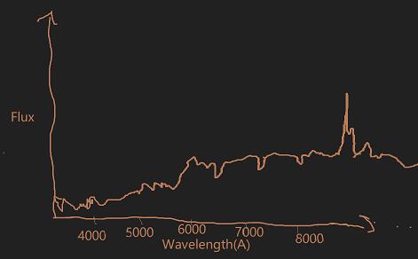
Redshift?
Effect of redshift: The spectral energy distribution(SED) of the source is shifted to longer wavelength
Notes:
redshift is a phenemenon where electromagnetic radiation from an object undergoes
an increase in wavelength(red refers to longer wavelength)
for example, percieved blue->red, ultraviolet->visible; visible->infrared
SED of an object, such as blackbody
Z denote the amount of redshift, relation between the emitted radiation and the
observed
hubble’s law, quasars have high redshift

Slide 33
Redshift?

Slide 34
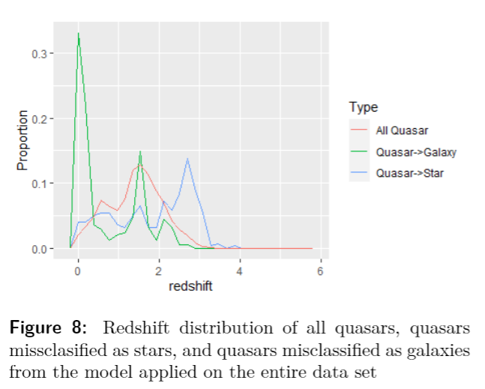

Slide 35
Discussion: Misclassified samples
Quasar->Star
Quasars missclassified as stars tend to have larger red-shifts than other quasars(2.2<z<3)
Similar color in optical bands & Limited training data
This type of error can be reduced by including near-IR bands into the model. Because quasar spectrum is a mostly flat continuum through infrared, but the flux density of a blackbody spectrum(stars) decreases as wavelength increases
Notes:
The colors of those quasars were similar to that of stars in the optical bands

Slide 36
Discussion: Misclassified samples
Quasar->Galaxy
For those with low redshift values, the lights from their host galaxy can be comparable to that of the active galactic nucleus, resulting in a galaxy-like spectrum.
We speculate that the two peaks(z around 1.6 and 2.2) in the redshift distribution of missclassified quasars resulted from certain spectral line being redshifted to certain wavelengths.
Notes:
The colors of those quasars were similar to that of stars in the optical bands

Slide 37
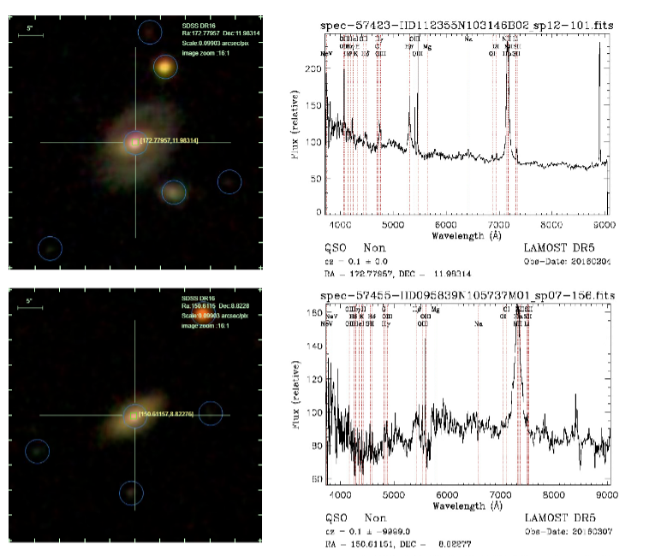

Slide 38
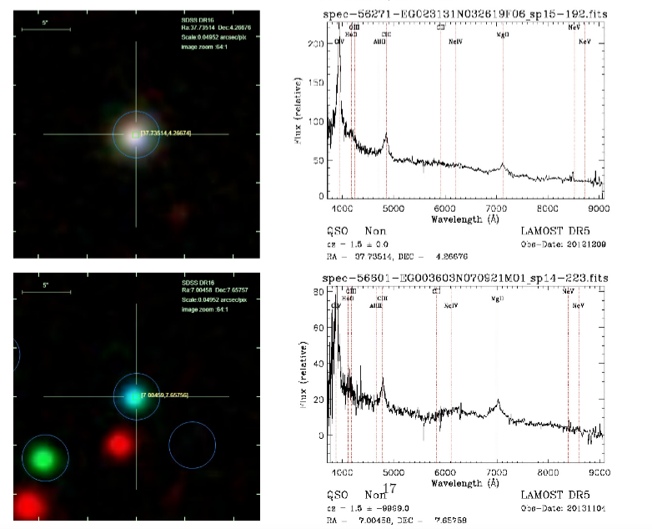
Notes:
z = 1.5

Slide 39
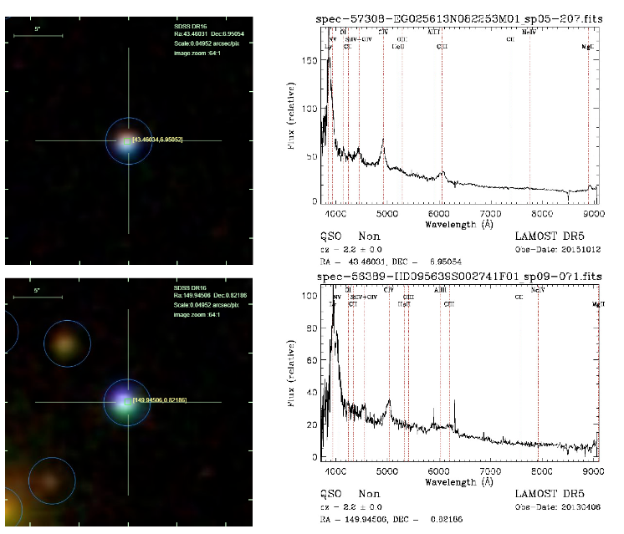

Slide 40
Discussion: Spectral types
Those class with limited amount of data (white dwarf, type B star) show poor performance
There's no clear cut between the MK classes of stars either in the color space or with other spectral features.(think of it as binning instead of classifying)
Effective temperature regression may provide more accurate information

Slide 41
Summary
We implement the random forest algorithm to classify star, galaxy and quasar using four photometric color.
The overall accuracy of the model is 99.54%, and the F1 score for the three classes are 0.998,0.935 and 0.770.
The model can provide reliable labels for the objects observed in the SAGE survey with g mag < 19.
The overall accuracy for the stellar classification model is 82.09%. This model still can be improved
Notes:
see next slide

Slide 42
Future Work
Possible improvements
Including morphological features: Several previous studies utilized morphological features to separate galaxies from other objects and results show that those features usually have higher importance than photometric ones(magnitude or color)
Extend to near-IR: By combining the SAGE survey catalog with near-IR measurements, we can effectively classify those high-redshift objects.
More training data: the extragalactic catalog of LAMOST survey is largely incomplete at deeper magnitudes(g > 20 mag). Matching our current data with other spectroscopic catalogs can help us to extend the model to fainter objects.

Slide 43
Future Work
Future directions
Compare different ML methods: We can test different supervised or unsupervised ML methods on a subset of the data to find the most effective one for this task.
Deep Learning: Instead of building a model from the extracted magnitudes, we can use deep learning methods(e.g CNN) to directly classify sources from the raw image data.
Stellar parameter regression: After separating stars from other objects, we can train a model to estimate the stellar parameters(i.e. effective temperature, surface gravity, metallicity) which will provide more information for future studies on this catalog.
Notes:
(not enough time… runtime is too long
retains all the information(including morphology...

Slide 44
Questions

