Slide 1
Deep Learning-based Infodemic Models To Assess Impact of Infodemics on the COVID-19 Emergency Responses

Slide 2
Purpose
To effectively model the infodemic spread to assess its impact on the pandemic responses. Assessment of the infodemics will help to prioritize and focus on appropriate mitigation strategies.

Slide 3
Rationale
Effective mitigation of the Coronavirus disease (COVID-19) or any other global pandemic relies on the people’s trust and adherence to the recommendations of established scientific bodies. The misinformation transmitted through infodemics is detrimental to individual’s physical and mental health, elevates stigmatization and hate speech, threatens precious health gains, leads to the poor observation of public health measures, and even costs lives [2]. A recent study shows that more than 35% of the most viewed COVID-19 related videos contain misinformation [3]. Among those misinformation videos, one myth – that highly concentrated alcohol consumption could disinfect the coronavirus – infiltrated the public’s belief and claimed over 800 lives [4]. Misinformation and distrust can be a particularly dangerous combination that causes people to reject health interventions such as vaccines, disregard health guidance, or try out unproven and dangerous therapies like ingesting methanol to prevent COVID-19.
Modeling methods, such as SEIR model, used to assess or predict the COVID-19 spread are not effective because infodemic spreads exponentially in the digital world. Factors such as large growth exponent and speed of infodemic spread require advanced Deep Learning approaches.

Slide 4
Research Questions
How effective are traditional pandemic modeling approaches when applied to infodemic assessment?
What are the alternative approaches for infodemic modeling and which ones are more effective globally?
How do we measure the impact of infodemic on the COVID-19 emergency responses?

Slide 5
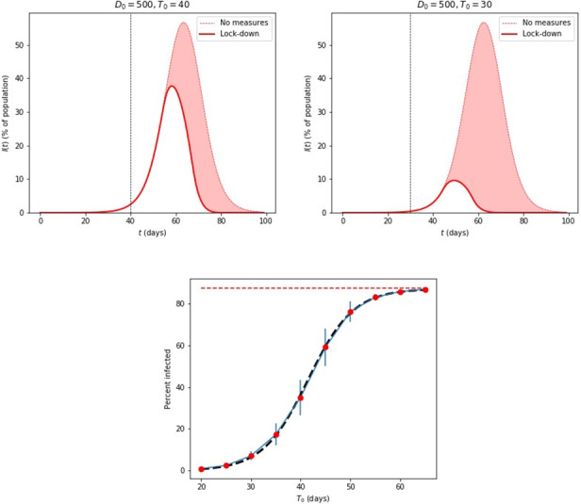
Traditional Models - Microscopic Agent-Based Model
- Percentage of population susceptible over period of time

Slide 6
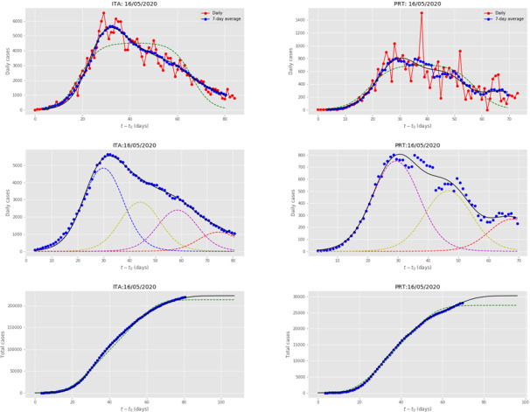
Traditional Models - The Multiple Wave Forced-SIR Model
- Percentage of population susceptible over period of time

Slide 7
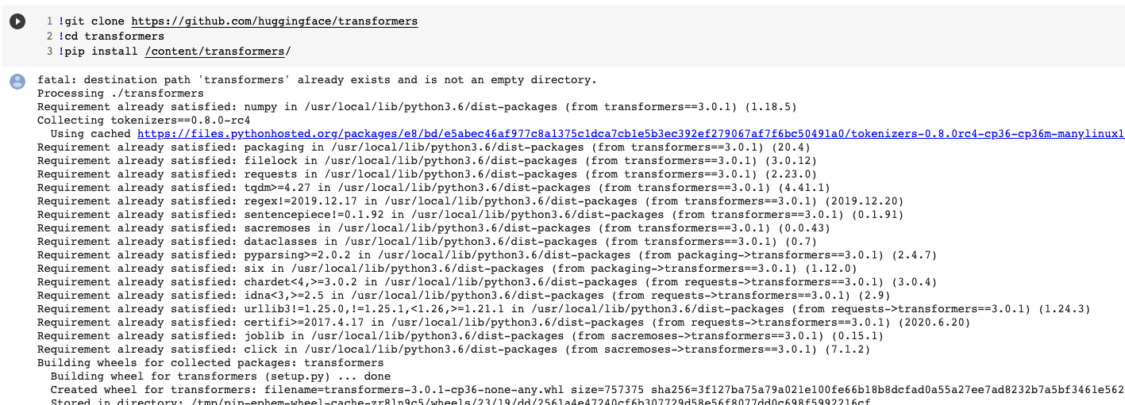
Running the model in Google Colaboratory

Slide 8
Comparison of the performance among different models
Model | Accuracy | F1-Score |  | Precision |  | Recall
 |  | Fake | Real | Fake | Real | Fake | Real
RoBERTa + SVM | 0.968 | 0.965 | 0.970 | 0.988 | 0.956 | 0.950 | 0.989
RoBERTa + MLP | 0.979 | 0.977 | 0.980 | 0.981 | 0.976 | 0.974 | 0.983

Slide 9
Impact of infodemic topics on emergency responses
Name | Documents | Current treatments | COVID-19 vaccine | General vaccine discussion | Non-proven treatments | The cause of the virus | Stigma around the spread | Stigma about or by infected people | Confirmed symptoms | Other discussed symptoms | Asymptomatic transmission | Modes of transmission | Transmission settings | Civil unrest | Mis- and disinformation | Myths | Measures in public settings | Environment | Inequalities
Angola | 849 | 2 | 43 | 0 | 0.35 | 2.47 | 0.82 | 0 | 0.71 | 0 | 0 | 0.82 | 7.3 | 0.71 | 0.24 | 1 | 0.71 | 1.41 | 0.47
Brazil | 149689 | 5 | 3 | 0.55 | 0.25 | 2.54 | 3.2 | 3.07 | 2.4 | 0.78 | 0.09 | 4 | 8.66 | 1.45 | 2.54 | 1 | 1.38 | 1.95 | 1.41
Canada | 77614 | 4 | 10 | 0.57 | 0.13 | 3.05 | 1.93 | 0.93 | 1.3 | 0.28 | 0.53 | 2.85 | 14.48 | 0.7 | 2.37 | 1 | 2.03 | 1.35 | 1.94
Spain | 50059 | 3 | 8 | 0.2 | 0.33 | 3.4 | 5.8 | 2.97 | 0.49 | 0.23 | 0.03 | 2.44 | 11.19 | 1.56 | 0.95 | 1 | 2.4 | 0.82 | 1.74
France | 45294 | 3 | 13 | 0.19 | 0.22 | 3.68 | 2.33 | 1.92 | 1.58 | 0.26 | 0.22 | 2.59 | 6.83 | 3.43 | 2.21 | 1 | 1.44 | 2.06 | 1.16
Indonesia | 2702 | 5 | 13 | 0.19 | 0.67 | 3.4 | 4.37 | 0.44 | 1.3 | 0.26 | 0.15 | 5.29 | 13.51 | 0.67 | 1.3 | 1 | 0.78 | 1.07 | 1.07
India | 47263 | 9 | 18 | 0.24 | 0.16 | 2.76 | 0.98 | 0.37 | 0.74 | 0.21 | 0.07 | 1.62 | 6.29 | 0.51 | 1.07 | 1 | 1.84 | 0.85 | 1.2
Kenya | 7303 | 2 | 9 | 0.25 | 0.16 | 1.92 | 0.73 | 0.16 | 0.52 | 0.21 | 0.05 | 1.55 | 6.44 | 0.41 | 1.14 | 1 | 2.37 | 0.73 | 1.6
Malta | 842 | 1 | 5 | 0 | 0 | 1.19 | 0.83 | 0.24 | 0.48 | 0.12 | 0 | 1.54 | 38.84 | 0.48 | 0.95 | 1 | 1.19 | 1.19 | 1.43
Mexico | 41919 | 4 | 11 | 0.19 | 0.46 | 3.41 | 1.61 | 1.9 | 0.48 | 0.4 | 0.05 | 2.03 | 14.92 | 2.2 | 1.37 | 0 | 2.71 | 0.63 | 1.81
Malaysia | 4977 | 2 | 4 | 27.1 | 0.1 | 2.11 | 1.77 | 0.28 | 0.62 | 0.18 | 0.12 | 0.92 | 10.27 | 0.46 | 1.19 | 0 | 0.7 | 0.68 | 0.94
Nigeria | 14442 | 26 | 19 | 0.6 | 0.28 | 2.68 | 0.82 | 0.3 | 1.74 | 0.15 | 0.08 | 1.23 | 7.76 | 0.73 | 1.74 | 1 | 5.36 | 0.64 | 1.55
Philippines | 10151 | 24 | 27 | 0.33 | 0.22 | 4.43 | 2.28 | 0.37 | 0.92 | 0.14 | 0.28 | 1.62 | 10 | 0.41 | 1.63 | 0 | 2.47 | 0.58 | 0.94
The United Kingdom | 166518 | 33 | 49 | 0.69 | 0.21 | 1.45 | 2.24 | 1.07 | 1.58 | 0.48 | 0.65 | 3.53 | 6.21 | 1.93 | 3.03 | 1 | 1.79 | 1.76 | 2.93
United States of America | 325114 | 38 | 42 | 0.94 | 0.3 | 3.51 | 6.38 | 1.68 | 2.33 | 0.58 | 0.49 | 3.77 | 3.51 | 1.05 | 3.91 | 2 | 4.02 | 2.58 | 4.25
South Africa | 15665 | 15 | 9 | 0.34 | 0.13 | 3.61 | 1.97 | 0.38 | 1.12 | 0.19 | 0.17 | 3.13 | 5.95 | 0.36 | 1.99 | 1 | 1.72 | 1.03 | 1.47

