Slide 1
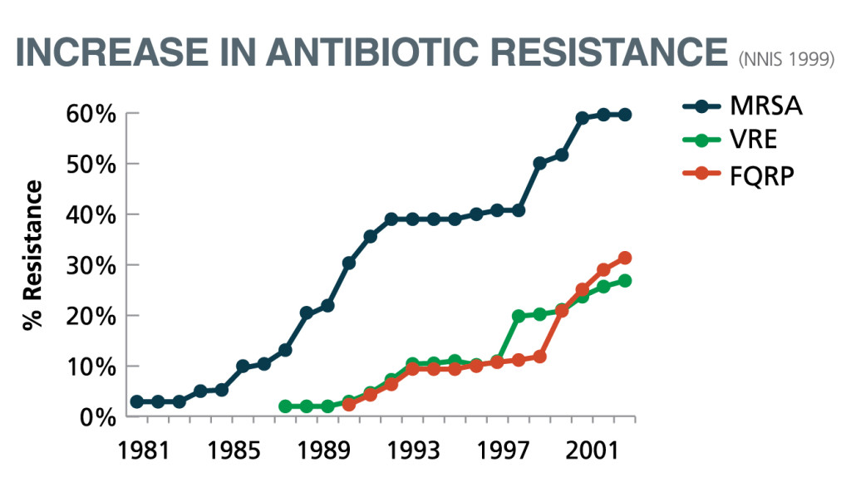
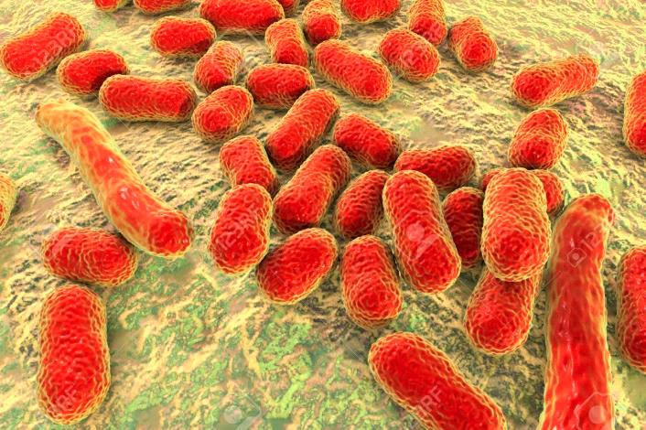
Antibiotic resistance is pressing, global issue
Introduction
Results
Conclusion
Danger to Public Health
Acinetobacter baumanii’s prophages
Prophages in A. baumannii found to contain virulence factors and antibiotic resistance genes
Image sources:
https://theconversation.com/how-to-train-the-bodys-own-cells-to-combat-antibiotic-resistance-106052
https://www.creative-biolabs.com/vaccine/acinetobacter-baumannii-vaccines.htm
https://www.agingresearch.org/antibiotic-resistance-and-why-you-should-be-concerned/

Slide 2
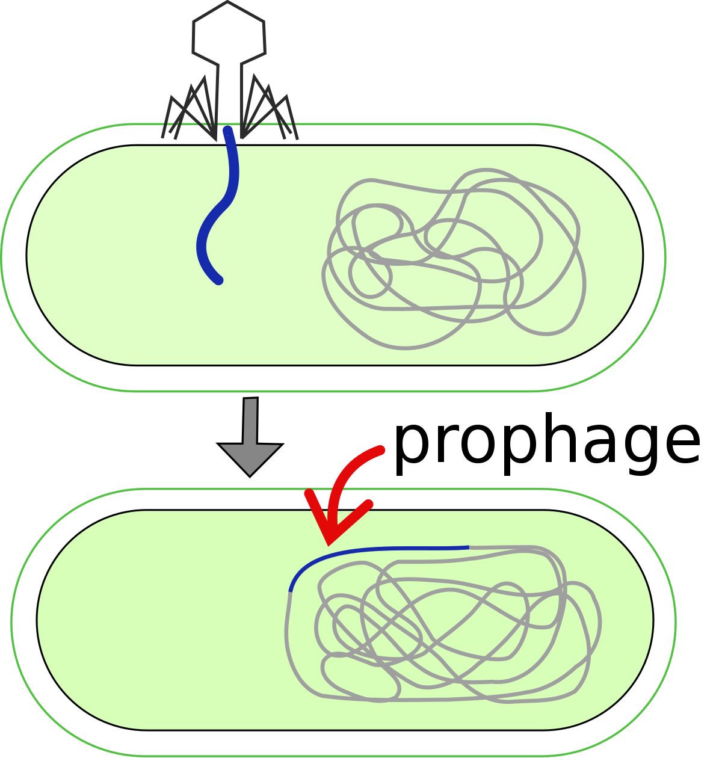
Prophages are viruses integrated into bacterial genomes
Introduction
Results
Conclusion
Prophage genes could encode pathogenicity-enhancing molecules that benefit the host bacteria
Image source:
https://en.wikipedia.org/wiki/Prophage

Slide 3
Research Questions
Introduction
Results
Conclusion
Could Acinetobacter pittii also contain prophages?
How will these prophages influence virulence and antibiotic resistance?

Slide 4
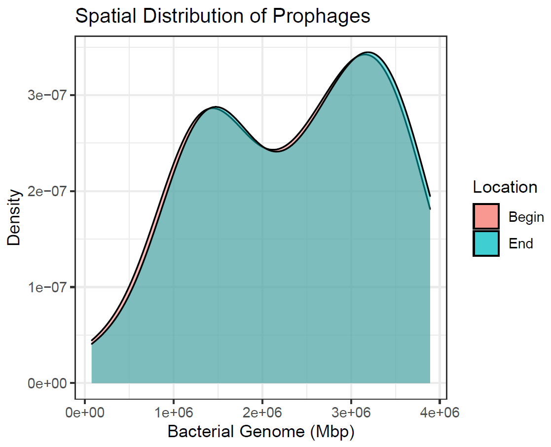
Prophages are present in Acinetobacter pittii
Introduction
Results
Conclusion
Spatial Distribution of Prophages
34 intact prophages in 17 A. pittii strains
Myoviridae prophages significantly shorter than Siphoviridae prophages, perhaps due to more recombination in bacterial genome
Prophages preferentially insert at 1.4Mbp and 3.2Mbp
Similar to A. baumannii results
Image source: done by finalist

Slide 5
Introduction
Results
Conclusion
Prophages contain virulence factors & antibiotic resistance genes
Virulence Factors
47 virulence factors
Notable: invasion plasmid antigens & zinc-binding alcohol dehydrogenases
Prevalent & virulent prophage: YMC/09/02/B1251_ABA_BP
Also common in A. baumannii
Image source: done by finalist

Slide 6
Introduction
Results
Conclusion
Prophages contain virulence factors & antibiotic resistance genes
Antibiotic Resistance Genes
37 resistance genes
Notable: RND efflux pump system
Image source: done by finalist

Slide 7
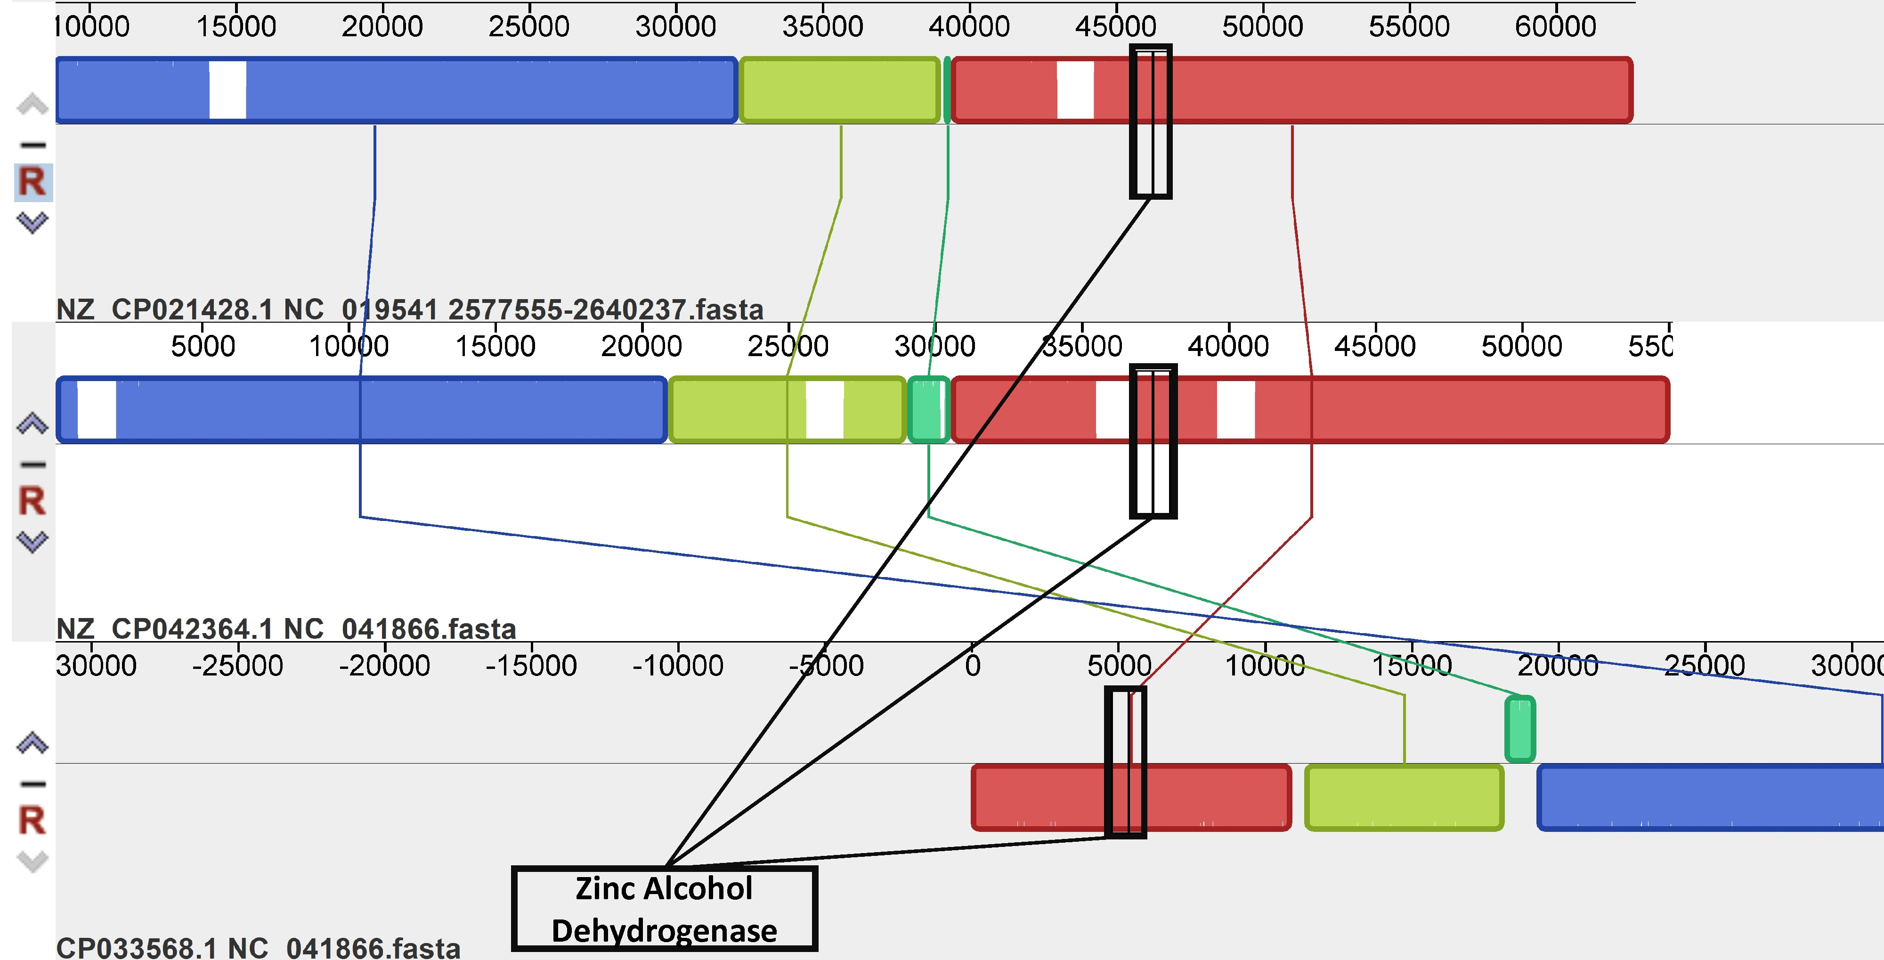
Virulence factors influence genomic structure
Introduction
Results
Conclusion
Synteny map of alcohol dehydrogenase within A. pittii prophages
Deletion of aquamarine block in the vicinity of the virulence factor
Inversion of light green and aquamarine blocks as well
Image source: done by finalist

Slide 8
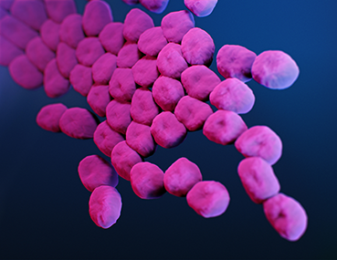
Introduction
Results
Conclusion
Conclusions
A. pittii contains virulence- and resistance-enhancing prophages
A. pittii exhibits similarities in its prophage relationships with other Acinetobacter species
Clinical implications because A. pittii causes nosocomial infections
Image source:
https://www.cdc.gov/hai/organisms/acinetobacter.html

