Slide 1
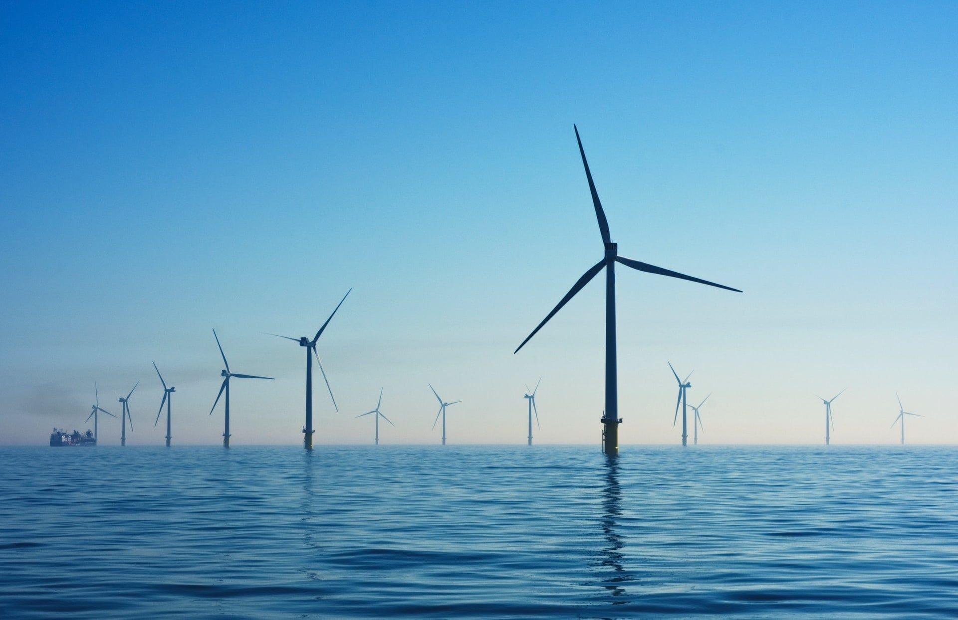
Wind Turbines
The Effect of Blade Length of Wind Turbines on the Amount of Energy it Produces
By Sarin Singhal

Slide 2
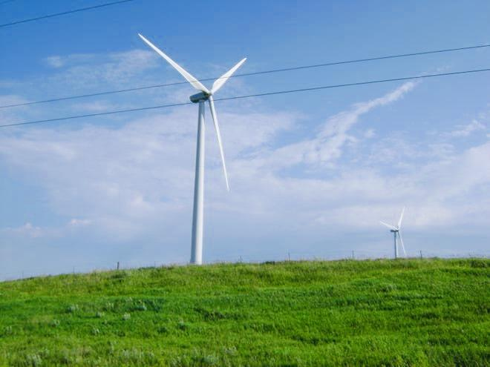
Question
How does the design of a wind turbine affect the amount of energy produced?

Slide 3
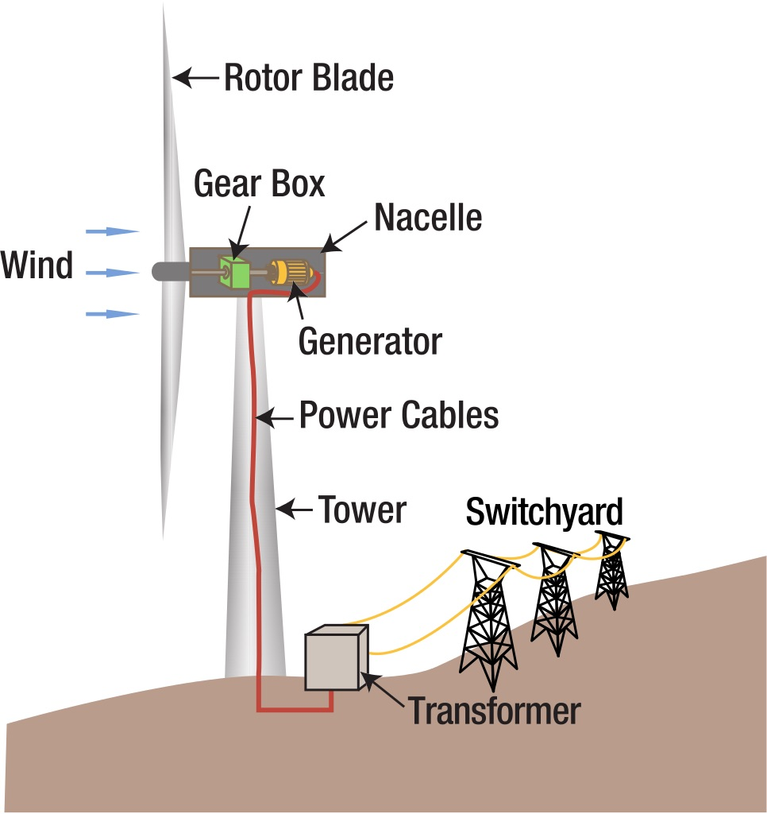
Research: Part I
Wind turbines are machines that create electricity using wind power. When wind pushes against a blade, the air pressure on one side decreases. The different air pressure causes the two sides of the blade to create lift and drag. Since lift is stronger than drag, the rotor begins to spin. The rotor spins a generator which then causes electricity to form (Energy.gov par 5). The information is important to understand how a wind turbine works. Some more important information is that wind turbines consist of six main features. These are the blades, the hub, the rotor, the nacelle, the foundation and the tower. (Rhythm par 4). This information is helpful in the case of a problem or a situation where you need to know certain parts.
Figure 1. Diagram of wind turbine.

Slide 4
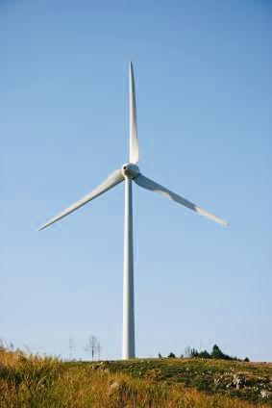
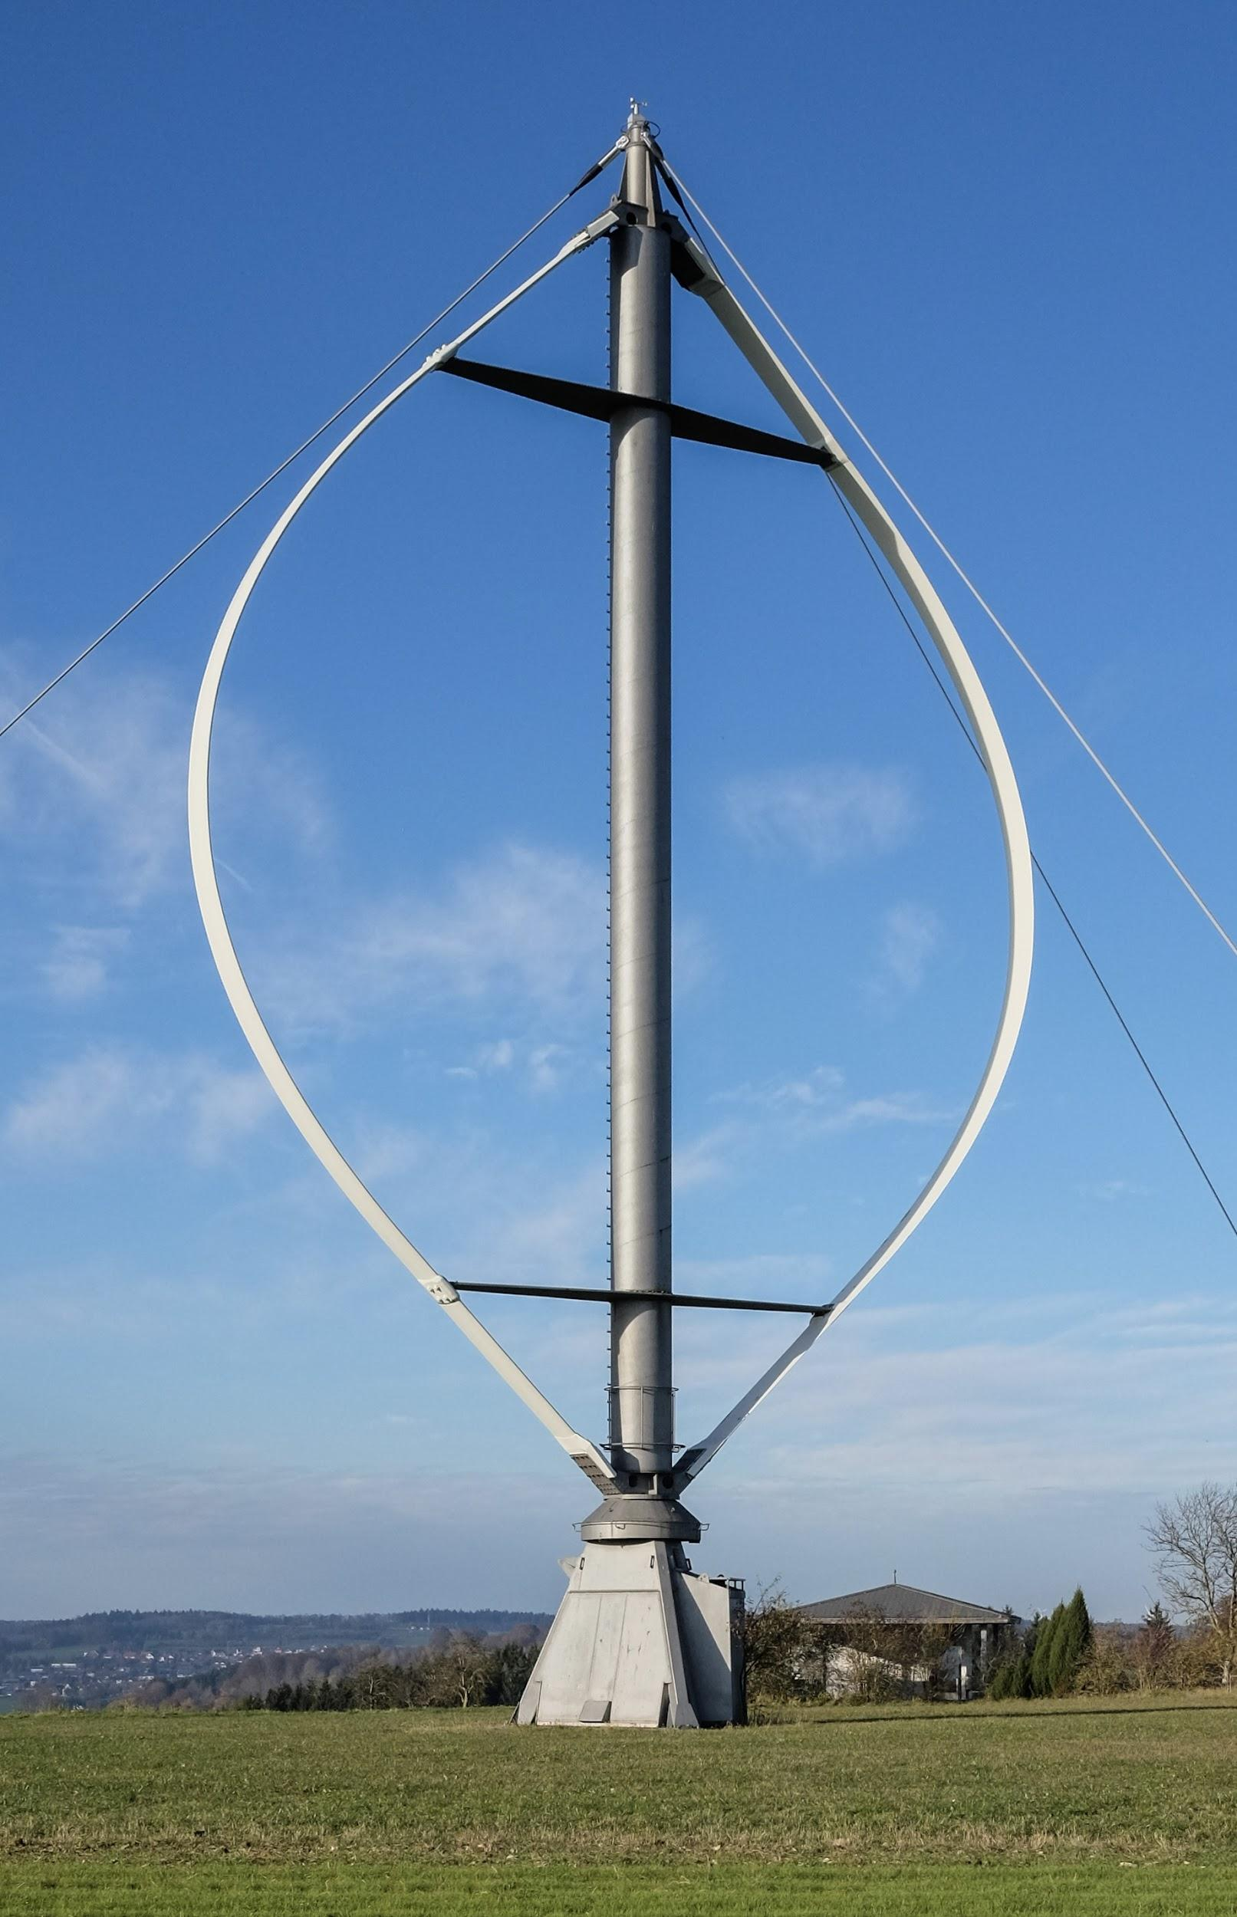
Research: Part II
There are two main types of wind turbines. The most standard type of wind turbine is called the horizontal axis wind turbine. The horizontal axis turbines are represented by helicopter propellers. Another well known wind turbine is called the vertical axis turbine. The vertical axis turbine is described looking like an egg beater (Inspire Clean Energy par 18). The most efficient out of these wind turbines is the horizontal axis design. The aerodynamic blades can generate more electricity than the vertical axis turbine because the lift can move the blades quicker and more efficiently (Inspire Clean Energy par 22). Using this information helped to narrow down the designs of the wind turbine which is the horizontal axis design. Longer rotor diameters allow wind turbines to capture more wind and produce more electricity. A turbine with longer blades will be able to capture more of the wind than shorter blades (Energy.gov par 5).
Horizontal axis turbine.
Vertical axis turbine.

Slide 5
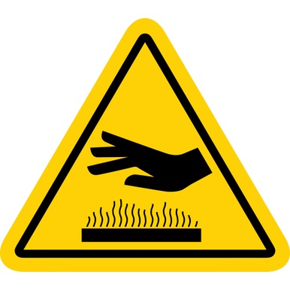
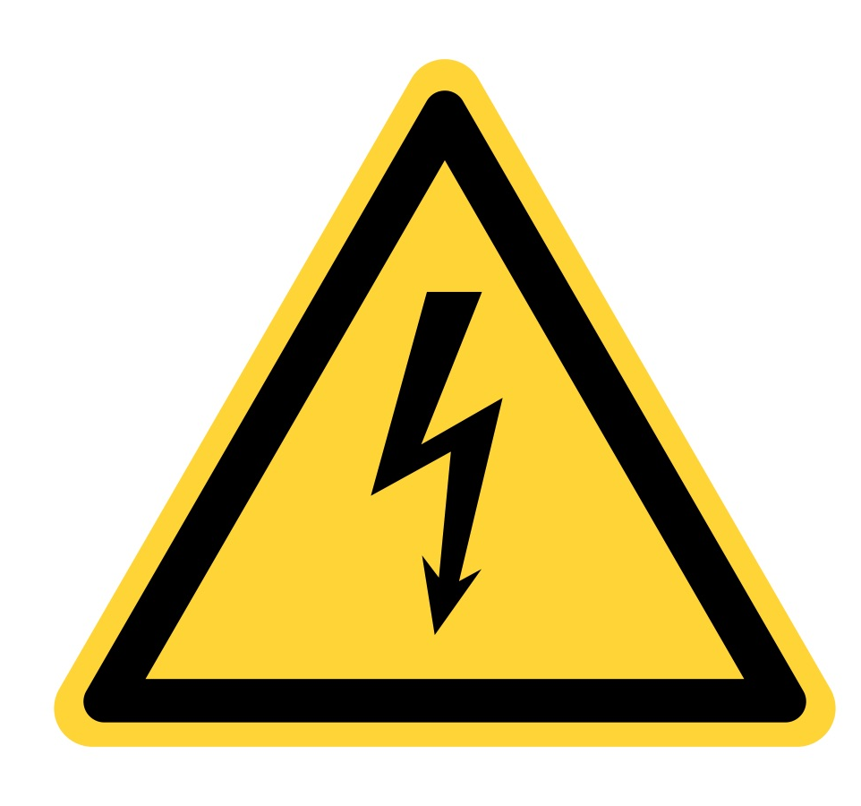
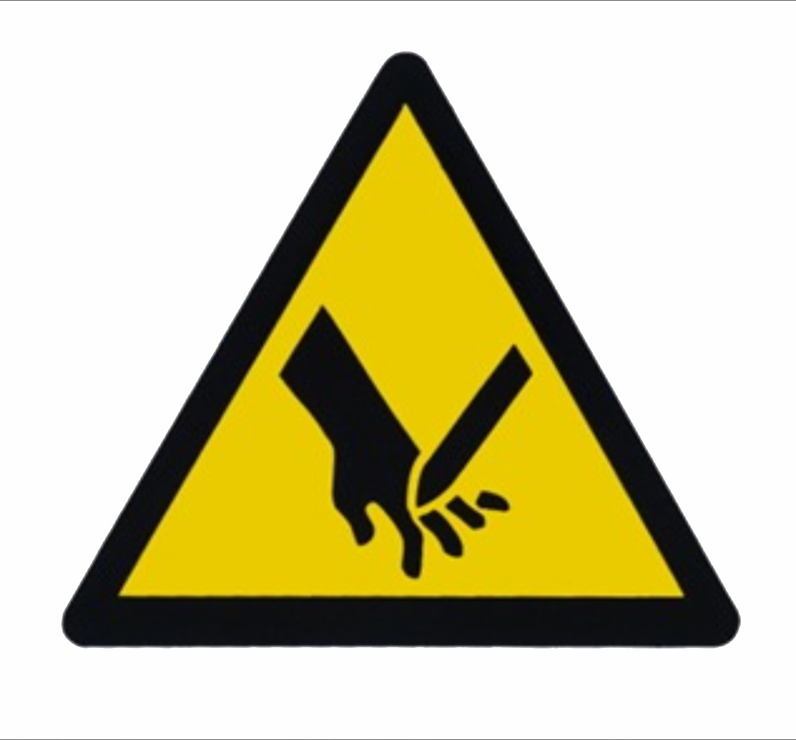
Risk Analysis
Electrical hazard. In this experiment I will be working with motors and wires. There is a chance of electrical injury if the insulation is not properly done.
Heat injury. There is a risk of burning yourself with the hot glue gun.
Mechanical injury. There is a chance of cutting yourself with the fast moving blades.

Slide 6
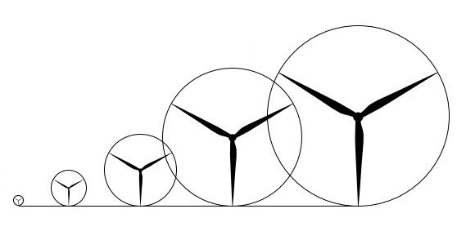
Variables
Independent variable: The length of the blades.
Dependent variable: The amount of energy produced by the wind turbine.
Controlled variables (constants):
The height of the tower
The speed of the wind
The materials
The motor
The digital multimeter

Slide 7
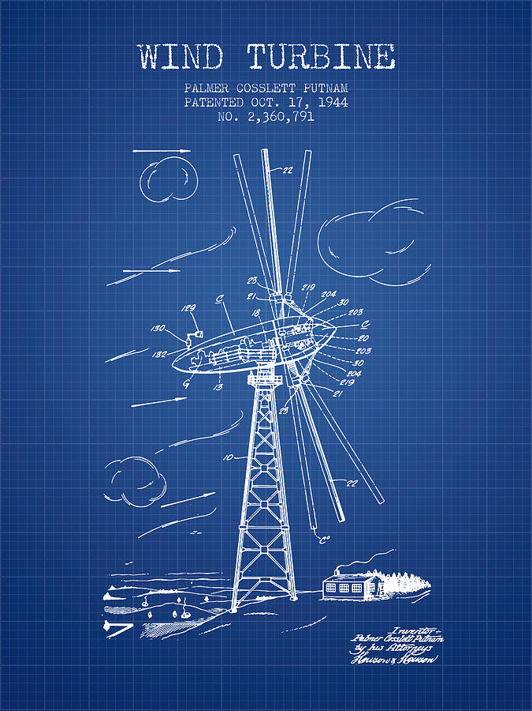
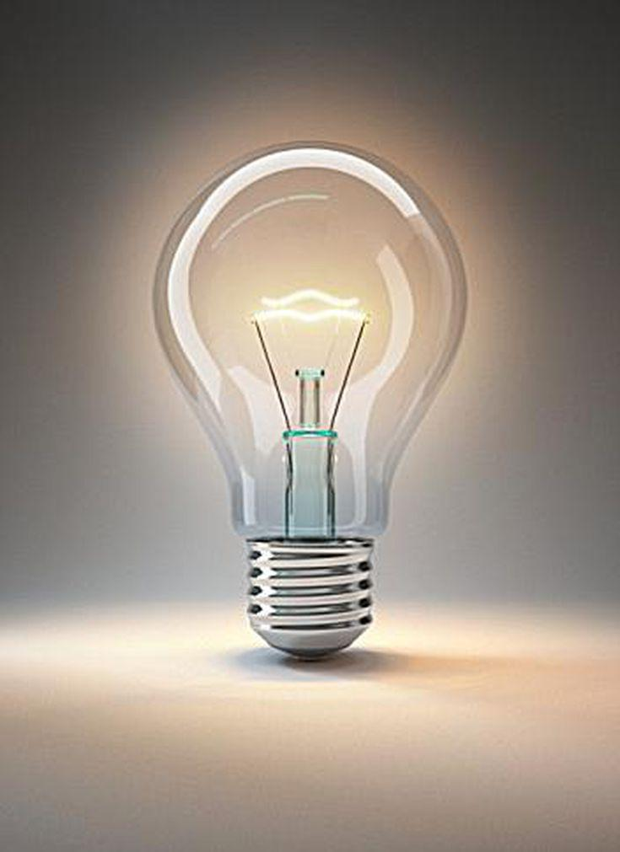
Hypothesis
If the length of blades are extended on model wind turbines, then more energy will be produced.
Image of a prototype wind turbine.

Slide 8
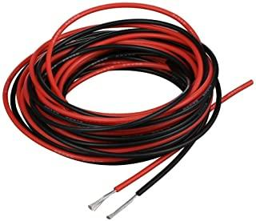
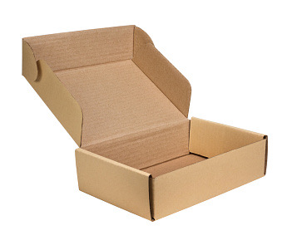
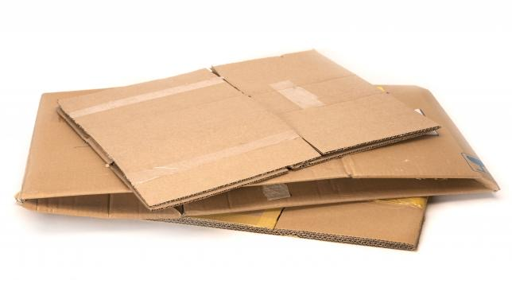
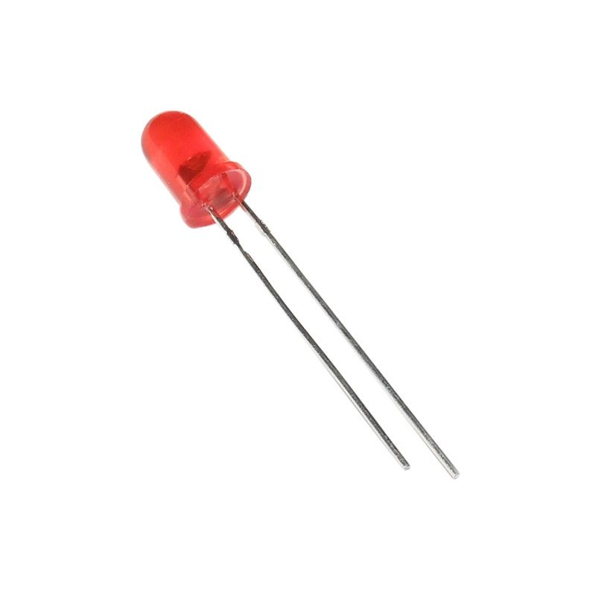
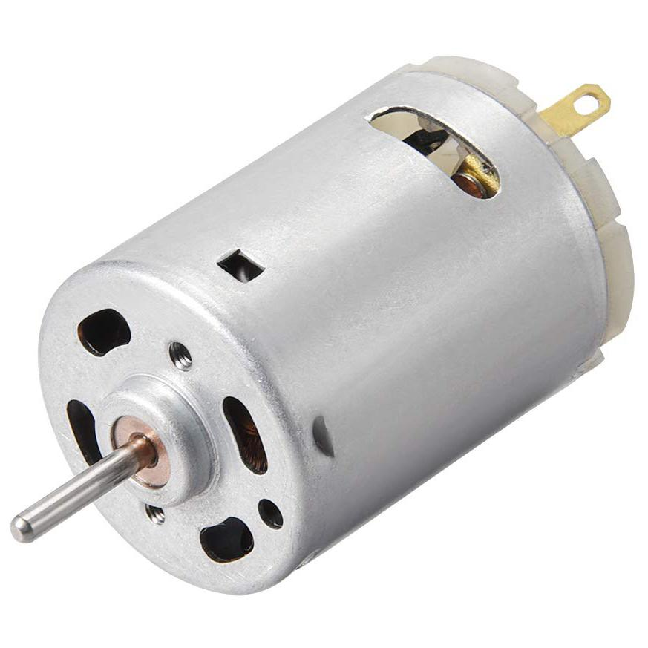
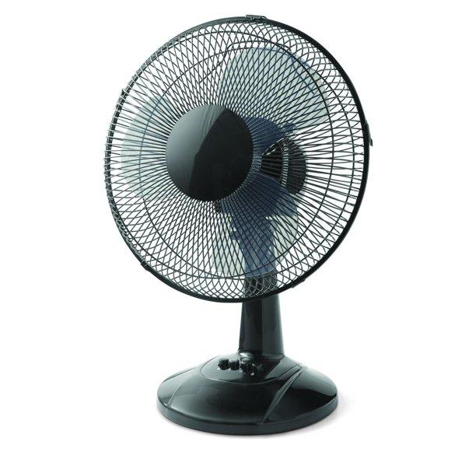
Materials
9 DC motors
3 large cardboard boxes
Low resistance LED light
A pair of scissors
Positive and negative wires
A hot glue gun
Super glue
Table fan
Plywood board measuring 56cm x 41cm
10 strips of Velcro
A small cardboard box measuring about 15cm

Slide 9
Procedure A: Part I
First, build the rotor. (Repeat this step 8 times.)
Take the large piece of cardboard and cut out 4 circle pieces which are 3cm in diameter each.
Glue all the circles together to make one thick circle.
Glue thin paper to the outside edge of the thick circle making sure to have it even and balanced.
Next, build the blades.
Cut 36 rectangular pieces from the cardboard, 12 measuring 6cm x 2.5cm, 12 measuring 8cm X 2.5cm, and 12 measuring 10cm x 2.5cm.
Cut out one edge of each blade so that it forms a round shape which enables you to easily glue them to the rotor.
Snip the corners on the other edge.
You’ll also need to slightly fold the blades to give it its curved shape.
Now take four blades from one size and glue it on the rotor slightly curved in order for the wind to push against it.
Once you have finished you should have 9 different rotors with blades of 3 different sizes coming off of them.

Slide 10
Procedure A: Part II
Now, build the tower.
Go back to your large piece of cardboard and cut out a thin portion of it, measuring 30cm x 12cm.
Wrap this cutout around a dowel or pen to make a hollow pole.
Glue the end of the paper to the middle of the paper to create the hollow cylinder. Now slide the pen or dowel out.
Now cut out a piece of cardboard measuring 4cm x 3cm.
Next, glue this piece of cardboard to the top of the tower and glue a piece of Velcro onto the cardboard measuring 2.5cm x 3cm.
Finally, mount the motor to the rotor: (Repeat this step 8 times.)
Take your DC motor and glue the bottom side of it to a piece of cardboard measuring 4cm x 3cm.
Now take the bottom piece of cardboard and glue the opposite side of Velcro on. This makes it possible to switch out different blades.
Take a rotor with 4 blades attached and make a small hole through its middle where the DC motor will attach.
Now put a dot of super glue on the end of the DC motor and insert it into the rotor.
Next, connect the positive and negative wires to the back of your motor.
Now take a small cardboard box and make a hole a little smaller than the size of your tower.
Finally, insert the tower into the box and secure the base with hot glue. Now glue the box onto the plywood board.

Slide 11
Procedure B
First, set up the wind turbine testing area.
Clear off a flat table. Place your wood containing the turbine and the LED on the table. Now gently place all 9 motors with attached rotors in groups of three onto the top of the table:
Group A: 6cm x 2.5cm
Group B: 8cm x 2.5cm
Group C: 10cm x 2.5cm
Take a table fan and place it on the left of the table.
Now, run the experiment.
Take one of the motors with blades coming off it from group A attach the Velcro coming from the tower onto the motor.
Take your table fan and face it directly in front of the wind turbine blades.
Turn on the fan at medium speed.
If the blades were build properly, they should be spinning.
Now take the digital multimeter and press the positive and negative probes against where the wires are connected into the motor.
Record the voltage produced with a multimeter.
Now repeat the steps for the rest of the wind turbines in group A, group B and group C.

Slide 12
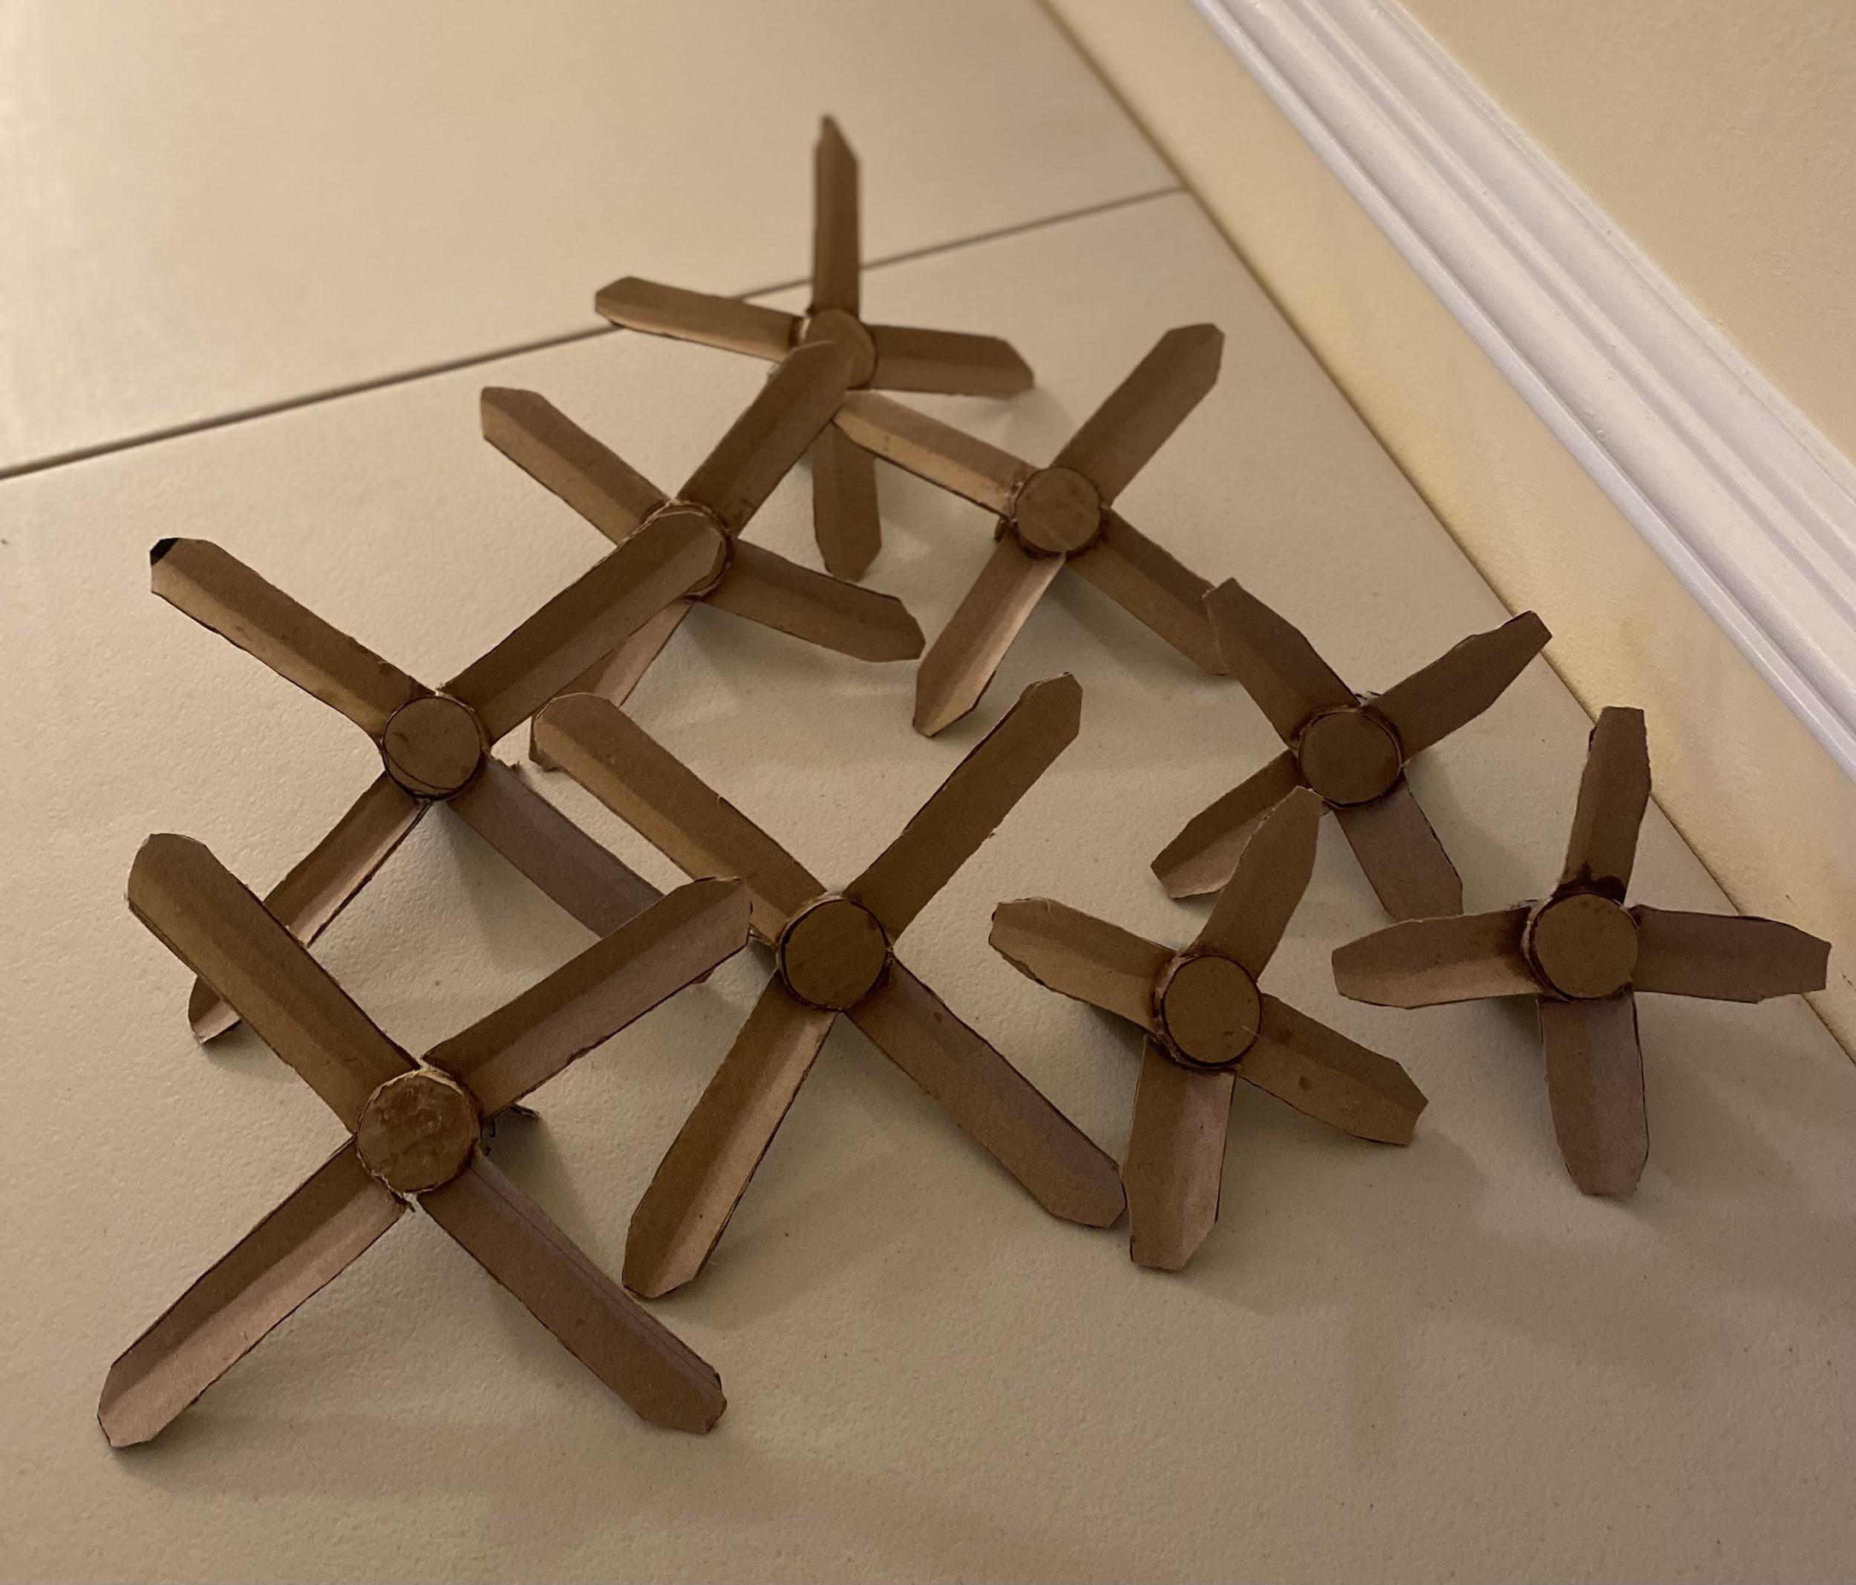
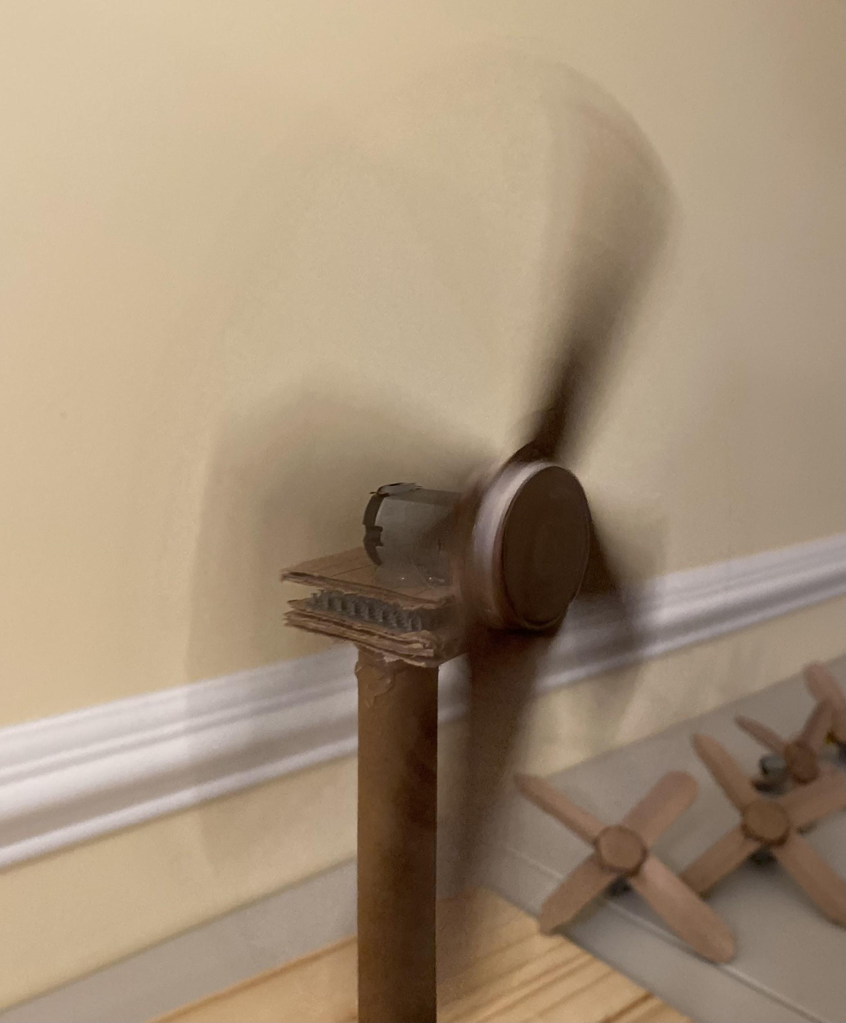
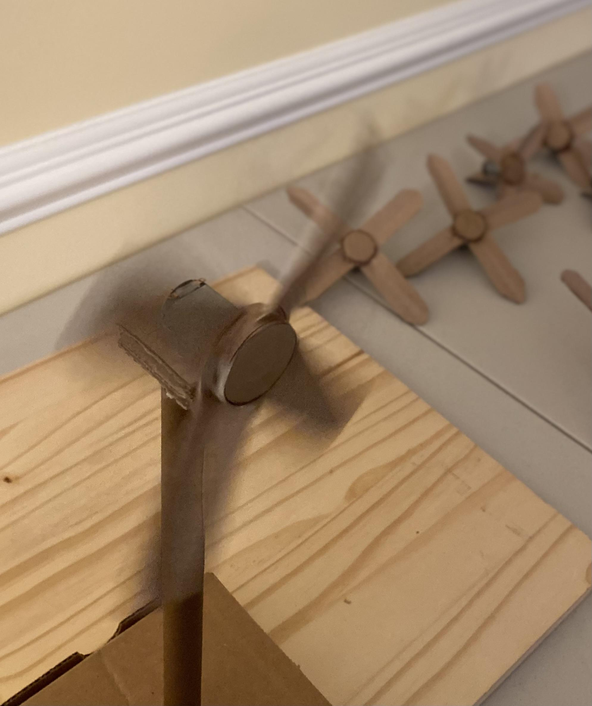
My Completed Model Wind Turbine

Slide 13
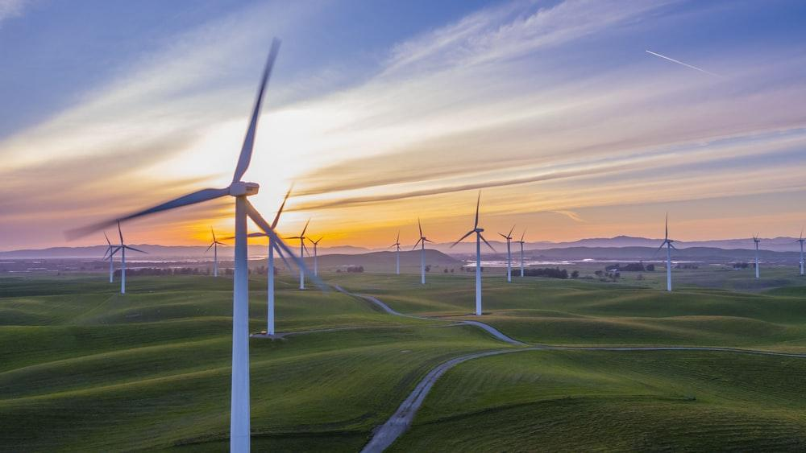
Observations
The closer the fan was to the turbine, the faster it spun.
The longer the blade, the faster the turbine spun.
The higher the wind speed, the faster the blade spun and produced energy.
The turbine spun the fastest when the fan was on the same level to the blades.

Slide 14
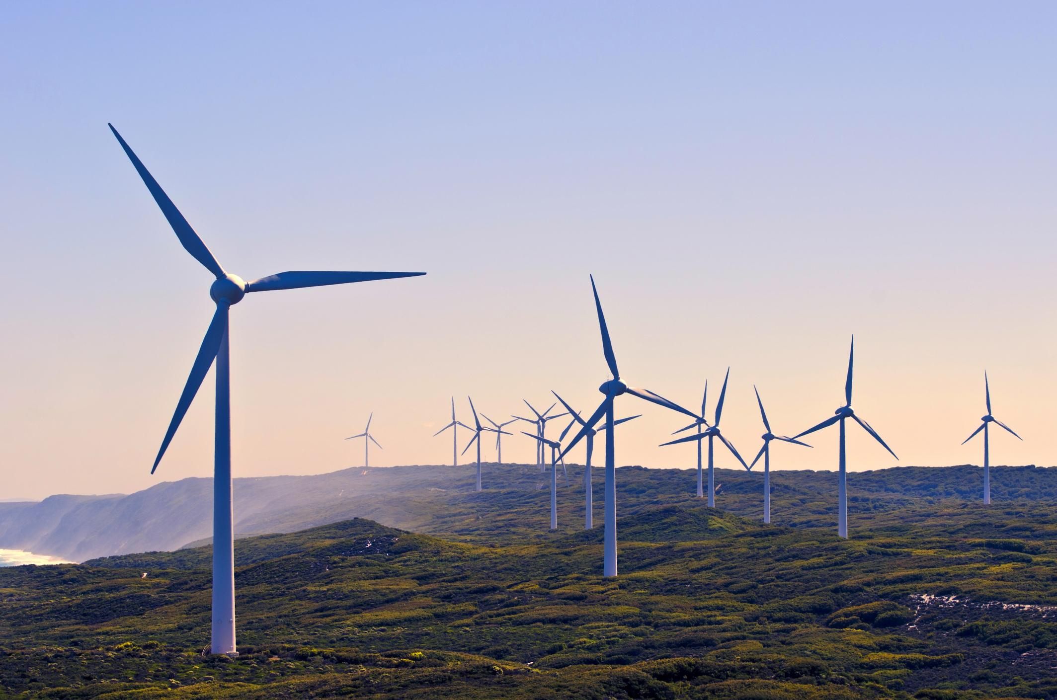
Data
The Effect of Length of Blades on Amount of Energy Produced by Wind Turbine
Length of Blades (cm) | Amount of Energy Produced by Wind Turbine (v) | Mean (v)
6cm | 0.8 | 0.6 | 0.7 | 0.7
8cm | 0.8 | 0.8 | 0.9 | 0.8
10cm | 1 | 0.8 | 0.9 | 0.9

Slide 15
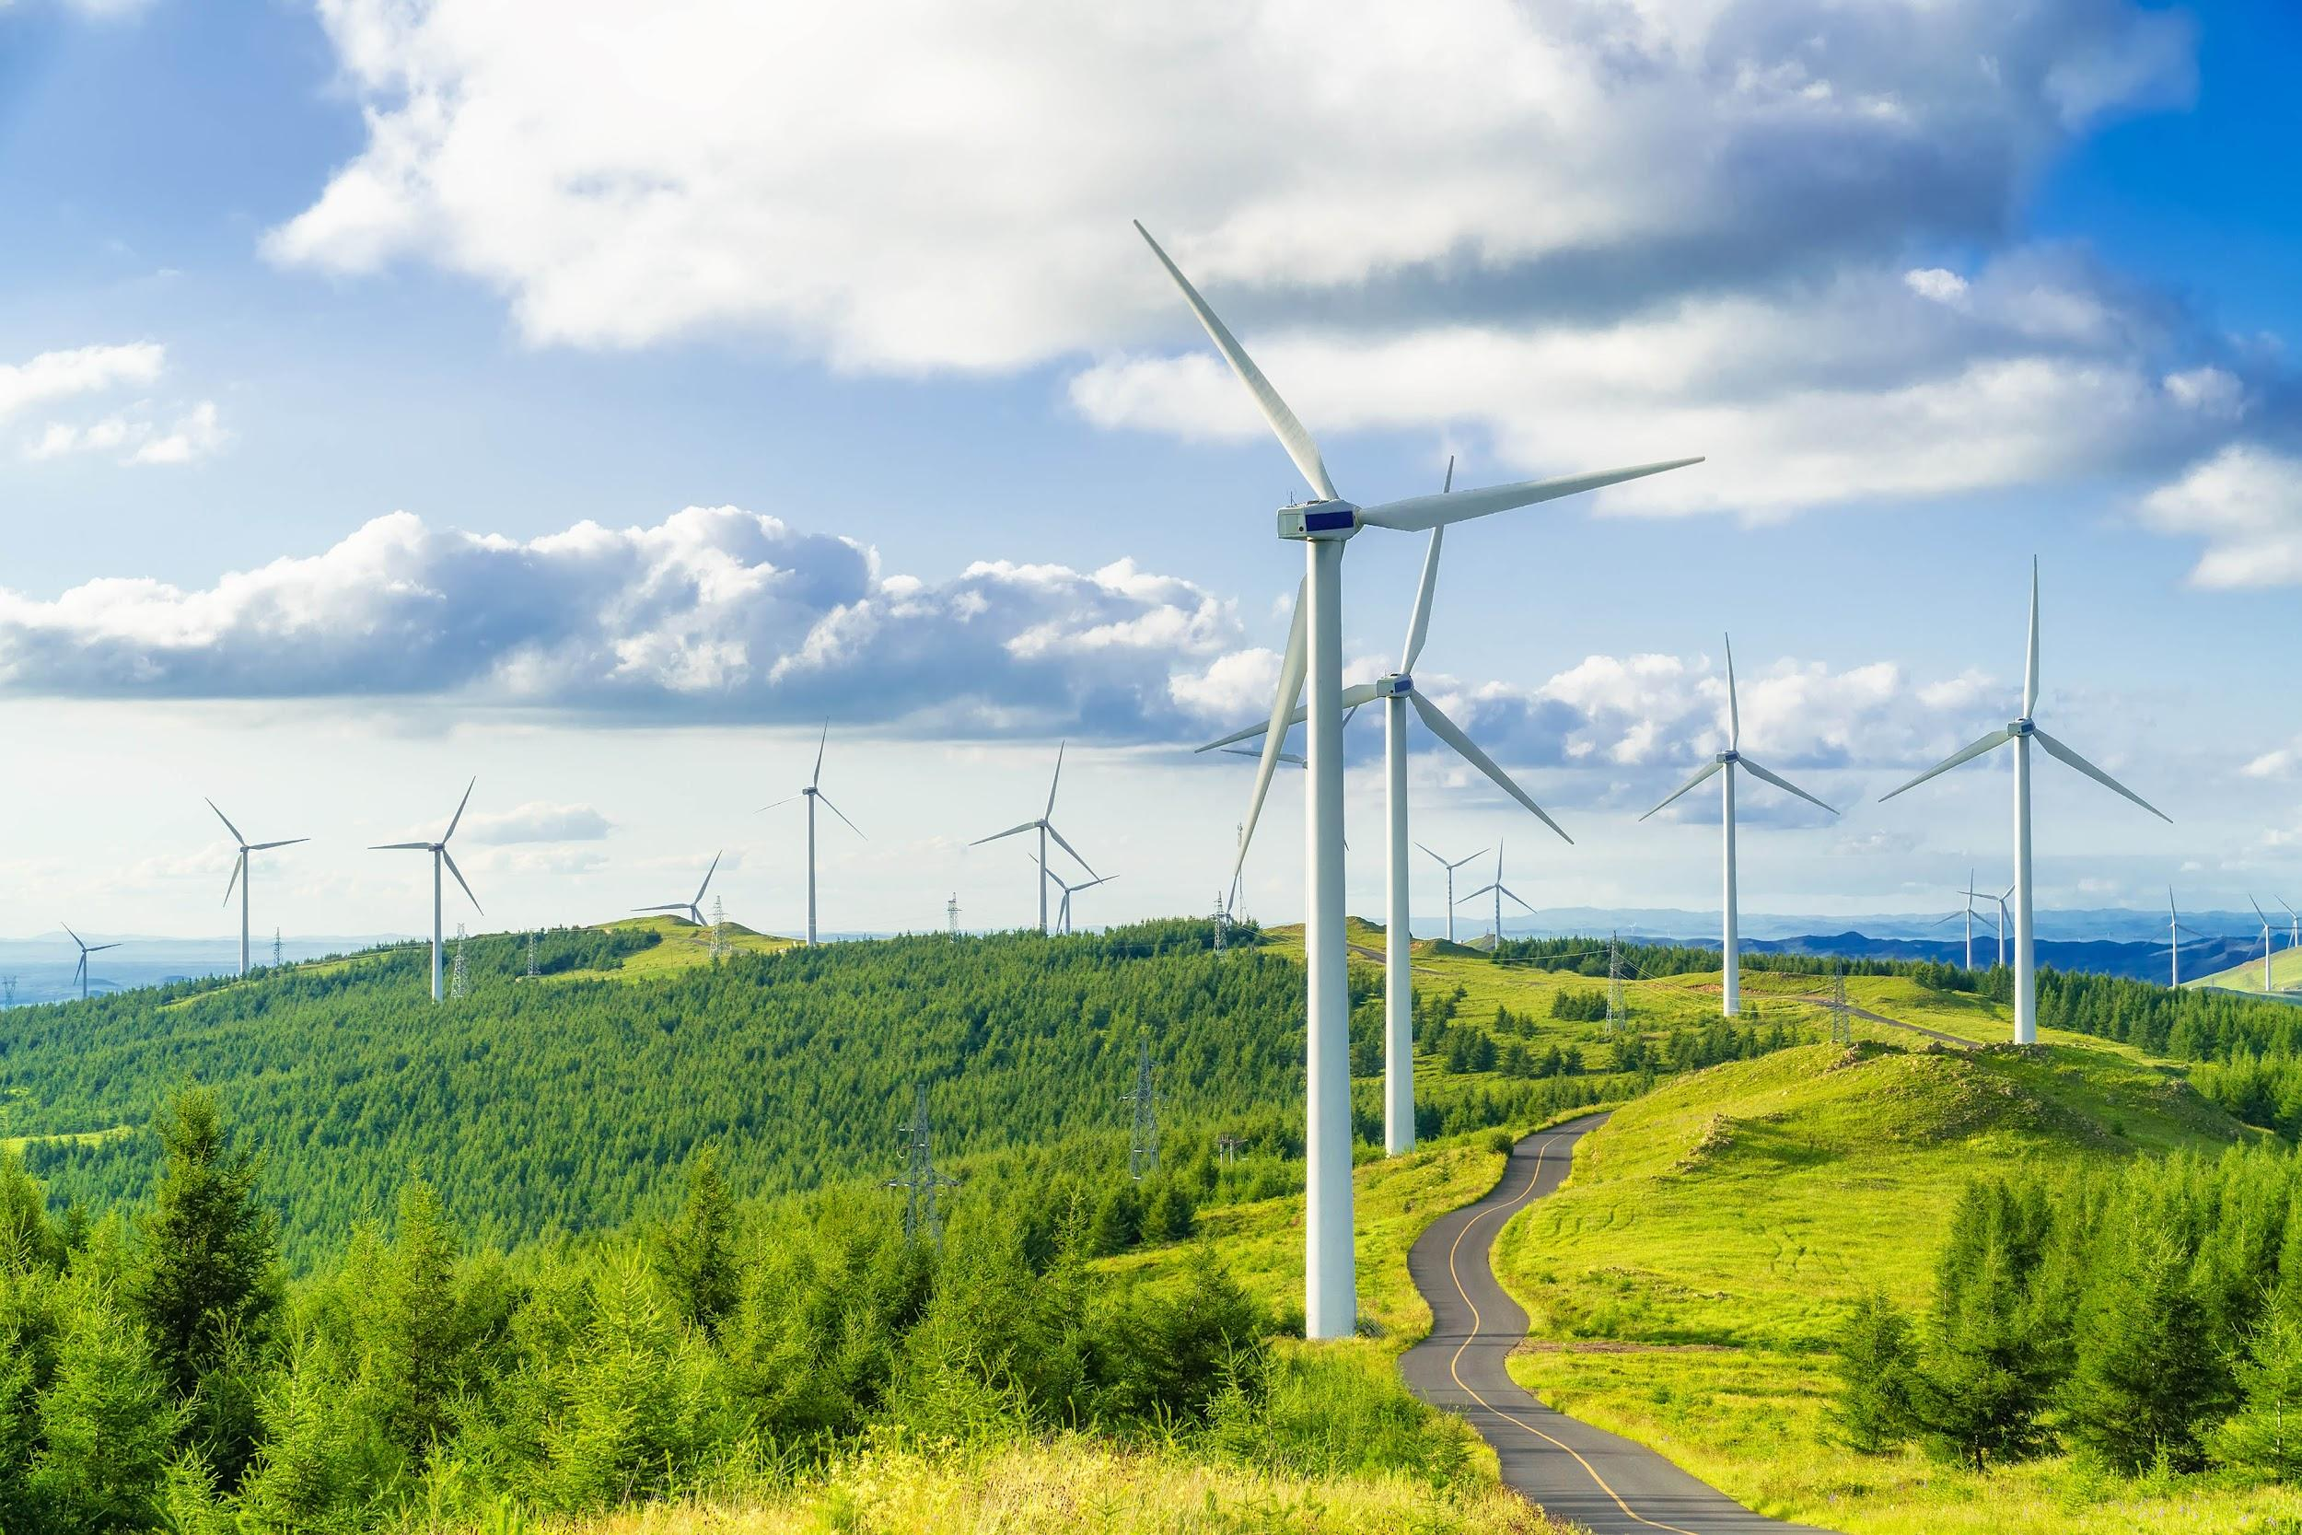
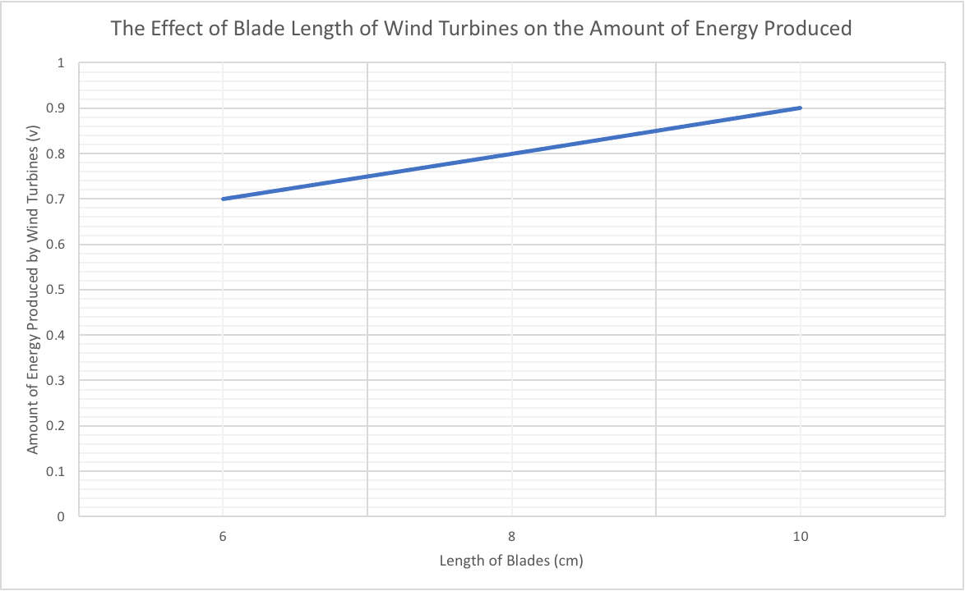
Graph

Slide 16
Conclusion
The hypothesis that if the length of blades are extended on model wind turbines, then more energy will be produced is accepted. The 6cm long blades produced a mean of 0.7 volts, the 8cm long blade produced a mean of 0.8 volts and the 10cm long blades produced a mean of 0.9 volts. A possible explanation for this is longer blades allow wind turbines to capture and collect more wind. Turbines with longer blades are able to capture more wind than shorter blades due to increased surface area. Further testing could involve measuring the amount of energy produced by wind turbines on different wind speeds or the amount of energy produced by wind turbines using different fans. Increasing the size of the blades could cause more energy to be created until a certain size is reached where the blades aren’t picking up as much wind to power the turbines.

Slide 17
Error Analysis
One possible systematic error that could happen would be if the digital multimeter was not calibrated. This might have caused a wrong measurement in the data. Another systematic error that could have occurred would be if the fan wasn’t spinning at the same speed during the entire recording session. A few possible random errors is that the cardboard used to make the blades could have had different thicknesses in different areas. Two other possible random errors would be if a draft of wind boosted the wind speed, or if a DC motor was defective and it caused the data to change.

Slide 18
Images Used
https://www.google.com/search?q=moving+blade+hazard+symbol&amp;tbm=isch&amp;ved=2ahUKEwiH5Z6nhOb0AhWXgHIEHUivCd0Q2-cCegQIABAC&amp;oq=moving+blade+hazard+symbol&amp;gs_lcp=ChJtb2JpbGUtZ3dzLXdpei1pbWcQAzoECAAQQzoGCAAQBxAeOggIABAHEAUQHjoECB4QClCkDljUI2CeJmgAcAB4AYABiAKIAfgJkgEFOS4zLjGYAQCgAQHAAQE&amp;sclient=mobile-gws-wiz-img&amp;ei=D_65YcehHZeBytMPyN6m6A0&amp;bih=695&amp;biw=1080&amp;prmd=isnxv&amp;rlz=1C9BKJA_enUS969US969&amp;hl=en-US#imgrc=uUCa16TWuKQ-5M.
https://www.google.com/search?q=wind+turbine+electrical+wires&tbm=isch&ved=2ahUKEwjutIaGxuP0AhXBg3IEHWxsAXkQ2-cCegQIABAC&oq=wind+turbine+electrical+wires&gs_lcp=ChJtb2JpbGUtZ3dzLXdpei1pbWcQAzIFCCEQqwI6BwgAELEDEEM6BQgAEIAEOgQIABBDOgQIABAYOgQIABAeUMkHWK4kYPQkaABwAHgAgAGRAogBjw2SAQYxMS41LjGYAQCgAQHAAQE&sclient=mobile-gws-wiz-img&ei=V7C4Ya6tGMGHytMP7NiFyAc&bih=695&biw=1080&prmd=isnxv&rlz=1C9BKJA_enUS969US969&hl=en-US#imgrc=QUEzWA-WlWfp6M&imgdii=jkPTYCejolPZ0M
https://www.google.com/search?q=wind+turbine&rlz=1C9BKJA_enUS969US969&hl=en-US&prmd=isnxv&source=lnms&tbm=isch&sa=X&ved=2ahUKEwja2fW5xOP0AhW1tDEKHSBoB4sQ_AUoAXoECAIQAQ&biw=1080&bih=695&dpr=2#imgrc=zaiWtDsRvTrcNM&imgdii=81E6_9iZ21HLZ
https://www.google.com/search?q=heat+hazard+symbol&tbm=isch&ved=2ahUKEwi41Of7gub0AhVasHIEHcUEDHsQ2-cCegQIABAC&oq=heat+hazard+symbol&gs_lcp=ChJtb2JpbGUtZ3dzLXdpei1pbWcQAzIFCAAQgAQyBAgAEBg6CAgAEIAEELEDOgQIABADOgQIABBDOgQIABANOggIABAIEA0QHjoECCEQCjoFCAAQzQJQzwZYvFtglV1oAHAAeACAAZsBiAG7EZIBBDE4LjaYAQCgAQGwAQDAAQE&sclient=mobile-gws-wiz-img&ei=p_y5YfjkOtrgytMPxYmw2Ac&bih=695&biw=1080&prmd=insxv&rlz=1C9BKJA_enUS969US969&hl=en-US#imgrc=7FHxakVq0WKIMM
https://www.google.com/search?q=electrical+hazard+symbol&tbm=isch&ved=2ahUKEwiV_JiJiOb0AhVesHIEHbphDV4Q2-cCegQIABAC&oq=electrical+haza&gs_lcp=ChJtb2JpbGUtZ3dzLXdpei1pbWcQARgCMgUIABCABDIFCAAQgAQyBQgAEIAEMgUIABCABDIFCAAQgAQ6CAgAEIAEELEDOggIABCxAxCDAToECAAQQzoLCAAQgAQQsQMQgwE6BwgAELEDEENQkx1Ynz1guUhoAHAAeACAAVKIAZIHkgECMTaYAQCgAQGwAQDAAQE&sclient=mobile-gws-wiz-img&ei=AgK6YZXzDN7gytMPusO18AU&bih=695&biw=1080&prmd=insxv&rlz=1C9BKJA_enUS969US969&hl=en-US#imgrc=TTJTeyGdPEQCkM
https://www.google.com/search?q=wind+turbine+blueprint&rlz=1C9BKJA_enUS969US969&oq=wind+turbine+blue&aqs=chrome.0.0i512j69i57j69i59j0i22i30l3.4551j0j7&hl=en-US&sourceid=chrome-mobile&ie=UTF-8#imgrc=pI_fXd5TQRXllM
https://www.google.com/search?q=wind+turbine+blades+size&rlz=1C9BKJA_enUS969US969&hl=en-US&prmd=ivsxn&source=lnms&tbm=isch&sa=X&ved=2ahUKEwjjoL_Vjbf1AhUJjYkEHcYuA8MQ_AUoAXoECAIQAQ&biw=1080&bih=695&dpr=2#imgrc=k0PqW_0yhIwBpM
https://www.google.com/search?q=wind+turbine+blades+size&rlz=1C9BKJA_enUS969US969&hl=en-US&prmd=ivsxn&source=lnms&tbm=isch&sa=X&ved=2ahUKEwjjoL_Vjbf1AhUJjYkEHcYuA8MQ_AUoAXoECAIQAQ&biw=1080&bih=695&dpr=2#imgrc=k0PqW_0yhIwBpM
https://www.google.com/search?q=cardboard&rlz=1C9BKJA_enUS969US969&hl=en-US&prmd=ivsxn&source=lnms&tbm=isch&sa=X&ved=2ahUKEwjwzMqYkbf1AhW8lIkEHVJwB2oQ_AUoAXoECAIQAQ&biw=1080&bih=695&dpr=2#imgrc=EbW5WQegrcADjM&imgdii=hj7dP1ZFNFg4HM
https://www.google.com/search?q=dc+motors&rlz=1C9BKJA_enUS969US969&hl=en-US&prmd=ivsxn&source=lnms&tbm=isch&sa=X&ved=2ahUKEwi4vfC8kbf1AhXwdd8KHXJZCfcQ_AUoAXoECAMQAQ#imgrc=jYy-m3H-bdMuOM
https://www.google.com/search?q=led+light&tbm=isch&ved=2ahUKEwjt07Lakbf1AhXnqnIEHeVkBuQQ2-cCegQIABAC&oq=led+light&gs_lcp=ChJtb2JpbGUtZ3dzLXdpei1pbWcQAzIHCAAQsQMQQzIHCAAQsQMQQzIICAAQgAQQsQMyBwgAELEDEEMyBQgAEIAEUN8IWN8IYPYJaABwAHgAgAE3iAFpkgEBMpgBAKABAcABAQ&sclient=mobile-gws-wiz-img&ei=v4PkYa34DefVytMP5cmZoA4&prmd=ivsxn&rlz=1C9BKJA_enUS969US969&hl=en-US#imgrc=hlsVM1lGylwBcM&imgdii=FoBTpQ5kZtUslM
https://www.google.com/search?q=pack+of+thin+negative+and+positive+wires+&tbm=isch&ved=2ahUKEwiVjtKOkrf1AhWfLFkFHcy9CwUQ2-cCegQIABAC&oq=pack+of+thin+negative+and+positive+wires+&gs_lcp=ChJtb2JpbGUtZ3dzLXdpei1pbWcQAzoFCAAQzQI6BQghEKsCOgQIHhAKOgQIIRAKUP8MWLtJYLxLaABwAHgAgAFLiAG_CZIBAjE5mAEAoAEBwAEB&sclient=mobile-gws-wiz
-img&ei=LITkYZXIMJ_Z5NoPzPuuKA&bih=695&biw=1080&prmd=ivsxn&rlz=1C9BKJA_enUS969US969&hl=en-US#imgrc=c4--x0jCMEC0yM
https://www.google.com/search?q=table+fan&rlz=1C9BKJA_enUS969US969&hl=en-US&prmd=ivsxn&source=lnms&tbm=isch&sa=X&ved=2ahUKEwi_tbaqkrf1AhXBlIkEHVDpBOIQ_AUoAXoECAIQAQ&biw=1080&bih=695&dpr=2#imgrc=JovvzTP7jxV0qM
https://www.google.com/search?q=wind+turbine+background&rlz=1C9BKJA_enUS969US969&hl=en-US&prmd=isnxv&source=lnms&tbm=isch&sa=X&ved=2ahUKEwjdjp_Kt8D1AhW-kokEHW49DSEQ_AUoAXoECAIQAQ&biw=1080&bih=695&dpr=2#imgrc=MhZfVhzs_ciNZM&imgdii=vsZonRIgZZig4M
https://www.google.com/search?q=large+field+wind+wind+turbines&rlz=1C9BKJA_enUS969US969&hl=en-US&prmd=isnxv&source=lnms&tbm=isch&sa=X&ved=2ahUKEwiRpfvutsD1AhXolIkEHfdmCSsQ_AUoAXoECAIQAQ#imgrc=_o8XooV0LmBDOM
https://www.google.com/search?q=small+cardboard+box&rlz=1C9BKJA_enUS969US969&hl=en-US&prmd=ivsxn&source=lnms&tbm=isch&sa=X&ved=2ahUKEwjQx8W7krf1AhXCkIkEHafyADwQ_AUoAXoECAIQAQ&biw=1080&bih=695&dpr=2#imgrc=2yFJrtQcKkVt1M
https://www.google.com/search?q=wind+turbine&tbm=isch&ved=2ahUKEwjui7_Pq7f1AhVmAFkFHcqyCqIQ2-cCegQIABAC&oq=wind+turbine&gs_lcp=ChJtb2JpbGUtZ3dzLXdpei1pbWcQAzIHCAAQsQMQQzIECAAQQzIECAAQQzIECAAQQzIICAAQgAQQsQM6BQgAEIAEOgQIABANOggIABANEAUQHjoGCAAQBxAeOggIABAHEAUQHlD1JVjSO2CiPmgAcAB4AIABVYgB0QWSAQIxMJgBAKABAcABAQ&sclient=mobile-gws-wiz-img&ei=657kYa7qKeaA5NoPyuWqkAo&bih=695&biw=1080&prmd=ivsxn&rlz=1C9BKJA_enUS969US969&hl=en-US#imgrc=OxfFMtmzqUSP0M&imgdii=at7ZQlrQ-EMQDM
https://www.google.com/search?q=wind+turbine+background&rlz=1C9BKJA_enUS969US969&hl=en-US&prmd=isnxv&source=lnms&tbm=isch&sa=X&ved=2ahUKEwiyyamTvMD1AhUvkokEHXdNDYUQ_AUoAXoECAIQAQ&biw=1080&bih=695&dpr=2#imgrc=ulC894Zsdf_0NM

Slide 19
Works Cited
“How Do Wind Turbines Work?” Energy.gov, www.energy.gov/eere/wind/how-do-wind-turbines-work.
“How Much Energy Does a Wind Turbine Produce? Turbine Energy Explained.” Inspire Clean Energy, https://www.inspirecleanenergy.com/blog/clean-energy-101/how-much-energy-does-wind-turbine-produce.
“What Is a Wind Turbine?” Rhythm, www.gotrhythm.com/blog/renewable-energy/what-is-a-wind-turbine.
“Wind Power.” Wind Power - Energy Education, www.energyeducation.ca/encyclopedia/Wind_power.
“Wind Turbines: The Bigger, the Better.” Energy.gov, https://www.energy.gov/eere/articles/wind-turbines-bigger.

