Slide 1
The Effects Of Sucrose on C. Elegan Population
Anika Singh, Senior, Robbinsville High School

Slide 2
HYPOTHESIS
Increased sugar intake will decrease pharyngeal pumping and the rate of reproduction, decreasing the overall lifespan and population. Standard diets will result in an eventual decrease of pharyngeal pumping and increase in the rate of reproduction, resulting in an average lifespan and population.

Slide 3
BACKGROUND
Increased sugar intake has a negative effect on humans
The endocrine system of nematodes are incredibly similar to that of humans

Slide 4
MATERIALS
C. Elegans
Petri Dish
NGM Lite
Sucrose
01
04
N2 Wild Type
Petri Dish x3
Nematode Growth Agar x1
0.1% and 0.5% sucrose plates
02
03

Slide 5
PROCEDURE
Pour NGM lite control plate (x1)
Pour NGM lite 0.1% sucrose plate (x1)
Pour NGM lite 0.5% sucrose plate (x1)
01
02
03

Slide 6
PROCEDURE
Place 1 cm chunk of N2 Wild Type C. Elegans from E. coli into each plate
Let sit in dry, cool area
OBSERVE RESULTS
04
05

Slide 7
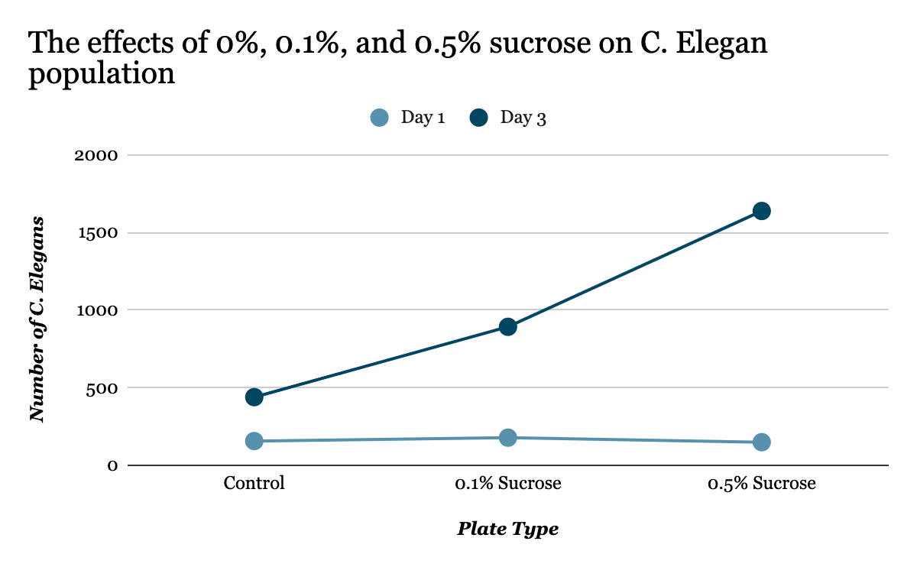
DATA

Slide 8
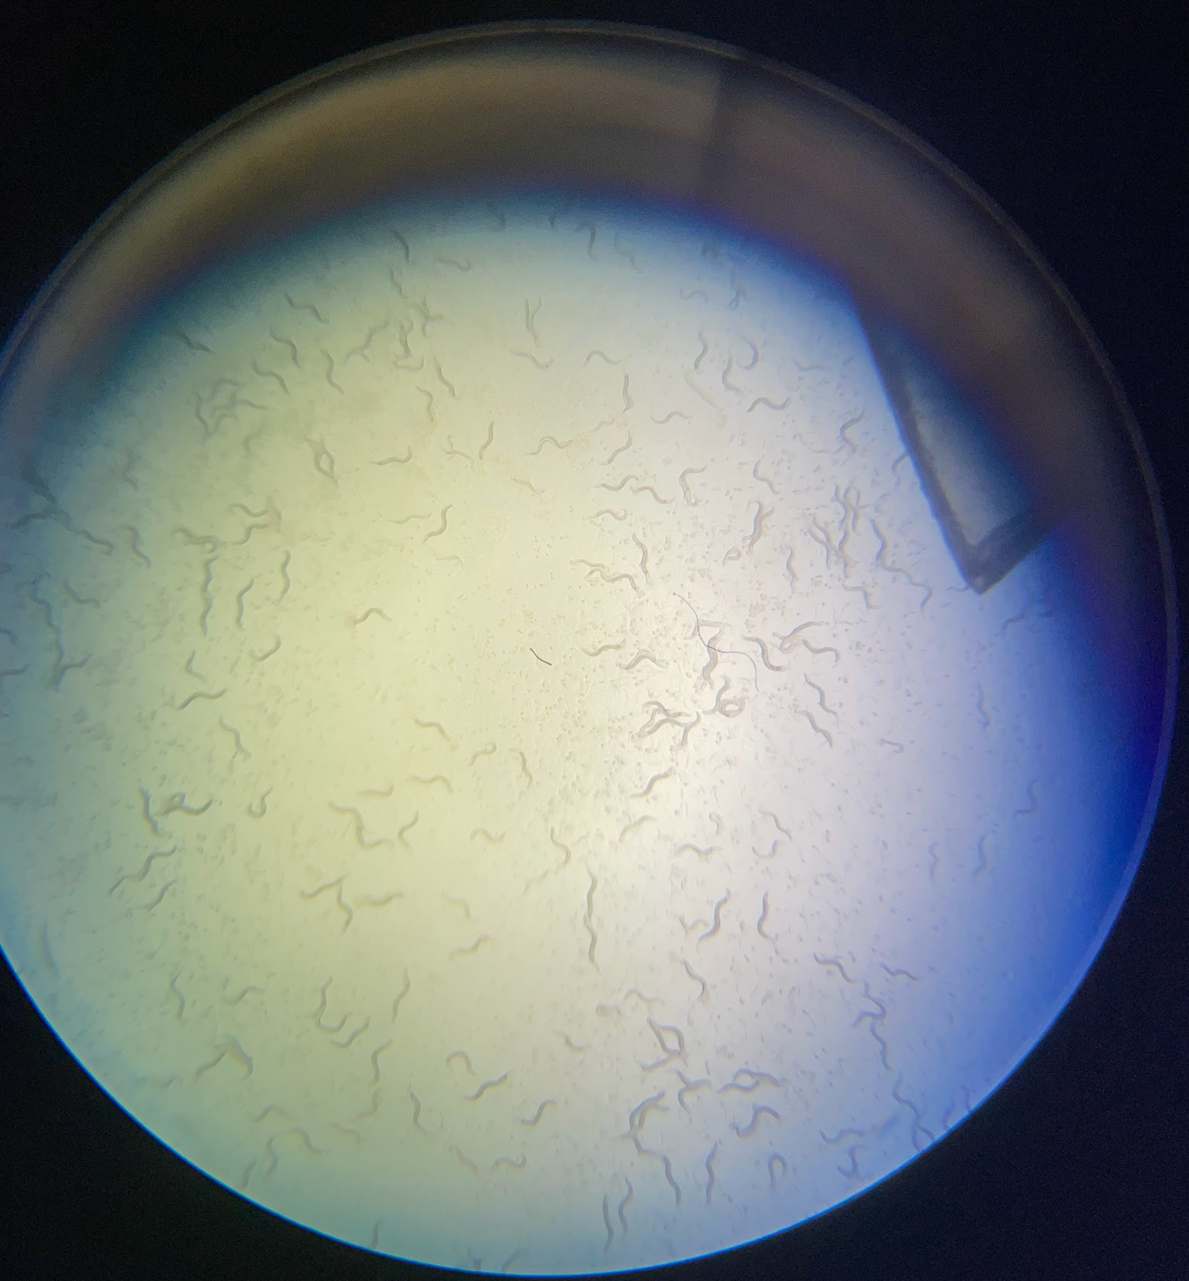
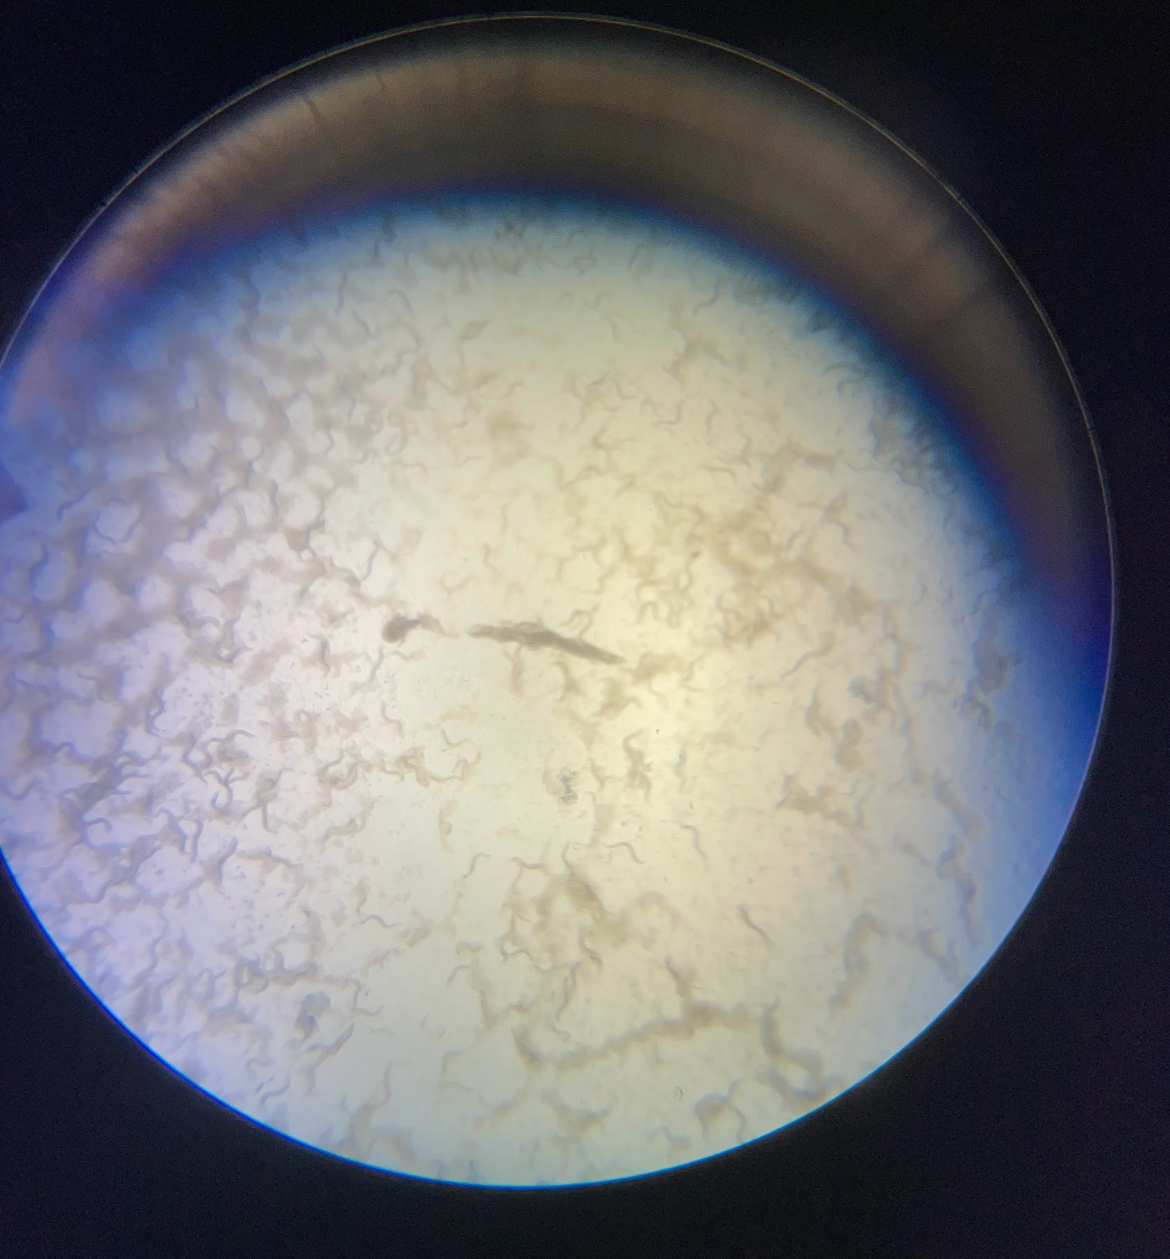
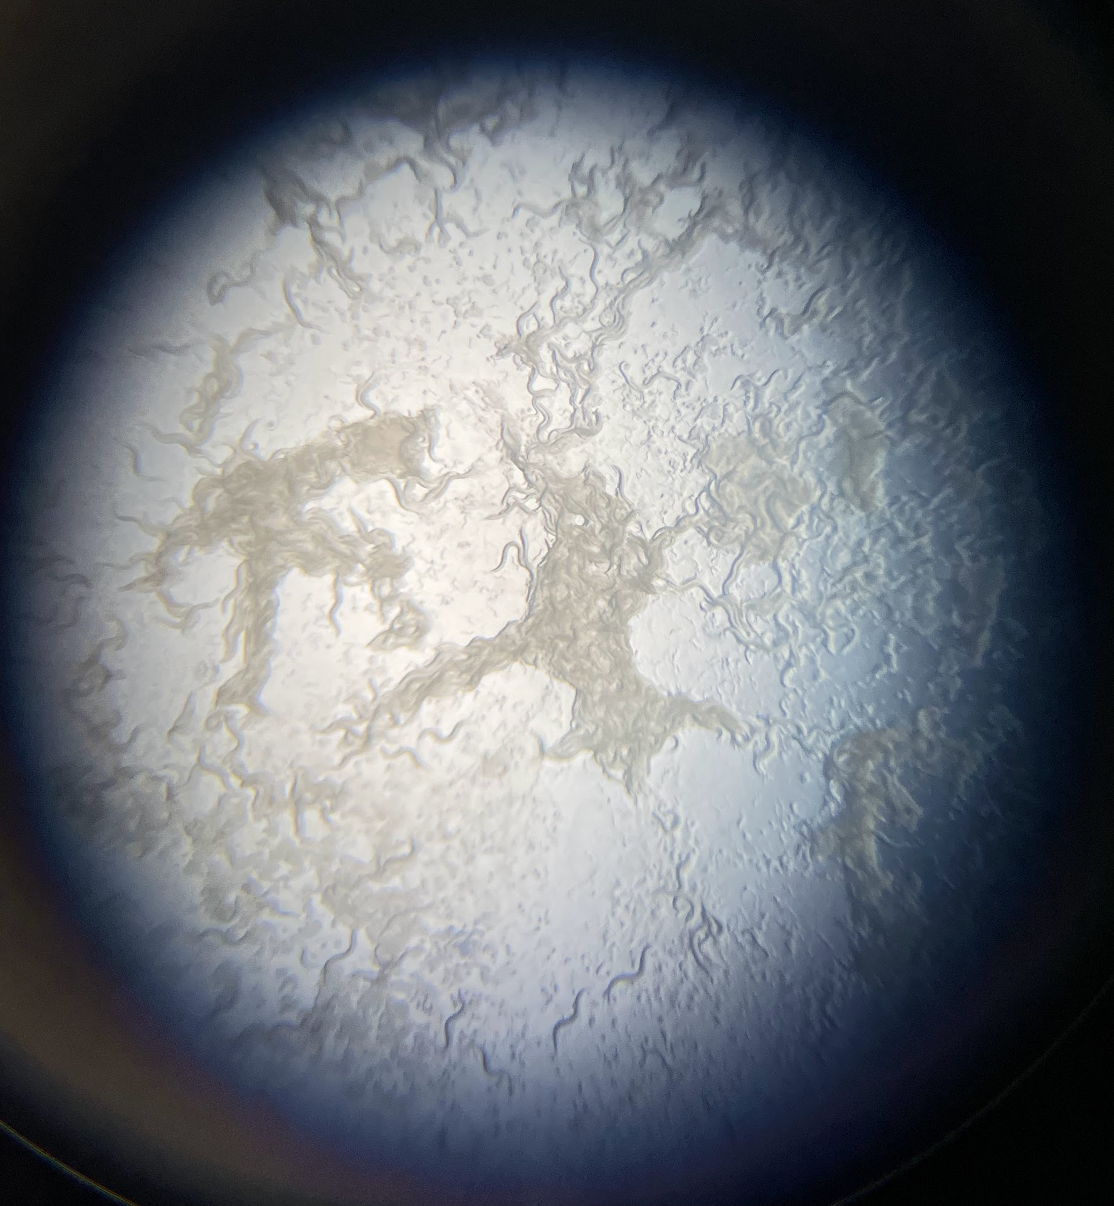
RESULTS
CONTROL
0.1% SUCROSE
0.5% SUCROSE
Notes:
After three days

Slide 9
ANALYSIS
Typical rate of population growth in control plate
Moderately increased rate of population growth in 0.1% glucose plate
Extremely increased rate of population growth in 0.5% glucose plate
Swarms of C. Elegans near areas where sugar was not spread fully

Slide 10
SUMMARY
Allowed for the research of the effects of sugar on nematode growth and development
Suggests that sucrose can be used as part of nematode diet
Sucrose demonstrated a profound impact on lifespan and rate of population growth

Slide 11
FUTURE STUDY
Different types of sugar
Ex: glucose, fructose, galactose
Different nematodes
Ex: human pinworm, roundworm

