Slide 1

2023 Mercer Science & Engineering Fair
Engineering novel functional bread through fortification with quercetin nanoparticles*
William Huang
The Lawrenceville School
Lawrenceville, New Jersey
* I thank Professor Chi-Tang Ho and Ms. Yujia Cheng of Rutgers University for technical
assistance and many useful suggestions. This paper has been accepted by 2023 Institute of
Food Technologists Annual Meeting in Chicago.

Slide 2
Healthy Bread
Starch-based bread products are among the most consumed foods in the world. After consumption, the 𝛂-amylase in our salivary glands and digestive systems will quickly convert starch into glucose, which is then absorbed into the bloodstream
The refined starches that comprise modern bread products give these foods high glycemic indexes, and continued consumption of such foods will increase the risk of type 2 diabetes
Considering the high costs and sometime painful for these chronic metabolic diseases, “healthy diets rich in fruits and vegetables may reduce the risk of cancer and other chronic diseases.”
− Centers for disease control and prevention (CDC), USA

Slide 3
Health Benefits of Quercetin
Quercetin (3,5,7-trihydroxy-2-(3,4-dihydroxyphenyl)-4H-chromen-4-one) is one of the most potent dietary flavonoids commonly found in
tea, red onion, apple skin, berries etc.
Quercetin is reported to have versatile biological functions
including anti-diabetic, anti-carcinogenic, anti-inflammatory,
anti-allergic, anti-viral and anti-hyperuricemic activities etc.
Quercetin possess anti-hyperuricemic activity as a result of their ability to reduce serum urate levels by inhibiting xanthine oxidase (XOD) enzyme;
However, the low solubility (0.17–7.7 μg/mL in water, 5.5 μg/mL in artificial gastric juice and 28.9 μg/mL in artificial intestinal juice), poor oral bioavailability and low chemical stability of quercetin are the main drawbacks that limit its use in foods.
Objectives: (1) To prepare quercetin nanoparticles and study the effects of quercetin size on its crystallinity, dough rheological properties and bioaccessibility; and (2) to prepare novel functional butter using diacylglycerol oil to replace triacylglycerol fats.

Slide 4
Experimental Methods
Quercetin nanoparticles were prepared using the media milling technology, and the particle sizes, crystallinities, and microstructures of quercetin before and after media milling were characterized by field emission scanning electron microscopy (FE-SEM) and X-ray diffraction.
AACC method 10-10B (AACC, 2000) was adopted to prepare the dough. Dough pieces were fermented at 30 ± 2 °C under 80 ± 5% relative humidity for 60 min. The dough was baked in 21.6 cm x 11.2 cm x 6.9 cm aluminum pan at 205 °C for 30 min.
The dynamic rheological and textural properties of quercetin-fortified doughs and the baked bread were measured using a rheometer and a texture analyzer respectively.
The changes in the bioaccessibility of quercetin were assessed using the TNO dynamic gastrointestinal model-1 (TIM-1) combined with a HPLC.

Slide 5
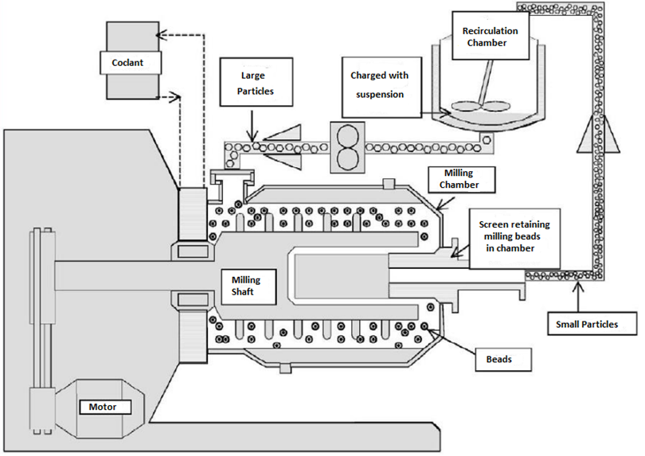
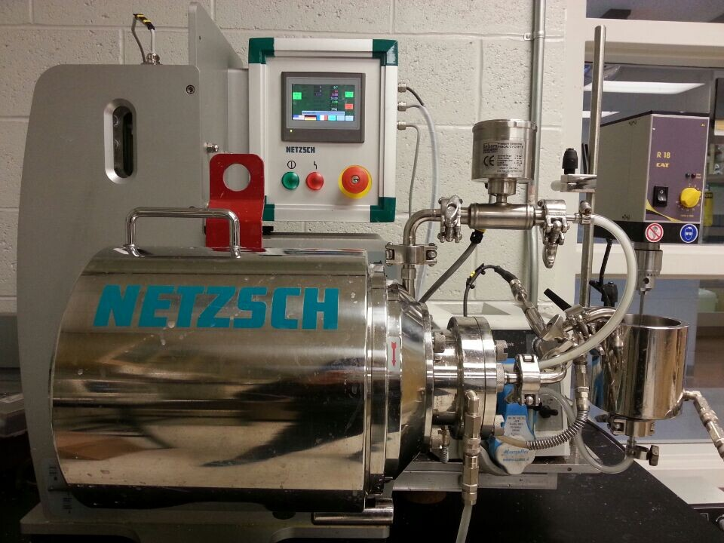
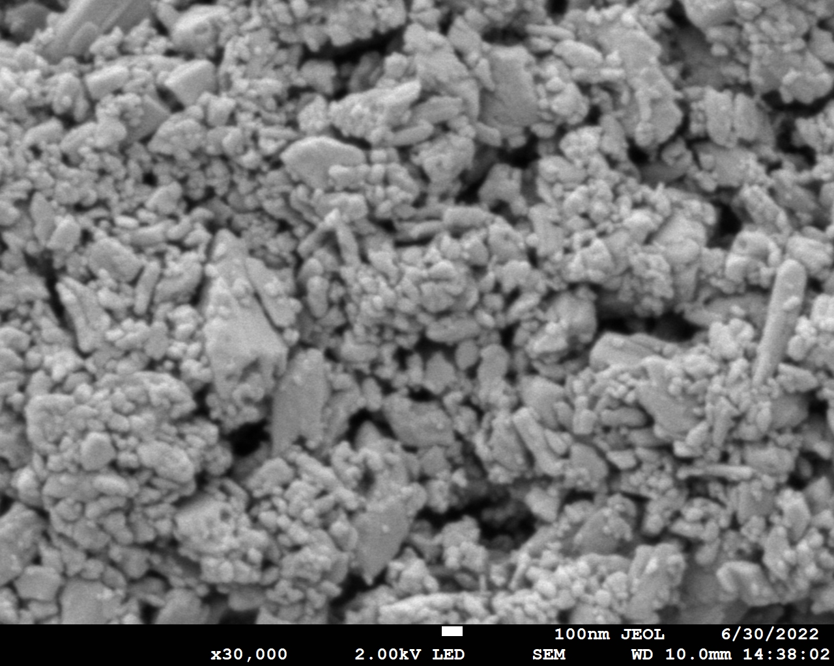
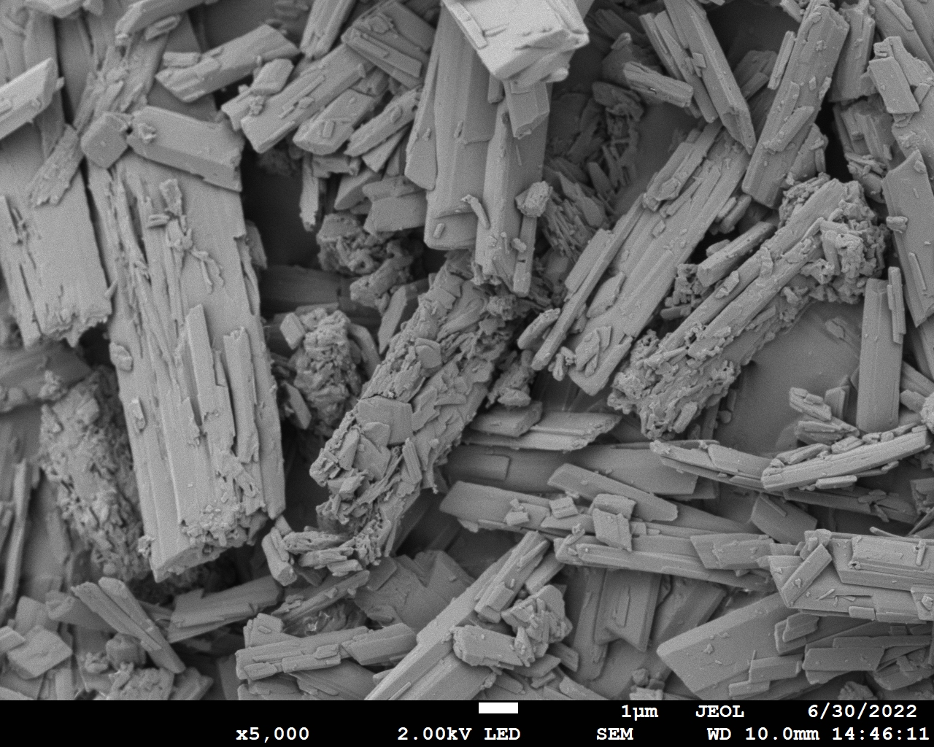
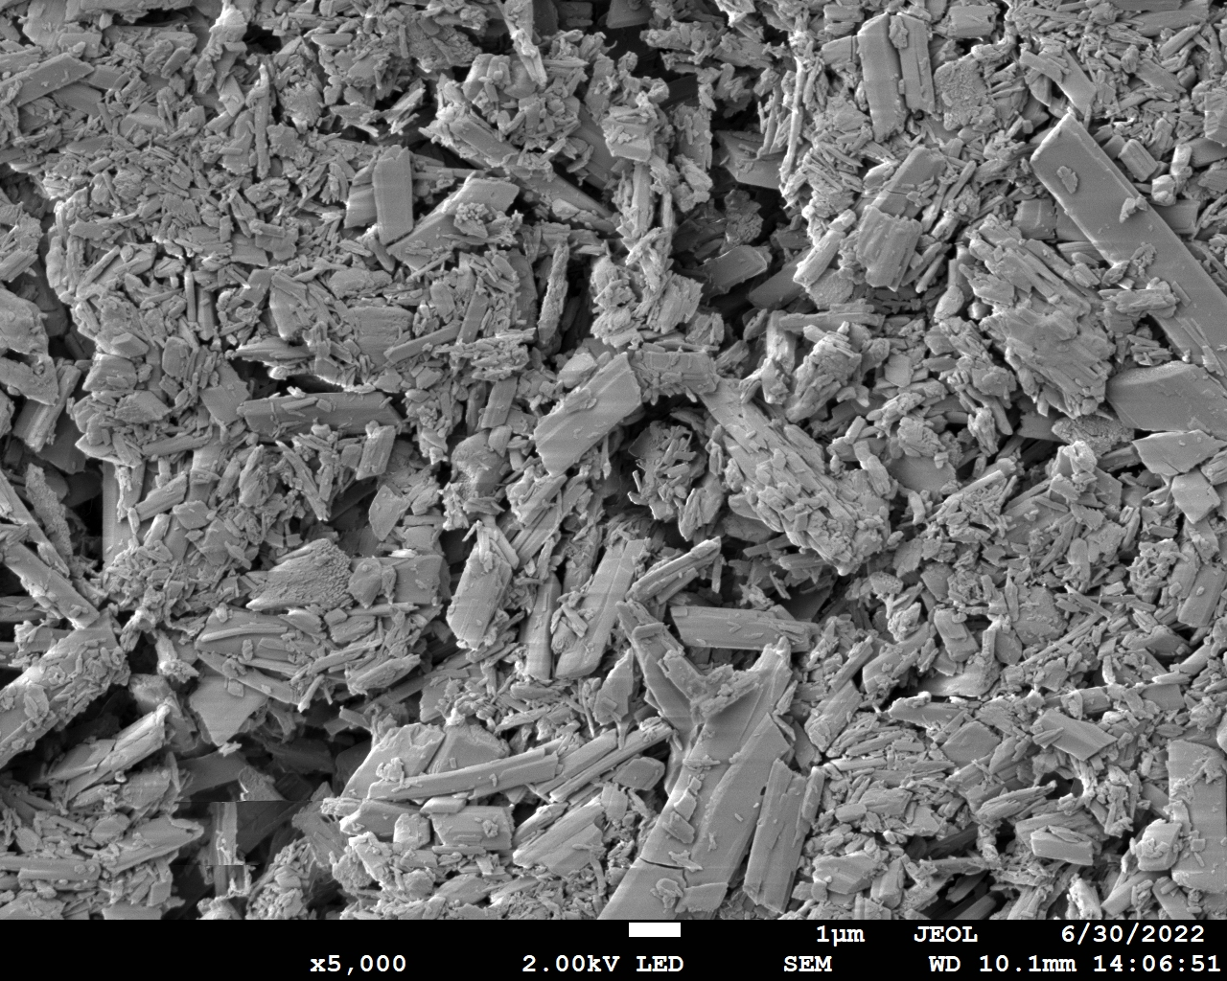
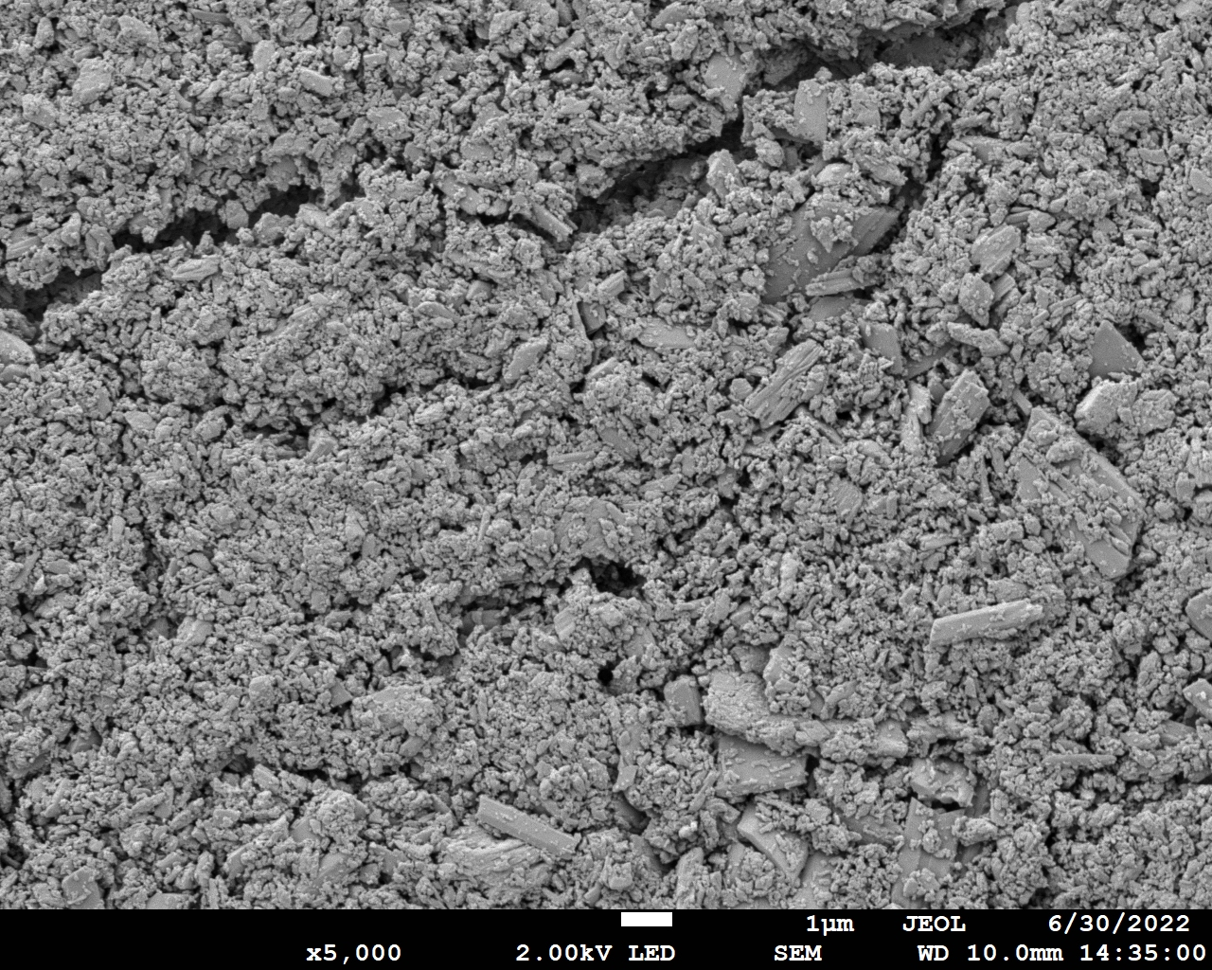
Preparation of Quercetin Nanoparticles
Abrasion
Fracture

Slide 6
Effect of Particle Size on Crystallinity
(X-Ray Diffraction Patterns)
Crystallites of pure quercetin are slightly larger (more detail of shoulders and doublets apparent for pure Q).
% Crystallinity of pure quercetin is slightly larger (e.g., background scattering under peak at 27 deg is less for pure Q).

Slide 7
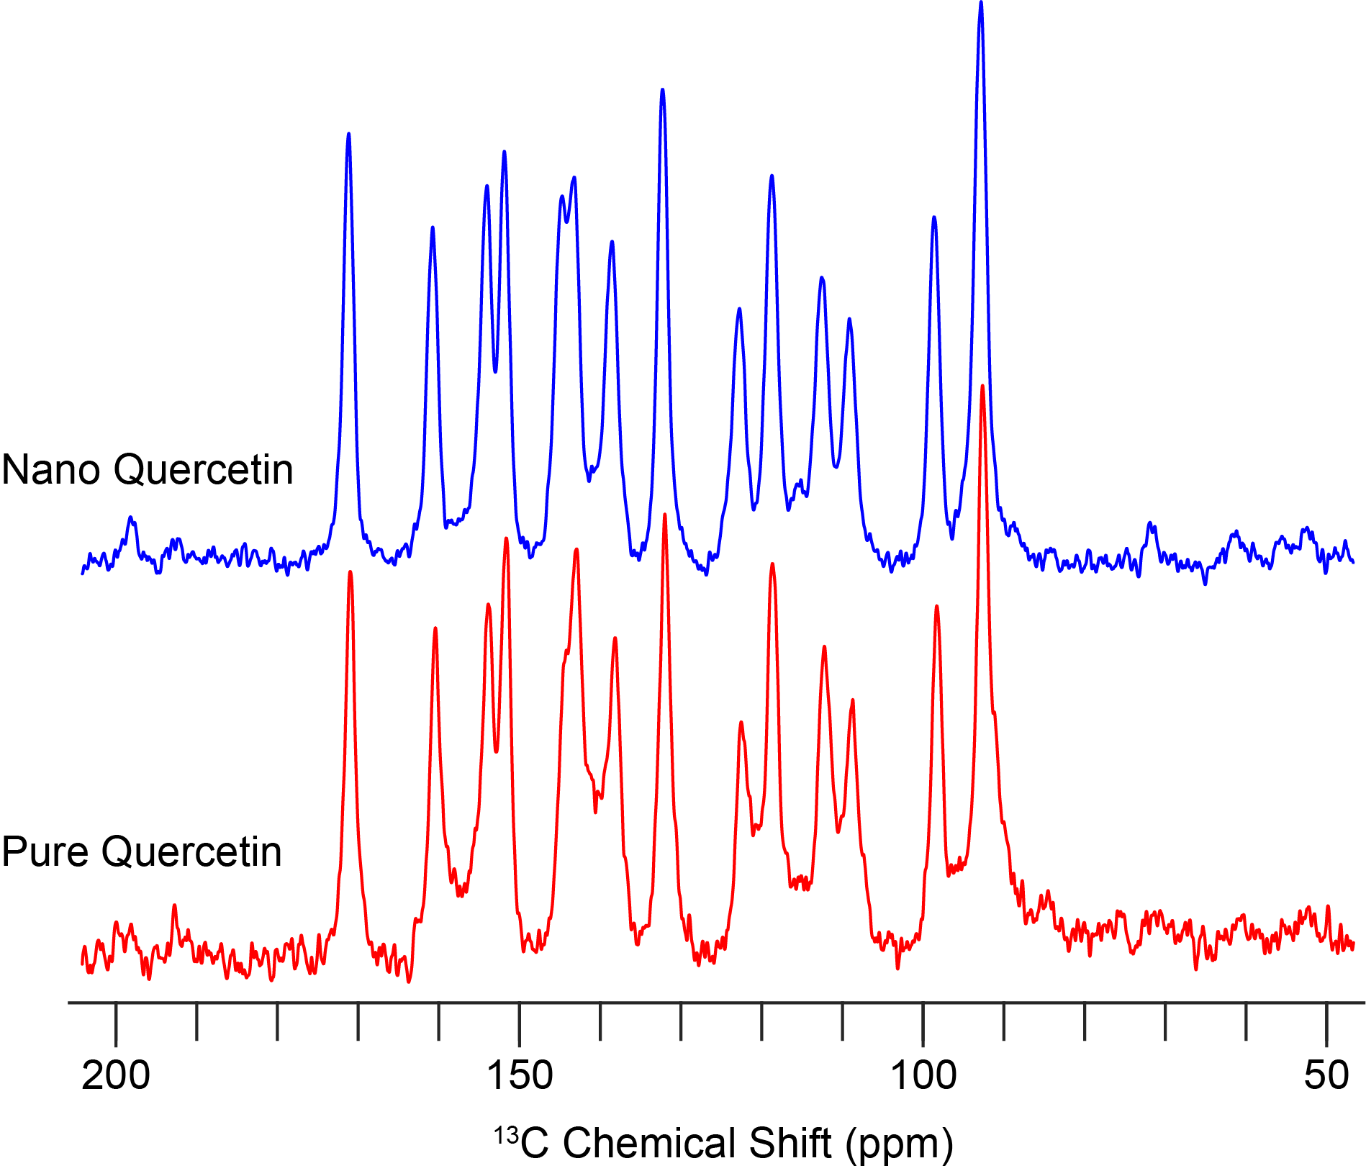
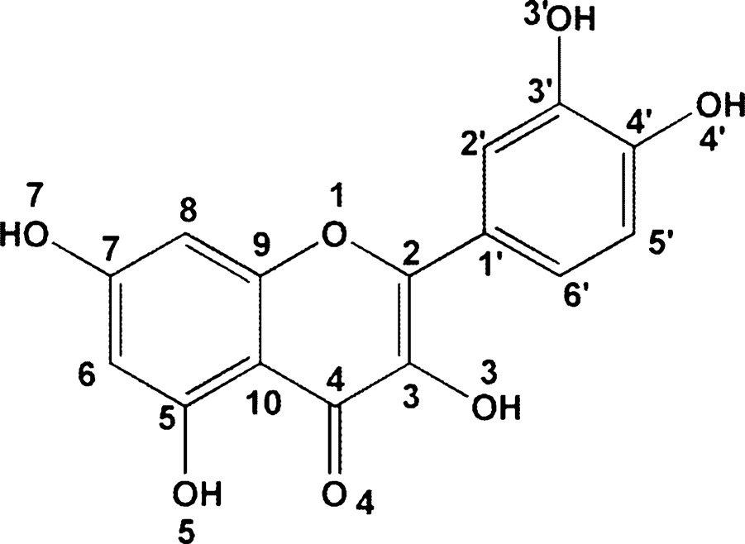
Solid State ¹³C NMR
NMR results showed that the chemical structure of quercetin was not changed after media milling.

Slide 8
Rheological Properties of Doughs after Proofing
All the doughs have solid-like properties; storage moduli were higher than loss
moduli over the angular frequency range studied
The addition of quercetin particles strengthened the storage modulus of the dough
Smaller quercetin particles had a larger effect in increasing the strength of dough

Slide 9
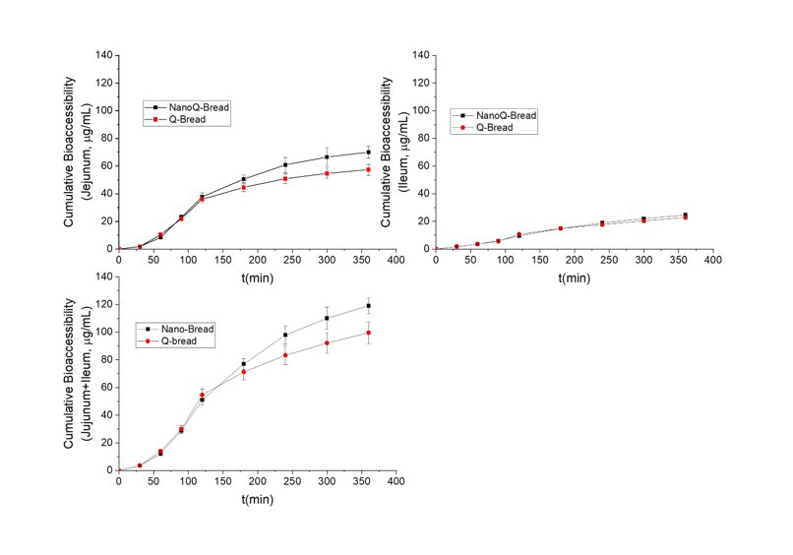
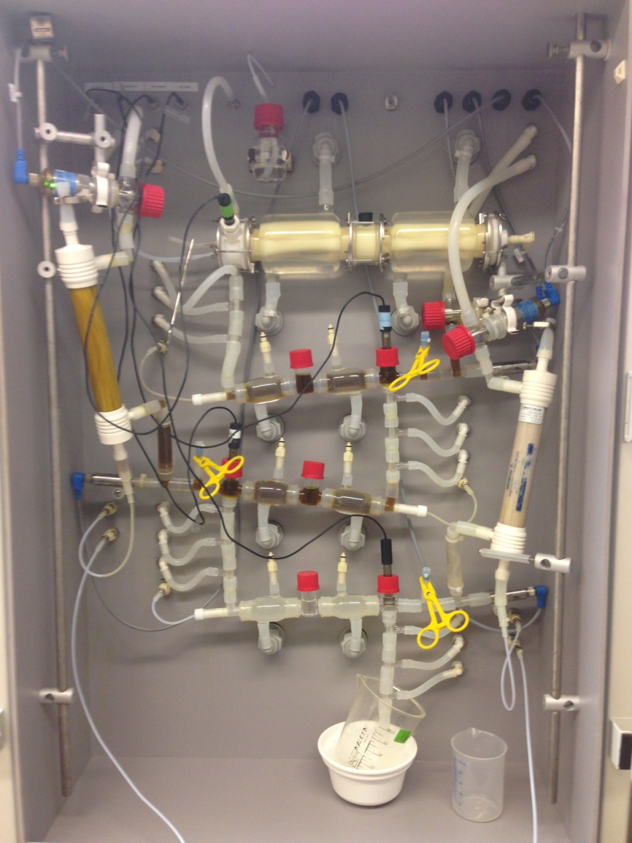
Dynamic in vitro Gastrointestinal Model (TIM-1) for the Bioaccessibility of Quercetin
The in vitro bioaccessibility of quercetin was higher for quercetin nanoparticles-fortified bread.

Slide 10
Conclusions
FE-SEM images showed that the particle sizes of quercetin were significantly reduced after 1 h media milling, but more homogeneous nanoparticles in the range of 100 nm-200 nm were achieved after 12 h milling time.
The XRD results indicated that media milling treatment mainly reduced the crystallite sizes and crystallinities of quercetin. However, the chemical structure of quercetin was not changed after media milling as evidenced by the solid state ¹³C NMR data.
The addition of quercetin particles strengthened the storage modulus of the dough and the texture of the baked bread.
The in vitro bioaccessibility of quercetin was improved by reducing the particle size to ~100 nm, as evidenced by the TIM-1 results.

Slide 11
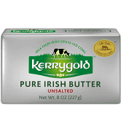
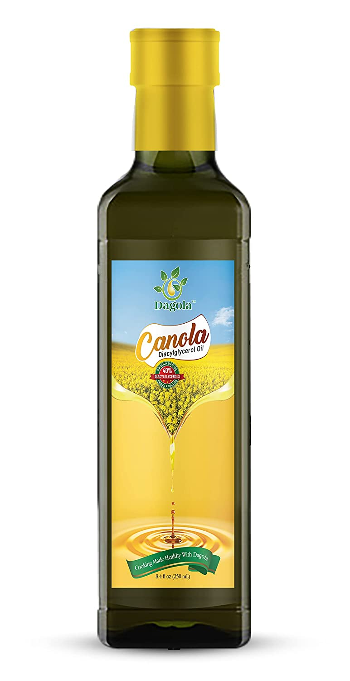
Diacylglycerols versus Triglycerides
Typically contains:
~ 80-82% triacylglycerols
~ 16-17% water
~ 1-2% milk solids other than fat
Negative effects: Butter fats are triglycerides (TAG) which can cause obesity,
hypertension, heart disease and type 2 diabetes.
Advantages of diacylglycerols (DAG) over TAG:
Fat molecules that contain two fatty chains in a glycerol molecule;
DAG have a lower calorie, better lipid metabolism which can reduce the risk of obesity and other metabolic diseases
DAD can improve glucose tolerance, thus reduce the risk of type 2 diabetes.
Canola (DAG) oil
(from Amazon)
Notes:
Structure of butterfat triglyceride containing myristic acid, palmitic acid and oleic acid.

Slide 12
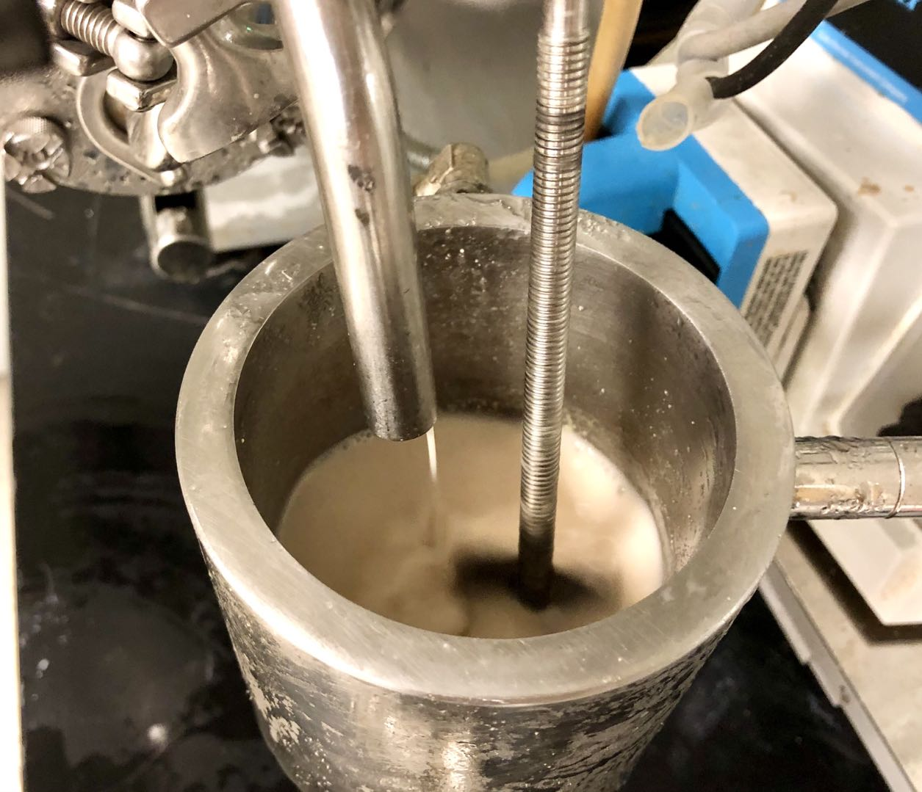
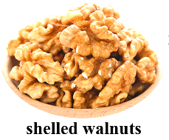

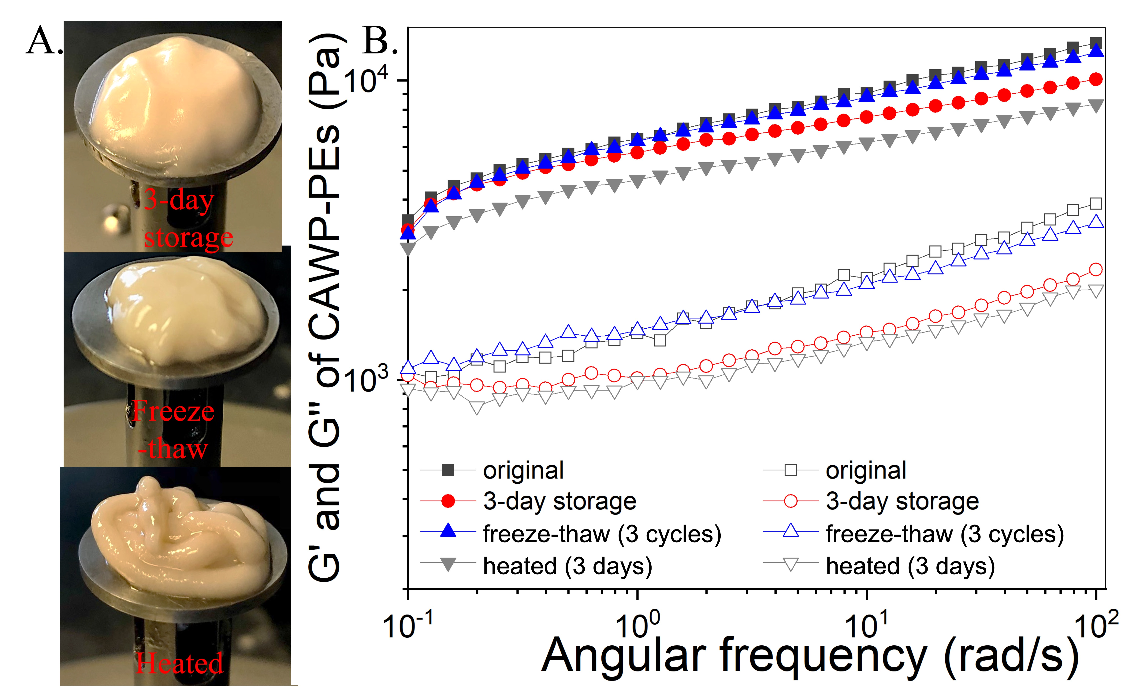
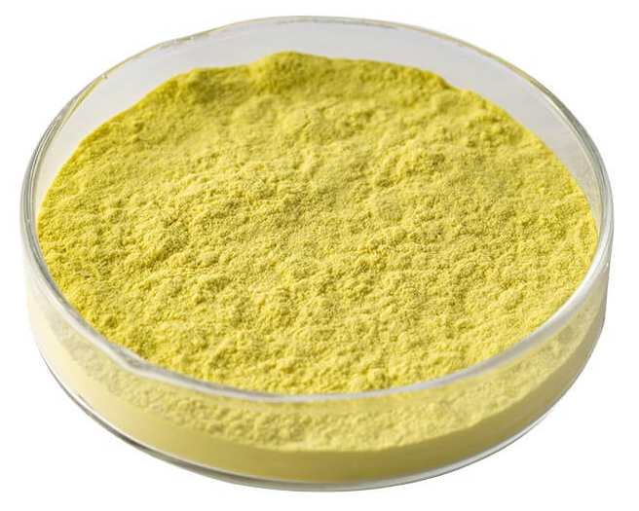
Healthy Functional Butter
(Ongoing Research)
Media milling with water
(Also interested in hazelnuts)
Homogenization at
12,000 rpm For 5 min
Canola Diacylglycerol oil
(purchased from Amazon)
Quercetin Dissolved in oil

