Slide 1
Burn the Worm: Advancing a New Model for Skin Injury and Infection
Davita Wrone
Princeton High School
Princeton, NJ

Slide 2
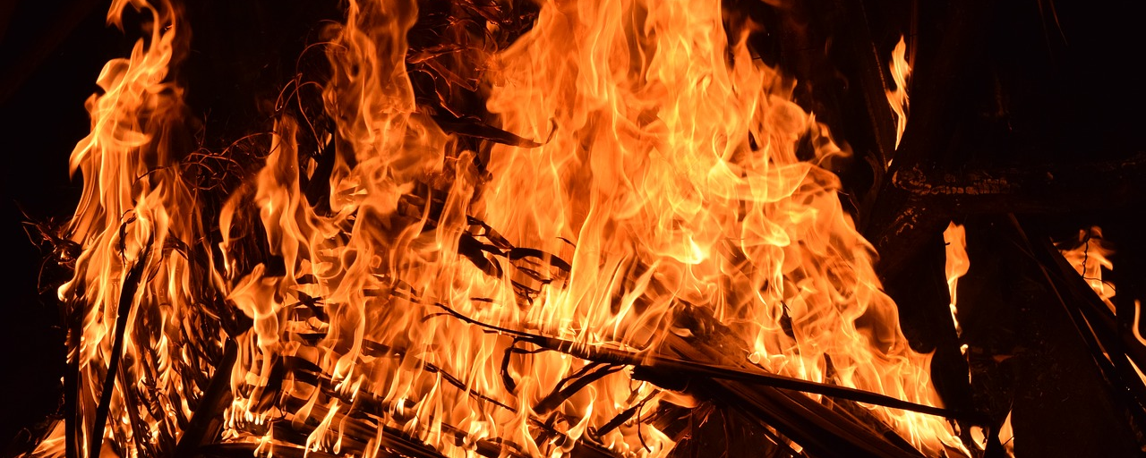
Burns are among the most catastrophic of all injuries.

Slide 3
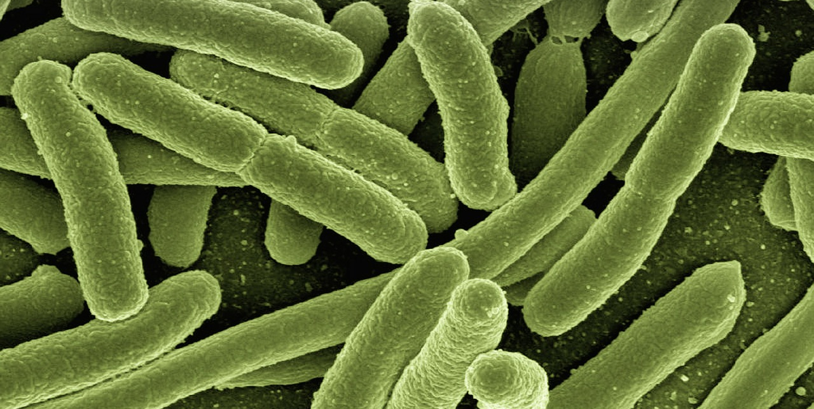
A primary complication is opportunistic infection.

Slide 4
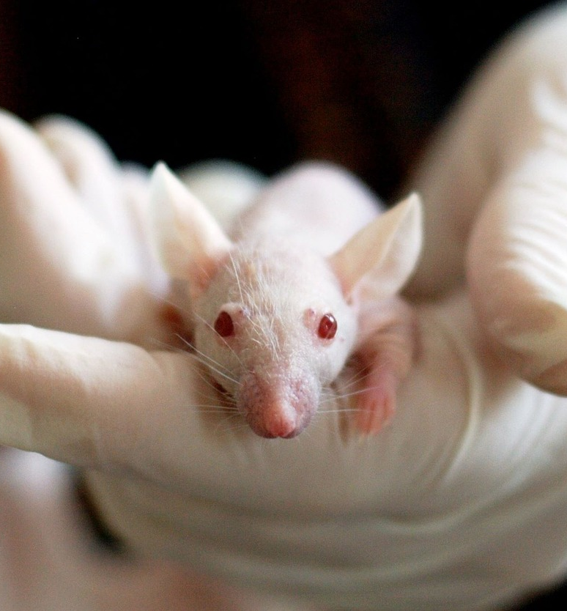
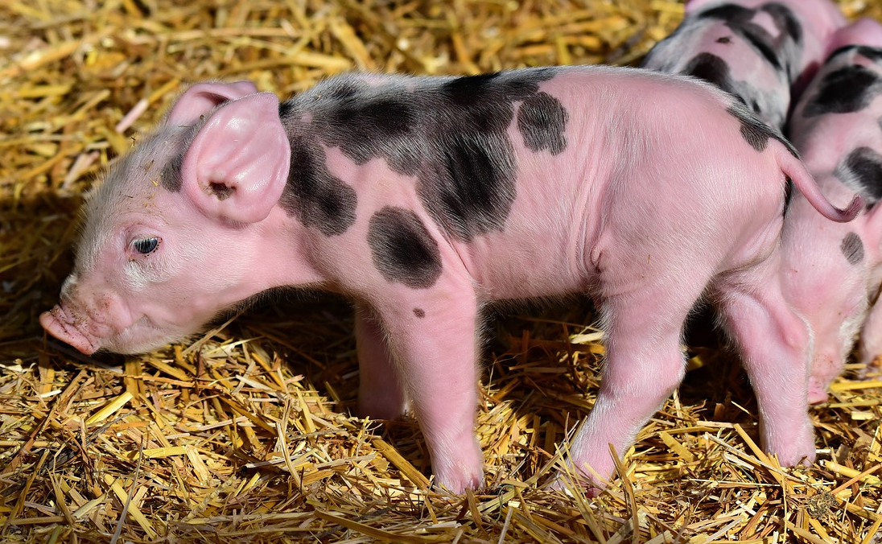
In vivo vertebrate models, while effective, bring issues.
Can feel pain
Need ethical review

Slide 5
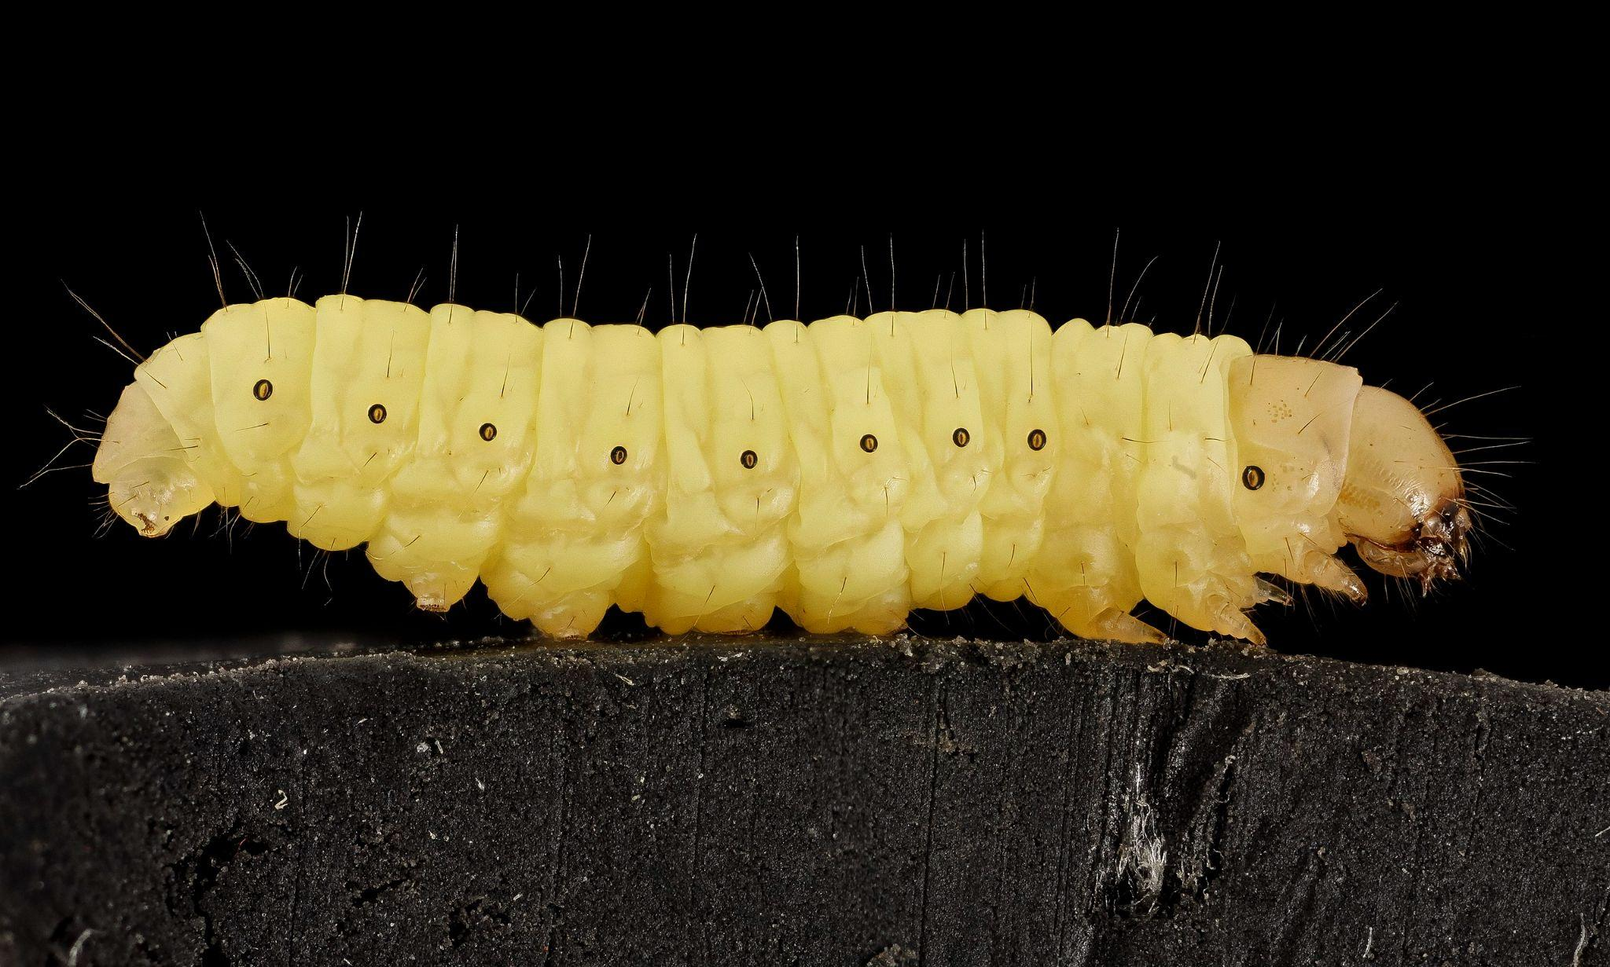
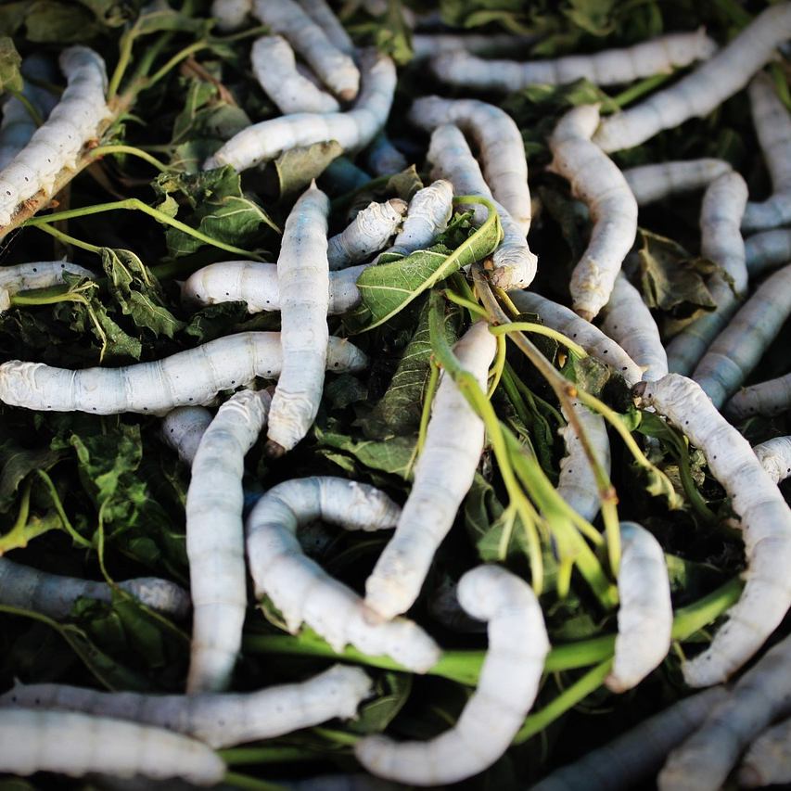
Current invertebrate models are also not ideal.
Small
Cannot survive at 37ºC

Slide 6
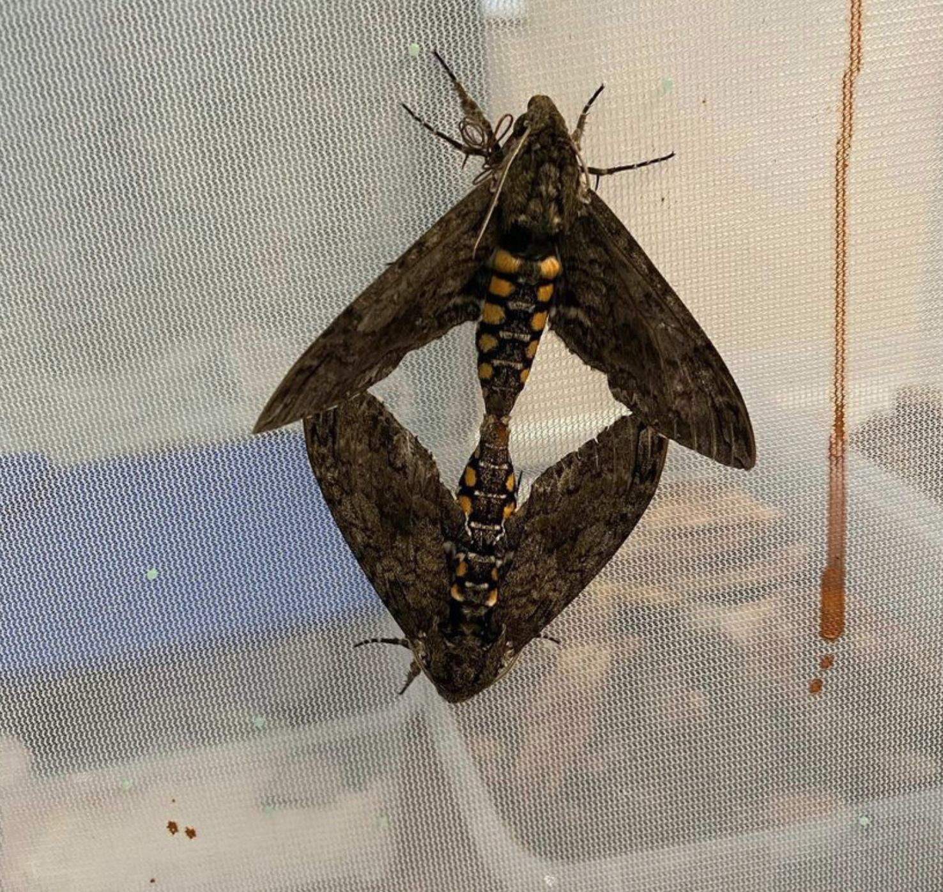
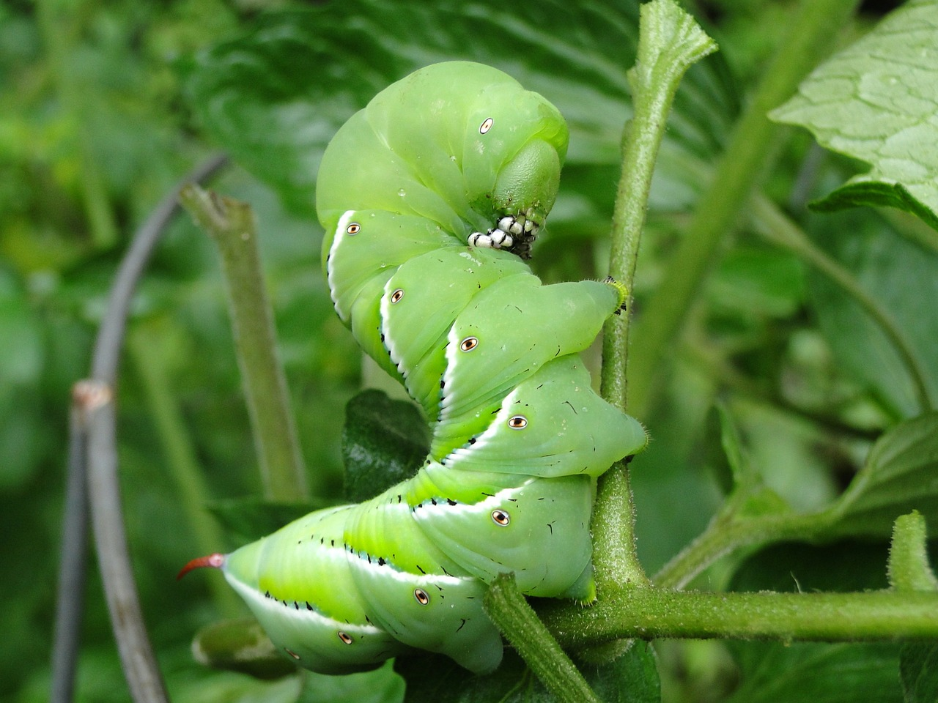
Manduca sexta, the tobacco hornworm
Easy to care for
Not too small
Can survive at 37ºC

Slide 7
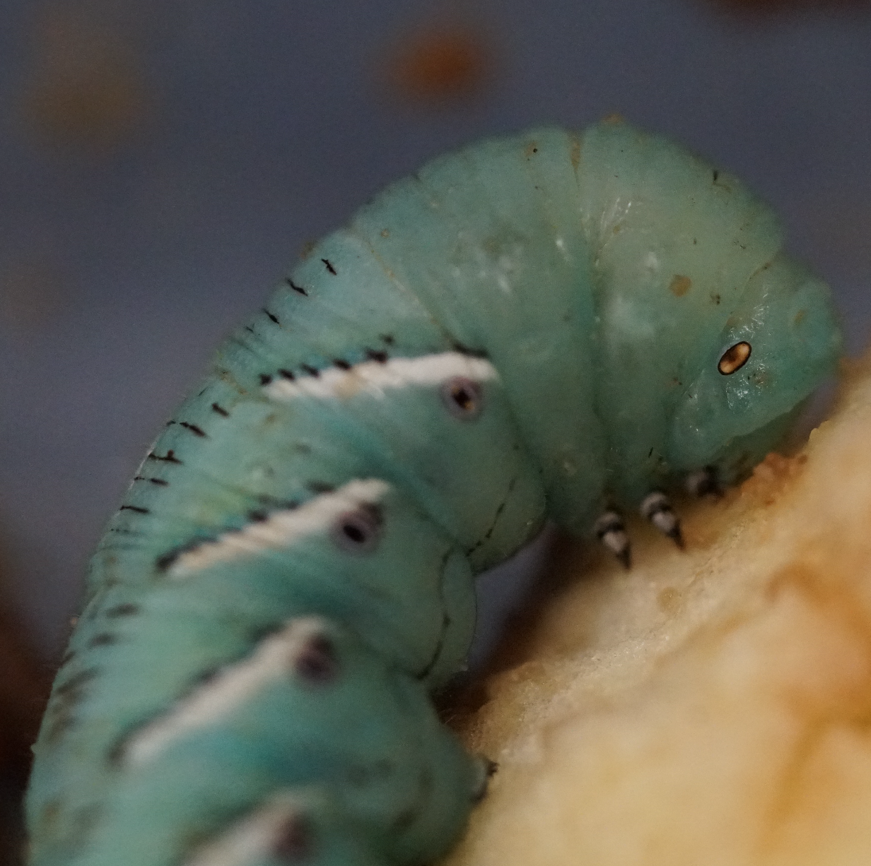
Hypothesis:
“If tobacco hornworms respond to burns in a manner that resembles heat injury and related infection in humans, then these larvae should demonstrate similar responses to burn injuries with over-the-counter skin ointments when compared to responses that are observed in humans.”

Slide 8
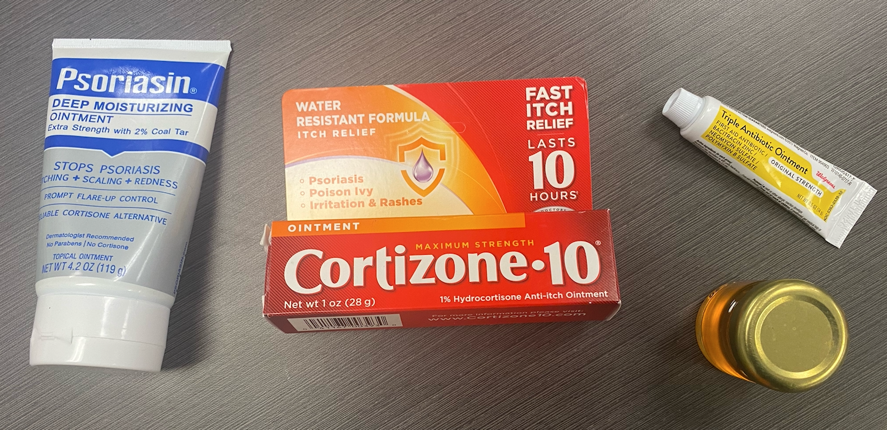
Over-the-counter skin treatments (plus honey).

Slide 9
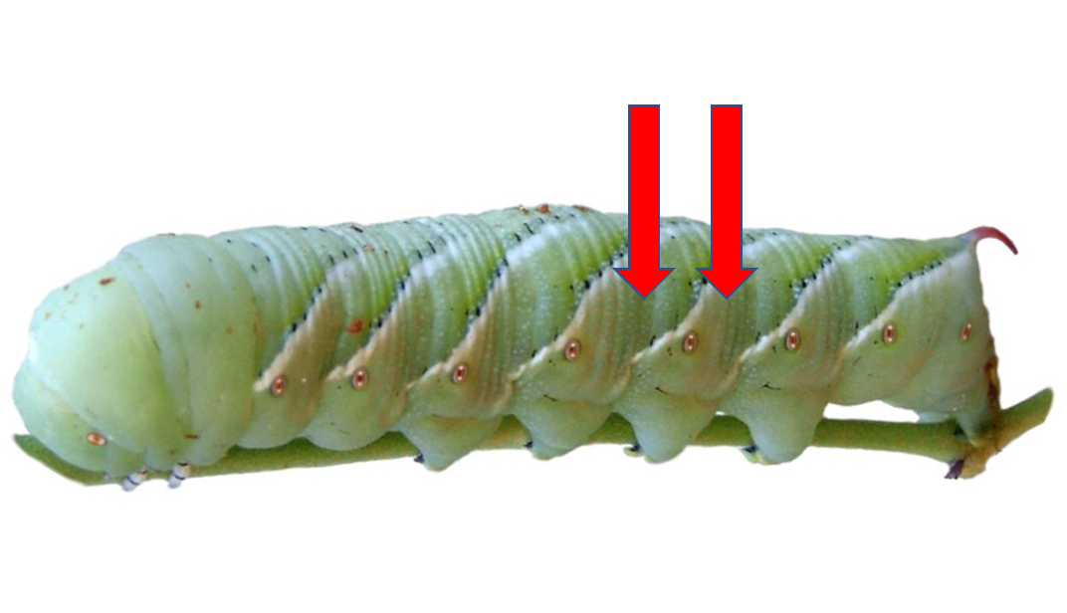
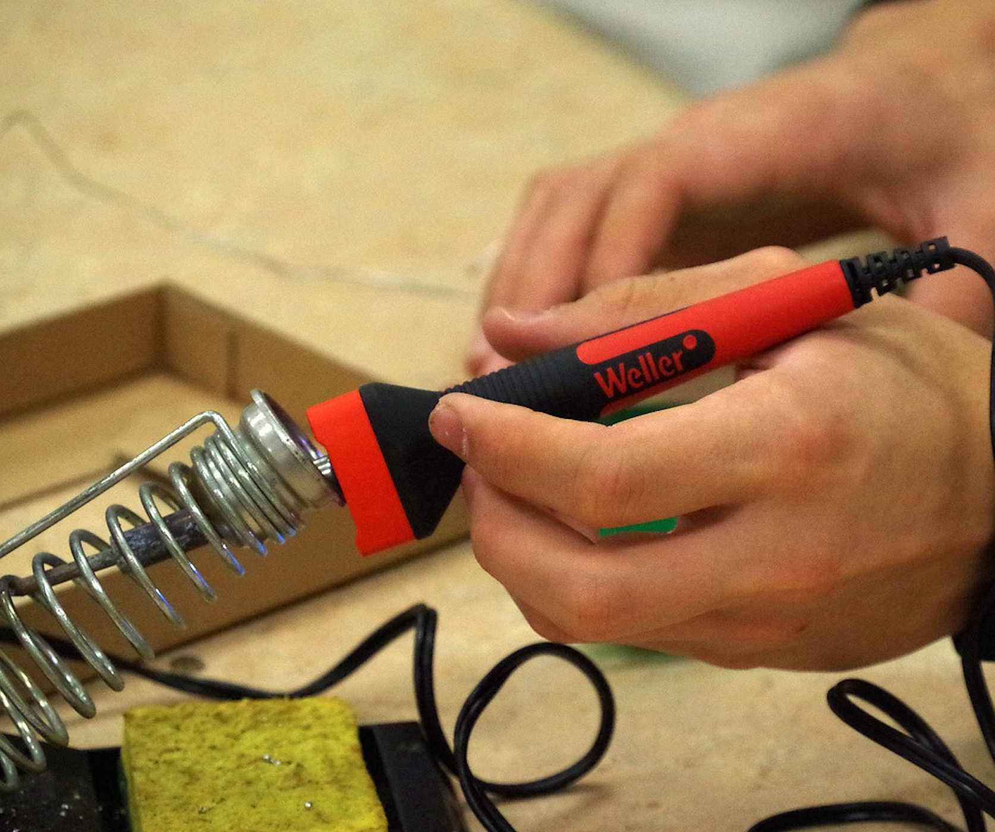
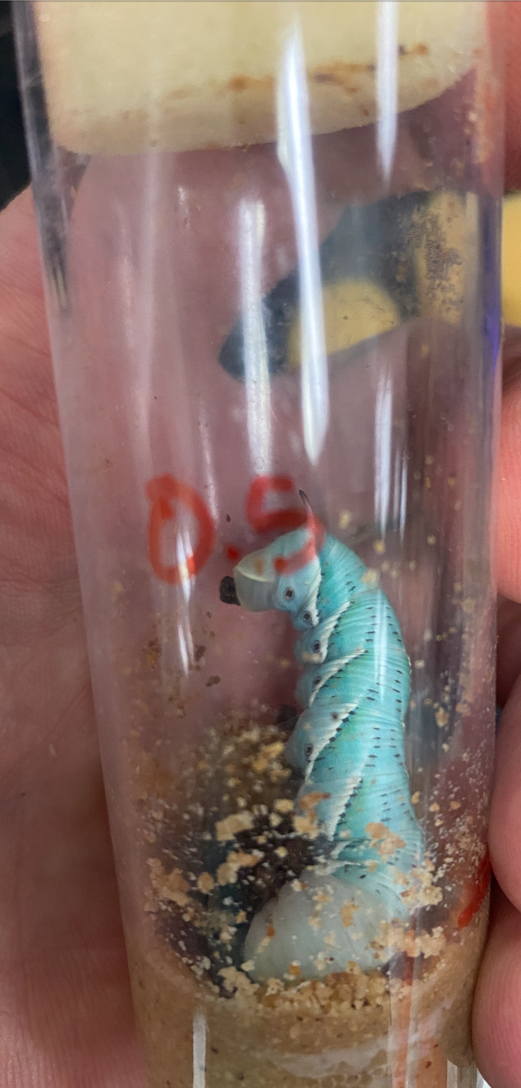
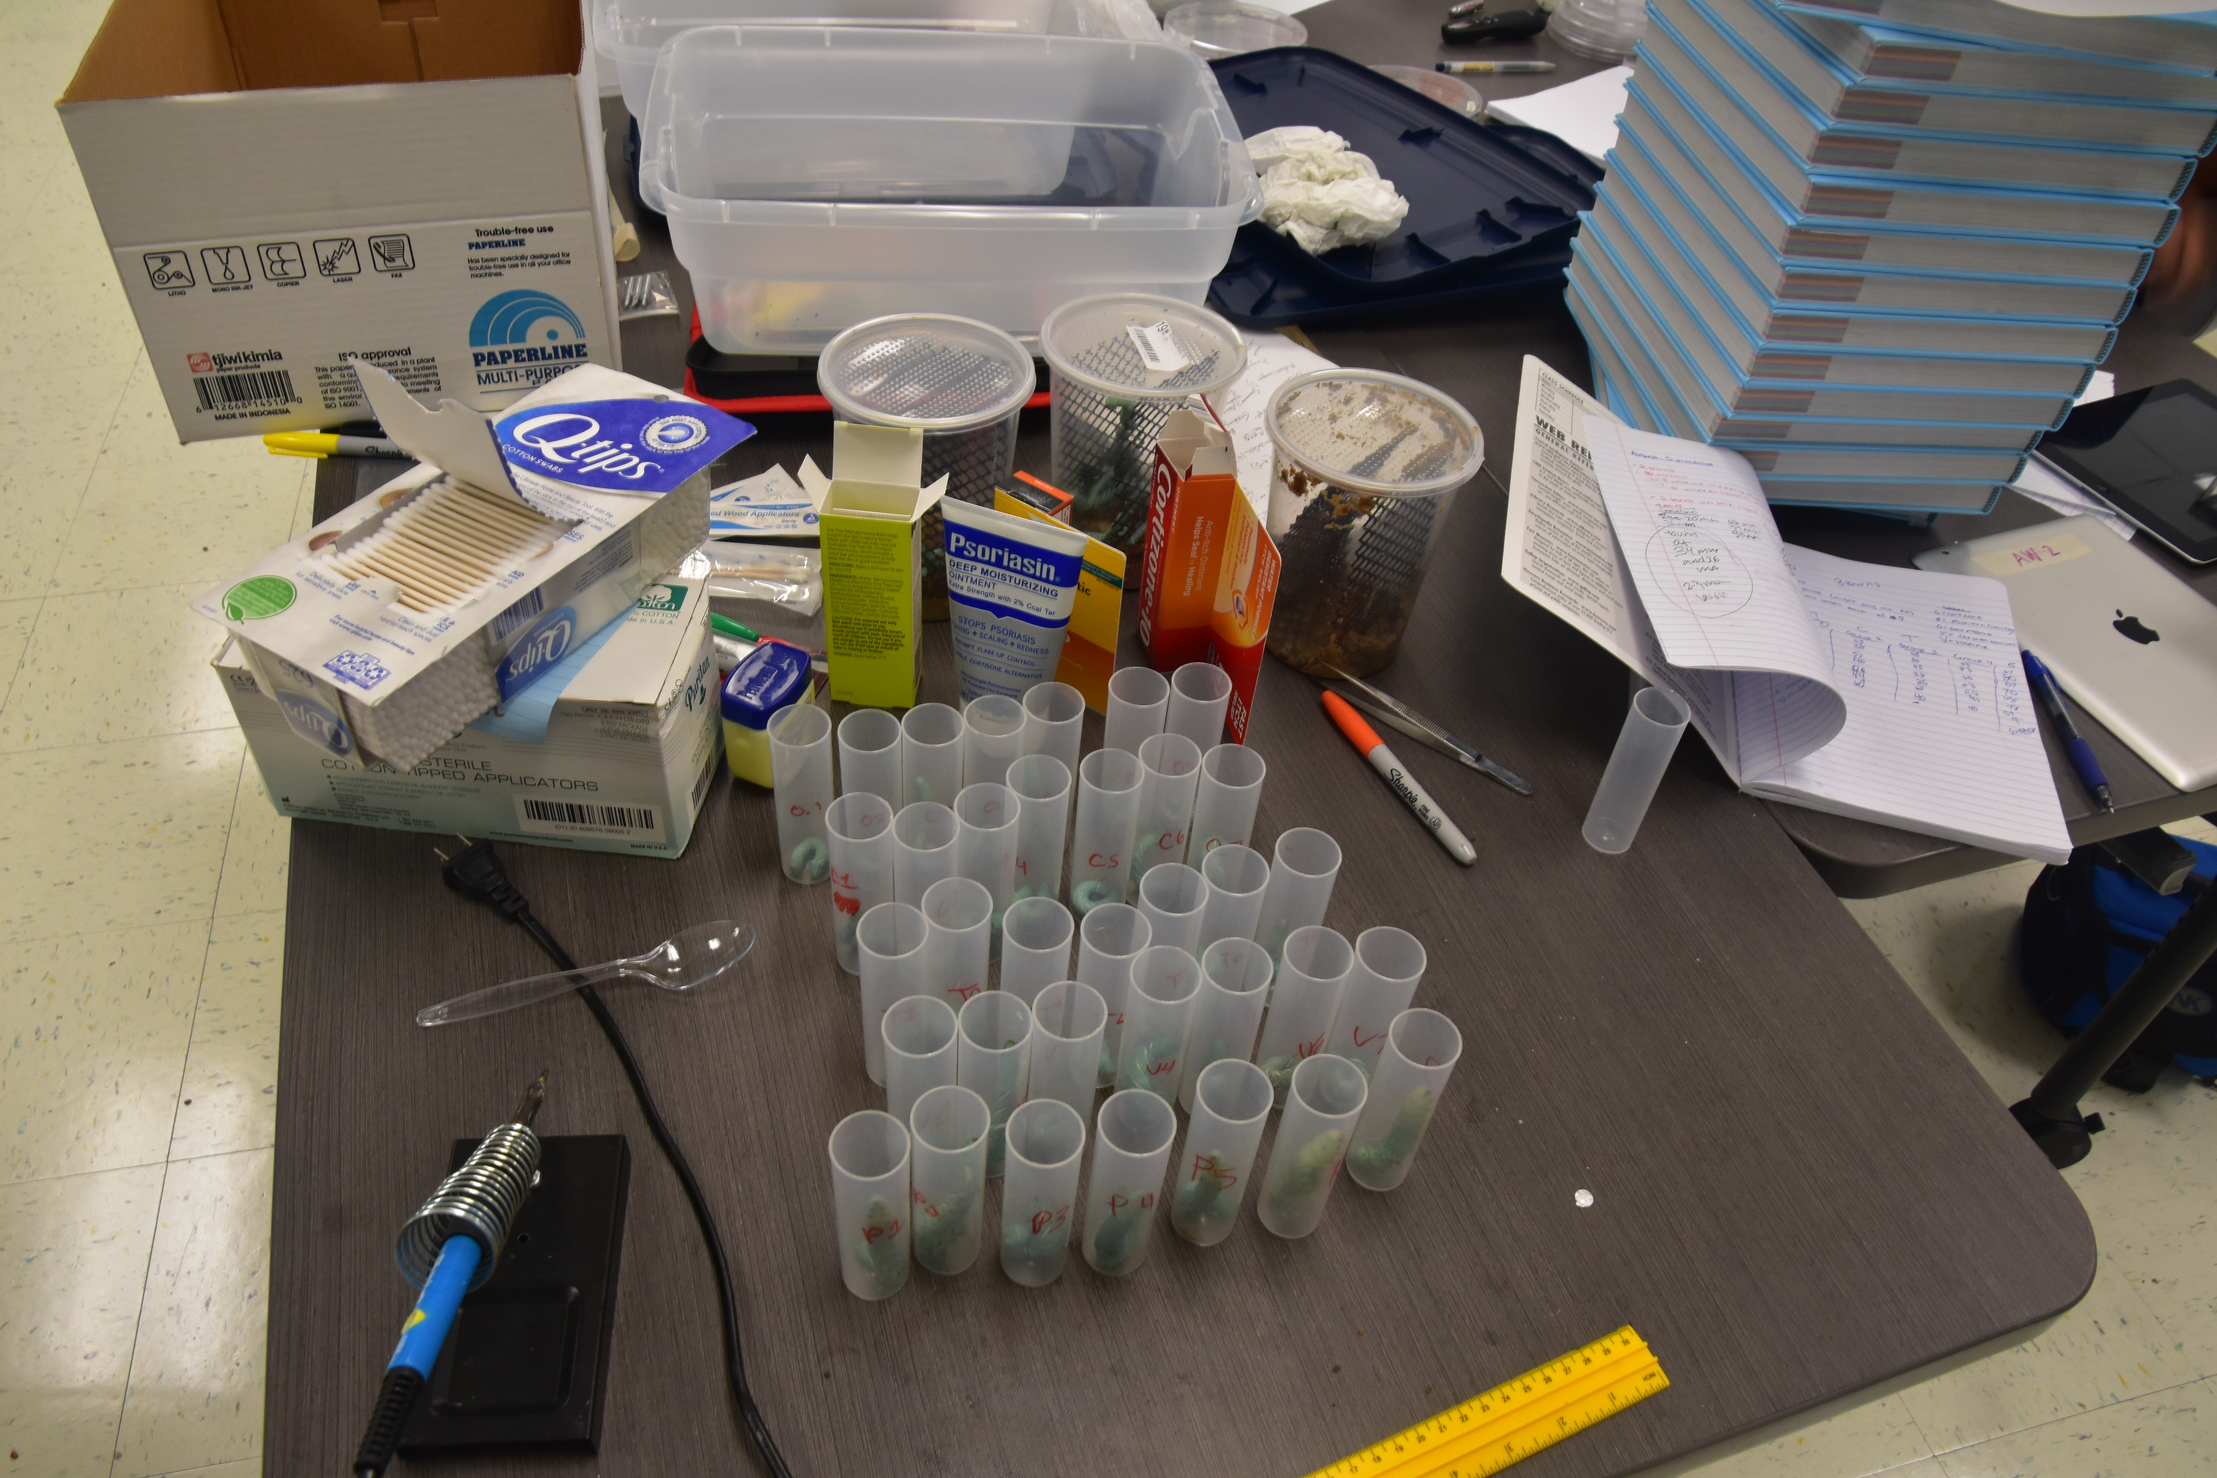
Procedure

Slide 10
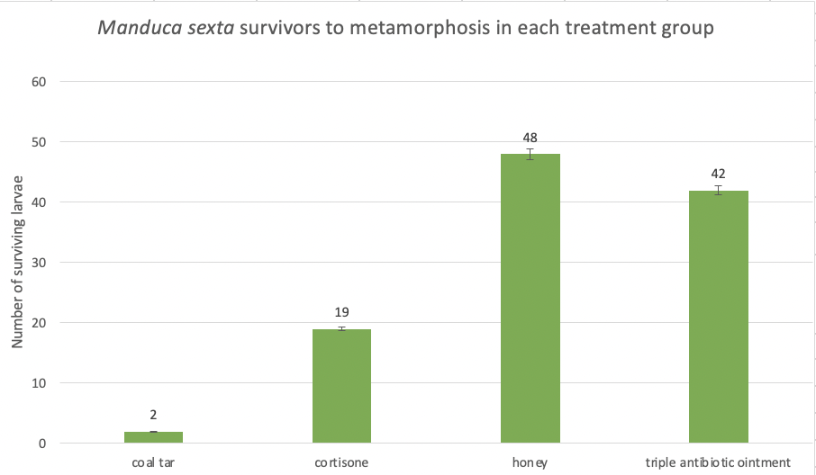
Results
Significant differences between the survival rates of:
treatment with coal tar vs. cortizone (p < 0.01)
cortizone vs. honey (p <0.01)
coal tar vs. triple-antibiotic ointment (p <0.01)
cortisone vs. triple antibiotic ointment (p <0.01)
No significant difference survival rates of:
honey vs. triple-antibiotic ointment (p = 0.2486).

Slide 11
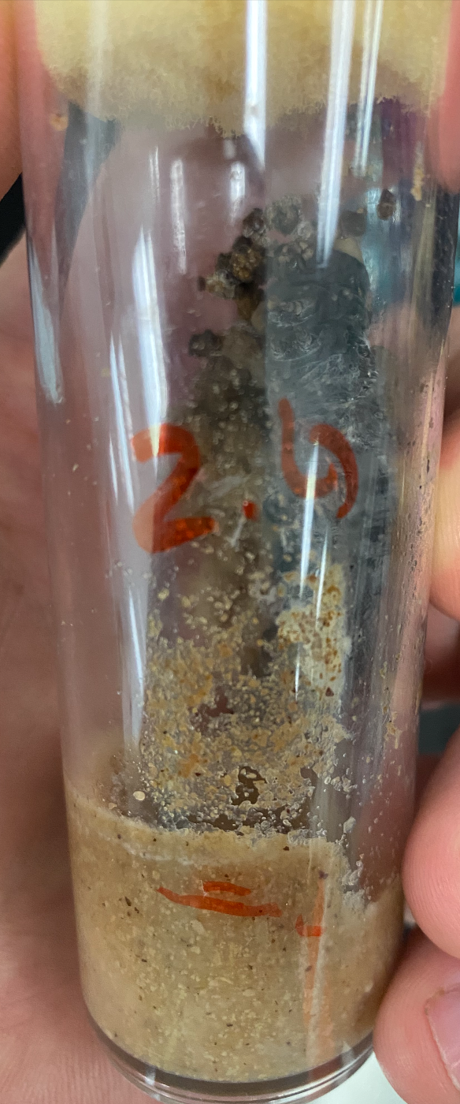
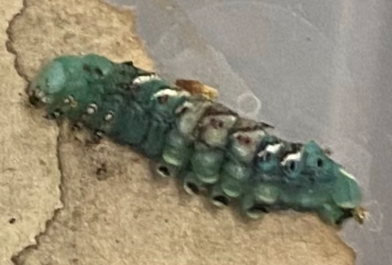
Discussion
No carcinogenic/mutagenic effects of topical coal tar application
Both coal tar and cortisone may have immunosuppressive effects
Honey needs further investigation as a preventative of skin infection
Original hypothesis was supported

Slide 12
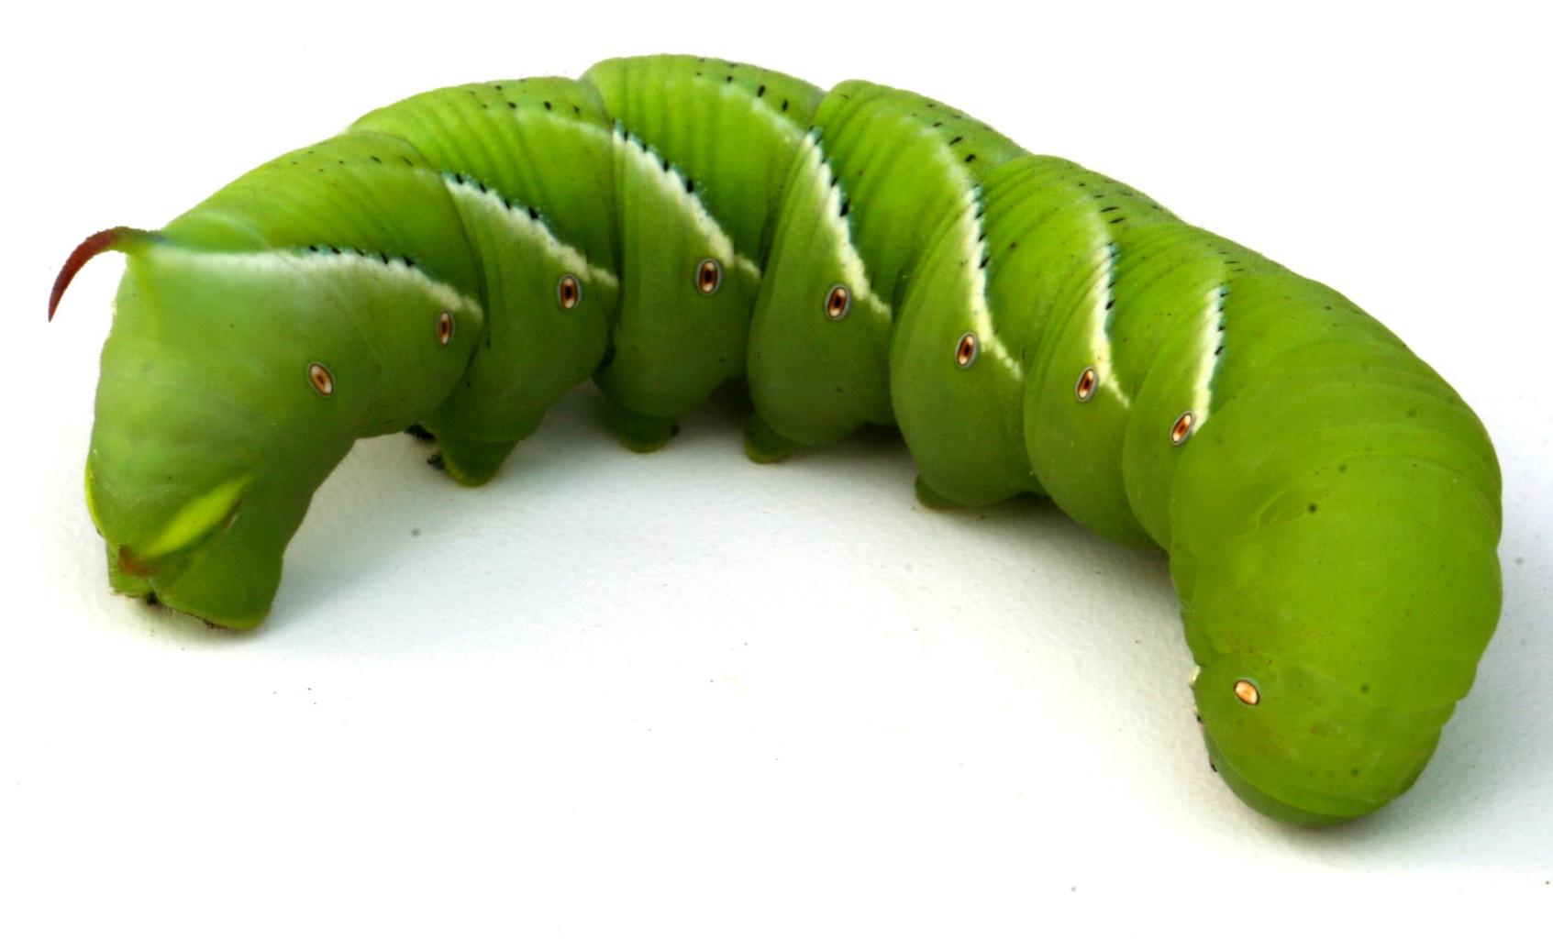
Conclusions
Manduca sexta larvae can respond to burn treatments as would be expected in vertebrate vertebrate models.
Advantages over current invertebrate
models that have been proposed.
May also be a good candidate for
immunological research; presents
advantages for posing fewer ethical
constraints.

Slide 13
References
Abdelli, N., Peng, L., & Keping, C. (2018). Silkworm, Bombyx mori, as an alternative model organism in toxicological research. Environmental Science and Pollution Research International, 25(35), 35048–35054. https://doi.org/10.1007/s11356-018-3442-8
Barnes P. J. (2006). How corticosteroids control inflammation: Quintiles Prize Lecture 2005. British Journal of Pharmacology, 148(3), 245–254. https://doi.org/10.1038/sj.bjp.0706736
Bloemsma, G. C., Dokter, J., Boxma, H., & Oen, I. M. (2008). Mortality and causes of death in a burn centre. Burns : Journal of the International Society for Burn Injuries, 34(8), 1103–1107. https://doi.org/10.1016/j.burns.2008.02.010
Borská, L., Fiala, Z., Smejkalová, J., Hamáková, K., & Kremlácek, J. (2004). Possible genotoxic risk of combined exposure to pharmaceutical coal tar and UV-B radiation. Central European Journal of Public Health, 12 Suppl, S14–S15.
Burrell B. D. (2017). Comparative biology of pain: What invertebrates can tell us about how nociception works. Journal of Neurophysiology, 117(4), 1461–1473. https://doi.org/10.1152/jn.00600.2016

Slide 14
References (continued)
Caron, D. P., Rimniceanu, M., Scibelli, A. E., & Trimmer, B. A. (2020). Nociceptive neurons respond to multimodal stimuli in Manduca sexta. The Journal of Experimental Biology, 223(Pt 3), jeb218859. https://doi.org/10.1242/jeb.218859
Hamamoto, H., Urai, M., Paudel, A., Horie, R., Murakami, K., & Sekimizu, K. (2012). Yakugaku Zasshi : Journal of the Pharmaceutical Society of Japan, 132(1), 79–84. https://doi.org/10.1248/yakushi.132.79
Hillyer J. F. (2016). Insect immunology and hematopoiesis. Developmental and Comparative Immunology, 58, 102–118. https://doi.org/10.1016/j.dci.2015.12.006
Kanost, M. R., & Blissard, G. W. (2015). Biological insights from the Manduca sexta genome. Preface. Insect Biochemistry and Molecular Biology, 62, 1. https://doi.org/10.1016/j.ibmb.2015.05.008
Kawamoto, M., Jouraku, A., Toyoda, A., Yokoi, K., Minakuchi, Y., Katsuma, S., Fujiyama, A., Kiuchi, T., Yamamoto, K., & Shimada, T. (2019). High-quality genome assembly of the silkworm, Bombyx mori. Insect biochemistry and molecular biology, 107, 53–62. https://doi.org/10.1016/j.ibmb.2019.02.002

Slide 15
References (continued)
Kunugi, H., & Mohammed Ali, A. (2019). Royal jelly and its components promote healthy aging and longevity: from animal models to humans. International Journal of Molecular Sciences, 20(19), 4662. https://doi.org/10.3390/ijms20194662
Li, G., Xia, X., Zhao, S., Shi, M., Liu, F., & Zhu, Y. (2020). The physiological and toxicological effects of antibiotics on an interspecies insect model. Chemosphere, 248, 126019. https://doi.org/10.1016/j.chemosphere.2020.126019
Lü, P., Pan, Y., Yang, Y., Zhu, F., Li, C., Guo, Z., Yao, Q., & Chen, K. (2018). Discovery of antiviral molecules and their vital functions in Bombyx mori. Journal of invertebrate pathology, 154, 12–18. https://doi.org/10.1016/j.jip.2018.02.012
Lyons, N., Softley, I., Balfour, A., Williamson, C., O'Brien, H. E., Shetty, A. C., Bruno, V. M., & Diezmann, S. (2020). Tobacco hornworm (Manduca sexta) caterpillars as a novel host model for the study of fungal virulence and drug efficacy. Virulence, 11(1), 1075–1089. https://doi.org/10.1080/21505594.2020.1806665
Mandal, M. D., & Mandal, S. (2011). Honey: its medicinal property and antibacterial activity. Asian Pacific Journal of Tropical Biomedicine, 1(2), 154–160. https://doi.org/10.1016/S2221-1691(11)60016-6

Slide 16
References (continued)
Maslova, E., Shi, Y., Sjöberg, F., Azevedo, H. S., Wareham, D. W., & McCarthy, R. R. (2020). An invertebrate burn wound model that recapitulates the hallmarks of burn trauma and infection seen in mammalian models. Frontiers in Microbiology, 11, 998. https://doi.org/10.3389/fmicb.2020.00998
Meng, X., Zhu, F., & Chen, K. (2017). Silkworm: a promising model organism in life science. Journal of Insect Science (Online), 17(5), 97. https://doi.org/10.1093/jisesa/iex064
Merchant, N., Smith, K., & Jeschke, M. G. (2015). An ounce of prevention saves tons of lives: infection in burns. Surgical Infections, 16(4), 380–387. https://doi.org/10.1089/sur.2013.135
Roelofzen, J. H., Aben, K. K., Oldenhof, U. T., Coenraads, P. J., Alkemade, H. A., van de Kerkhof, P. C., van der Valk, P. G., & Kiemeney, L. A. (2010). No increased risk of cancer after coal tar treatment in patients with psoriasis or eczema. The Journal of Investigative Dermatology, 130(4), 953–961.
Rowan, M. P., Cancio, L. C., Elster, E. A., Burmeister, D. M., Rose, L. F., Natesan, S., Chan, R. K., Christy, R. J., & Chung, K. K. (2015). Burn wound healing and treatment: review and advancements. Critical Care (London, England), 19, 243. https://doi.org/10.1186/s13054-015-0961-2

Slide 17
References (continued)
Teramoto, H., Amano, Y., Iraha, F., Kojima, K., Ito, T., & Sakamoto, K. (2018). Genetic code expansion of the silkworm Bombyx mori to functionalize silk fiber. ACS Synthetic Biology, 7(3), 801–806. https://doi.org/10.1021/acssynbio.7b00437
Xu H. (2014). The advances and perspectives of recombinant protein production in the silk gland of silkworm Bombyx mori. Transgenic Research, 23(5), 697–706. https://doi.org/10.1007/s11248-014-9826-8
Zabelina, V., Klymenko, V., Tamura, T., Doroshenko, K., Liang, H., Sezutsu, H., & Sehnal, F. (2015). Genome engineering and parthenocloning in the silkworm, Bombyx mori. Journal of Biosciences, 40(3), 645–655. https://doi.org/10.1007/s12038-015-9548-y
Zavlin, D., Chegireddy, V., Boukovalas, S., Nia, A. M., Branski, L. K., Friedman, J. D., & Echo, A. (2018). Multi-institutional analysis of independent predictors for burn mortality in the United States. Burns & Trauma, 6, 24. https://doi.org/10.1186/s41038-018-0127-y
Zhou, Z., Yang, H., & Zhong, B. (2008). From genome to proteome: great progress in the domesticated silkworm (Bombyx mori L.). Acta Biochimica et Biophysica Sinica, 40(7), 601–611. https://doi.org/10.1111/j.1745-7270.2008.00432.x

