Slide 1
Scrubs with bugs: cleaning, disinfecting, and foaming properties of soaps made with sustainable oils
Daniela González
Princeton High School

Slide 2
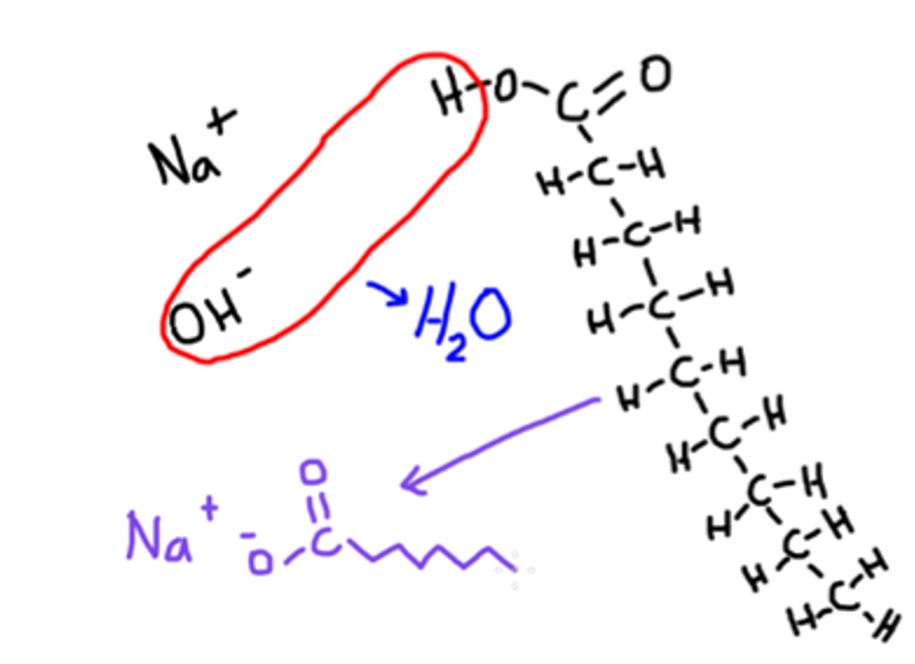
Soap is made through the process of saponification.
Chemical reaction of a fatty acid (or mixture of fatty acids) with a strong base such as sodium hydroxide or potassium hydroxide
Practiced in civilizations that date back at least 5,000 years ago, including Egypt and the Roman Empire (Gibbs, 1939)
Saturated fats (solids at room temperature) may be mixed with unsaturated fats (liquids) at room temperature to make soaps with varying characteristics
Forms molecules with a hydrophilic carboxylate end (COO⁻) and a nonpolar, hydrocarbon tail

Slide 3
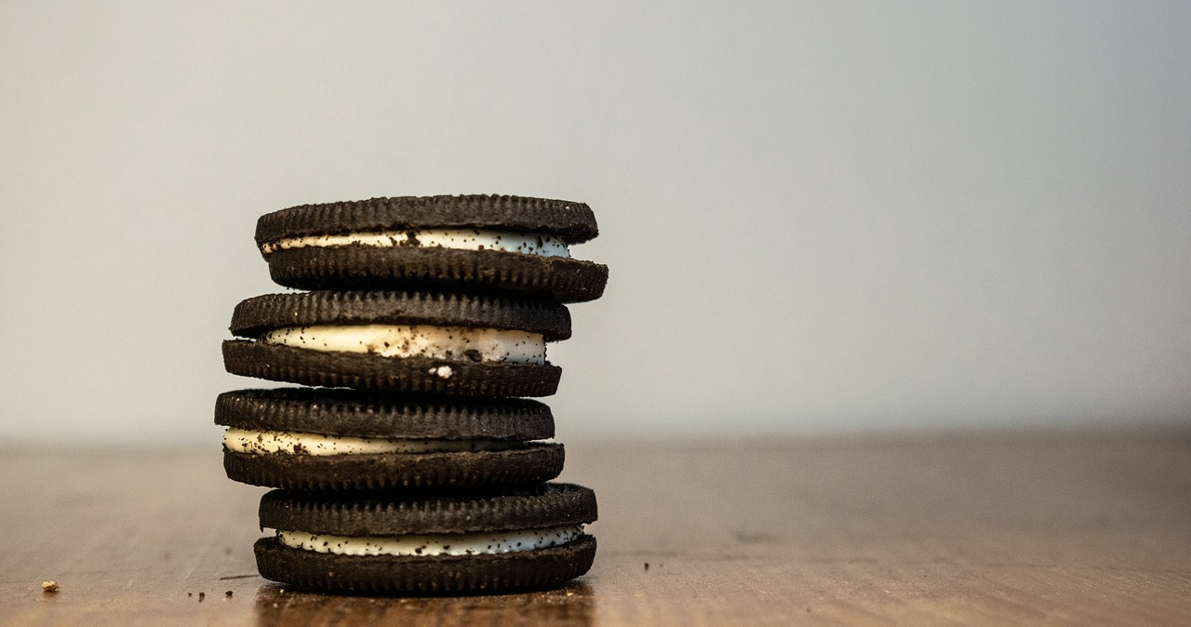
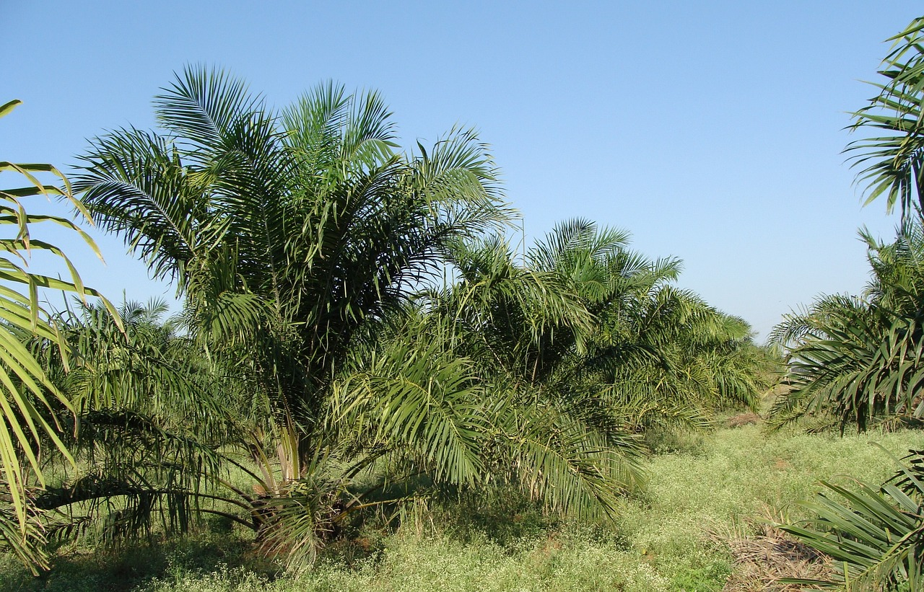
Palm oil is an ingredient that is found in many products.
Native to West Africa
High-yield source of lipids with favorable characteristics for foods and cosmetics (Murphy et al., 2021).
Cultivation of oil palms occurs on plantations that have extended across southeast Asia and Latin America (Paterson & Lima, 2017)
Habitat destruction and associated climate change (Jimeno et al., 2019)
Even “sustainable” palm oil is controversial (Cazzolla Gati et al., 2019; Ramli et al., 2020)

Slide 4
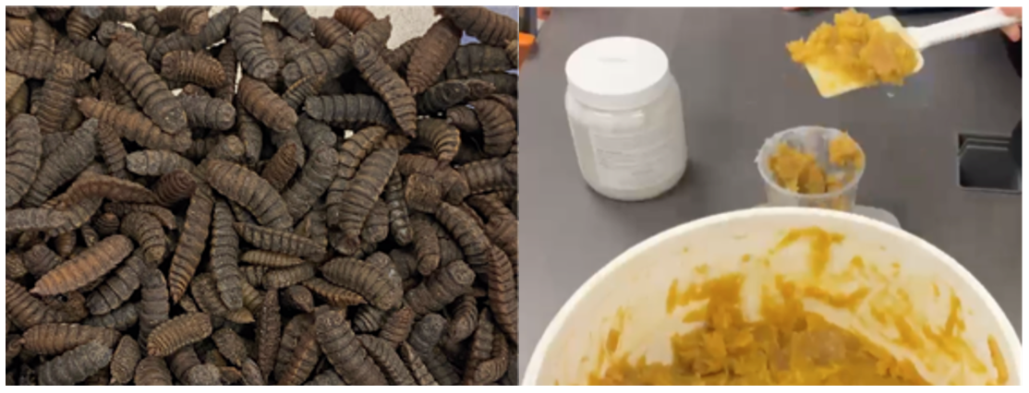
Other oils with similar lipid profiles may be more sustainable.
Coconut oil is produced by small farmers on plots where other plant species may grow, preserving local biodiversity (Rochmyaningsih, 2020)
Coconut plantations yield up to 3,000 kg of oil per hectare (Jagdish, 2019); oil palms can yield 4,000 kg per hectare (Murphy et al., 2021)
Oil extracted from black soldier fly larvae (BSFL) have similar properties to both palm oil and coconut oil (Tzompa-Sosa et al., 2021)
BSFL can be raised on food waste, a potential source of greenhouse gases
BSFL are 29% oil (Kim et el., 2020)

Slide 5
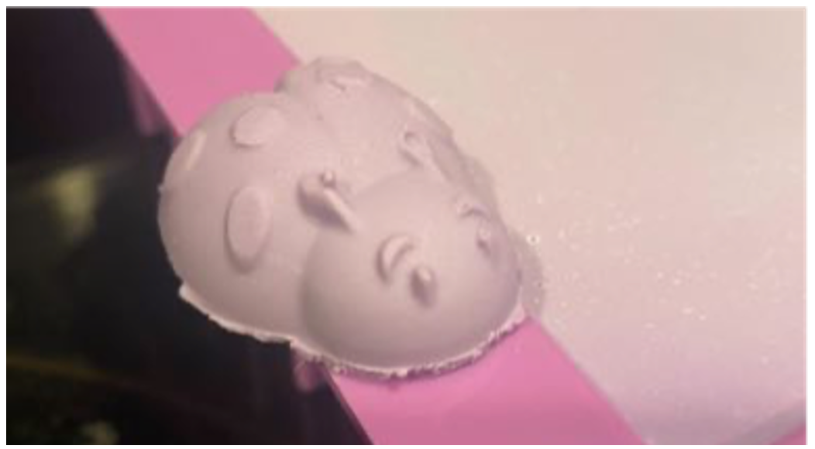
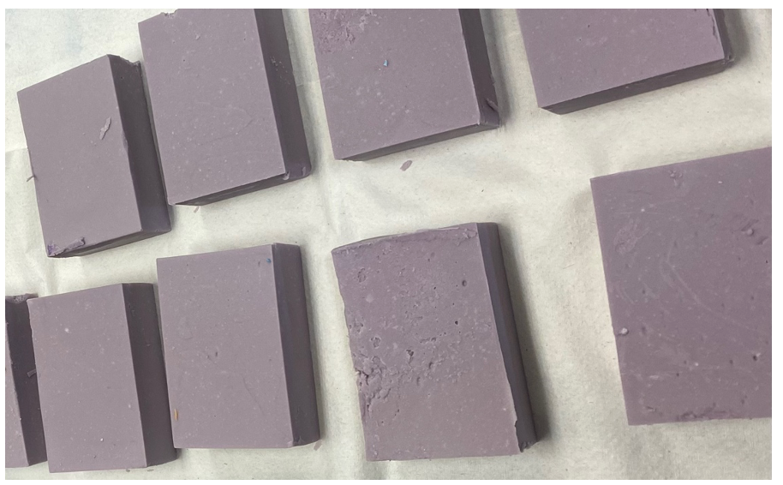
Could oil made from BSFL make new consumer products?
Making soap from BSFL oil will reduce dependence on palm oil and prevent food waste from heading for landfills
Many ”do it yourself” soapmaking kits use palm oil as the solid fat component
Hypothesis: Due to the similar lipid profiles shared by palm, coconut, and BSFL oils, any one of these can form the solid fat component of an effective soap
Prediction: Using an identical recipe, soap made from BSFL oil will be just as effective at cleaning grease and bacteria as soap made from palm oil

Slide 6
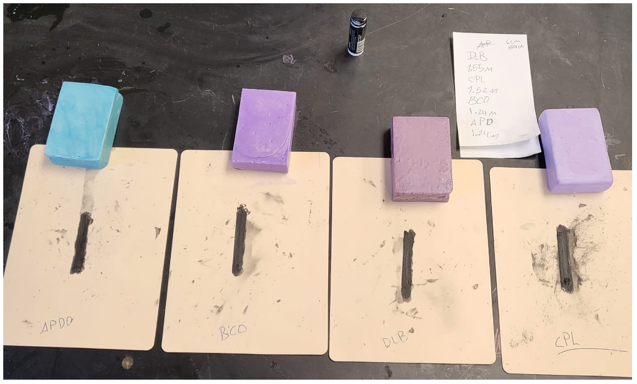
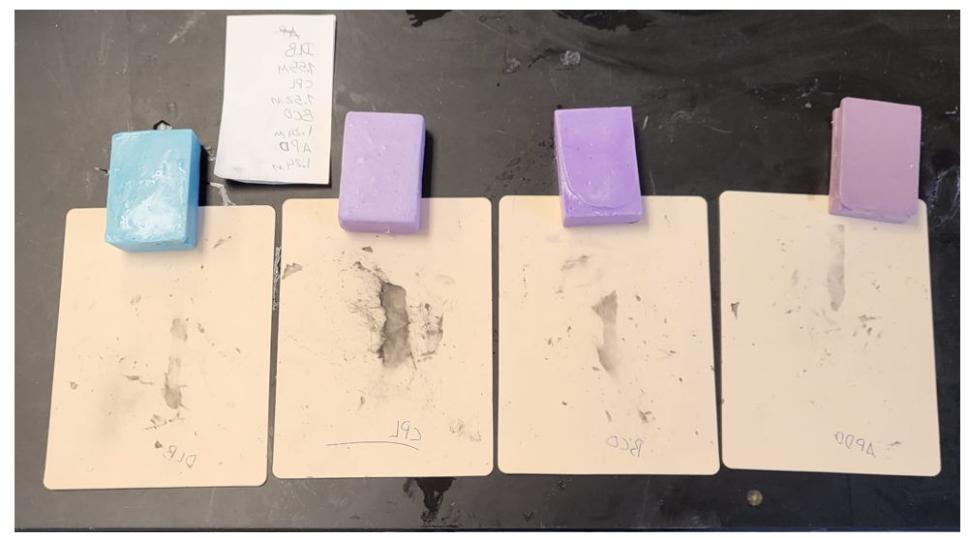
Experiment #1: The ability of soaps to remove grease
Using nontoxic black eye grease, a 5.0 cm x 0.5 cm line was drawn on artificial silicone skin
Each surface was washed in a standardized fashion until no more grease could be removed
Solid oil in each soap recipe was the independent variable, and time (measured in seconds) needed to clean was the dependent variable
Each soap recipe included sunflower oil as the liquid component, beeswax, violet fragrance, and purple mica powder for coloring
One additional soap recipe (colored blue) was included, because of its properties at effectively disinfecting and cleaning grease

Slide 7
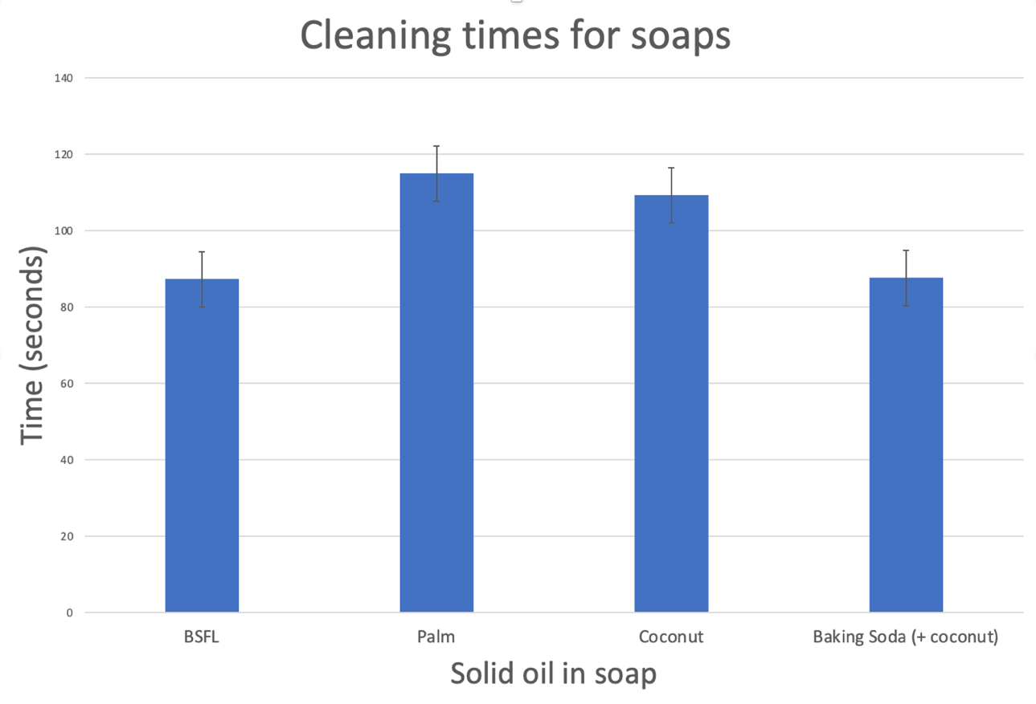
Cleaning times required for different soap recipes
Fig. 1: Comparison of the cleaning times for soaps derived from oil of the black soldier fly larva (BSFL) plus beeswax and sunflower oil (left), palm oil plus beeswax and sunflower oil (second from left), coconut oil plus beeswax and sunflower oil (second from right) and coconut oil plus baking soda and sunflower oil (right). The cleaning times for baking soda and BSFL soaps were statistically shorter than palm oil and coconut oil with beeswax.

Slide 8
Experiment #2: The ability of soaps to remove bacteria
Using E. coli K-12 (Carolina Biological), a 1.0 cm x 1.0 cm rectangle of silicone skin was inoculated with a human-safe bacterial culture
Positive controls: no washing, washing with water
Negative control: washing with 10% bleach solution
Each of the four soaps were lathered and used to wash skin for 30 seconds in water at 24.1ºC.
Swabs were taken after each of these skins were washed, and remaining bacteria were plated
Independent variable: solid oil used in soap, dependent variable: number of bacterial colonies

Slide 9
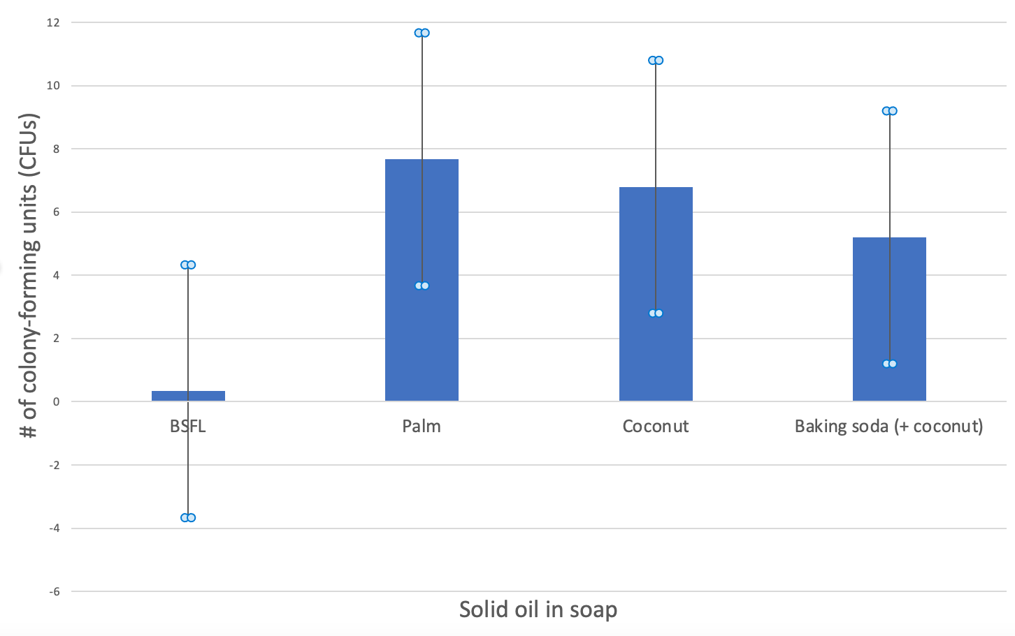
Average number of colony-forming units (CFUs) after washing
Fig. 2: Comparison of bactericidal properties of tested soaps. While it may appear that soap made from BSFL oil is more effective at killing E. coli bacteria than the other varieties, the results were not significant as can be seen by the large error bars due to a great deal of CFU variation on plates.

Slide 10
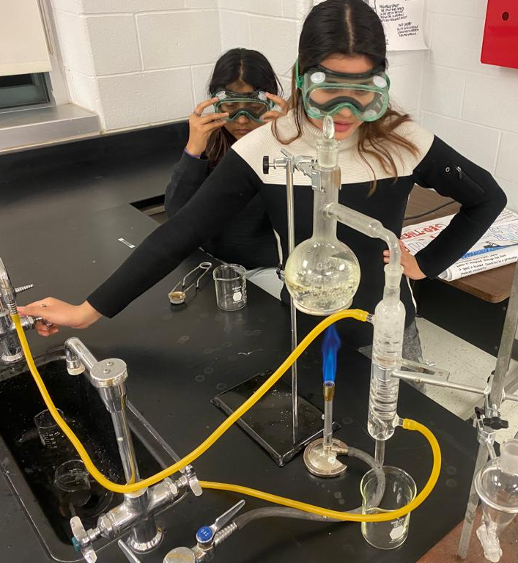
Discussion
Soaps made from BSFL oil can perform at least equally to soaps based on palm oil on the measurement of bacteria removal
Soaps made from BSFL oil may have additional antimicrobial properties due to the presence of antibiotic compounds (Zhang et al., 2022)
Soaps made from BSFL oil are able to remove more grease than soaps based on palm oil or coconut oil, unless baking soda is added
Soaps made from BSFL oil have a distinctive odor that some might find unpleasant, so further refining of this oil (possibly through steam distillation) is required (Son et al., 2020)

Slide 11
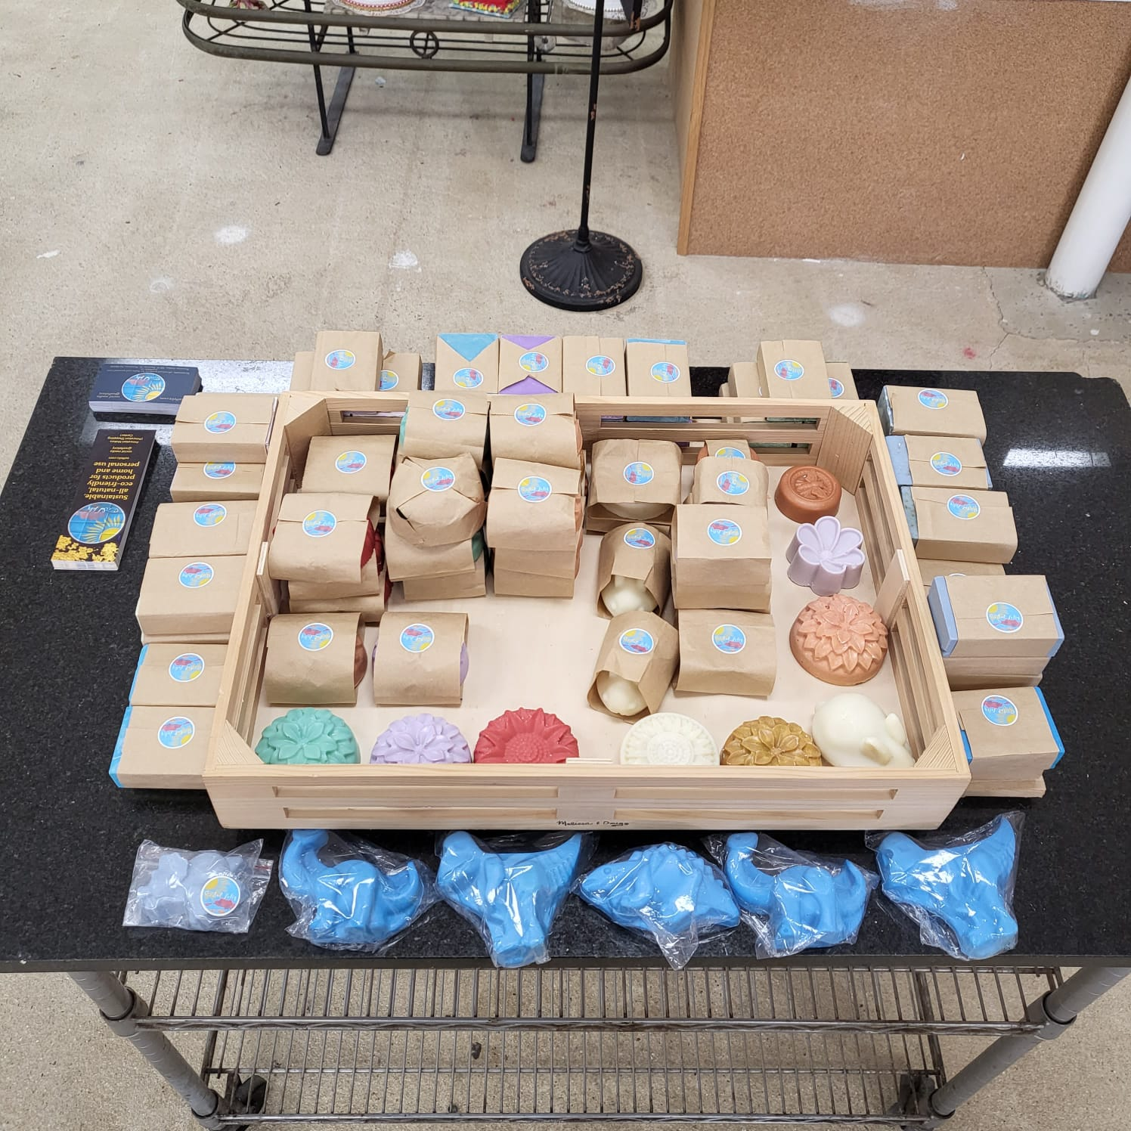
Conclusion
More metrics need to be measured, but it appears possible that an effective soap can be produced from oil extracted from black soldier fly larvae
This soap, along with other products where palm oil could be replaced, would have two major benefits:
Removing discarded food from the waste stream, where it will not produce greenhouse gases when buried in landfills
Reduced demand for palm oil, which will result in less deforestation and preserve remaining biodiversity

Slide 12
References
Cazzolla Gatti, R., Liang, J., Velichevskaya, A., & Zhou, M. (2019). Sustainable palm oil may not be so
sustainable. The Science of the Total Environment, 652, 48–51. https://doi.org/10.1016/j.scitotenv.2018.10.222
Jagdish (2019). Hybrid coconut cultivation, yield, varieties for profit. Retrieved from https://www.agrifarming.in/hybrid-coconut-cultivation-yield-varieties-for-profit
Jimeno, V., Quilez, J., Anadón, A., & González-Gross, M. (2019). Palm oil on the edge. Nutrients, 11(9), 2008. https://doi.org/10.3390/nu11092008
Kim, Y. B., Kim, D. H., Jeong, S. B., Lee, J. W., Kim, T. H., Lee, H. G., & Lee, K. W. (2020). Black soldier fly larvae oil as an alternative fat source in broiler nutrition. Poultry Science, 99(6), 3133–3143. https://doi.org/10.1016/j.psj.2020.01.018
Murphy, D. J., Goggin, K., & Paterson, R. (2021). Oil palm in the 2020s and beyond: challenges and solutions. CABI Agriculture and Bioscience, 2(1), 39. https://doi.org/10.1186/s43170-021-00058-3
Paterson, R. R. M., & Lima, N. (2017). Climate change affecting oil palm agronomy, and oil palm cultivation increasing climate change, require amelioration. Ecology and Evolution, 8(1), 452–461. https://doi.org/10.1002/ece3.3610
Ramli, U. S., Tahir, N. I., Rozali, N. L., Othman, A., Muhammad, N. H., Muhammad, S. A., Tarmizi, A., Hashim, N., Sambanthamurthi, R., Singh, R., Manaf, M., & Parveez, G. (2020). Sustainable palm oil: the role of screening and advanced analytical techniques for geographical traceability and authenticity verification. Molecules, 25(12), 2927. https://doi.org/10.3390/molecules25122927

Slide 13
References
Rochmyaningsih, D. (2020, July 17). Claim that coconut oil is worse for biodiversity than palm oil sparks furious debate. Retrieved from https://www.science.org/article/claim-coconut-oil-worse-biodiversity-palm- oil-sparks-furious-debate
Son, Y. J., Choi, S. Y., Hwang, I. K., Nho, C. W., & Kim, S. H. (2020). Could defatted mealworm (Tenebrio molitor) and mealworm oil be used as food ingredients?. Foods, 9(1), 40. https://doi.org/10.3390/foods9010040
Tzompa-Sosa, D. A., Dewettinck, K., Gellynck, X., & Schouteten, J. J. (2021b). Replacing vegetable oil by insect oil in food products: effect of deodorization on the sensory evaluation. Food Research International (Ottawa, Ont.), 141, 110140. https://doi.org/10.1016/j.foodres.2021.110140
Zhang, S., Xiong, P., Ma, Y., Jin, N., Sun, S., Dong, X., Li, X., Xu, J., Zhou, H., & Xu, W. (2022). Transformation of food waste to source of antimicrobial proteins by black soldier fly larvae for defense against marine Vibrio parahaemolyticus. The Science of the total environment, 826, 154163. https://doi.org/10.1016/j.scitotenv.2022.154163

