Slide 1
Modeling COVID-19 transmission in aircraft cabin by integrating particle dynamics, dilution effect, and risk assessment
Colin(Xinkai) Yu
Princeton International School of Mathematics and Science
Notes:
注意：10、11

Slide 2
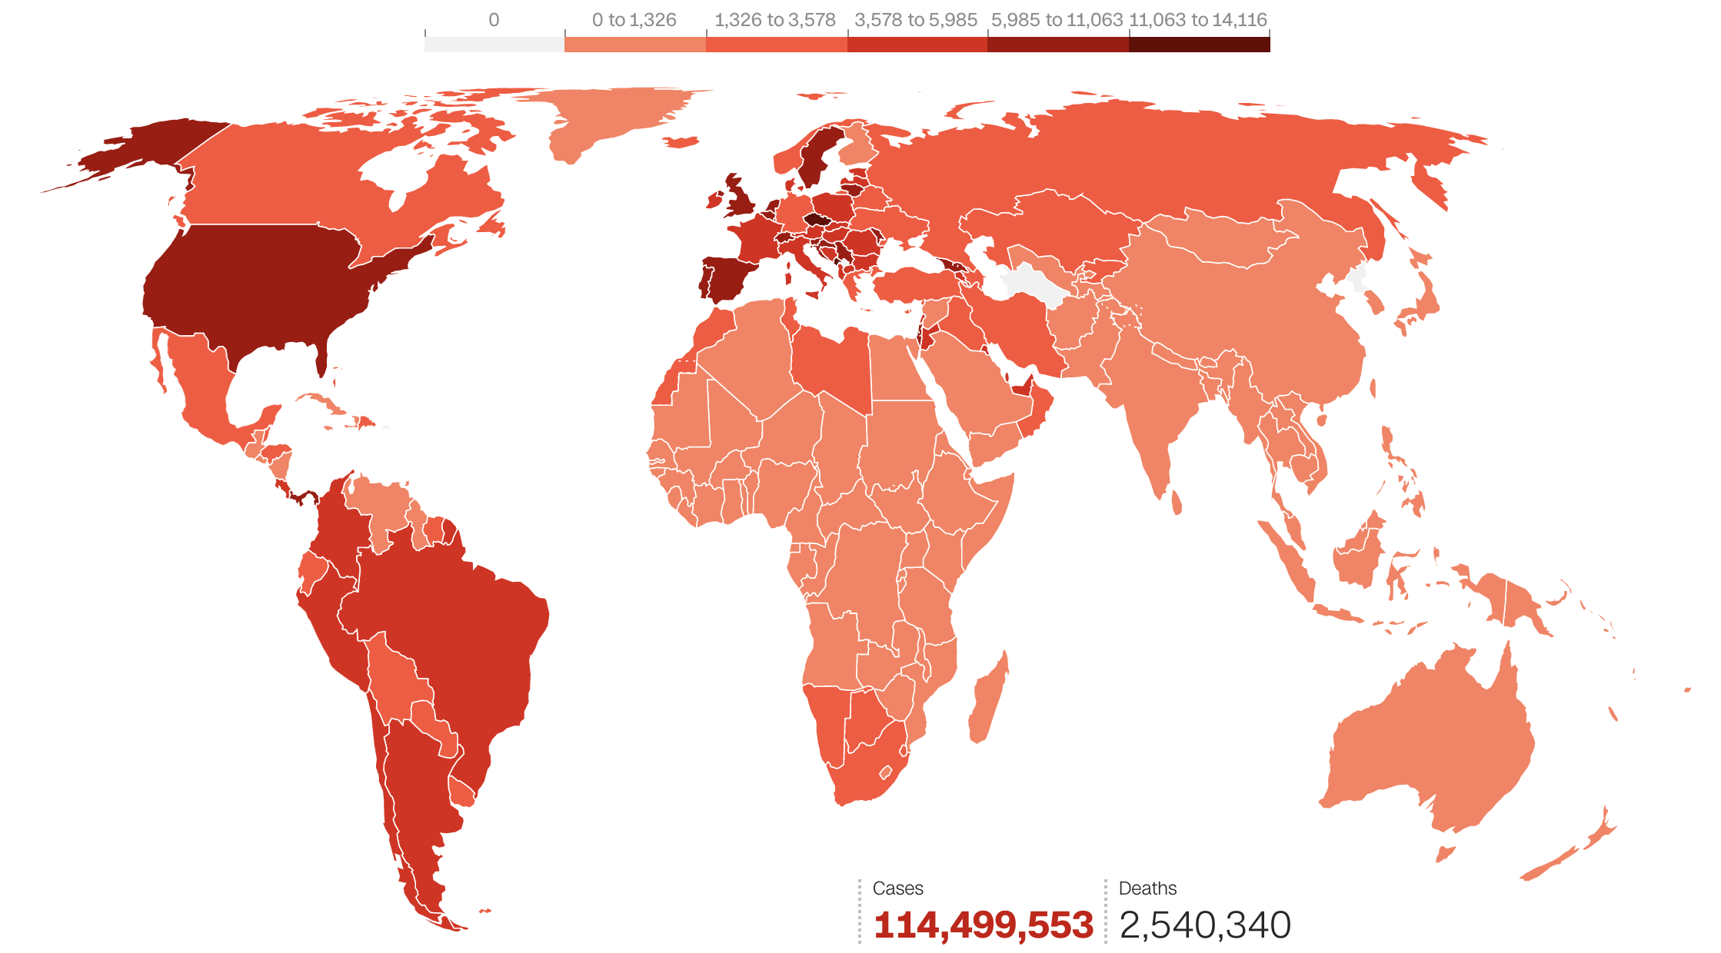
Background Information
Until March 2nd, 2021…
Globally reported about 114.5 million cases
Globally approximately 2.5 million deaths
Restriction on international travel
Raising concerns on air travel
1
© 2021 Cable News Network

Slide 3
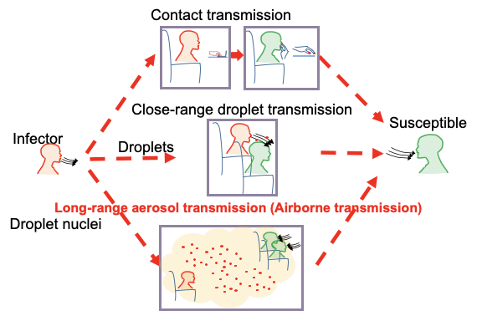
Three Possible Routes of COVID-19 Transmission
2
WHO. Transmission of SARS-CoV-2: implications for infection prevention precautions. [2] Tellier et al. BMC Infect. Dis. 2019, 19(1): 101.

Slide 4
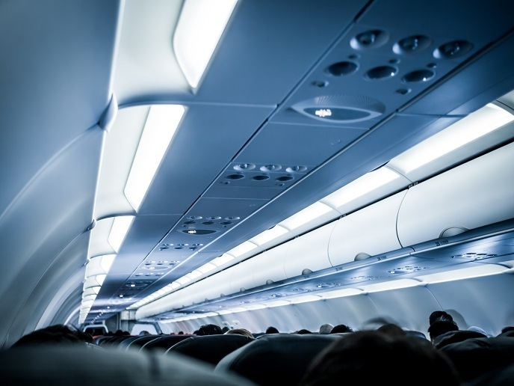
Project Background
Goal: Assess Covid-19 infection risk in aircraft cabins and propose possible measures and modifications that can be implemented to improve the safety of air travel under the pandemic of COVID-19
© A3pfamily, Shutterstock
3

Slide 5
Past Approaches
Covid-19 transmission in the cabin is a new problem, existing risk model cannot be directly applied
Past research overly simplified the field inside the aircraft to be uniform
Consequence: It is not possible to distinguish the infection risk between different locations
My solution: Treat it as a non-uniform field and propose a new and integrated simulation model
4

Slide 6
Major Tasks
Task 1: Develop a model and accurately simulate the non-uniform airflow field and the pollutant concentration field inside the aircraft cabin
Task 2: Define and calculate the local dilution ratio for the concentration field obtained in Task 1.
Task 3: Analyze and quantitatively evaluate the risk factors of possible transmitting Covid-19 under different scenarios in the aircraft cabin. Then provide suggestions on lowering the infection risk in the cabin.
5

Slide 7
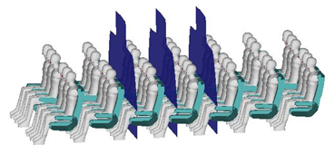
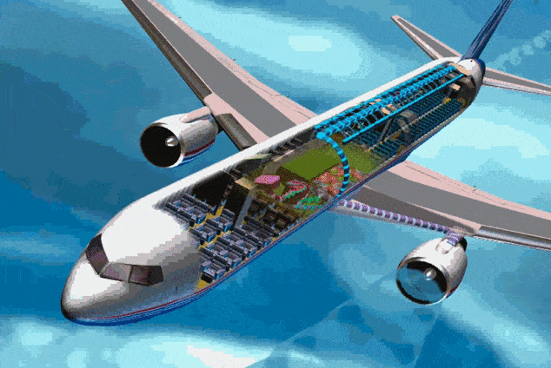
Task 1: 7-row “Standard Case”-Geometry
7-row section as “Standard case”
Geometric model: Based on B737 series (3-3 cabin)
Number of rows: 7
Number of seats: 42
© 1995 - 2020 Boeing
6
Notes:
pressure如何得到的需要说明
Airworthiness standard: outside air 0.25 kg/min/p是什么？

Slide 8
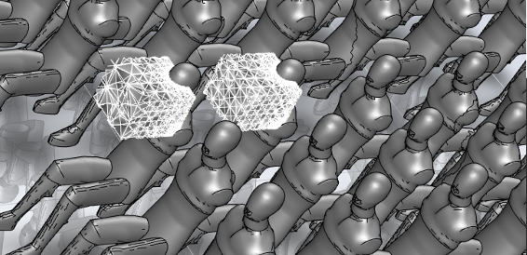
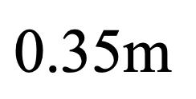
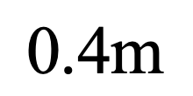
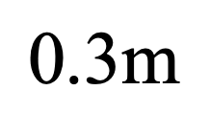
Task 1: 7-row “Standard Case”-Boundary Conditions
Total ventilation rate：0.35 kg/s ( 0.5 kg/min/p, outside+recircu.)
Air inlet: 19℃ (66.2 ℉)
Breath: 33℃ (91.4 ℉), 0.3 m³/h (8.677E-05 kg/s)
Floor: 25 ℃ (77 ℉)
Sidewalls and ceiling: 24 ℃ ℃ (75.2 ℉) ^{[11]}
Passenger surface: 31 ℃ (87.8 ℉)
Pressure: 0.85 atm (4600 ft) with the air density 1.04kg/m³ ^{[12][13]}
Breath zone
Grid: Totally 9 million grids for 7-row mockup
7

Slide 9
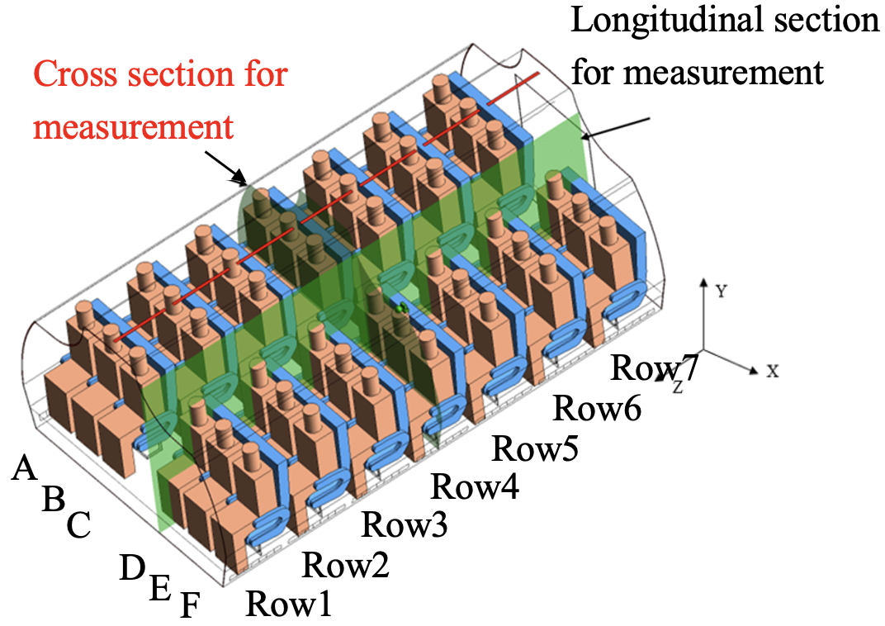
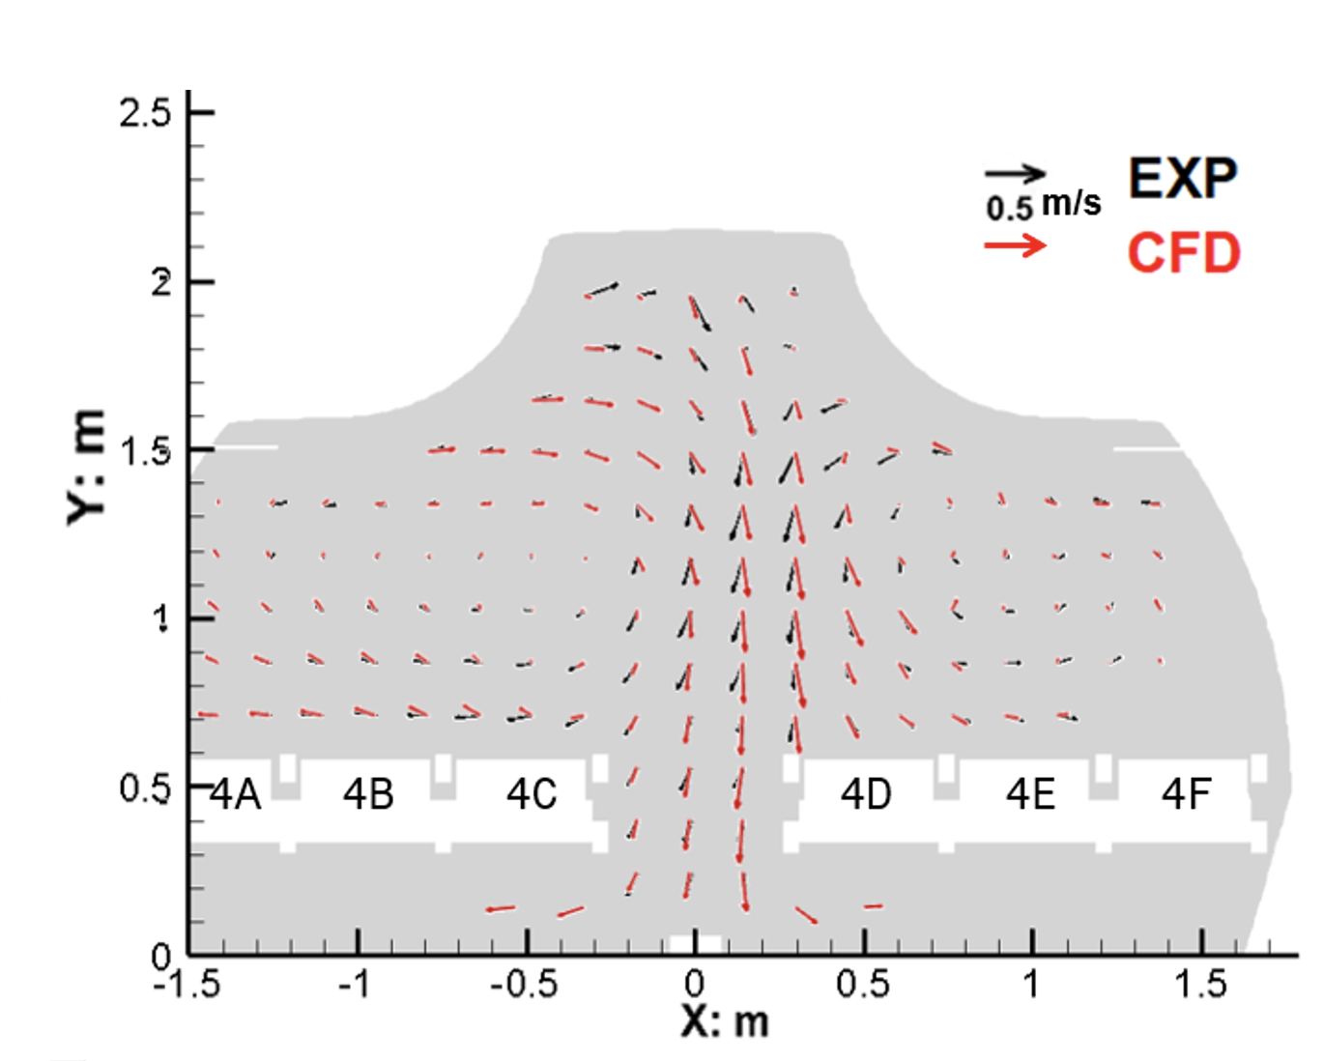
Task 1: Validation of the Airflow Model
Airflow fields in the cross section across the fourth row
8

Slide 10
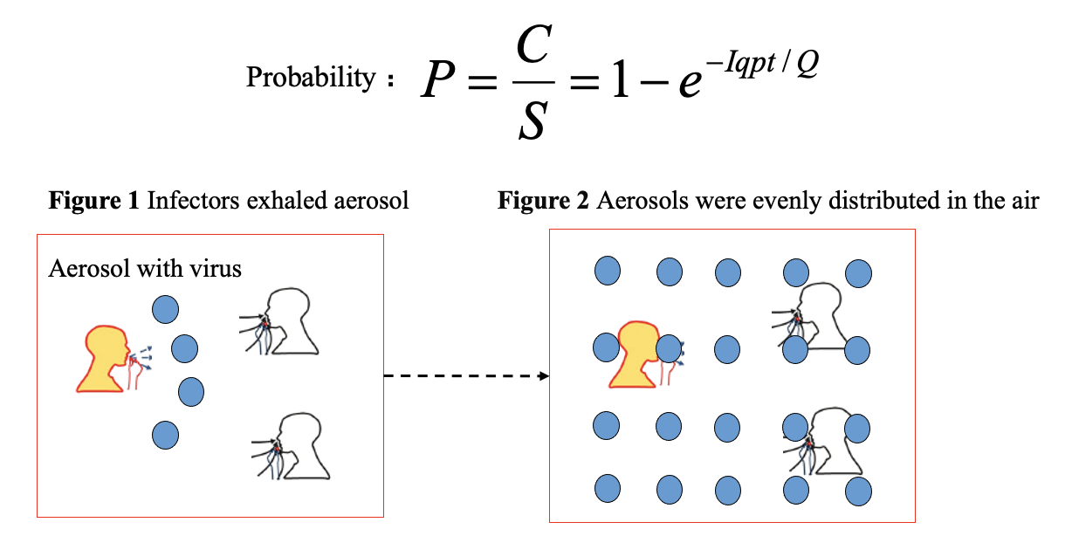
Task 2: Classical Probability Model of Aerosol Transmission
-Wells-Riley Equation
C —— number of infection cases;
S —— susceptible;
I —— number of infectors;
q — quanta produced by one infector (quanta/h);
p — pulmonary ventilation rate of susceptible (m³/h), for seated person p=0.03 (m³/h);
t —— the duration of exposure (h);
Q —— clean air volume rate (m³/h)
Quantum: the dose necessary to cause infection to a new susceptible (maybe one or more airborne pathogens) , and analogous to “quantal pollutant”
9
Notes:
wr方程的应用范围需要再清晰一点

Slide 11
Task 2: Limitation of Wells-Riley Equation
Only applicable when pathogen particles have even spatial distribution
In aircraft, the environment is complex(uneven spatial distribution)
The traditional Wells-Riley equation is not directly applicable
10

Slide 12
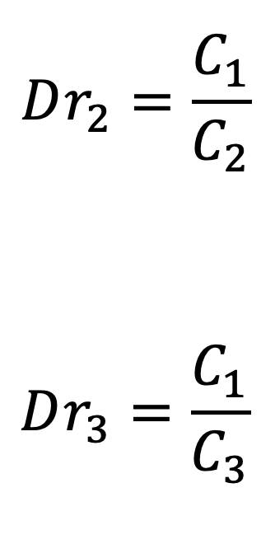
Task 2: Introduction of the Dilution Ratio
Dilution ratio (Dr)
It is defined as the ratio of quanta "concentration" at the site of infector (actually the expected value of quanta appearance), and quanta "concentration" in the breath zones of susceptible.
Infector’s exhaled aerosol with the virus
Aerosol distribution in the air
11
Notes:
再组织一下说得更清楚

Slide 13
Task 2: Benefits of Dilution Ratio
The concentration of quantum pathogen at different locations can be expressed
Wells-Riley equation(modified) can be applied to every location, and then the infection risk distribution can be obtained
Since the dilution field is irrelevant with the quanta “concentration” at the site of the infector, cases with different infector site “concentrations” can share the same dilution ratio field
12

Slide 14
Task 2: Advanced Risk Model
Probability can be extended to the non-uniform environment as follows (also considering the effect of masks)
P —— local probability of the susceptible；
q —— quanta produced by one infector (quanta/h)；
t —— the duration of exposure (h)；
Dr —— Local dilution ratio ；
η_{I}, η_{s} — mask filtering efficacy of Infectors and susceptible, respectively;
p_{s}/p_{I} — the ratio of pulmonary ventilation rate of susceptibles and infector respectively, which could be 1 with the same pulmonary ventilation rates;
One calculation method of dilution ratio Dr:
Eulerian method
13

Slide 15
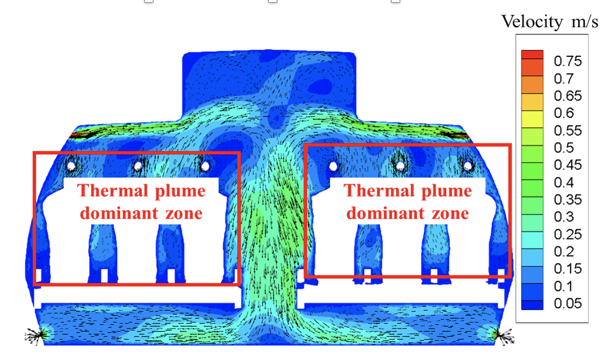
Task 3: Characteristics of the Flow Field
Standard Case
0.5 kg/min/p total air flow rate, flow field of cross-section Z=3.1
“Saddle”-shaped flow field
Thermal plume around the human body
14

Slide 16
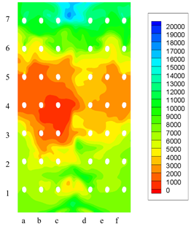
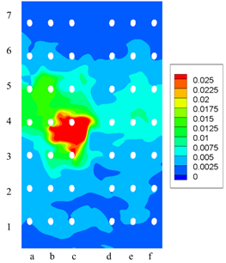
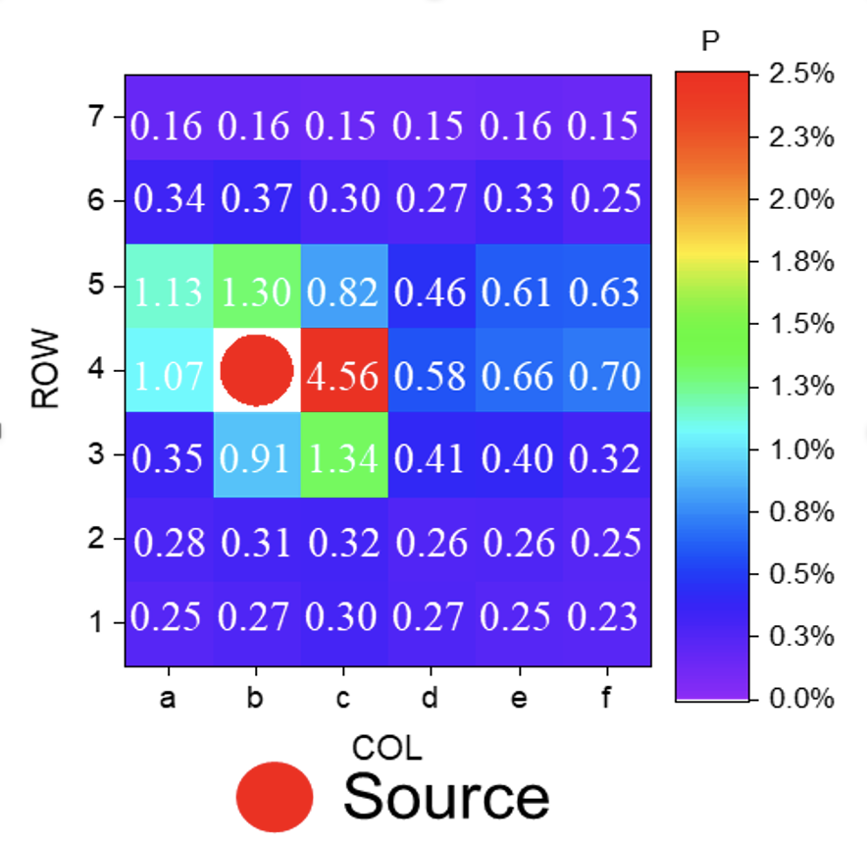
Task 3: Scenario Studies—“Standard Case”
“Standard Case” (all surgical masks, 2h, middle seat 4-b, 20 quanta/h)
a) Dilution ratio
b) Probability
Infection risks at passengers’ breathing zone
1.2m Height Section
Risk of infection: non-uniform, highest 1%- 4.6% near the infector
Sectional zoning effect: limited to the same row and two or three rows ahead/behind
The results indicated that the zoning effect was achieved in the cabin and special attention should be paid to regions in close proximity of the infector.
15
Notes:
每一组对应的条件要清楚的给出
standard case先讲清楚，然后改变一些参数（戴口罩），然后改变位置
case的结论要给出来
主要影响周边两排之内的乘客

Slide 17
Task 3: Scenario Studies—Different Types of Mask
Masks (2h, q = 20 quanta/j, flow rate = 0.5kg/min/p)
Masks help to reduce the probability of risks from max. 10% to max. 0.11%.
16

Slide 18
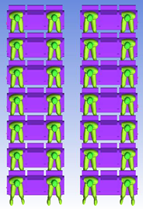
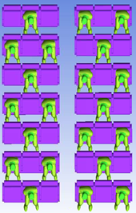
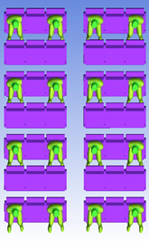
Task 3: Scenario Studies—Temporary Improvement Measures
Temporary improvement measures
When infectors could not be identified but under high risk
Seating arrangements to increase “social distancing”
Source
a) Scenario 1 (n=28, 66%) b) Scenario 2 (n = 21, 50%) c) Scenario 3 (n=16, 38%)
Distance = 0.9m & 0.8m Distance = 0.9m & 0.92m Distance = 0.9m & 1.6m
Vacating next seats Vacating alternatively Vacating both rows and next seats
17

Slide 19
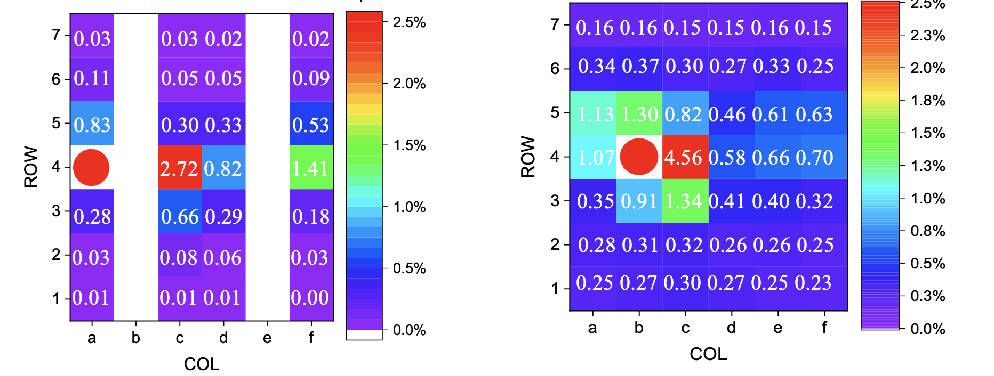
Task 3: Scenario Studies—Vacating Next Seats
Scenario 1 Vacating next seats (2h, q = 20 quanta/h, flow rate = 0.5 kg/min/seat, all with surgical masks)
P
P
The location with the highest infection risk is 4-c, the risk of infection is 2.7%.
The infection rate of all other locations in the cabin lower than 1%.
Compared with the Standard case (max. 4.56%), the highest infection rate was reduced by two fifth.
18
Notes:
右图选的不一定对
比较的是离病人最近的人的感染概率的变化，所以坐在靠窗没有影响

Slide 20
Task 3: Scenario Studies—Comparing Different Ways of Vacating Seats
Effect of vacating seats (2h, q = 20 quanta/h, flow rate = 0.5 kg/min/seat, all with surgical masks)
Scenario 1 (n=28, 66%)
Scenario 2 (n = 21, 50%)
Scenario 3 (n=16, 38%)
The highest infection risks are 2.7%, 2.1%, and 1.1% by vacating 34%, 50%, and 62% seats respectively . Compared with the Standard case max. 4.6%.
19

Slide 21
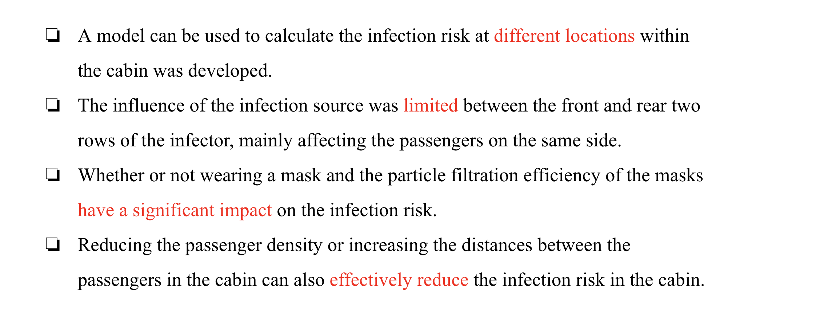
Conclusion
20

Slide 22
Acknowledgement
This project was conducted under the guidance of Prof. Xudong Yang and Dr. Junzhou He at Tsinghua University, Beijing.
21

Slide 23
Thank You！

