Slide 1
Electrify Your Electrolytes: The Effect Drinks Have on Your Electrolytes
By: William Black

Slide 2
BACKGROUND RESEARCH/PURPOSE:
When you workout, play a sport, sweat, or even get sick, the impact to your body is that electrolytes are lost. These electrolytes need to be replaced to keep your body healthy and keep our cells healthy. One major function they perform is to balance the water in and outside the cells. Another major function is to allow muscles to move.
Electrolytes have a major part in healthy cells. Electrolytes are chemical substances they break into ions in a solution, within our body, that conduct electricity or a spark. This electricity is what allows our muscles to move. Without electrolytes, your muscles wouldn't contract or allow you to move. Sodium, potassium, chloride and magnesium are the most common examples of electrolytes. Electrolytes regulate nerve and muscle function, repair damaged tissue, and help to balance blood acidity as well as pressure.

Slide 3
According to Amy Goodson, MS , the average intake that is recommended daily for a person in milligrams: Sodium-Less than 2300 mg, Potassium-3000 mg, Chloride-2300 mg, Magnesium-350 mg, and Phosphate-700 mg. Electrolytes can be found in food and drinks. Fruit and vegetables, such as beets, bananas, oranges,sweet potatoes and watermelon are high in electrolytes. Sports drinks are the most common electrolyte drinks. However, there are also juices, pedialyte and milk.
With anything, your body can have an imbalance of electrolytes. (This is different from dehydration; lack of water in the body.) Too much or too little electrolytes can lead to serious health complications. Signs someone has an imbalance of electrolytes are, but not limited to, muscle spasm, twitching, irregular heartbeat, tiredness, muscle weakness, and seizure. It was reported that adults are more likely to suffer imbalance of electrolytes than children. Imbalances can be the result of exercise, heat, vomiting and/or diarrhea, diabetes, and a disease like kidney disease.

Slide 4
Our experiment required a way to test the number of electrolytes in our sample liquid. We choose a digital multimeter in order to get accurate readings. Digital multimeters replaced needle-based analog meters due to their ability to measure with greater accuracy, reliability and increased impedance. Donald Macadie introduced its first digital multimeter in the early 1920’s. A digital multimeter is a test tool that is used to measure two or more electrical values principally voltage, current and resistance. It is a tool for technicians in the electrical industries. The digital multimeter measures the electrolytes in the liquid because the electrolytes close the circuit, and sends a reading to the multimeter. The higher the reading the more electrolytes in the liquid.

Slide 5
Hypothesis
I think that the milk will provide the most electrolytes because it contains several vitamins.

Slide 6
TESTABLE QUESTION:
How does a specific drink affect the number of electrolytes your body takes in?

Slide 7
MATERIALS:
The materials I used were:
Digital multimeter -which included the following:
Black wire with one end as an Alligator clip
Red wire with one end as an Alligator clip
Snap connector for 9 volt battery
9Volt Battery
copper wire
Ruler
Paper towels
6 4 oz containers
Plastic straw
Scissors
Tape
Liquid measuring cup
Powerade Ultra (lemon-lime), Gatorade (lemon-lime), Gatorade 2 (low sugar- lemon lime), Milk (1%) , Orange juice, and Water

Slide 8
PROCEDURE:
Cut one 5cm piece from the drinking straw.
Cut two 12cm pieces of a copper wire.
Wrap the one piece of copper wire around one end of the cut straw leaving 5cm unwrapped.
Wrap the other copper wire around the other end, leaving 5cm unwrapped.
Make sure the multimeter is off.
Plug the black wire probe into the port labeled “COM”.
Plug the red wire probe into the port labeled “VΩmA”.
Connect the snap connector to the 9V battery.
Use the red wire alligator clip to connect the red wire to the red wire end of the battery snap connector.
Connect the black wire alligator clip end to one end of the copper wire attached to the straw.
Connect the black end of the snap connect to the other end of the copper wire attached to the straw.
Pour 4 oz. of each liquid (Powerade Ultra, Gatorade, Gatorade 2, Milk 1%, Orange Juice, Water) into their own contianier.
Place the straw with copper wire attached into the container with water and record the reading in your journal.
Dry the straw and copper off on a paper towel.
Repeat steps 13 through 14 until each sample was tested one time.
Empty cup, rinse, and dry
Repeat steps 12 through 15 for trial 2.
Repeat step 16.
Repeat steps 12 through 15 for trial 3.
Shut down and disconnect everything.

Slide 9
DATA:
Results of Electrolytes in Microamps
Drink → Trials ↓ | Powerade Ultra | Gatorade | Gatorade 2 | Milk 1% | Orange Juice | Water
1 | 44.7 | 22.2 | 29.3 | 42.1 | 55.3 | 1.1
2 | 37.0 | 24.0 | 24.3 | 66.5 | 42.6 | 0.9
3 | 39.6 | 25.1 | 27.6 | 44.7 | 35.2 | 0.8
Average | 40.4 | 23.8 | 27.0 | 51.1 | 44.4 | 0.9

Slide 10
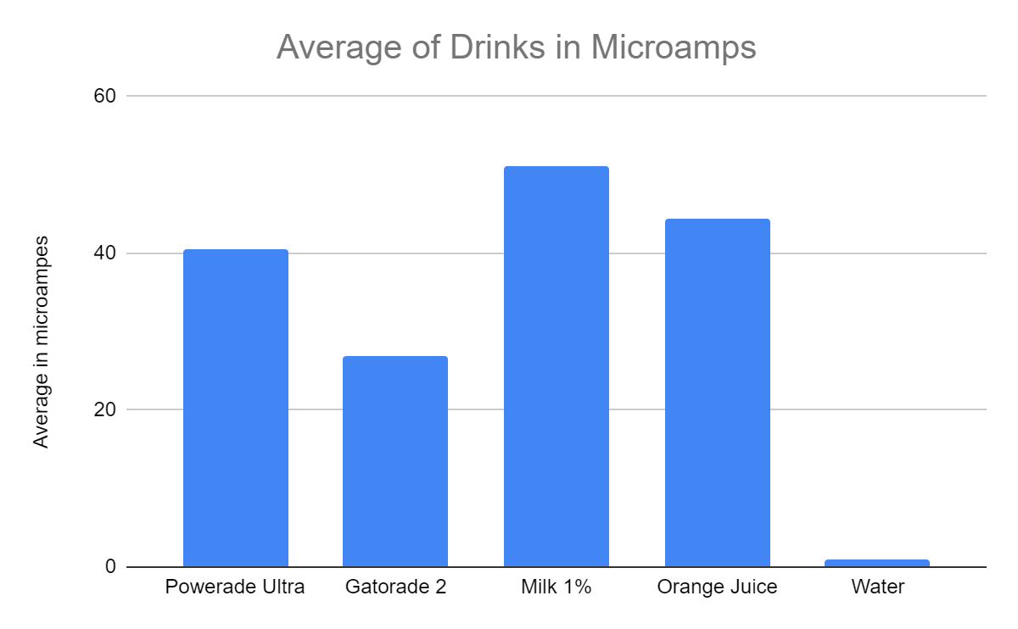

Slide 11
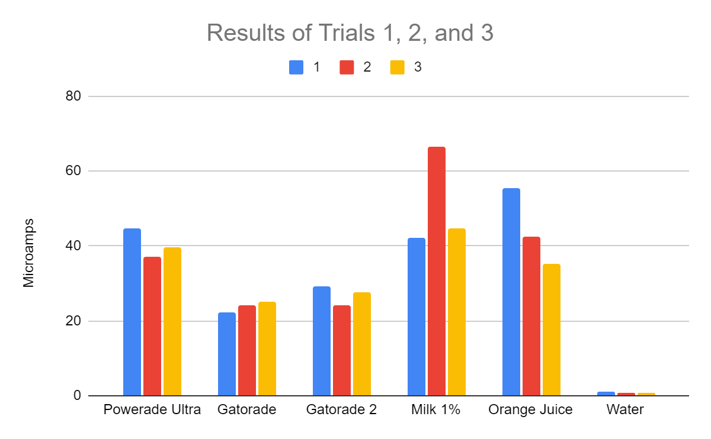

Slide 12
ANALYSIS:
We measured using microamps which are a millionth of an ampere. Ampere is the basic unit for measuring electrical current. Based on my results, I found out the 1% milk has the most electrolytes. For trial 1, the milk measured 42.1 microamp. For trail 2 and 3 the microamp was 66.5 and 44.7. This made the average 51.1 microamp. For the orange juice, trial 1 measured 55.3 microamp. For trail 2 and 3 the microamp was 42.6 and 35.2. This made the average 44.4 microamp. For the powerade ultra, trial 1 measured 44.7 microamp. For trail 2 and 3 the microamp was 37 and 39.6. This made the average 40.4 microamp. For gatorade 2, trial 1 measured 29.3 microamp. For trail 2 and 3 the microamp was 24.3 and 27.6. This made the average 27 microamp. For gatorade, trial 1 measured 22.2 microamp. For trail 2 and 3 the microamp was 24 and 25.1. This made the average 23.8 microamp, and for water, trial 1 measured 1.1 microamp. For trail 2 and 3 the microamp was 0.9 and 0.8. This made the average 0.9 microamp.
I realized that the drinks with less sugar and low fat had the most electrolytes (except for water). After I analyzed my results, I realized water would not have a high amount of electrolytes since water is used more to rehydrate and does not contain added minerals or vitamins. Milk and orange juice contains several minerals and vitamins that the body needs. Both are natural sources of electrolytes since they don’t contain added sugar. Sports drinks tend to be very popular because they are easier to carry, sold in small packages and don't require refrigeration. In addition, sports players promote the sports drinks industry.
A possible source of error is that when I started getting further in the experiment the copper wire connected to the black wire started to turn green but the copper wire that connects to the battery stayed the same color. This could be a result of oxidation (when copper reacts to oxygen in the air [Statue of Liberty did the same thing]).

Slide 13
CONCLUSION:
The purpose of this experiment was to find the drink that contained the highest amount of electrolytes. My results prove my hypothesis was correct; 1% milk contained the highest amount of electrolytes with an average of 51.1 microamp. Orange juice contained the second highest; average of 44.4 microamp. I think this is because they are natural and better for you. Milk and orange juice had no additional additives. The sports drinks have a long list of ingredients that are not from nature. In addition, the sport drinks all contain yellow 5 dye (since I did lemon-lime sport drinks). Other sources of natural electrolytes are in fruits and vegetables.
If I were to do this experiment again, I would test different types of milk; whole milk, 1%, 2%, and chocolate milk. I would also try and test different bands of orange juice and flavors of sports drinks.

Slide 14
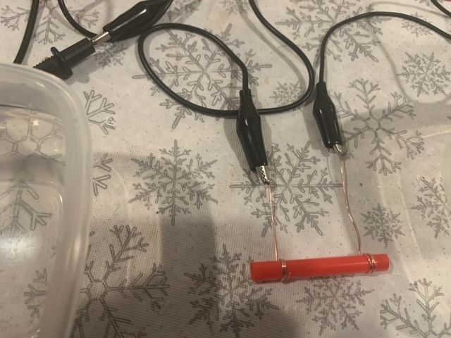
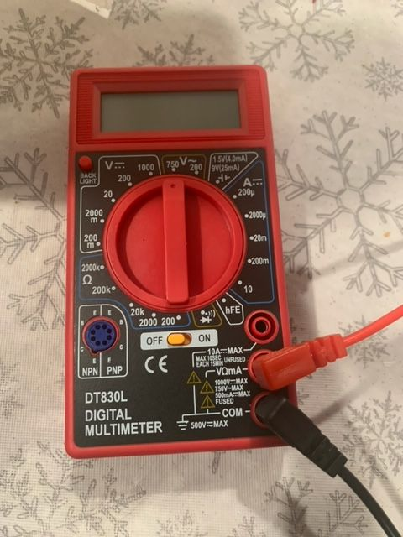
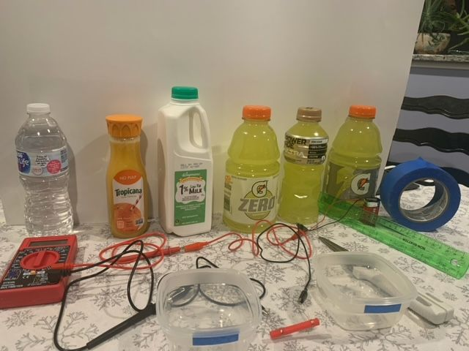

Slide 15
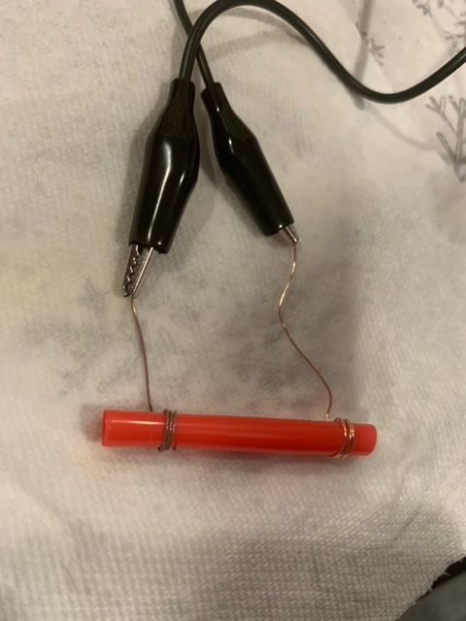
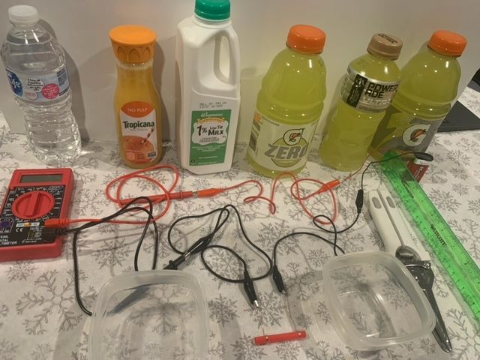

Slide 16
Thank You!

