Slide 1
The influence of dark matter viscosity on galaxy formation
Princeton International School of Mathematics and Science
Jihao Yu

Slide 2
Outline
Last Parsec Problem
Self Interacting Dark Matter(SIDM)
Describing fluid-like viscous Dark matter motion

Slide 3
Last Parsec problem(1/4)

Slide 4
Last parsec problem(1/4)
Three reasons that balckholes merge:
-Dynamic friction
-Outburst of stars interstellar mediums
-Loss of energy through radiation

Slide 5
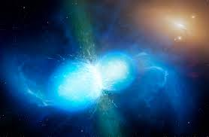
Loss of energy through radiation
V ↓
L(mrv) ↓
r ↓

Slide 6
Outburst of stars and Interstellar medium
⬆
⬇

Slide 7
Outburst of stars and Interstellar medium
⬆
⬇

Slide 8
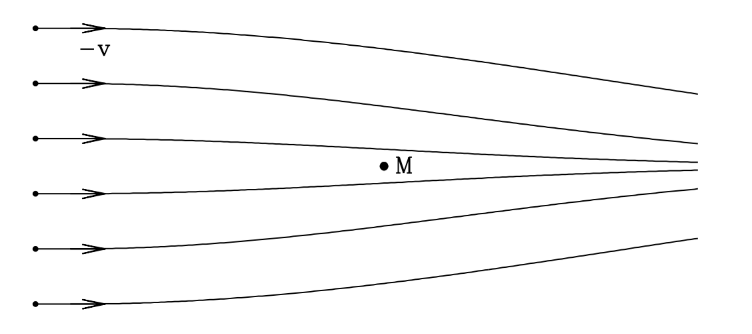
Dynamical friction

Slide 10
What’s wrong here?
It takes too long for merging to occur & Stay apart within a few parsecs for millions of years
1. Stars are cleared out inside the orbit
2. Dynamical friction and energy radiation are too weak

Slide 11
Dark matter
Dark matter takes up about 95% of mass
Canonical Dark Matter(CDM)
-Gravity
Self Interacting Dark Matter(SIDM)
-Gravity
-Pressure
-Strong interaction
-……

Slide 15
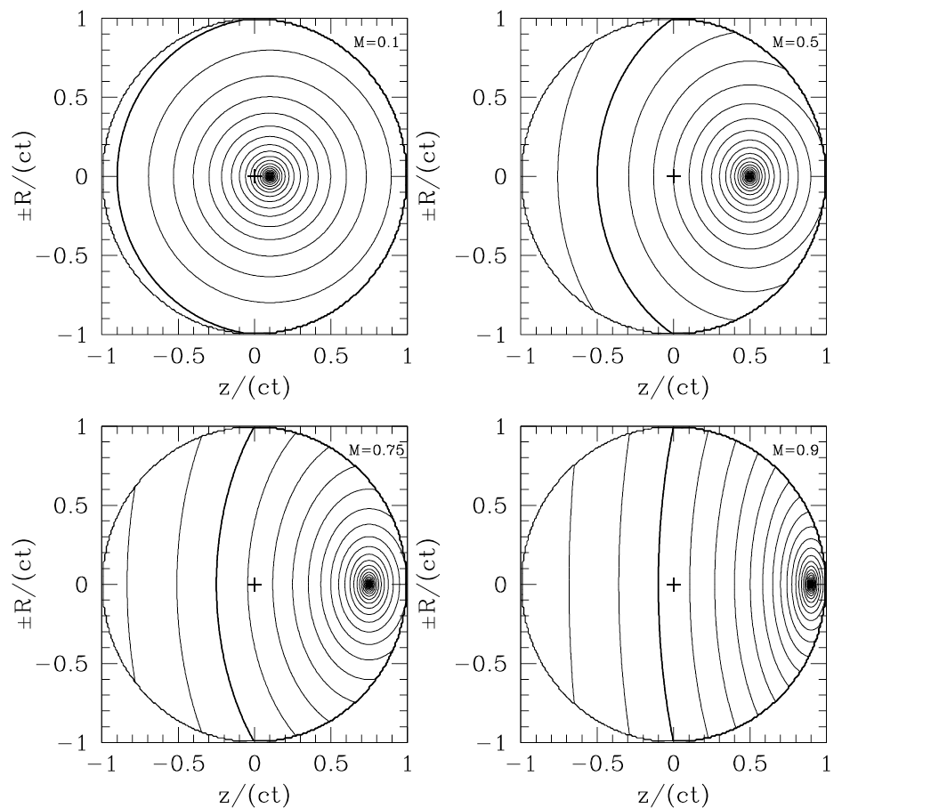
Describe Dynamical Friction

Slide 16
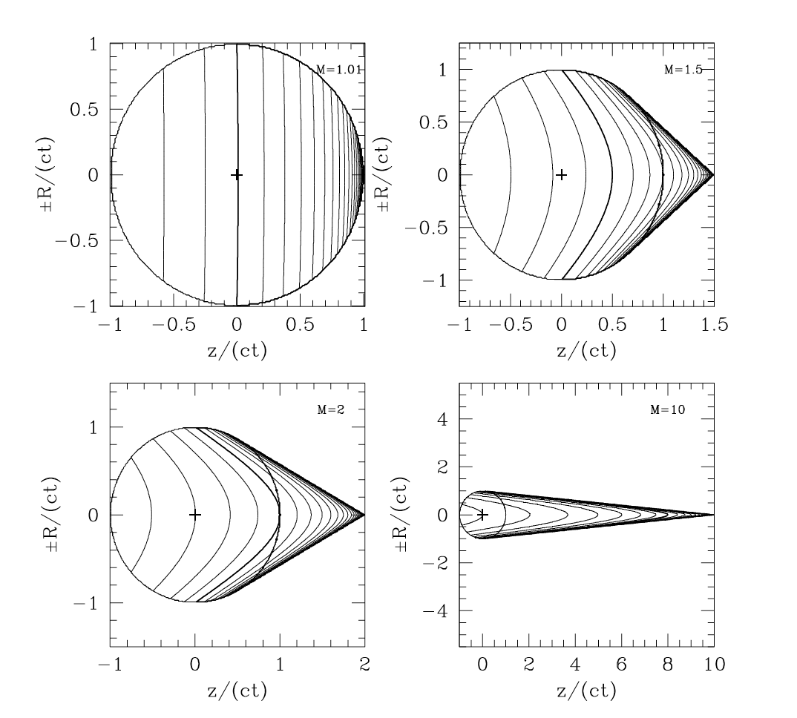
Describe Dynamical Friction

Slide 17
Subsonic condition:
Supersonic condition:
M is denoted as v/cs, cs is the sound speed

Slide 18
SIDM

Slide 19
SIDM

Slide 22
Conclusion
Self Interacting Dark Matter does help to solve the Last Parsec problem. However, the dynamical friction timescale is still overestimated. Further assumptions of SIDM properties are required to solve the problem

Slide 23
Thank you!

