Slide 1
Designing the Extrusion System of Chocolate 3D printer
Hongyi Jiang, Adam Kemp, Applied Engineering Research

Slide 2
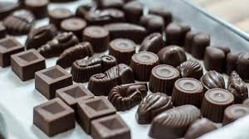
Research Goal
We need chocolate!!!

Slide 3
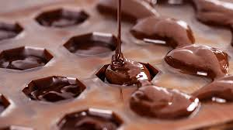
Problems with current chocolate:
Lack of structural complexity
Require a long time of molding
Not convenient

Slide 4
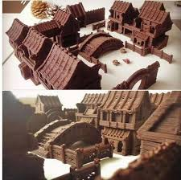
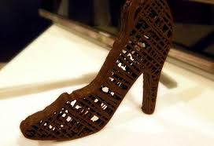
Advantages of Food 3D printing:
High degree of freedom
Personalized food designs.
Notes:
pictures

Slide 5
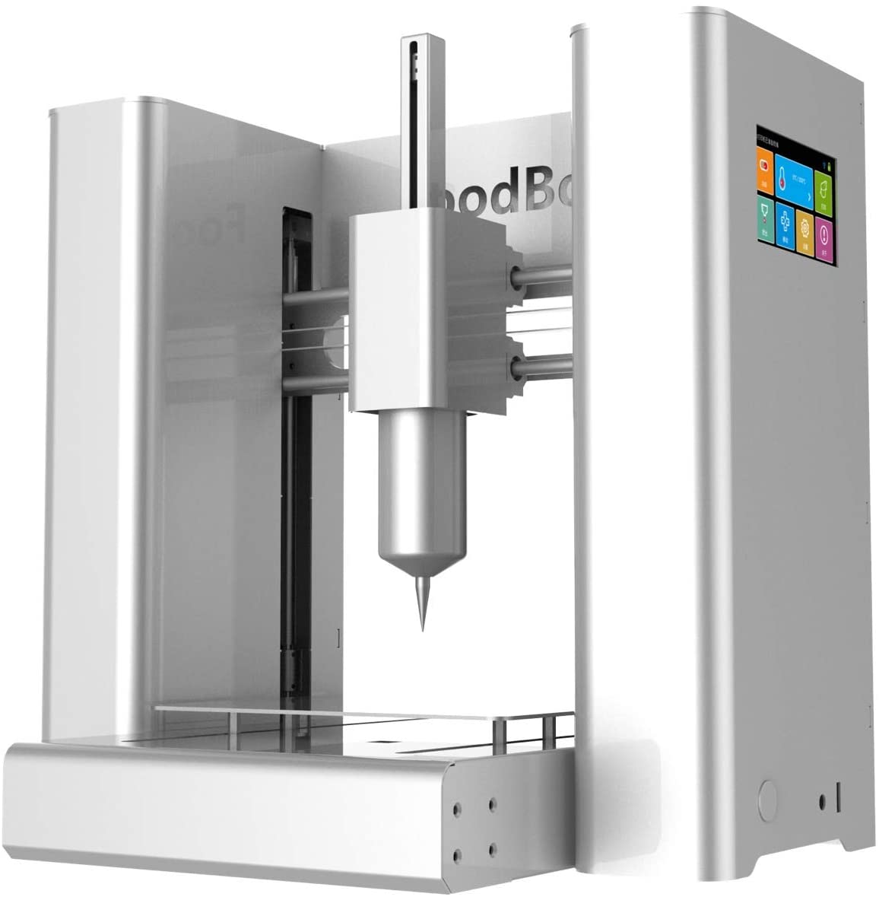
Problems with Current Chocolate 3D Printer
Expensive
Limited functions
Cannot perform tempering
$2499
Notes:
Elaborates, pictures expensive while useless

Slide 6
Research Potential
Provide a useful tool for pastry chef
Improve the efficiency of producing chocolate
Require less skill to master
Personalized design for everyone
Notes:
Learning curve, reduce redundant work, complex chocolate production accessible for everyone

Slide 7
Research Objectives
Design a Chocolate 3D printer that print out complex structures of chocolate with tempering process from chocolate chips
Notes:
Tempering process as pictures

Slide 8
Qualitative performance objectives
The printer is cheap
The printer is convenient to use
The chocolate product is delicious
The chocolate is safe to eat
The chocolate printer can attract consumers

Slide 9
Quantitative performance objectives
The difference between the final product and the designed 3D model is about 2mm.
The 3D printer can continuously print for over 5 hours
The 3D printer can print out an object with a volume at least 100 cm³
The temperature should stay around 2 ℃ to the target temperature during 90% of the printing process.
The 3D printer can print with less than 2% waste of material

Slide 10
Research Approach

Slide 11
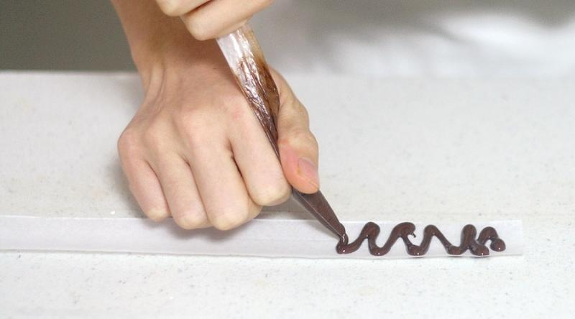
Research Approach
Fused deposition modeling
Notes:
Picture larger, highlight extrusion system

Slide 12
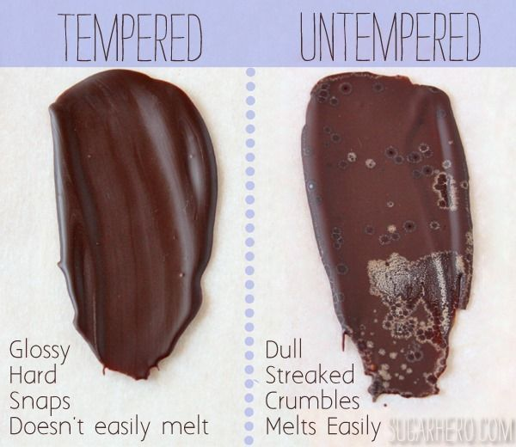
Research Approach
Notes:
Title,

Slide 13
Tempering process
Crystal | Melting point | Characteristic
I | 17 °C (63 °F) | Soft, crumbly, melts too easily
II | 21 °C (70 °F) | Soft, crumbly, melts too easily
III | 26 °C (79 °F) | Firm, poor snap, melts too easily
IV | 28 °C (82 °F) | Firm, good snap, melts too easily
V | 34 °C (93 °F) | Glossy, firm, best snap, melts near body temperature (37 °C)
VI | 36 °C (97 °F) | Hard, takes weeks to form

Slide 14
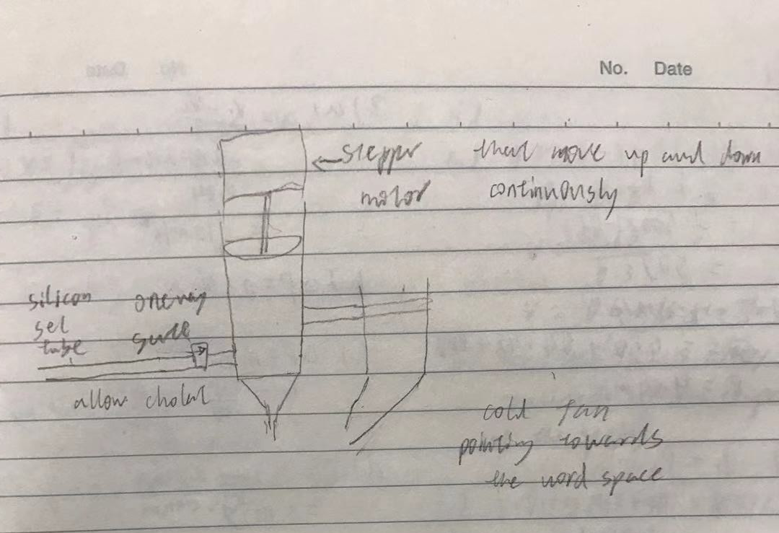
Design
Notes:
clearer

Slide 15
Design

Slide 16
Design
Blender
Valve
Cooling fan
Notes:
names

Slide 17
Future Plan
Finish the design 3D model in next weeks
Choose the proper parts to construct the prototypes at the beginning of February
Start building and testing prototypes by the mid-February
Assemble everything when ?
Notes:
dates

Slide 18
Thanks for Listening
Notes:
Improve:
Text alignment, size of pictures, chocolate

Slide 19
References
1. Hershey to Launch the First Ever 3D Printed Chocolate Exhibit, Brian Krassenstein, Dec 17, 2014. https://3dprint.com/31758/hersheys-3d-printing-exhibit/
2. J. I. Lipton, 3D PRINTING FOOD , FOAM AND FORCES : ADDITIVE MANUFACTURING OF EDIBLE CONSTRUCTS , CELLULAR STRUCTURES AND ACTUATORS A Dissertation Presented to the Faculty of the Graduate School of Cornell University in Partial Fulfillment of the Requirements for the Degree of Doctor of Philosophy by Jeffrey Ian Lipton August 2015 (2015).
3. Derossi, A.; Caporizzi, R.; Ricci, I.; Severini, C. Critical Variables in 3D Food Printing; Elsevier Inc.: Amsterdam, The Netherlands, 2019; ISBN 9780128145647
4. Tran, J.L. 3D-Printed Food. Minnesota J. Law Sci. Technol. 2016, 17, 855.
5. About Upprinting Food. Available online: https://www.upprintingfood.com/about (accessed on13 April 2020).
6. Izdebska, J.; Zołek-Tryznowska, Z. 3D food printing—Facts and future. Agro Food Ind. Hi Tech 2016, 27, 33–37.

