Slide 1
Combating the Effect of Global Warming on Plants through Photosynthesis Selection
By. Srinand Tanakala

Slide 2
Hypothesis
Throughout the world, there are many areas in which water levels vary. This is forced to the extremes due to the present of climate change and increased water levels and higher temperatures. Due to this, some areas receive more precipitation and other areas become even hotter and experience less temperature. In order to farmers to see which photosynthetic pathway is most efficient in growing in varied water level conditions, Purslane is compared with Sorghum and Orchids. Since Purslane utilizes both a combination of C4 and CAM, it would present the most maximum growth throughout all water levels.

Slide 3
Materials
Purslane seeds
Sorghum seeds
Orchid seeds
Water
Biodegradable cups
Potting soil
Fertilizer
Micro environment with temperature control
Artificial light source

Slide 4
Procedures
Set up 18 biodegradable cups with 300 grams of potting soil in each one
Label one cup as “Sorghum-C4”, another cup as “Purslane-C4 & CAM”, and the final cup as “Orchids-CAM”
Create 3 sets of these cups and the cups in each set must be labelled “low water”, “medium water”, and “high water”
Ensure that there are three cups labelled low water, three cups labelled medium water, and three cups labelled high water
Create divots in the soil that are 0.5” deep and place a sorghum seed inside the cup labeled “Sorghum-C4” for the set that is labeled low water. Seeds must be 4” apart
Cover with soil upon placing
Repeat steps 4 and 5 for the other two plants in their respective cups
Repeat steps 4-6 for both medium and high water groups
Let plants be able to have access to natural sunlight by being near a window sill or placing an artificial light source nearby for approximately 8 hours
Set of low water plants will get 15 mL once a day. Medium plants will get 15 mL of water twice every day. High water plants will get 15 mL of water three times a day.
Record observations in regards to height, initial mass, new mass, leave color and state, and other important information every Friday

Slide 5
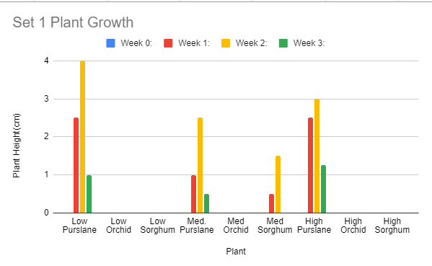
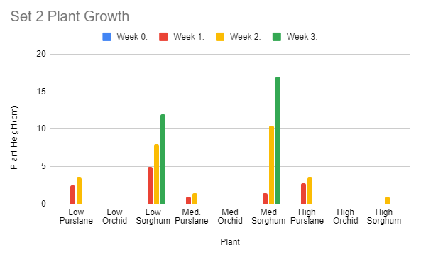
Data

Slide 6
Data(Set 1)

Slide 7
Data(Set 2)

Slide 8
Analysis
Outstanding points to note:
Orchids presented no growth in any of the environments
Shows it is worse in both plants in adaptability and temperature needs and how they are not the plant of the future
In set 1, it was seen that low purslane presented the highest growth and the maximum height, especially seen in the low water level group where it reached a maximum of 4 cm. High purslane was close next and then it was followed by medium purslane. In this set, the only other group that presented growth was medium sorghum, although it was incomparable to all three groups of purslane.
In set 2, complete contrast in plant yields with Purslane, overall, having the least maximum growth height and sorghum having the biggest maximum growth height. Medium sorghum, the plant the grew the tallest, grew to a height of 10.5 centimeters. Unlike the previous set, none of the purslane groups grew to a tall height, with all of them averaging a maximum height of 3.16.

Slide 9
Analysis cont…
Due to the complete contrast of both sets and no overarching idea can be supported by both sets, there is no conclusive evidence that purslane is indeed the most ideal plant with having both C4 and CAM photosynthesis in comparison to sorghum and orchids. Although it can be concluded that orchid is indeed the worst since it had absolutely no growth in both sets and in all water levels.
Note. the decrease in height during week 3 is due to the shriveling and death of the plants and them not being able to sustain life in said environment.

Slide 10
Summary
Project accurately entailed plant growth over time and the varied results presents the idea to run more trials under more isolated conditions and change different variables such as temperature and humidity to see these factors’ effect on plant growth
Hypothesis was not supported as purslane only showed the highest growth in experiment set 1, but not set 2.

