Slide 1
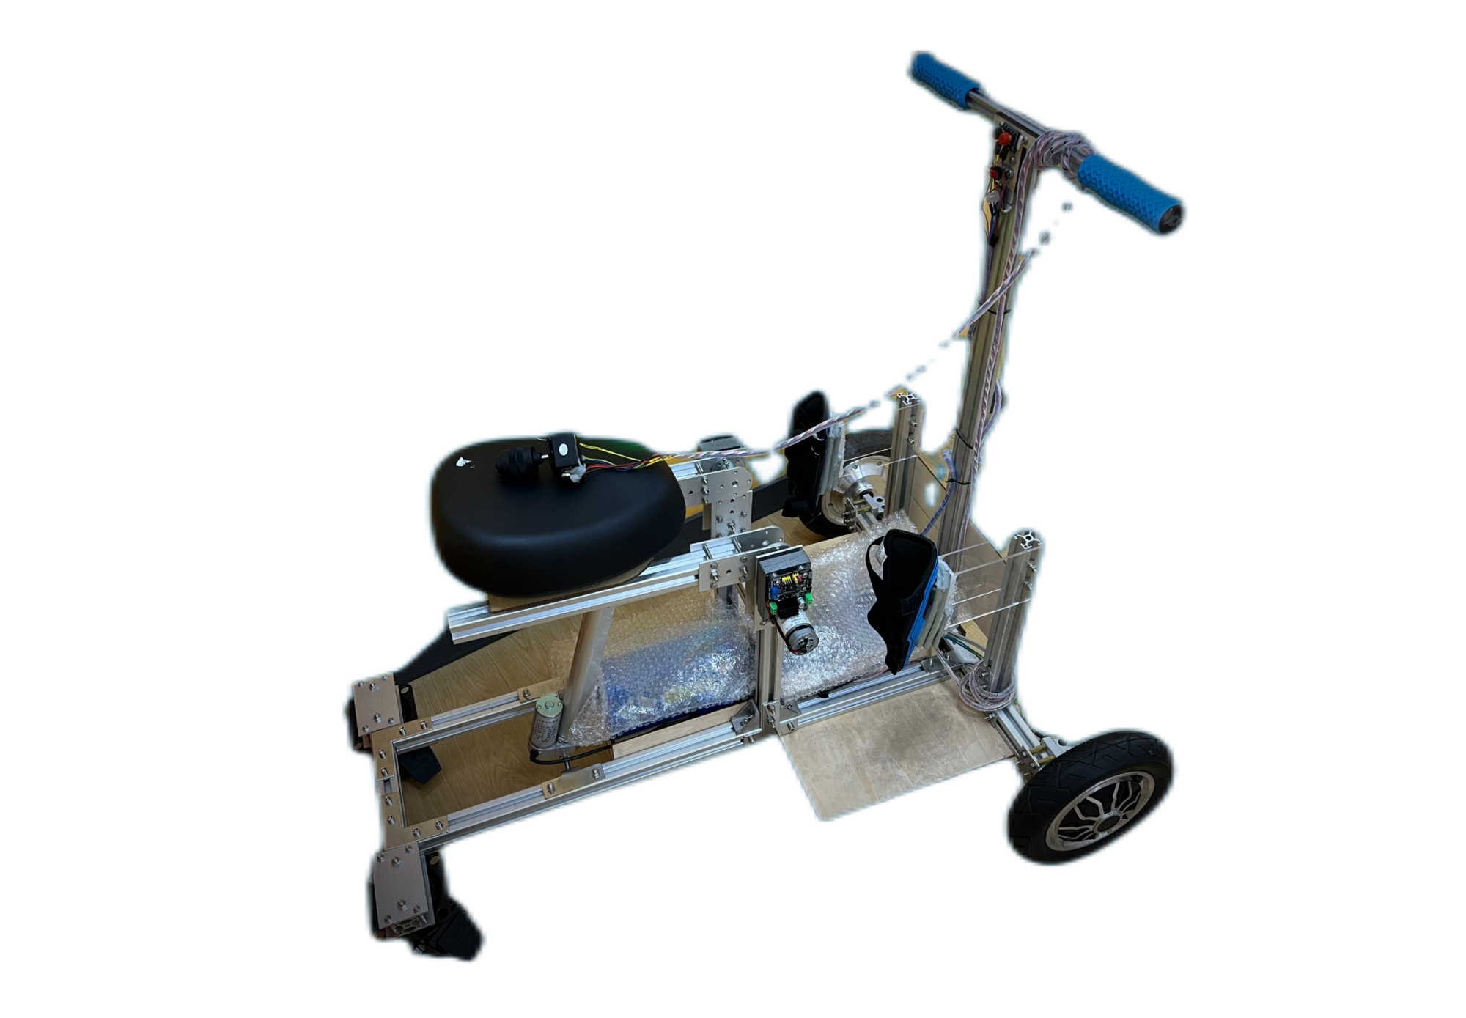
Takes You to See a Farther World
Standing Mobility Device
CX330 Corp.
Amy
CTO
email：amy.chen@prismsus.org

Slide 2
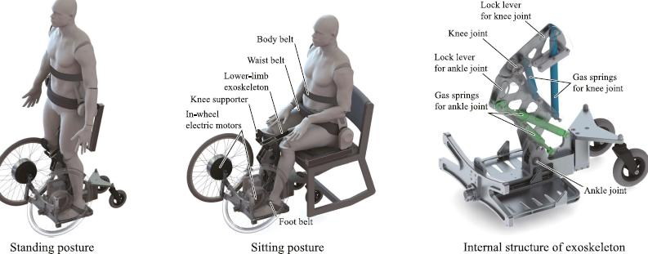
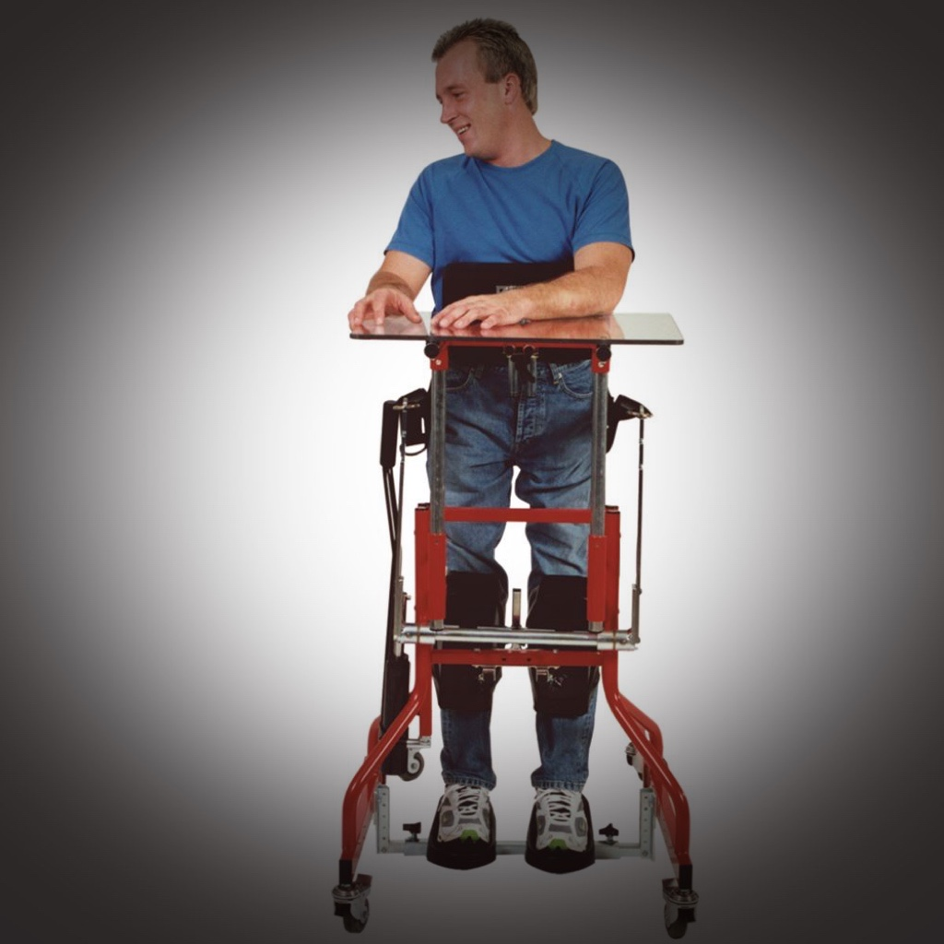
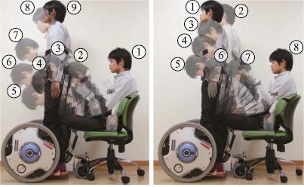
KEYWORD | OTHERS |  | Standing Mobility Device
multi-function | Either mobility Or standing assisted |  | Both mobility And standing
independence | Dependent on human assistance all the time Due to demographic aging and labor shortages, it brings more inconvenience to people paralyzed in lower limbs |  | Stand and move freely WITHOUT external force Designed mechanically and ergonomically to help people with disabilities to stand with a press of button and also move independently
flexibility | Either upright Or prone standing frame upright : suitable for patients with better hand and trunk control prone : suitable for patients with insufficient tension and poorupper trunk control: |  | Change to ANY Position with specific calculation data, help disabled people stand up by pushing a button change their position by using a rocker to go to any position
affordability | Either expensive & complicated OR high level of environment requirements Complicated operation and big size have a certain limitation to some environments. NOT suitable for the elderly home use or outside use. |  | Convenient, Flexible and User-friendly The device does NOT have the problem of complicated structure and difficult operation
relaxation | More back pain and burden of force on trunks The patient may have back pain and the burden of force on the soles of the feet after 30 minutes of assisted standing due to the force. |  | LESS muscle strength for support With electromechanical methods, the patient does not have to rely on his or her own muscle strength for support during use.
safety | Higher risk to lose balance and fall The existing small and easy-to-use walking aids do not have a standing aid function, so when the patient falls and cannot stand up with the walking aid, the situation is likely to deteriorate further when no one is around, and the probability of this happening is about 24%. |  | No need to use his own force to ensure balance The patient does not have to use his own force to ensure balance, but only needs to rely on the seat to fix the position, the probability of falling can be controlled to less than 5%.
INNOVATION

Slide 3
Market Size
2-40 per million
17,000
310,000
249million
17.9%
400million
1/3
594.5 billion
Global medical device market
Degree of population aging
in China
Cases of spinal cord injury
world wide
According to EvaluateMedTech’s analysis, the global medical device market is expected to continue to grow steadily over the next five years and will reach to 594.5 billion.
According to data released by the National Bureau of Statistics of China, as of the end of 2020, the population of people aged 60 and above had reached 249 million, accounting for 17.9% of the total population. It is estimated that by 2035, the elderly population in China will reach 400 million, accounting for nearly one-third of the total population.
According to the World Health Organization (WHO), an estimated
2-40 cases of spinal cord injury occur per 1 million population annually worldwide, with spinal cord injuries being more common in low and middle-income countries. Therefore, hundreds of thousands to millions of people may be affected by spinal cord injury worldwide each year.

Slide 4
Target Consumer Group
& Marketing Strategies
group 2:
Institutions like hospitals, nursing homes, rehabilitation institutions, charity organizations ect
group 1:
Patients with intact lower limbs
but cannot walk and stand.
personal influence
social media
inviting some famous and recognized professors or public figures in the industry to endorse the products.
Public service bazaar, website，social media are also some good promotion channels .
advertising
cooperating with some advertising companies to produce and promote product advertisements
1
2
3
4
5
sales chanels
sales can be made through the official website of the distributor where the product is manufactured, as well as through agents, and direct cooperation with medical institutions.
cooperation
With some medical institutions and other related products for joint promotion。
Marketing

Slide 5
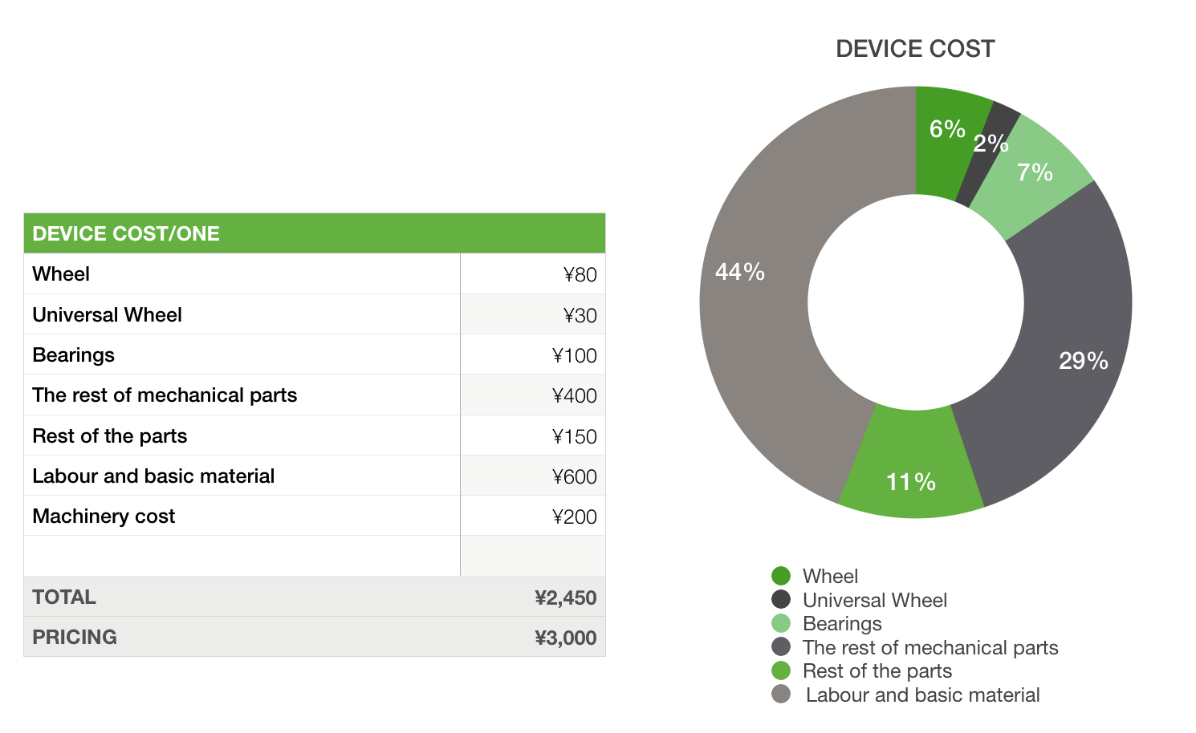
Device Cost
Cost-2450RMB
Pricing-3000RMB
Initial sales gross profit/actual profit
600,000RMB

Slide 6
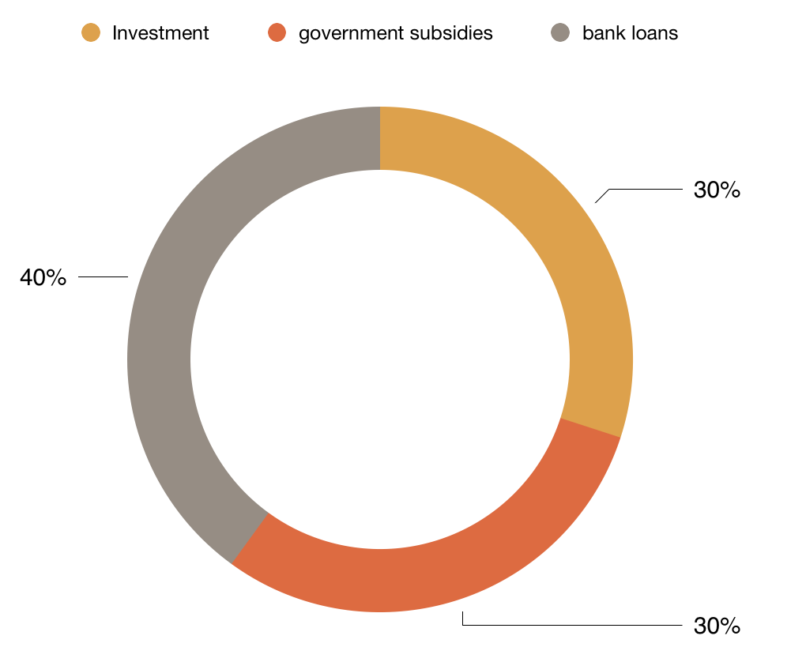
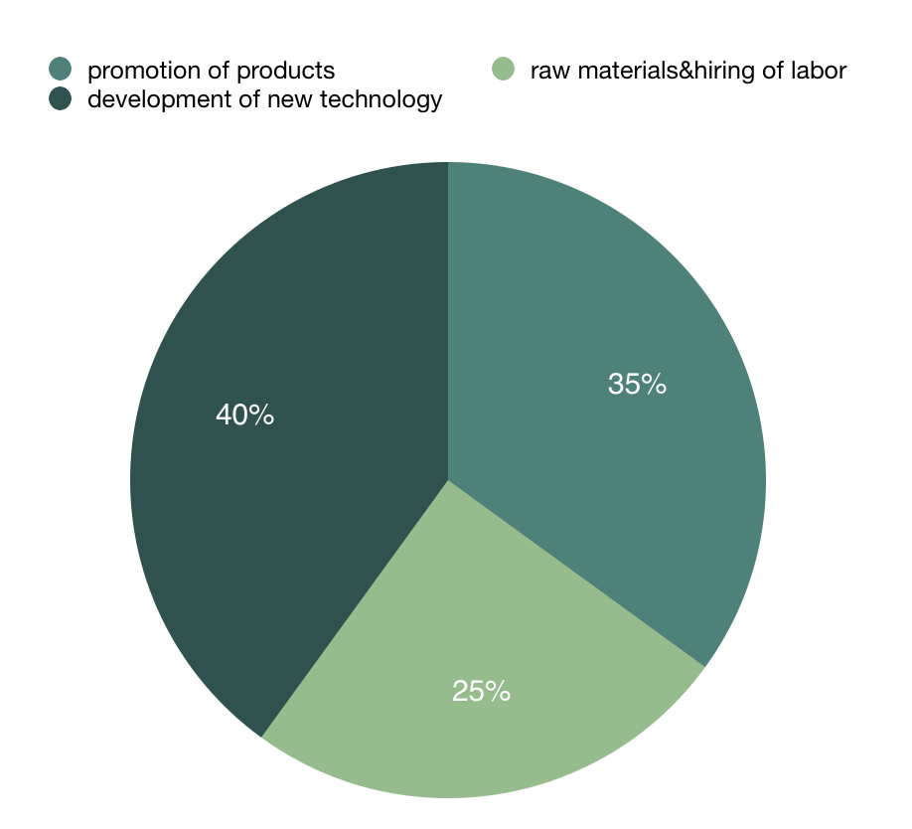
Fundraising
We may need to invest money in advertising for the promotion of our products, as well as in the development and promotion of product-related websites. Also, the investment will be used for the development of new materials and new machinery technology to improve the product and reduce the cost and price of the property through technological improvements. These funds may also be used for the purchase of raw materials and the hiring of labor. The development and promotion of the product is expected to cost 500,000 RMB, which will be obtained through investment, government subsidies and bank loans. Raising investment can inject more capital into the project, while government subsidies can show the government's support for this type of product. A bank loan will ensure the relative stability of the funds.

