Slide 1
Biochemical Nanosensor Networks for Accurate Injury Detection
Lawrence He
Princeton High School
Mercer Science and Engineering Fair 2023

Slide 2
Introduction
Hamst ring inj ury occurs f requent ly among at hlet es.
I am a Division I Epee fencer. Hamstring injuries have impacted my results in several nat ional t ournament s.
This work proposes an architecture of hamstring injury detection. It includes nanosensors and data collectors to gather bio-paramet ers. The goal is to minimize the deployed nano sensors while gathering enough information for accurate injury detect ion and root reason ident if icat ion.

Slide 3
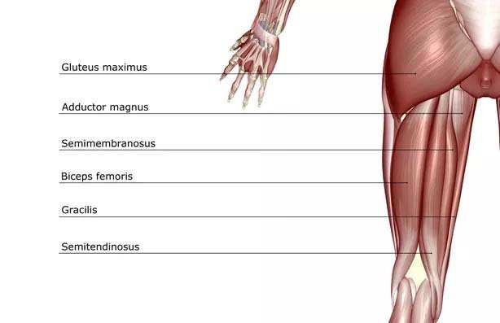
Background
Hamst ring inj ury is a t op inj ury for NCAA at hlet es (3. 05 per 10, 000 sport exposures).
Hamst ring group consist s of many muscles and t endons (Fig. 1). We should accurat ely det ect
t he inj ured part before applying t reat ment .
Body- Sensor Network (BSN) is driven by advances in int egrat ed devices in nano scale.
BSN is believed t o play an essent ial role in
fut ure applicat ions of healt hcare and medical services.
Medical nanosensors are inj ect ed t o human body t o collect vit al dat a on heart rat e,
respirat ory rat e, t emperat ure, blood pressure. Recent work uses nanosensors t o gat her ot her signs such as cholest erol levels, glucose levels, oxygen sat urat ion, as well as images.
Fig. 1 Muscles in Hamstring group

Slide 4
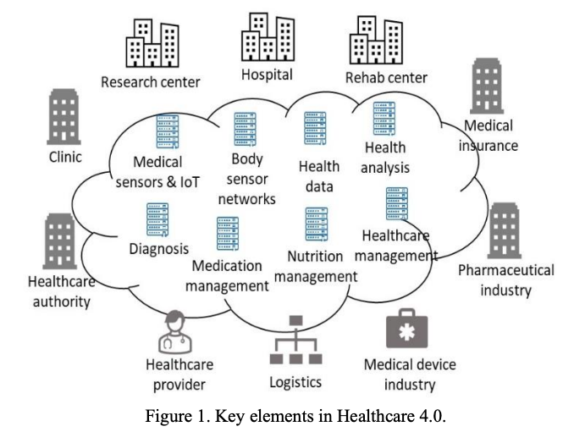
Methodology
Figure 1 shows a diagram of Healthcare 4.0. This is a system that synthesizes
medical sensors
artificial intelligence (AI)
big data
the Internet of Things (IoT)
machine learning
and augmented reality (AR)
to transform the healthcare field.
The BSN will provide data to the Healthcare 4.0 system.

Slide 5
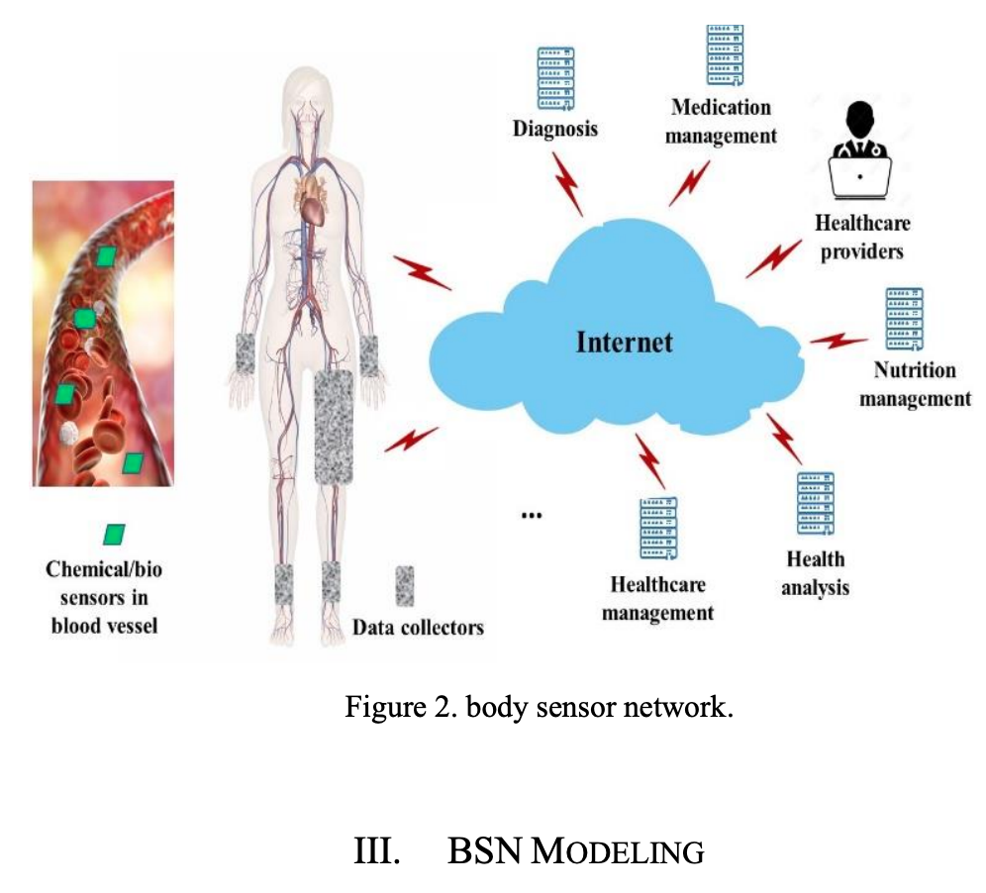
Methodology (cont.)
Fig. 2 shows an architecture of the BSN-based injury detect ion syst em. Nanosensors are
inject ed t o t he circulat ory syst em. Wearable dat a collect ors are placed around t he hamst ring group and ot her places. Nanosensors t ransmit dat a t o wearable devices when f lowing t hrough.
Wearable devices process or t ransmit dat a t o data centers that can be accessed by doctors and physicians.
Nanosensor usage should be limited t o t he ext ent of necessity. The goal is to use the minimum amount of nanosensors t o collect enough dat a.
Fig. 2 Proposed injury detection architecture

Slide 6
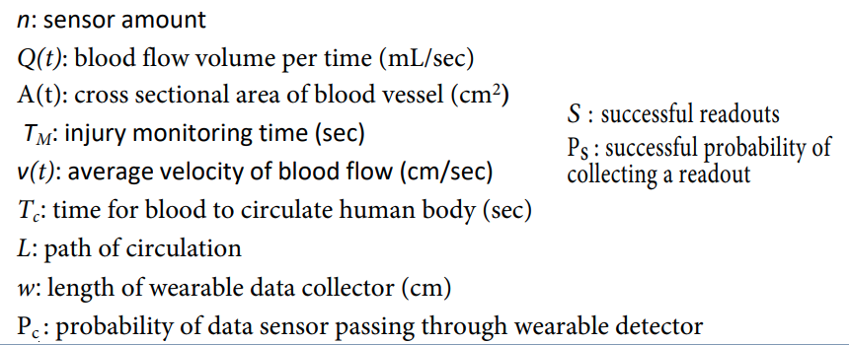
Mathematical Model
Goal:
Get minimum n to meet s ≥ M
Constraints:

Slide 7
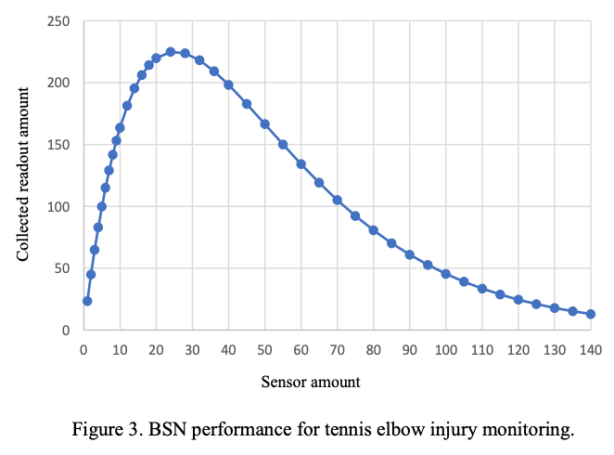
Simulation Results
Fig. 3 shows the performance of the BSN for the tennis elbow injury
A max readout was achieved at about 24 sensors. Notice also that 140 sensors gathers even less information than the first data point. More nanosensors is not necessarily better (the cost is also more).

Slide 8
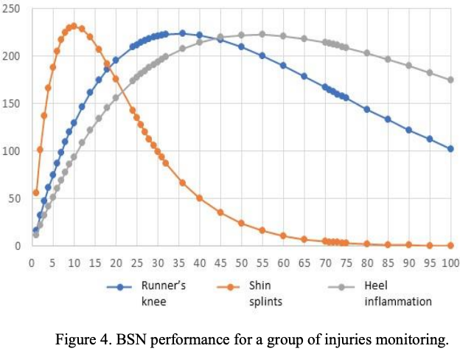
Simulation Results (cont.)
Fig. 4 shows the performance of the BSN for multiple injuries: runner’s knee, shin splints, and heel inflammation
Shin splints: the max readouts was achieved at 10 sensors
Runner’s knee: max readouts at about 35 sensors
Heel inflammation: Max readouts at about 55 sensors
Notice again how more sensors does not equate to more successful readouts

Slide 9
Future Work
Use the BSN architecture to detect other substances in the body such as blood sugar levels and glucose levels
Use the BSN architecture to diagnose diseases and viruses such as COVID-19
Explore the effect of more efficient wearable data collectors on the BSN system
Integrate more powerful and efficient sensors on the BSN system

