Slide 1
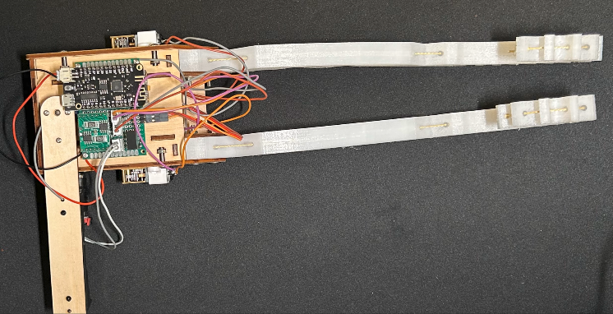
Developing a Soft Robot Inspired by Octopuses for Efficient Ladder Climbing
Senior Division | Category: General Engineering

Slide 2
Introduction & Purpose
The current State of Robotics
Proposed Solution – Soft Robotics
The majority of robots used today are made of stiff, hard materials.
Lacks adaptability and versatility.
Robots will likely need to be extremely versatile in the future since we might require them to travel to foreign plants, climb over cliffs, and squeeze through cracks.
Solution → A new class of robots (Soft Robotics)
Soft robotics is a different approach to designing and building robots with different advantages and disadvantages. Soft robotics is a different approach to designing and building robots with advantages and is made of highly deformable materials that can change shape and adapt to different environments. Hard robots are made of rigid materials that can perform precise and fast movements. Some advantages of soft robotics are:
They can interact safely with humans and delicate objects.
They can mimic biological organisms and learn from them.
They can avoid collision and absorb impact.
They are more malleable and can adapt to different environments.

Slide 3
Goals & Design Criteria
Engineering:
Create a robot with chassis that can carry all of the sensors and motors with great structural integrity, is capable of grabbing and climbing a ladder consistently, and have a program that grants user control and automatic action.
Includes a pair of soft robotics arms.
Use any Arduino mainboard.
Two to four motors capable of controlling the arm and pulling the robot upwards.
An angle sensor that has angle feedback.
A servo that can control weight to balance the robot.
Have a Bluetooth module to allow user control.
Programming:
Create a program with Arduino and libraries to control the sensors and motors. Then write a program to allow user control through Bluetooth and some automatic actions programmed into the robot previously.
A program that can control motors and sensors through respective libraries.
With Bluetooth control built-in.
Have automatic actions built in.

Slide 4
Methods
Research
Do research on every component.
Purchase
Buy all of the necessary materials.
Create chassis design and assemble the robot.
Program
Program the robot to receive Bluetooth signals.
Calibrate
Calibrate the servo and motors to move fast and accurately.
Experiment
Experiment with the robot to check its abilities.
Rinse & Repeat
Create multiple iterations of the robot.
Design & Build
Calibrate the angle sensor and use algorithms to filter values.
Find out where it can improved.

Slide 5
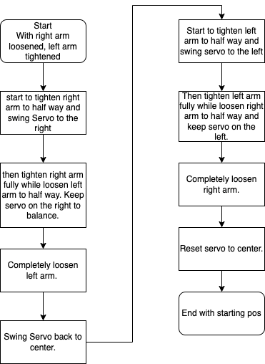
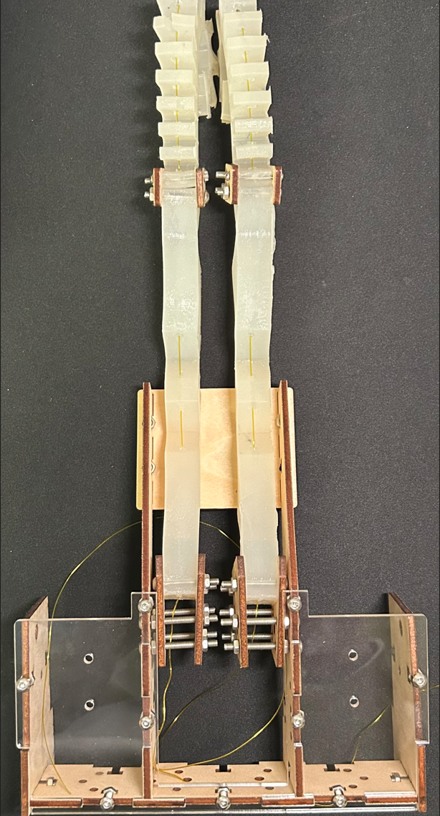
Robot Design – First Iteration
Hardware:
Contains a laser-cut plywood chassis with enough room to place all of the necessary components.
Two rubber arms with string holes through.
A servo attached to the bottom of the robot to balance weight.
Two motors mounted at the bottom of the robot.
Uses Infrared remote to control the robot.
Software:
- The program simply consists of the robot moving each arm once and stopping.

Slide 6
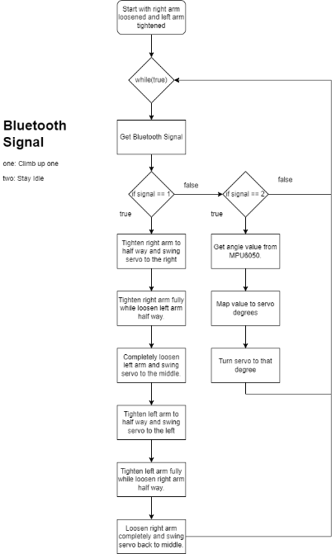
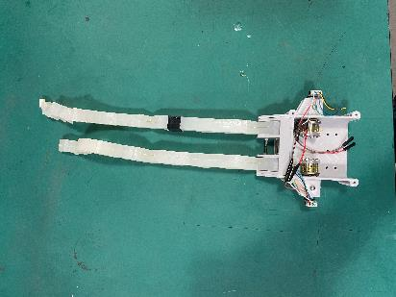
Robot Design – Second Iteration
Hardware:
Uses a 3D-printed chassis with screws and two independent chambers for the motors.
Uses a special string mechanism to tighten and loosen the spring.
All motors and sensors mounted directly to the chassis body.
Using Bluetooth to control the robot instead of infrared.
Software:
- The program now consists of a loop that will keep moving and have self-correct with a servo at the bottom.

Slide 7
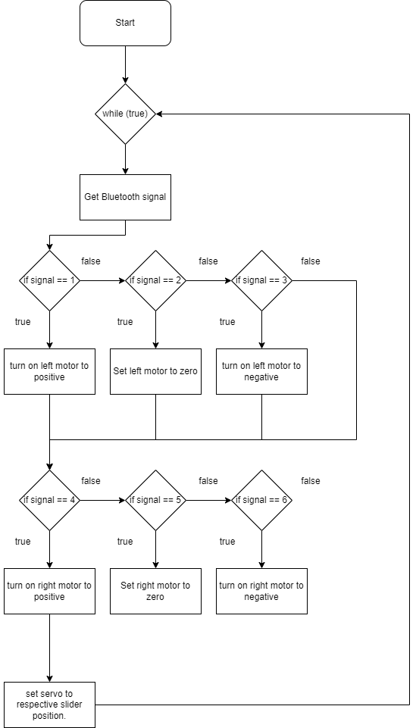
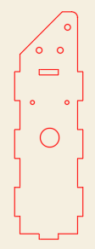
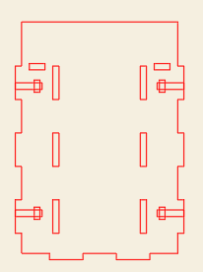
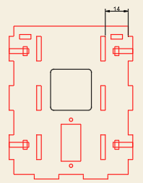
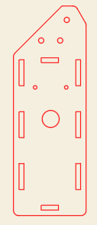
Robot Design – Third Iteration (Final)
Hardware:
Uses a plywood chassis again because of the lighter weight.
Improved upon the last string mechanism.
Changed the arm material and completely redesigned previous designs.
Uses ESP-32 as the mainboard.
All wires are soldered together.
Added two additional motors, which are now mounted with a special mounting bracket.
Changed the Bluetooth module.
Software:
- This is the most complicated program out of all as it allows the most user control.

Slide 8
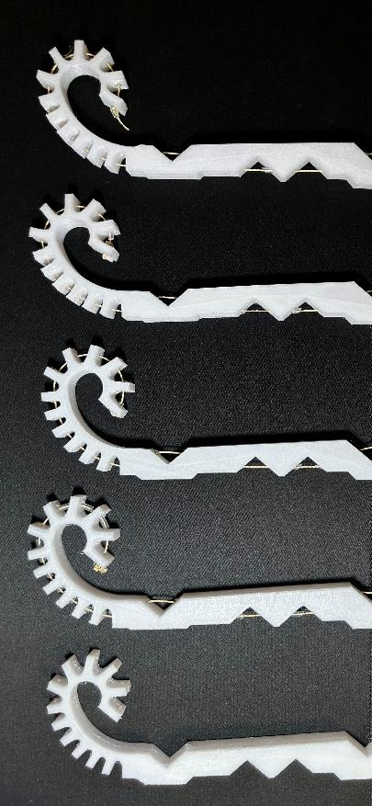
Experiment and Data
Arm Testing
Climb Testing
It’s tested that the current robot can climb a ladder at about one interval (can vary) for every 7 seconds.
It’s successful for a range of ladder intervals. (any length less than 10 cm)
 | Joint 0 | Joint 1 | Joint 2 | Joint 3 | Joint 4 | Total Force
1st from left | 5 (N) | 7 (N) | 7.5 (N) | 8.5 (N) | 11 (N) | 75 (N)
2nd from left | 5 (N) | 9 (N) | 7.5 (N) | 8.5 (N) | 9 (N) | 67 (N)
3rd from left | 5 (N) | 7 (N) | 7.39 (N) | 8.5 (N) | 11 (N) | 62 (N)
4th from left | 3.2 (N) | 7 (N) | 7.39 (N) | 8 (N) | 10 (N) | 55 (N)

Slide 9
Analysis
Arm:
Forces required to bend the joints need to be carefully tuned.
Forces required to bend the joints should gradually increase to allow them to bend gradually, with the exception of joint two and three which bends at the same time.
Modifying forces required to bend joints is as simple as a thickening or thinning of the materials on the joint as well as changing the joint intervals.
(Exact intervals, Thickness of each joint)
Chassis:
From all three iterations of the robot, it’s concluded that the best material for the chassis is plywood because of its low mass, and the chassis also need to stay compact to reduce as much redundant weight as possible.
Besides, there must be holes where the sensors, motors, and mainboard can be placed. Without them, they will be very unstable. Wires also need to be soldered, as when they are left unsoldered; they fall out easily.
(Compact, Light, Soldered wires)

Slide 10
Advantages & Disadvantages
Low cost Efficient & Accurate
Soft, malleable, and adaptable
Using a single motor with a structural design to realize the compound action of flexible tentacles
Lacks accurate control.
Each action may vary due to the inaccuracy of robot control.
Arduino’s lack of multithreading.
Only one string for each arm.

Slide 11
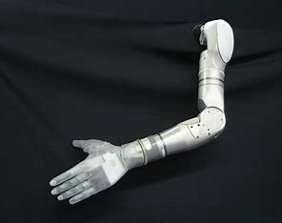
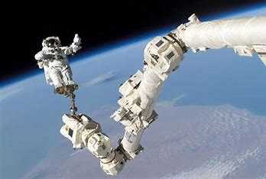
Conclusion
- it can be concluded that this direction of soft robotics is very practical and has a bright future. It can release many people from performing dangerous tasks and substitute them while also helping disabled people regain control and l. Certain tasks that are done with hard robotics can also be replaced with soft robotics for a better result.
Future Plans:
- Improve upon accuracy.
- Incorporate an app (built from the ground up) to discover and connect at once instead of relying on third-party Bluetooth.
- increase its ability to climb on more surfaces instead of limiting its ability to climb only on ladders.

Slide 12
References
Margheri, L., Laschi, C., & Mazzolai, B. (2012). Soft robotic arm inspired by the octopus: I. From biological functions to artificial requirements. Bioinspiration & Biomimetics, 7(2), 025004. https://doi.org/10.1088/1748-3182/7/2/025004
Mazzolai, B., Margheri, L., Cianchetti, M., Dario, P., & Laschi, C. (2012). Soft-robotic arm inspired by the octopus: II. From artificial requirements to innovative technological solutions. Bioinspiration & Biomimetics, 7(2), 025005. https://doi.org/10.1088/1748-3182/7/2/025005
Iida, F., & Laschi, C. (2011). Soft Robotics: Challenges and Perspectives. Procedia Computer Science, 7, 99–102. https://doi.org/10.1016/j.procs.2011.12.030
Cianchetti, M., Arienti, A., Follador, M., Mazzolai, B., Dario, P., & Laschi, C. (2011). Design concept and validation of a robotic arm inspired by the octopus. Materials Science and Engineering: C, 31(6), 1230–1239. https://doi.org/10.1016/j.msec.2010.12.004
‌Calisti, M., Corucci, F., Arienti, A., & Laschi, C. (2015). Dynamics of underwater legged locomotion: modeling and experiments on an octopus-inspired robot. Bioinspiration & Biomimetics, 10(4), 046012. https://doi.org/10.1088/1748-3190/10/4/046012

