Slide 1
PROSPECTS FOR BRAIN-COMPUTER INTERFACES: NEURALINK VS. STENTRODE
Christine Wu

Slide 2
Introduction
Brain Computer Interface is a technology that directly connects the brain with an external apparatus, such as a computer or robotic limb, by recording, interpreting, and giving commands based on neuron firing patterns.
Conditions that can be treated by BCI modulated stimulation or a BCI external device:
Neurological disorders such as epilepsy and Tourette's syndrome
Paralysis, resulting from spinal cord injury, amputation, motor neuron disease, stroke, and more
Degenerative disorders such as Alzheimer’s and Parkinson’s
Anxiety disorders such as OCD
Two prominent BCIs: Neuralink’s Link device and Synchron’s Stentrode

Slide 3
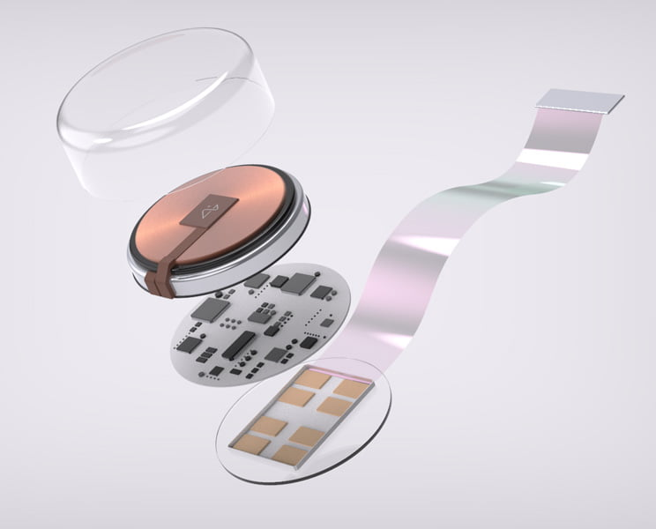
The Neuralink Approach
23mm diameter
Requires open brain surgery by a robotic sewing machine
Open a hole in the skull
Sew back together
Wireless bluetooth connection between link and external device
https://mixed-news.com/en/neuralink-to-test-brain-chips-on-humans-for-the-first-time/
Notes:
Wireless bluetooth connection between link and external device
No wires sticking out of head, unlike more traditional BCIS such as utah array

Slide 4
The Neuralink Approach
Strengths:
Link directly contacts brain tissue
Higher signal bandwidth
Ability to access deeper parts of brain
Weaknesses:
Invasive
Glial scar tissue buildup as regenerative method
Compromised ability to record signals
Permanent damage - Inability for axons to bridge scar tissues and for nerves to regrow
Inflammation

Slide 5
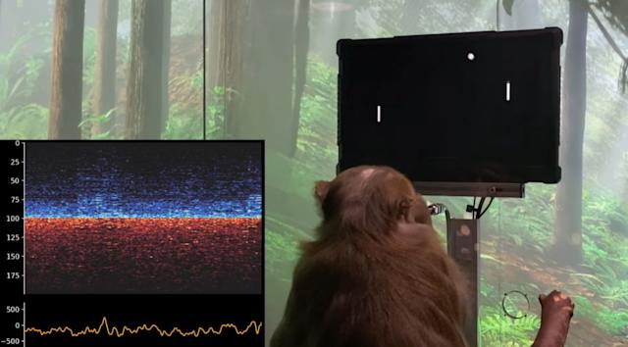
Neuralink Pre-Clinical Trial
Neuralink has been tested on pigs and monkeys, but has not published any data on their trial.
Out of the 23 monkeys Neuralink tested between 2017 and 2022, only 7 survived.
Monkeys experienced seizures, paralysis, and so much suffering they pulled out their own hairs.
At least one monkey underwent brain bleeds and severe vomiting.
https://www.engadget.com/monkey-mindpong-link-003709524.html

Slide 6
Neuralink Clinical Trial
Neuralink applied for FDA approval of a clinical trial in December 2022 but has not yet received a decision.
In December 2022, Neuralink claimed that they’re working closely with the FDA and clinical trials will start within six months.
In 2019, Musk said the company is hoping for human trials by the end of 2020.
In May 2020, February 2021, and December 2021, Musk claimed that human trials would begin within a year.

Slide 7
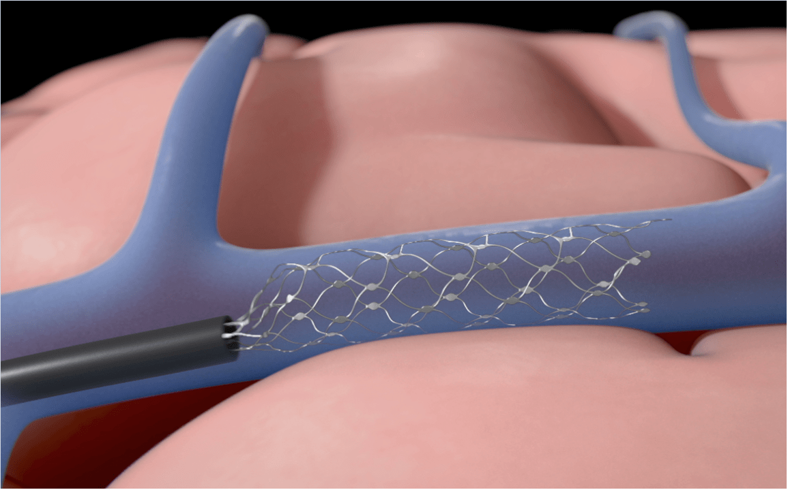
The Stentrode Approach
4mm diameter
Endovascular approach - 2 hour surgery
Transports from jugular vein to Superior sagittal sinus
Catheter tube pulled out, stentrode self expands
Each disk can record activity of 10,000 neurons
Delicate wires transport signal to wireless transmission system in chest
https://neuronewsinternational.com/stentrode-receives-fda-breakthrough-device-designation/

Slide 8
The Stentrode Approach
Strengths:
Non-invasive Endovascular Approach
Safer
Weaknesses:
Inability to reach deeper parts of the brain
Limited signal bandwidth

Slide 9
Stentrode Pre-Clinical Trial
Among the eight sheep tested, stimulation-induced motor responses were achieved from 58% of implanted electrodes.
Neurovascular stent stimulation successfully elicited responses from the lip, face, jaw, neck and limb of the sheep.
An endovascular electrode array was also tested in sheep and use for comparison.
Contrasting the invasive array, the Stentrode approach delivered an observable pattern of activation, demonstrating the great potential of the Stent device.
Lead induced risks of stenosis and thrombosis were properly addressed and possible solutions were discussed.

Slide 10
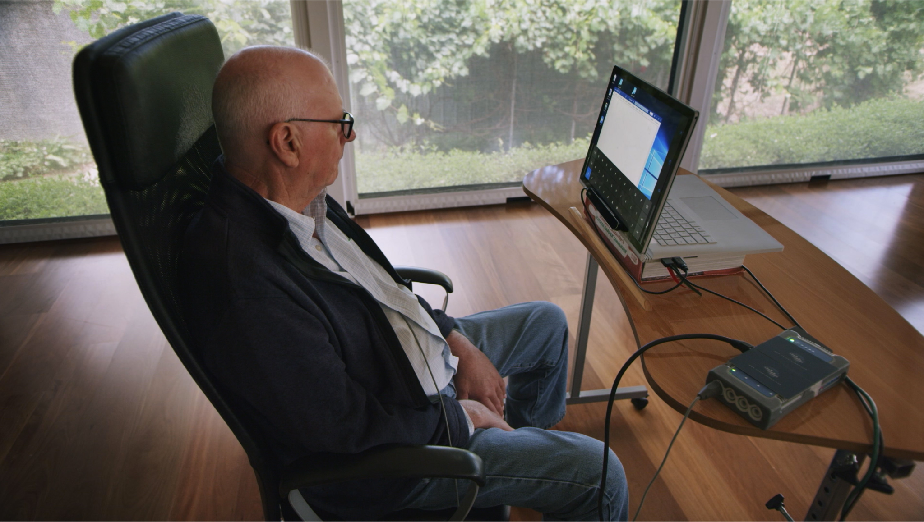
Stentrode Clinical Trial
Four severely paralyzed patients with Amyotrophic Lateral Sclerosis were able to gain unsupervised home use of Stentrode to complete daily online tasks.
12 months after implant, there were no adverse events and no device migration.
Signal strength was stable throughout, with an average bandwidth of 233 Hz.
Each patient successfully learned to control a computer.
https://www.businesswire.com/news/home/20201028005613/en/Patients-with-Severe-Paralysis-Use-Stentrode-Brain-Computer-Interface-to-Text-Email-Shop-Bank-Online-First-in-human-Study-Reports

Slide 11
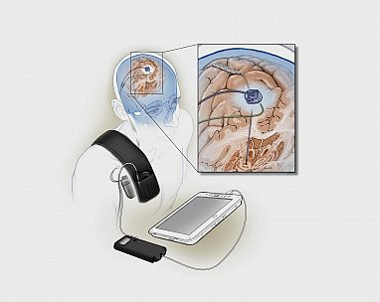
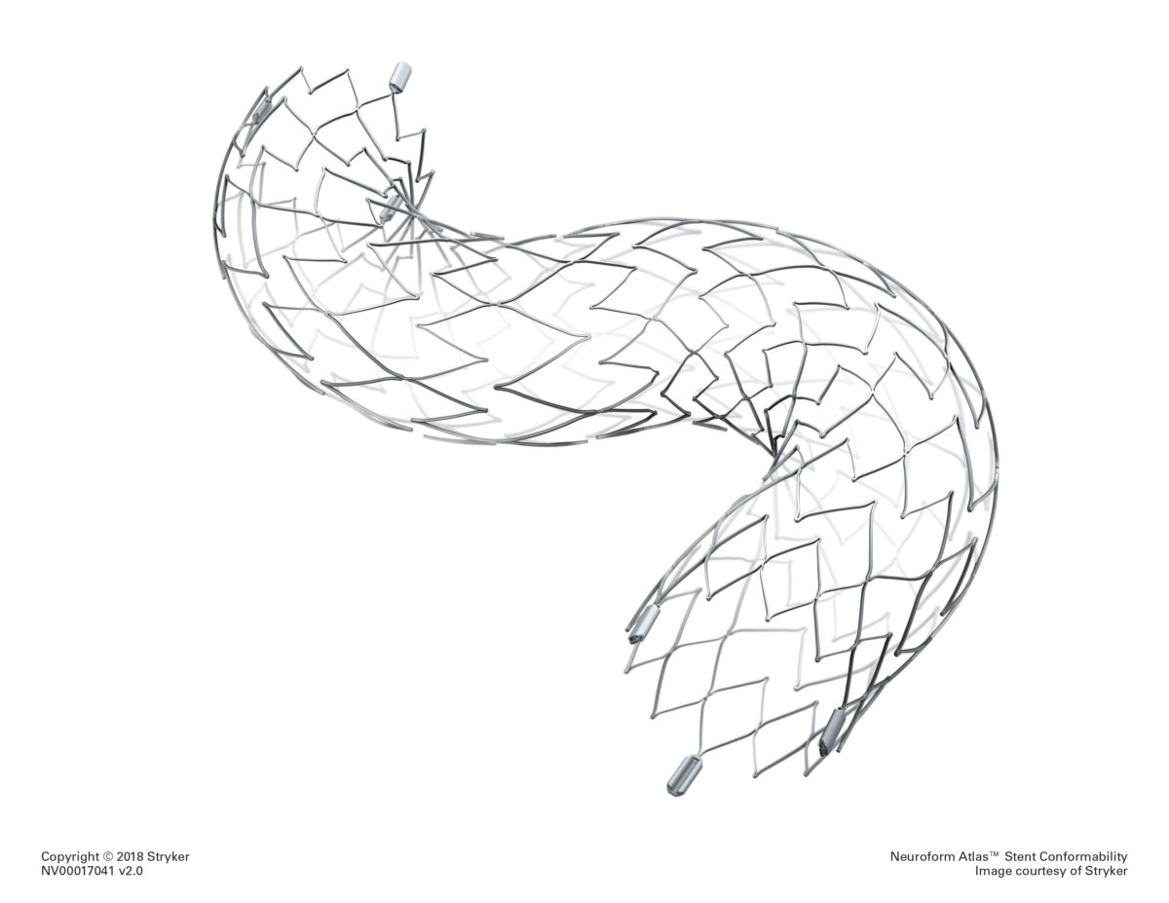
Methods
As the Link and Stentrode are relatively new, other products were used to model the approaches.
Adverse event trends for Deep Brain Stimulators for OCD and Implanted Brain Stimulator For Epilepsy can indicate possible adverse events that may occur for Neuralink, an implanted brain-computer interface
Adverse event trends for Intracranial Neurovascular Stents can indicate possible adverse events that may occur for Stentrode, a minimally invasive endovascular brain-computer interface.
Potential adverse events of Neuralink and Stentrode were analyzed through recording adverse event data from the FDA MAUDE (Manufacturer and User Facility Device Experience) Adverse Events database.
https://www.nih.gov/news-events/nih-research-matters/adaptive-deep-brain-stimulation-parkinsons-disease
https://lsom.uthscsa.edu/neurosurgery/stryker-neurovascular-atlas-stent/

Slide 12
Research Questions
What adverse events are possible for an implanted brain-computer interface such as Neuralink? What can we learn from existing devices that are implanted in the brain, such as deep brain stimulators? Could the outcome of the primate studies have been avoided with a better understanding of adverse events?
What adverse events are possible for an endovascular brain-computer interface such as Stentrode? What can we learn from existing devices that are introduced into the blood vessels of the brain, such as intracranial neurovascular stents?

Slide 13
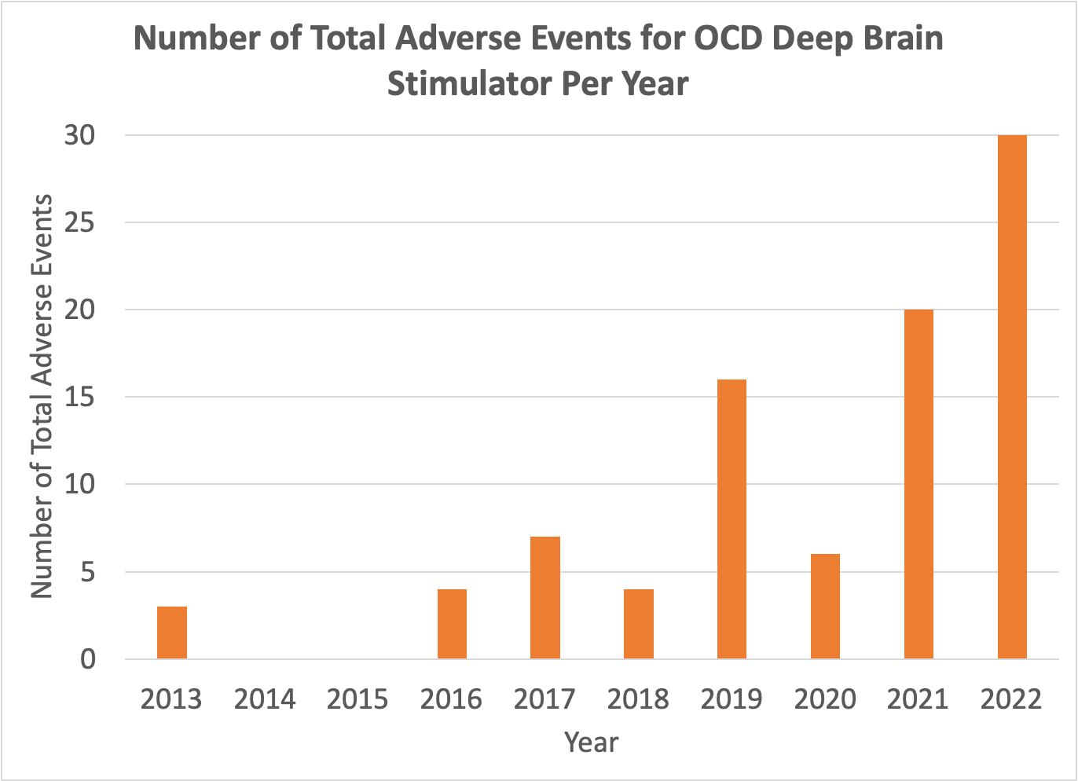
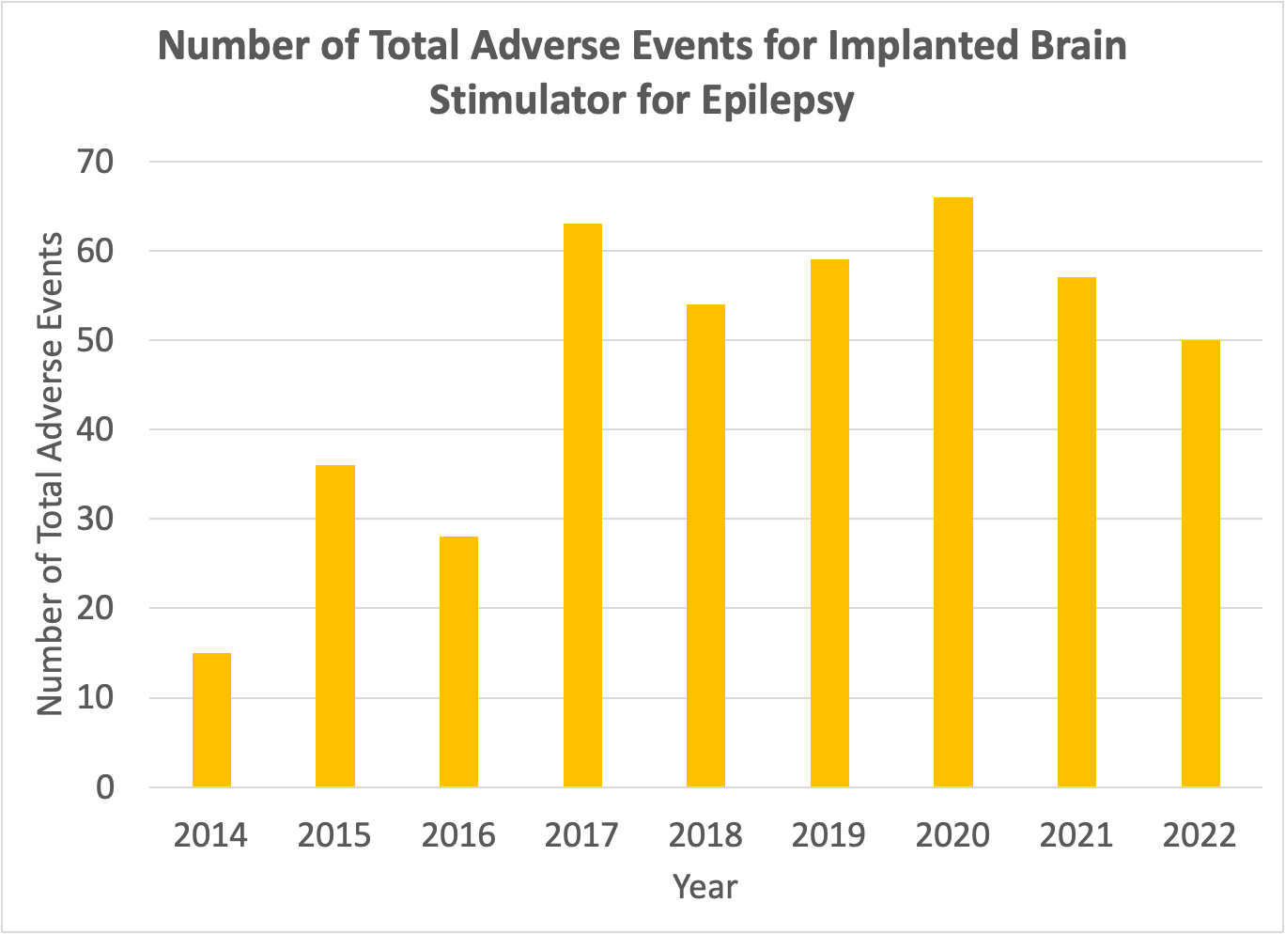
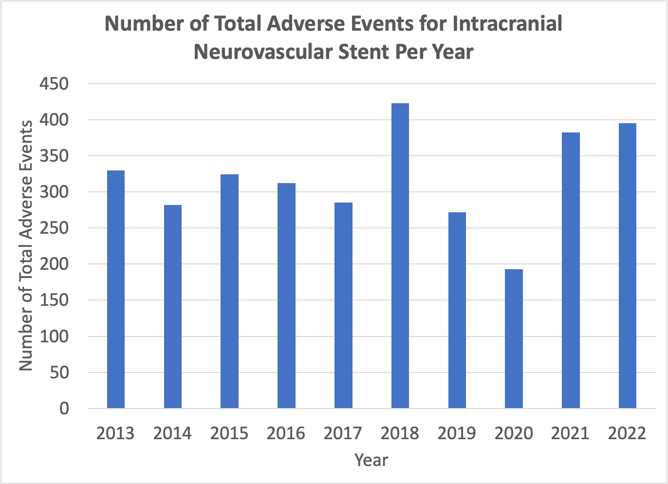
Results

Slide 14
Results
A T-Test was performed using monthly adverse events data from the starting search year to 2022.
The increase in OCD Deep Brain Stimulator Adverse Events from 2013 to 2022 was significantly important (p<0.01)
The increase in Implanted Brain Stimulator for Epilepsy Adverse Events from 2014 to 2022 was significantly important (p<0.007)
The increase in Intracranial Neurovascular Stent Adverse Events from 2013 to 2022 was not significantly important (p>0.3)
From the starting search year to 2022, invasive products OCD Deep Brain Stimulator and Implanted Brain Stimulator for Epilepsy showed an increasing trend in adverse events, whereas Intracranial Neurovascular Stent showed a steady trend.

Slide 15
Results
Possible reasons for rise in adverse events for OCD Deep Brain Stimulators and Implanted Brain Stimulator for Epilepsy
More procedures being performed
Since DBS was first developed in 1987, it’s unlikely that the late 2010s and early 2020s saw a sudden influx of patients.
Patients are in worse condition
We would expect to see a decrease in adverse events with more clinical experience, not an increase. The increase in adverse events for deep brain stimulators, modeling Neuralink’s invasive approach, is concerning.

Slide 16
Conclusion
Based on successful pre-clinical and clinical trials, as well as the steady adverse events data trend, it is recommended that minimally invasive approaches such as Stentrode be prioritized in brain-computer interface research.

Slide 17
Citations
https://www.youtube.com/watch?v=M5w8s2PKwxI
https://www.youtube.com/watch?v=YreDYmXTYi4
https://www.businessinsider.com/neuralink-elon-musk-microchips-brains-ai-2021-2#elon-musk-said-neuralink-hopes-to-start-implanting-its-chips-in-humans-in-2022-two-years-later-than-hed-originally-envisaged-10
https://www.pcrm.org/ethical-science/animals-in-medical-research/physicians-committees-response-neuralinks-nov-30-2022-show-and-tell#:~:text=Monkeys%20suffered%20paralysis%2C%20seizures%2C%20and,monkeys%20used%20at%20UC%20Davis.
https://pubmed.ncbi.nlm.nih.gov/31015730/
https://www.ncbi.nlm.nih.gov/pmc/articles/PMC7193719/
https://www.businesswire.com/news/home/20220329005986/en/Synchron-Announces-Long-Term-Safety-Results-from-Fully-Implanted-Endovascular-Brain-Computer-Interface-Stentrode%E2%84%A2-for-Severe-Paralysis
https://www.ncbi.nlm.nih.gov/pmc/articles/PMC3785222/#:~:text=Much%20of%20the%20recent%20scientific,and%20PD%20at%20Grenoble%2C%20France.
https://www.massdevice.com/synchron-study-backs-brain-computer-interfaces-safety/
https://www.nature.com/articles/s41551-018-0321-z

