Slide 1
Novel Quantum Materials for Low Power Electronics
Shloka Shriram
Princeton High School

Slide 2
Global Energy Consumption
Challenge: AI & Computing Devices
Challenge: Thermal Regulation Systems
ChatGPT’s energy consumption = 175,000 people
AI consumption >85 terawatt-hours per year by 2027
Electronic switch between conducting & insulating states
30% of energy worldwide used by buildings
60% of energy consumed by buildings for heating/cooling
Windows cannot switch optical reflectance
Solution: Brain Inspired Computing
Solution: Thermochromic Windows
Human brain = ~20 watts of energy
Switches mimic neurons and synapses
Passive thermal control enables temperature regulation
Optical switch: changes reflectance based on temperature
Quantum Materials
Sharp electrical & optical switching properties under external stimuli
Vanadium Dioxide (VO₂) widely studied

Slide 3
Vanadium Dioxide (VO₂)
Insulator-Metal Transition (IMT)
Sharp electrical/optical switch at 340K (67ºC)
Electrical switch in conductivity: insulator → metal
Optical switch in reflectance: transparent → opaque
Tungsten (W 6+) Doping
n-type dopant: increases conductivity, weakens insulating state
Different ionic radius than V: structural strains
Reduces the IMT temperature to room temperature (300K, 30ºC)
Scientific Questions
How does doping concentration affect the IMT temperature?
How does ionic radii of the dopant affect the IMT temperature?
How does threshold voltage relate to the IMT temperature?
Can semiconductor models estimate IMT properties?
Can doping concentration be measured in VO₂?
Fig. 1: Tungsten Doping of VO₂

Slide 4
Vision, Objectives, and Process
Vision
Objectives
Accelerate the use of quantum materials (W-VO₂) in real world technologies (brain-inspired computing, thermochromic windows)
Create models for W-VO₂ to establish relationships between dopant and IMT characteristics
Enable predictions of the tunable IMT properties
Process
1. Data Collection
Conducted literature review of experimental data from the past 20+ years
2. Model Creation
Analyzed data to build models and determine relationships
3. Model Validation
Compared model against the Adler Impurity Conduction Model
4. Predictive Simulation
Simulated Rutherford Backscattering Spectroscopy (RBS) for determining doping concentration

Slide 5
Q1: IMT Temperature vs. W-Doping Concentration
Fig. 2: IMT Temperature (K) and W-doping Concentration (at. %)
Fig. 3: IMT Temperature (K) and W-doping Concentration (at. %) <1.6 at. % W
Tungsten doping continuously decreases the transition temperature
Up to ~1.6 at. % W, a linear relationship exists (~-21K/at. % W)
Beyond 1.6 at. % W, clear change in trend → structural distortions

Slide 6
Q2: Dopant Ionic Radii vs. IMT Temperature
Fig. 4: Rate of Decrease (C/at. %) and Dopant Ionic Radius (pm)
Fig. 5: IMT Temperature (K) for 3 at% dopant concentration and Dopant Ionic Radius (pm)
Ionic radius vs. rate of decrease in IMT temperature: no correlation
Dopant ionic radius vs. IMT temperature for 3%: no correlation
Structural effects not as significant as electronic effects

Slide 7
Q3: Threshold Voltage vs. IMT Temperature
Threshold Voltage: minimum voltage needed to drive IMT
IMT temperature and threshold voltage are directly correlated
Common mechanism for electrical and thermal switching
At 1.6 at.% W:
IMT temperature is ~300K (30ºC)
Threshold voltage decreased by 76%
Fig. 6: Relationship Between Transition Temperature at at. % W and Threshold Voltage at at. % W

Slide 8
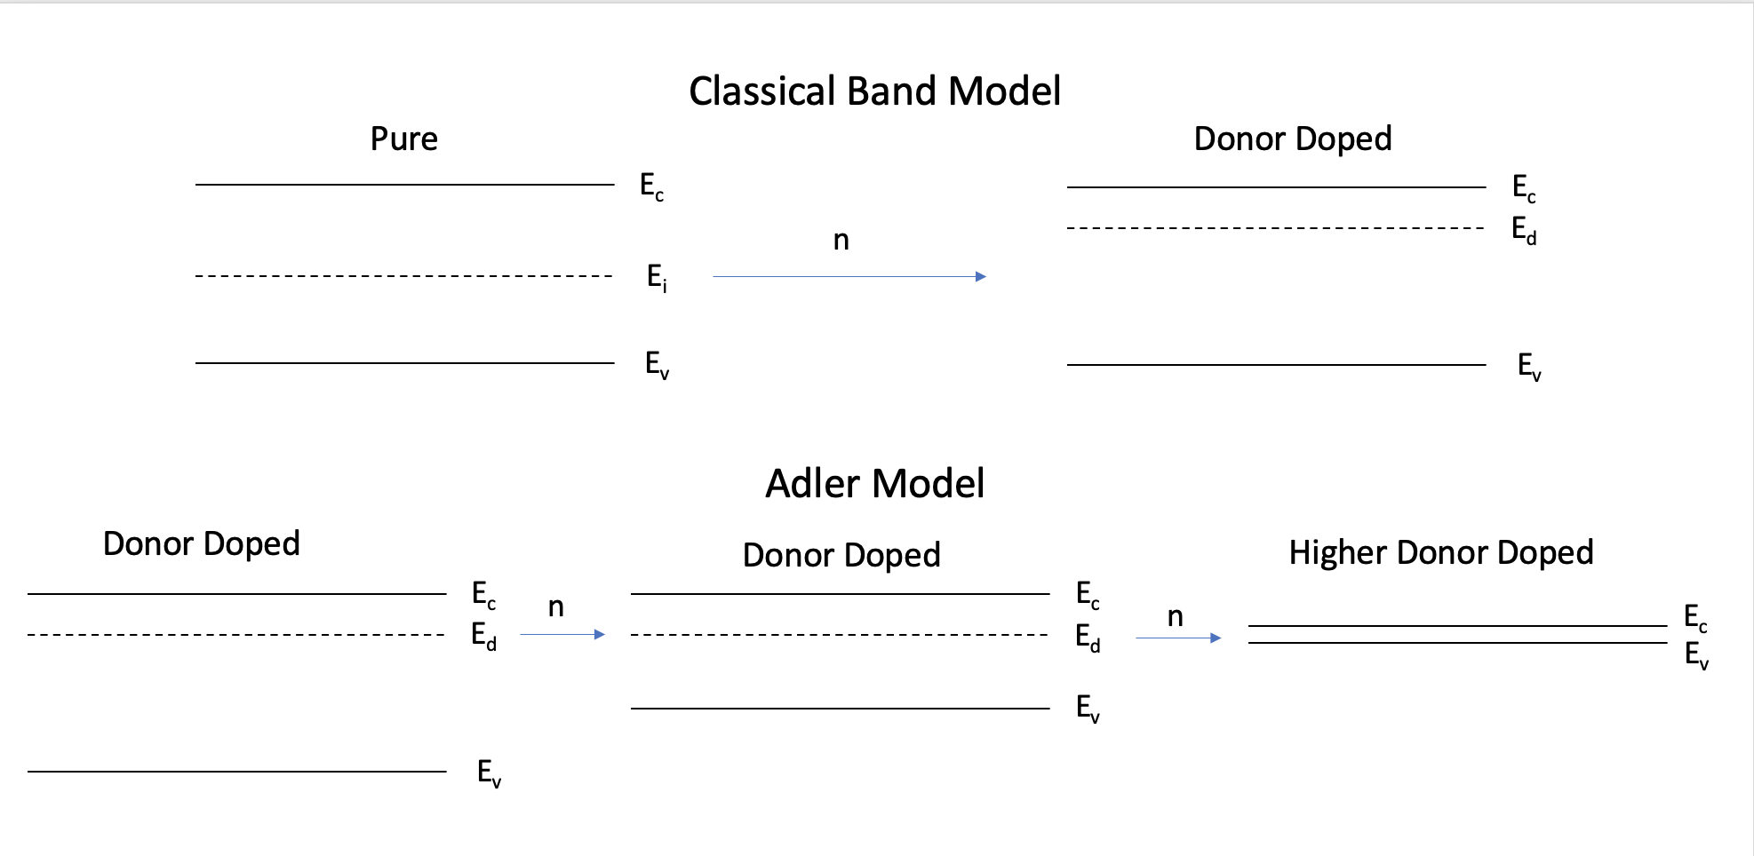
Q4: Adler Impurity Conduction Model
Combines semiconductor doping theory with IMT in quantum materials
Where E_{g} is the band gap, k is the Boltzmann constant, T_{t} is the transition temperature, x_{d} is the dopant concentration
Reduction in activation energy due to W doping supports model
$$\frac{E_{g}}{kT_{t}}=8.1\left(1+4x_{d}\right)+\left(\frac{x_{d}}{2}\right)\ln{(\frac{1}{x_{d}}})$$
Fig. 7: Schematic of a Classical Band Model and the Adler Impurity Conduction Model
Fig. 8: Activation Energy (meV) and W-doping Concentration (at. %)

Slide 9
Q4: Validation of My Linear Model
Source | Rate of Decrease (K/at%)
Linear Model (This Work) | 20.82
Zhang et al., 2013 (Density Functional Theory – hybrid functionals) | 18.6
Zhang et al., 2013 (Density Functional Theory – GGA + U) | 27
Fig. 9: Percent Difference in Transition Temperature (Tt) as a Function of W-Doping
Table 1: Comparison of My Model and DFT Reports
Linear Model (~-21K/at% W) agrees with Adler Model at low doping density
Adler Model has a non-linear term → differences at higher concentrations
Model agrees with other theoretical literature reports

Slide 10
Q5: Estimating W Concentration in VO2 with RBS
O
V
W
Fig. 10: RBS Spectra of Varying WxV1-xO2
Fig. 11: RBS Spectra of Varying WxV1-xO2 (W Peak)
Rutherford Backscattering Spectroscopy (RBS): characterization tool
Simulations with SimNRA yield spectra of W_{x}V_{1-x}O₂
RBS can be used to determine W concentration in nanoscale materials

Slide 11
Summary
Created quantitative, linear models to establish relationships for W-VO₂
IMT temperature, threshold voltage, W doping concentration
Conserve experimental resources, guide materials discovery
Significant cost savings and accelerated timelines for mainstream use of VO₂
Models enable predictive design of IMT properties for energy efficient technologies
Models predict 1.6 at.% W-doped VO₂ can reduce energy consumption by 76%, operates at room temperature
Applications: brain-inspired computers, thermochromic windows

Slide 12
Thank you!
Acknowledgements
Dr. Hussein Hijazi (Rutgers University, Department of Physics)
Ms. Jacqueline Katz (Princeton High School)
Center for Nanoscale Materials, Argonne National Laboratory
Discussions at Fall 2023 Materials Research Society Meeting, Boston
PHS Research Program
Ms. Smolyn, Mr. Eastburn, Mr. Smirk
Dr. Barnes-Johnson
Selected References
de Vries, A. (2023). The growing energy footprint of artificial intelligence. Joule, 7(10), 2191-2194.
Kamalisarvestani, M., R. Saidur, S. Mekhilef, and F. S. Javadi. Performance, materials and coating technologies of thermochromic thin films on smart windows. Renewable and Sustainable Energy Reviews 26 (2013): 353-364.
Adler, D., & Brooks, H. (1967). Theory of semiconductor-to-metal transitions. Physical Review, 155(3), 826.
Xue, Y., & Yin, S. (2022). Element doping: a marvelous strategy for pioneering the smart applications of VO 2. Nanoscale, 14(31), 11054-11097.
Shao, Z., Cao, X., Luo, H., & Jin, P. (2018). Recent progress in the phase-transition mechanism and modulation of vanadium dioxide materials. NPG Asia Materials, 10(7), 581-605.
Shen, N., Chen, S., Shi, R., Niu, S., Amini, A., & Cheng, C. (2021). Phase transition hysteresis of tungsten doped VO2 synergistically boosts the function of smart windows in ambient conditions. ACS Applied Electronic Materials, 3(8), 3648-3656.
Niklasson, G. A., Li, S. Y., & Granqvist, C. G. (2014, November). Thermochromic vanadium oxide thin films: Electronic and optical properties. In Journal of Physics: Conference Series (Vol. 559, No. 1, p. 012001). IOP Publishing.

