Slide 1
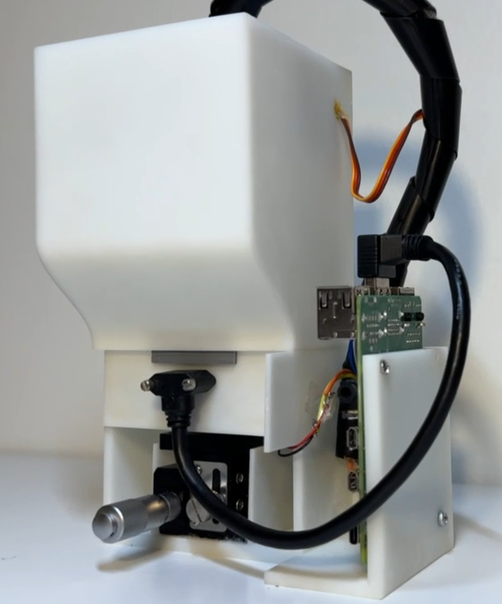
3D digital holographic microscopy water quality detection system
Princeton International School of Mathematics and Science
Taven Chen

Slide 2
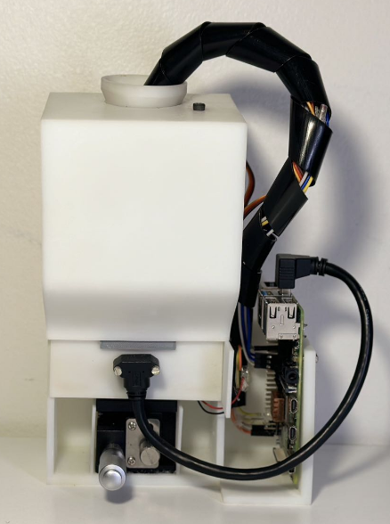
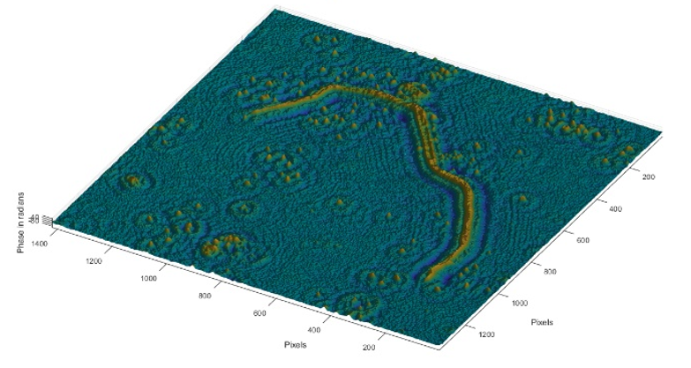
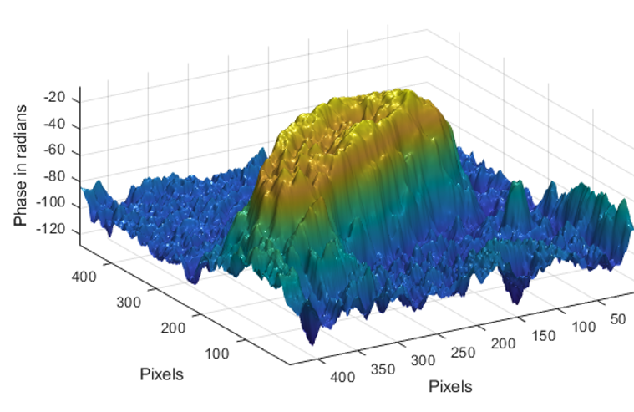
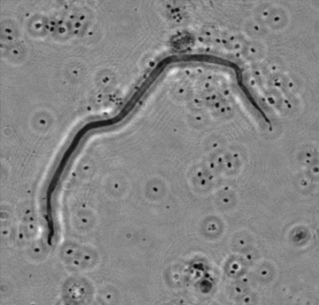
Break Through 5 Pain Points
DIY able
Contact non-real-time non-3D measurement
Non-contact real-time 3D measurement
Heavy and expensive Inexpensive and portable
Height: 18.5cm
Length: 16.8cm
Width: 8.3
3D Printed
highly cost effective 300$

Slide 3
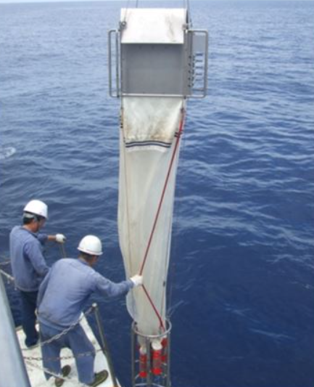
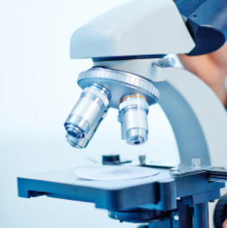
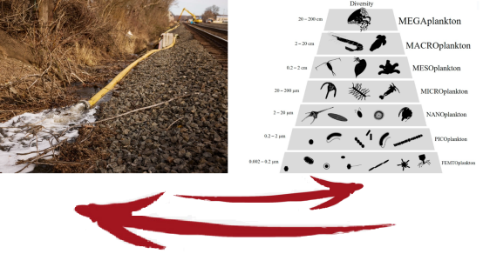
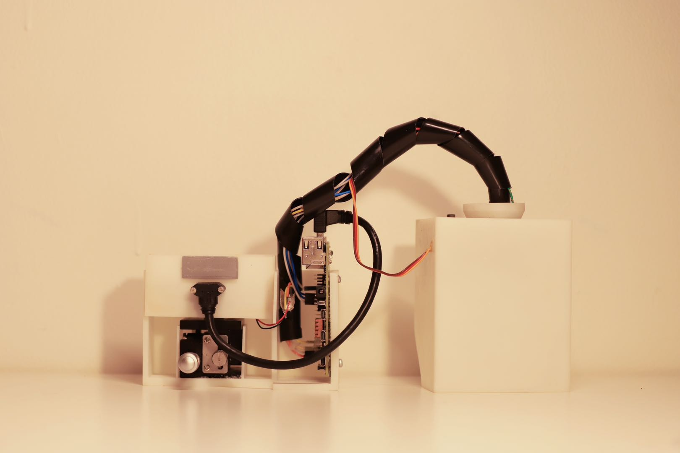
Research Background
Ohio Train Derailment
Off-site detection
2D detection
Large and expensive
Traditional Method
In site measurement
3D detection
Small and inexpensive
Digital real-time measurement
Digital Holographic Microscopy
Underwater plankton is closely related to the quality of the corresponding living water environment

Slide 4
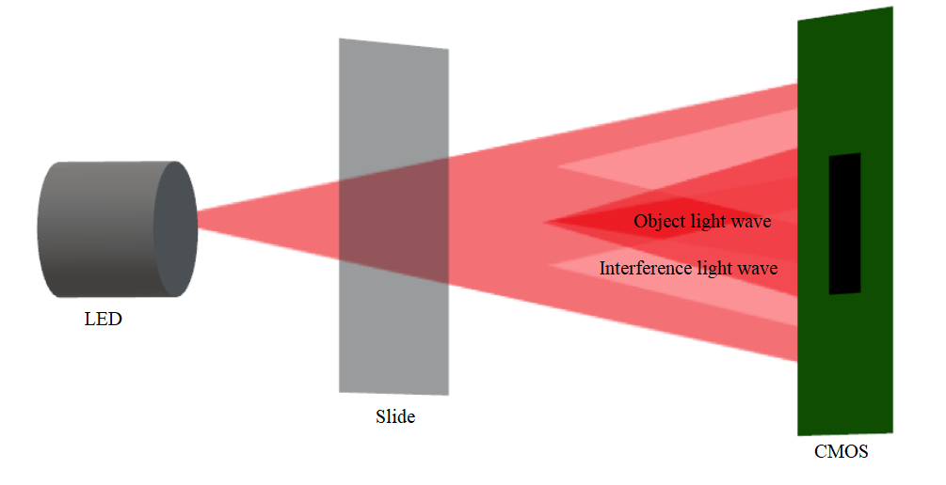
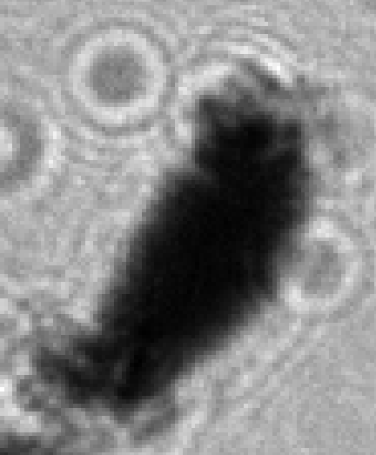
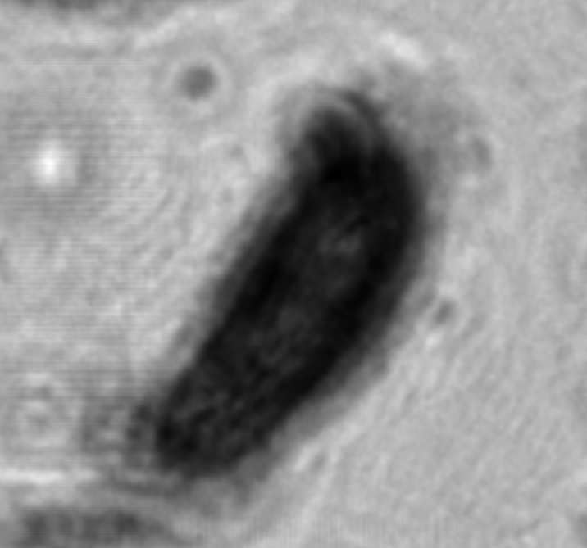
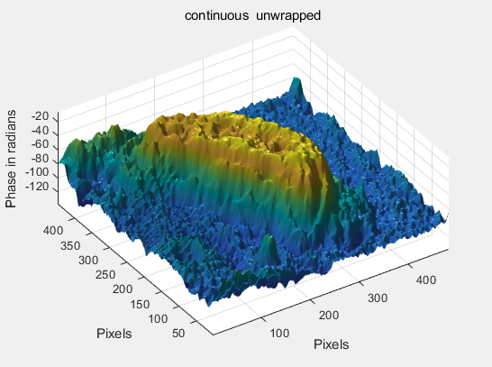
Product Description
Hologram
Digital Holography
The digital holographic micrograph contains the wave front information of the observed object, and then the phase and amplitude (light intensity) information of the measured object can be obtained by numerical reconstruction of the hologram by computer, and then the digital three-dimensional reconstruction can be completed.
Light intensity diagram
Phase diagram
3D diagram

Slide 5
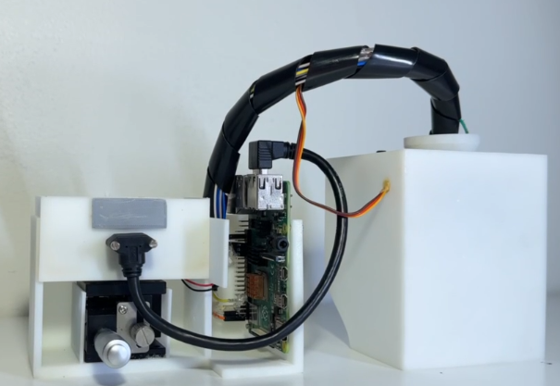
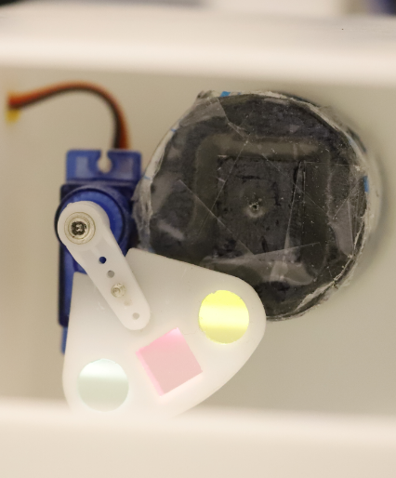
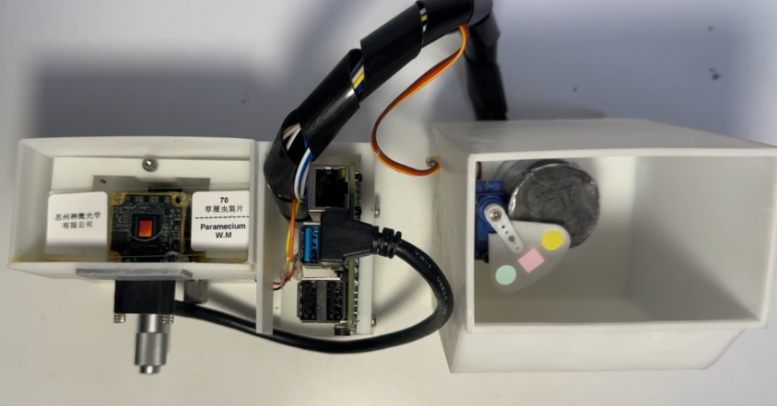
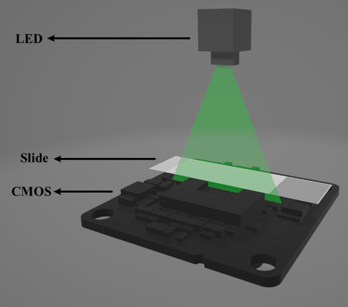
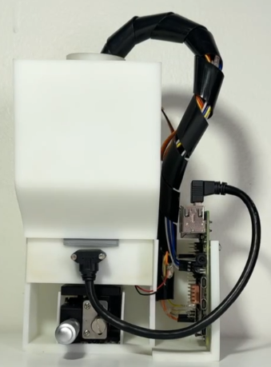
a
c
d
b
e
f
Light path diagram

Slide 6
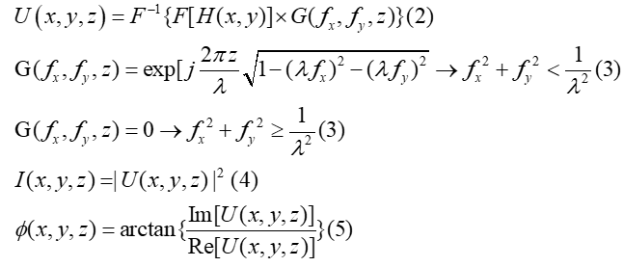
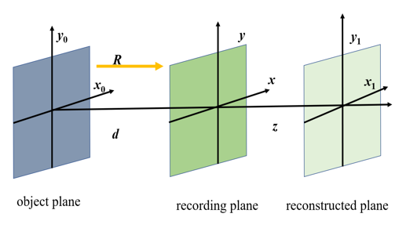
Basic principles of lens-free on-chip holography
Lensfree on-chip holography
Angular spectrum algorithm
Hologram: H(x, y)
Object light: O(x, y)
Reference light: R(x, y)
r(x, y): amplitude information of the reference lights
o(x, y): amplitude information of the object lights
φ(x, y): phase information of the object light wave.

Slide 7
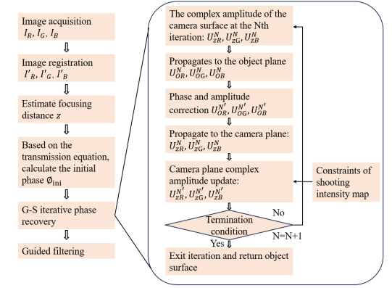
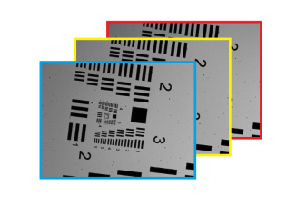
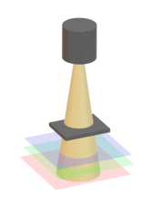
Gerchberg-Saxton Algorithm

Slide 8
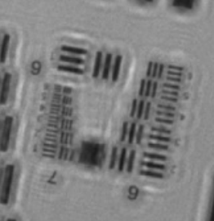
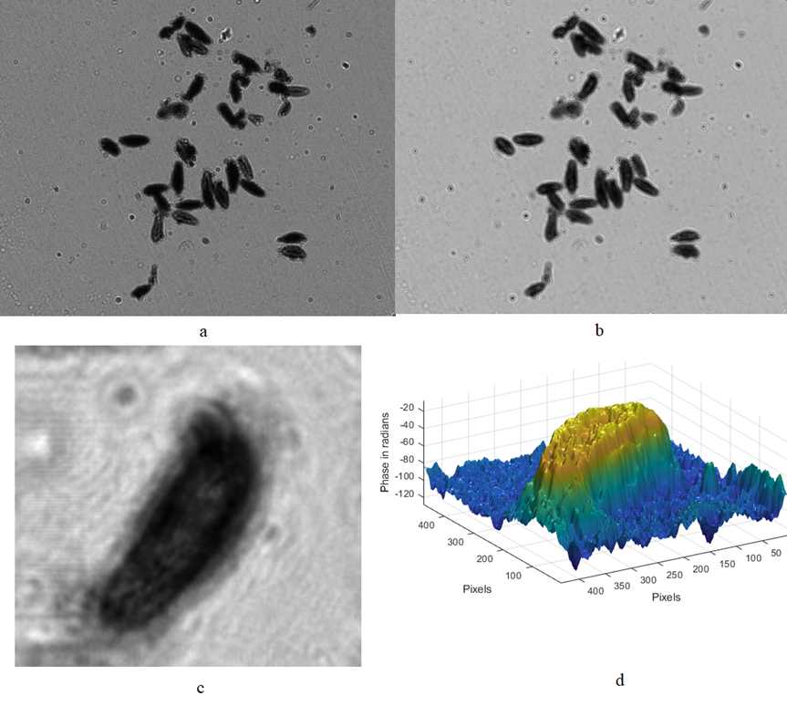
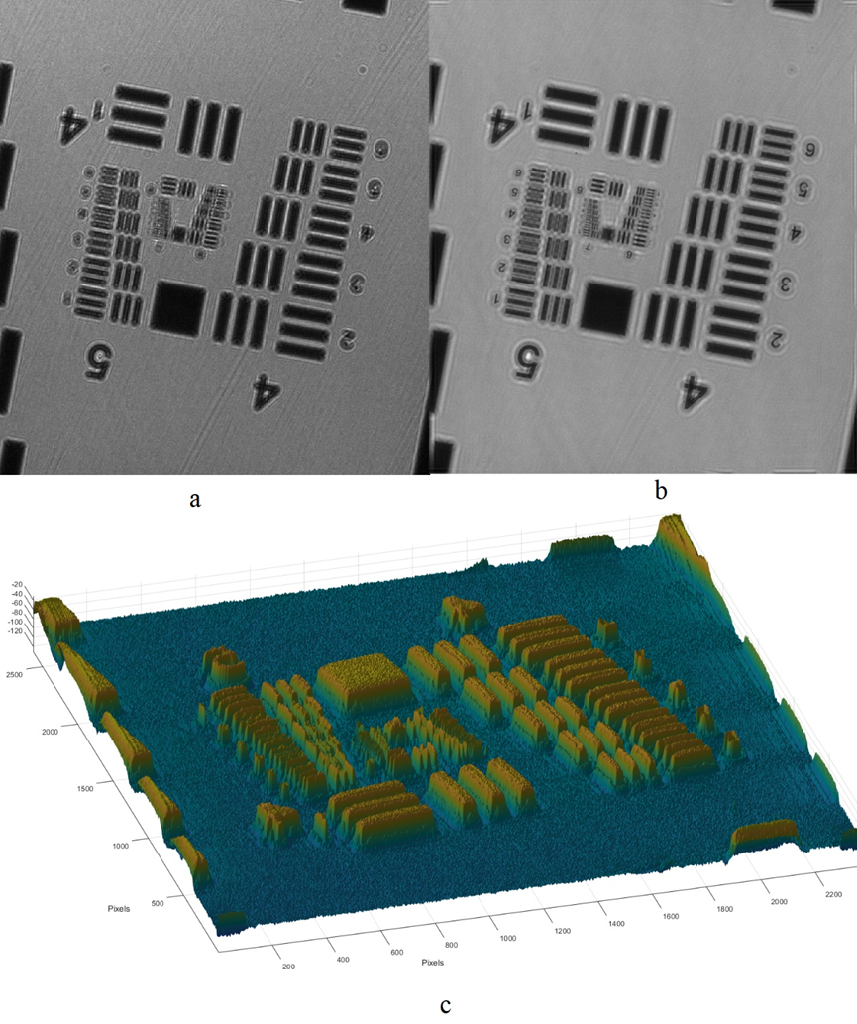
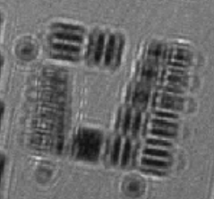
Preliminary Results
USAF Resolution Board
Paramecium
Hologram
Light intensity diagram
Hologram
Light intensity diagram
3D diagram
Light intensity diagram
3D diagram

Slide 9
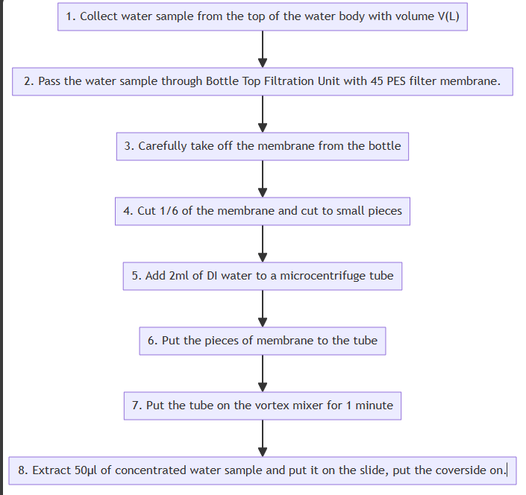
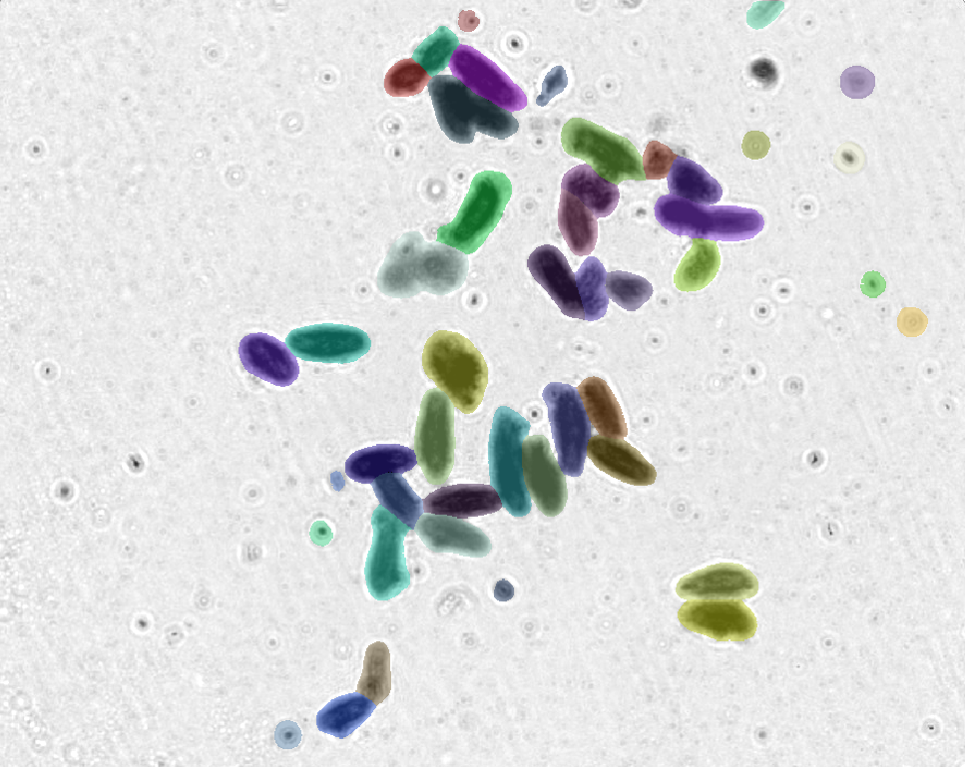
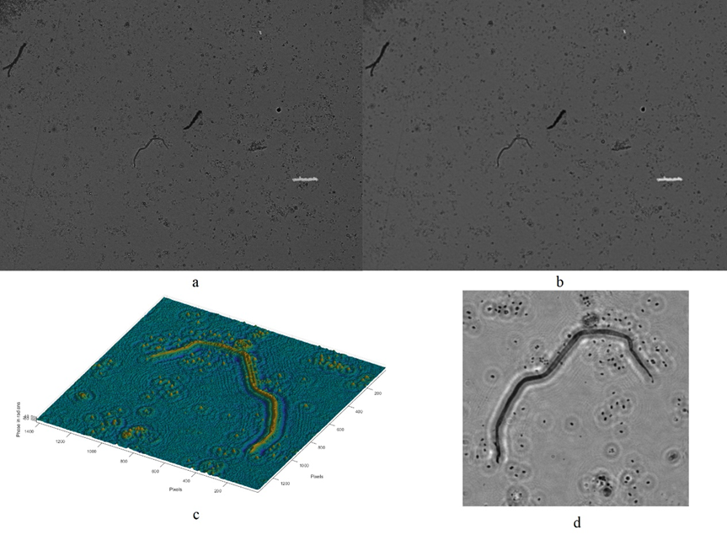
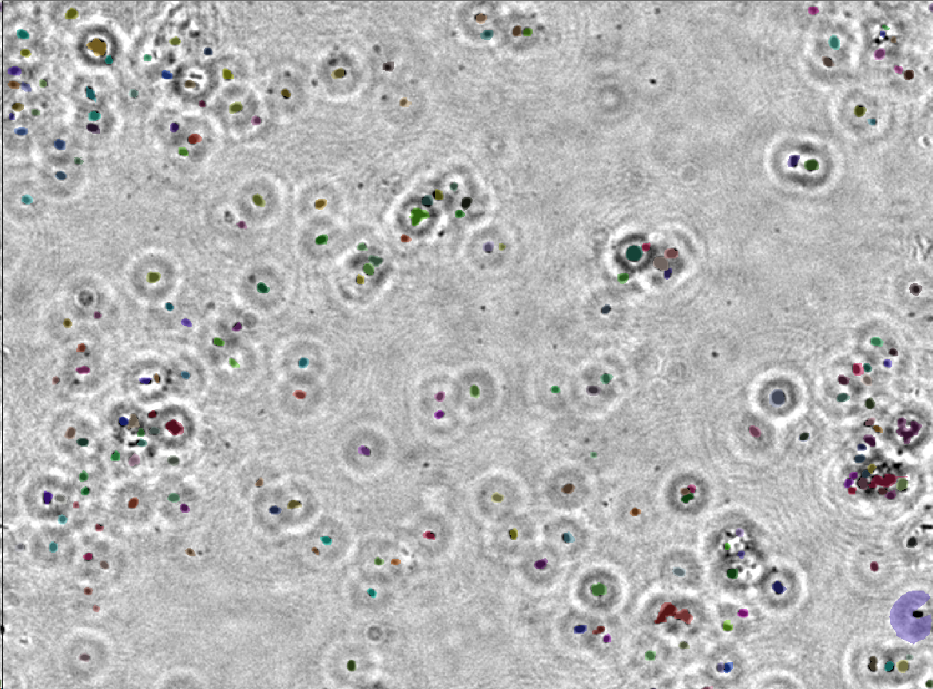
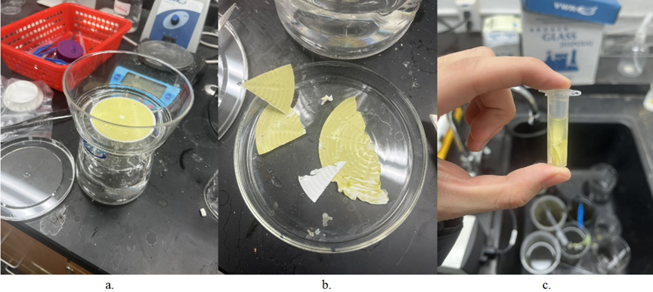
Final result analysis
Hologram
Light intensity diagram
3D diagram
Light intensity diagram

Slide 10
Pros and Cons
Iterative algorithm time optimization
1
1
Low cost and lightweight
2
Cons
Pros
Non-contact and real time
2
3
Conjugate phase residue
3D measurement

Slide 11
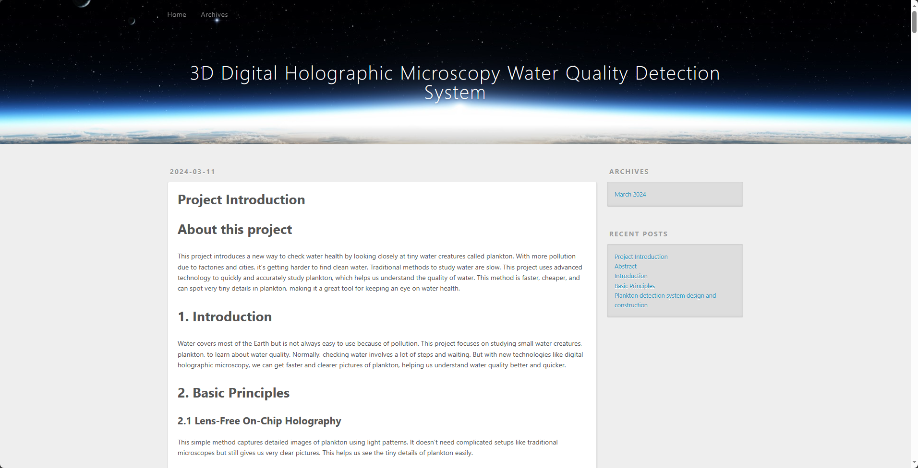
Conclusion
contact-free √
3-D imaging √
wide FOVs √
high resolution √
cost-effective design √
level set based cell segmentation√
My study into digital holographic microscopy (DHM) and lensless digital holographic microscopy (LDHM) as tools for assessing water quality through plankton analysis marks a significant step towards innovative environmental monitoring methods
Further Improvements
1. Incorporation of AI and Machine Learning:
To automate plankton identification and counting, aiming to enhance analysis speed and accuracy.
2. Expansion of Plankton Image Database:
To improve system sensitivity across various pollution types by including images under different conditions.
3. Improvements in Portability and Field-Readiness: To make the equipment more adaptable for use in varied environmental settings.
4. Contribution to Water Quality Monitoring: Solidifying the proof of concept for advanced optical methods in environmental monitoring, aiming to augment efficiency, reach, and impact of global water quality initiatives.
3D File, Example Code, Contact information:
https://chenwen051116.github.io/

Slide 12
References
1. Boyd, C. (2012). Water quality. Aquaculture: farming aquatic animals and plants. Wiley-Blackwell, Oxford, 52-83.
2. M.K. Kim, Digital Holographic Microscopy (Springer, 2011).
3.U. Schnars and W. Jueptner, Digital Holography (Springer, 2005).
4. B. Kemper and G. von Bally, “Digital holographic microscopy for live cell applications and technical inspection,” Appl. Opt. 47(4), A52–A61 (2008).
5. M. Takeda, H. Ina, and S. Kobayashi, “Fourier-transform method of fringe-pattern analysis for computer-based topography and interferometry,” J. Opt. Soc. Am. 72(1), 156–160 (1982).
6. M. Pirga and M. Kujawinska, “Two directional spatial-carrier phase-shifting method for analysis of crossed and closed fringe patterns,” Opt. Eng. 34(8), 2459 (1995).
7. T. Ikeda, G. Popescu, R. Dasari, and M. Feld, “Hilbert phase microscopy for investigating fast dynamics in transparent systems,” Opt. Lett. 30(10), 1165–1167 (2005).
8. Y. Park, C. Depeursinge, and G. Popescu, “Quantitative phase imaging in biomedicine,” Nat. Photonics 12(10), 578–589 (2018).
9. T. Kozacki and K. Falaggis, “Angular spectrum-based wave-propagation method with compact space bandwidth for large propagation distances,” Opt. Lett. 40(14), 3420–3423 (2015).
10. Y. Zhang, H. Wang, Y. Wu, M. Tamamitsu, and A. Ozcan, “Edge sparsity criterion for robust holographic autofocusing,” Opt. Lett. 42(19), 3824–3827 (2017).
11. Y. Wu, Y. Rivenson, Y. Zhang, Z. Wei, H. Günaydin, X. Lin, and A. Ozcan, “Extended depth-of-field in holographic imaging using deep-learning-based autofocusing and phase recovery,” Optica 5(6), 704–710 (2018).
12. A. Ozcan and E. McLeod, “Lensless Imaging and Sensing,” Annu. Rev. Biomed. Eng. 18(1), 77–102 (2016).
13. E. McLeod and A. Ozcan, “Unconventional methods of imaging: computational microscopy and compact implementations,” Rep. Prog. Phys. 79(7), 076001 (2016).
14. D. Gabor, “A New Microscopic Principle,” Nature 161(4098), 777–778 (1948).
15. T. Agbana, H. Gong, A. Amoah, V. Bezzubik, M. Verhaegen, and G. Vdovin, “Aliasing, coherence, and resolution in a lensless holographic microscope,” Opt. Lett. 42(12), 2271–2274 (2017).
16. Vashist SK, Mudanyali O, Schneider EM, Zengerle R, Ozcan A. 2013. Cellphone-based devices for bioanalytical sciences. Anal. Bioanal. Chem. 406:3263–77
17. Ozcan A. 2014. Mobile phones democratize and cultivate next-generation imaging, diagnostics and measurement tools. Lab Chip 14:3187–94
18. Greenbaum A, Ozcan A. 2012. Maskless imaging of dense samples using pixel super-resolution based multi-height lensfree on-chip microscopy. Opt. Expr. 20:3129–43
19. Bishara W, Sikora U, Mudanyali O, Su T-W, Yaglidere O, et al. 2011. Handheld, lensless microscope identifies malaria parasites. SPIE Newsroom, Aug. 5. http://spie.org/x51571.xml
20. Su T-W, Choi I, Feng J, Huang K, McLeod E, Ozcan A. 2013. Sperm trajectories form chiral ribbons. Sci. Rep. 3:1664
21. Seo S, Isikman SO, Sencan I, Mudanyali O, Su T-W, et al. 2010. High-throughput lens-free blood analysis on a chip. Anal. Chem. 82:4621–27
22. Ministry of Ecology and Environment of the People's Republic of China. (2021). Water quality—Determination of Phytoplankton—Membrane filtration method (Report No. HJ 1216-2021). Ministry of Ecology and Environment of the People's Republic of China https://big5.mee.gov.cn/gate/big5/www.mee.gov.cn/xxgk2018/xxgk/xxgk06/202009/W020200930591312856871.pdf

