Slide 1
Eco-friendly Remediation of PFOA Contamination using BTs-ZVI (Banana Peel, Tapioca - Zero Valent Iron)
Emily Lee

Slide 2
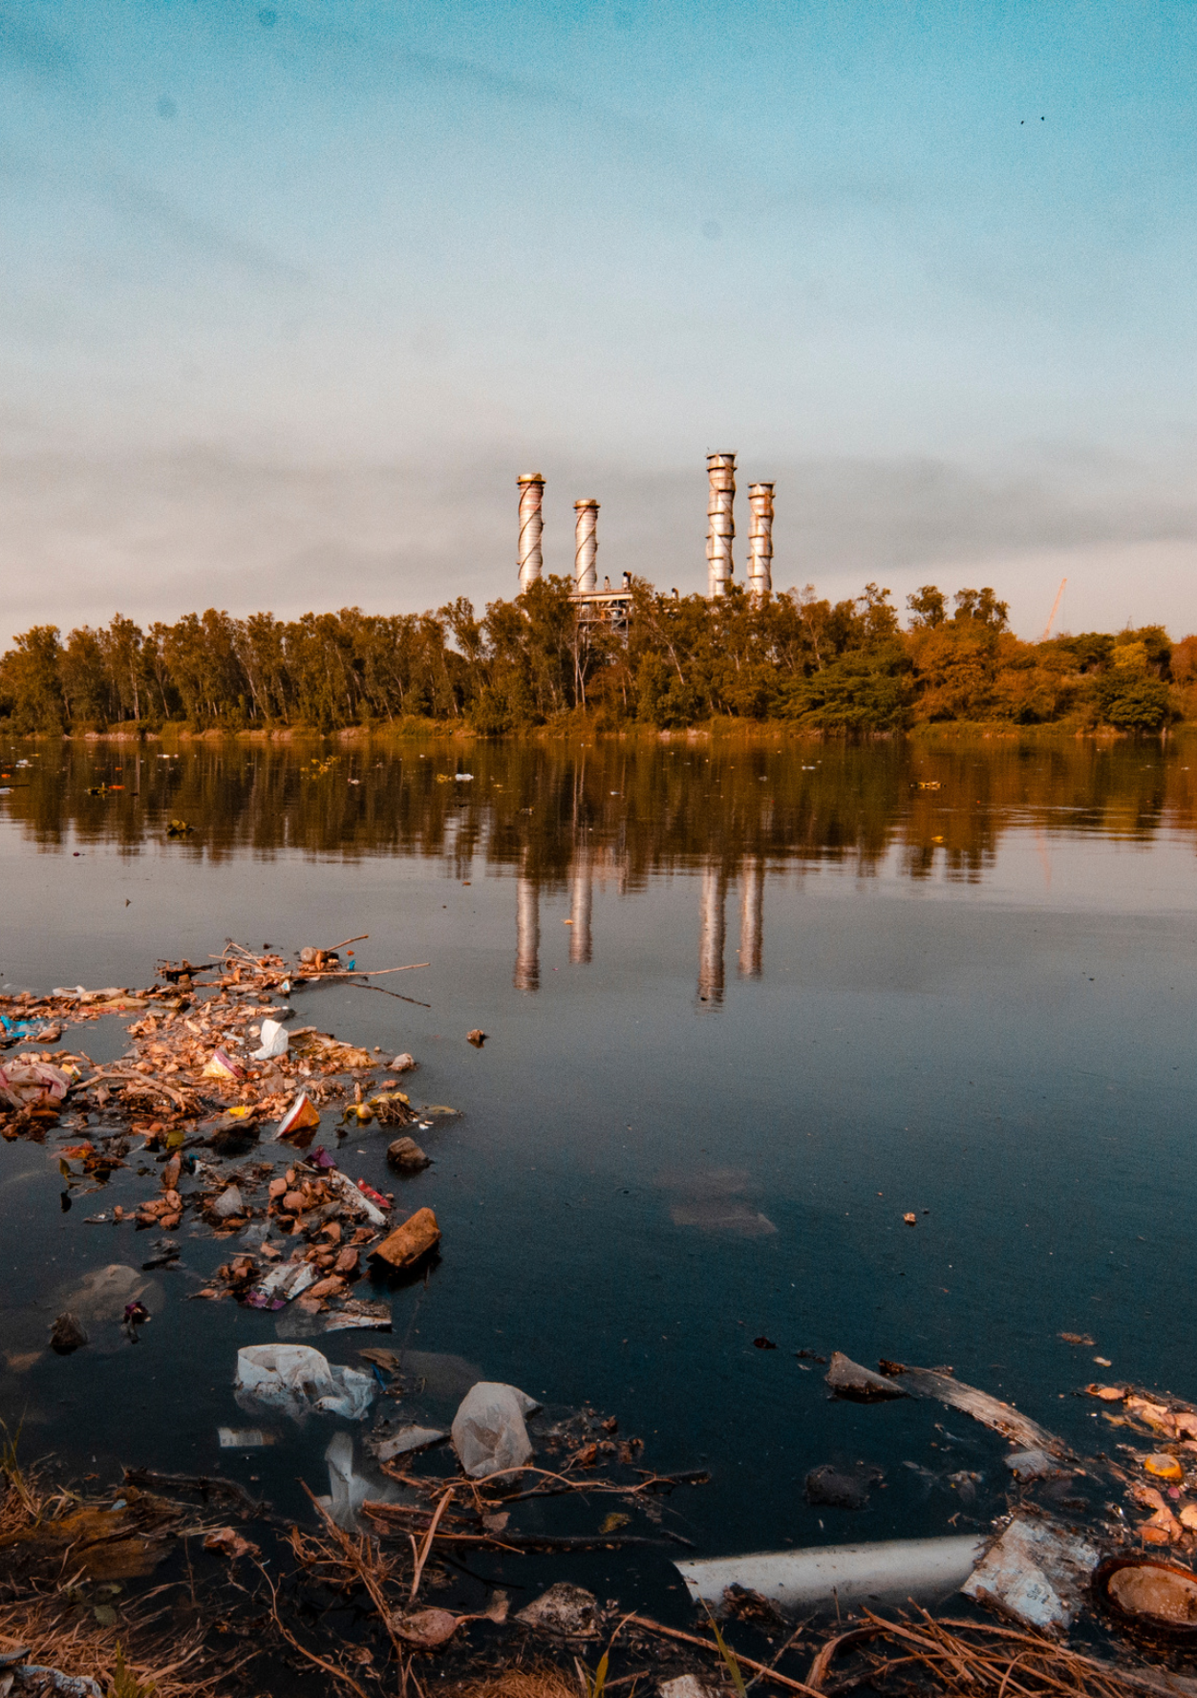
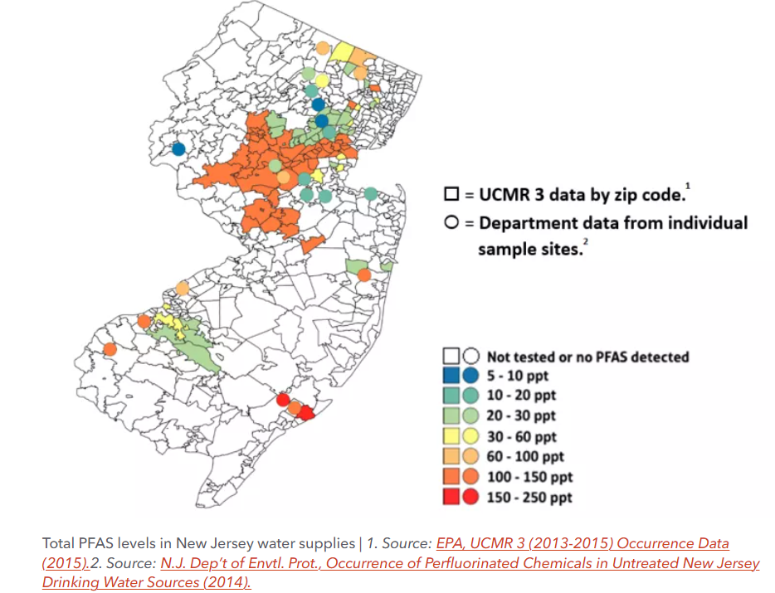
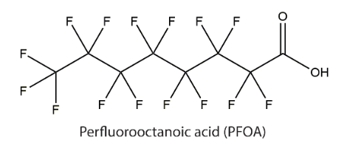
Introduction
PFOA (Forever Chemical)?
PFAS are absorbed on microplastics in drinking water: the dangers for female exposure include reproductive health issues since PFASs are widely used and are soluble in water.
Over 500,000 people were being affected by PFOA as more than 34 water systems in New Jersey were found to contain it.
The most renowned method to degrade PFASs is oxidation processes, which utilizes UV irradiation in different conditions.

Slide 3
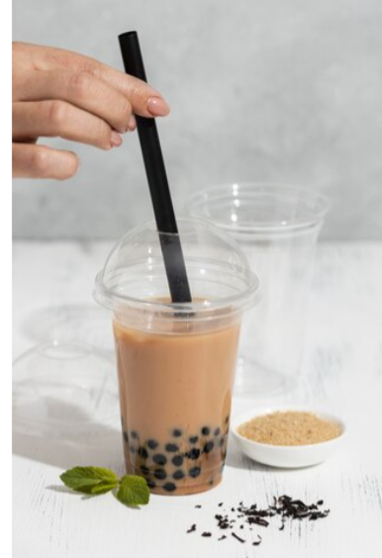
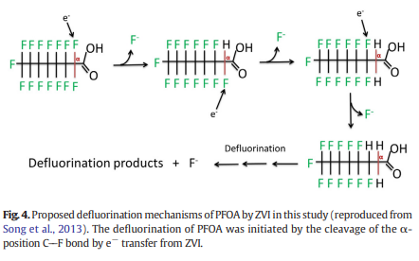
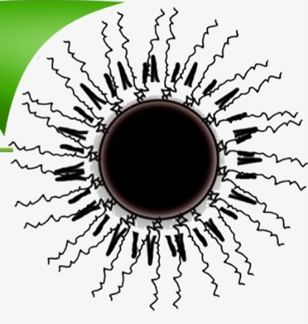
Purpose
Formation of ZVI using banana peel and Tapioca starch
Bananas are ranked as second most wasted product in New Jersey, can be used as reducing agents. Tapioca swells and gelatinizes at 60°C.
The initiation of the defluorination reaction of PFOA is initiated by the electrons produced from ZVI.
Banana
Peel
Metal
Solution
ZVI

Slide 4
Method
Creation of ZVI using Banana peel
2. Formation of BTs-ZVI
3. Decomposition of Methylene Blue, E.Coli in NaCl, Brine shrimp & Plant growth
1) BTs-ZVI(lst) : Banana Peel+FeCl3
→ ZVI → Tapioca starch →heat
2)BTs-ZVI(2nd) : Banana Peel+FeCl3
+Tapioca starch → heat → ZVI

Slide 5
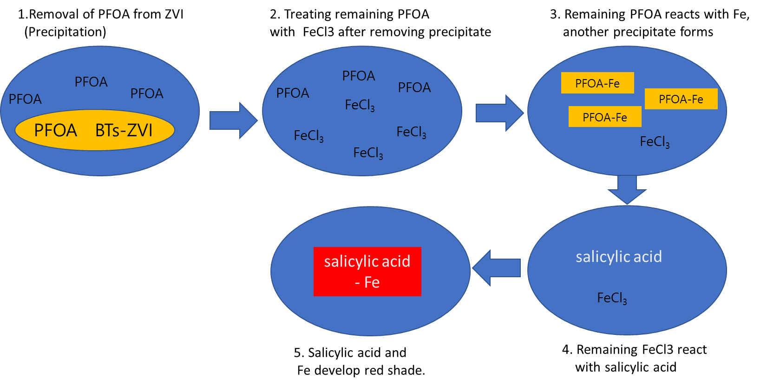
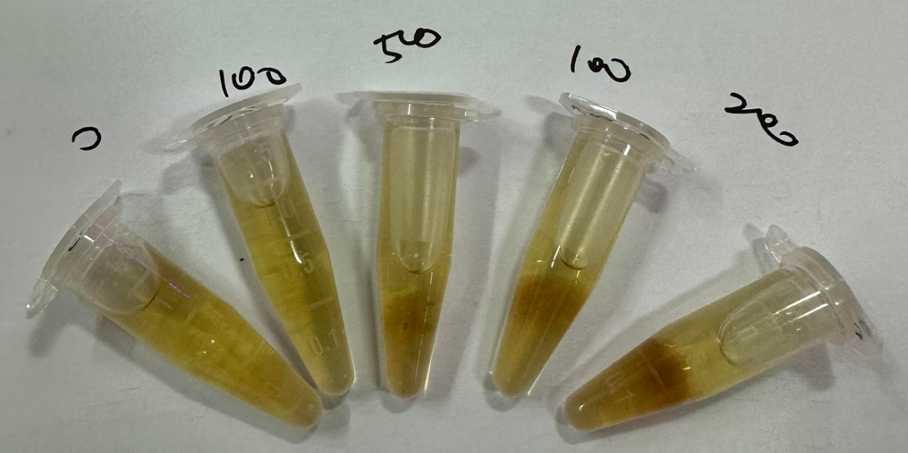
Method
4. Reaction of ZVI and checking of PFOA

Slide 6
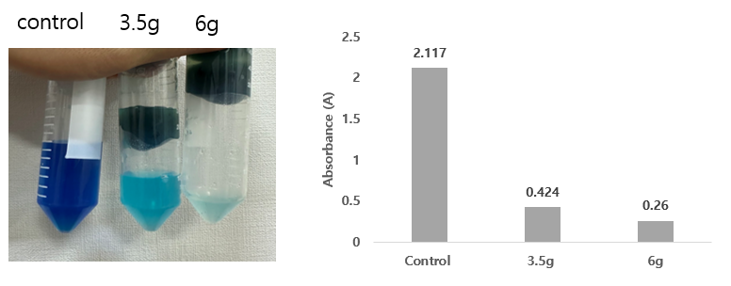
Result
Degradation of Methylene blue and change in E. Coli treated with NaCl
- Methylene Blue was decomposed when treated with UV and ZVI
- Change in E.Coli treated with NaCl is similar to when treated with BTs-ZVI

Slide 7
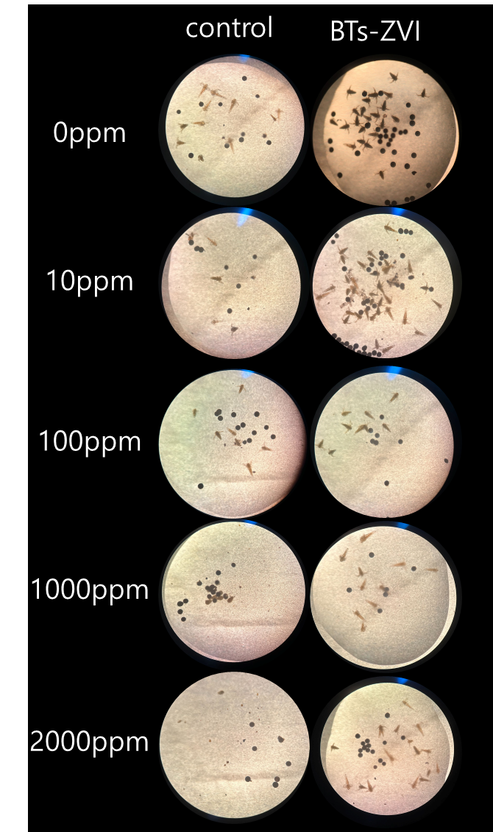
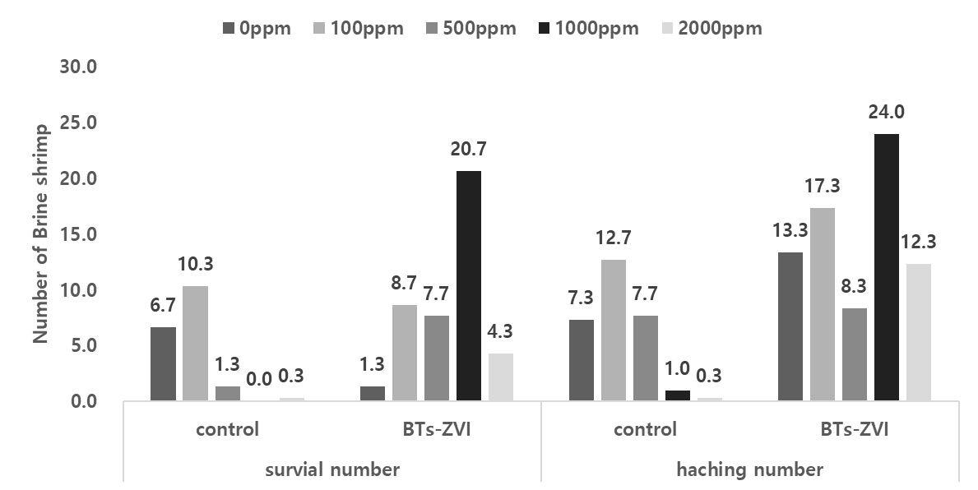
Result
2. Hatching and survival rate of Brine shrimp
Brine Shrimp hatching and survival rate increase in PFOA solution treated with BTs-ZVI

Slide 8
Result
3. Mass of BTs-ZVI and reaction to PFOA
Mass of BTs-ZVI in PFOA < Mass of Tapioca
Added banana peel relatively reduces amount of Tapioca, in turn reduces water absorbency

Slide 9
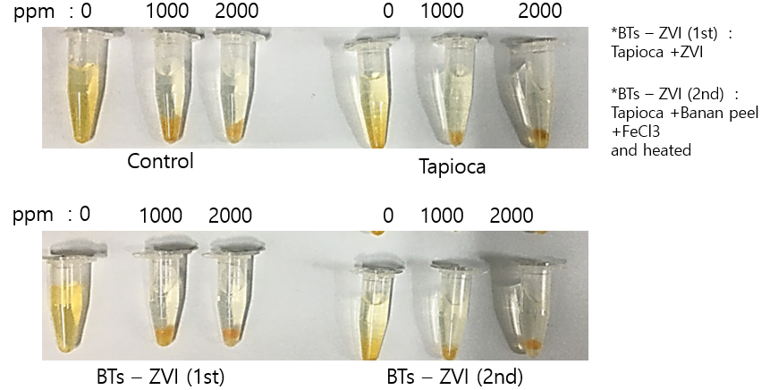
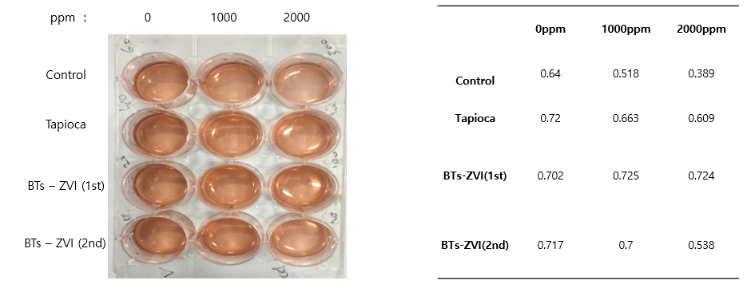
Result
3. Changes in the PFOA solution
Collection of PFOA solution treated with BTs-ZVI → Treated with 0.1M FeCl₃
Precipitate increases along with PFOA density
Treatment of salicylic acid after precipitate removal, absorbance measurement at 580 nm

Slide 10
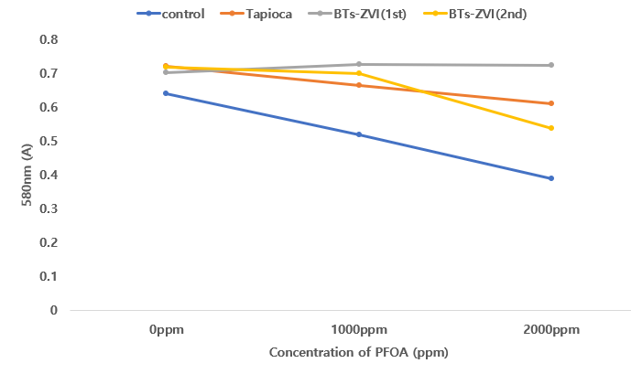
Result
3. Changes in the PFOA solution
FeCl3 low because remaining PFOA was low (Relative increase of FeCl3)
→ Afterwards, entire FeCl3 reacted with salicylic acid, showed coloration
Large amounts of remaining PFOA, more FeCl3 reacted (Relative decrease of FeCl3)
→ Remaining FeCl3 decreased, lower reaction rate

Slide 11
Result
3. Survival rate of Brine shrimp
High survival rates of Brine shrimp→
1000 ppm of PFOA : BTs-ZVI(2nd), 2000 ppm of PFOA: BTs-ZVI(1st)

Slide 12
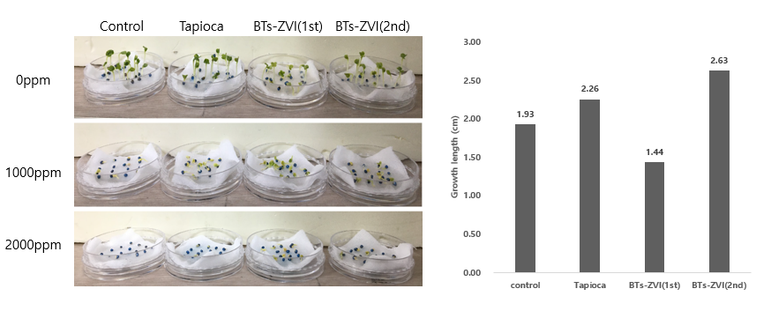
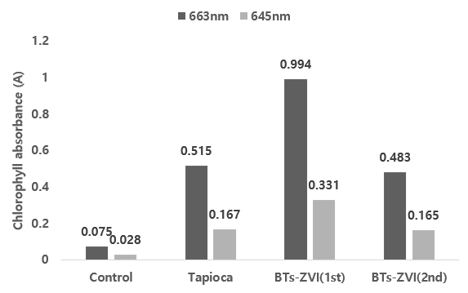
Result
3. Changes in the PFOA solution
Tapioca and BTs-ZVI(2nd) experienced a 7x increase in absorbance compared to the control group. BTs-ZVI(1st) had the highest absorbance.

Slide 13
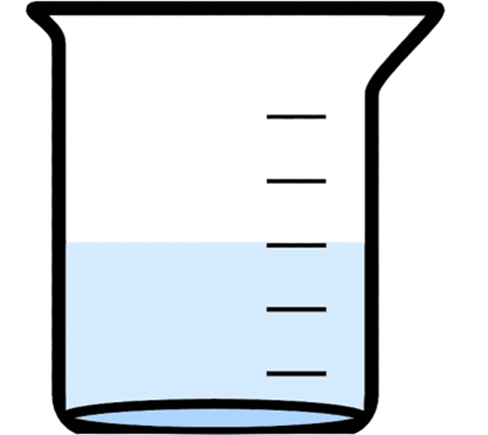
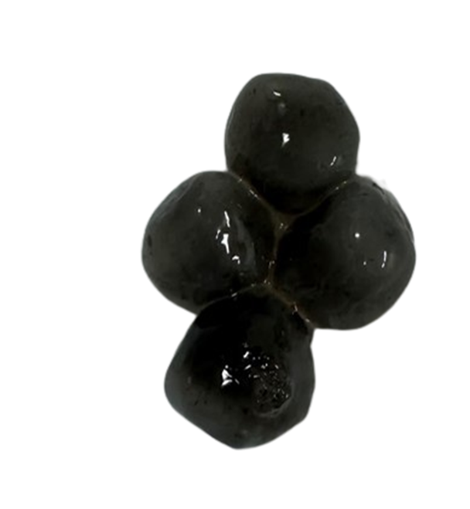
Conclusion
BTs-ZVI
PFOA
Purity
PFOA Removal
Can make up for ZVI solution’s shortcomings with beads, PFOA can be efficiently removed in water.
Utilized Wasted Banana peel and Tapioca characteristics to easily craft BTs-ZVI
PFOA Detecting?
Future works
Confirmation of decomposition time in water, Recycling and usage of Filter type, Toxicity test of precipitate
PFOA can be confirmed through Phenol coloring reaction in the experiment

