Slide 1
Analysis of E. coli growth dynamics during Lambda(vir) phage infection reveals phage decay
Benjamin Gitai
Princeton High School

Slide 2
The Antimicrobial Resistance Crisis
Bacteria are becoming resistant to existing antibiotics
This is leading to many deaths
We need new ways of killing bacteria
10M
1.8M
1.3M
Antimicrobial Resistance Collaborators, Lancet 2022

Slide 3
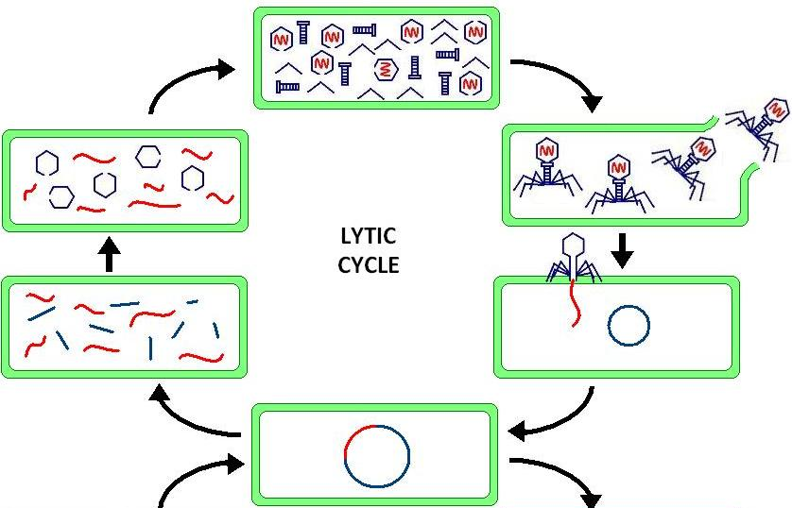
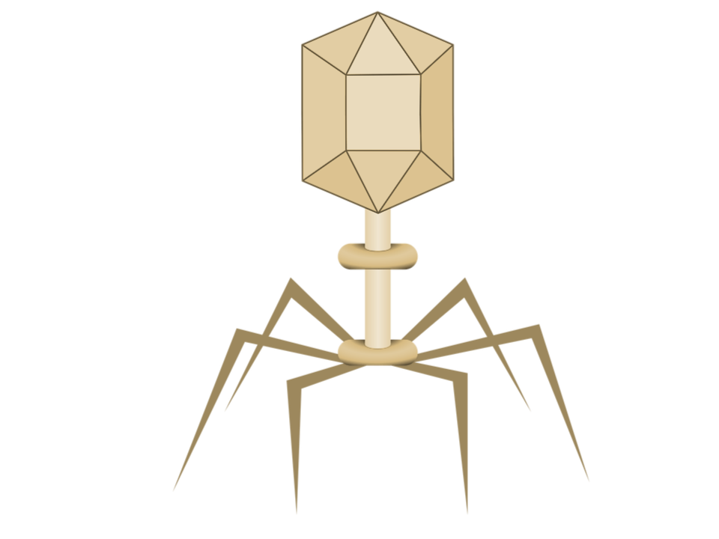
Phage are viruses that specifically kill bacteria
Wikipedia

Slide 4
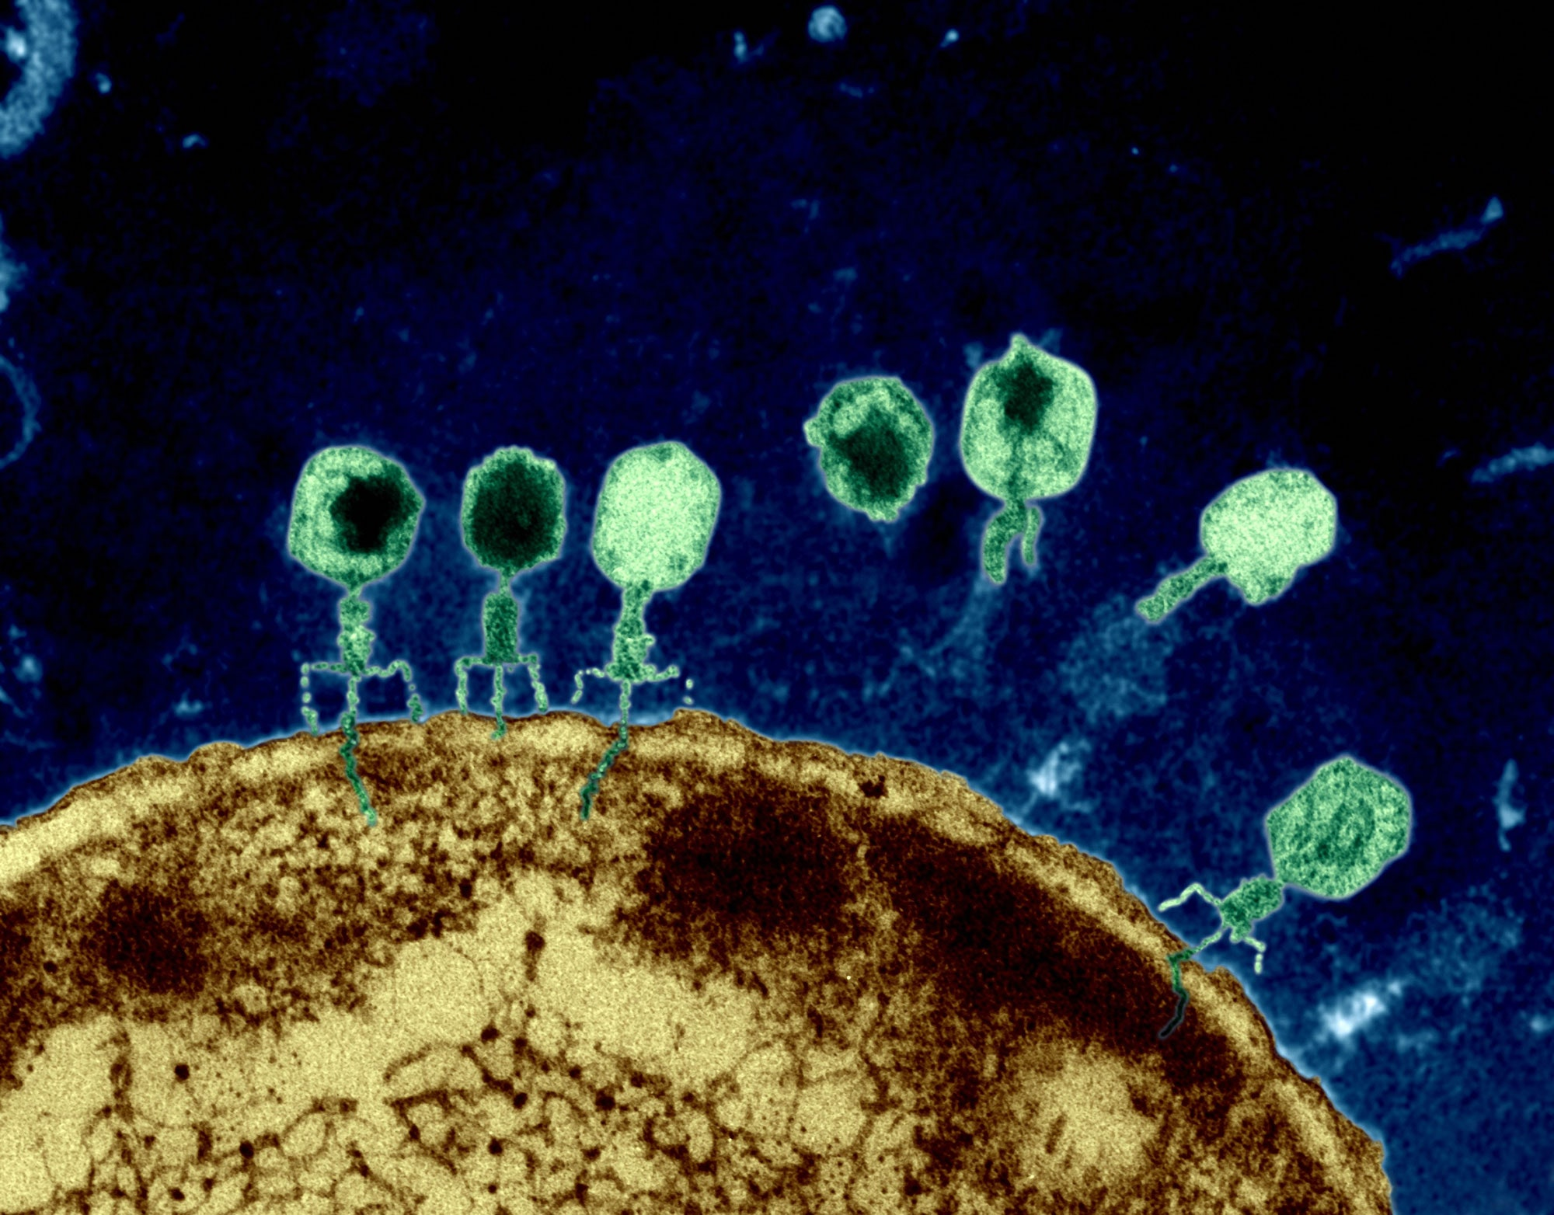
Phage Therapy
Use phages as “non-traditional” antibiotics to kill bacteria
Could save us from the AMR crisis
Issues:
  Not as effective in trials as expected
  Poor drug-like qualities
  Bad for transportation
Surprising because phage are very stable when stored in the fridge
The New Yorker - 2015

Slide 5
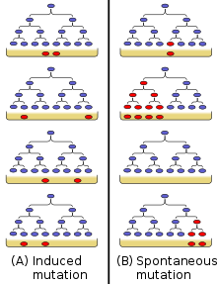
The Luria Delbruck Experiment
Used different sized populations of E. coli with phage
End-point assay: measured the amount of bacteria that survived after being lysed by the phage
Proved that bacteria mutation is random rather than induced
Did not measure the dynamics of the bacteria phage interactions

Slide 6
Our Hypothesis:
Understanding the dynamics of phage-bacteria interactions might help us address the AMR crisis
1. Repeat Luria-Delbruck Experiment (but with lots of measurements):
Does variance increase with decreasing bacterial population?
2. Do phage decay?

Slide 7
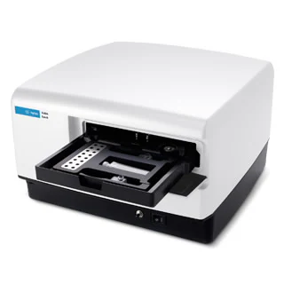
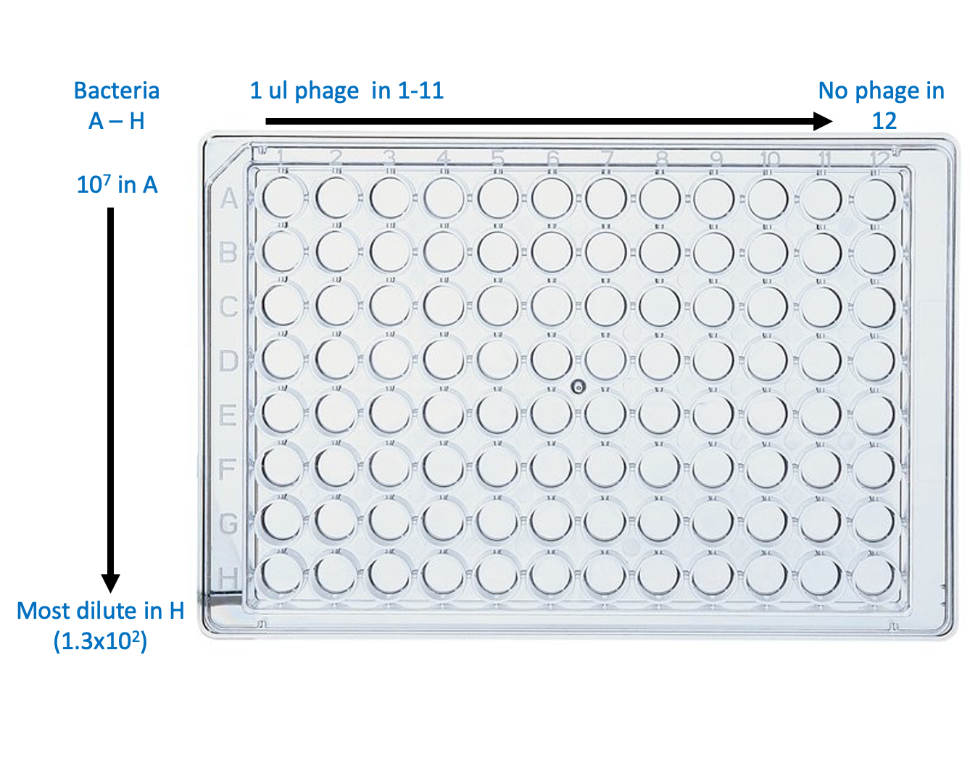
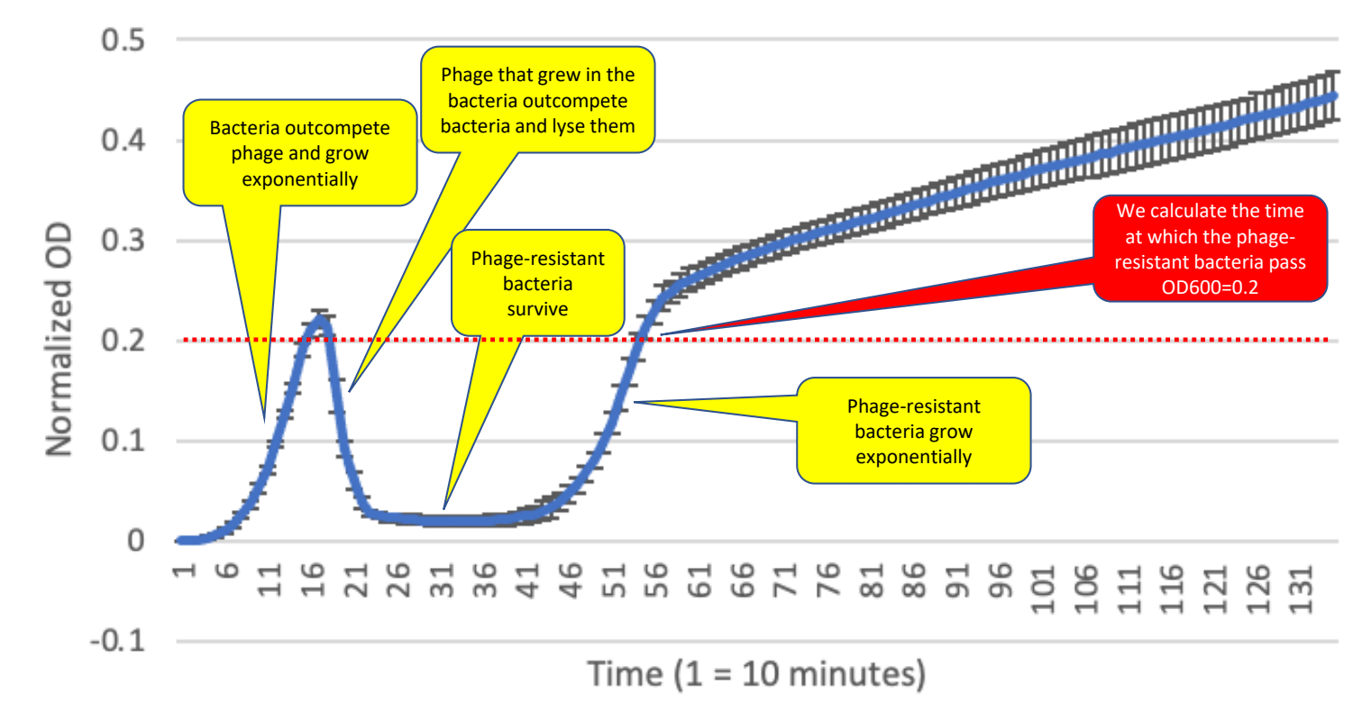
Experimental Setup
Plate set up: Constant concentration of phage
5-fold serial dilutions of E. coli
11 replicates, one control
Optical density (OD) measurements taken every 10 minutes for 20 hours to track bacterial growth
We calculate the time at which the phage-resistant bacteria pass OD600=0.2

Slide 8
OD600 Measurements every 10 minutes
Low population
High population

Slide 9
Does variance in growth in the presence of phage change with decreasing bacterial population?
A: 10⁷ bacteria (highest population)
H: 1.3 x 10² bacteria (lowest population)
High variance
Low variance
We successfully recapitulated the Luria-Delbruck experiment using dynamics: decreases in population sizes led to increases in variance (random presence of mutation, not induced)
High population
Low population

Slide 10
Experiment 2: Do phage decay over time?
Plate set up: Constant concentration of phage and E. coli
Phage shaken at 37C for 5 different times (0 to 16hr) before adding to E. coli
11 replicates, one control
Optical density (OD) measurements taken every 10 minutes for 16 hours
Bacterial peak OD increases as phage are shaken at 37C, implying that phage decay over time

Slide 11
Do dead bacteria contribute to the OD600?
Killed bacteria: boiled for 20 min (cooled for 10 min)
Non-boiled E. coli left at standard conditions for 30 minutes
Dead bacteria still have a significant optical density

Slide 12
Conclusions
  Phage decay rapidly at 37ºC
  Patients undergoing phage therapy are receiving much lower effective doses than expected
  This could justify increasing dosage to a more effective level, potentially increasing the viability of phage therapy as an alternative to antibiotics
  Dead bacteria have a significant OD
  Any experiment using OD measurements of bacteria over time should take this into account

