Slide 1
Multi-Terrain Adaptable Post Disaster Rescue Navigation Vehicle
Division: Senior
Name: Haolin Yu
Category: General Engineering

Slide 2
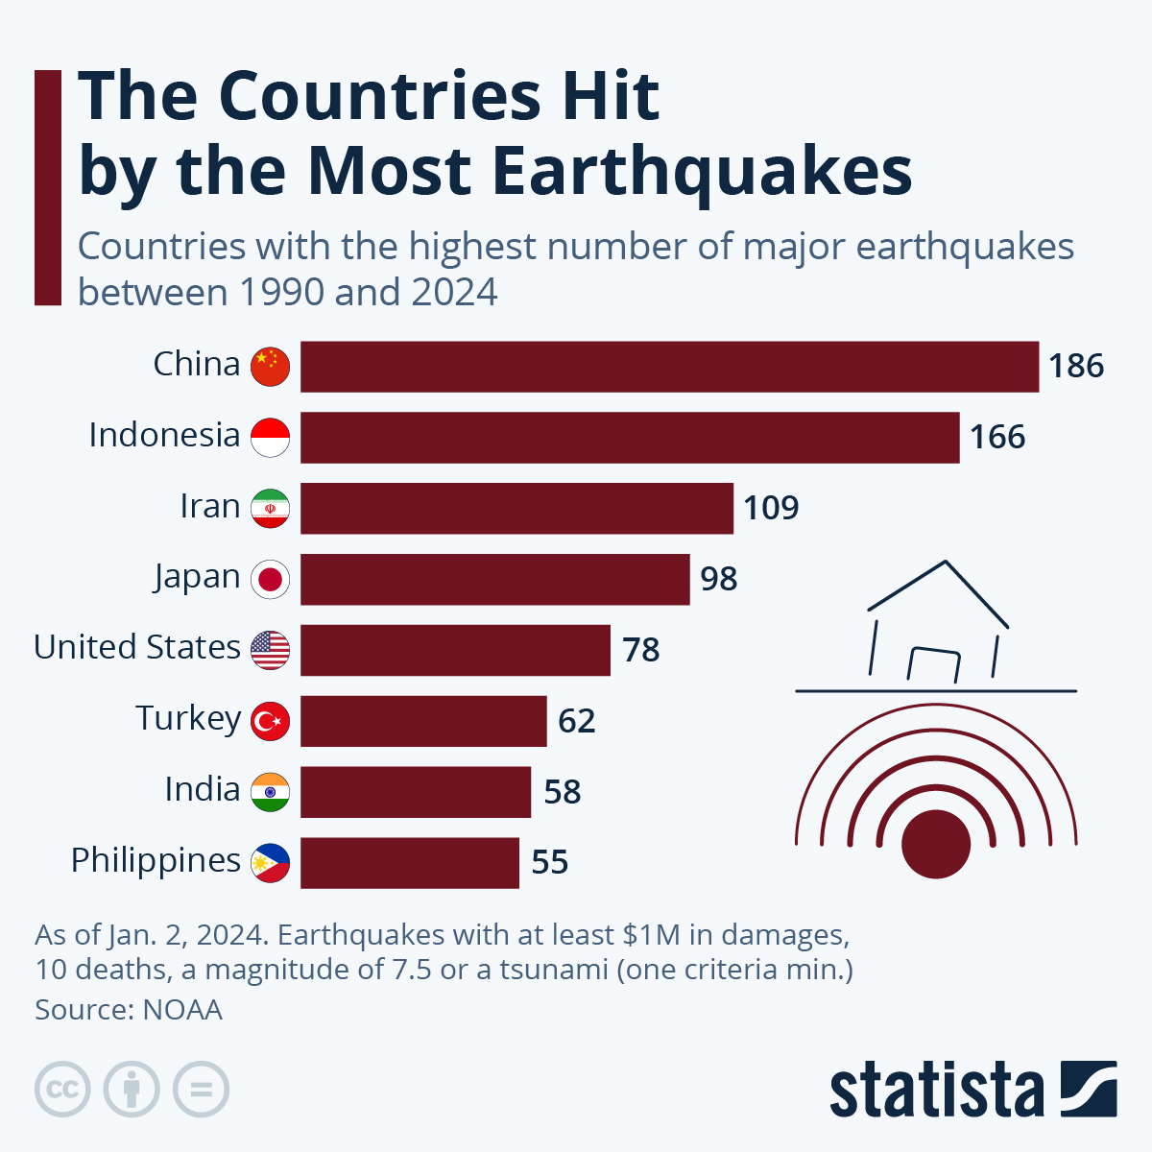
Earthquakes In China
China Suffers A Lot From Earthquake:
China lies right in the region where a lot of continental plates meet. It suffers from continental earthquakes frequently due to active tectonic movements. Most of the earthquakes in China are continental, and they account for one-third of of continental earthquake globally.
In 2008 Sichuan Earthquake, the more than 69,000 people died , 376,100 people injured. A lot of them are firefighters and relief workers too.
Source: https://ourworldindata.org/the-worlds-deadliest-earthquakes

Slide 3
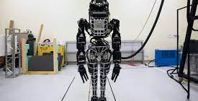
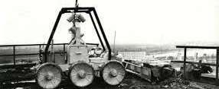
Current Rescue Technology and Flaws
The first picture is a robot designed by Boston Dynamic. It is expected to do multi-tasking and hard movements. However, it is too expensive to put to use on a large scale.
The second figure is designed in 1995. Due to the large size and primitive design, it lacks the ability to work efficiently and gets stuck easily.

Slide 4
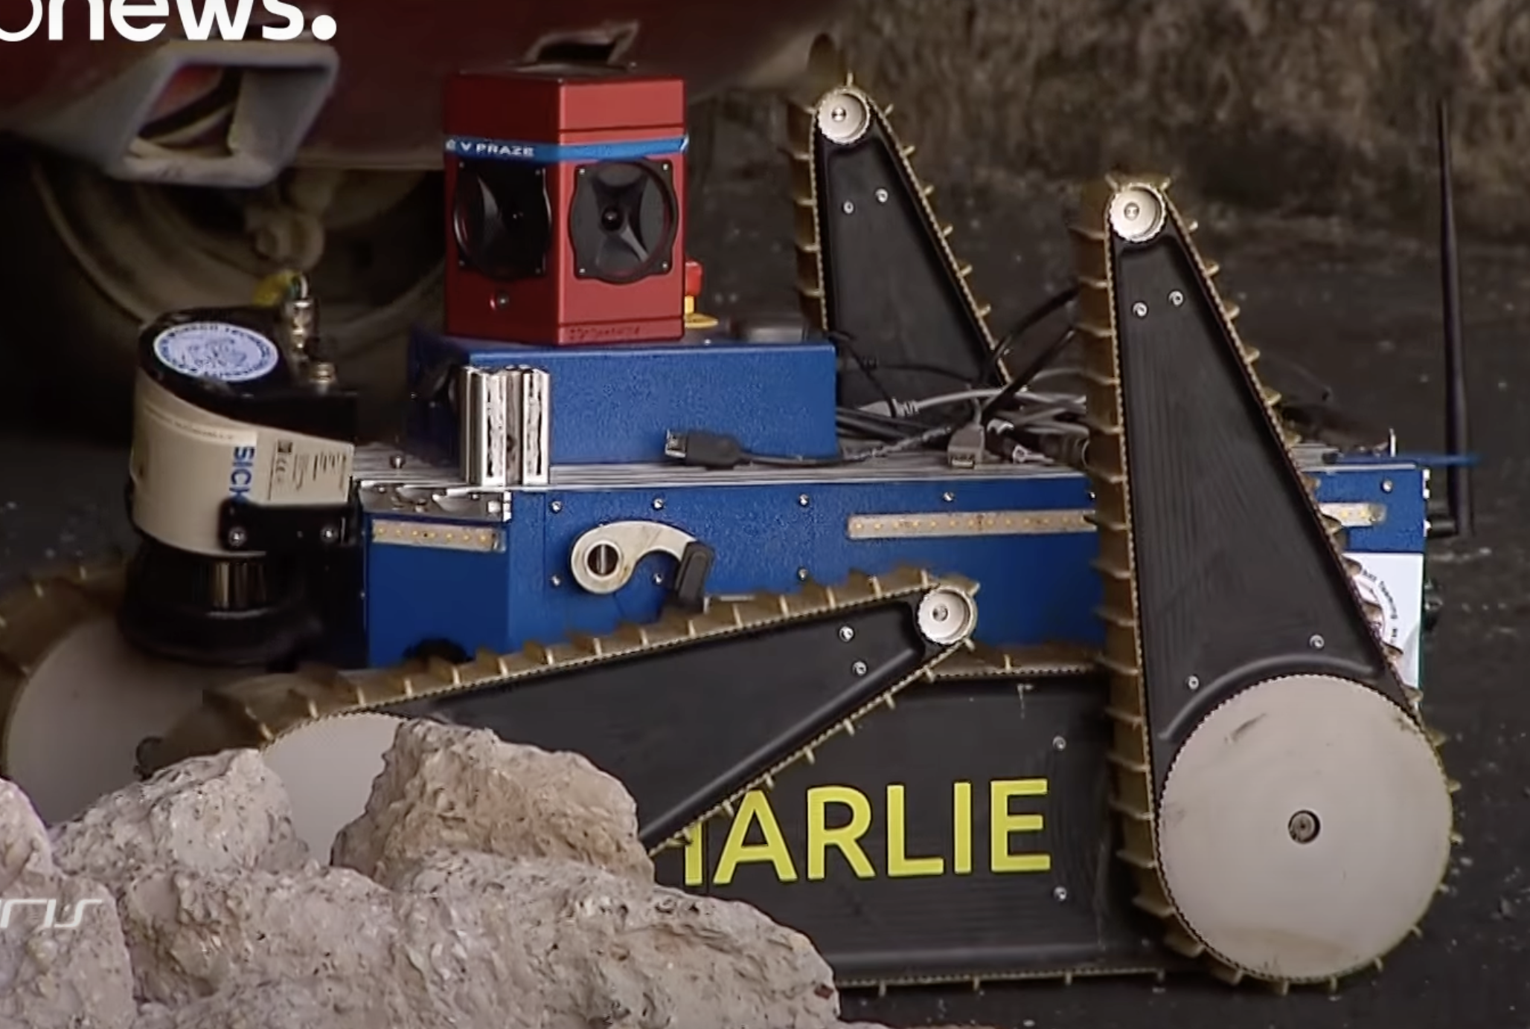
Inspiration Of My Project
The vehicle at the right is able to cooperate with a drone to film the entire environment to create a 3-d environment. The automobile itself has a unique design of the wheels, allowing the robot to maneuver over intricate terrains.
I Want To Design A Similar Vehicle But More Cost Effective, Light-weighted, Easy-to-Control and Multi-Terrain Adaptable.
TRADR Post-Disaster Bot

Slide 5
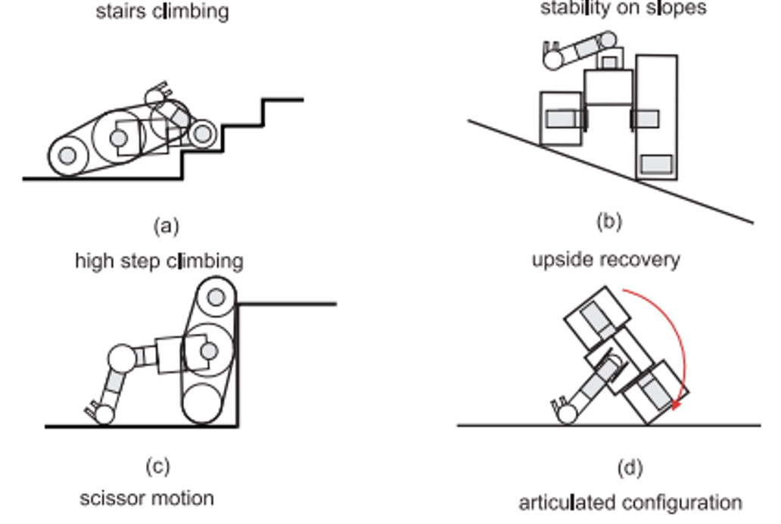
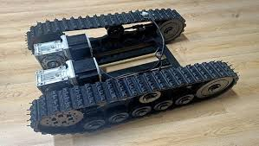
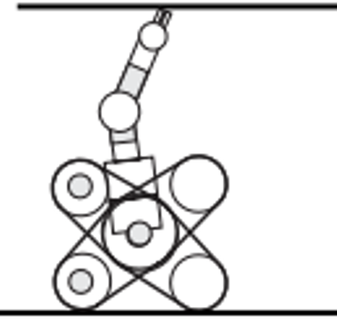
Goal Of My Design
To adapt different harsh terrains, I have to utilize the caterpillar tracker very well. It increases friction and could help heavy vehicles navigate through obstacles. The following picture is the type of caterpillar tracker that a tank uses. However, I want to make the two caterpillar bands at the sides able to do 360 degrees rotation. This would bring the navigation ability of my vehicle to a next level.
The vehicle will be able to perform the following movements.
The Design of the Vehicle requires AutoCAD (combined with 2-d laser cutter), Fusion (combined with 3-d printer) and Arduino for coding. I tried to used arcylic plate with steel plates so that I can make the vehicle sturdy and light-weighted. By making the vehicle light-weighted, it is easier to go over difficult terrains.

Slide 6
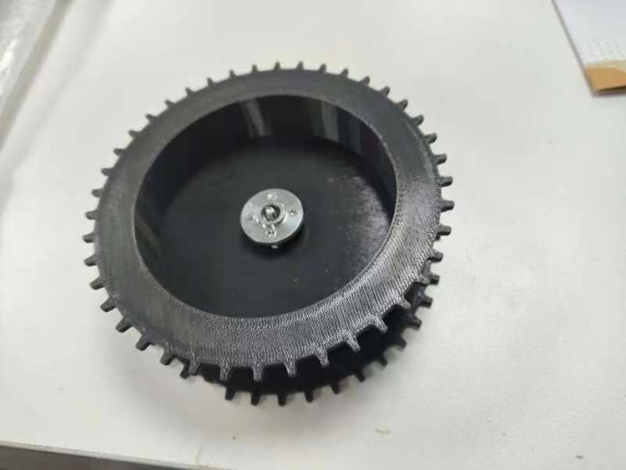
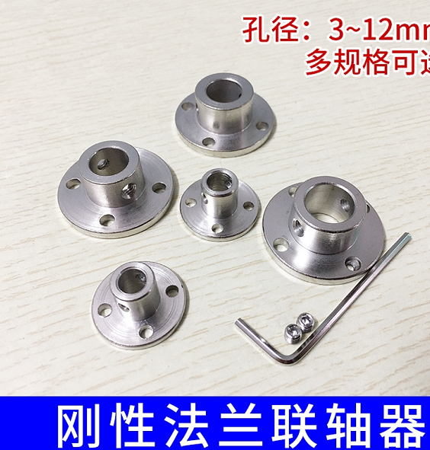
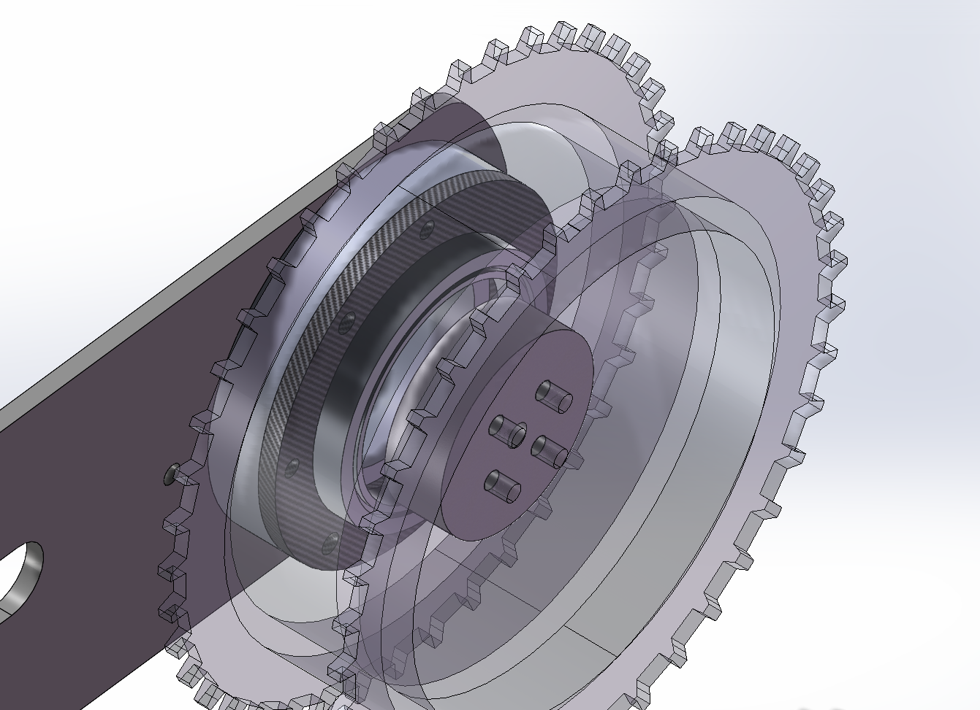
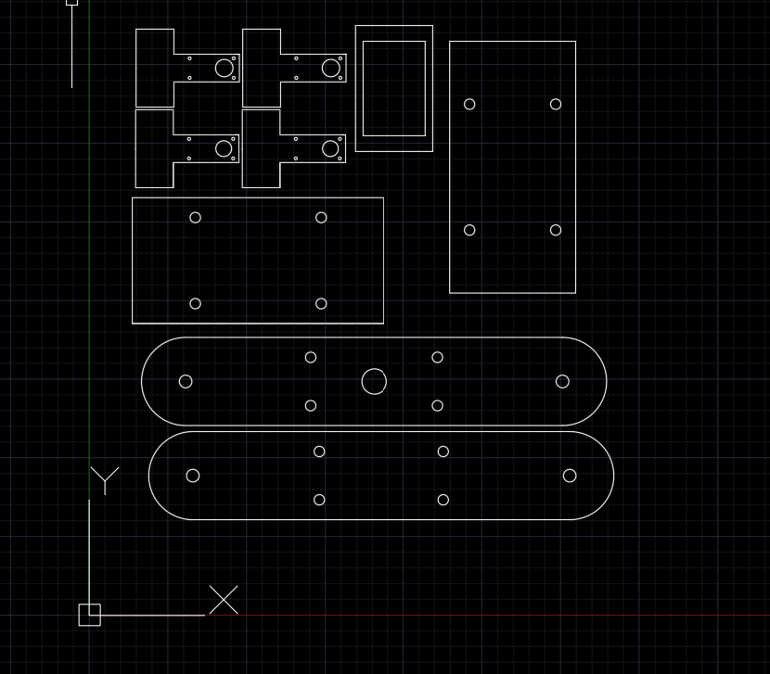
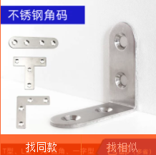
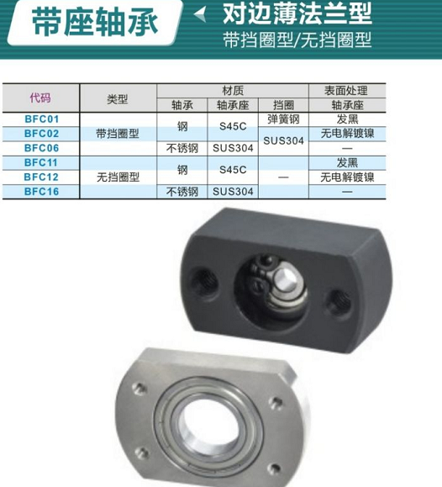
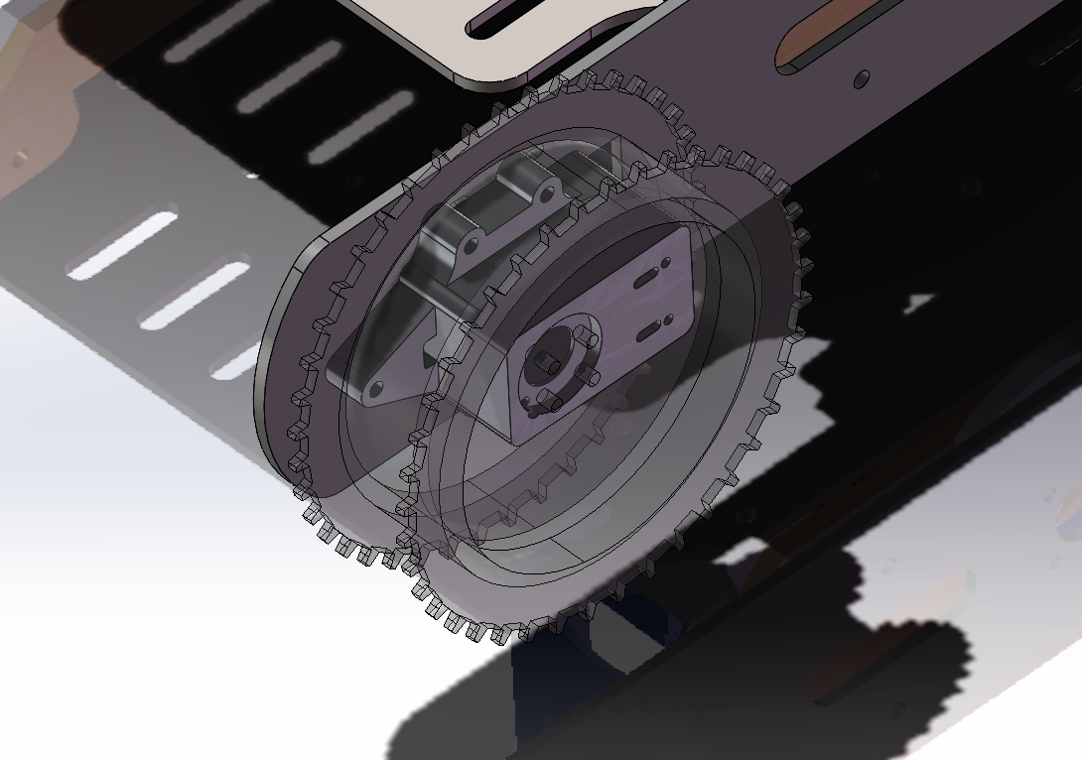
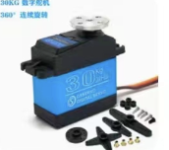
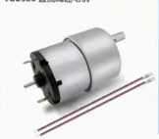
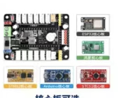
Materials
It is a 3-d printed gear that would fit my caterpillar band. Using this design instead of four seperate gears on one side ensures that the caterpillar band doesn’t get stuck.
The software I used was Fusion.
I bought some connectors online such as flange coupling. I also bought a mechanic claw for my vehicle
The picture below is a 2-d graph I designed for my bases. I did a few modifications in my version 2.

Slide 7
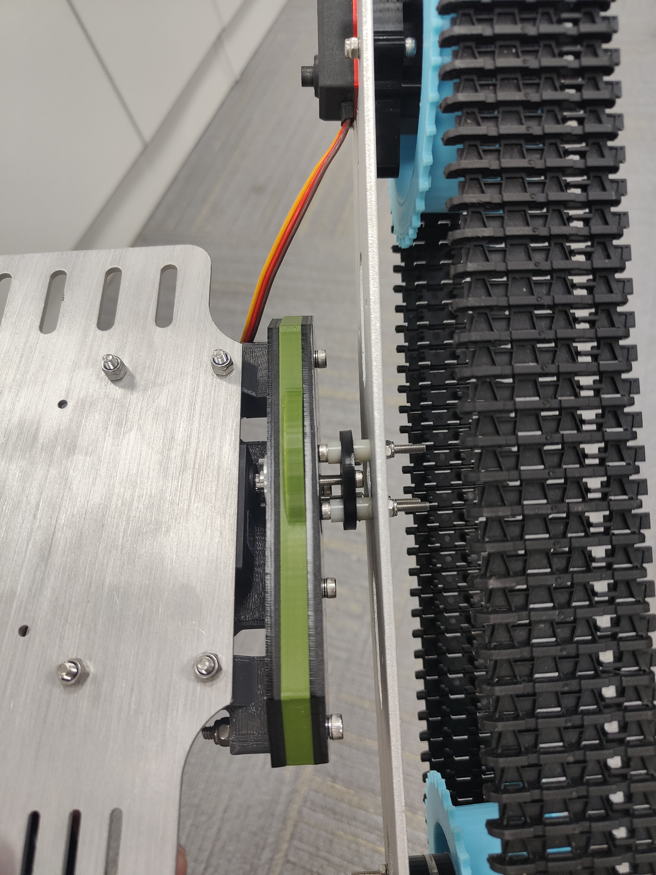
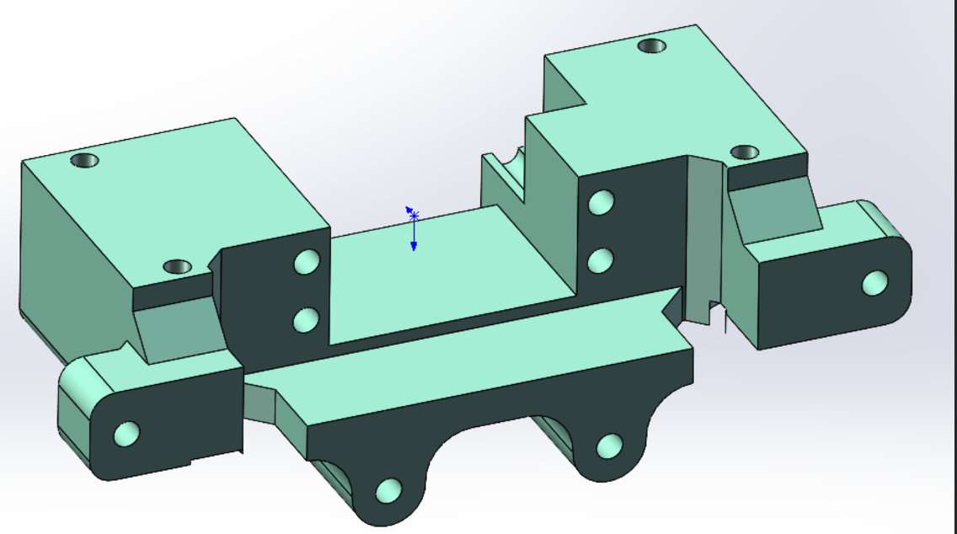
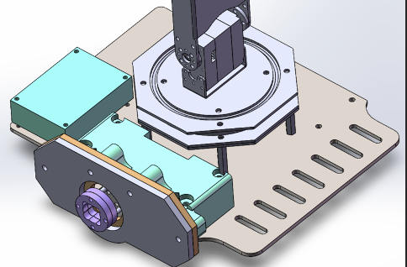
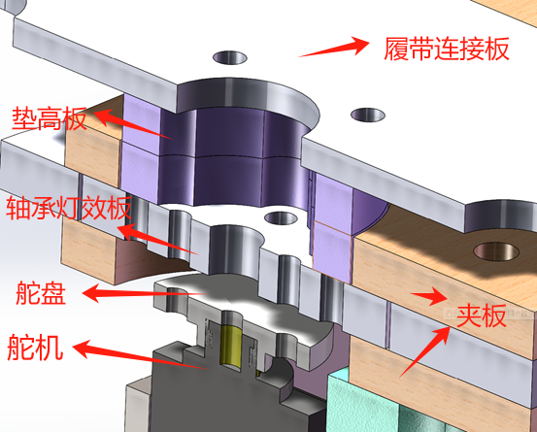
Structure Design
The main structure of my design (shown below) is primarily responsible for connecting the track propulsion section with the main control board and providing rotational freedom and power to the mechanical arm's main body. Due to the substantial weight of the tracks, the strength of the connections in this area needs to be sufficiently high to meet the demands of track obstacle traversal.
The first generation used a direct connection structure with servos, resulting in severe wear on the steering wheel and significant track movement. Therefore, a bearing clamp structure was adopted, using a 5mm thick acrylic plate instead of a rotating bearing. The gaps generated by laser cutting serve as the rotational pair. The apertures in the front and rear clamp plates are smaller than the diameter of the intermediate bearing replacement plate, achieving similar effects to bearings while ensuring higher strength. The intermediate rotating plate needs four connecting holes to link with the steering wheel. The intermediate bearing equivalent plate acts as a spacer, and the track connection plate is rigidly connected together. The clamp plates are connected to the servo mounting parts. I designed some new structures to reinforce this part. In the figure above, blue part is identical with the 3-d model , and there is a 360-degree servo right under the blue structure. This is really a unique design that cost me a lot of time.

Slide 8
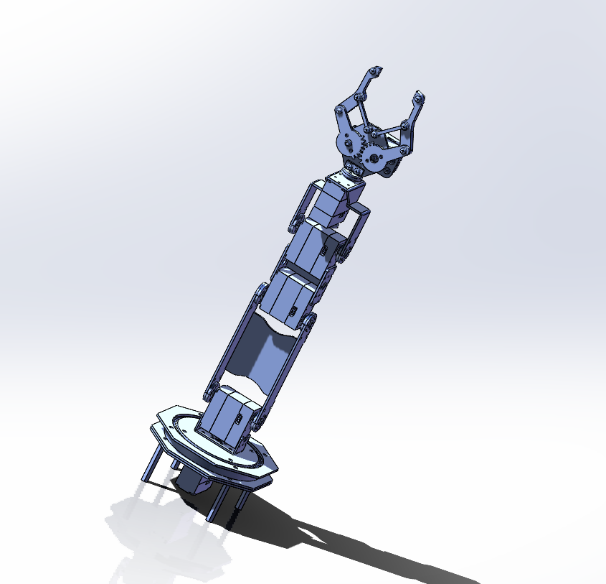
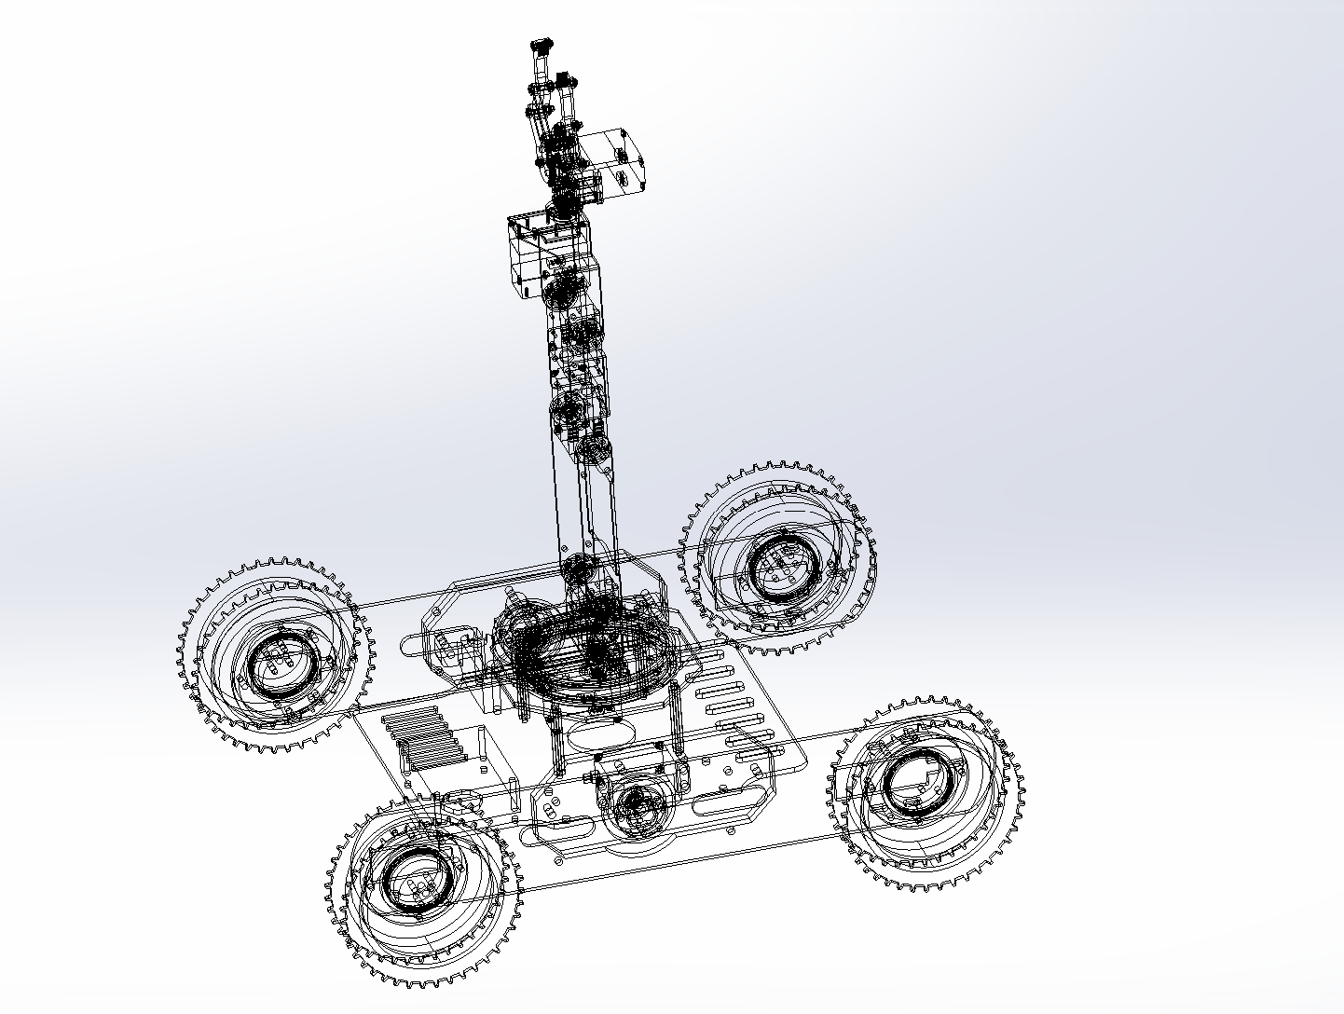
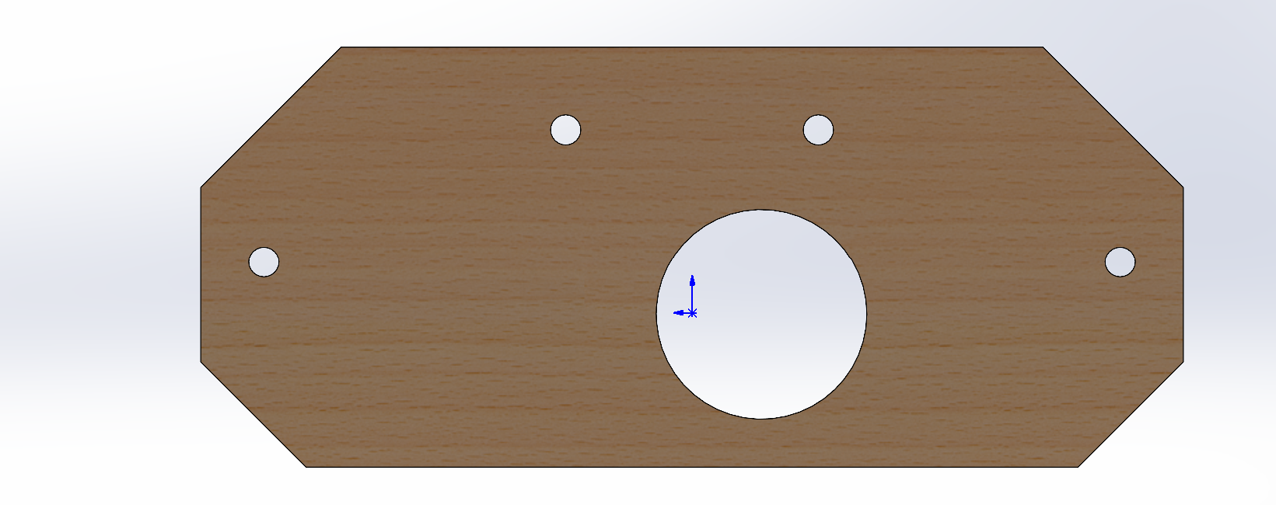
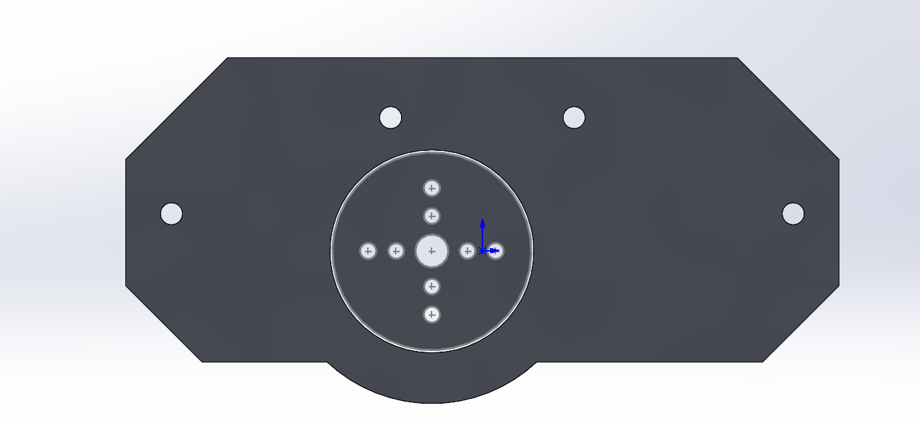
Structure Design
The two outer plates, shown in figure(d), each has a large hole for the screws from the other side to come through. These reinforce the connection between the servo and the caterpillar bands. The plate in the middle has a smaller hole that allows bearing to come through, as shown in figure(e). In figure (c), the purple part is used to maintain a proper distance between caterpillar bands and the base so that the bands will no collide with the screws going from outside to inside.
The arm is powered by six steering engines. The torque of the steering gear with the larger load at the bottom is 30kg.cm, while the steering gear with the smaller load at the upper end is 15kg.cm. The length of the robot arm is 381 mm. The installation on the ground can catch obstacles outside the chassis, meeting our needs to remove obstacles
3-d model of my mechanic arm
(c)
(d)
(e)
3-d model of my vehicle

Slide 9
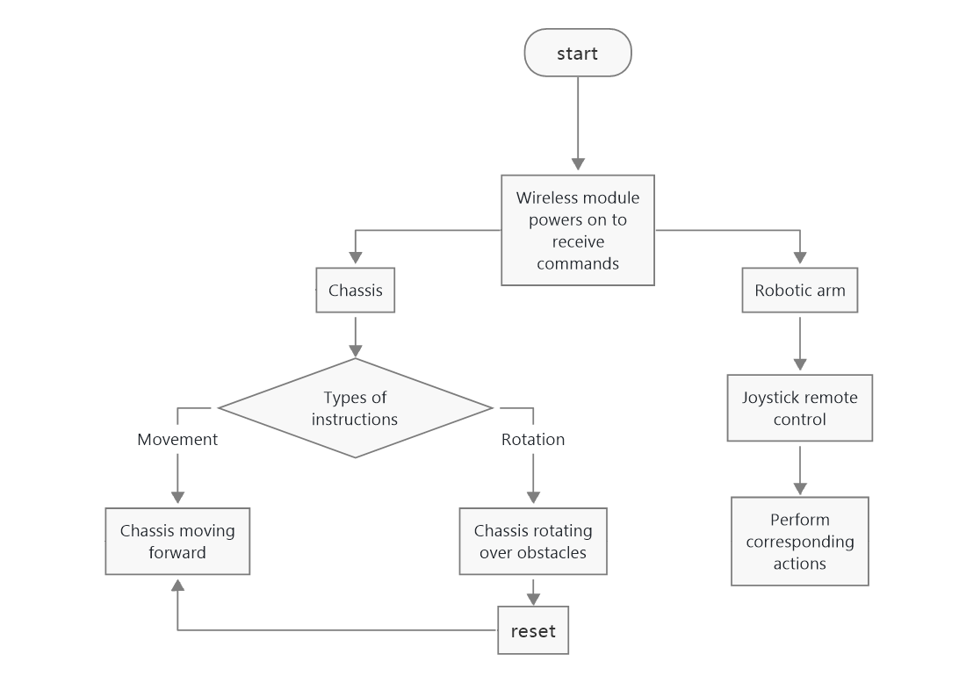
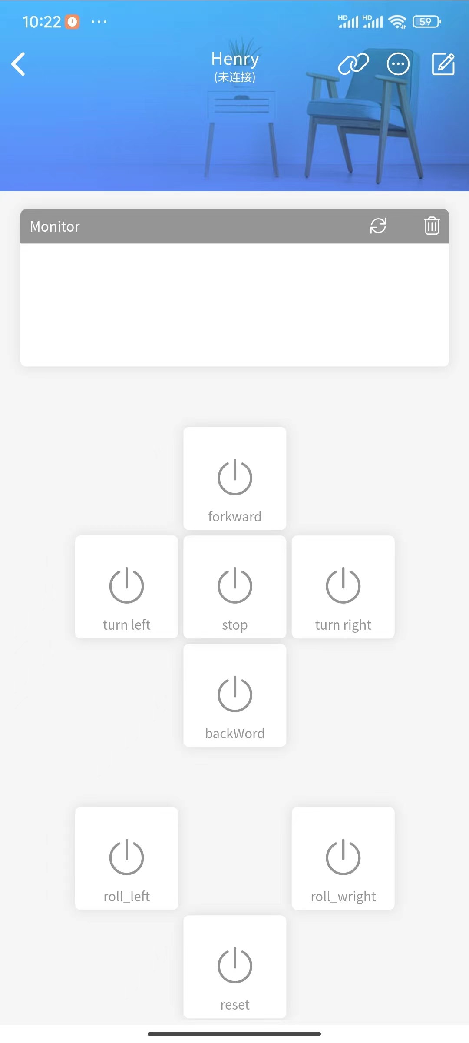
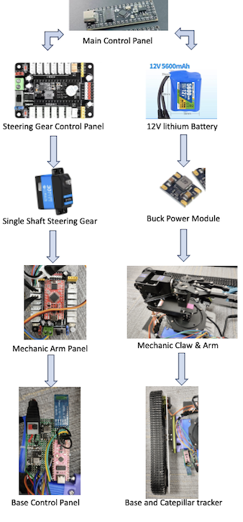
Software And Hardware
Control System:
Our chassis and arm parts are divided into two control systems, but also into two power management, meaning that there are two separate power modules for power supply. Because the two steering engines responsible for rotation have more electricity and larger current, sharing a power supply may cause the current to be too large and cause the circuit board to be burned through. The chassis is controlled by a mobile phone, and the mechanical wall is controlled by a PS2 controller. The control of the mobile terminal is shown in the figure below.
Hardware System:
For the coding part, I used the Arduino. Here it indicates that the pwm of servo0 specifies 500-2500, which corresponds to the 0-180 Angle of the 180 steering gear. Our initialization defines the pwm as 1500, which is to achieve the median of 500-2500 to achieve the alignment of the steering gear.
In addition, the steering gear 3456 is controlled by directly writing the steering gear Angle. This is because the steering gear 3456 is operated by the joystick of SP2 handle, and the output corresponding to the joystick operation is a virtual quantity. Here, the data returned by the joystick is calculated by the following function to define the rotation Angle of the steering gear.

Slide 10
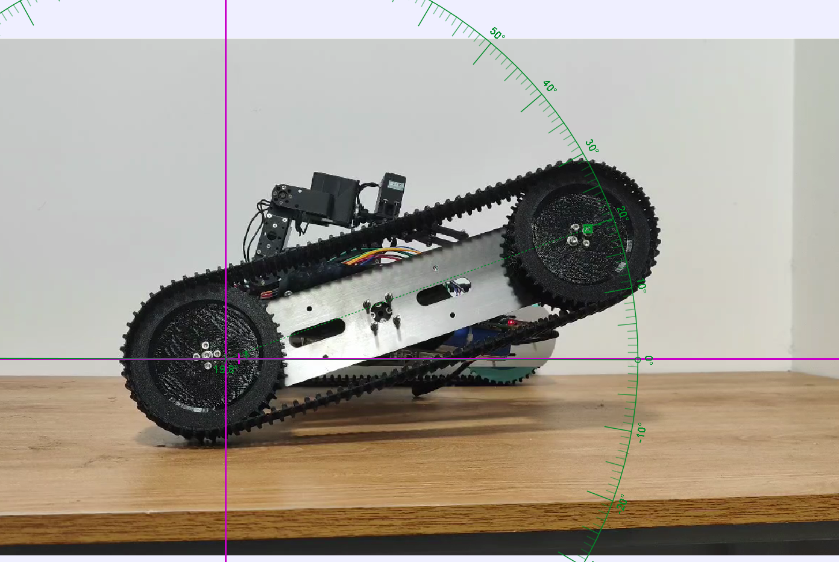
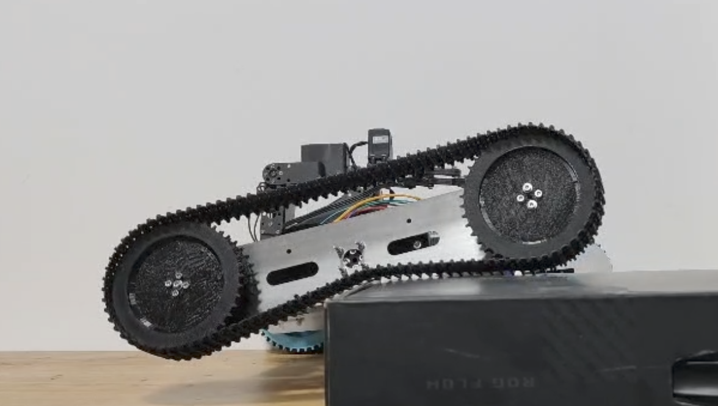
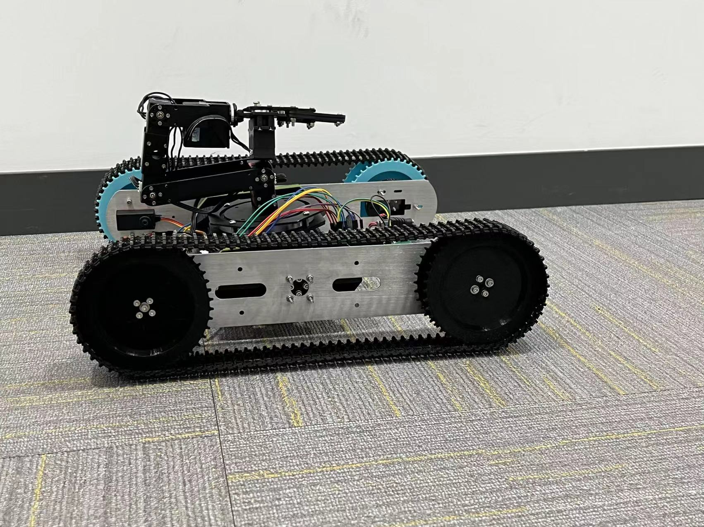
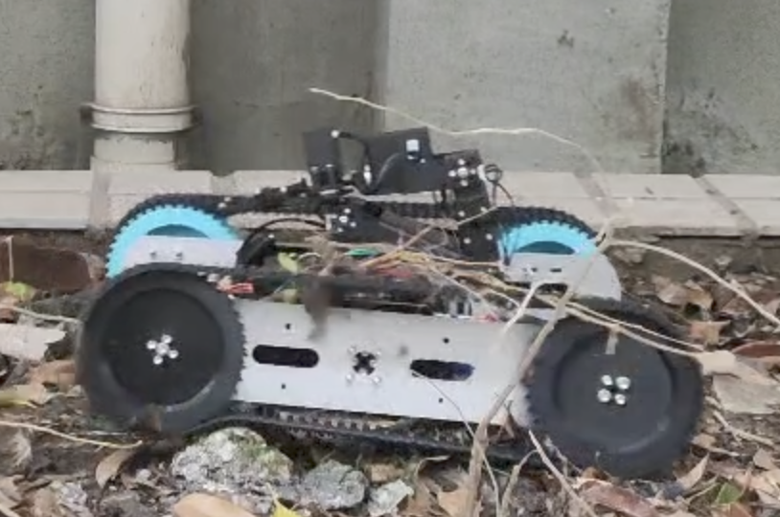
Experiments and Analysis
The robot is able to lift one side to 30 degrees to maintain absolute balance. It is also able to cross obstacle with one side. After my improvement, the ability to cross obstacles improved by 81 percent.
I did two tests to evaluate the vehicle’s stability on flat and bumpier roads. The vertical shifts are very ideal (there is not a lot of vertical shifts when moving in both cases), proving the vehicle’s ability to stay stable and won’t tear apart in harsh terains.
The figure at the left is when the vehicle is on a bumpy road, and the results are down below.
The figure at the left is when the vehicle is on a normal road, and the results are down below.

Slide 11
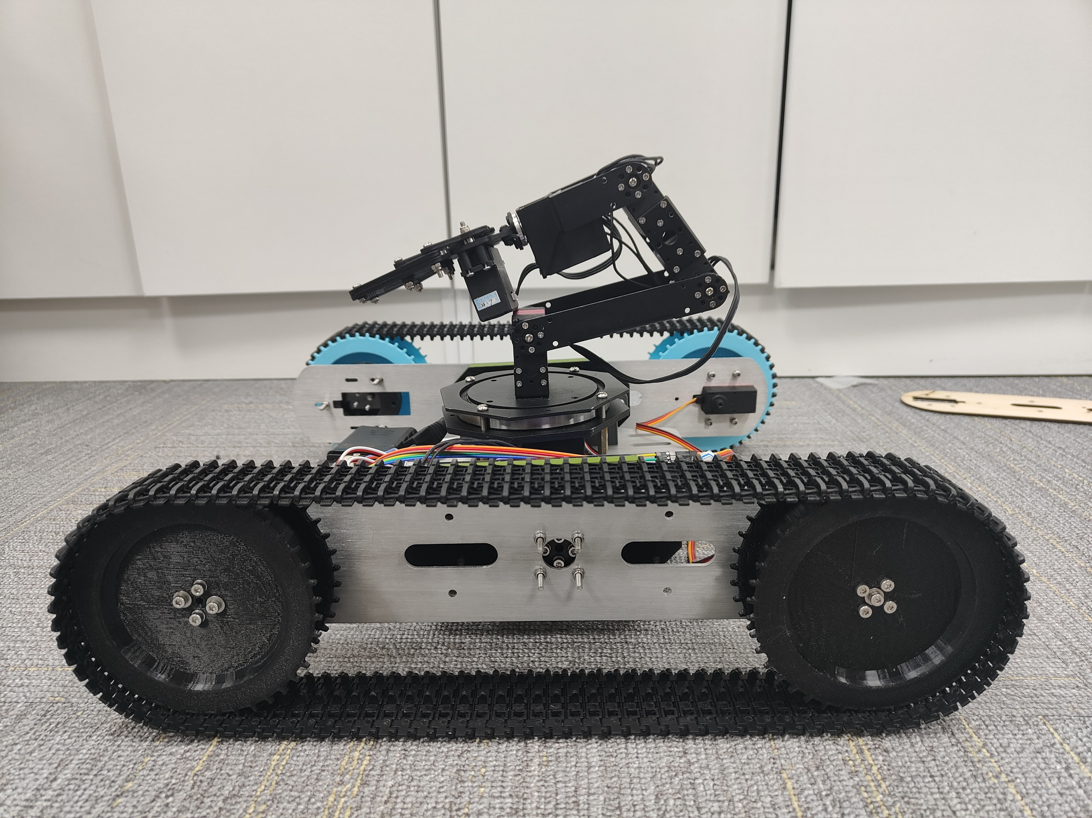
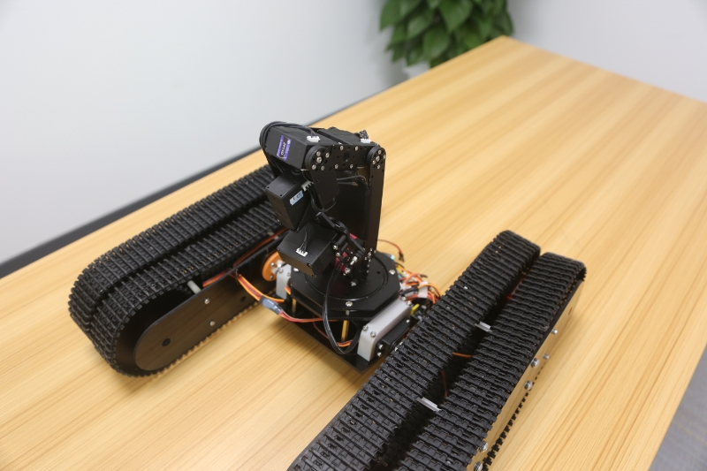
Overall Advantage and Prospect
Ver.2
The difference between my vehicle and other vehicles is the unique obstacle crossing ability, especially how I utilized the concept of rotational caterpillar track. The vehicle is also:
-Cheap In Cost
-Light-Weighted
-Flexible and Stable
-Fast Speed
Future Overlook:
Other sensors could be added to the top of the mechanic claw, such as a thermo sensor. It could locate the victims more accurately.
Add more wheels to the base. This may sacrifice the lightness of the vehicle, but it may solidify the body and lower the risk of tilting and the break of caterpillar bands.
Utilize a stronger bluetooth connectiion so tha the vehicle can work remotely (places farther than 100m)
Overall, this is still a prototype, and it has a lot of potential and future.
Ver.1

Slide 12
Reference
[1] Chengxin Wen,and Hongbin Ma.An efficient two-stage evolutionary algorithm for multi-robot task allocation in nuclear accident rescue scenario.Applied Soft Computing 152.(2024):111223-.
[2] Arunkumar V.Rajasekar Devika,and Aishwarya N..A Review Paper on Mobile Robots Applications in Search and Rescue Operations.Advances in Science and Technology 6680.(2023):65-74.
[3] Kim Tae Ho, et al.The Design of a Low-Cost Sensing and Control Architecture for a Search and Rescue Assistant Robot.Machines 11.3(2023):329-329.
[4] Chengxin Wen,and Hongbin Ma.An efficient two-stage evolutionary algorithm for multi-robot task allocation in nuclear accident rescue scenario.Applied Soft Computing 152.(2024):111223-.
[5] [1]Seongil Hong, et al.Design and Control Strategy for Rescue Robot to Execute Rescue Missions in a Highly Unstructured Environment.Journal of Institute of Control Robotics and Systems 26.8(2020):683-695.
[6] Li Fuhao, et al.Rescue Robots for the Urban Earthquake Environment..Disaster medicine and public health preparedness 17.(2022):1-5.
[7] Qingyun Zhou, et al.Strong earthquake recurrence interval in the southern segment of the Red River Fault, southwestern China.Frontiers in Earth Science 11.(2023):
[8] Robotics and Perception Group, Department of Informatics and Neuroinformatics University of Zurich and ETH, Zurich Zürich Switzerland, et al.The current state and future outlook of rescue robotics.Journal of Field Robotics 36.7(2019):1171-1191.

