Slide 1
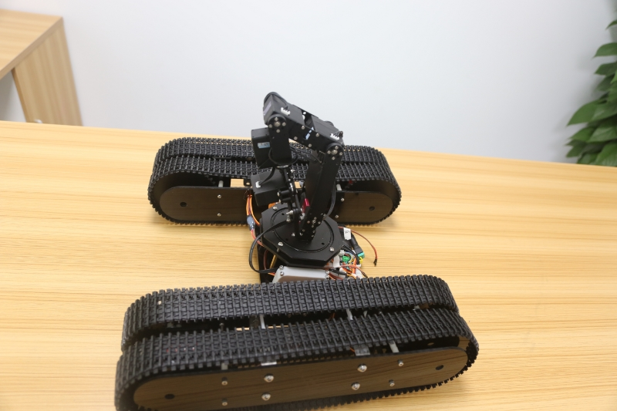
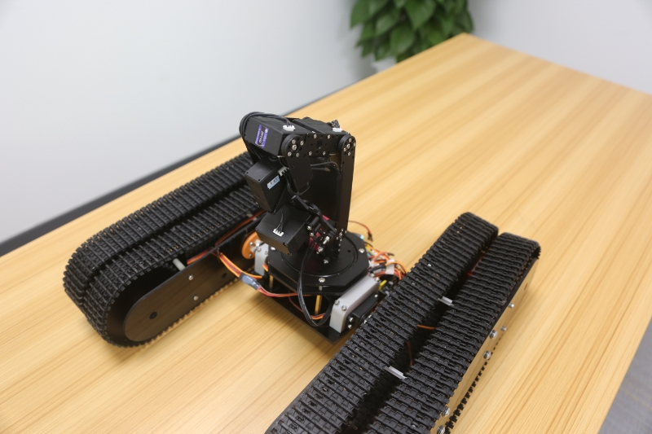
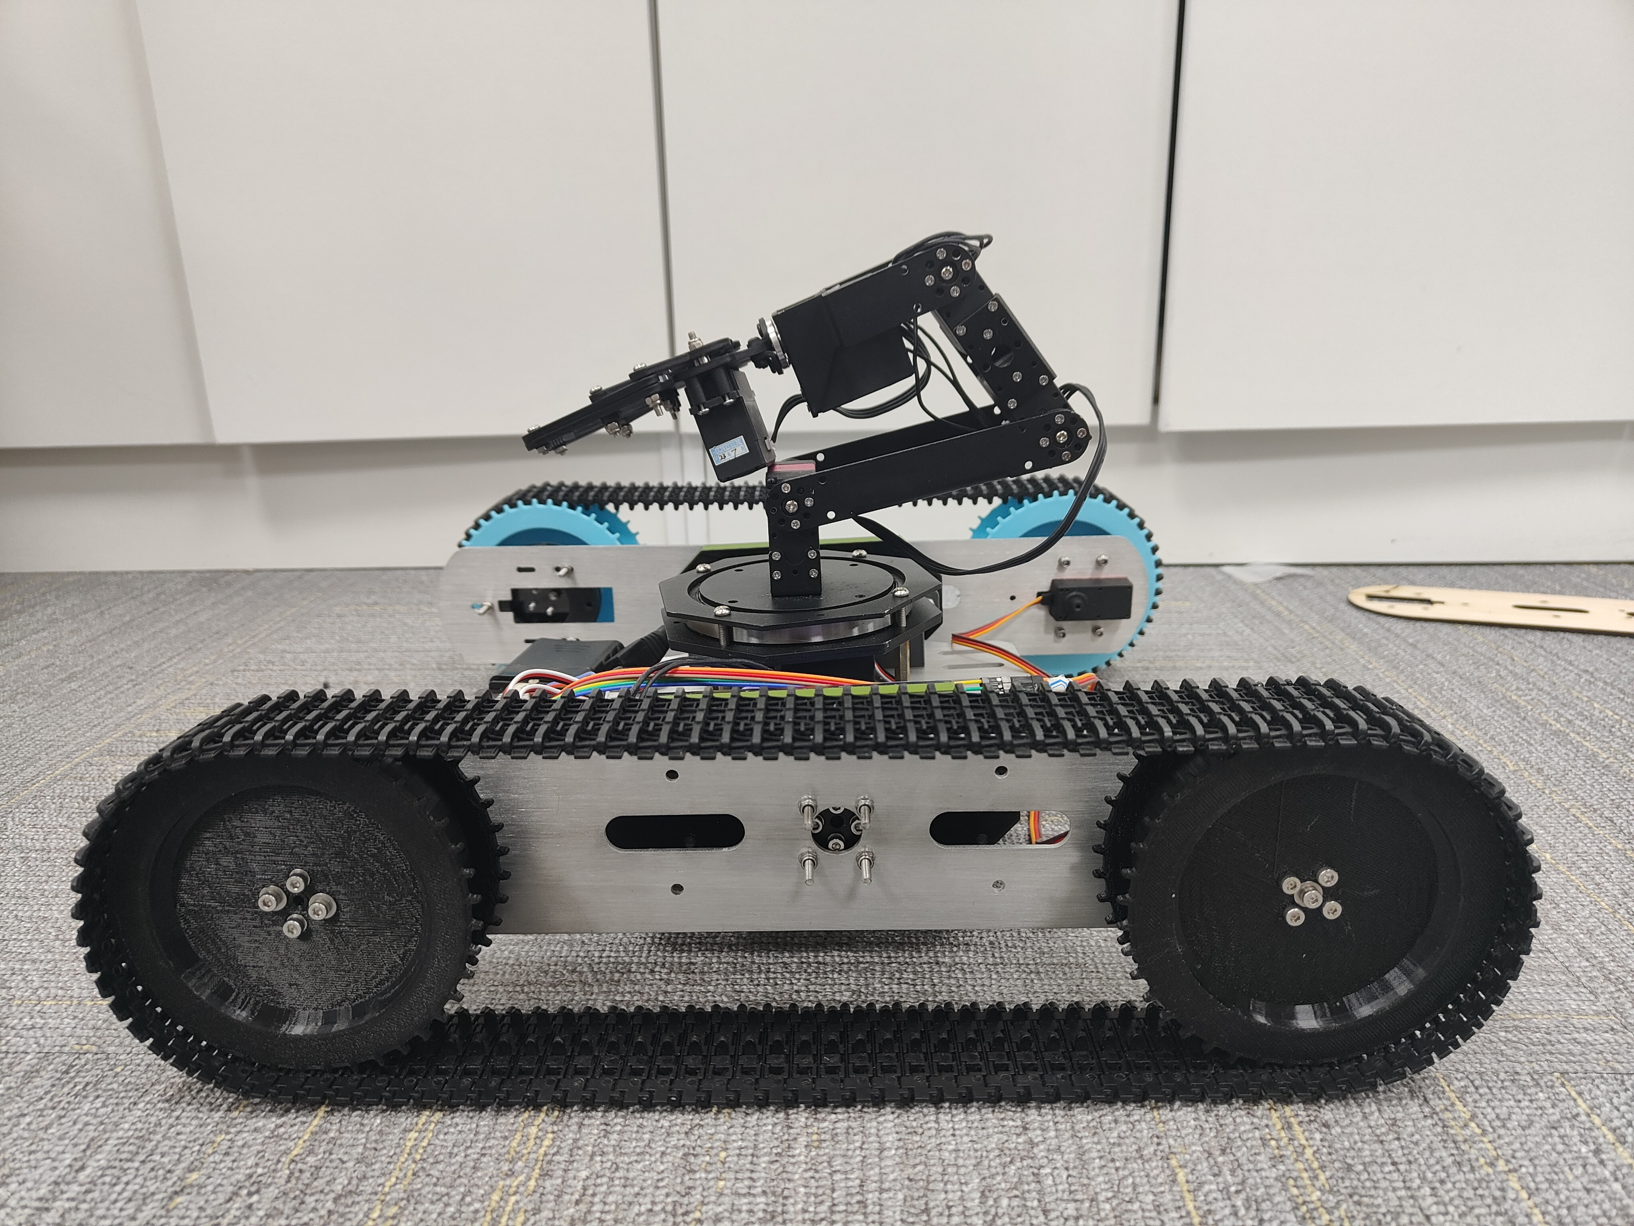
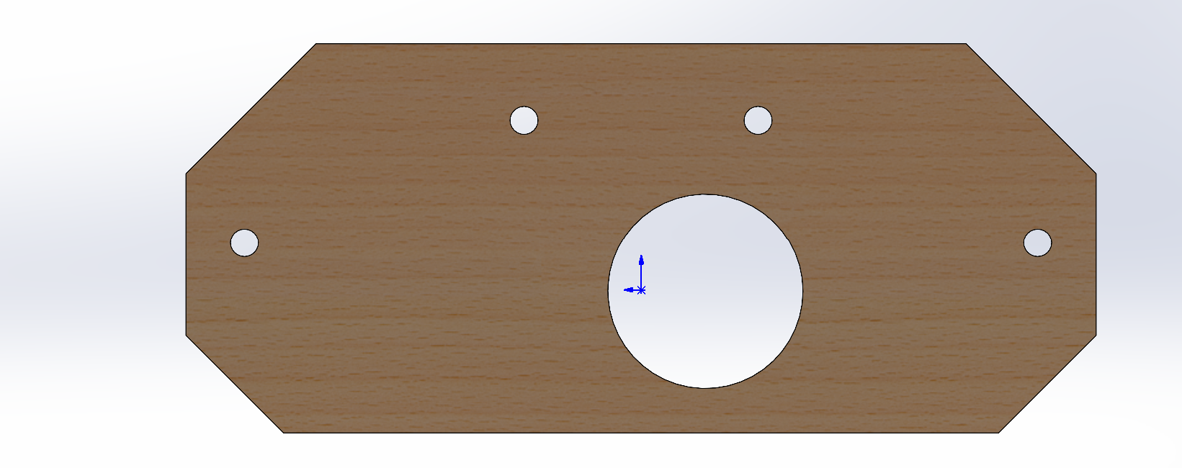
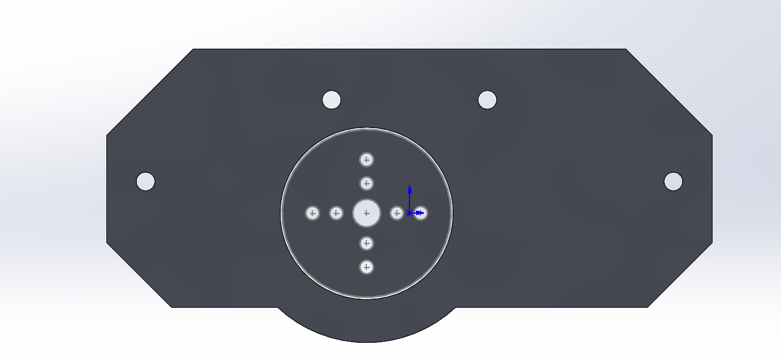
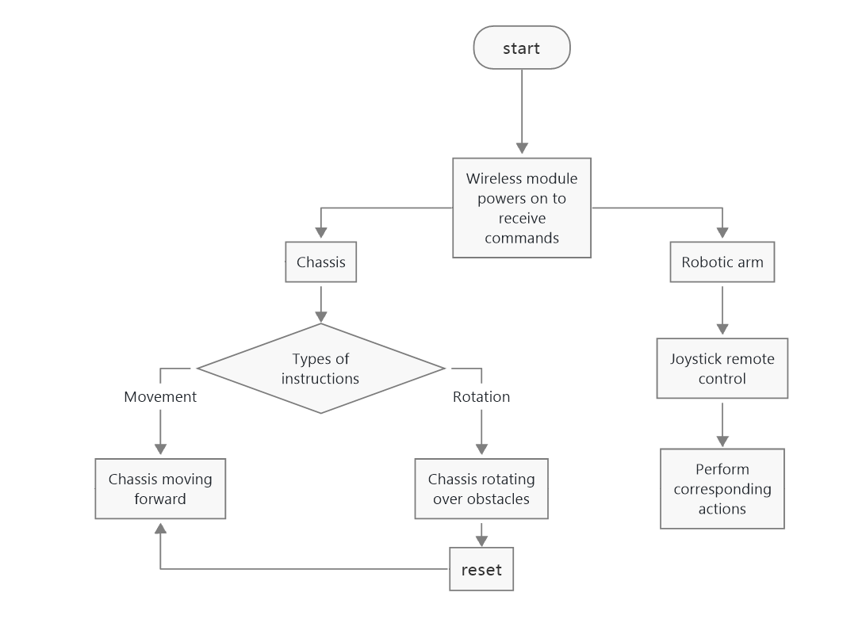
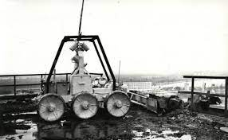
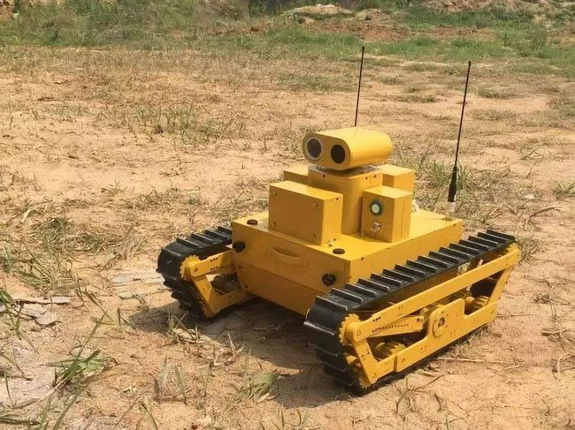
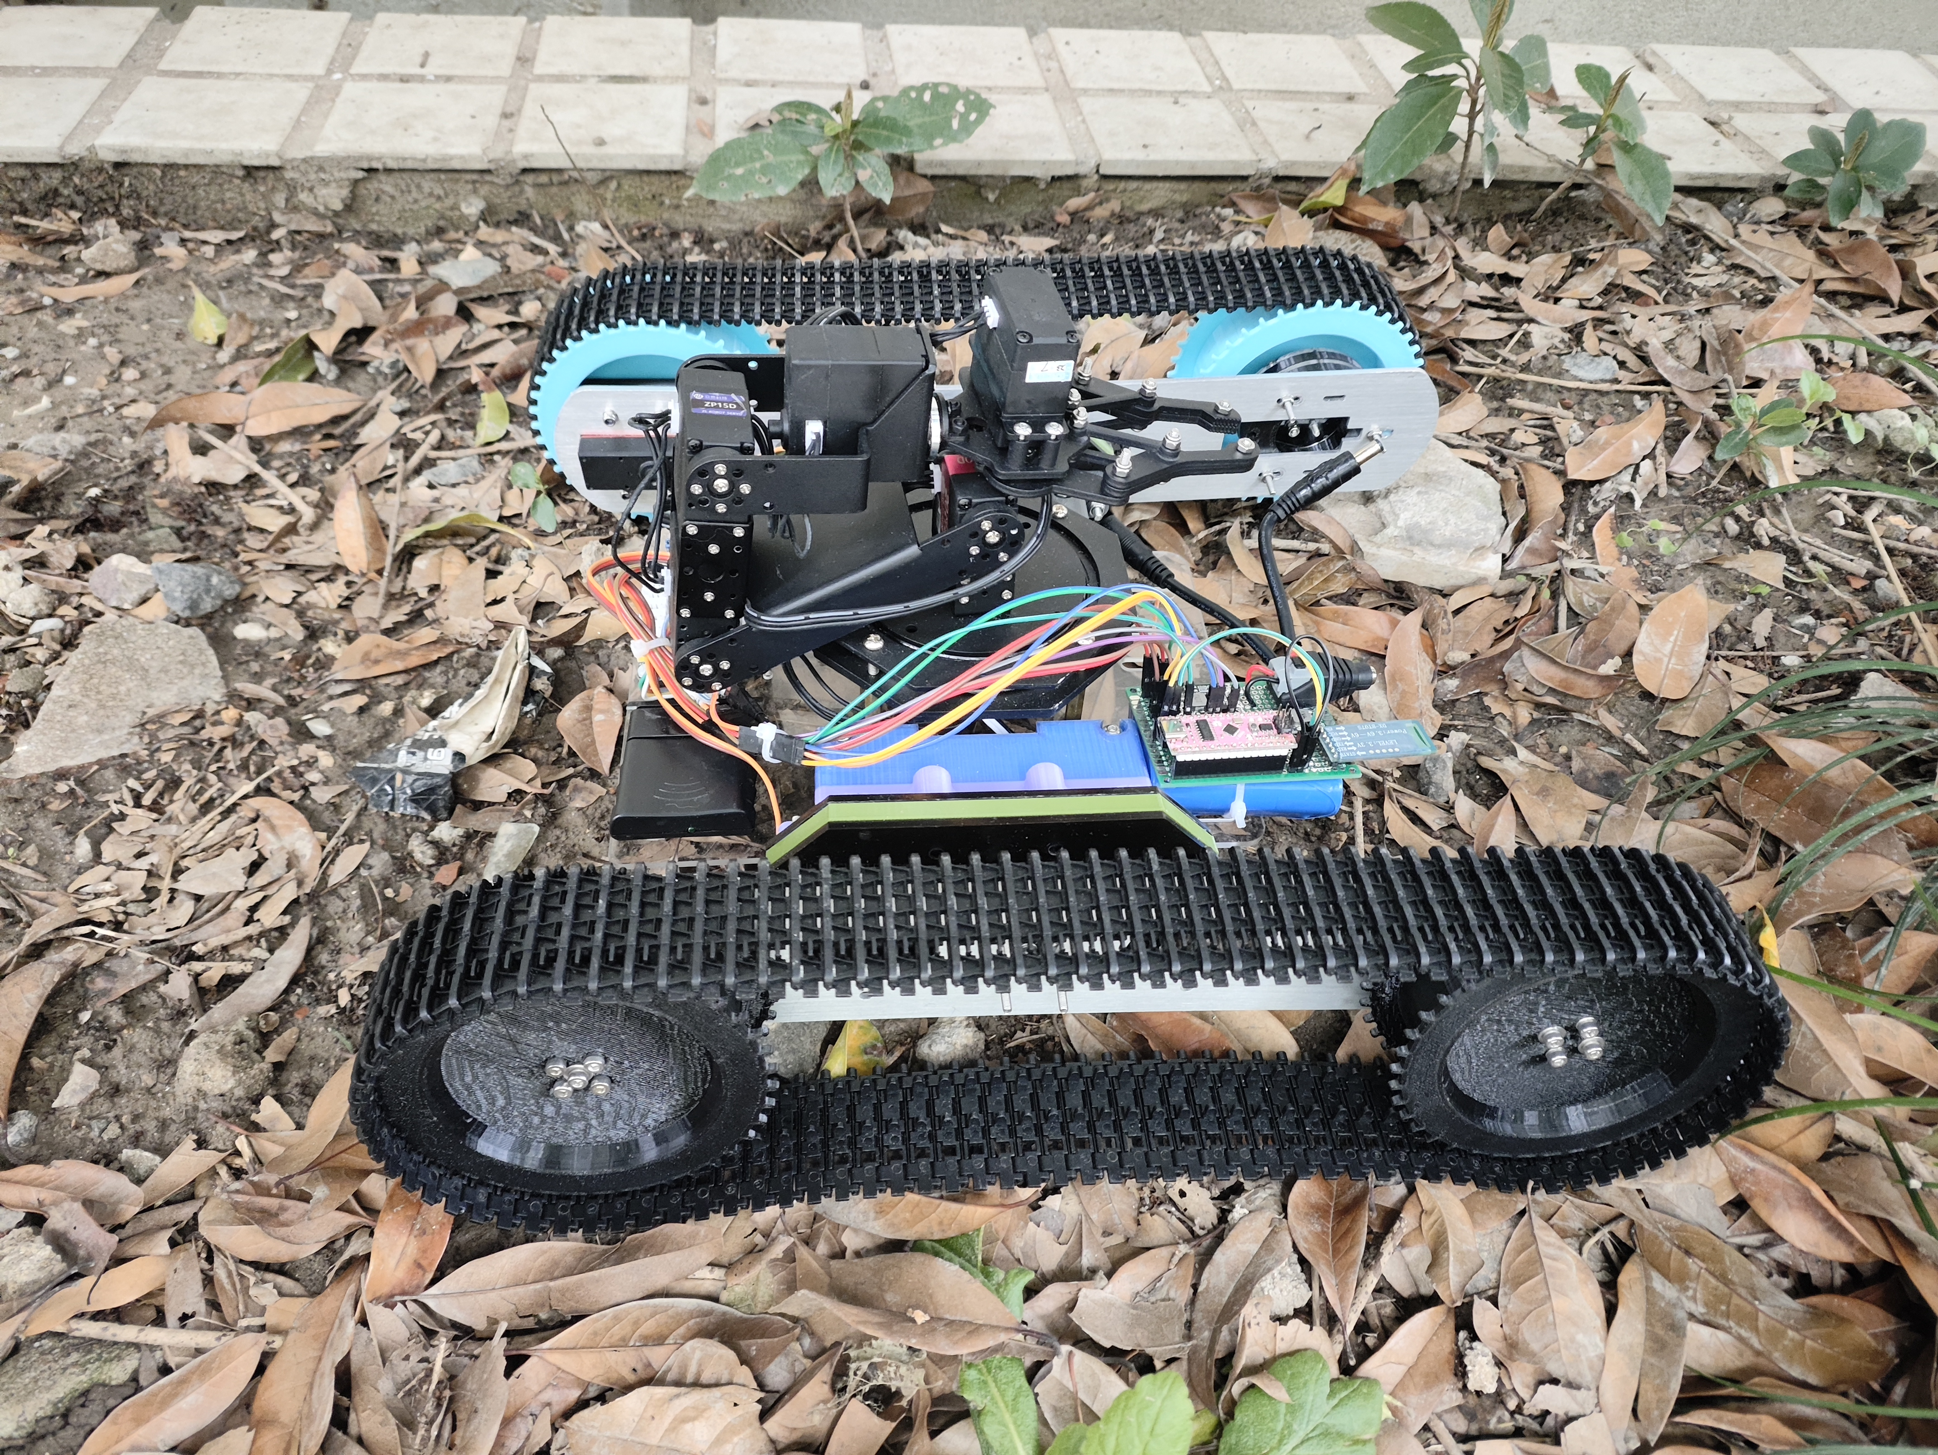
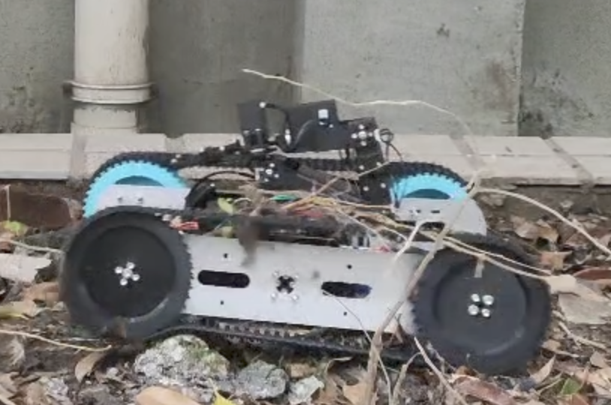
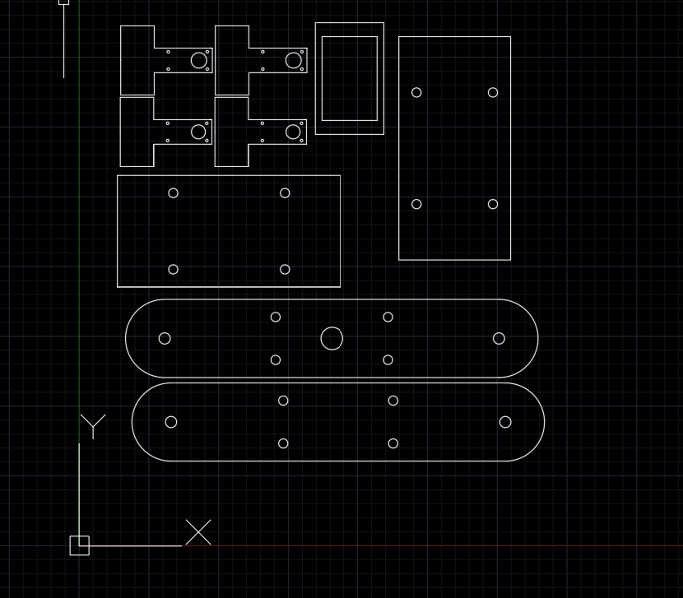
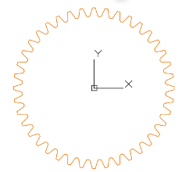
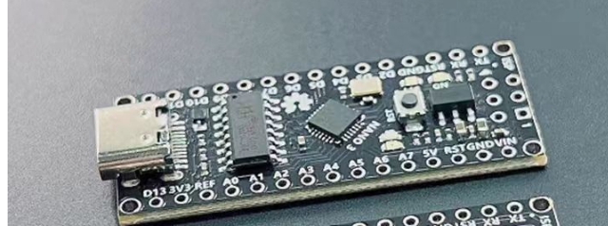
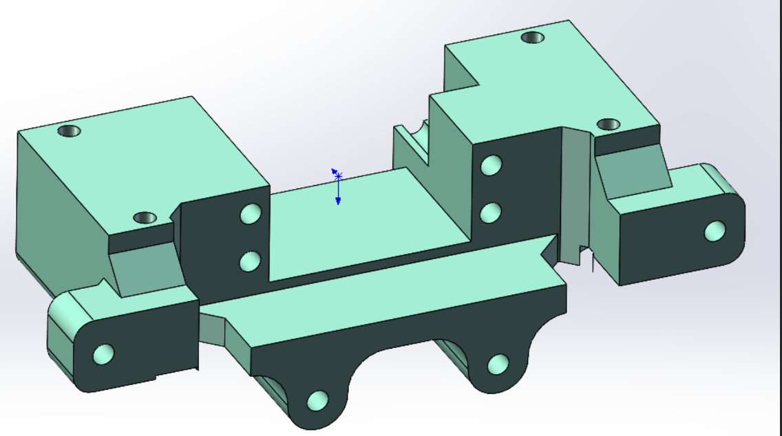
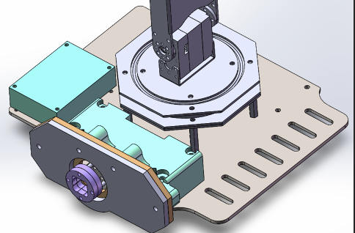
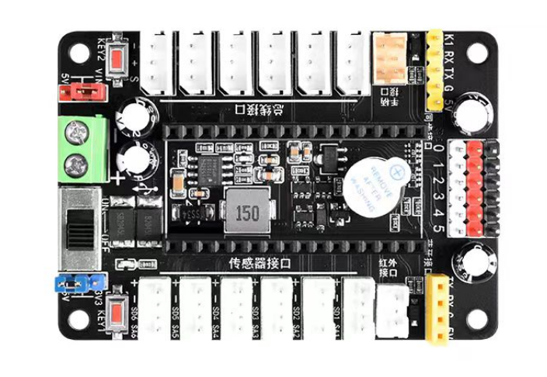
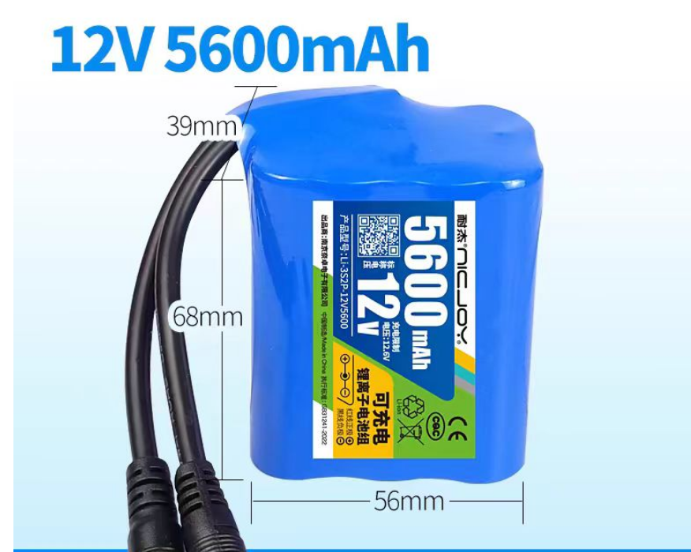
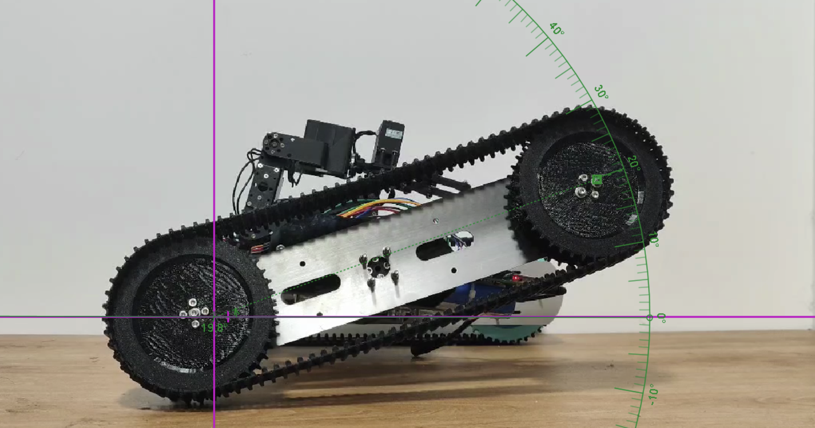
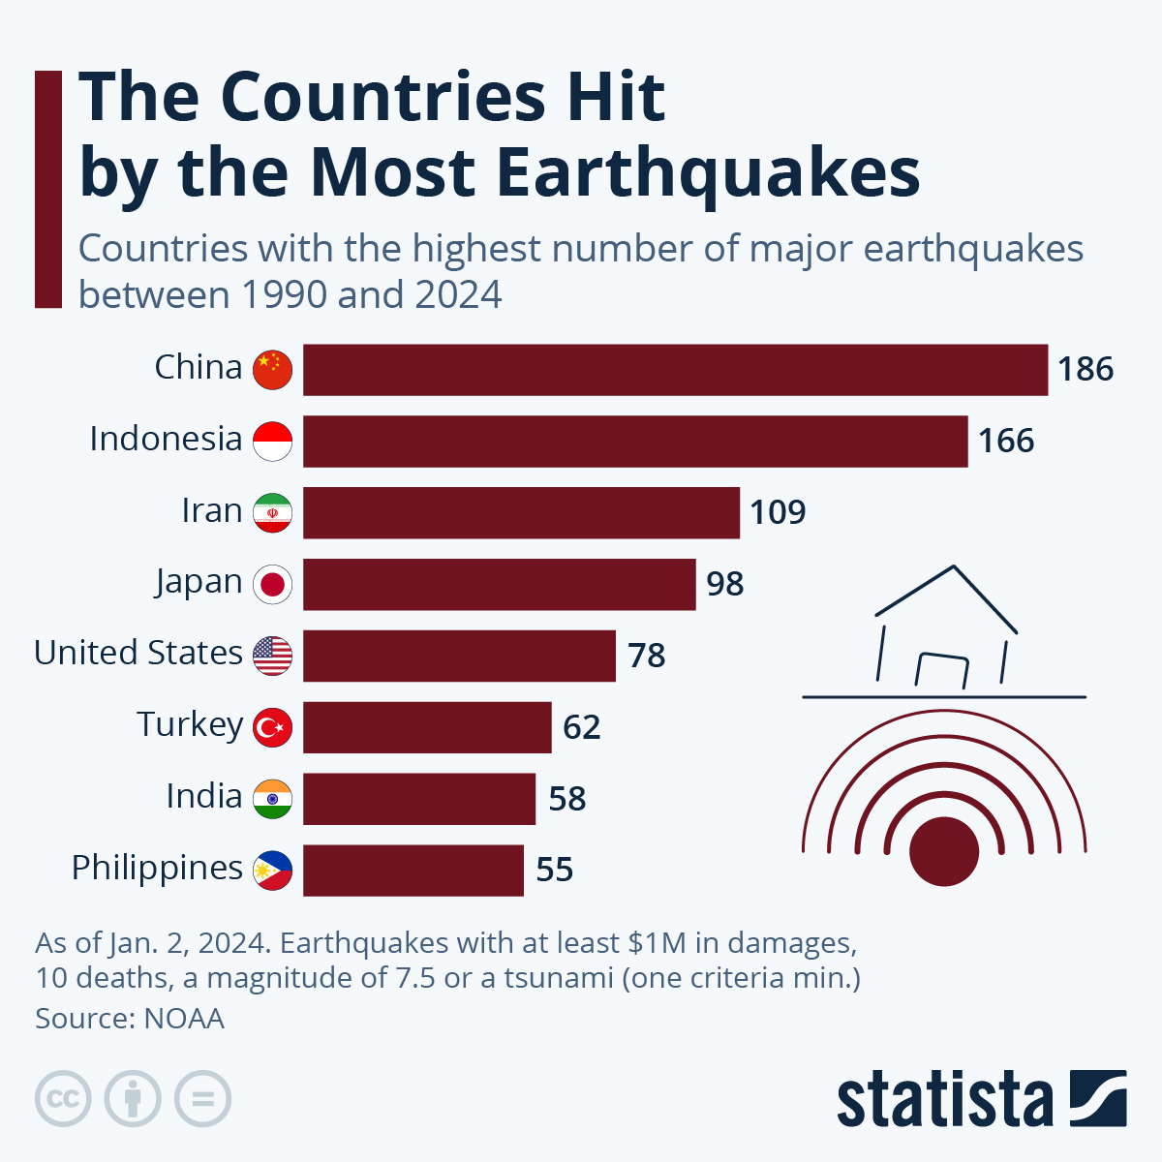
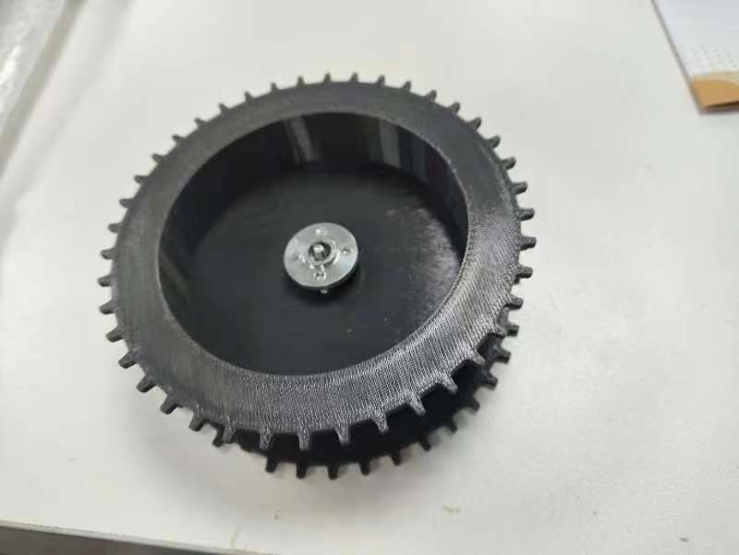
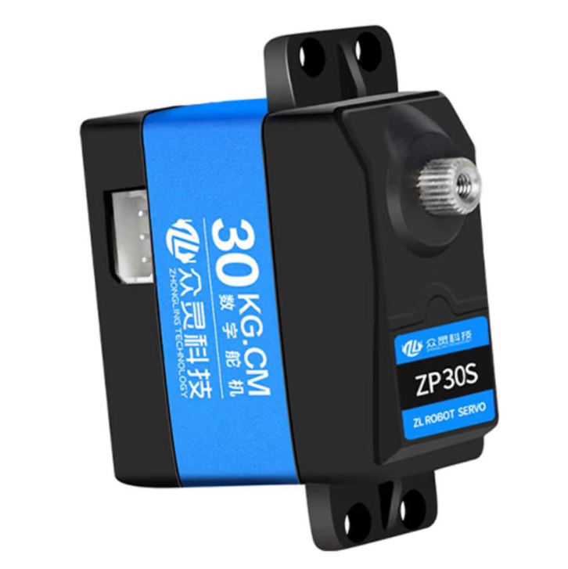
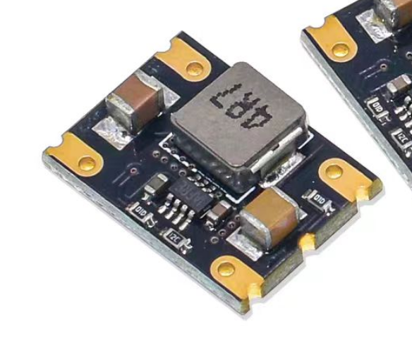
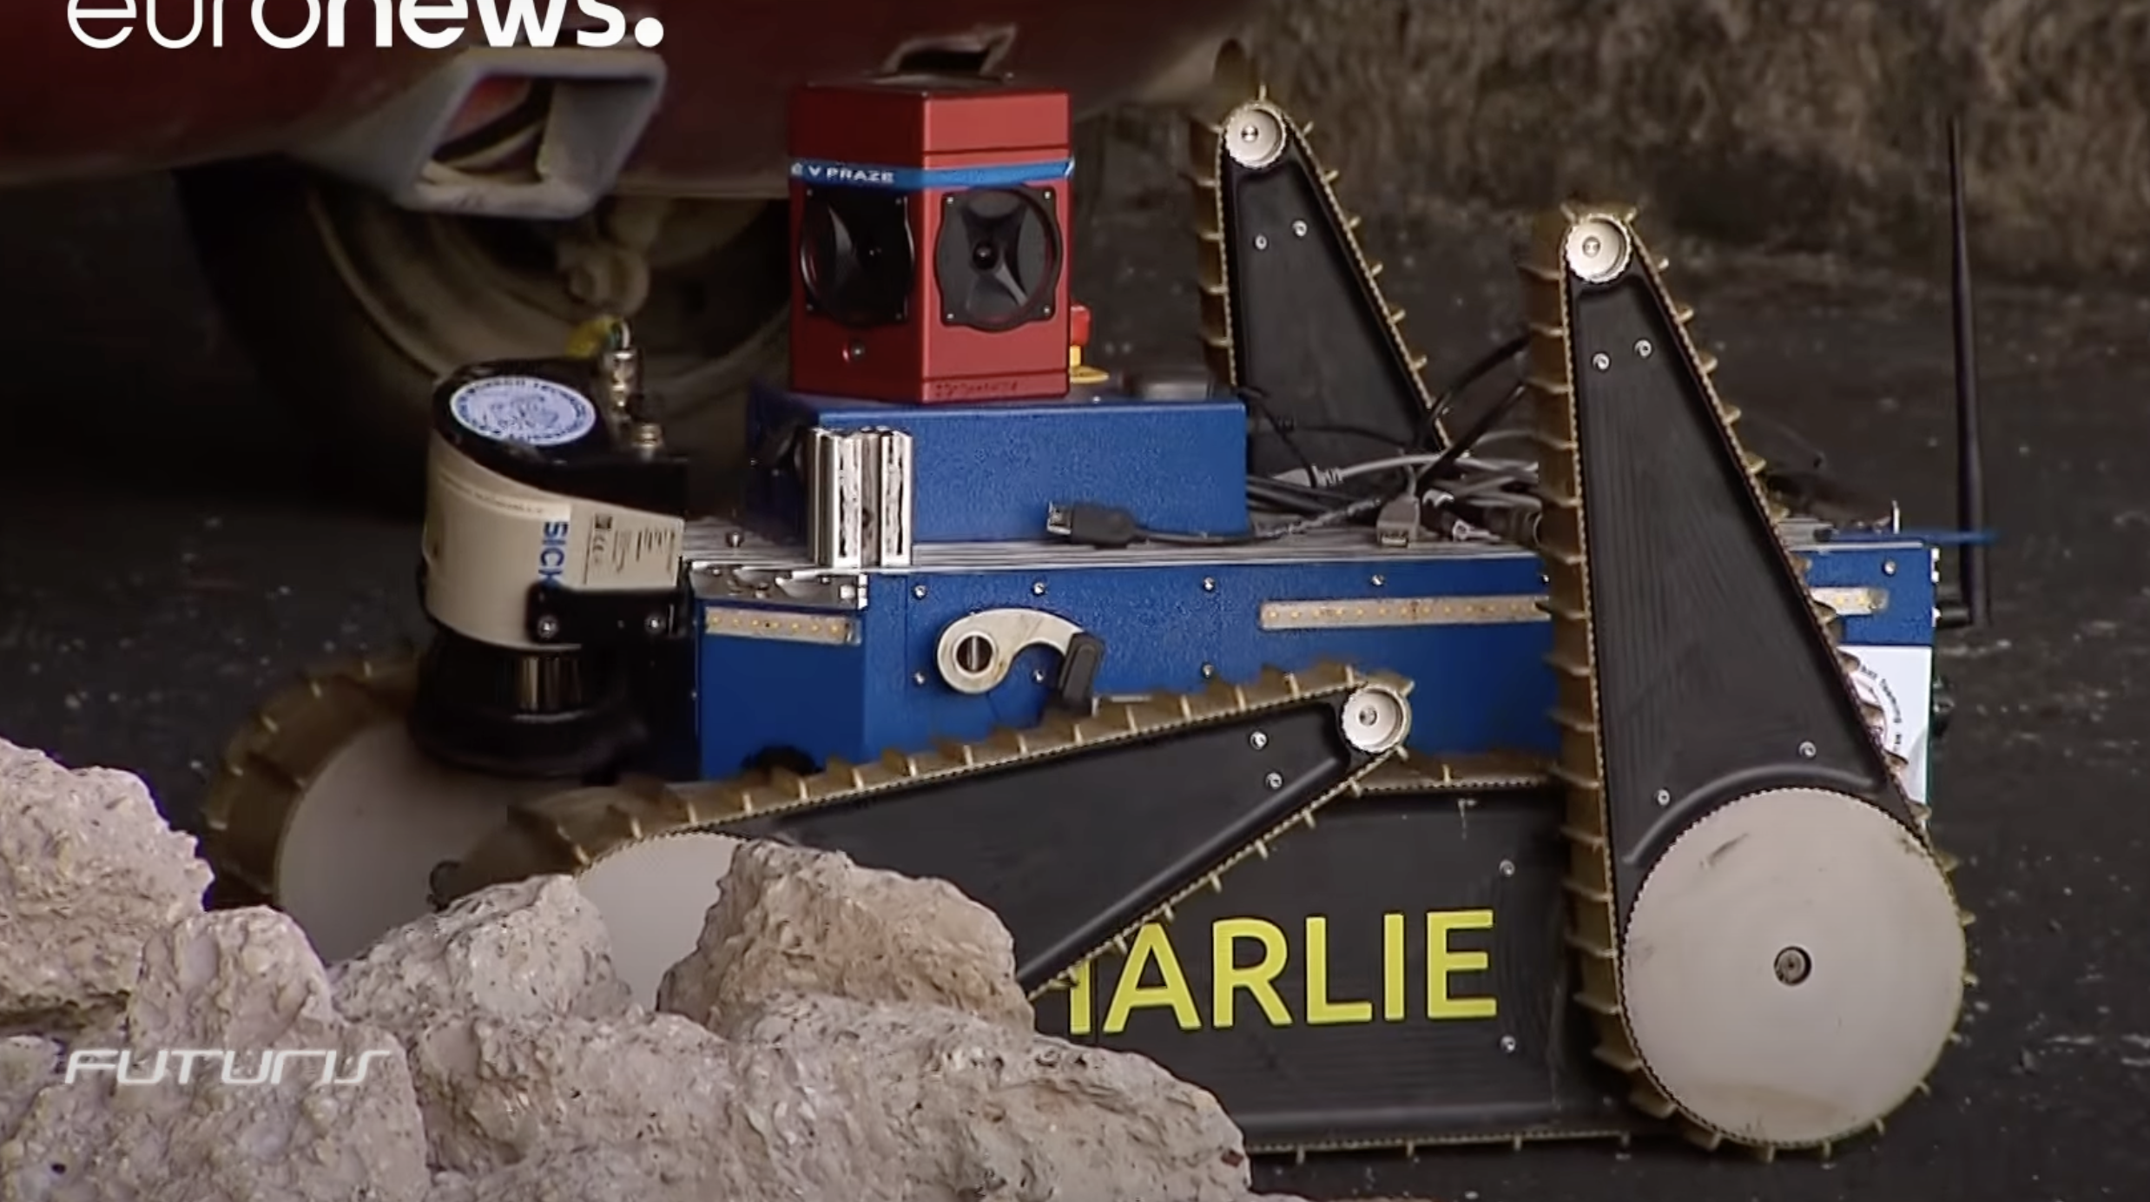
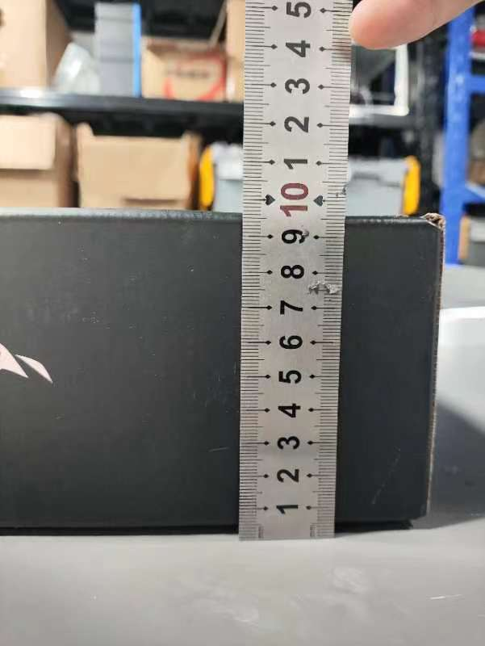
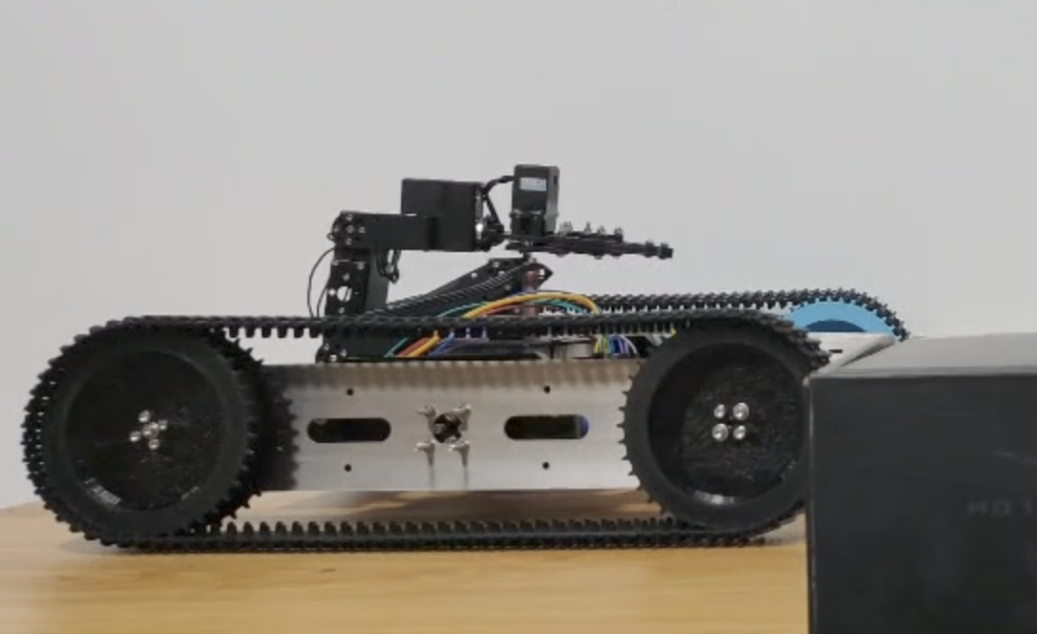
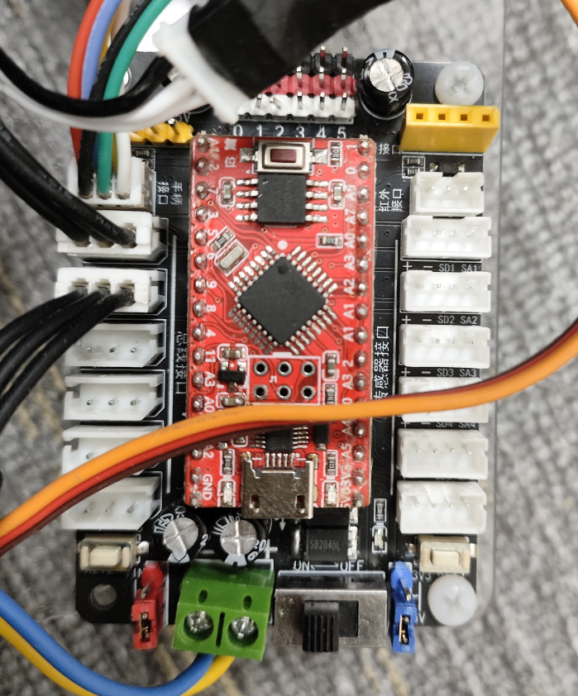
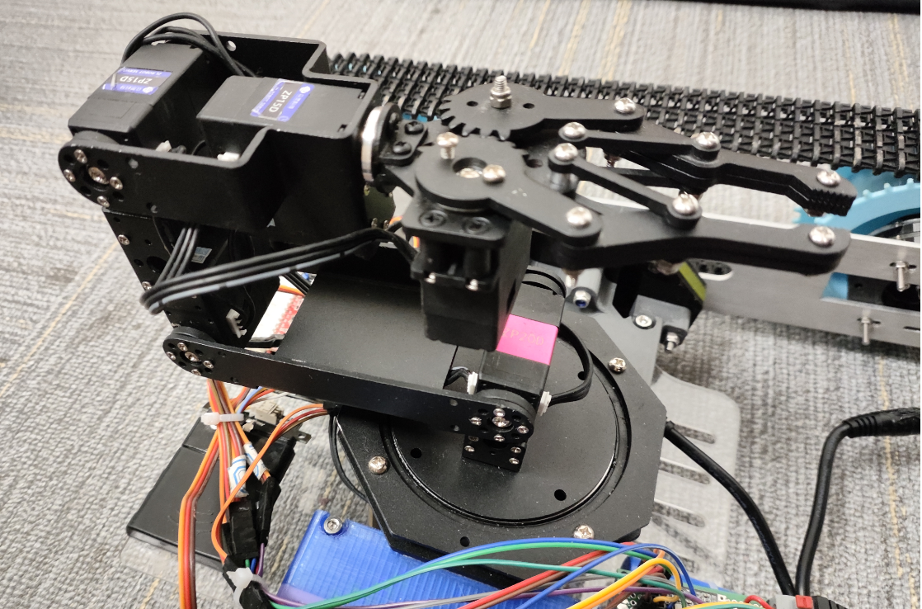
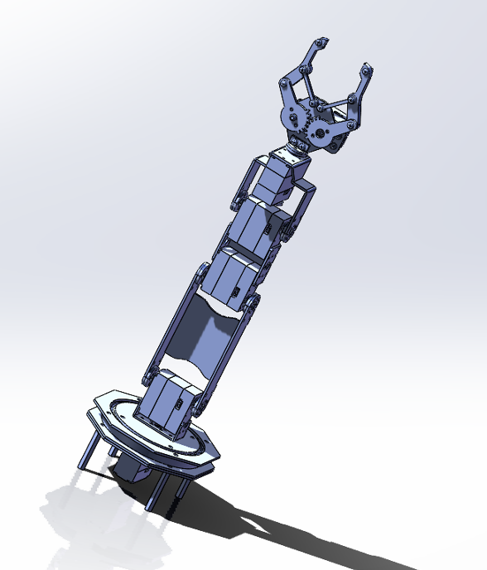
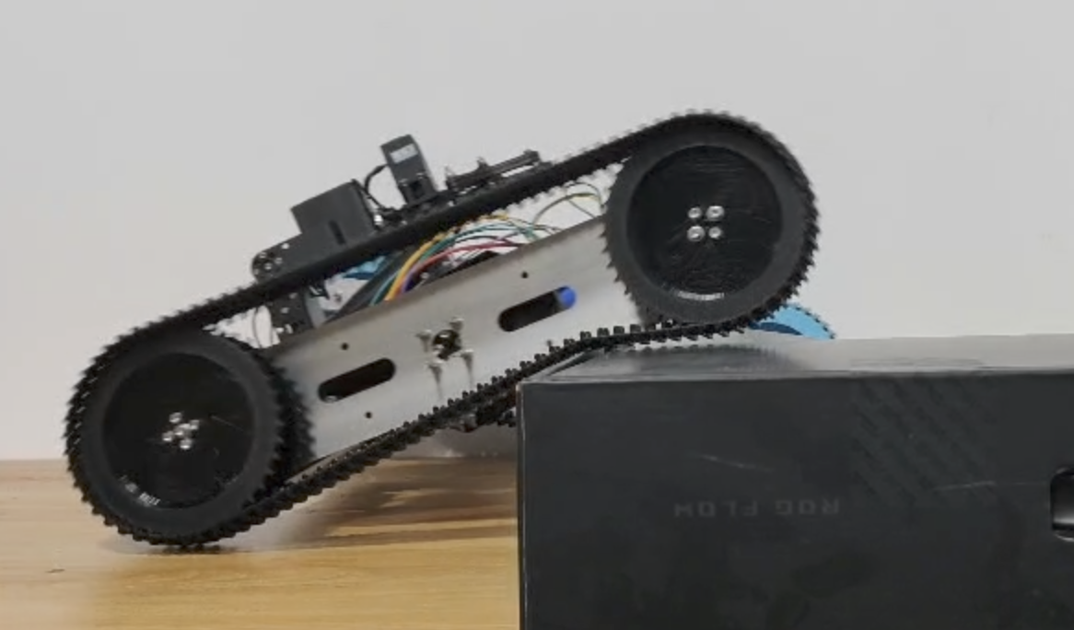
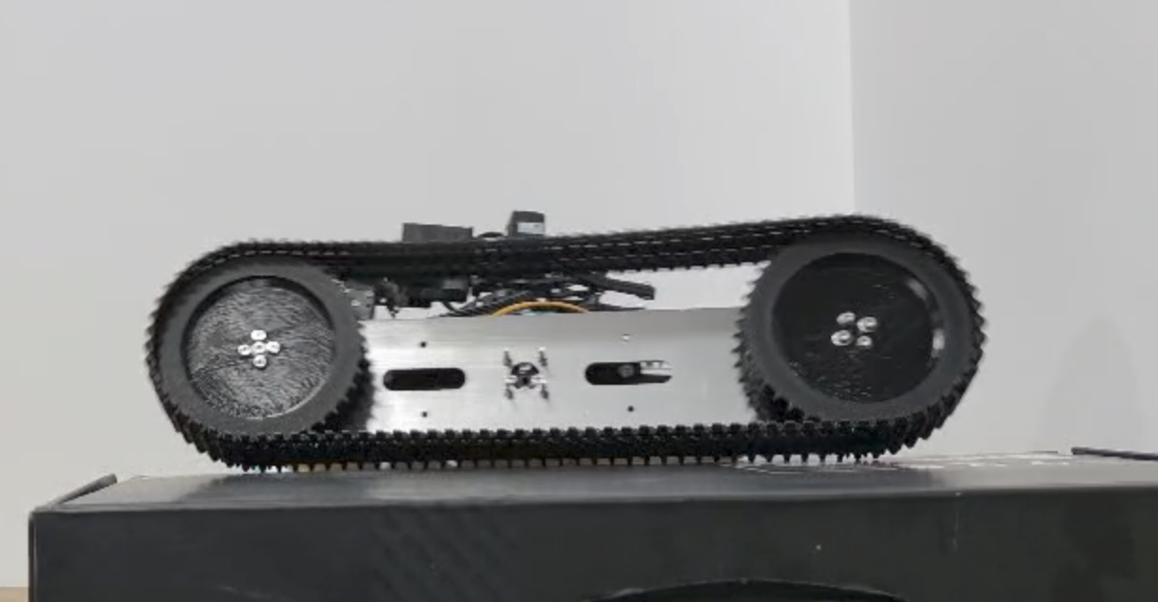
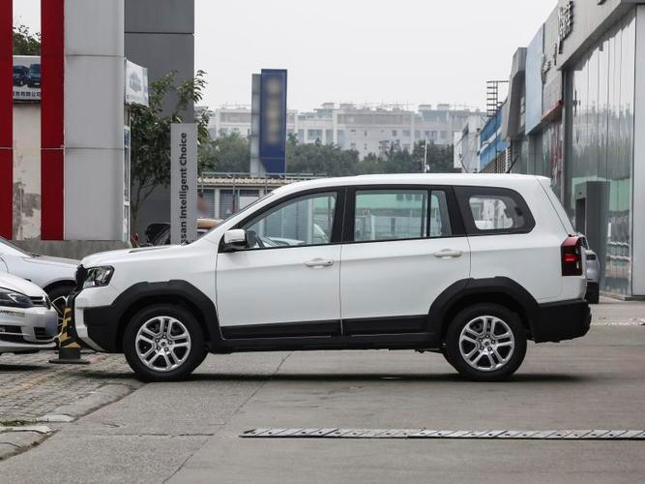
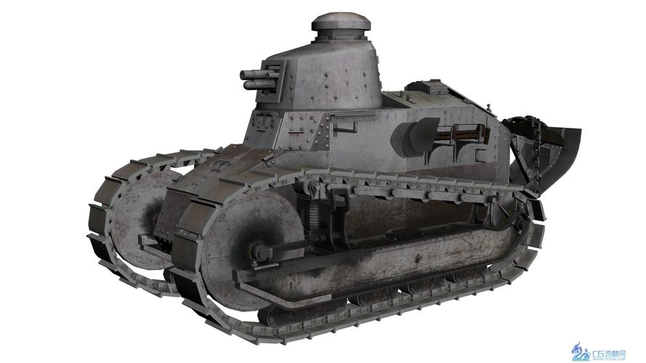
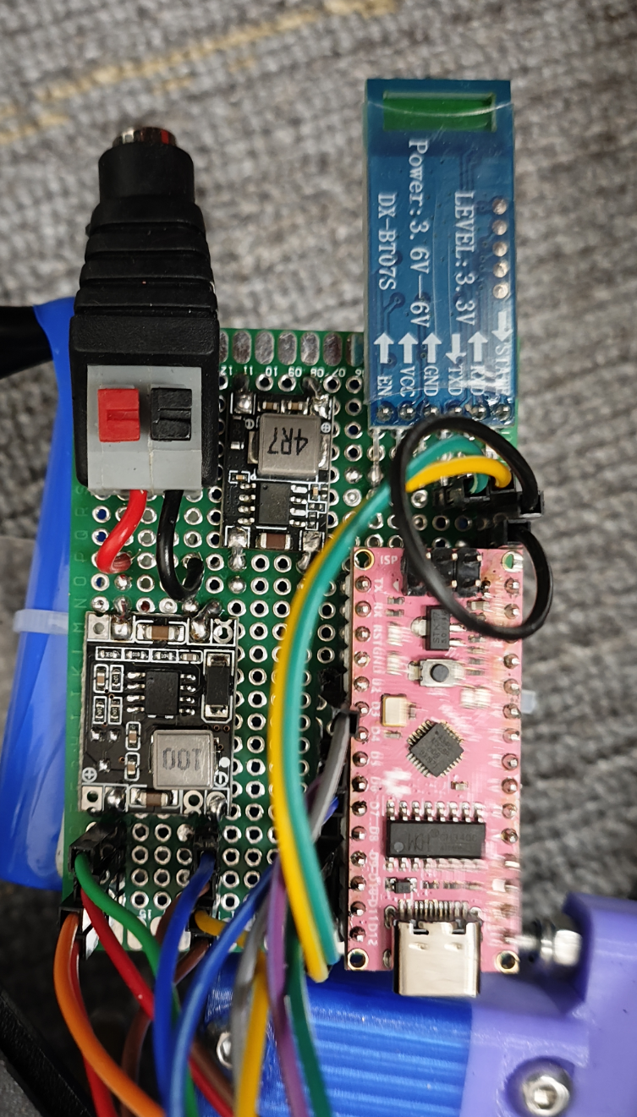
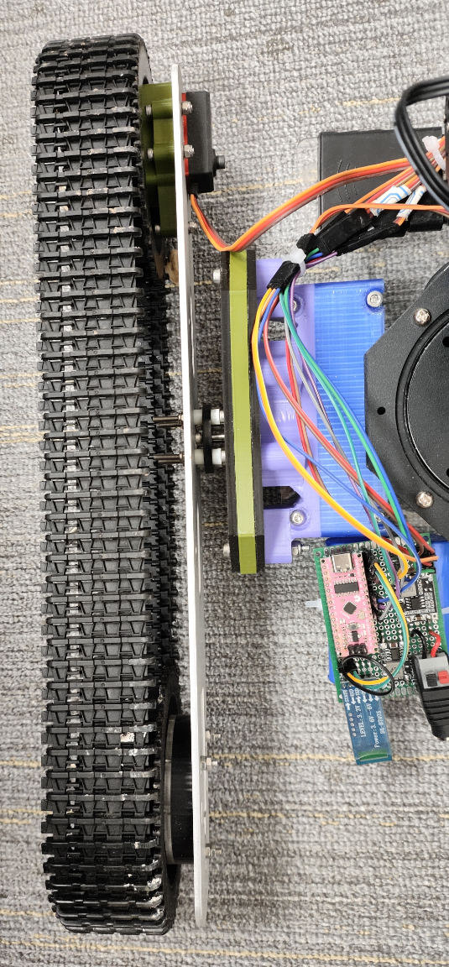
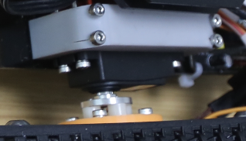
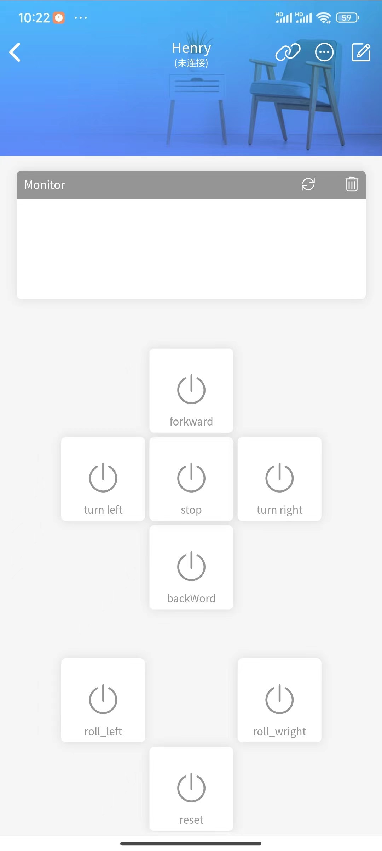
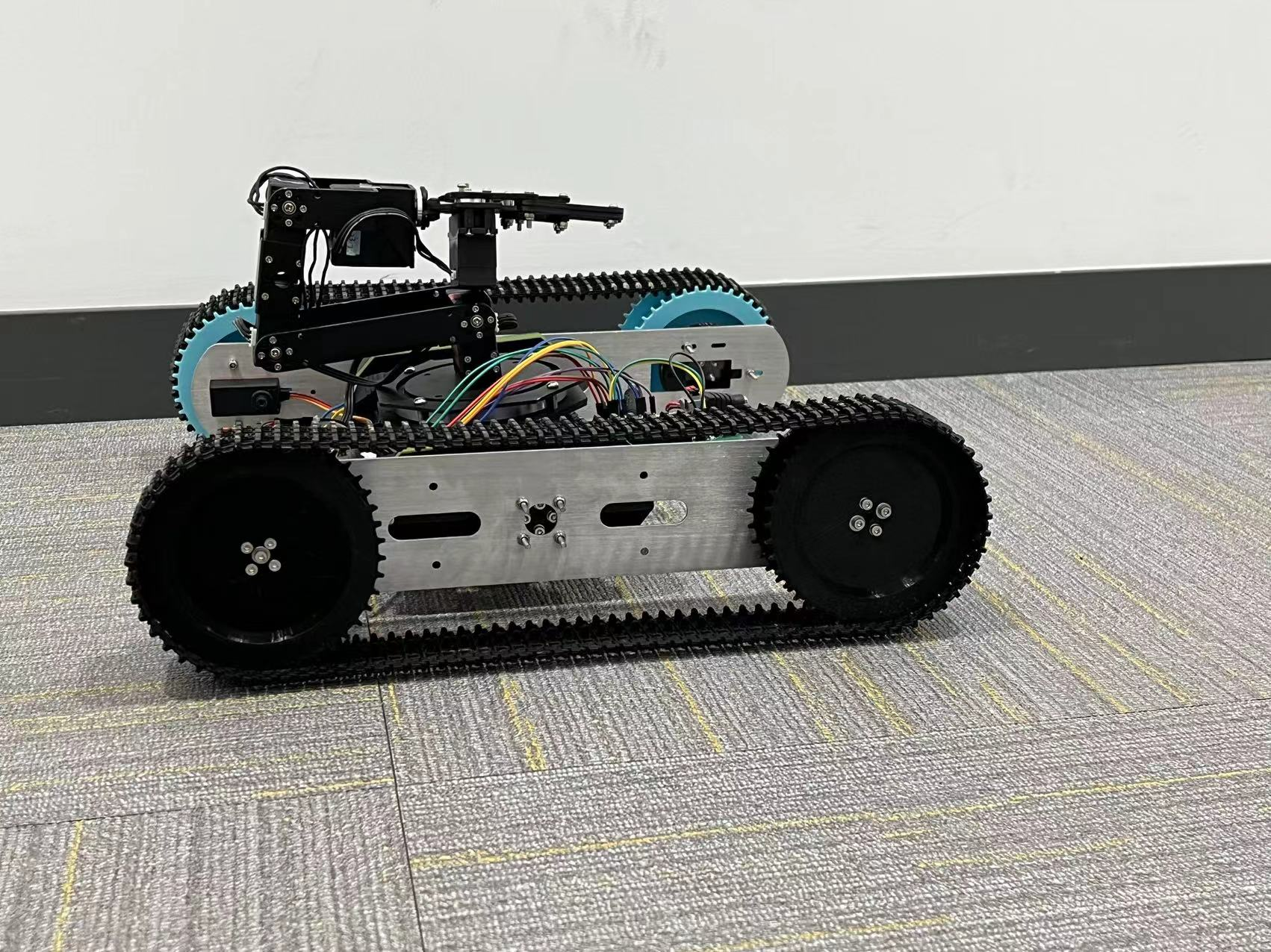
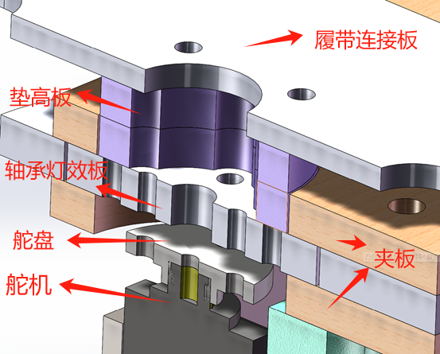
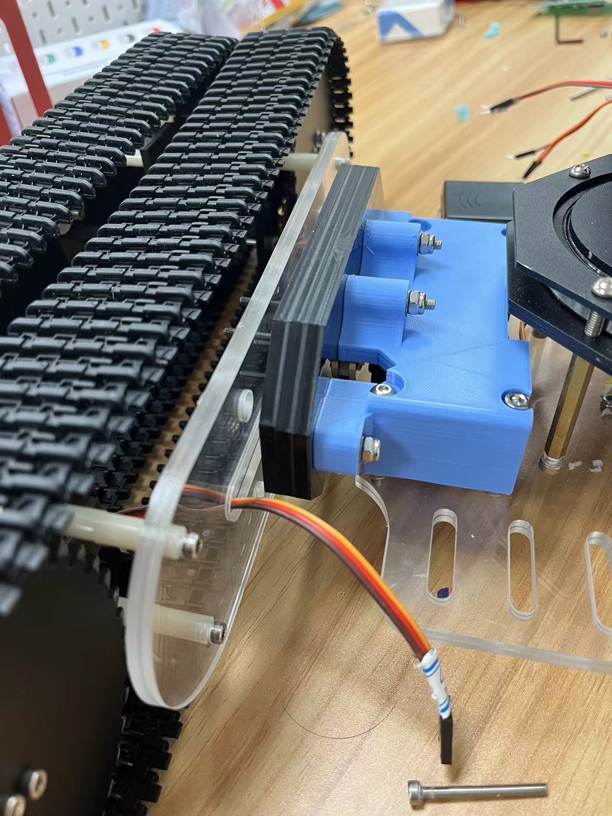
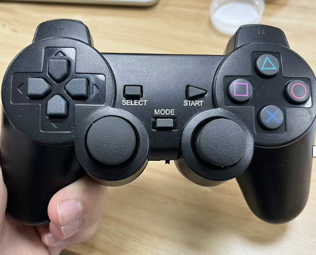
Figure 1&2 : Version One Model
Multi-Terrain Adaptable Post Disaster Rescue Navigation Robot.
Figure 2: Version Two Model
Haolin Yu
INTRODUCTION & RELATED WORKS
METHODS & MATERIALS
Codes and Software control
RESCUE NAVIGATION ROBOT
Save the lives of the Firefighters
Many possibilities for extensions
High potential for practical applications
CONTROL SYSTEM
In experiment 2, I took the vehicle outside to a place where there are rocks, leaves and some other obstacles. The road is relatively bumpy. However, the robot remained stable overall because there is not a lot of big vertical shifts in the graph. The reason why there are some sudden up and downs is ineivitable when going over a rock.
TRADITIONAL RESCUE VEHICLES
The two outer plates, shown in the figures above, each has a large hole for the screwsfrom the other side to come through. These reinforce the connection between the servo and the caterpillar bands.
Figure 12&13: Newly Designed Protection Plate
Figure 3&4: Early prototypes designed for Chernobyl and other urban rescue missions
HARDWARE SYSTEM
Figure 23&24: Stability of the vehicle on normal road
AREAS OF FOCUS
Multi-Terrain Adaptation
Speed
Stability
Easy to Manipulate
Figure 14: 2-D laser cutter graph for my caterpillar band tracker.
Figure 15: 2-D design of the gear for the caterpillar band tracker.
OUR OBJECTIVES
3-D Model Of My Connector:
Figure 17: Utilization of the Connector.
Main Control Panel
Figure:25 Vehicle during experiment
Experiment 2: Obstacle Crossing Ability
BACKGROUND
Steering Gear Control Panel
12V lithium Battery
Being the country that suffers the most from Earthquake, hundreds and even thousands of people die from the disasters. The level 6.8 Gansu Earthquake happened while I was working on this project in Shanghai as well. A lot of people suffered. I hope to find a method to minimize the fatality rate of the rescuers.
NEW STRUCTURE
The caterpillar bands easily gets stuck, and it was because any horizontal shaking would make the caterpillar bands deviate from originate position. Thus, I designed a belt wheel shown in the figure at the right. This successfully prevent the caterpillar bands from stuck when moving.
Figure 5: Earthquake Distribution
Single Shaft Steering Gear
Buck Power Module
Figure 26: Largest angle that the caterpillar tracker could reach to remain stability.
I was inspired by the design by this Navigation Bot. The use of it is unlike traditional rescue bots thart carry people out of the debris. Such a robot is designed to explore unkown dangerous areas to determine if there are survivors. If there are, it could than help evaluate the safeness of rescueing by going and study places where human are hard to reaching in the debris. This gives the rescuers more information and help generate the rescue methods.
Figure 18: Newly Designed Gear.
Figure 6:TRADR Rescue Navigation Robot
Powered by six servos
6-free robotic arm
Able to grasp small but heavy object
can grasp obstacles beyond the chassis
Mechanic Arm Panel
Mechanic Claw & Arm
I chose an obstacle that has a height of 10 centimeters. The vehicle could easily pass the obstacle by lifting one side of the caterpillar tracker to a degree of 30 degrees.
Figure 7: Car Figure 8: Tank
Cars have wheels while tanks have extra caterpillar bands. Rescue Navigation Bots could utilize the same design to adapt to different harsh environments, but I can make it even more multi-terrain adaptable.
Figure 19: First robot prototype
Figure 6: TRADR Post Disaster Rescue Navigation Bot
Cars have wheels while tanks have extra caterpillar bands. Rescue Navigation Bots could utilize the same design to adapt to different harsh environments, but I can make it even more multi-terrain adaptable.
Blue Tooth Control
Base Control Panel Base and Catepillar tracker
CONCLUSIONS
The connection between these two large parts is a screw. This will cause a lot of horizontal shift of the vehicle which affects the stability of the robot and may even tear the entire vehicle apart.
The chassis section is controlled via a mobile phone, while the robotic arm section is operated using a PS2 game controller. The control interface on the mobile phone is shown in the figure at the right.
Overall Characteristic of My Vehicle:
EXPERIMENTS & RESULTS
Light-weighted and Stable
-Cheap In Cost
-Able to perform complicated motions. Theoratically, the caterpillar tracker could reach 180 degrees, but 30 to 80 degrees would be enough in most cases.
Speedy
Able to pick up heavy objects.
I did two experiments to test the stability of the vehicle in different scenerios.
Figure 9: Ver.1 Connection between caterpillar track and Base.
For experiment 1, I tested the stability of the vehicle on a plain road without any obstacles.The Graph below exhibits the stability of the vehicle whe moving, and there is barely any vertical shift. This also shows how solid the vehicle is as well.
NEW STRUCTURE
Protector Added
Increased the radius of the transmission torque shaft
Future:
NEW STRUCTURE
Protector Added
Increased the radius of the transmission torque shaft
Figure 21: normal road
-Add other sensors at the top of the arm
-Solidify the Bluetooth connection
-This is just a prototype, and it has a lot of potential. A lot of things could be added, and a lot of bugs will be fixed to make it more cost efficient, solid, and helpful.
Figure 10&11: Improved Connection between caterpillar track and Base.
Figure 20: Control Table
Figure 22: Stability of the vehicle on normal road
*See selected references on the back of the poster
** All images, charts, and graphs created by researcher unless otherwise stated

