Slide 1
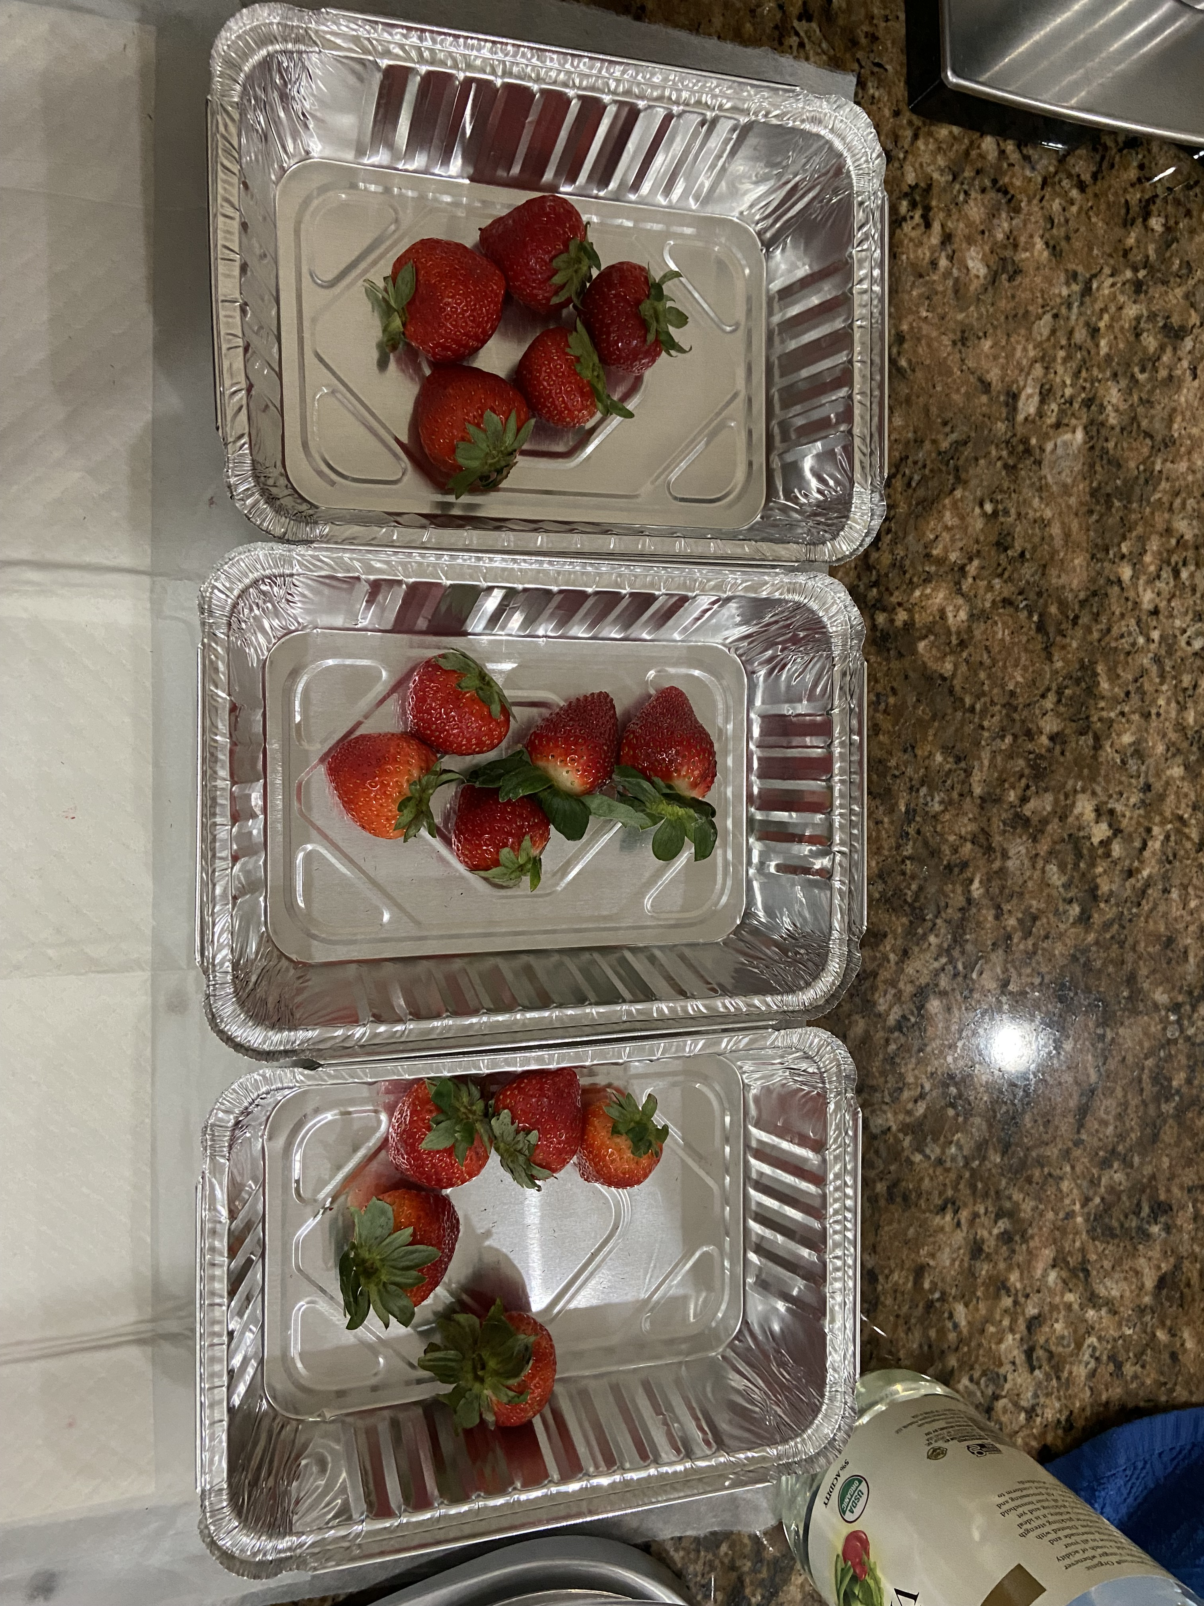
HOW CLEAN ARE YOUR STRAWBERRIES…?
The Effect of Home-Made Disinfectant Solutions on
Strawberries Freshness.
ANA SOFIA GUTIERREZ-GONZALEZ
CHAPIN SCHOOL -7TH GRADE

Slide 2
Question
What type of homemade disinfectant helps keep strawberries fresh longer?

Slide 3
Research
Strawberries are a very popular fruit to eat, mostly eating it fresh is the best way.(Facts - Strawberries and More.)
But there are risks from pathogens lurking in the fruit that can cause foodborne illnesses because of the way they are harvested and produced. (Office of the Commissioner).
Even if most containers of strawberries say the best way to wash them is to use running water before consuming them, it’s not removing the risk of infection, but instead removing the dirt and other debris. (ZANDER, A., and M. BUNNING.)
Also using produce washes or detergents aren’t the safest methods either, for they can have toxic chemicals that can soak into the strawberry and change the taste. (ZANDER, A., and M. BUNNING.)
But there are two methods that are proven safe and effective to disinfect strawberries and those are using a solution of vinegar or kitchen salt. But are they as effective and safe as people say?
This experiment, is design to demonstrate that disinfecting strawberries, which means reducing bacteria, increases the time they keep their freshness.

Slide 4
Hypothesis
If the strawberries are washed with a vinegar disinfectant solution,
then they will be fresh longer.
Materials
Fresh stemmed strawberries
Kitchen scale
3 graduated cylinders (1L)
18 aluminum trays
Sterile gauze
Tweezers
Kitchen salt
Kitchen white vinegar
Potable water
New and clean ziploc bags(sandwich size)
Kitchen fridge
Beaker (500 ml)
Clean spoon
Parafilm(for sealing graduated cylinder)
Whole Foods 5% acidity vinegar

Slide 5
Procedure:
The experiment was carried out in my Home Kitchen Counter .
1. Get a pack of strawberries from the same brand
2. Select 45 stemmed strawberries about the same size, weight, color, and freshness
3. Using a kitchen scale, weigh your strawberries and record the weight on a sheet of paper
4. Preparation of the 1:1 water-vinegar solution.
4A:Open a new bottle of distilled white vinegar
4B:Using a clean and dry graduated cylinder, pour 500 ml of water. 4C:Carefully, add 500ml of vinegar to the water.
4D:Seal the cylinder and mix the liquids.
4E:Label the cylinder as “Vinegar solution.” Set aside.
5. Preparation of 1 liter of salt solution (10%: 10 grams of kitchen salt in 100ml of water)
5A: Weigh 100 g of kitchen salt on the kitchen scale
5B: Use another clean and dry graduated cylinder and measure 1,000 ml of water .
5C:In a 1,000 ml beaker, pour the salt and then add 200 ml of water. 5D:Mix with a clean spoon until there isn't any solid salt left. 5E:Transfer the solution from the beaker to the cylinder.
5F:Add more water to the cylinder to reach 1,000 ml.
5G:Seal the cylinder and mix.
5H:Set it aside and label it “Salt solution.”
6. Get 5 strawberries into each of the 9 aluminum trays
7. Label 3 trays with “Water”, 3 with “Vinegar”, and 3 with “Salt.”

Slide 6
Procedure
8. Add 300 ml of tap water to the 3 “Water” trays and start a timer for 10 min.
9. Add 300 ml of the vinegar solution to each of the 3 “Vinegar” trays and start the second timer from 10 min.
10. Add 300ml of the salt solution to each of the 3 “Salt” trays and start a third timer for 10 min.
11. When the time is up, transfer the strawberries with tweezers to a tray of 300ml of clean water and rinse 3x carefully for 5 min. (Note: be sure the solution covers all the strawberries)
12. After rinsing, transfer the strawberries with tweezers to their own separate piece of gauze. Keep every group separate.
13. Pat gently to dry
14. Afterwards, transfer the strawberries into their own ziploc bag. There should be 15 bags in all. Name them “Water 1,2, or 3”, etc.
15. Put all the bags into the fridge for 5 days
16. After 5 days, remove all the bags from the fridge.
17. Realize the visual inspection of every strawberry on the bag, assigning the number of points accordingly the picture on figure #1.
18. Collect the data on a table.
19. After the data collection, discard the strawberries in the regular trash can. NOTE: The strawberries are not to be consumed after the experiment is stopped and analyzed.

Slide 7
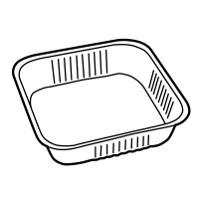
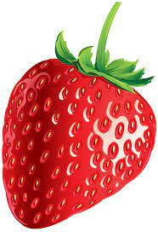
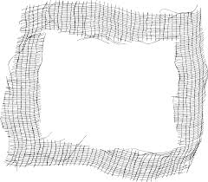
1.Soak the fruit in 300mL of solution During 10 min
Procedure (Diagram)
NaCl 10% Solution in water.
Tap Water
Vinegar (1:1)
2.Transfer the fruit with tweezers to clean tap water to rinse. Shake 3 times.
Stemmed Strawberries with uniform size and ripeness ( bright color), not signs of disease, and no signs of mechanical or water damage (dark spots) .
3.Transfer the fruit with clean tweezers to a dry, sterilize gauze pad.
Pat dry the fruit carefully.
4.Transfer the fruit in a new, clean, dry ziplog bag. Seal the bag avoiding extra air
5.Refrigerate for 5 days
6.Visual inspection. Calculate total points ( visual aid)

Slide 8
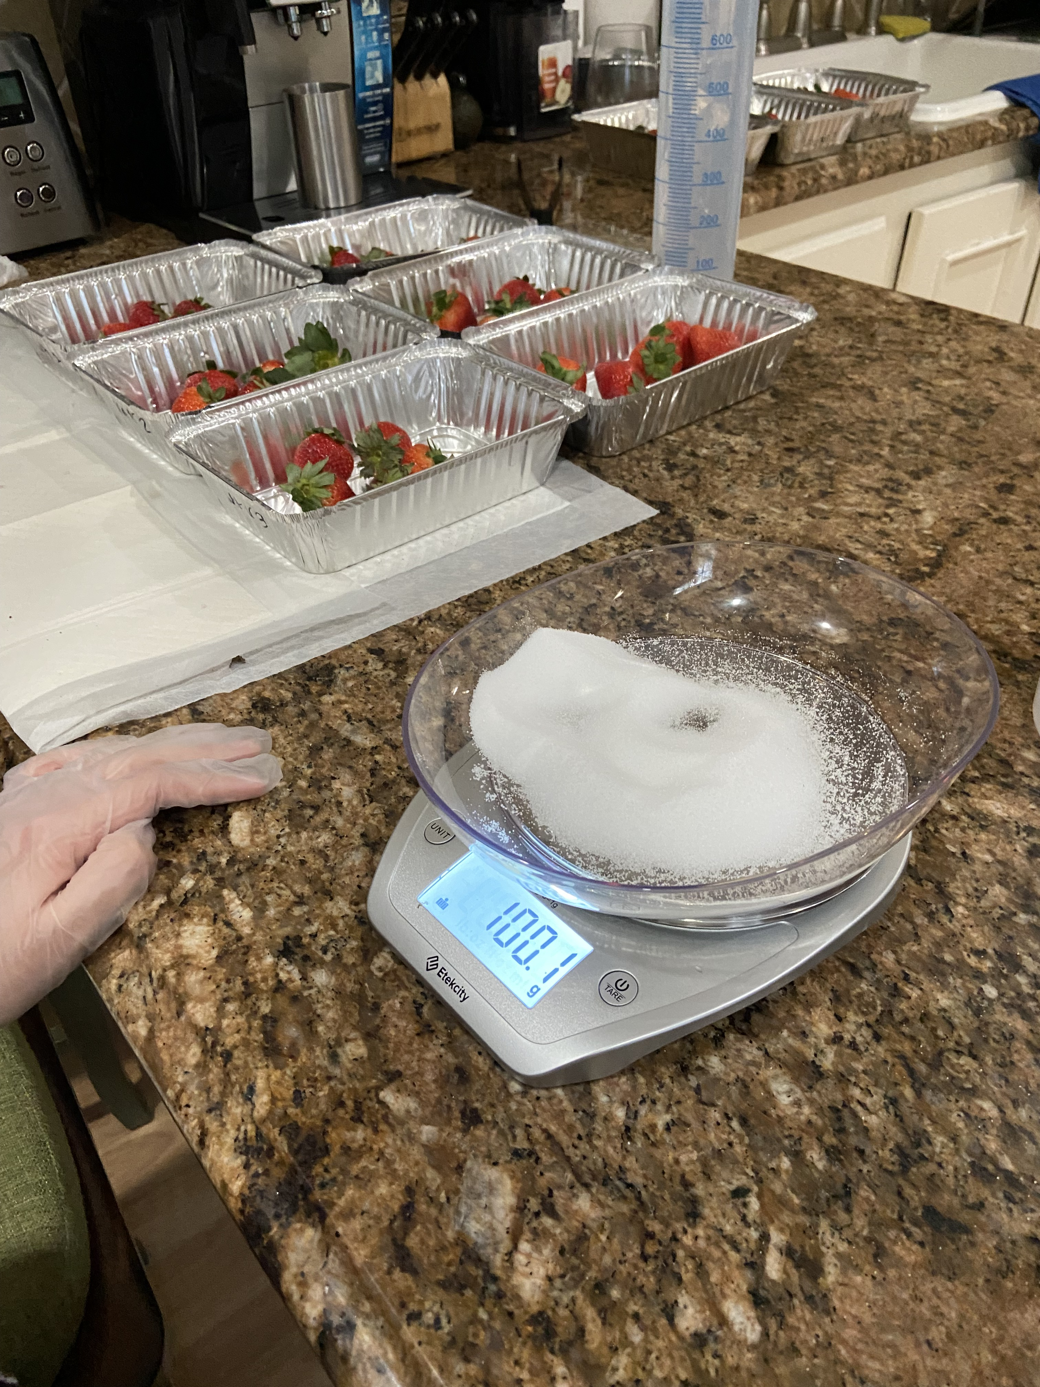
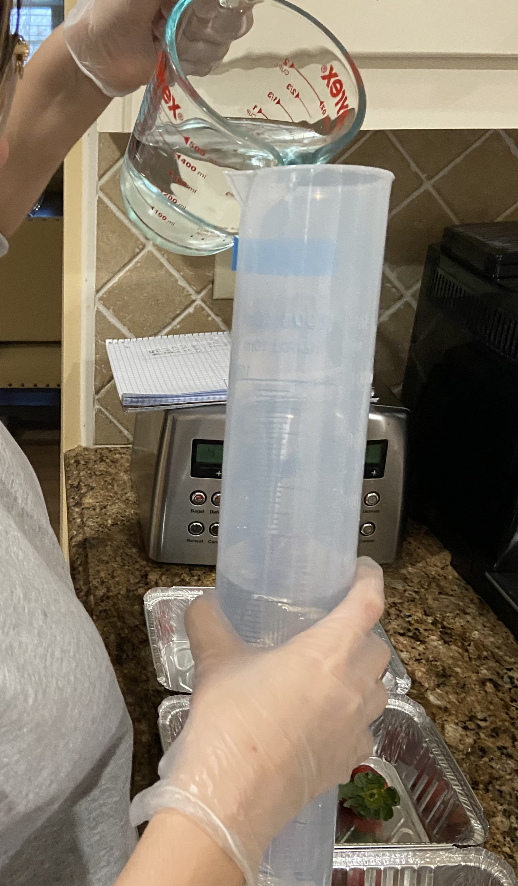
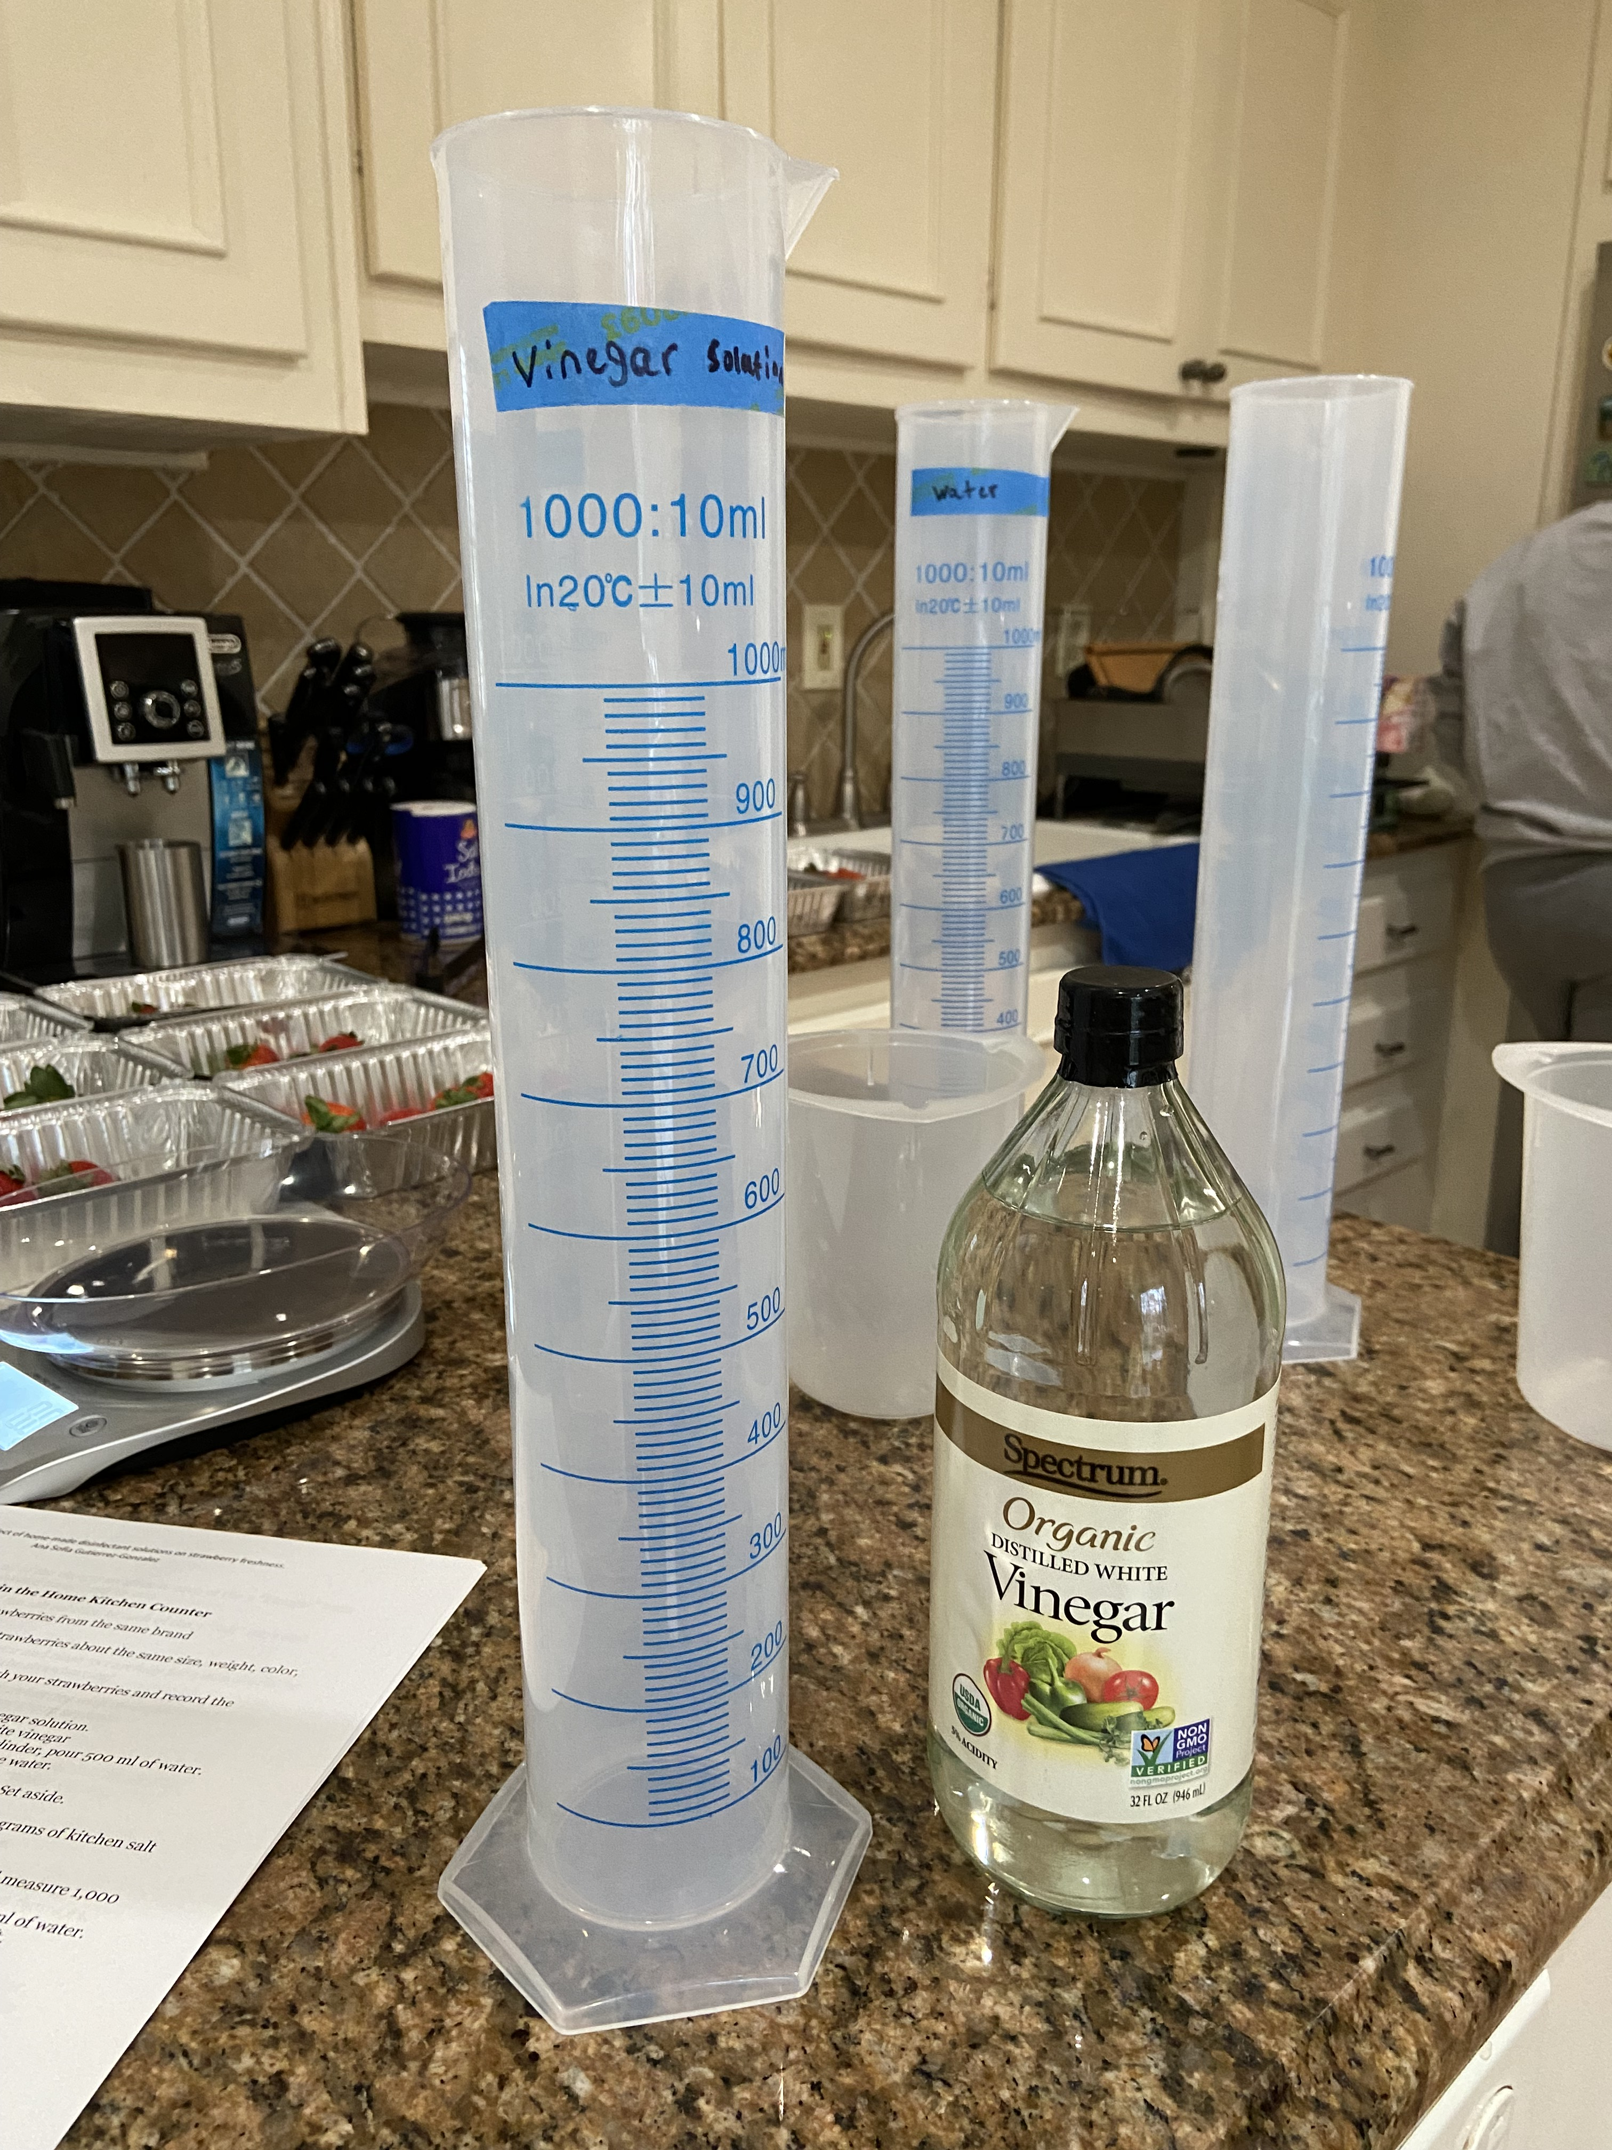
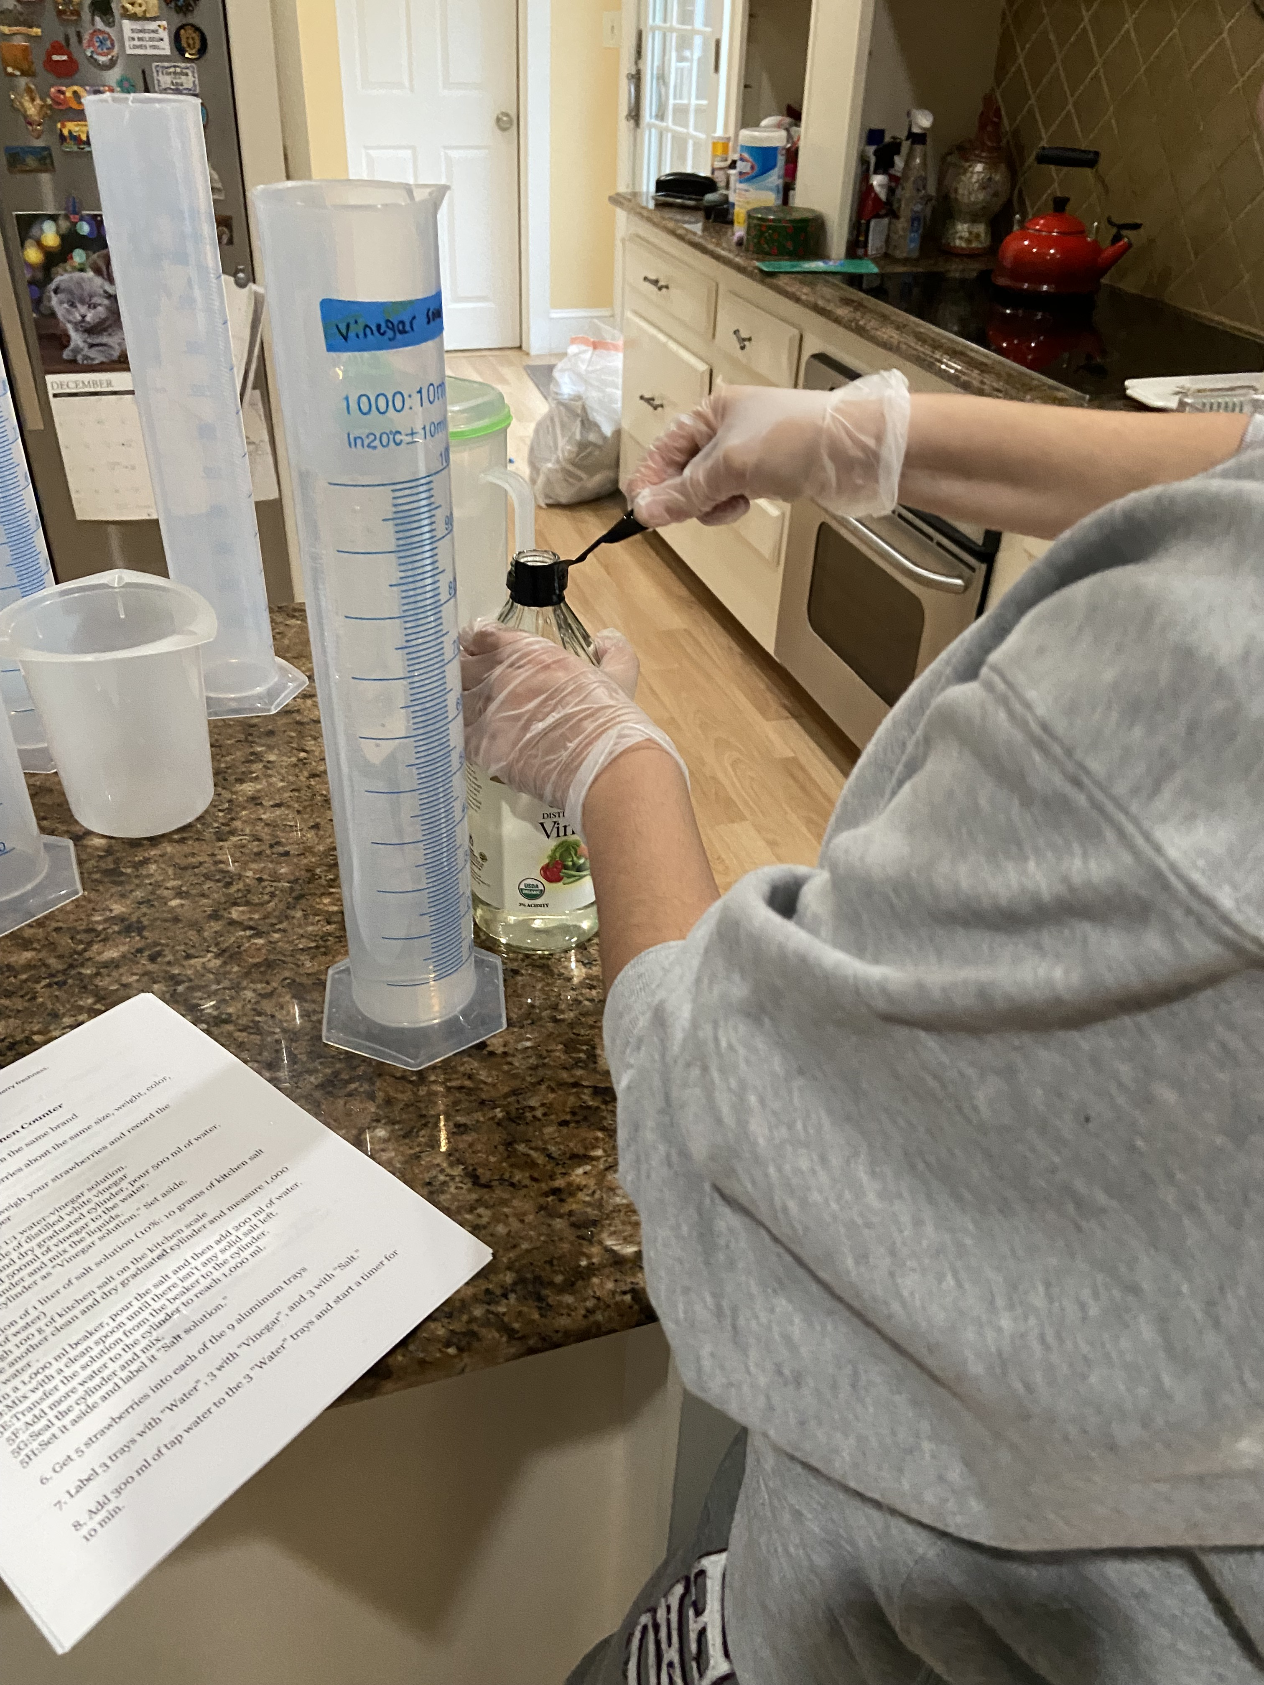
Solution Preparation

Slide 9
DATA ANALYSIS.
Figure 1. Visual Aid to evaluate strawberry freshness after treatment
Total Points 4 3 2 1
Total points description:
4. Bright and glossy RED color, no signs of bruising or dark spots. The stem looks bright green.
3. Less bright color, no bruising. Stem looks green and not dry.
2. Dark RED color without brightness and purple areas. Stem looks dry
1. Brownish or purple dull color. Dark and white spots as signs of spoilage. Stem looks very dry and yellowish .

Slide 10
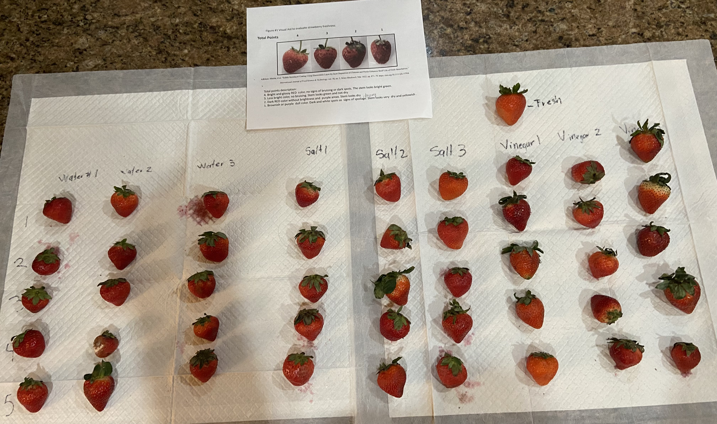
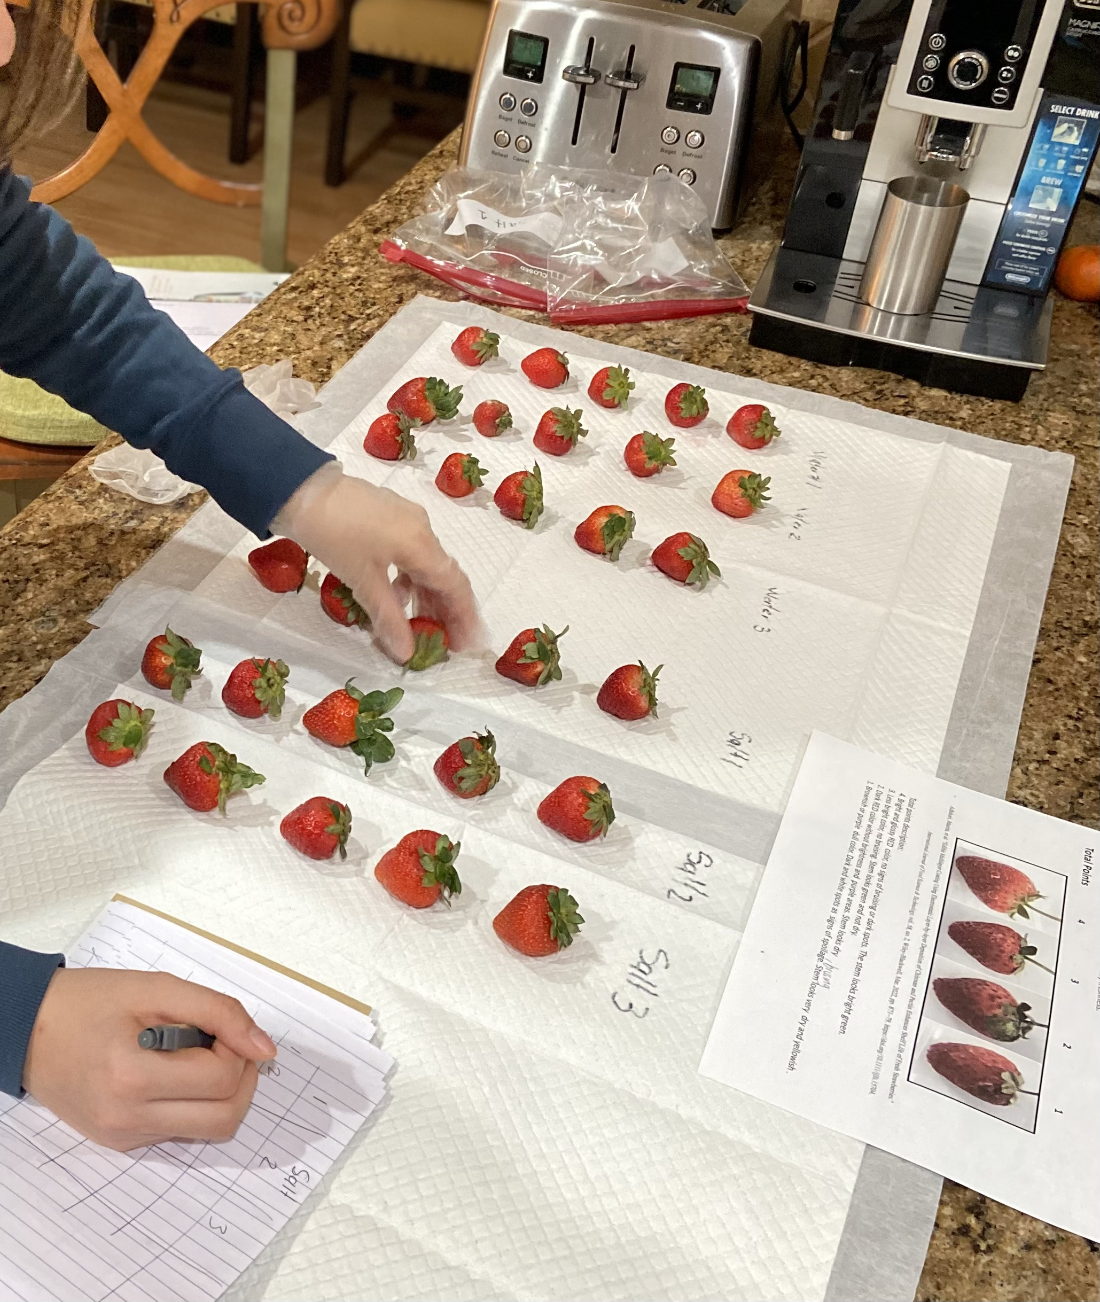
Data Collection
With the table as shown in Figure 1,each strawberry was compared with the score from 1 to 4.,from four being the best to one being the worst.
3 people observed each strawberry to avoid bias. Every score was recorded on a piece of paper and the average was each average each person recorded.

Slide 11
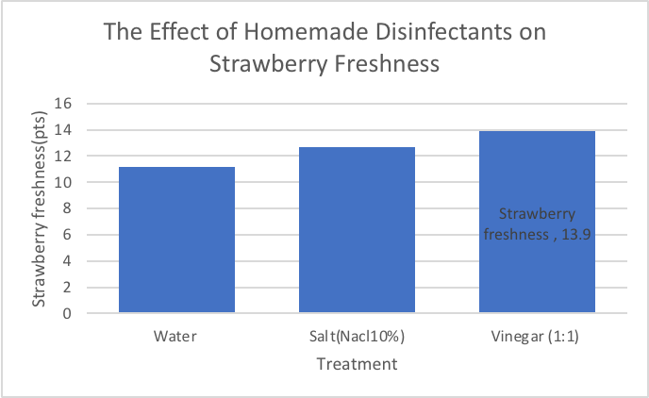
Results
Freshness evaluation after 5 days after refrigeration.
Table 1. Data

Slide 12
Conclusion
The hypothesis of the vinegar solution being used to clean strawberries to keep them fresh longer, which according to the data, is accepted. This is because the mean of the points of the strawberries treated with the vinegar solution was the highest of the three groups(13.9pts). The strawberries were mostly bright and glossy red, the stem was green, and barely shown any signs of spoilage. In contrast with the group that used water to treat the strawberries, which was the only group with at least a clearly rotten strawberry. The salt group had a mean of 12.64pts, which surpassed the mean of the water treatment group(11.13pts), meaning it is another good way to clean the strawberries, instead of using only water.
The ways strawberries are cultivated and harvested makes them more exposed to be contaminated with microorganisms. With this experiment, it is proven that an extra step to clean strawberries, such as rinsing them with disinfectant(a chemical that kills bacteria)solutions, such as salt and vinegar, helps to preserve them longer because they reduce the load of microorganisms on the surface of the strawberry. These solutions are easy to prepare and do not alter the taste or texture of the fruit. The treatment makes them safer to eat.

Slide 13
Error Analysis
There were some random errors in the procedure of the experiment. There could have been one while weighing the strawberries, which could have been leaving the strawberry for a while and not notice the actual weight appear. Another random error could be while adding in the salt or vinegar into the water. If you did not add the right amount of the substances or read the meniscus right, the data would be affected by it. A systemic error would be picking out strawberries that were not the same size or form and another one would have been when adding the substances into the pans with the strawberries. If they did not have the same amount of substances in each group. If this happened throughout the entire experiment, the groups and data would be unfair and the experiment would need to be done again. One of the most important systemic errors that could have happened is that during the analysis of the strawberry freshness, there were 3 people writing the points. This is to avoid the bias from the chart that is used to give the points.

