Slide 1
Modular Robotics Multi-unit and Reconfigurable Robot
Senior Division | Category: Software & Embedded System

Slide 2
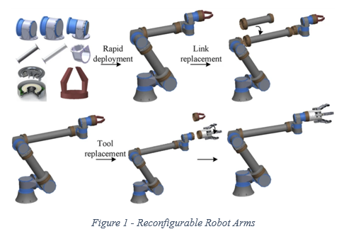
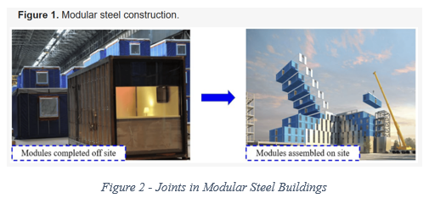
Introduction & Purposes
What is modularity?
What is this project meant for?
Reconfigurable
Many parts make up an entire robot through some connection method.
Currently, most robots are made as a whole, not intended to be taken apart and recombined easily (It’s really robots). However, in the future, robots will likely need to be extremely versatile in the future since we might require them to travel to foreign plants, climb over cliffs, and squeeze through cracks.
On the other hand, modular robotic is a completely different approach to designing and building robots with different advantages and disadvantages. Some of the advantages includes:
High adaptability
Easy maintenance
Potentially future proof

Slide 3
Goals & Design Criteria
Engineering:
Create units with 3 joints each that can carry all of the sensors and motors with great structural integrity, is capable of connection consistently, and have a program that grants user control and automatic action.
Includes 3 joints.
Use any Arduino mainboard.
3 servos and 1 motor capable of controlling the unit and connecting to other units.
Have a Bluetooth/wifi module to allow user control.
Programming:
Create a program with Arduino and libraries to control wireless communication and motors. Then write a program to allow user control through Bluetooth and some automatic actions programmed into the robot previously.
A program that can control motors through respective libraries.
With Bluetooth control built-in.
Have automatic actions built in.

Slide 4
Design Plans
How do I want to achieve modularity? AKA, how do I want to connect units together?
I want to use a mechanical joint instead of magnetic.
I’m not going to use wheels to make each unit move. Then for each unit, I will have 3 joints, so that it won’t get too large and would still be able to move.
Research
Do research on every component.
Purchase
Buy all of the necessary materials.
Create chassis design and assemble the robot.
Program
Program the robot to receive Bluetooth and ESP_Now signals.
Calibrate
Calibrate the servo and motors to move fast and accurately.
Experiment
Experiment with the robot to check its abilities.
Rinse & Repeat
Design & Build
Improve on where it can improve (might be programming, might be hardware).
How to control these units?
Custom printed PCB for each unit and solder a mainboard on top of it.
To control, I would program each mainboard with Arduino.

Slide 5
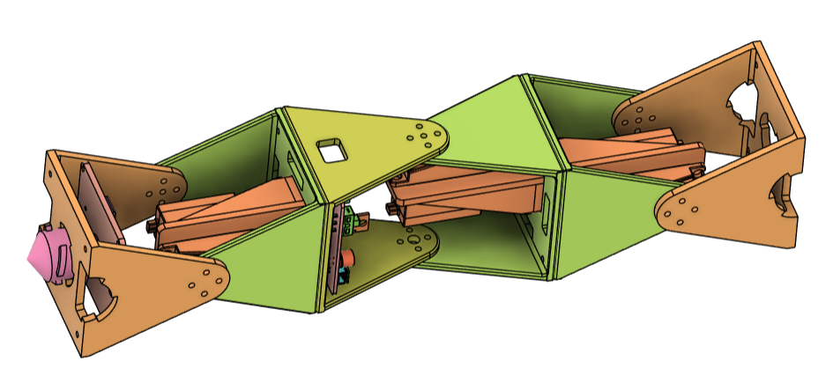
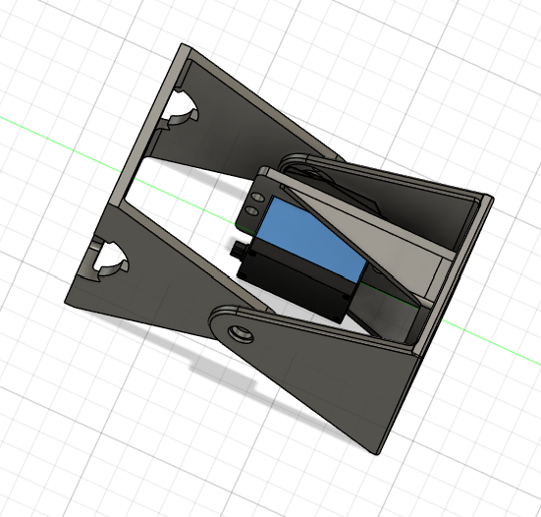
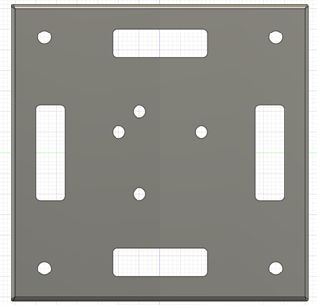
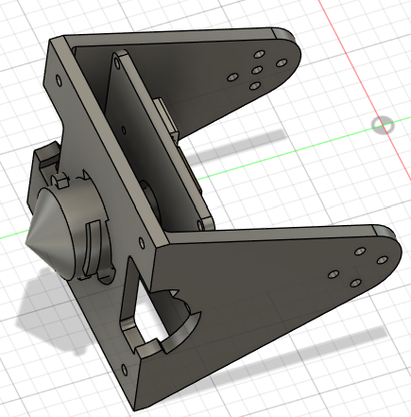
Mechanical Design – Joints & Connectors
There are three main problems to think about:
How should the joint be made?
How should the servo be mounted?
How to connect three of this joint?
To create joints, I used a flange and a servo to provide rotational power.
To connect units, I used a rotational locking mechanism. However, because of the mechanical joint design, the tolerance is small.
Opening for
program upload
Side connectors
Connectors
Connector Head
Servo
Servo Holder
PCB
Rotational joints
Battery goes here
Figure 3 –Single Unit Construction
Important to note that joints in this project means the joints within each unit, and not the place where two units connector (I call that the connector).
Figure 4 – Single Subunit
Figure 5 – Connections Between Subunits
Figure 6 – Connecter Head and Side Connectors

Slide 6
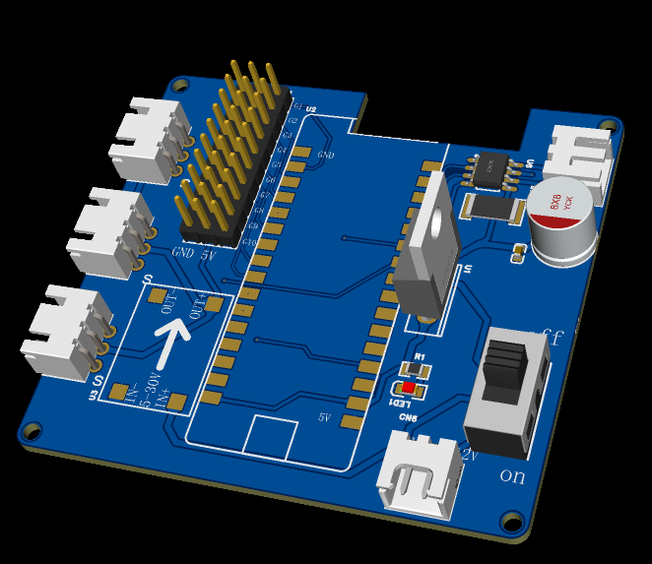
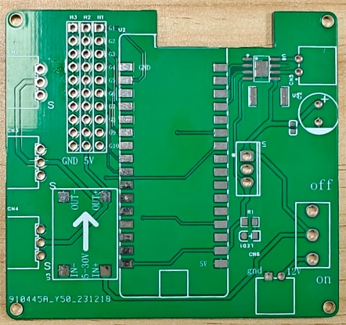
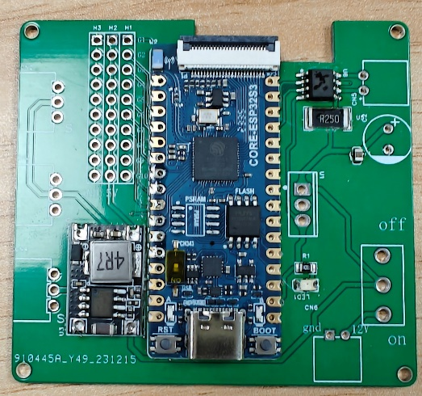
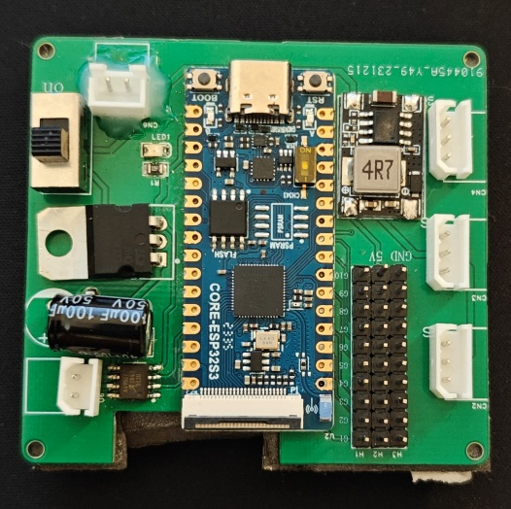
PCB – Design & Solder
Designing
Soldering
After having the PCB printed and delivered, I soldered on all components.
Including: ESP32-S3, resistors, polar capacitors, A4950, L7805 (Buck Chip), DC to Dc Buck Module.
Figure 7 – PCB Schematic
Figure 8 – PCB Construction

Slide 7
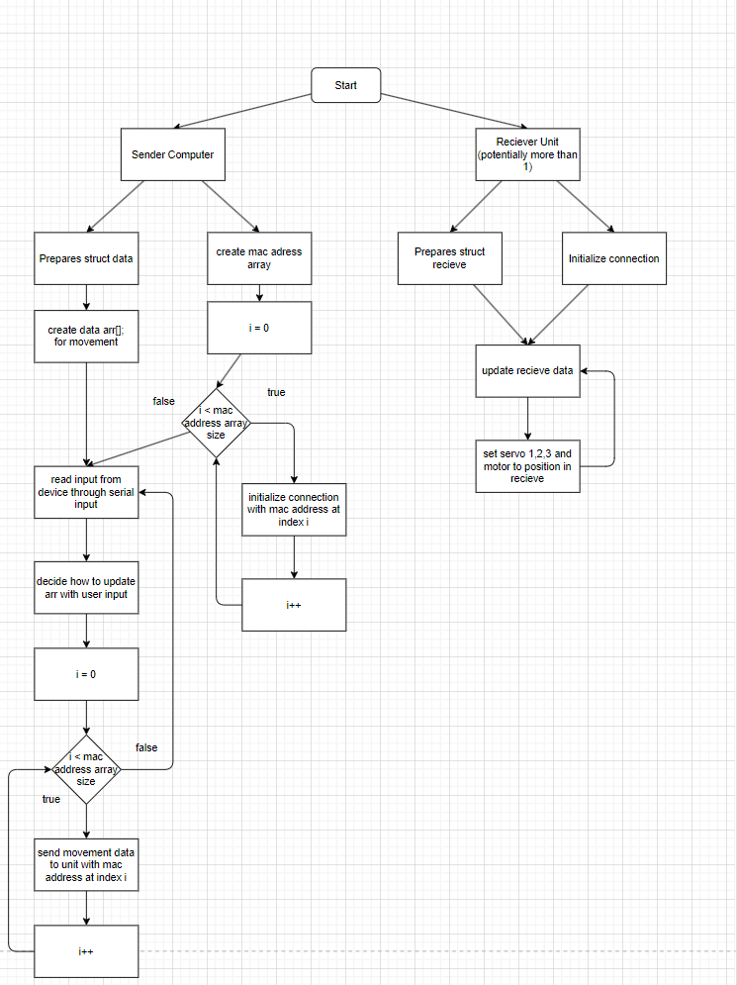
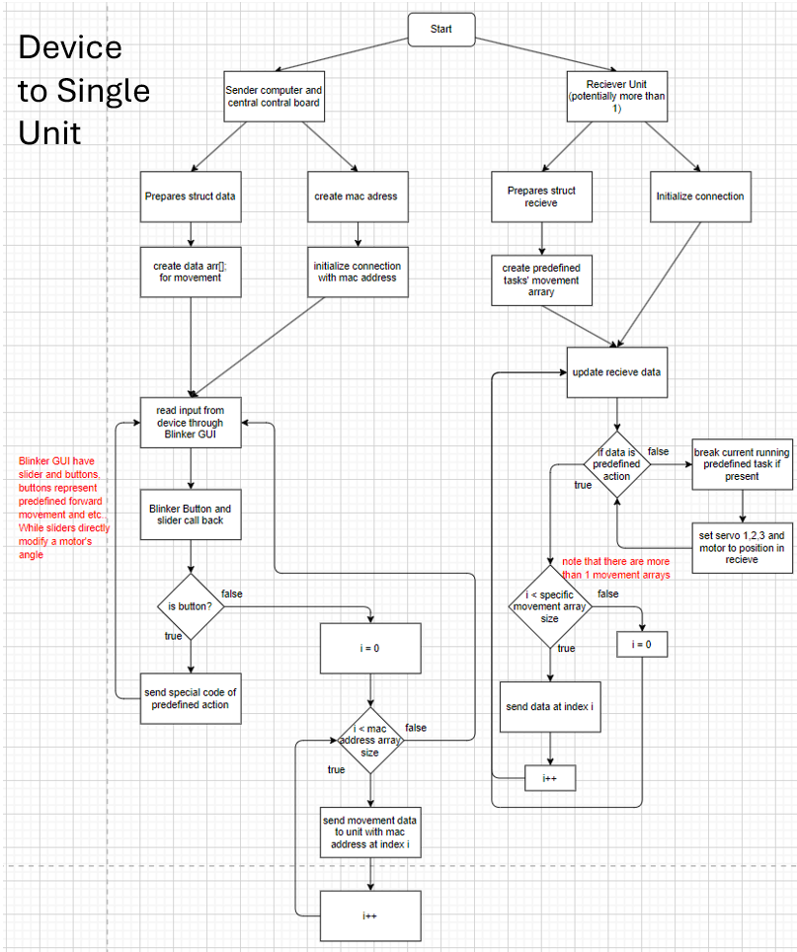
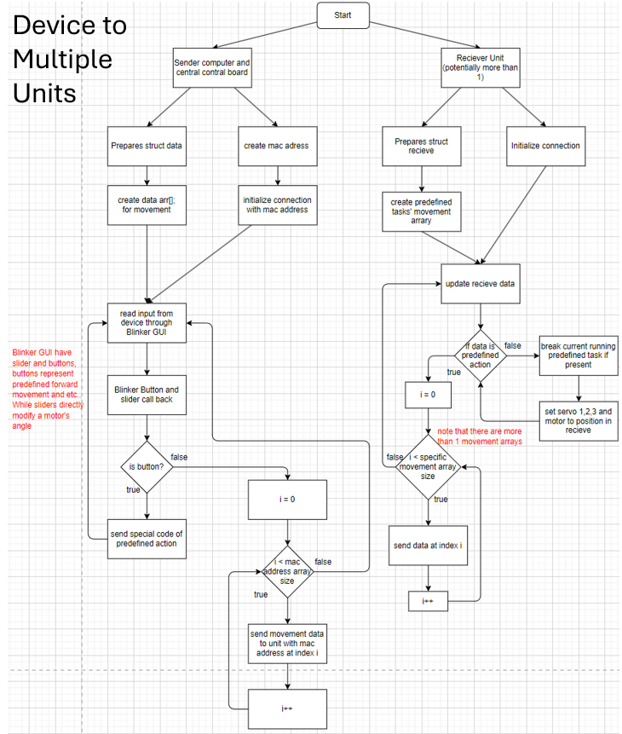
Programming - Overview
Unit to Unit
To control all units at once, one mainboard is chosen to be the central control board. Device to unit communication is achieved with Blinker, unit to unit communication is achieved with ESP_Now.
Figure 9 – Program Logic Flow Charts

Slide 8
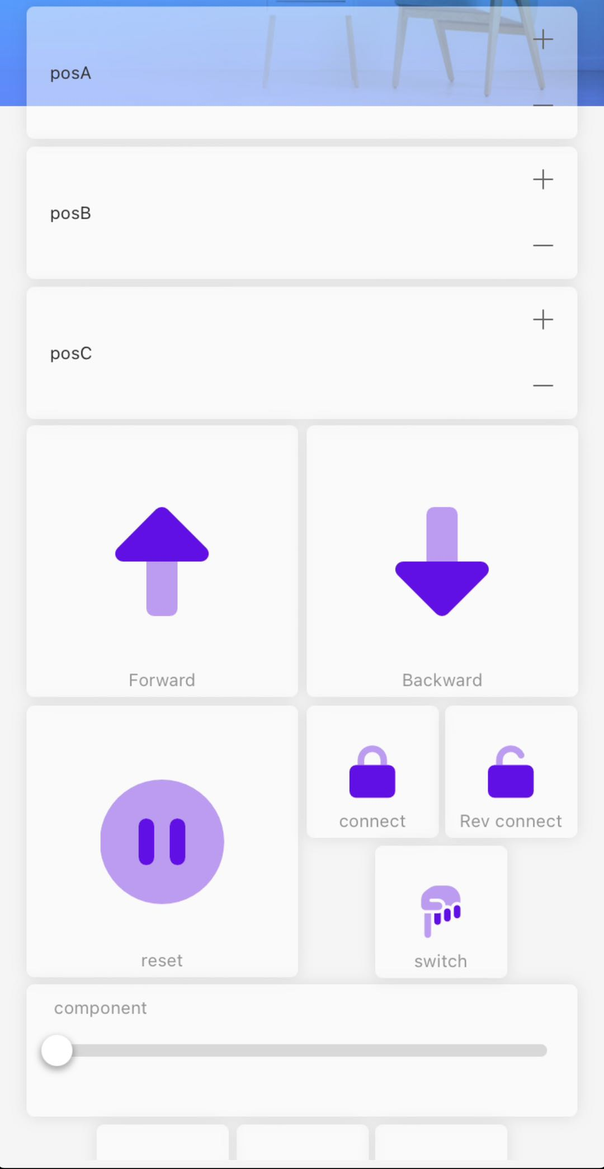
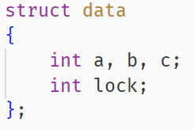
Programming - Wireless Communication & Data Packaging
Blinker:
It requires an app to be installed (then connected to mainboard with Bluetooth or wifi) and a user defined GUI.
ESP_Now:
It need mac addresses to establish connections.
Central control unit will send a data package to each unit that it controls.
Each data package include the following data:
Positions of each servo as an integer.
Status of the connector motor as a bool.
Figure 10 – Data Structure
Figure 11 – Blinker GUI

Slide 9
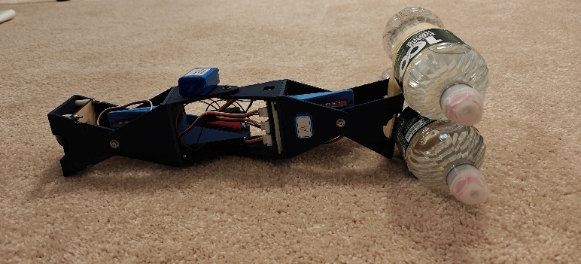
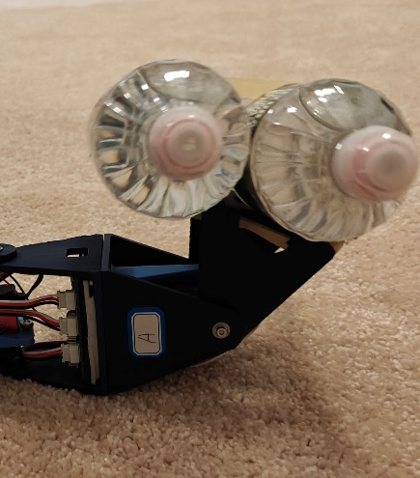
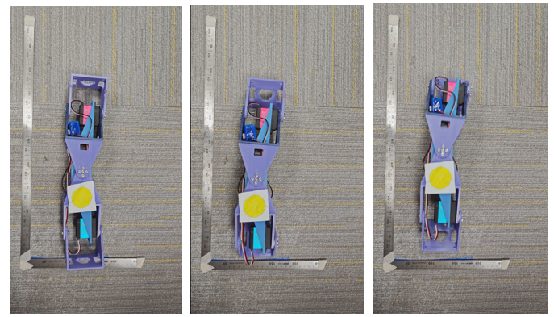
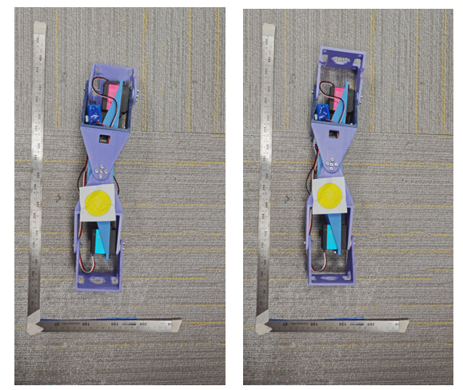
Experimentation
Figure 12 – Two Unit Movement Experiment
I’ve conducted this experiment on a carpet and pressed the other side down with my hands.
I’ve conducted this experiment on hard surface with low coefficient of friction. The tracking is done for single unit movement (in analysis).
Figure 14 – 1.4KG Force Testing
Figure 13 – Single Unit Movement Experiment
Type | Speed
1 Unit (crawling) | 4.28cm/s
2 Units (walking) | 0.77cm/s
4 Units (crawling) | 4.67cm/s
0.7KG Weight | Passed
1.2KG Weight | Passed
1.4KG Weight | Passed
1.9KG Weight | Failed

Slide 10
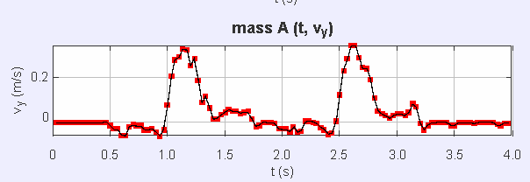
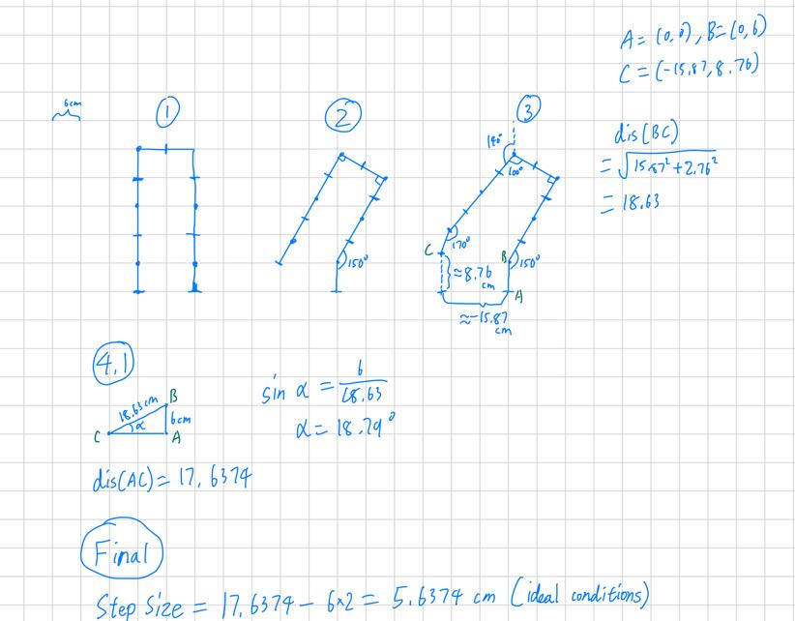
Analysis
Combined – Hardware:
Overall, the hardware is pretty stable and every connection is table. However, it definitely lack the structural integrity that non-modular robot have.
Besides, it also have slight problem with connector as the material isn’t perfectly smooth and could cause problems.
Combined – Software:
Overall, the current software is competent in simply controlling 4-units, 2-units and a single unit.
However, it’s currently incapable on dynamic rearrangement and unit to unit communication isn’t very possible (as there aren’t sensors to detect connections).
Software also needs a way to communicate with lower latency (currently )
Figure 15 – Single Complete Unit
Unit:
Each unit is quite capable. It can move forward and backward pretty well.
However, due to the design of each unit, it cannot turn, which is a problem.
The battery mounting mechanism could be better as it is currently taped on the robot (it is pretty stable for now).
Figure 16 – Single Unit Tracking
Figure 17 – Two Unit Calculations

Slide 11
Conclusion _ & Future Goals
Advantages:
Wide adaptability, easy repair and replacement.
it can be concluded that this direction of modular robotics is very practical and has a bright future. It can release people and other rather ineffective robots from performing tasks and replacing with more effective types of robot. Certain tasks can already be replaced with modular robotics, such as robotic arms and explorer robots.
Improve upon the connection between units
Design better joints that can rotate 360 degrees.
Use stronger materials and joint designs to allow for greater strength and degrees of freedom.
Improve the software to allow for dynamic connections and movement.
Improve wireless communication technique to a lower latency.
It’s currently somewhat difficult to design, hard to program, movement are difficult to design and program.

Slide 12
References
[1] G. Song, Y. Zhou, Z. Wei and A. Song, A smart node architecture for adding mobility to wireless sensor networks, Sens Actuators A Phys, Vol. 147, No. 1, pp. 216-221, 2008.
[2] Xu, W., Han, L., Wang, X., Yuan, H., & Liang, B. (2020). Intelligent modularized reconfigurable mechanisms for robots: development and experiment. Research Square (Research Square). https://doi.org/10.21203/rs.3.rs-19729/v2
[3] Yang, C., Xu, B., Xia, J., Chang, H., Chen, X., & Ma, R. (2023). Mechanical behaviors of inter-module connections and assembled joints in modular steel buildings: A comprehensive review. Buildings, 13(7), 1727. https://doi.org/10.3390/buildings13071727
[4] Dorigo, M. (2005). SWARM-BOT: an experiment in swarm robotics. Proceedings 2005 IEEE Swarm Intelligence Symposium, 2005. SIS 2005. https://doi.org/10.1109/sis.2005.1501622
[5] Dorigo, M. (2014). The Swarm-bots and Swarmanoid experiments in swarm robotics. Dorigo - 2014 IEEE International Conference on Autonomous Robot Systems and Competitions (ICARSC) - 2014. https://doi.org/10.1109/icarsc.2014.6849753
[6] Liu, C., Lin, Q., Kim, H., & Yim, M. (2022). SMORES-EP, a modular robot with parallel self-assembly. Autonomous Robots, 47(2), 211–228. https://doi.org/10.1007/s10514-022-10078-1
[7] Kuo, V., & Fitch, R. (2014). Scalable multi-radio communication in modular robots. Robotics and Autonomous Systems, 62(7), 1034–1046. https://doi.org/10.1016/j.robot.2013.08.007
[8] Luo, H., & Lam, T. L. (2023). Auto-Optimizing connection planning method for Chain-Type modular Self-Reconfiguration robots. IEEE Transactions on Robotics, 39(2), 1353–1372. https://doi.org/10.1109/tro.2022.3218992

