Slide 1
Navigating the Tumor Microenvironment: Identifying Novel Biomarkers in Non-Small Cell Lung Cancer Using Single-Cell Transcriptomics
ZiXuan Xin
Project ID
The Lawrenceville School, Lawrenceville, NJ, USA
*All images/graphics/figures created by ZiXuan Xin unless otherwise referenced
1

Slide 2
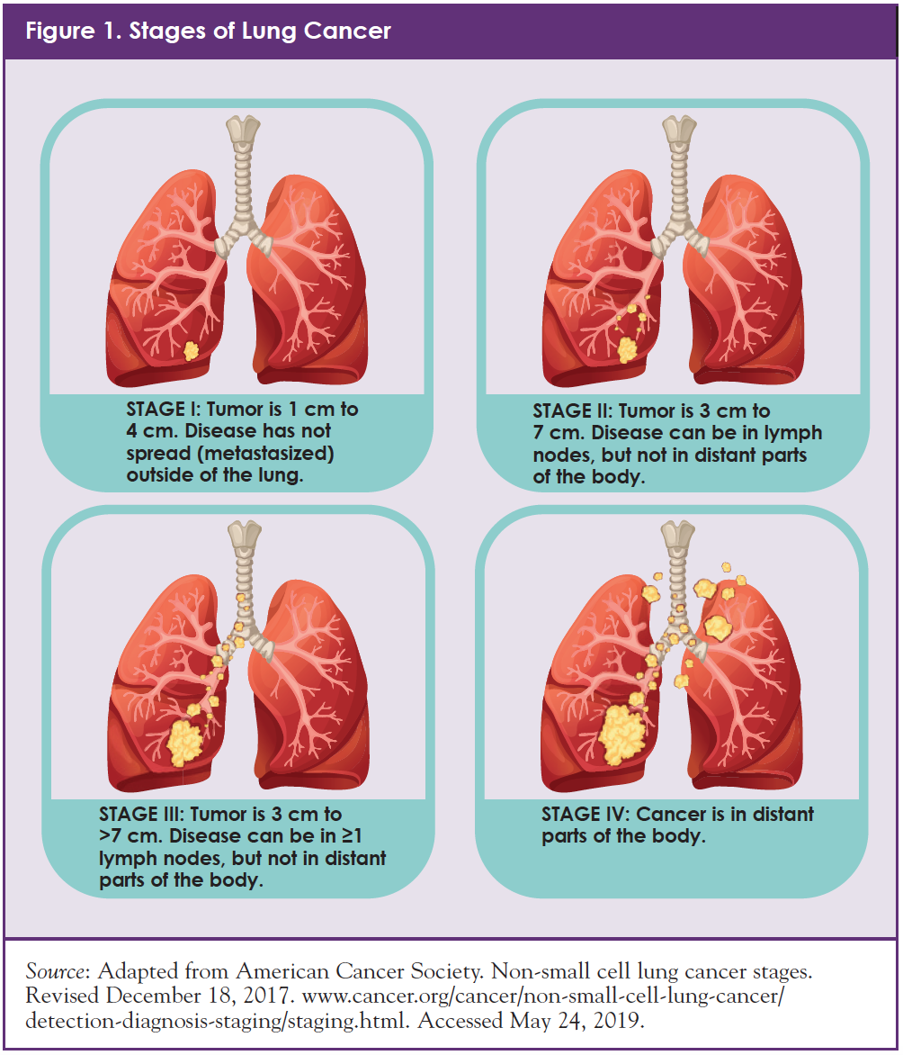
I. Introduction
Challenges in Cancer Treatment
1. Non-Small Cell Lung Cancer (NSCLC) is the most regular subtype (80%-85%) of Lung Cancer， which holds the highest mortality rate within the 36 cancer types.
2. 2%-20% of NSCLC patients survive five years from diagnosis.
3. Approximately 60% of patients are diagnosed with locally advanced or advanced stage disease.
4. Today, TME research in NSCLC is not in-depth enough, and finding more relevant biomarkers is crucial for cancer treatment/immunological developments.
Purpose for Research?
Exploring frequent malignant cell types in NSCLC from a cellular angle and analyzing significant cancer risk factors in cell transcriptional expression matrix.
Investigating NSCLC tumor immunological microenvironment and comprehensively analyzing potential predictive patterns between immunological components and cancer.
Finding potential novel biomarkers for drug innovation purposes.
Hypothesis and Contribution
Figure 1. https://conquer-magazine.com/issues/special-issues/august-2019-personalizing-treatment-for-patients-with-non-small-cell-lung-cancer-the-important-role-of-biomarker-testing
This project hypothesizes that there exists previously undiscovered or untapped biomarkers within the NSCLC tumor micro-environment, and thus, will utilize bioinformatics techniques to discover novel biomarkers, in attempt to provide new directions towards drug design and innovation.
2

Slide 3
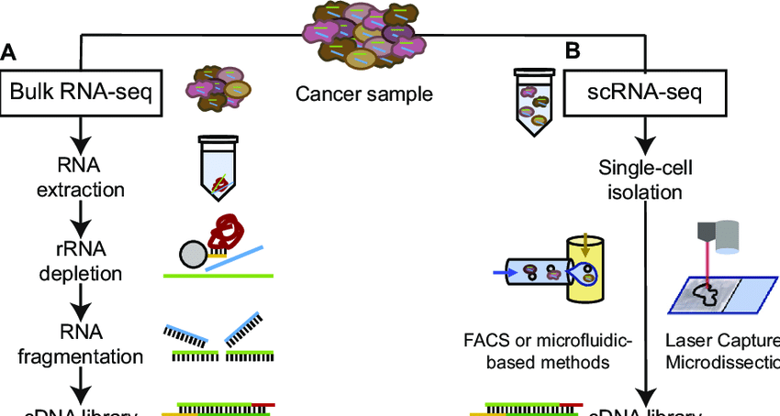
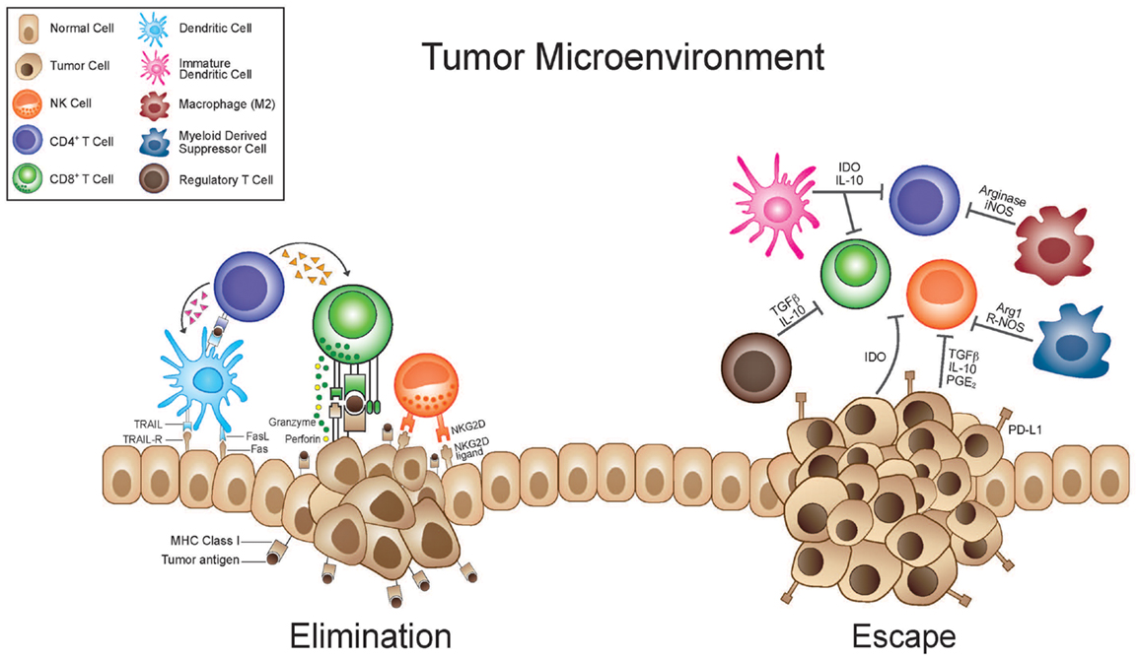
I. Introduction
Why Single Cell Transcriptomics?
1. Bulk RNA-seq is non-specific, it only calculates the mean genetic expression across a large cellular population.
2. Sc-RNA-seq on the other hand, isolates and quantifies single cellular expressions, allowing researchers to (i) identify health cells from tumor cells at early developmental stages (ii) understand the role specific cells play in a complex biological system through providing in-depth features on a singular cell and (iii) offer new insights into population heterogeneity within cells within the same tissue.
Figure 2. Bulk RNA-seq vs Single Cell Transcriptoics
https://www.researchgate.net/figure/Workflows-of-bulk-and-scRNA-seq-experiments-A-Bulk-RNA-seq-of-solid-tumours-is-based_fig1_336733732
Why Tumor microenvironment?
(1) The dynamic between cancer cells and TME may be an “active promoter of cancer progression” because the TME may “support cancer cell survival, local invasion, and metastatic dissemination” depending on its components (Melo et al., 2021).
(2) Stromal cells composition variation contribute to tumorigenesis by secreting chemicals that lead to “angiogenesis, proliferation, invasion, and metastasis” (Melo et al., 2021).
Figure 3 Tumor Microenvironment
https://www.frontiersin.org/files/Articles/51138/fonc-03-00197-HTML/image_m/fonc-03-00197-g001.jpg
3

Slide 4
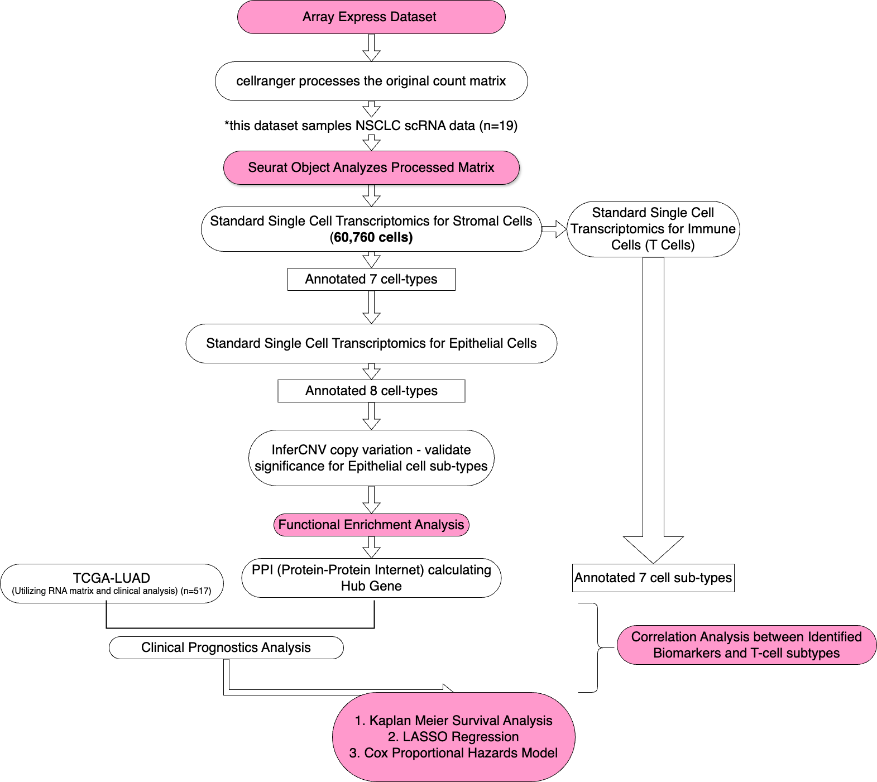
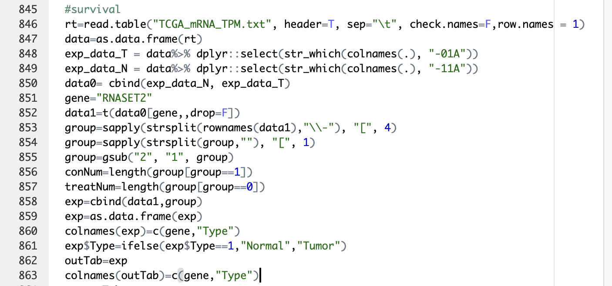
II. Methodology
Data Processing/Visualization Tools
Rstudio was used for data processing as well as producing prognostic clinical models. For example, Rstudio was used to perform dimension reduction techniques (PCA), cluster analysis and annotating procedures, functional enrichment analysis, etc.
Cytoscape_v3.10.1 allowed for the use of the CytoHubba(v0.1) plug-in to filter hub genes. Out of the 11 topical analysis methods in CytoHubba (v0.1), MCC (Maximal Clique Centrality) algorithm was applied.
Figure 5. A segment of Rstudio code to graph the K-M curve
Figure 4. Research Flow Chart
4

Slide 5
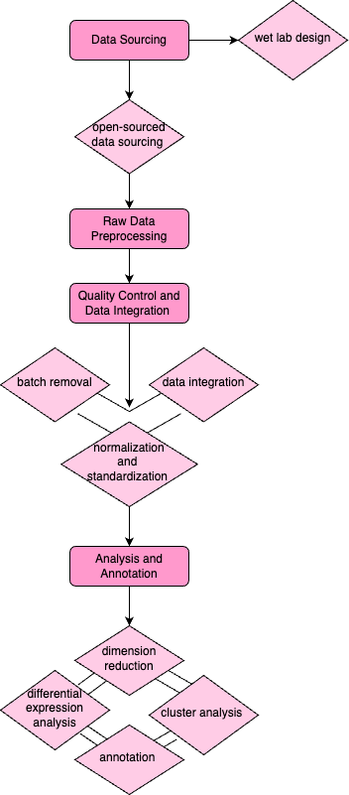
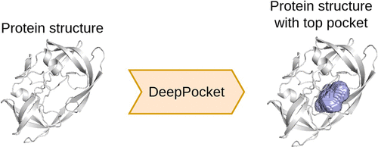
Methodology
Standard single cell transcriptomics analysis
Clinical Prognostic Analysis
- Utilizing TCGA dataset to visualize the Kaplan Meier Survival Curve, Cox Proportional Analysis, and the Lasso regression model (Abd ElHafeez et al., 2021).
Cox Proportional Analysis:
Lasso Regression Model:
- The Receiver Operating Character curve (ROC) and the area under its curve (AUC) further validates model generated hypothesis.
- Lastly, correlation analysis was used to identify the possible cell subtypes that the genetic biomarkers may resemble.
Protein Binding Pocket Detection
PyMol is an open-source proprietary molecular visualization system that may be used to find druggable binding sites on 3D protein structures (also known as protein pockets).
Figure 6. Standard single cell transcriptomics flowchart
Figure 7.Protein Neural Pocket Graphics https://pubs.acs.org/doi/abs/10.1021/acs.jcim.1c00799
5

Slide 6
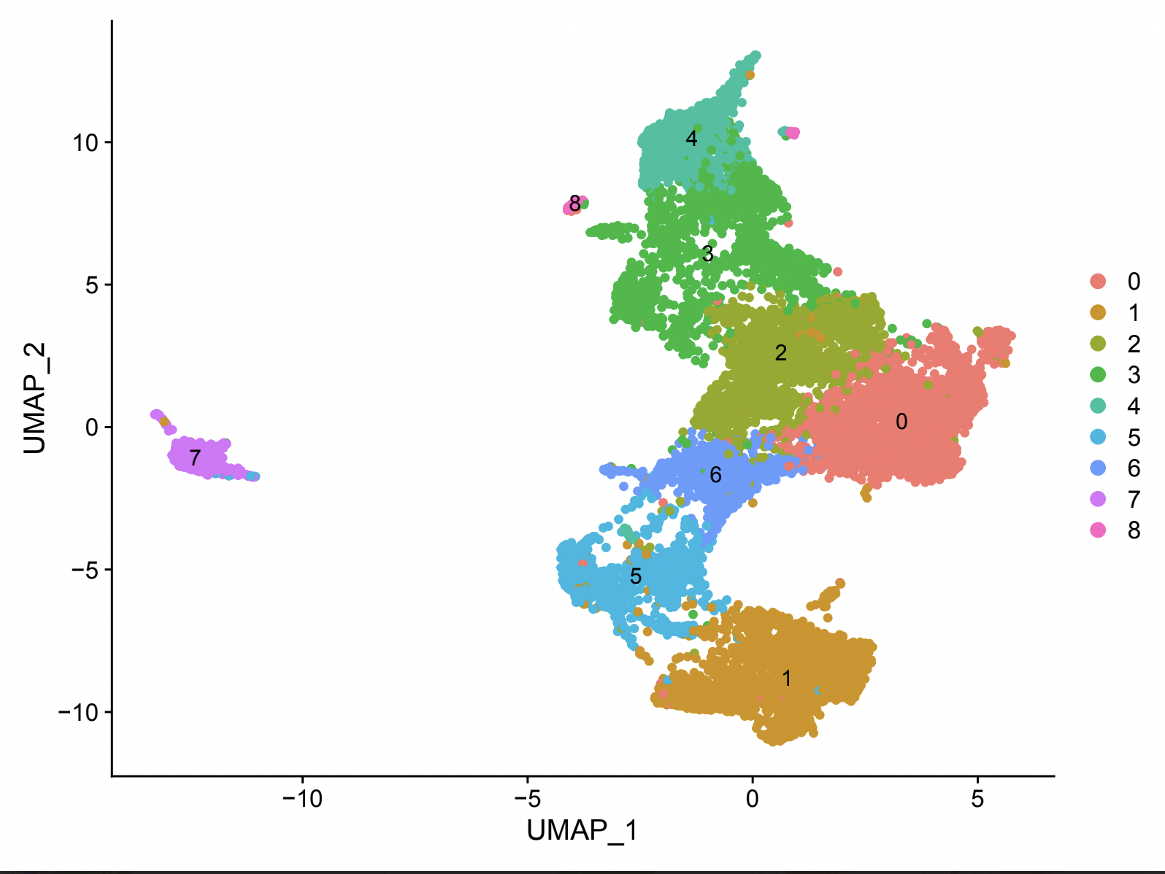
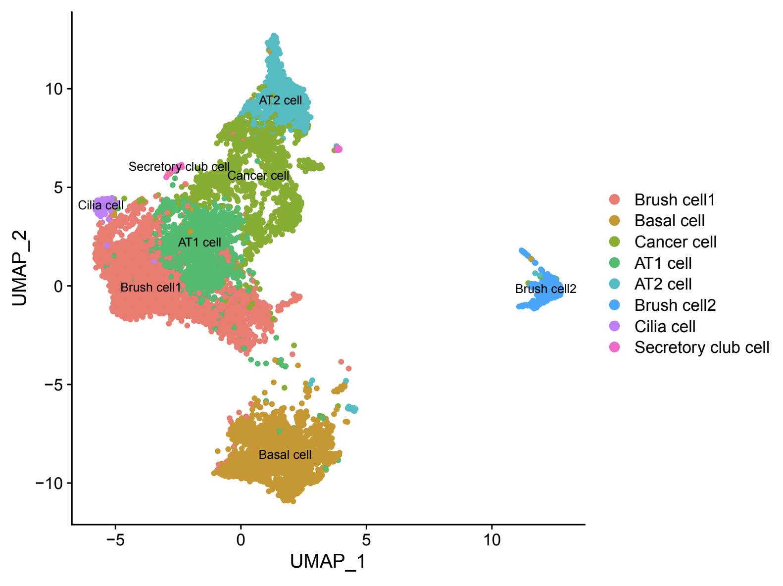
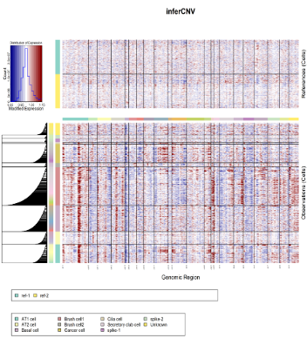
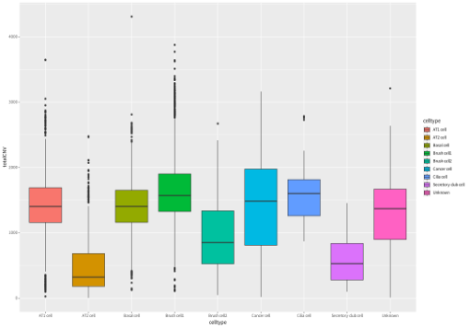
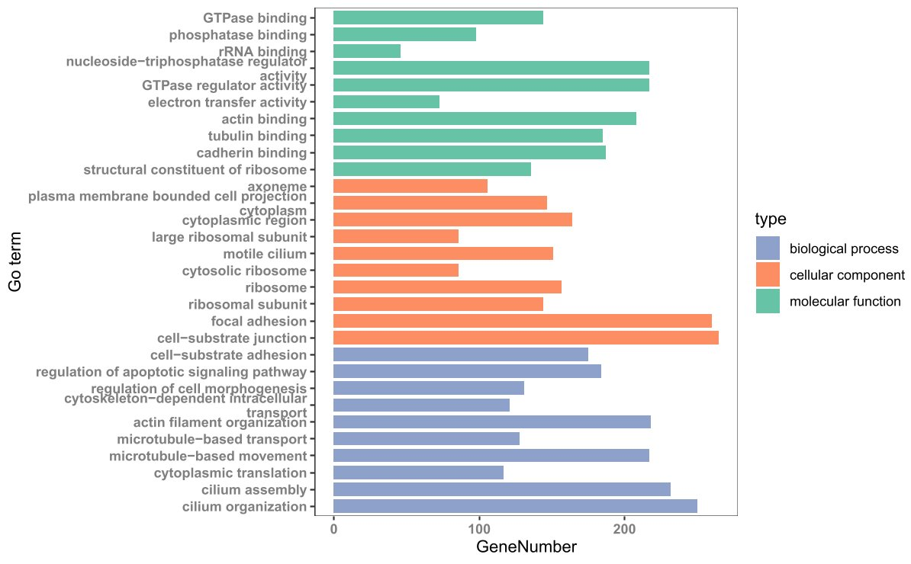
III. Results/Discussion
Figure 8. UMAPs of epithelial cell sub-types
Epithelial cell sub-type UMAP prior annotating
Epithelial cell sub-type UMAP post annotating
Figure 9. Visualization of Copy Number Variations
InferCNV results
Epithelial cell sub-type copy number result boxplot
1. All epithelial cell subtypes showed both areas with concentrated higher and lower modified expressions in its genomic region in the observation cells relative to the reference cells.
GO Enrichment Analysis found Cadherin Binding as one of the primary molecular functions, and Epithelial cadherins(E-cadherins) provide cell adhesion: it is proven to be involved in the formation of epithelial types of cancers such as carcinomas. More generally, destabilized cadherin complexes is associated with tumor progression in multiple cancer types.
2. Large levels of genetic mutation, which can be inferred from dramatic concentrations of modified expressions, indicates changes to cell division, which leads to cancerous tumor formation.
3. The boxplot demonstrated that basal cells have the largest range of copy number variation and that the proportion of tumor cells is highest in brush cells and the lowest cilia cells.
Figure 10. GO Enrichment Results
6

Slide 7
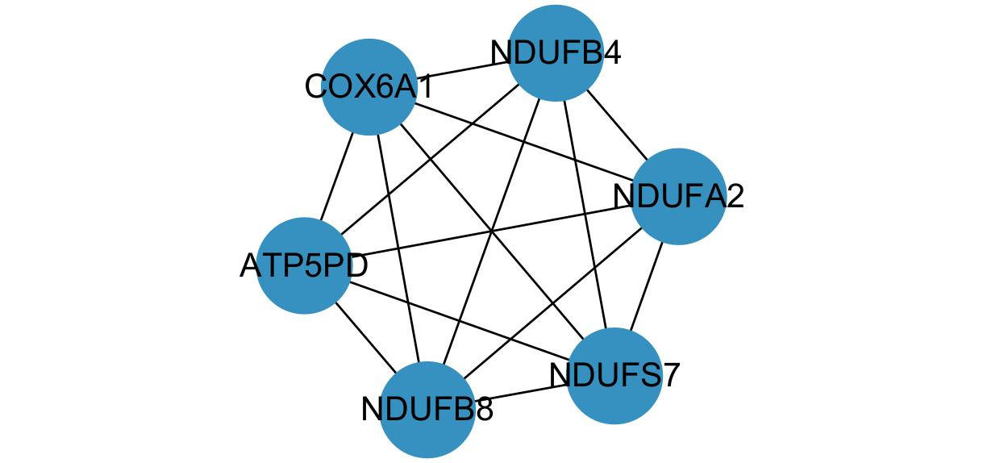
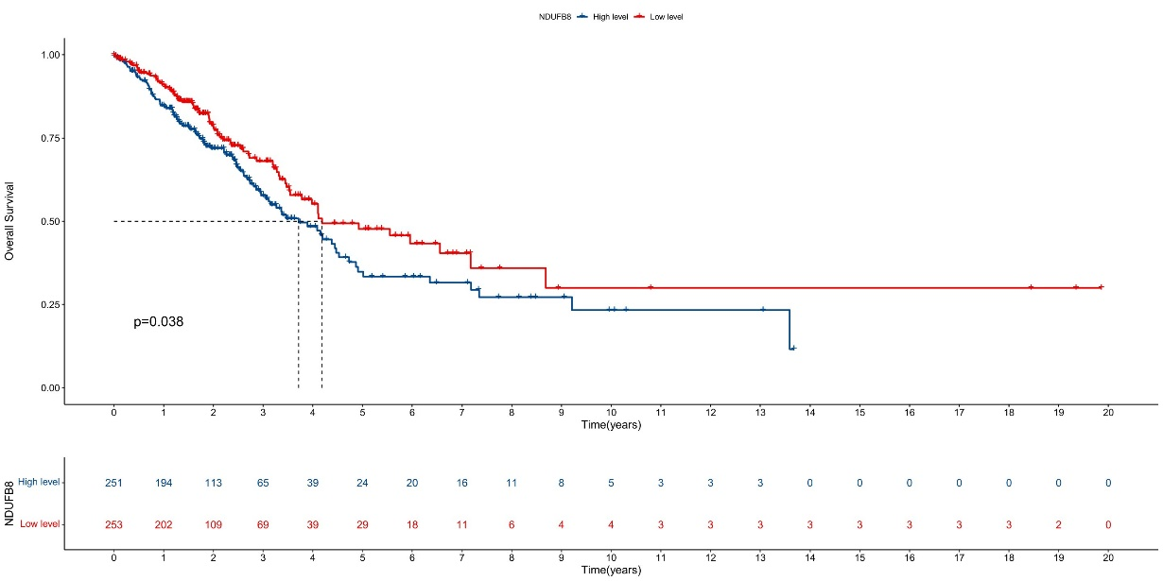
III. Results/Discussion
K-M Survival curves for all six hub genes displayed that NDUFB8 has a high potential research value in the field of LUAD tumor type NSCLC (p=0.038, p<0.05).
Figure 11. Hub Gene Diagram generated by CytoHubba
Figure 12. K-M survival curve for NDUFB8 gene
- NDUFB8 catalyzes the oxidation of NADH and electron transfer, which is consequential for the OXPHOS machinery.
- Previous studies have established that other components of the OXPHOS machinery are highly predictive in detecting early-stage NSCLC.
However, while it is conclusive that high levels of OXPHOS genes helps detect early-stage cancer because the process energizes cancer cells, there is very limited research on NDUFS8 on the area of NSCLC making further studies necessary.
7

Slide 8
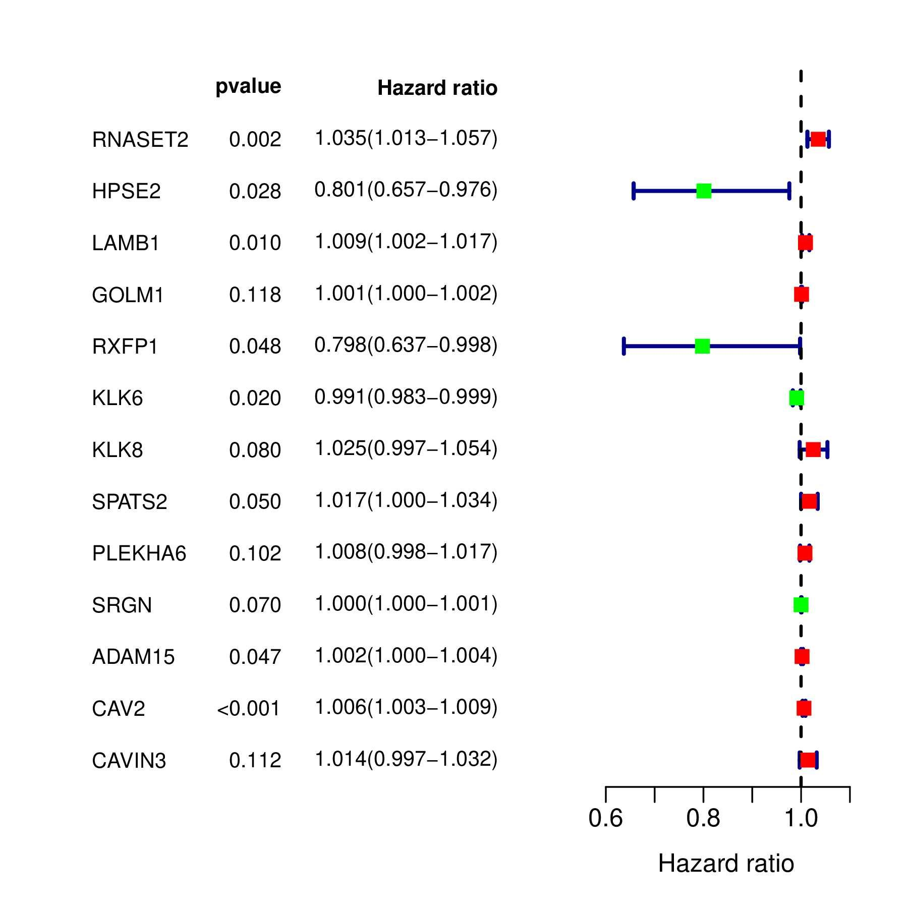
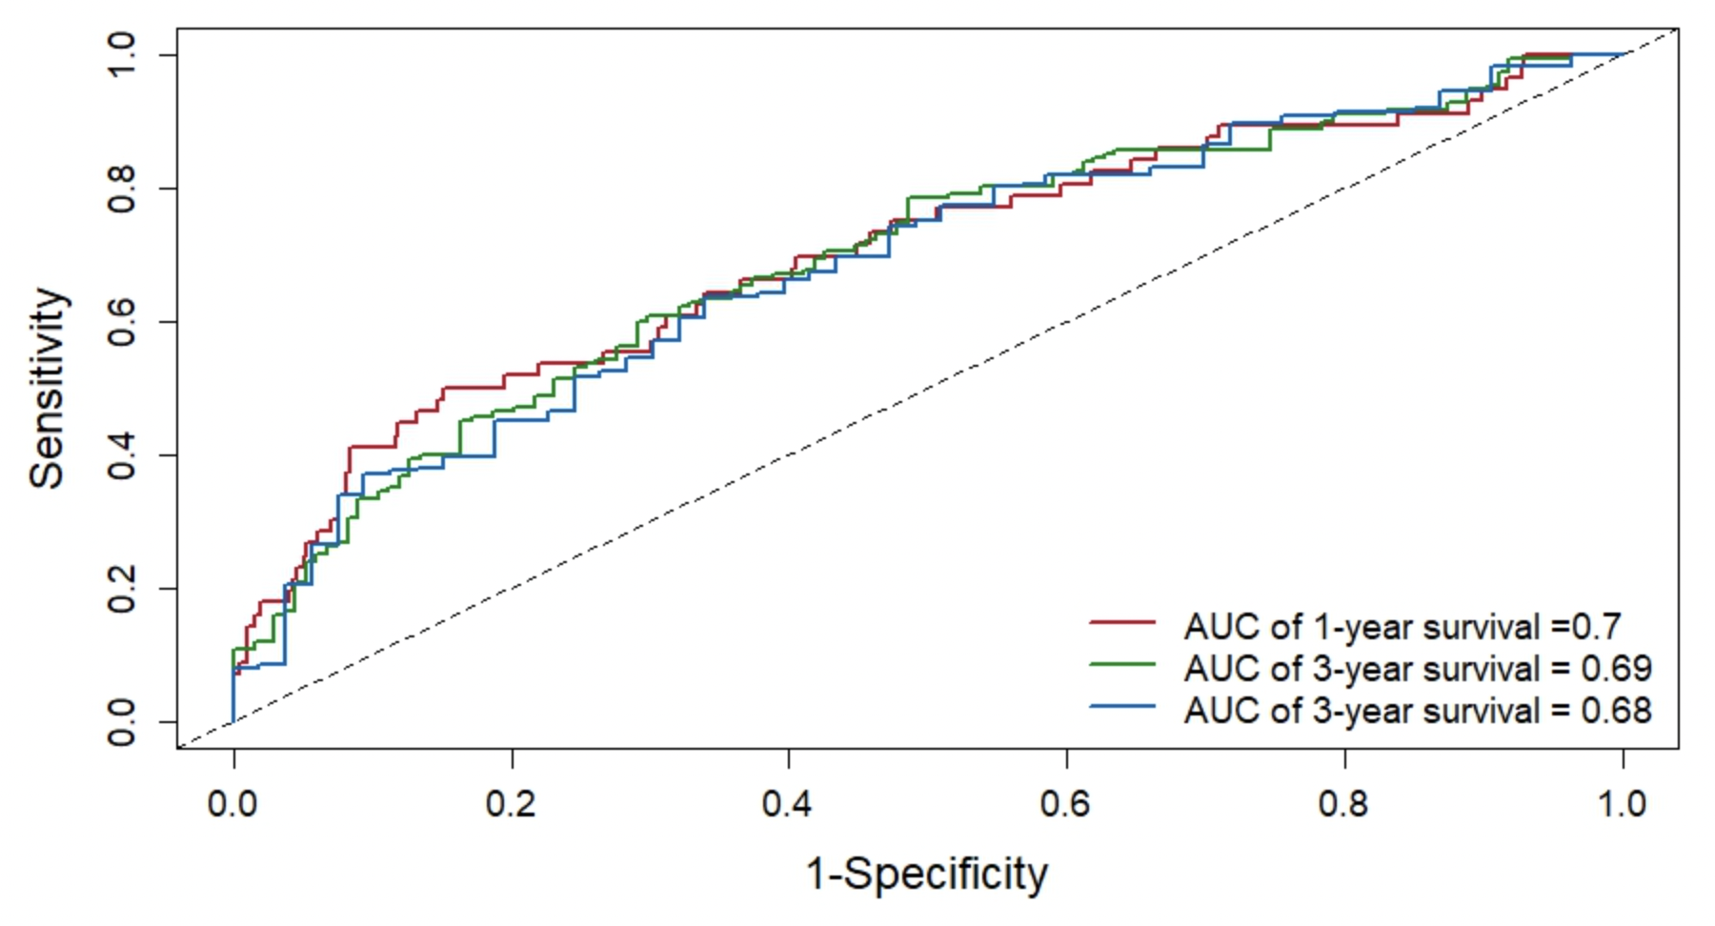
III. Results/Discussion
The Random Forest Algorithm and Multivariate Cox Regression Model showed that:
(i) HPSE2 and RXFP1 are associated with decreased risk of lung cancer and increased survival times
(ii) NASET2, LAMB1, and CAV2 are associated with increased risk of lung cancer and decreased survival times.
gene | coef | exp(coef) | se(coef) | z | p
RNASET2 | 0.033947 | 1.03453 | 0.0109 | 3.114 | 0.001843
HPSE2 | -0.2223 | 0.800678 | 0.101267 | -2.195 | 0.028152
LAMB1 | 0.009352 | 1.009396 | 0.003629 | 2.577 | 0.009963
GOLM1 | 0.000693 | 1.000694 | 0.000444 | 1.562 | 0.118173
RXFP1 | -0.22614 | 0.797604 | 0.114406 | -1.977 | 0.048079
KLK6 | -0.00912 | 0.990918 | 0.00392 | -2.327 | 0.019954
KLK8 | 0.024677 | 1.024984 | 0.014092 | 1.751 | 0.079928
SPATS2 | 0.016496 | 1.016633 | 0.008426 | 1.958 | 0.050258
PLEKHA6 | 0.007752 | 1.007782 | 0.004734 | 1.637 | 0.101527
SRGN | 0.000288 | 1.000288 | 0.000159 | 1.811 | 0.070206
ADAM15 | 0.002233 | 1.002236 | 0.001123 | 1.989 | 0.046695
CAV2 | 0.005874 | 1.005891 | 0.001564 | 3.755 | 0.000173
CAVIN3 | 0.014055 | 1.014154 | 0.008837 | 1.59 | 0.111727
Figure 13. Random Forest Algorithm Visualizer
Table 1. Multivariate Cox Regression Model Data Output
The final risk factors was validated by the combined ROC (receiver operating characteristic curve) curve with an AUC (area under curve) of 1~3 year survival to be 0.68-0.7.
In general, an AUC of 0.6 - 0.8 is regarded as acceptable, meaning that the risk factors found in this study affects the ability to diagnose patients of the disease NSCLC.
Figure 14. Receiver Operating Characteristic Curve with AUC
8

Slide 9
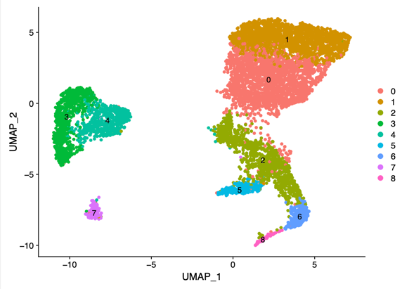
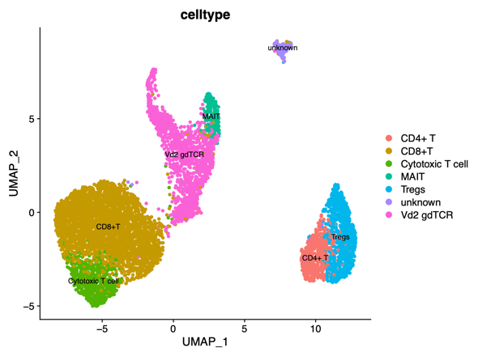
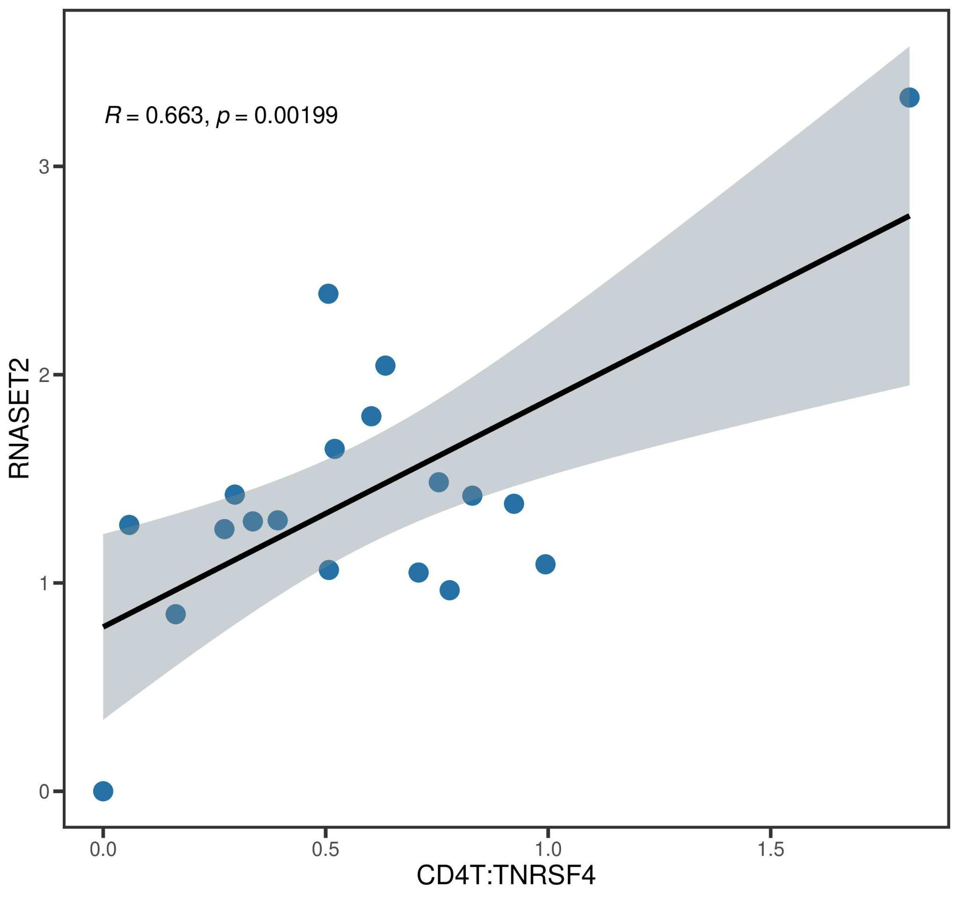
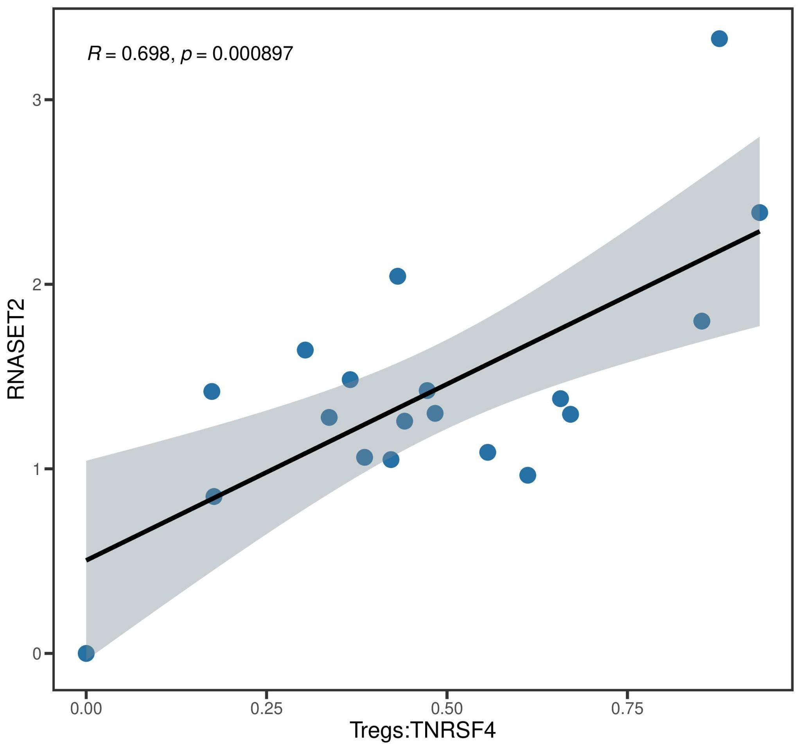
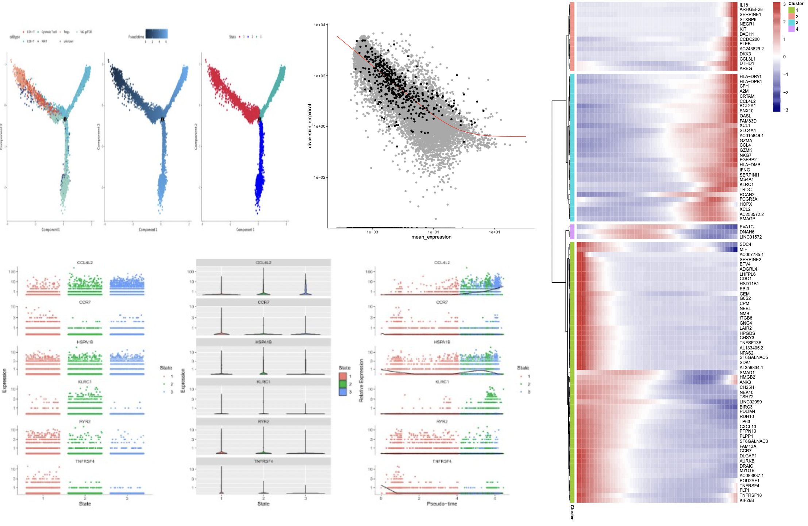
III. Results/Discussion
A significant correlation (r>0.5 and p<0.01) was found between RNASET2 and both T-regulatory cells and CD4+T cells. This was explainable because T-regulatory cells, also known as regulatory T cells, are a subtype of CD4+T cells, and accounts for 5~10% of peripheral blood (PB) CD4+T cells.
Figure 15 UMAPs of e With a p value of 0.038 (p <0.05), The K-M Survival T- cell sub-types
T cell sub-type UMAP prior annotating
T cell sub-type UMAP post annotating
Figure 16. Correlation Analysis Visualization
Correlation Graph between RNASET2 and Treg cells
Correlation Graph between RNASET2 and CD4+ cells
The Correlation Analysis validated previous studies that described RNASET2 as a “putative regulator of several functional features within the immune system” (Aquati et al, 2019).
Figure 17. Pseudo-time visualization
Pseudo-time graph
Dispersion map
Marker gene heat map
Pseudo-time-state progression
Specifically, the three Pseudo-time Graph visualizations suggested that CCL4L2, the marker gene for CD4+T cells, HSPA1B, the marker gene for cytotoxic T cells, and TNFRSF4, the marker gene for T-regulatory cells have visible trends.
9

Slide 10
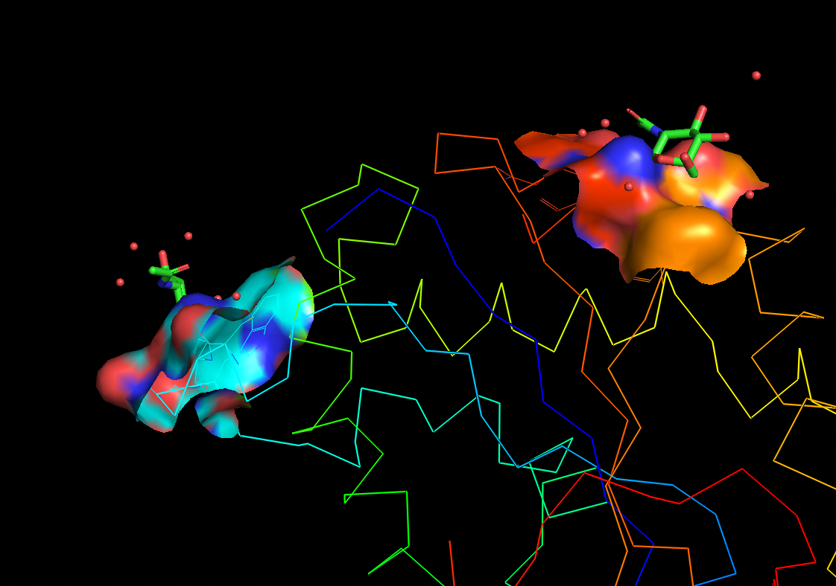
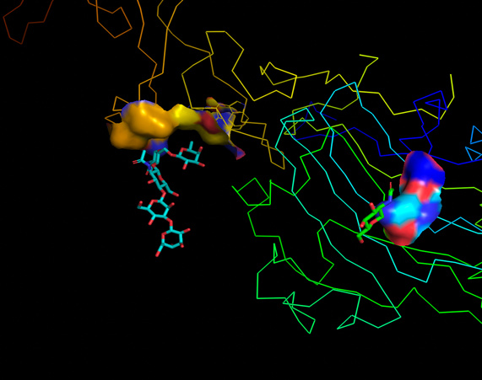
III. Results/Discussion
From the thirteen risk variable genes found through multivariable cox analysis, two genes contained potential protein bind pockets: specifically, LAMB1 and RNASET2, both of which are positively associated with increased risks of NSCLC and a decreased survival rate.
Although drug innovation that focuses on inhibiting LAMB1 is limited, LAMB1 has been historically associated with the initiation and progression of pneumoconiosis. Studies found that reduced activity of LAMB1 transcription correlates to reduced levels of Coal worker's pneumoconiosis (CWP). Similarly, an analysis of the effects of LAMB1 on gastric cancer prognosis states that the gene “elevated cell proliferation, invasion, and migration” by “promotes cell growth and motility via the ERK/c-Jun axis” ((Lee et al., 2021).
Figure 18. Protein Binding Pocket Visualization
Visualization for RNASET2
Visualization for LAMB1
Although previous researchers have suggested that there was a down-regulation of RNASET2 in cancerous gastric tissues in comparison to adjacent non-cancerous tissues, the same article describes decreasing levels of RNASET2 in cancerous stomach tissues as a “consequence of GAC (Gastric Adenocarcinoma Cancer), instead of the driver.” Furthermore, a CRISPR/Cas9 analysis found that “RNASET2 knock out had no significant effect angiogenesis and tumor cell” (Hosseini et al., 2022).
10

Slide 11
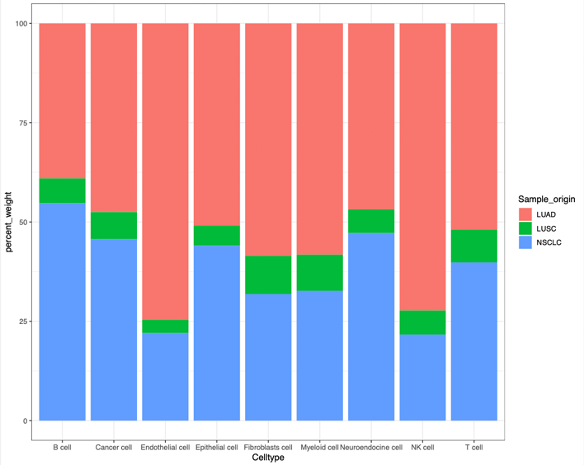
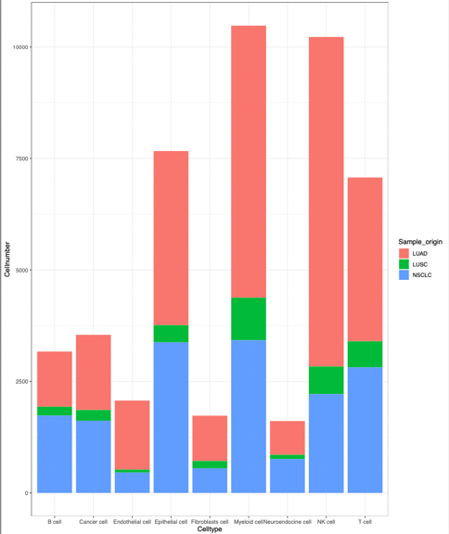
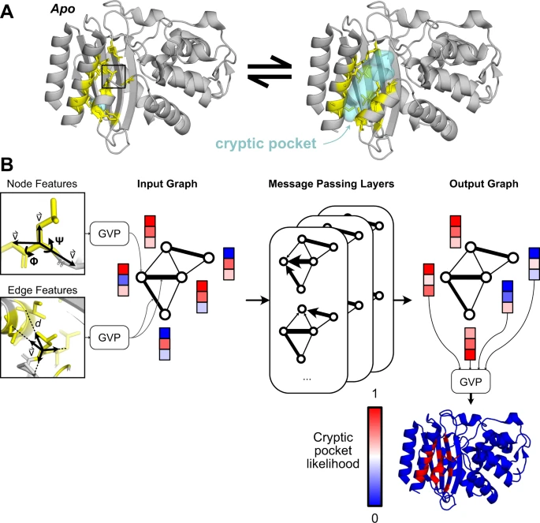
IV. Limitation/Future Work
Limitations
Future Works
Create new, distinct algorithms to calculate the ligand compatibility between the protein binding pockets and potential medical treatments.
Produce new algorithms to predict the probability of cryptic protein pockets and further expand the predicting algorithm from the probability of potential cryptic pockets to their potential shape.
Figure 19. Visualization composition of NSCLC subtype
Distribution of NSCLC Subtype by Cell Number
Distribution of NSCLC Subtype by proportion
Figure 20. Protein Neural Network
https://www.researchgate.net/figure/PocketMiner-uses-graph-neural-networks-to-predict-cryptic-pocket-formation-A-Proteins_fig1_368909120
While this study aims to perform a thorough analysis of NSCLC tumor structure and potential carcinogens, most of this study focuses on LUAD, a subtype of NSCLC, rather than LUSC because the open-sourced dataset that this study adopted found a higher proportion of tumor cells under the LUAD subtype.
*Note that the relationship between drugs and protein binding pockets models the induced-fit theory, stating that both the protein structure and ligand site modify its shape to maximize binding efficiency and success*
11

Slide 12
V. References
Bruno, A., Noonan, D. M., Valli, R., Porta, G., Taramelli, R., Mortara, L., & Acquati, F. (2022). Human rnaset2: A highly pleiotropic and evolutionary conserved tumor suppressor gene involved in the control of ovarian cancer pathogenesis. International Journal of Molecular Sciences, 23(16), 9074. https://doi.org/10.3390/ijms23169074
Chen, G., Ning, B., & Shi, T. (2019). Single-Cell rna-seq technologies and related computational data analysis. Frontiers in Genetics, 10. https://doi.org/10.3389/fgene.2019.00317
Cox, T. M. (2023). Lysosomal diseases. Encyclopedia of Cell Biology, 977-1028. https://doi.org/10.1016/b978-0-12-821618-7.00282-0
The GeneCards Suite: From Gene Data Mining to Disease Genome Sequence Analyses (PMID: 27322403 ; Citations: 2,595) Stelzer G, Rosen R, Plaschkes I, Zimmerman S, Twik M, Fishilevich S, Iny Stein T, Nudel R, Lieder I, Mazor Y, Kaplan S, Dahary, D, Warshawsky D, Guan - Golan Y, Kohn A, Rappaport N, Safran M, and Lancet D Current Protocols in Bioinformatics(2016), 54:1.30.1 - 1.30.33.doi: 10.1002 / cpbi.5 [PDF]
Hosseini, S. A., Salehifard Jouneghani, A., Ghatrehsamani, M., Yaghoobi, H., Elahian, F., & Mirzaei, S. A. (2022). CRISPR/Cas9 as precision and high-throughput genetic engineering tools in gastrointestinal cancer research and therapy. International Journal of Biological Macromolecules, 223, 732-754. https://doi.org/10.1016/j.ijbiomac.2022.11.018
Ji, M., Zhao, Z., Li, Y., Xu, P., Shi, J., Li, Z., Wang, K., Huang, X., & Liu, B. (2021). FBXO6-mediated rnaset2 ubiquitination and degradation governs the development of ovarian cancer. Cell Death & Disease, 12(4). https://doi.org/10.1038/s41419-021-03580-4
Jovic, D., Liang, X., Zeng, H., Lin, L., Xu, F., & Luo, Y. (2022). Single‐cell RNA sequencing technologies and applications: A brief overview. Clinical and Translational Medicine, 12(3). https://doi.org/10.1002/ctm2.694
Kalainayakan, S. P., FitzGerald, K. E., Konduri, P. C., Vidal, C., & Zhang, L. (2018). Essential roles of mitochondrial and heme function in lung cancer bioenergetics and tumorigenesis. Cell & Bioscience, 8(1). https://doi.org/10.1186/s13578-018-0257-8
Meller, A., Ward, M., Borowsky, J., Kshirsagar, M., Lotthammer, J. M., Oviedo, F., Ferres, J. L., & Bowman, G. R. (2023). Predicting locations of cryptic pockets from single protein structures using the pocketminer graph neural network. Nature Communications, 14(1). https://doi.org/10.1038/s41467-023-36699-3
Melo, C. M., Vidotto, T., Chaves, L. P., Lautert-Dutra, W., Reis, R. B. D., & Squire, J. A. (2021). The role of somatic mutations on the immune response of the tumor microenvironment in prostate cancer. International Journal of Molecular Sciences, 22(17), 9550. https://doi.org/10.3390/ijms22179550
Mithoowani, H., & Febbraro, M. (2022). Non-Small-Cell lung cancer in 2022: A review for general practitioners in oncology. Current Oncology, 29(3), 1828-1839. https://doi.org/10.3390/curroncol29030150
Orr, J. C., & Hynds, R. E. (2021). Stem cell–derived respiratory epithelial cell cultures as human disease models. American Journal of Respiratory Cell and Molecular Biology, 64(6), 657-668. https://doi.org/10.1165/rcmb.2020-0440tr
Remark, R., Becker, C., Gomez, J. E., Damotte, D., Dieu-Nosjean, M.-C., Sautès-Fridman, C., Fridman, W.-H., Powell, C. A., Altorki, N. K., Merad, M., & Gnjatic, S. (2015). The non–small cell lung cancer immune contexture. A major determinant of tumor characteristics and patient outcome. American Journal of Respiratory and Critical Care Medicine, 191(4), 377-390. https://doi.org/10.1164/rccm.201409-1671pp
Rodak, O., Peris-Díaz, M. D., Olbromski, M., Podhorska-Okołów, M., & Dzięgiel, P. (2021). Current landscape of non-small cell lung cancer: Epidemiology, histological classification, targeted therapies, and immunotherapy. Cancers, 13(18), 4705. https://doi.org/10.3390/cancers13184705
Stuart, T., Butler, A., Hoffman, P., Hafemeister, C., Papalexi, E., Mauck, W. M., Hao, Y., Stoeckius, M., Smibert, P., & Satija, R. (2019). Comprehensive integration of single-cell data. Cell, 177(7), 1888-1902.e21. https://doi.org/10.1016/j.cell.2019.05.031
Tan, Z., Chen, X., Zuo, J., Fu, S., Wang, H., & Wang, J. (2023). Comprehensive analysis of scRNA-Seq and bulk rna-seq reveals dynamic changes in the tumor immune microenvironment of bladder cancer and establishes a prognostic model. Journal of Translational Medicine, 21(1). https://doi.org/10.1186/s12967-023-04056-z
Wang, C., Yu, Q., Song, T., Wang, Z., Song, L., Yang, Y., Shao, J., Li, J., Ni, Y., Chao, N., Zhang, L., & Li, W. (2022). The heterogeneous immune landscape between lung adenocarcinoma and squamous carcinoma revealed by single-cell RNA sequencing. Signal Transduction and Targeted Therapy, 7(1). https://doi.org/10.1038/s41392-022-01130-8
Zhang, Y., Wang, D., Peng, M., Tang, L., Ouyang, J., Xiong, F., Guo, C., Tang, Y., Zhou, Y., Liao, Q., Wu, X., Wang, H., Yu, J., Li, Y., Li, X., Li, G., Zeng, Z., Tan, Y., & Xiong, W. (2021). Single‐cell RNA sequencing in cancer research. Journal of Experimental & Clinical Cancer Research, 40(1). https://doi.org/10.1186/s13046-021-01874-1
12

