Slide 1
Machine Learning Video Analysis to Assess Pitcher’s Injury Risk in Baseball Games
Xuancheng Li
Notes:
Say hi

Slide 2
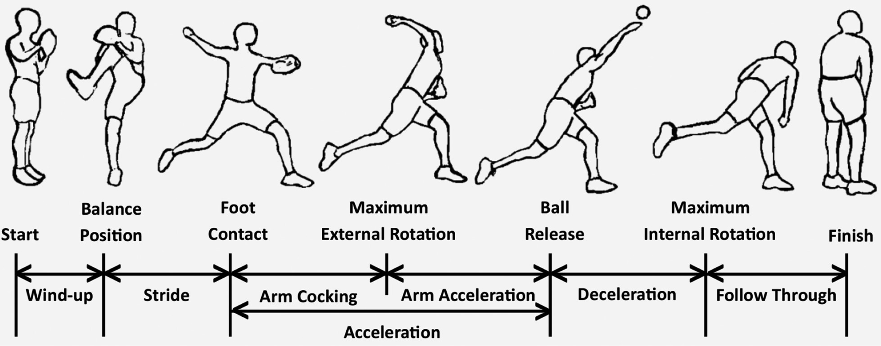
The pitching process
Notes:
Detailed description of pitching motion

Slide 3
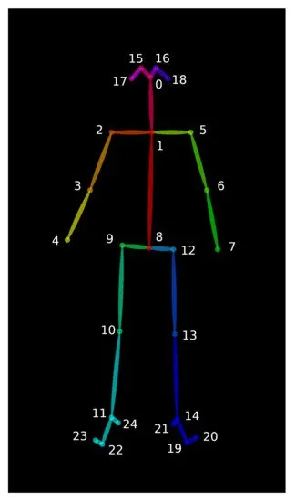
Openpose
Notes:
Feature generation: takes an RGB image as input, and generates a set of feature maps (F).
Multi-stage CNN: gets F from the previous step as input, and jointly predicts from it: a. Part Confidence Maps b. Part Affinity Fields (PAFs)
Parsing: performs a set of bipartite matchings to associate body-part candidates from the previous step’s results
Assembling: assembles the results into full-body poses for all the people in the image

Slide 4
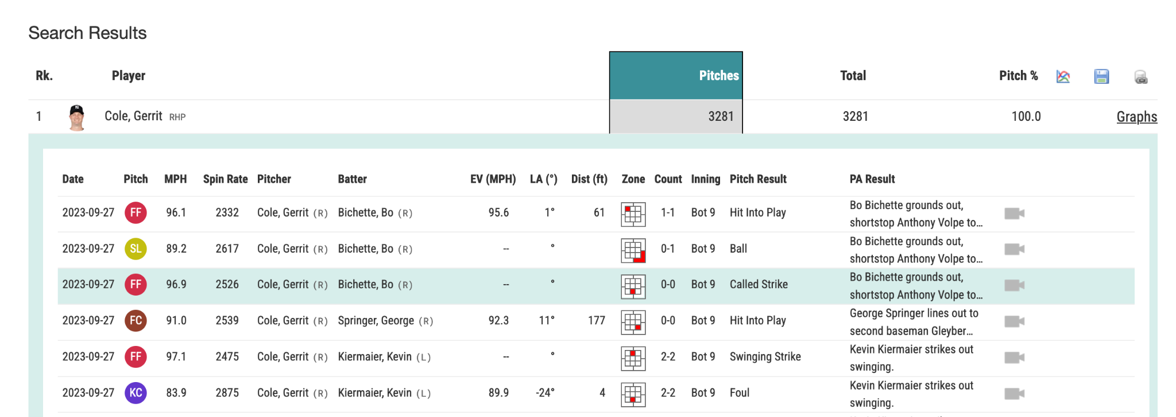
Data Collection
Notes:
Everything in MLB is publicly available
Data collection: videos for every pitch, injury list (IL) visits

Slide 5
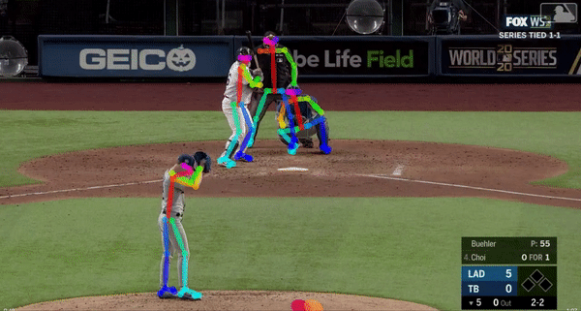
Notes:
Use Openpose algorithm to track player motion in baseball play-by-play videos.

Slide 6
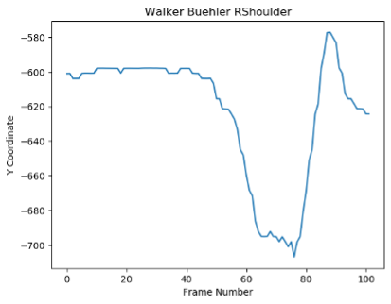
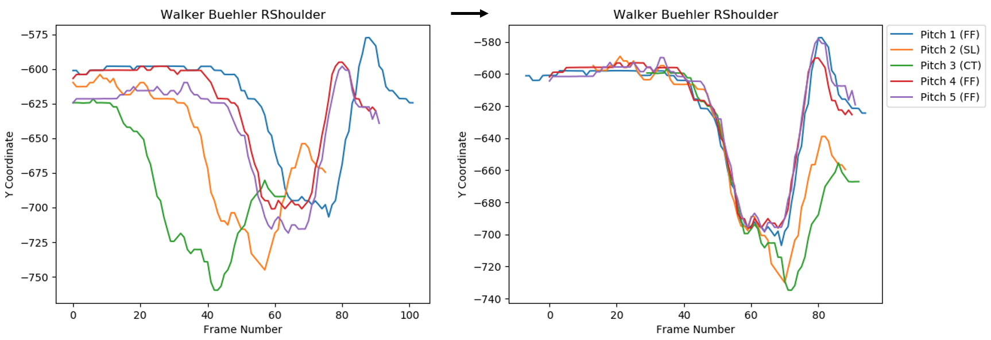
Notes:
Find certain patterns of pitching movements and their correlation with placements on injured list (IL)

