Slide 1
Revolutionizing Asthma Treatment:
A Breakthrough in LABA Design Enhances Both Selectivity and Efficacy
Sophia Liu, The Lawrenceville School

Slide 2
Introduction
Asthma is the most common chronic disease among children, affecting 262 million patients worldwide and accounting for 450,000 deaths annually.¹
Long-acting β2-agonist (LABA) is a frontline asthma treatment, binding to β2 adrenoceptors (β2ARs) on airway smooth muscle cells to induce bronchodilation.
Unfortunately, current LABAs sacrifice efficacy or selectivity for the other, either increasing risk for cardiac arrest by 2-fold or weakening bronchodilation effects.²

Slide 3
Literature Review
Studies developing analogs (i.e., drug candidates) of LABAs also sacrifice efficacy or selectivity for the other.
The challenge is that β2AR and β1AR share one of human's most conserved ligand-binding sites: a mere 0.58 Å structural deviation, 92% gene similarity, and only one differing residue in their ligand-binding sites.3
The popular virtual high throughput screening method is ineffective in discovering simultaneously selective and efficacious analogs.
Year | LABAs | Efficacy | Selectivity (for β2AR over β1AR)
1972 | Formoterol^ | Full agonist | 200-fold⁴
1983 | Salmeterol^ | Partial agonist | 1000-fold⁴
2009 | 6 analogs⁺ | Inverse agonists | Negligible⁵
2013 | Vilanterol^ | Partial agonist | 1000-fold⁶
2013 | 6 analogs⁺ | 4 full agonists + 2 partial agonists | Negligible⁷
Table 1. Efficacy and selectivity of approved LABAs and published analogs of LABA.
^ Approved LABAs
⁺ Analogs of LABA selected through virtual high throughput screening

Slide 4
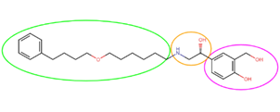
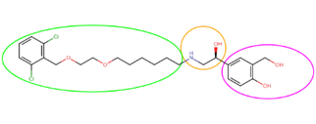
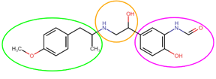
Literature Review
Salmeterol
Formoterol
Vilanterol
Virtual high throughput screening fails to leverage the following known connections between LABAs’ structural groups, receptor interactions, and physiological effects:
Each LABA consists of
A head group: hydrogen bonds with Ser203 and Ser207 are needed to activate β2AR fully.
An ethanolamine group: hydrogen bonds with Asn312 and Asp121 are needed to activate β2AR.
A tail group: π interactions with exosite are needed for selectivity.
The head group of formoterol accounts for its full agonism and higher efficacy.
The tail groups of salmeterol and vilanterol account for their higher selectivity.
Table 2. Chemical structures of salmeterol, formoterol and vilanterol. Magenta represents head group, orange represents ethanolamine group and green represents tail group.

Slide 5
Purpose
Hypothesis
To design the first selective and fully efficacious analog of LABA.
If structural groups of different current LABAs are combined with consideration of known connections between LABAs’ structural groups, receptor interactions and physiological effects,
then the resulting analog will have the efficacy of the most efficacious LABA currently and selectivity of the most selective LABA.^
^Efficacy is shown when the analog has an equal to or more negative change in Gibbs free energy (ΔG) than the most efficacious LABA when docked to β2AR and forms all hydrogen bonds necessary to activate β2AR. Selectivity is shown when the analog has an equal to or less negative ΔG than the most selective LABA when docked to β1AR. This is because more negative ΔG signifies a more energetically favorable binding pose and higher binding affinity. Binding affinity to β2AR should be high and low for β1AR.

Slide 6
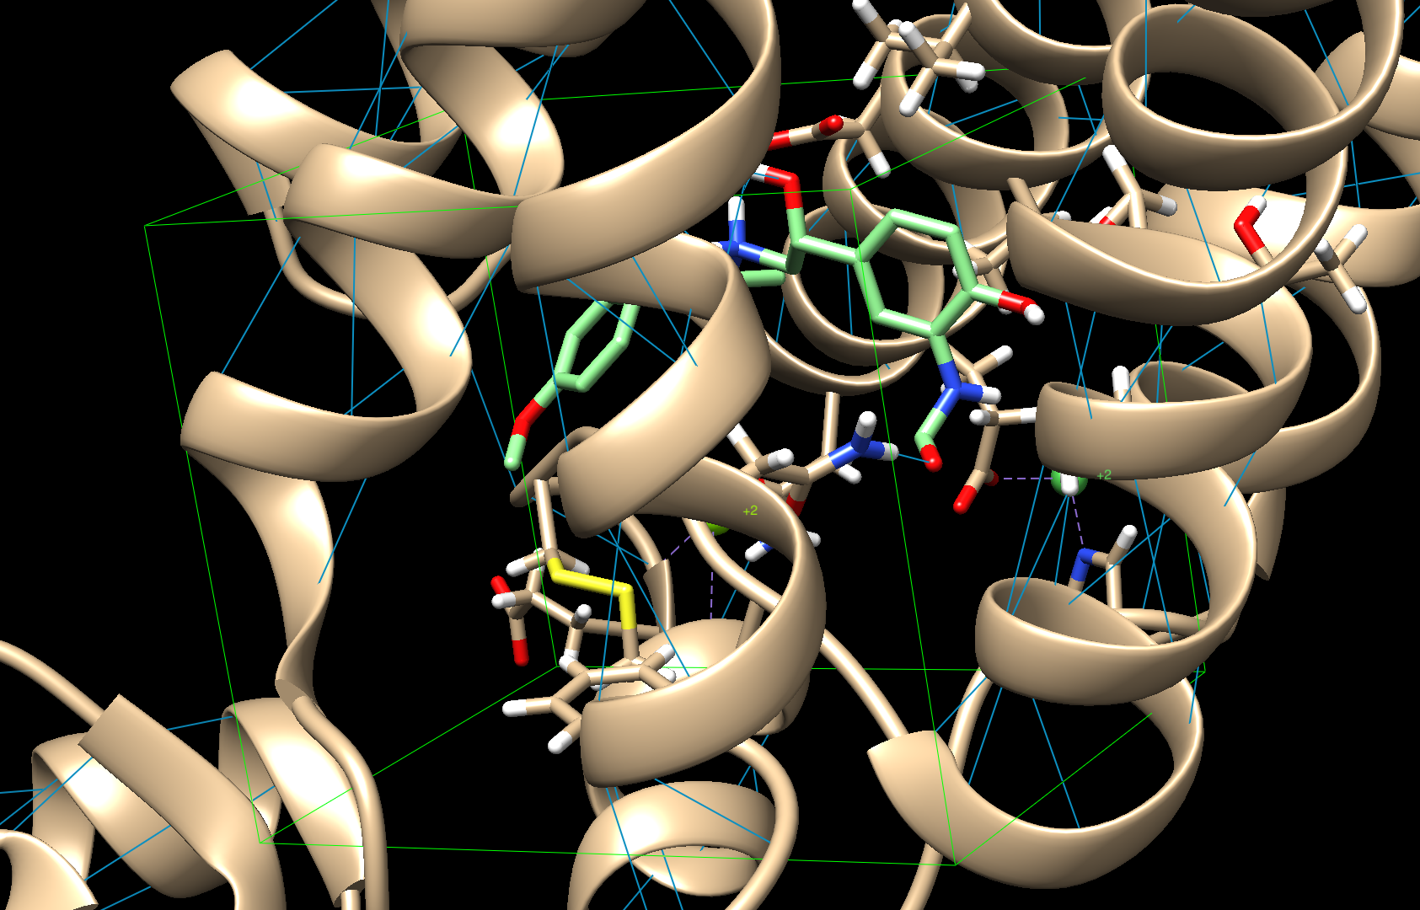
Materials
A laptop
Various open source softwares including Avogadro, AutoDock Vina, Chemaxon MarvinSketch, Discovery Studio Visualizer, SwissADME and UCSF Chimera
Files of β2AR (ID: 6MXT), β1AR (ID: 6IBL), salmeterol (ID: K5Y), formoterol (ID: H98) and vilanterol (ID: GW6)
Fig 1. Molecular Docking Software UCSF Chimera using AutoDock Vina algorithm. The green box is the active site. Protein is in beige color and ligand is in green.
Note
Molecular docking software was used because it simulates intermolecular interactions between the ligand and the protein, providing more insights for designing better analogs.
The open-source AutoDock Vina algorithm was used because it allows for flexible ligand and flexible protein side chain docking. Moreover, its scoring system is based on (ΔG), a reliable measure of binding affinity.

Slide 7
General Methods
Ligand | Chemical Structures
Salmeterol
Formoterol
Vilanterol
Analog 2
Analog 20
Analog 67
Analog 71
Analog 73
Protein Preparation in UCSF Chimera
Molecular Docking of Control Groups (Approved LABAs) to β2AR and β1AR for Five Trials Each in AutoDock Vina
2D and 3D Designing of Analogs using ChemAxon and Avogadro
Testing of Analogs for Drug-likeness using SwissADME
Molecular Docking of Analogs to β2AR and β1AR for Five Trials Each in AutoDock Vina
Qualitative and Quantitative Analysis in UCSF Chimera, Excel, and Discovery Studio Visualizer to Find Insights for Designing Better Analogs.
Steps 3-7 were repeated, totaling to 76 novel analogs.
Table 3. Chemical structures of salmeterol, formoterol, vilanterol and some of the analogs

Slide 8
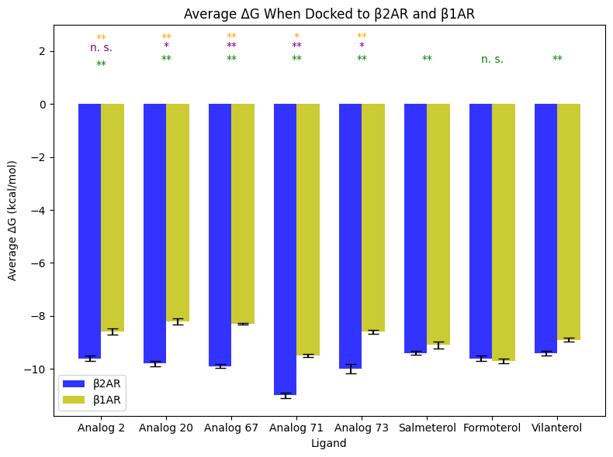
Results and Quantitative Analysis
Analog 20 had a ΔG of -9.9 kcal/mol and -8.3 kcal/mol when docked to β2AR and β1AR, respectively, which correspond to a 1.5-fold increase in binding affinity for β2AR compared to the most efficacious LABA and a 4-fold decrease in binding affinity for β1AR compared to the most selective LABA.
Ligand | ΔG in β2AR (kcal/mol) | ΔG in β1AR (kcal/mol)
(R,R)-Formoterol | -9.6 | -9.8
(R)-Salmeterol | -9.4 | -9.2
(R)-Vilanterol | -9.5 | -9.0
Analog 2 | -9.8 | -8.8
Analog 20 | -9.9 | -8.3
Analog 67 | -10 | -8.3
Analog 71 | -11.2 | -9.6
Analog 73 | -10.2 | -8.7
yellow: represents t-test comparing each ligand’s ΔG to the control groups for β1AR
purple: represents t-test comparing each ligand’s ΔG to the control groups for β2AR
green: represents t-test comparing each ligand’s ΔG for β2AR and β1AR
* p-value<0.01 ; ** p-value<0.05 ; n.s. p-value>0.05

Slide 9
Results and Qualitative Analysis
When docked to β2AR, analog 20, which has the head group of formoterol, formed all hydrogen bonds (Ser203, Ser207, Asn293, Asp113, Asn293) necessary for full β2AR activation. It also engaged in π interactions with the exosite, which is critical to selectivity.

Slide 10
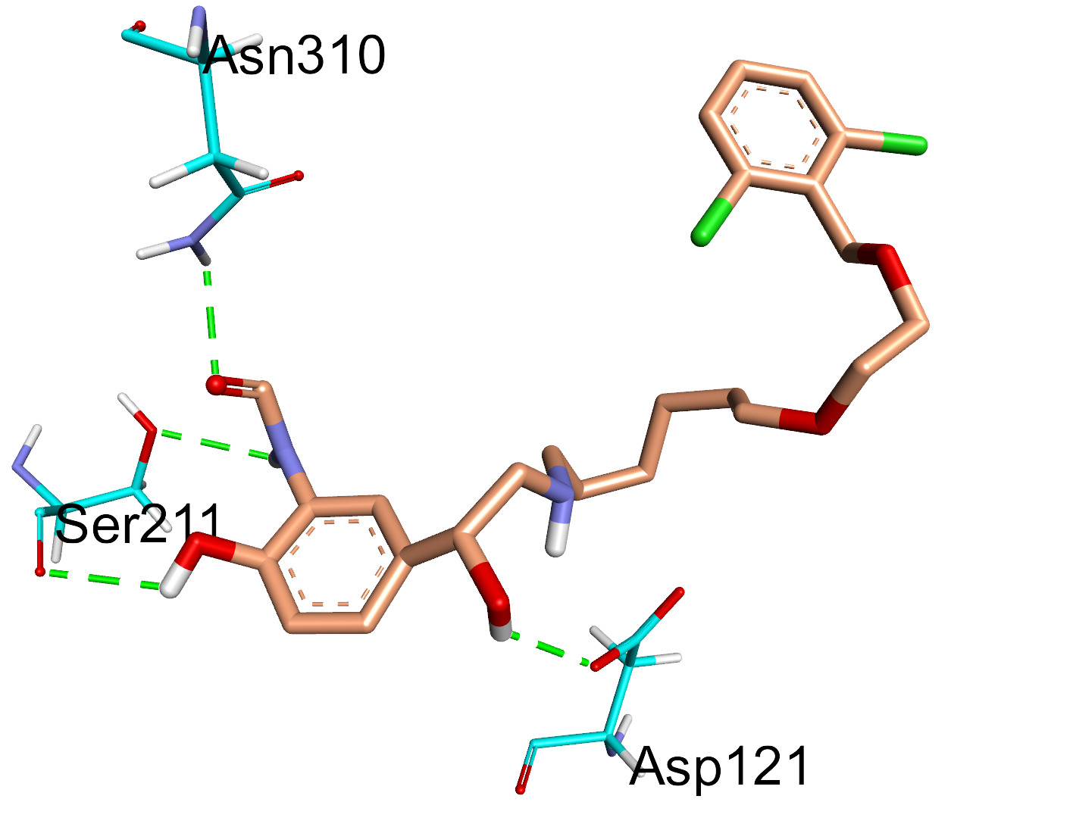
Results and Qualitative Analysis
When docked to β1AR, analog 20, which has the tail group of vilanterol, had fewer of interactions than when it was docked to β2AR, suggesting selectivity.

Slide 11
Conclusion
Analog 20 had a 1.5-fold higher binding affinity for β2AR than the most efficacious LABA. It also formed all hydrogen bonds and π interactions necessary for full β2AR activation, suggesting full efficacy.
Analog 20 also had a 4-fold lower binding affinity for β1AR than the most selective LABA, suggesting high selectivity.
This study successfully designed novel analog 20, which not only is the first analog of LABA to be selective and fully efficacious, but also the first to outperform current LABAs in both efficacy and selectivity in silico.

Slide 12
Application and Future Work
Further molecular dynamic simulation and biochemical assays should be conducted to confirm these in silico results.
Given that β2AR and β1AR are among the most conserved pairs of receptors in humans, this study’s ability to overcome the challenges of designing a selective and efficacious drug—by leveraging known connections between LABAs’ structural group, receptor interactions, and physiological effects—would have significant implications for works attempting to create drugs that target highly conserved receptors.
This study would also impact works in the newer field of multi-target drugs, especially those dealing with both agonists and antagonists.

Slide 13
References
All photographs and figures by student
[1] Global Initiative for Asthma. (2022). Global strategy for asthma management and prevention. https://ginasthma.org/wp-content/uploads/2022/07/GINA-Main-Report-2022-FINAL-22-07-01-WMS.pdf
[2] Lemaitre, R. N., Siscovick, D. S., Psaty, B. M., Pearce, R. M., Raghunathan, T. E., Whitsel, E. A., Weinmann, S. A., Anderson, G. D., & Lin, D. (2002). Inhaled beta-2 adrenergic receptor agonists and primary cardiac arrest. The American Journal of Medicine, 113(9), 711-716. https://doi.org/ 10.1016/s0002-9343(02)01384-0
[3] Billington, C. K., Penn, R. B., & Hall, I. P. (2016). β2 agonists. Handbook of Experimental Pharmacology, 23-40. https://doi.org/10.1007/164_2016_64
[4] Cazzola, M., Imperatore, F., Salzillo, A., Di Perna, F., Calderaro, F., Imperatore, A., & Matera, M. G. (1998). Cardiac effects of formoterol and salmeterol in patients suffering from COPD with preexisting cardiac arrhythmias and hypoxemia. Chest, 114(2), 411-415. https://doi.org/10.1378/chest.114.2.411
[5] Kolb, P., Rosenbaum, D. M., Irwin, J. J., Fung, J. J., Kobilka, B. K., & Shoichet, B. K. (2009). Structure-based discovery of β2-adrenergic receptor ligands. Proceedings of the National Academy of Sciences, 106(16), 6843-6848. https://doi.org/10.1073/pnas.0812657106
[6] Cazzola, M., Rogliani, P., & Matera, M. G. (2019). Ultra-LABAs for the treatment of asthma. Respiratory Medicine, 156, 47-52. https://doi.org/10.1016/j.rmed.2019.08.005
[7] Weiss, D. R., Ahn, S., Sassano, M. F., Kleist, A., Zhu, X., Strachan, R., Roth, B. L., Lefkowitz, R. J., & Shoichet, B. K. (2013). Conformation guides molecular efficacy in docking screens of activated β-2 adrenergic G protein coupled receptor. ACS Chemical Biology, 8(5), 1018-1026. https://doi.org/10.1021/cb400103f

