Slide 1
Semi-Supervised Pulmonary Auscultation Analysis with Cross Pseudo Supervision
Jieruei Chang
Princeton High School
March 16TH 2024
Mercer Science and Engineering Fair

Slide 2
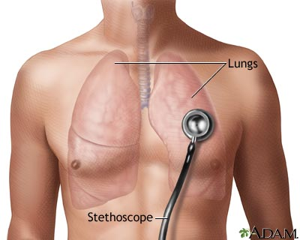
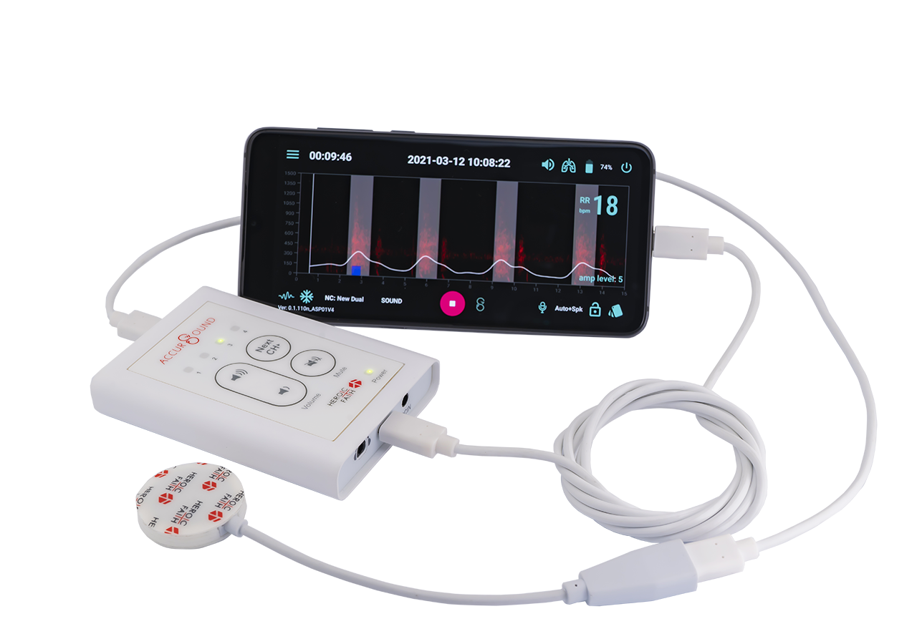
Motivation
Diagnosis of respiratory illness
COVID, COPD, Chronic Bronchitis
Pulmonary Auscultation
Non-invasive: Fully external method
Effective: Respiratory illnesses change airway geometry, directly causing different sounds
The case for automation
Reduce diagnostic errors due to physician audial acuity
Long-term patient monitoring
Notes:
Our research motivation is to improve the diagnostic accuracy of respiratory illnesses such as COVID, COPD, and Chronic Bronchitis. One of the first steps in diagnosis is pulmonary auscultation, or the act of listening to lung sounds with a stethoscope. It is one of the oldest medical practices, dating back several hundreds of years, but it remains prevalent today because of several benefits: it is non-invasive, making it a safe procedure, and it is effective because respiratory diseases directly affect how air passes through the lungs.
However, pulmonary auscultation is still done largely manually. This poses a problem by creating a reliance on the experience and audial acuity of the healthcare practitioner. An automated system could reduce this human error. An automated auscultation analysis system could also aid in long term patient monitoring, making it easier for a physician to determine the progression of a patient’s respiratory condition over time.

Slide 3
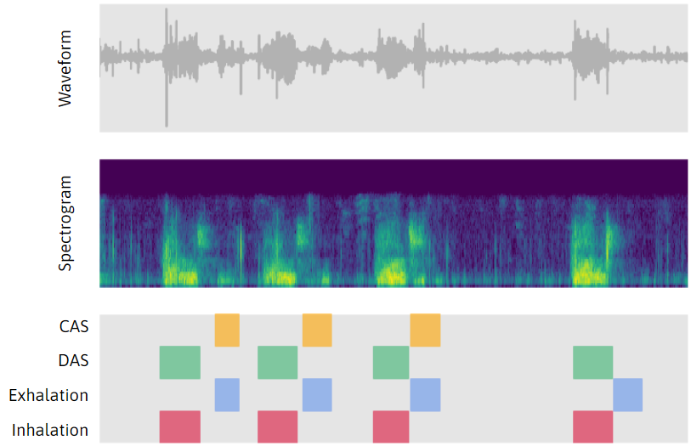
Background
Pulmonary Auscultation Analysis
Labeling of respiratory sounds
Inhalation / Exhalation
Continuous Adventitious Sounds (CAS)
Wheeze, Rhonchi, Stridor
Discontinuous Adventitious Sounds (DAS)
Crackles
Multilabel temporal segmentation problem
Challenges
High intra-variation in lung sounds; difficulty in differentiation between different classes
Limited dataset size
Notes:
This is a multilabel problem, because multiple classes can appear at the same time as shown here. This is important, because the overlap between different sounds is used for diagnosis. The location of adventitious sounds in the inhalation-exhalation cycle is also important, making it a temporal segmentation problem as well.

Slide 4
Challenges - High Intra-Variation
Inhalation
Exhalation
DAS
CAS (Wheeze)
CAS (Stridor)
CAS (Rhonchi)
Notes:
To show the difficulty in determining different sounds, here are some spectrogram visualizations of the different sounds.
It is possible to differentiate them; for example, CAS often has horizontal stripes running through the spectrogram; this is because CAS is a more musical sound, so there are some frequencies that are more strongly presented. DAS tends to have vertical stripes because they are crackling sounds. However, it is still a very difficult task; we see that many DAS events appear similar to inhalation events, and there is high variation between various CAS events, even those within the same subclass.

Slide 5
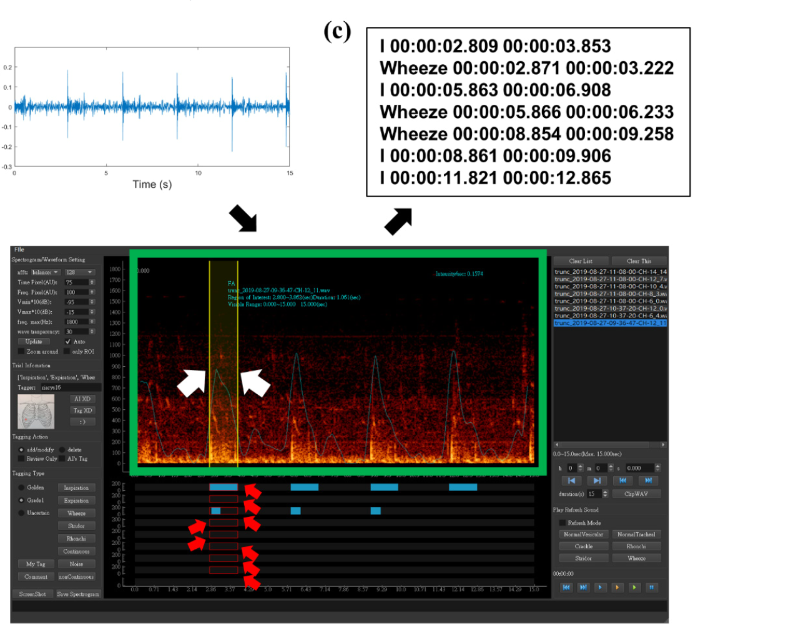
Challenges - Limited Dataset Size
Time-consuming procedure requiring use of both audio and spectrogram information
Requires specialized expert annotators
We use the largest publicly-available dataset, but still many classes have few examples
F.-S. Hsu et al., “Benchmarking of eight recurrent neural network variants for breath phase and adventitious sound detection on a self-developed open-access lung sound database―HF Lung V1,” PLoS One, 2021
Notes:
This difficulty in determining clear class boundaries is further reflected in the labeling setup used to create the dataset. On the right is a diagram from the authors of the dataset that we used, which shows that both audio and visual spectrogram information needs to be used for an accurate judgement. Furthermore, since we also care about the temporal positioning, each event must be individually tagged with start and end times, which makes annotation more difficult.
The annotation must also be done by trained experts ― generally be conducted by physicians whose time is limited. This limits the size of available datasets. Even though in this work we use the largest dataset publicly available, many of the classes (specifically CAS and DAS) have few examples.

Slide 6
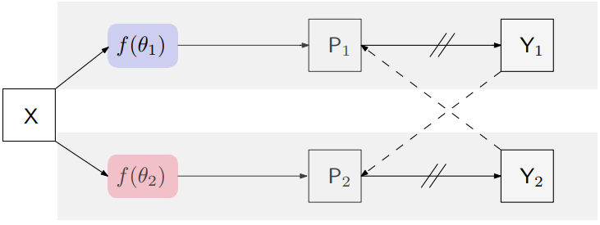
Approach
Semi-Supervised Learning
Small set of labeled data and a larger set of unlabeled data
Cross Pseudo Supervision (CPS)
Twin Network Architecture
Network Pretraining
Transfer learning for better performance on low-data settings
X. Chen, Y. Yuan, G. Zeng and J. Wang, ”Semi-supervised semantic segmentation with cross pseudo supervision,” CVPR 2021
Notes:
To solve these issues, we present two techniques which are our main contribution: applying semi-supervised learning and network pretraining to pulmonary auscultation analysis.
The semi-supervised learning setup uses a small set of labeled data and a larger set of unlabeled data, and the goal is to improve performance using the unlabeled data. While annotation is difficult as explained previously, obtaining unlabeled data is relatively easy in a hospital setting.
In this work, we use the semi-supervised technique of Cross Pseudo Supervision. CPS uses a twin network architecture; each network generates pseudo labels that are used to supervise the other network. Despite its simplicity, the CPS approach has been shown to outperform other semi-supervised methods.
For a further improvement on low-data classes, we use network pretraining on a feature extractor.

Slide 7
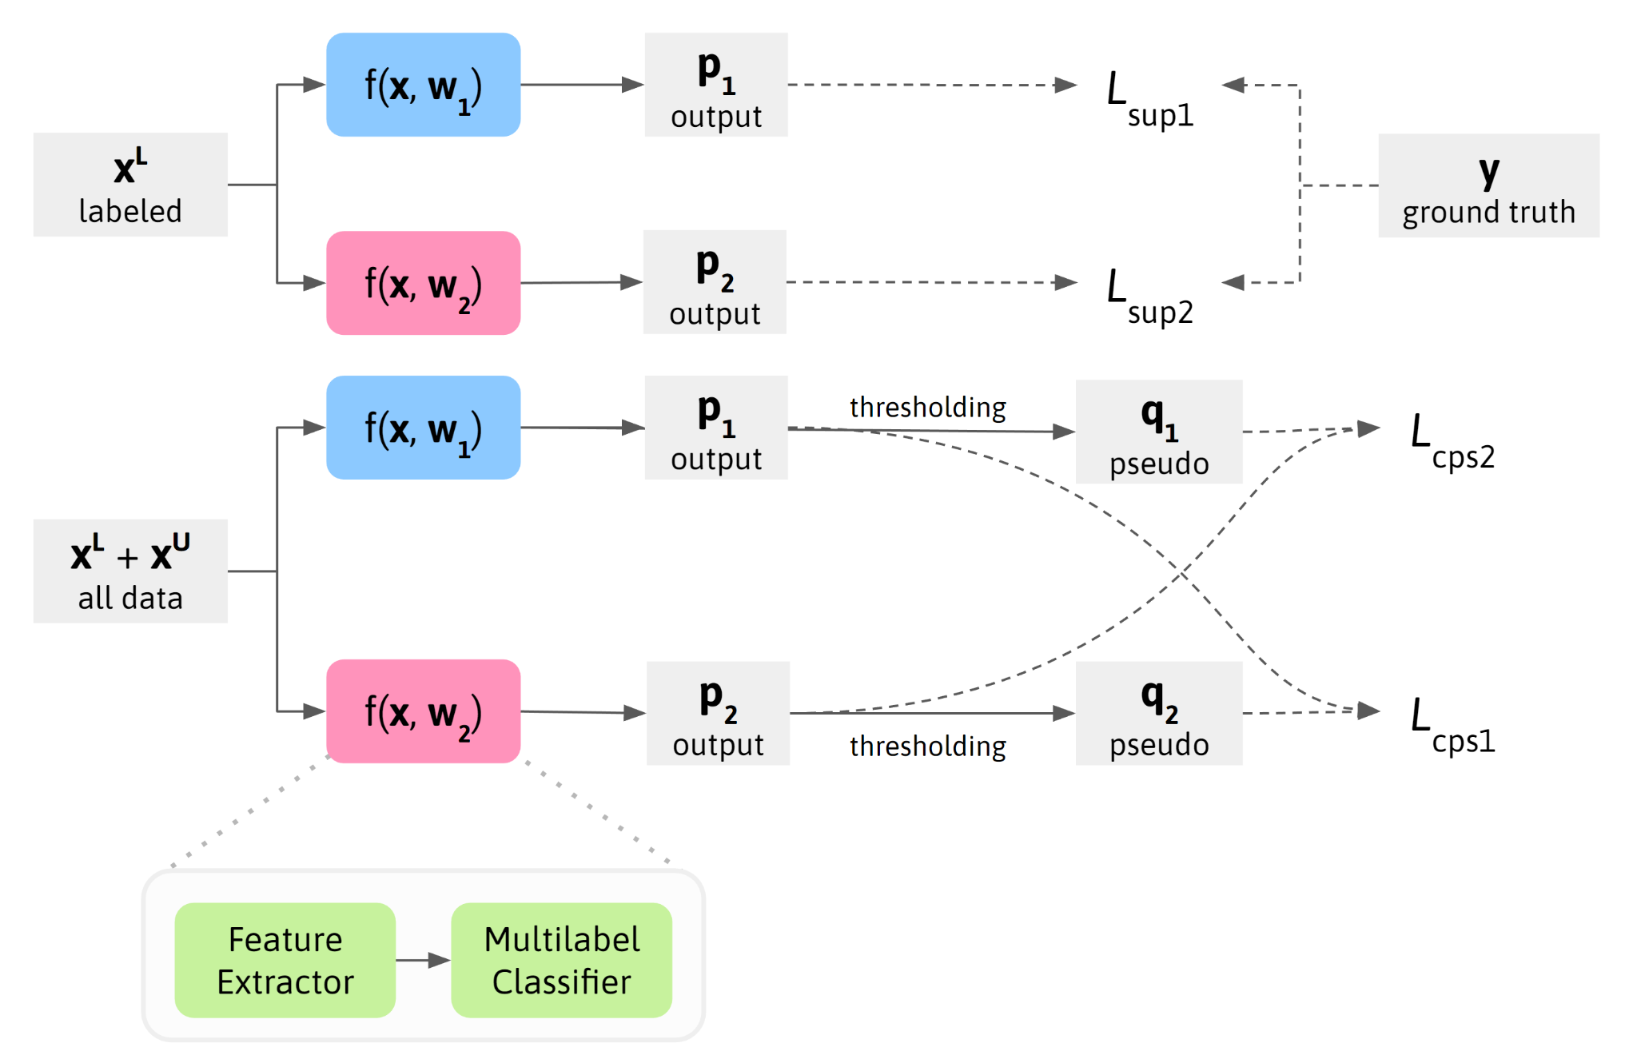
CPS Network Framework
Notes:
This is our overarching network framework. We train two networks, which are identical in structure but differently initialized. The training step consists of a supervised portion using just the labeled data, and an unsupervised portion using all of the data. In the supervised portion, the two networks are separately trained against the ground truth. In the unsupervised portion, we use Cross Pseudo Supervision, training each network against the pseudo label generated from the other network.

Slide 8
CPS Network Framework
supervised
Notes:
This is our overarching network framework. We train two networks, which are identical in structure but differently initialized. The training step consists of a supervised portion using just the labeled data, and an unsupervised portion using all of the data. In the supervised portion, the two networks are separately trained against the ground truth. In the unsupervised portion, we use Cross Pseudo Supervision, training each network against the pseudo label generated from the other network.

Slide 9
CPS Network Framework
unsupervised
Notes:
This is our overarching network framework. We train two networks, which are identical in structure but differently initialized. The training step consists of a supervised portion using just the labeled data, and an unsupervised portion using all of the data. In the supervised portion, the two networks are separately trained against the ground truth. In the unsupervised portion, we use Cross Pseudo Supervision, training each network against the pseudo label generated from the other network.

Slide 10
CPS Network Framework
single network
Notes:
So that is the overarching setup. But what does f actually look like?

Slide 11
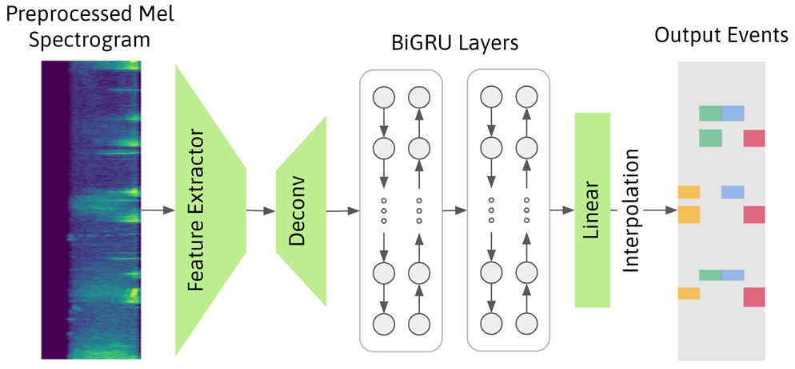
Single Network Architecture
Preprocessed Mel Spectrogram
BiGRU Layers
Output Events
Feature Extractor
Deconv
Linear
...
...
...
...
Interpolation

Slide 12
Single Network Architecture
AudioSet-pretrained PANN
(Q. Kong et al., “PANNs: Large-scale pretrained audio neural networks for audio pattern recognition,” IEEE TASLP 2020)

Slide 13
Single Network Architecture
Notes:
We choose to use GRU layers because of their ability to capture long-term temporal relationships. The bidirectional aspect of a BiGRU allows it to consider past and future information simultaneously, giving it more contextual information to aid in differentiating between classes.

Slide 14
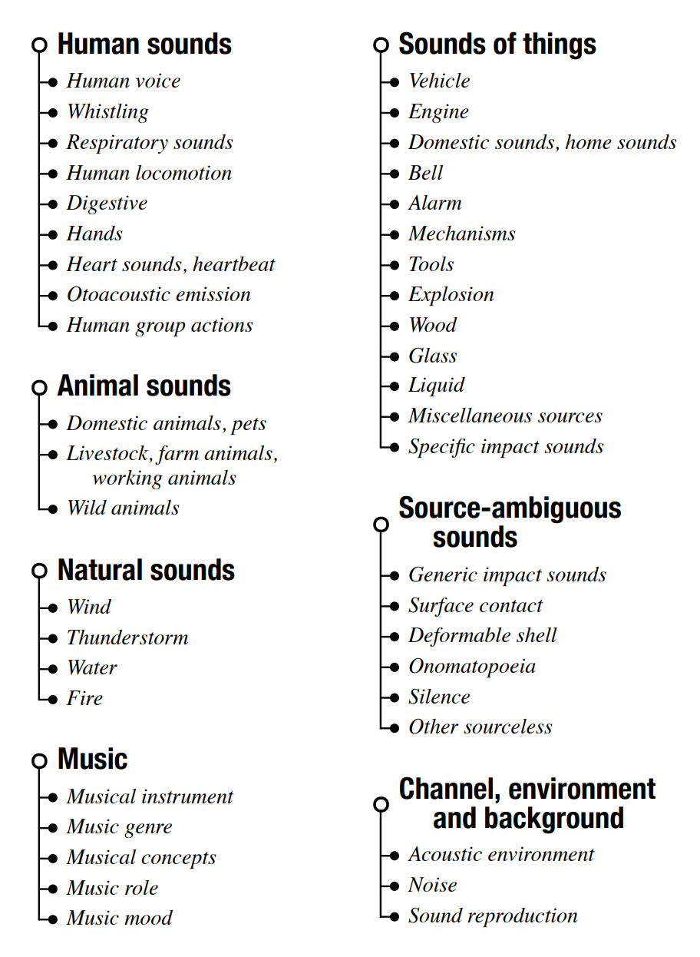
Pretraining
Pretrain feature extractor on large-scale audio dataset (AudioSet)
Unrelated to actual dataset
Try to improve model performance in low-data classes
Off-the-shelf pretrained PANN model
Deconvolution upsampling, as pretrained model is designed for clip-level classification, not temporal labeling
AudioSet ontology
(J. F. Gemmeke et al. “Audio Set: An ontology and human-labeled dataset for audio events,” 2017 IEEE ICASSP)

Slide 15
Loss Function
Binary Cross Entropy Loss between pseudo label and model predictions
Weighted due to class imbalance
Thresholding function as softmax/one-hot does not work due to multilabel classification problem
Notes:
Whereas the original Cross Pseudo Supervision method uses one-hot pseudo labels for semantic segmentation, this is infeasible in our problem setting because multiple classes of sounds may be present at the same time. Instead, we generate pseudo labels via thresholding. We then use a binary cross entropy loss to calculate both unsupervised and supervised losses. We weight the loss to account for the class imbalance in the dataset.

Slide 16
Ablation Study
BiGRU leverages strong temporal relationships (Inhalation/Exhalation cycle)
Notes:
To show the effect of each component, we conduct an ablation study where we add each part of the model one by one.
We see that the addition of BiGRU layers produces significant improvement on inhalation and exhalation, demonstrating the BiGRU model's ability to exploit time-wise relationships due to the strong causal correlation between these two classes.

Slide 17
Ablation Study
BiGRU leverages strong temporal relationships (Inhalation/Exhalation cycle)
Pre-training improves performance on classes with few examples (CAS, DAS)
Notes:
Pretraining on AudioSet results in a large improvement in on the DAS and CAS classes, showing that this pretraining improves the model generalizability in low-data situations, as these are the two classes with the fewest number of training examples.

Slide 18
Ablation Study
BiGRU leverages strong temporal relationships (Inhalation/Exhalation cycle)
Pre-training improves performance on classes with few examples (CAS, DAS)
CPS leads to significant improvement across all categories
Notes:
Finally, using unlabeled data with Cross Pseudo Supervision leads to substantial increases across all four classes, showing that the model can successfully leverage the unlabeled data to expand the training dataset via pseudo-labeling.

Slide 19
Ablation Study
Baseline
Proposed
BiGRU leverages strong temporal relationships (Inhalation/Exhalation cycle)
Pre-training improves performance on classes with few examples (CAS, DAS)
CPS leads to significant improvement across all categories
Notes:
For a further performance evaluation, we choose the basic BiGRU model as a baseline to compare to our proposed semi-supervised method.

Slide 20
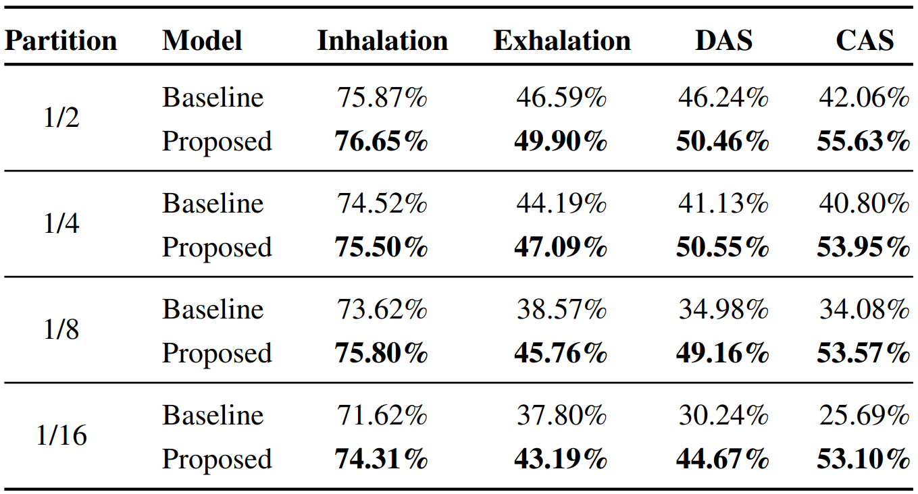
Performance
F1 score comparison between baseline (non-CPS, non-pretrained) and proposed models
Notes:
We evaluate both models using the F1-score under different partitions of labeled and unlabeled data, from half of the data being labeled to just one-sixteenth of the data being labeled. We see that in every partition in every class, the proposed approach outperforms the baseline model.

Slide 21
Performance
Area under the Receiver Operating Characteristic (AUC)
Inhalation
Exhalation
DAS
CAS
Notes:
We also use the AUC as an evaluation metric to compare the two methods; again, the proposed model outperforms the baseline in all cases. Furthermore, we see that in general, as the number of labeled samples decreases, the performance gap between our proposed method and the baseline method increases. The baseline performance drops dramatically whereas our method degrades much more slowly; in fact the DAS and CAS classes show very little degradation at all.

Slide 22
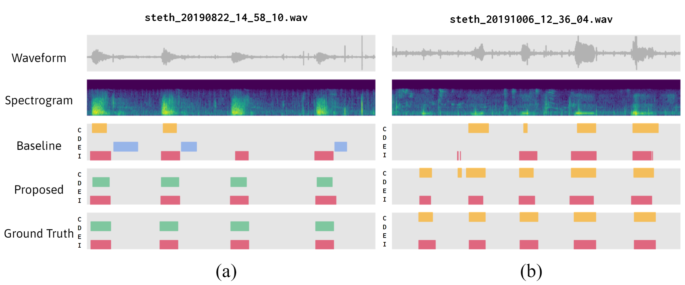
Experiments
Qualitative Analysis
½ labeled data
⅛ labeled data
Notes:
Finally, we conduct a qualitative analysis of the model outputs to verify our results. We see that the semi-supervised model provides results much closer to the ground truth labels compared to the baseline. This is especially true for the CAS and DAS classes, which is not a coincidence as they are the two classes with the least amount of data. This further emphasizes the suitability of our approach in low-data problem settings.

Slide 23
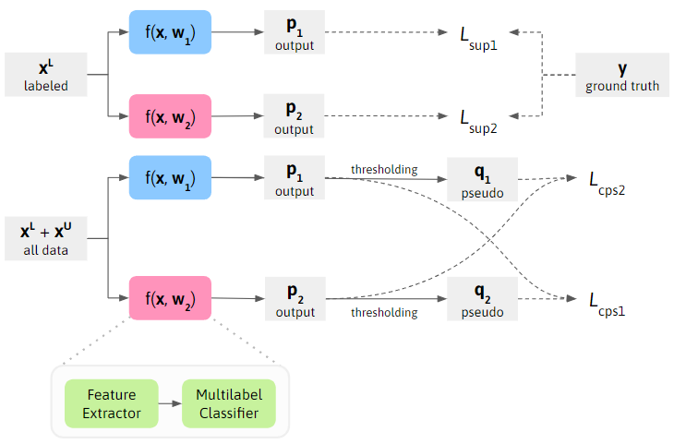
Summary
Semi-supervised techniques are a viable approach in pulmonary auscultation analysis
Motivate creation of large-scale unlabeled datasets
Improve respiratory diagnostic accuracy and allow for noninvasive long-term patient respiratory monitoring
Notes:
In summary, we have shown that Cross Pseudo Supervision, coupled with network pretraining and BiGRUs to understand temporal relationships, outperforms purely supervised baselines in pulmonary auscultation analysis. These results can help to motivate the creation of large-scale unlabeled datasets, further improving pulmonary auscultation models to allow for better respiratory diagnostic accuracy and noninvasive long-term patient monitoring.

